Slide 1
CEOS Chair 2018 priorities
Committee on Earth Observation Satellites
Mauro Facchini
European Commission
CEOS Plenary 2017
Agenda Item # 12.7
Rapid City, South Dakota, USA
19 – 20 October 2017

Slide 2
CEOS Chair 2018
As the 2018 CEOS Chair, the European Commission will
Ensure continuity and coherence of CEOS activities by:
supporting and further developing priorities and themes of current Chair (USGS) are through 2018
understanding of common priorities and coordination with the incoming SIT Chair (NOAA).
Beyond this, the European Commission will provide leadership on a number of initiatives

Slide 3
Continuation and development
The European Commission will work with USGS, ESA, and the incoming SIT Chair NOAA and the relevant stakeholders to ensure the required continuity of the following activities:
Implementation of the study of future data access and analysis architectures.
Supporting the ad-hoc team on Sustainable Development Goals (SDGs) through increased engagement with national statistics agencies and analyzing the mainstreaming of these efforts into policy.
Moderate Resolution Sensor Interoperability.
Consideration of future partnerships and priorities for CEOS, notably with GEO, the UN system, development banks, and the big data players.
Expediting existing CEOS thematic acquisition strategies – in relation to forests, agriculture, disasters, climate, carbon, and water.

Slide 4
Rationalization of on-going activities
The European Commission will promote continued discussion to rationalise/integrate many ongoing, partly overlapping CEOS activities:
Land Surface imaging and its applications i.e. LSI-VC activities including those on Analysis ready data (ARD),
USGS priority activity on moderate-resolution interoperability,
CEOS open datacube activities,
Future Data Architectures (FDA) and related Pilots
CEOS support to GFOI and GEOGLAM and SDCG
Together with NOAA as incoming SIT Chair, to address an aspect of internal process:
Longer-term issue in the sustainability and implementation of ad-hoc teams and initiatives for integration in standing entities of CEOS such as the Working Groups and Virtual Constellations

Slide 5
CEOS Chair 2018 priorites
Specific Chair Initiative #1: Laying the foundation for an international CO2 and GHG emission monitoring system
Specific Chair Initiative #2: Bring the benefits of Future Data Architectures to the present - identify new targets

Slide 6
CEOS Chair 2018 priority A
Specific Chair Initiative #1: Laying the foundation for an international CO2 and GHG monitoring system
Three specific activities are foreseen for advancing this effort in 2017-2018:
Facilitate the completion and follow-on activities of the AC-VC whitepaper on defining an optimum constellation for CO2 and GHG monitoring, including the joint competences of CEOS and CGMS, and in the general framework of the continued implementation of the CEOS Carbon Strategy
Place the space segment in the broader context of a fully sustained system for CO2 monitoring. Individual CEOS Agencies have counterparts in their individual countries/regions who have responsibility for Inventories, the required modelling, in-situ infrastructure and the ground segment elements.
Advance the relationship with CGMS for an operationally implemented and sustained observation capability. Consider establishing a formal working relationship between CEOS and CGMS as with the successful ongoing relationship on Systematic Observations of ECVs in support of UNFCCC.

Slide 7
Chair priority A workshop in 2018
On “placing the space segment in the broader context of a fully sustained system for CO2 monitoring”
The EC proposes to organise a dedicated discussion workshop:
Bringing together these different stakeholders to define best practices and synergies
Exploring possibilities for common approaches to some of the system development.
This would also require the strong engagement of CGMS as well as CEOS Associate members such as the WMO.
June 2018 period. Probably somewhere in Northern Italy …

Slide 8
CEOS Chair 2018 priority B – Data
Conclude the initial study of Future Data access and analysis Architectures (FDA) with recommendations for a "Generation 2020" of operational systems and their global interoperability. Consider follow-on within WIGISS
Introduce the new Copernicus DIAS as an enabling element for operational implementation of services, CEOS pilot projects and other Small-scale demonstrators
Continue to support and expand the efforts related to exploitation environments based on ARD
CEOS Open Data Cube and links to non EO domains
Earth System Data Cube methodologies
Expand work on the user classification and user needs inventory
Instantiate a new effort to define FDA for the post 2025 timeframe, including e.g. near real time aspects and related technology gaps
Notes:
Finalise the study of Future Data access and analysis Architectures (FDA) with recommendations for the generation 2020 of operational systems and their global interoperability.
Develop broad support among CEOS agencies to develop a blend of global networks, regional and national hubs that support thematic Data Cubes.
Based on available technologies and available/emerging standards

Slide 9
Chair priority B workshop in 2018
Data related workshop proposals
The European Commission proposes to organise dedicated workshops (possible topics):
Access to Copernicus data and information, and additional data, in a flexible tool environment for data exploitation – introducing Copernicus DIAS for CEOS
Consolidation and prioritisation of user needs – proposing a shortlist for a CEOS coordinated response
Land observation and data to support the CEOS Carbon Observation from space
Innovative integration of SAR data/products in CEOS; exploiting the full potential of interferometry

Slide 10
The Team
Philippe Brunet (Chair)
Mauro Facchini (Chair Representative)
Astrid-Christina Koch
Mark Dowell
Michael Berger (contr. ESA)
Robert Husband (contr. EUMETSAT)
Martin Ditter (FDA priority)
Amanda Regan (RTD)
Symbios (S. Ward, M. Steventon, G. Dyke)

Slide 11
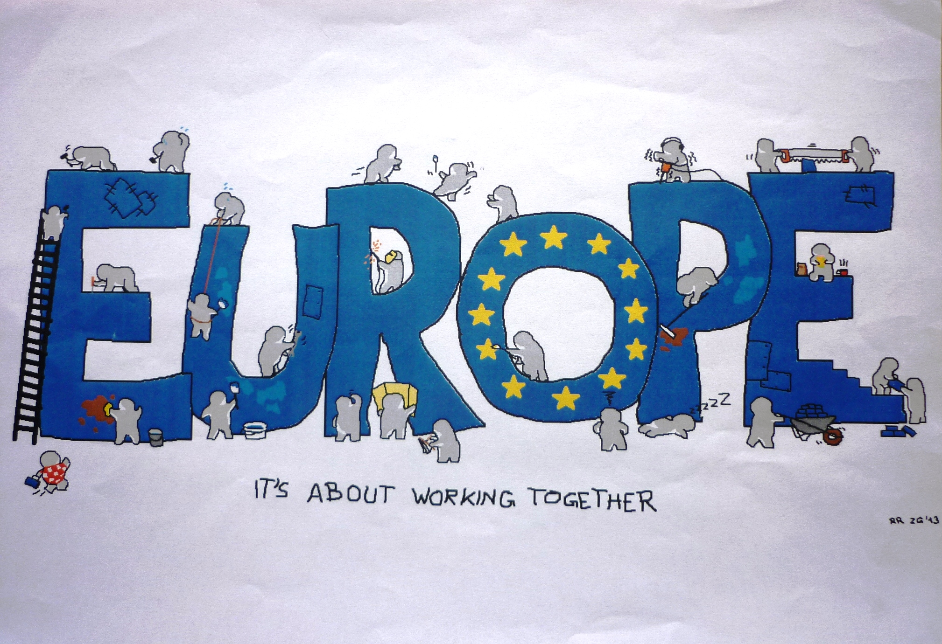
Working together: common spirit

Slide 12
Preparing for a seamless transition…
Local Delicacies

Slide 13
2018 European Commission Plenary
17th-18th October 2018 – (16th of October for side sessions)
Brussels – Palais des Congrés

Slide 14
Video

