Slide 1

CEOS Carbon Strategy Implementation
Committee on Earth Observation Satellites
Mark Dowell
European Commission
CEOS Plenary 2017
Agenda Item # 3.1
Rapid City, South Dakota, USA
19 – 20 October 2017

Slide 2


COP-21: Paris Agreement Article 7 (7c)
Strengthening scientific knowledge on climate, including research, systematic observation of the climate system and early warning systems, in a manner that informs climate services and supports decision- making
Developing the Transparency Framework (the need to promote transparency, accuracy, completeness, consistency, and comparability, and environmental integrity) & Global Stock-take
SBSTA Conclusions:
Noted with appreciation the [Status] report by GCOS
Encouraged GCOS to consider the outcomes of the twenty-first session of the Conference of the Parties when preparing the GCOS IP 2016
Invited GCOS to collaborate with relevant partners to continue enhancing access to, and understanding and interpretation of, data products and information to support decision-making on adaptation and mitigation at national, regional and global scales
@
Notes:
These requirement on Carbon are not going away – if anything they will become greater
Paris agreement not prescription on how but provides process
Transparency Framework will substitute MRV

Slide 3
Action in GCOS IP 2016
“Specifically CEOS and CGMS will undertake, over the next few years, dedicated preparatory work in a coordinated international context…:
The definition of an architecture of space component elements to address the requirements of a CO₂ and GHG monitoring system , … This will provide a global holistic perspective both from the point of view of existing and planned space segment assets as well and that for an optimum global constellation.
The documentation of best practices on the relationships between individual space agencies and their counterparts working on the modelling aspects, the inventories and in-situ data provision, …
The further consolidation of partnerships and collaborations between the relevant international entities including: the relationship between CEOS and CGMS on the space component aspects, the partnership with the WMO and GEO on the broader framework, … and finally the relationships with GCOS itself, UNFCCC and IPCC TFI process in better defining the role for space-based observation in the inventory guideline process.”

Slide 4
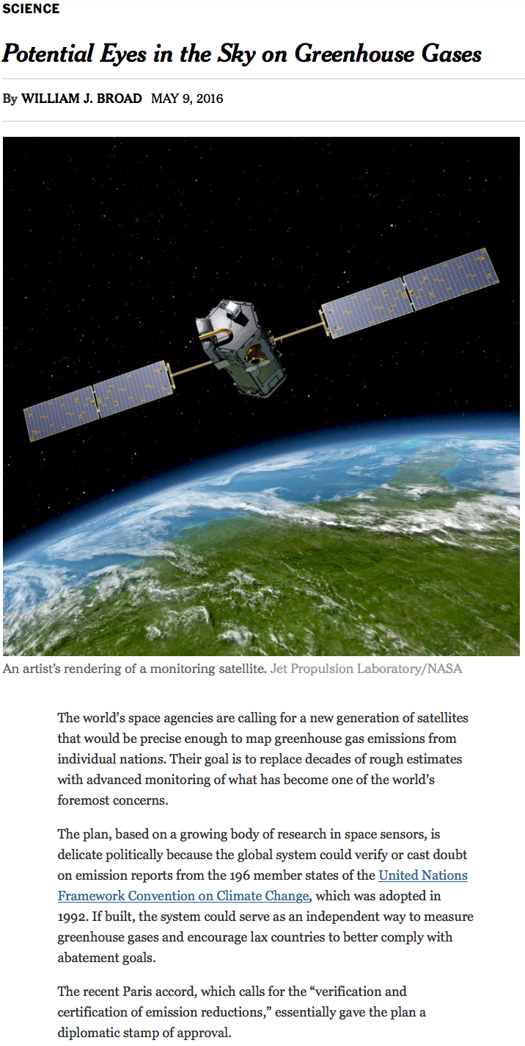
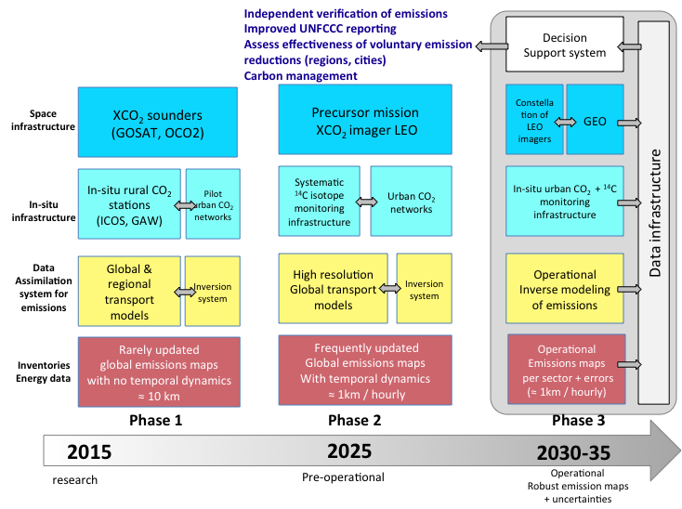
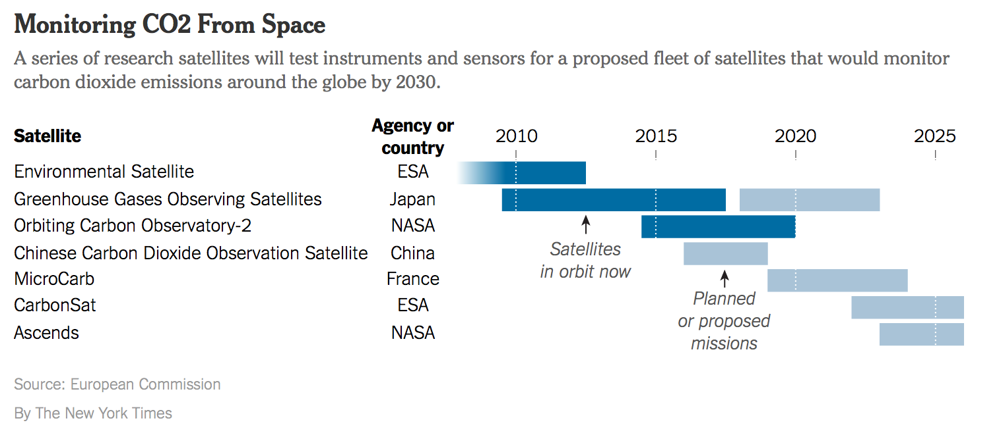
Systems Approach
International effort and coordination

Slide 5
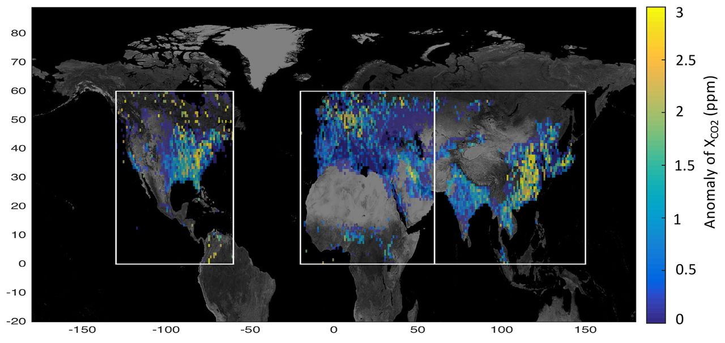

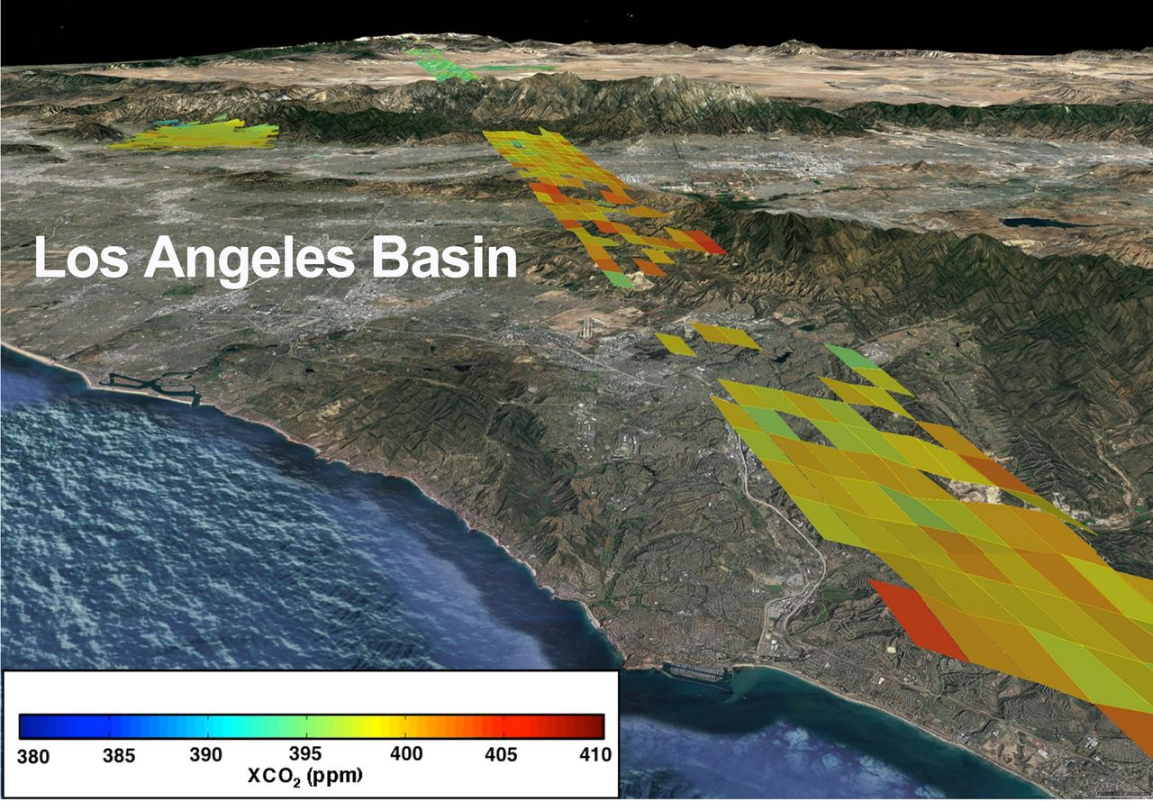
Advancing the state-of-the-art
Maps of the OCO-2 anomaly (mean in each grid box of the daily anomaly from the regional median) in 1° by 1° cells between September 2014 and April 2016.
A. Eldering et al. Science 2017;358
OCO-2 measurements across the Los Angeles basin and into the desert north of Los Angeles taken during one overpass on 8 September 2015.

Slide 6

CEOS Carbon activity - history and Background
GEO Carbon Report developed in June 2010 by team led by Ciais et al. (GCP).
CEOS Strategy for Carbon Observations from Space – written in response to above, completed in March 2014 – Wickland et al.
42 Actions identified in the report for specific response– first discussed at SIT Technical Workshop in September 2013

Slide 7
Truly cross-cutting within CEOS
Spreadsheet identified lead CEOS “Entity” as:
    Atmospheric Chemistry-VC: 6 Actions
    Land Surface Imaging-VC: 4 Actions
    Working Group Climate: 7 Actions
    Working Group Calibration/Validation: 11 Actions
    Strategic Implementation Team: 7 Actions
    N/A: 2 Actions
    Many other WGs and VCs named as contributing

Slide 8
Some Actions have been undertaken…(from LSI-VC)
CARB-08-03: CEOS Agencies with historical moderate-resolution (~250 m - 1 km) satellite data records will strive to ensure these data are publicly available …
CARB-08-04: CEOS Agencies with historical medium-resolution (~30 m -100 m) satellite data records will strive to ensure these data are publicly available …
Notes:
As these actions are closely related, the SEO has developed this consolidated report as a response to both of these Carbon actions. It is assumed that “publicly available” means the datasets are free/open for public use and there are no restrictions. The tables below summarize the known (current and future) moderate and medium resolution satellite data records measuring land properties relevant to carbon science. Also included in these tables are data policies, measurement type, revisit, swath and resolution. The data for these tables is taken from the CEOS Mission/Instruments/Measurements (MIM) database (http://database.eohandbook.com/).

Slide 9
Initial Proposed Initiatives
AC-VC: white paper on a GHG constellation;[Presentation 3.2]
LSI-VC: adopt GEOGLAM requirement process & gap analysis
WGClimate: focus gap analysis work on carbon-specific ECVs;
WGISS: on a carbon data portal to facilitate the discoverability and accessibility of ECV products and space-borne CDRs relevant for the carbon actions.;
NASA-ESA: cal/val and production of biomass products from CEOS missions – based on previous bi-lateral NASA/ESA initiative
WGCV: Summarize current list of validated land data products relevant to Carbon Strategy, document a validation framework, online platform for intercomparisons
JAXA: on the opportunity to engage with IPCC TFI guideline process, promoting satellite EO ;[Presentation 3.3]
These address a good cross-section of Actions across the Carbon Strategy

Slide 10
Mandate for Satellite Carbon report content, undertaken by AC-VC
Based on existing requirements, define the key characteristics of a global architecture for carbon (CO₂, CH₄) measurements from space.
Consider observational needs for both composition and fluxes, natural and anthropogenic
Include known plans and considerations from space agencies worldwide in overall system architecture to ensure global consistency of design
Incorporate potential observations from both GEO and LEO potential missions in an optimal system, and consider optimal acquisition strategies across the system including orbits, equator crossing times, sensor characteristics etc.
Include instrument on-orbit calibration and geophysical validation aspects
Build on work already undertaken by AC-VC in response to the CEOS Carbon Strategy
Provide a reference architecture against which individual agencies can develop their plans to optimise joint implementation.
Report at Plenary 2018, with interim report Plenary 2017

Slide 11
LSI-VC Inititiave - Requirements Approach
LSI-VC exploring adoption and generalization of the CEOS ad hoc Working Group on GEOGLAM approach to apply to other thematic areas
Ensuring capture of both observational requirements and downstream product/service requirements
Utilize existing ad hoc teams for eliciting requirements from communities of practice and augment as needed
Look at CEOS Carbon Strategy for pilot implementation

Slide 12
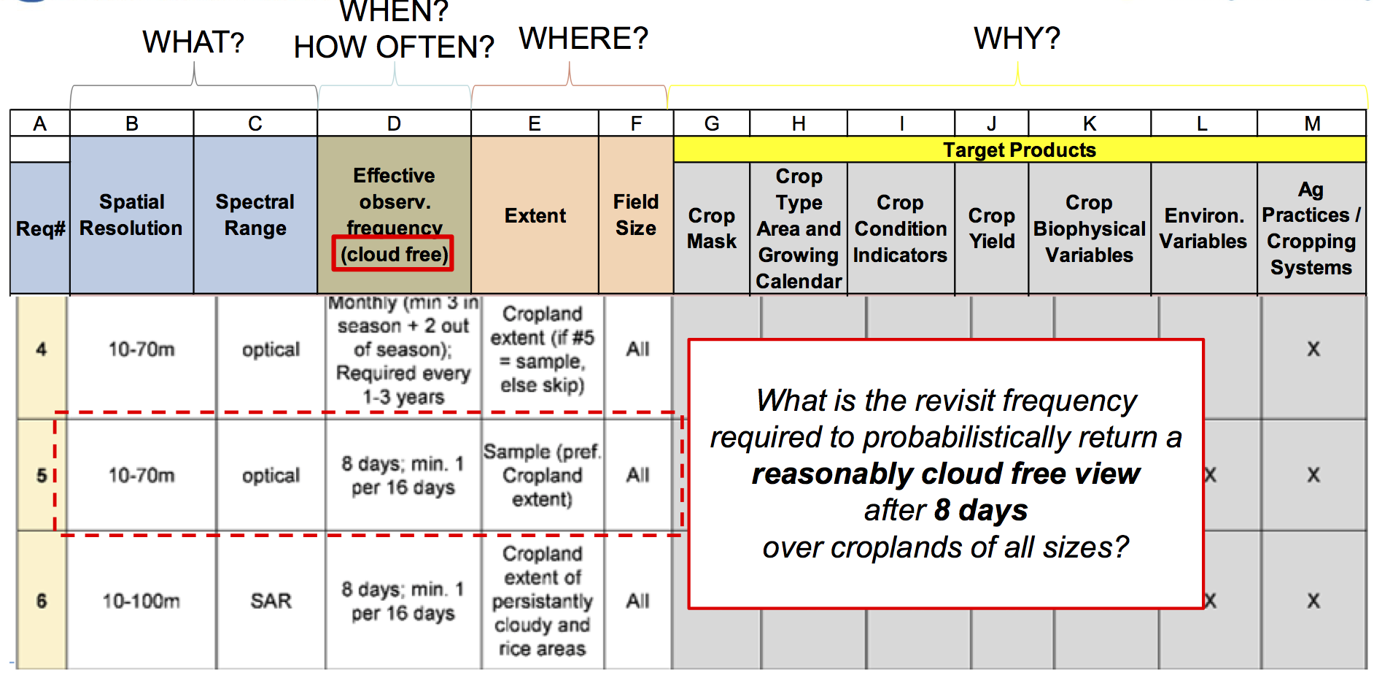
LSI-VC – Requirements Analysis

Slide 13
Information
Wetland Carbon Flux
Order of operations
CO₂ Emissions
Land Cover Conversion
Methane Emissions
Variable
Data Type 2
Data Type 1
Daily
Data Type 3
7-16 Days
Data Type 4
Cloud Free Frequency
Observations
Data Type 5
Monthly
Notes:
A carbon working group decides on:
Scope of eventual activity
Key priority variables with which to start (e.g. Wetlands, Permafrost, Mangroves, Forest…)
Maybe prioritized by importance to climate change
Maybe prioritized by gaps in current understanding or observation capacity (e.g. we know that lidar is needed for forest carbon…)
Maybe prioritized by overlap in terms of EO with GFOI and GEOGLAM
Maybe prioritized by political mandate
This group should be composed of EO-users who have a good understanding of informational requirements (what decisions can be empowered through EO?)
e.g. NASA CMS; JRC (Dowell) and others in the community

Slide 14
A Framework for Characterizing and Evaluating Requirements: CARBON
1. Policy Driver
WHY do we need to monitor? → Information needs
  What decisions are supported? → this is the key point of departure
WHAT variables? → Monitoring application’s data needs, to derive Information
WHAT instrument characteristics? → Spatial, Spectral
WHAT purpose? → R&D agenda? Firm operational needs?
WHERE? → Target features
WHEN? → Target periods
HOW OFTEN? → inc. Latency
  Every year? Every 5 years? Every decade?
  How many times per year?
PRIORITY?
2. Tabular Best Practices, Community Insight
Spatial Datasets:
Depends on variables chosen!
3. Tabular
+
Spatial Datasets
4. Mission capacity & gap analyses

Slide 15
Some thoughts on the value of this activity for LSI-VC & agencies
Result of Carbon requirements could be a similar table to GEOGLAM’s
  Empowers tabular & spatial representation of common needs
    Where do we have critical gaps across MULTIPLE applications?
    Which observations have a high bang-for-their-buck return on investment?
    Acquisition planning for non-systematic sensors across multiple apps
    Future mission design & justification
Tie-ins to ARD and FDA work → common denominator of sorts
  What standard pre-processed products have utility across multiple activities?
  Are multiple communities experiencing the same gaps?
  Iterative learning from one anothers working groups under LSI-VC umbrella
Priority
Carbon Priority Products/Variables

Slide 16
WGClimate Initiative
For consistent ECV Carbon products take advantage of Inventory output to produce subset of ECV Products contributing to Carbon Strategy
Space Based GCOS ECVs in Inventory
      Products requested in Carbon Strategy

Slide 17
Carbon: WG-Climate
ECV Inventory
Defining Essential Climate Variables for Carbon and Beyond
(minimum five-year data record)
Tropospheric CO₂ column
  13 current ECVs derived from SCIAMACHY, GOSAT, and AIRS
  13 future ECVS planed using GOSAT, IASI, and AIRS
Tropospheric CH₄ column
  8 current ECVs derived from SCIAMACHY, GOSAT, IASI, and AIRS
  7 future ECVs planned using GOSAT
Tropospheric CH₄ profile
  10 current ECVs derived from IASI and AIRS
  8 future ECVs planned using AIRS
Stratospheric CH₄ profile
  1 current ECVs derived from IASI

Slide 18
LAI, FAPAR, Land cover
LAI:
  1 current ECVs derived from AVHRR/MODIS (NOAA CDR)
  4 future ECVS planed using Meteosat-8-SEVIRI, SPOT-4/5-Vegetation, PROBA-V-Vegetation, AVHRR
FAPAR:
  1 current ECVs derived from AVHRR/MODIS (NOAA CDR)
  4 future ECVs planned using Meteosat-8-SEVIRI, SPOT-4/5-Vegetation, PROBA-V-Vegetation, AVHRR
Land cover
  1 current ECVs derived from Envisat-MERIS and SPOT-4-Vegetation
  1 future ECVs planned using Envisat-MERIS, AVHRR, SPOT-4-Vegetation, PROBA-V-Vegetation

Slide 19
Actions assigned to WGClimate
Encourage the production and availability of high-quality, consistent long time series data products based on multiple sensors and missions for carbon and climate science and for model-data and data-data intercomparison exercises. | WGCV AC-VC LSI-VC OCR-VC
Make publicly available all information necessary to document the accuracy, clarity, and traceability of the satellite data and data products they produce. | WGCV VCs
Coordinate efforts to develop compatible (e.g., temporal and spatial resolution, grids, data formats, common auxiliary data, units) carbon data products from multiple missions | OCR-VC AC-VC LSI-VC WGCV
Ensure the long-term accessibility of satellite data and data products for carbon cycle science and policy. This must include arrangement for secure archives, documentation, and metadata as well as for provisions for easy discovery and access | WGISS
Serve as a point-of-contact for appropriate satellite products for major model-data intercomparison exercises related to the carbon cycle. | WGClimate chair membership on WDAC
Notes:
Activation highlighted in red consistent with WGClimate Inventory-Gap Analysis process

Slide 20
WGISS Activities for
CEOS Carbon Initiatives
(CARD-15)
WGISS will begin facilitating discoverability and accessibility of ECV Products and space-born CDRs relevant for the CEOS Carbon Action via WGISS Interoperability Systems & Standards (FedEO/CWIC/IDN, OpenSearch) once WGClimate has completed their (meta) gap-analysis across the Carbon ECVs.
In response to the CEOS Carbon Strategy, WGISS and the CEOS Carbon Team are exploring the idea and approach of collaboratively developing a Carbon Portal to discover and access relevant CEOS data products available via the WGISS infrastructure components.
  The teams are beginning to develop requirements and success criteria based on the extent it provides discoverability of the products of value to the carbon cycle community.
  As success development of a Carbon Portal is likely a multi-year effort, the teams will begin with a demonstration project focused on delivering selected products of value to the carbon community.

Slide 21
WGISS
WGISS – Working Group on Information Systems and Services
Objective / Deliverable | Projected Completion Date | Background Information
CARB-15: Carbon Data Portal | Q4 2017 | Implement a carbon data portal to facilitate the discoverability and accessibility of ECV products and space-borne CDRs. The portal is designed with service-oriented architecture and follows the principles outlined by the GEOSS Community Portal white paper. The portal will seamlessly access data both in CWIC and FedEO to provide necessary data and services to the carbon science community of both CEOS and GEOSS.
WGISS is working with WGClimate and CEOS Carbon Leads. Held the initial WGISS Carbon Portal telecon with Mark Dowell and Stephen Plummer on March 28th to begin defining requirements for facilitating discoverability and accessibility of ECV Products and space-born CDRs relevant for the CEOS Carbon Action via WGISS Interoperability Systems & Standards (FedEO/CWIC/IDN, OpenSearch).
Defining initial search and access functions to be provided by the portal prototype and documenting initial science-discipline use cases to search and access particular collections (possibly Land-Carbon, Ocean-Carbon and/or an Atmosphere-Carbon case). Developing Carbon Portal Project Plan.

Slide 22
WGCV
2017-2019 Work Plan
3.2 Progress on the implementation of the CEOS Strategy for Carbon Observations from Space
CARB-19: Land product validation listing and framework | Q4 2017 | Summarize current list of validated land data products relevant to Carbon Strategy. Document validation framework and protocols Provide guidance for online platform for intercomparison of terrestrial carbon products. | WGCV

Slide 23
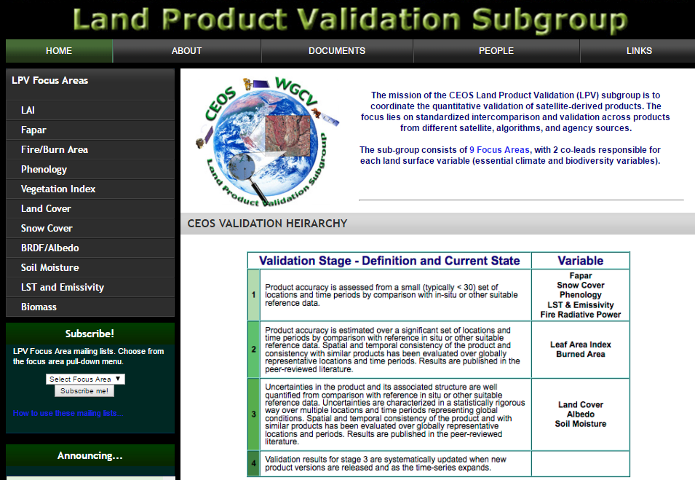
Recent CARB-19 : Land Product Validation Listing –
Summarizing current list of validated land data products relevant to Carbon Strategy - Validation according to CEOS LPV standards and documented on the CEOS LPV website
CEOS/WGCV/LPV has completed listing of 11 carbon-focused variables, totaling 138 land products from 11 CEOS Agencies.
https://lpvs.gsfc.nasa.gov/
9 of these product categories are listed as GCOS Essential Climate Variables (ECVs*)
2 of these products categories are listed as GEOBON Essential Biodiversity Variables (EBVs*).
*
*
*
*
*
*
*
*
*
*
*

Slide 24
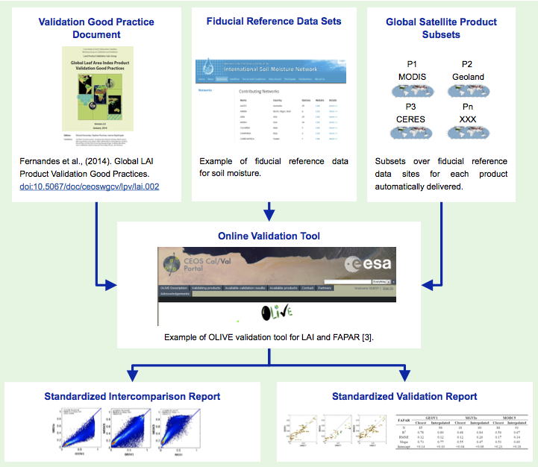





CARB-19: CEOS Land Validation Framework
Schaepman-Strub et al., (2017) submitted
CEOS LPV has established a framework with the aim of independent validation and consistent uncertainty reporting across products as main output.
Multiple agencies are coordinating five actionable tasks:
        [NASA] Develop best practice validation protocols for Albedo and Land Surface Temperature ECVs, where validation methods are sent through rigorous peer-review (Q4-2018).
        [NOAA/ESA/EUMETSAT] Ensure access to processed fiducial reference data (ongoing).
        [USGS/NOAA/NASA] Support automated subsets of global satellite products (LPCS; Q2-2017.)
        [NASA] Implement data analysis tools (Q2-2018).
        [NASA/ESA] Deliver standardized intercomparison and validation reports (Q4-2018)
1. 2. 3.
4.
5.

Slide 25
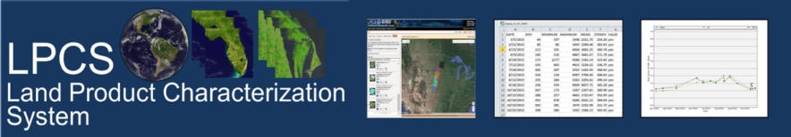
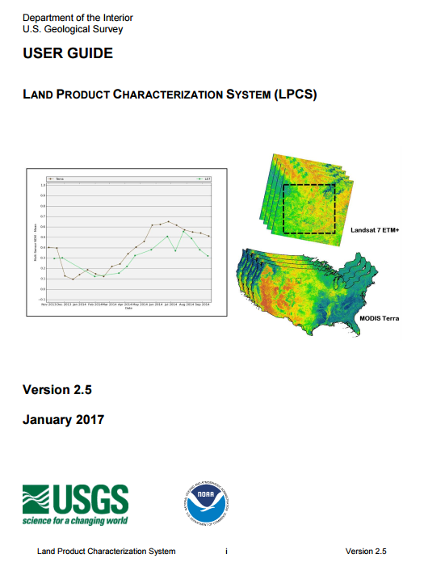
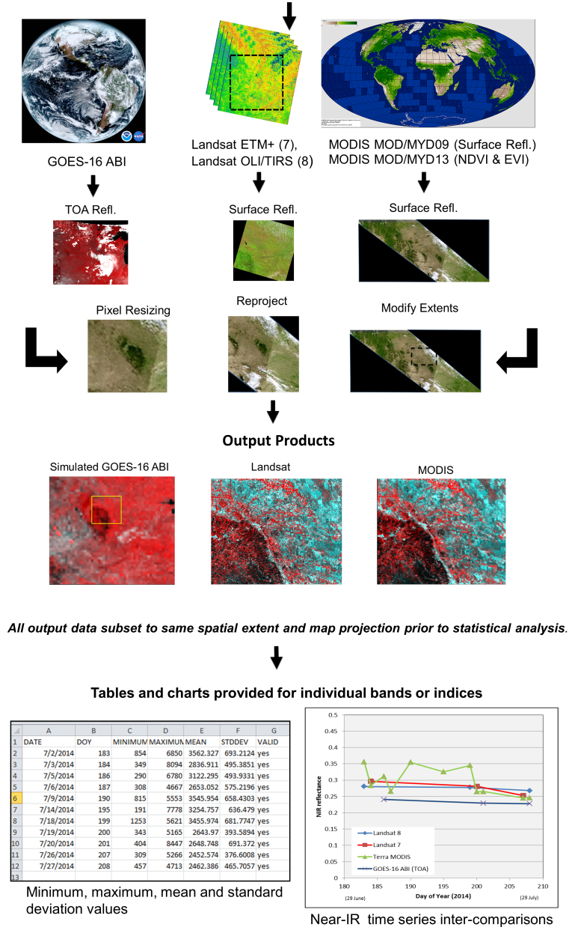

CARB-19: Online Platform for Intercomparison -
Land Product Characterization System (Q2-2017)
At WGCV-42, LPV announced the launch of the Land Product Characterization System (LPCS). LPCS is a web-based system designed to facilitate intercomparison of higher-level, satellite-derived, global land products. Key features include:
Analysis functions that permit data to be identified, retrieved, co-registered, and compared statistically through a single interface.
Access to the latest data collections of Landsat 4 through 8, Terra and Aqua MODIS, Suomi-NPP VIIRS and GOES-16 ABI.
Future products will include ESA Sentinel-2 and -3 series.
LPCS User Guide provides detailed information related to system features and functionality.
https://landsat.usgs.gov/lpcs

Slide 26
Aboveground Biomass Protocol Development
The LPV focus area on biomass is developing a good practices guide to biomass model calibration and product validation at a global (or near global) scale, including:
Good practices for biomass estimation in the field
  Required measurements at tree and plot scales
  Allometric equation selection
  Error/uncertainty estimation and reporting
  Data standards: what are ideal, what are acceptable (e.g. repeatability)
  Terrestrial Laser Scanning
Linking remote sensing observations to field estimates
  Geolocation good practices
  Application of TLS and/or ALS to scale from field plots to spaceborne measurements
Biomass model calibration accuracy reporting
  Statistical recommendations for product inter-comparability, e.g. Cross validation
Global Product Validation Protocol
  Recommended independent datasets for validation
  Recommended sample design for plot selection
  Assessment of global representativeness of validation plots
  Statistical recommendations for error reporting
Timeline
September, 2017: Writing committee formed, protocol structure drafted
October, 2017: Writing committee assigned draft tasks
November, 2017: Meeting at ISSI in Bern to flush out draft
2018: Protocol editing & peer review

Slide 27

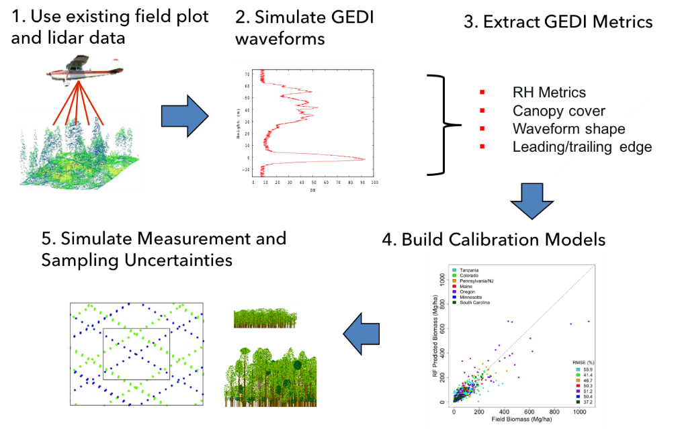
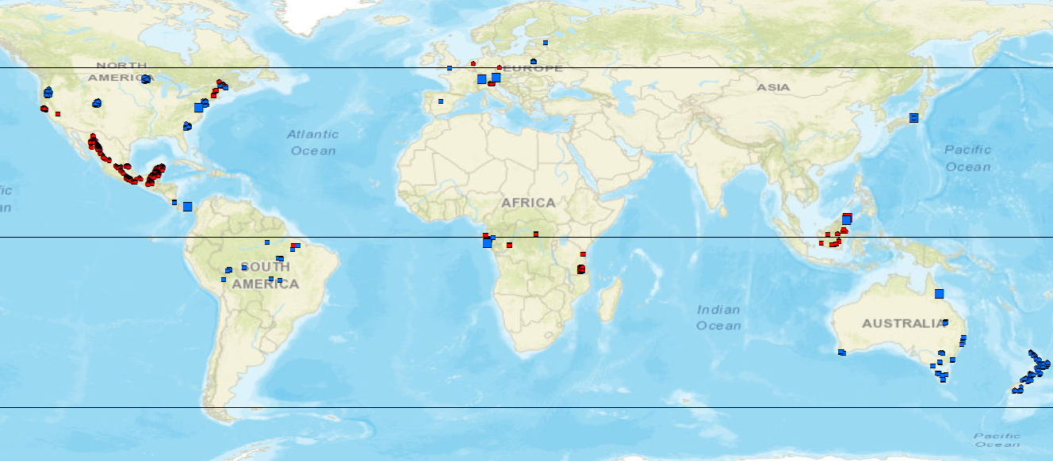
CEOS-LPV Biomass Focus Area Activities
NASA-GEDI Science Team is compiling a global dataset of coincident field and airborne lidar.
Reference archive includes ~4,000 plots (0.0625-0.25 ha), and 18,500 simulated footprints (25m) over ~100 corresponding field sites.
Next steps: CEOS-LPV Biomass team (NASA/ESA) will work to determine which GEDI reference sites can fill the needs of all missions (including data access) (Q2-2018).
GEDI collaborations on data sharing and processing include projects relating to the ESA’s Forest Observation System (FOS) and the pre-proposal research for the ESA-NASA Mission Exploitation Platform (MEP).
GEDI will launch in December, 2018, producing ~12 billion lidar observations and associated forest height and biomass measurements
 | Projects Ready | Project in Progress | Projects Identified | Total by Region
Australia | 6 | 10 | 0 | 16
Asia | 11 | 0 | 4 | 15
Europe | 8 | 1 | 8 | 17
North America | 14 | 4 | 13 | 41
Africa | 8 | 0 | 2 | 10
Central America | 5 | 2 | 0 | 7
South America | 12 | 3 | 4 | 19
Total by Status | 64 | 20 | 31 | 115

