Slide 1
CEOS-CGMS WGClimate
Jörg Schulz, EUMETSAT, WGClimate Chair
2018 CEOS Plenary
Agenda Item 2.1
Brussels, Belgium
16 – 18 October 2018

Slide 2
Statement to SBSTA-49 and COP-24
3-14 December 2018, in Katowice, Poland.

Slide 3
Statement to SBSTA-49 and COP-24
CEOS now has an open mandate to report to SBSTA on progress. This mandate is given in the conclusions from last year, FCCC/SBI/2017/7 paragraph 56, and reads: “The SBSTA recognized the progress made by the satellite community (see para. 51(e) above), in close collaboration with GCOS, in the development of the essential climate variable inventory. It noted the usefulness of the essential climate variable inventory for climate services. It invited CEOS and CGMS to report on progress at future sessions of the SBSTA, as appropriate”
CEOS contribution to SBSTA-49 and COP-24 consists of:
CEOS-CGMS Statement on Coordinated Response to UNFCCC Needs for Global Observations to SBSTA-49 presented by EUMETSAT on behalf of VNSC (document for endorsement);
More detailed report expanding the statement on progress on WGClimate work and GHG monitoring – will use the executive summaries from gap analysis report and GHG whitepapers as resource;
Support to the information note on behalf of the SBSTA chair drafted by UNFCCC Secretariat on request.

Slide 4
Statement to SBSTA-49 and COP-24
The draft statement was submitted to CEOS on 8 October;
Received edits and comments from NOAA, USGS, NASA, ESA, and GCOS;
Revised document with track change uploaded to CEOS Plenary web site 15 October;
Proposed for endorsements with changes applied;
Document to be sent to UNFCCC Secretariat by 26 Nov 2018;
Presentation to COP-24/SBSTA-49: 2 or 3 Dec 2018.

Slide 5
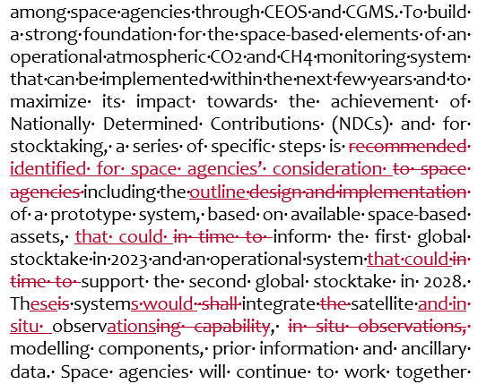
Edits by NOAA/NASA/USGS
Middle of 5th paragraph
Changes proposed to align language between statement and GHG white paper
WGClimate gap analysis report and GHG white paper explicitly referenced in paragraph 4 and 5, respectively.

Slide 6
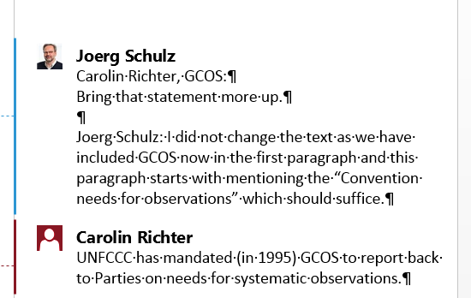
Comments/Edits by GCOS
End of 4th paragraph

Slide 7
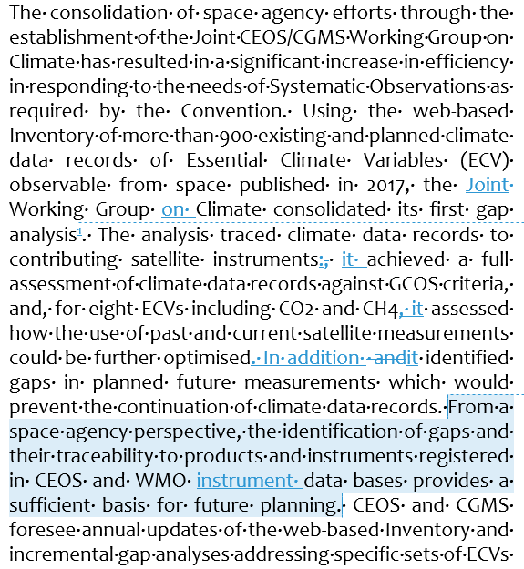
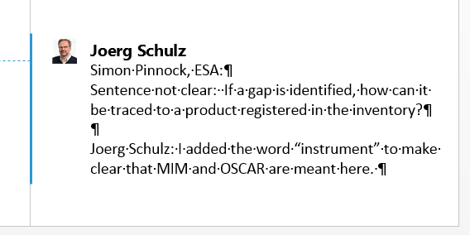
Comment from ESA

Slide 8
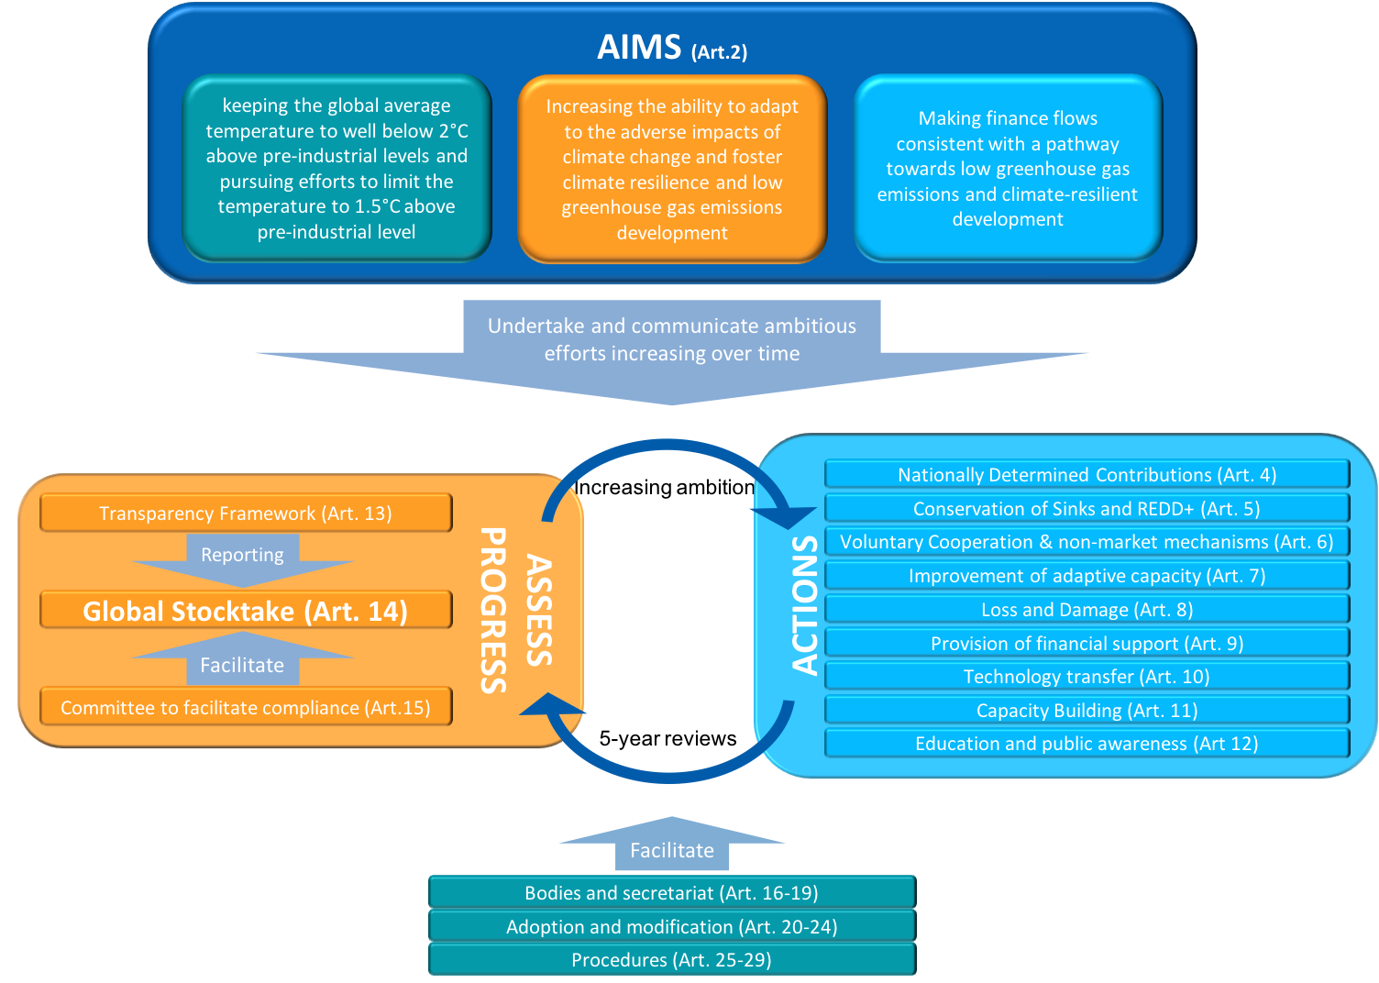
Statement on the Paris Agreement
CEOS-31-01 | WGClimate to explore development of a brief, consolidated statement of space agency contributions in support of each Article of the Paris Agreement. | 32nd CEOS Plenary

Slide 9
Space Agency contribution to the Paris Agreement
CEOS-31-01 | WGClimate to explore development of a brief, consolidated statement of space agency contributions in support of each Article of the Paris Agreement. | 32nd CEOS Plenary
✓
Consulted GCOS and GEO that performed similar analysis in their areas;
Applied categorisation of Paris Agreement articles as depicted by GCOS (see next slide);
Document provides an assessment in support of individual articles of the Agreement;
Addressed in particular CEOS cross cutting Working Groups contributions;
Plan to publish the short note of 9 pages on CEOS and climatemonitoring.info web sites;
Plenary is asked to close the action.

Slide 10
Partnerships - GCOS
GCOS plans a GCOS multi-panel meeting 18-22 March 2019 in Marrakech, Morocco. This will be back to back with WGClimate and WCRP Data Advisory Council;
Selected aims important for WGClimate:
Planning of a GCOS Science Conference, updated Status Report and revised Implementation Plan;
Agree consistent approaches to panel activities including review of ECV Requirements, monitoring how well ECV are being observed and reviewing IP actions.
Back to back meeting with WCRP DAC to further foster use of Climate Data Records in Reanalysis and Climate Model Evaluation;
GCOS Workshop: Space-based Essential Climate Variable (ECV) observations for climate adaptation and mitigation, 4-7 February 2019, WMO, Geneva, Switzerland.
CMRS-13: Development and Promotion of Case Studies

Slide 11
ECV Inventory, gap analysis, and Coordinated Actions
Gap analysis and coordinated action plan endorsed by CEOS and CGMS Plenaries (CMRS-15 and 16 completed);
Started to work with WGISS on DATA-9: ECVs/CDRs Discovery and Access through WGISS Systems.
Update of the Inventory being fully compatible with GCOS 2016 IP will start in October 2018 (CMRS-17 on time);
Coordinated Action #2 to allow an easier accommodation of agencies planning the generation of CDRs has been implemented;
To prepare for support to GCOS for the revision of the 2015 status report gap analysis 2019 will update all generic parts, changes to ECV products addressed in cycle#2, and some ECV products not addressed in cycle #2 but explicitly addressed in GCOS IP actions (CMRS-20 and 21 on time).
A new support contract has been signed covering support to mid-2021;
Continued financial support from the EC for the Inventory is gratefully acknowledged.
Action Plan & Creation of conditions to deliver CDRs
ECV Inventory
Gap Analysis & Recommendations
2018/2019

Slide 12
Public Access to ECV Inventory
http://climatemonitoring.info
Public access to Inventory via climatemonitoring.info. This is the shopping window of WGClimate and will be further developed;
Users can:
Download the ECV Inventory content for own analysis;
Find direct access points to CDRs in the Inventory;
Get access to WGClimate gap analysis results and coordinated actions;
Get access to case studies results analysing the use of CDRs for applications.
Advertisement still to be done (CEOS-SEC Action 238-07).

Slide 13
Implementation of Coordinated Actions
Implementation of Coordinated Actions will be distributed in CEOS and CGMS;
Implementation has started:
Presentation and first discussion with WGCV on CDR validation;
First activities and discussion with MIM and OSCAR on addressing issues in those data bases relevant for gap analysis;
First discussion with VC-SST on how to address analysis of usefulness of not used historical sensors for SST data records;
VC-PV is taking up recommendation and action on precipitation to stimulate the production of an improved precipitation climatology;
Telecons are planned with all impacted VCs to address Actions and understand VC/WG capabilities with the target to make arrangements for the update of the CEOS Workplan 2019-21.

Slide 14
WG Climate Leadership Proposal
USGS informed CEOS that current Vice-Chair John Dwyer, unfortunately cannot fulfil Chair term Nov. 2019-Nov. 2021;
WGClimate is in need for a new Chair and Vice-Chair in Nov 2019;
Deviating from the ToR WGClimate proposes:
Ask agencies for nominations for a new Vice-Chair with reduced term Nov. 2019-Nov. 2020 becoming Chair for Nov. 2020-Nov. 2022;
WGClimate plan to decide on nominations at next WGClimate meeting with endorsement at 33rd Plenary 2019;
Extend term of current chair, Jörg Schulz (EUMETSAT) by one year to Nov. 2020 with endorsement at 33rd Plenary 2019.
Rational:
Replacement of complete leadership in Nov. 2019 is difficult to achieve;
Proposed deviation from the ToR is because of exceptional circumstances;
WGClimate activities need stability in leadership of the WG.
Plenary is asked to endorse way forward.

