Slide 1



Australia

Slide 2

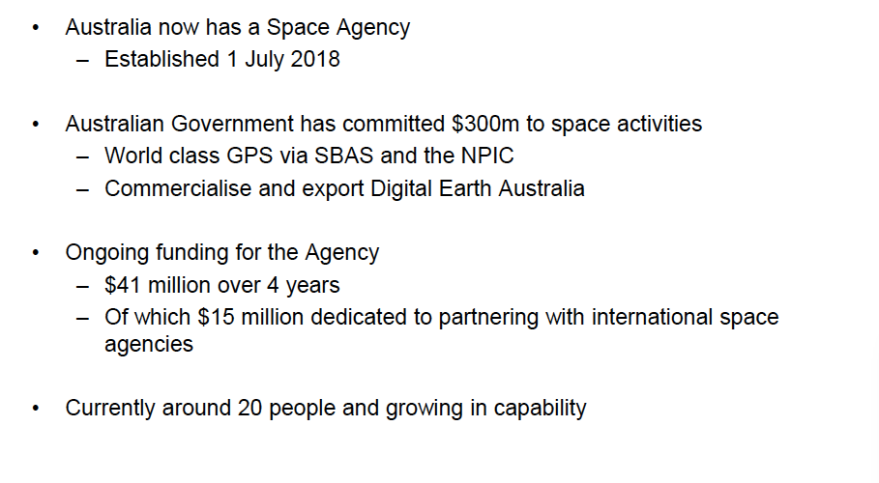

Slide 3
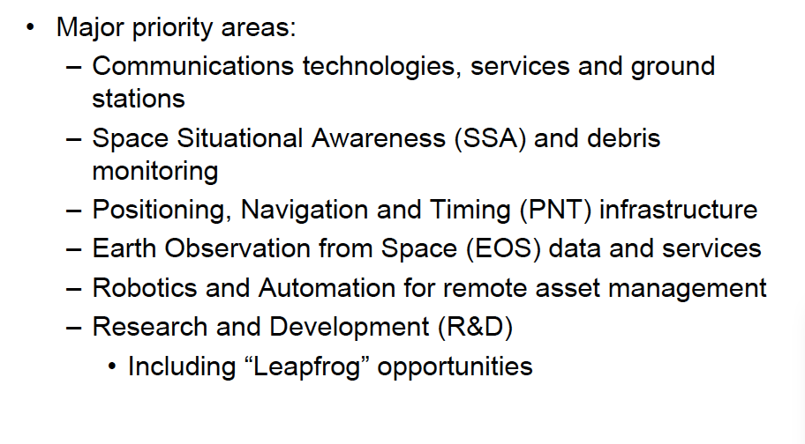
Strategic Priorities Australian Space Agency

Slide 4
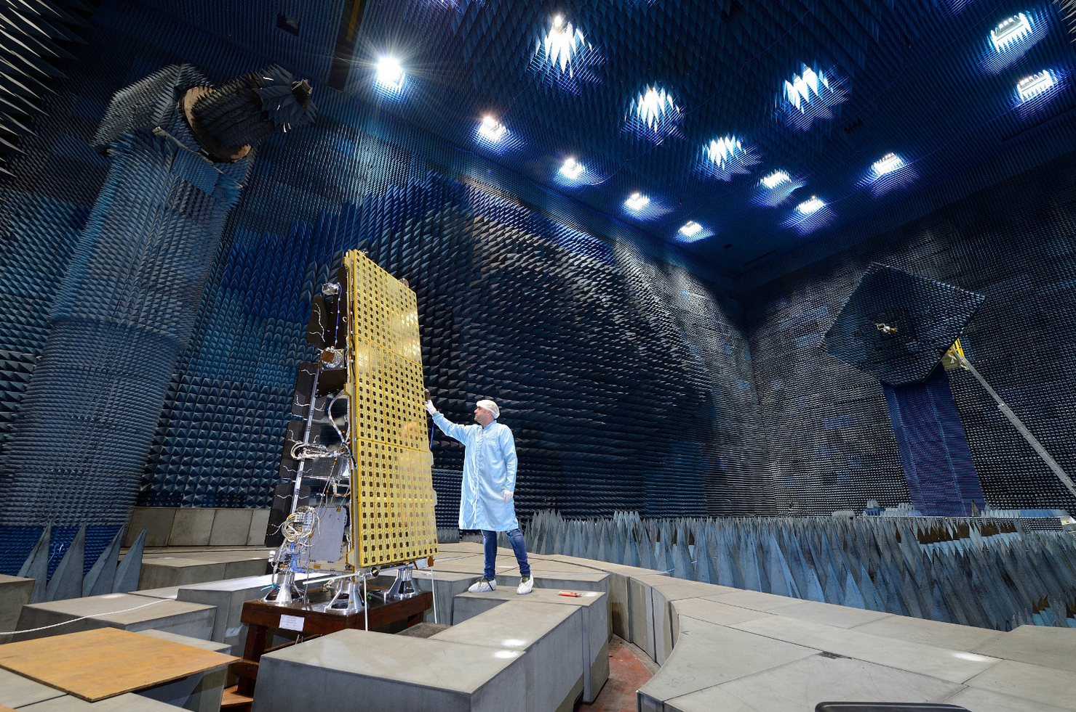
NovaSAR-1
Launched September 18, 2018.
Status: Nominal , in commissioning phase.
7 years lifetime
Automatic Identification of Ships (AIS) on-board
6m, 20 x 1000+km StripMap Mode
Special wide swath Maritime Mode (400 x 800km)
S-band, 3GHz
Operated from UK, but payloads available to partners

Slide 5
NovaSAR-1 - Australia
Our 10% capacity is managed by CSIRO as a National Research Facility
Free & Open data for Australian R&D and partnerships
Online ‘booking system” will open in February 2019
Explore new applications & commercial/market opportunities for CSIRO and commercial partners
Improve access to SAR for partners and partner countries
  A vital technology, especially in cloud-affected areas
  A pathfinder towards a future national satellite constellation
A key data source for:
    Disasters, security, development and reconstruction
    Environment, Agriculture
    Defence and security interests
    International partnerships

Slide 6
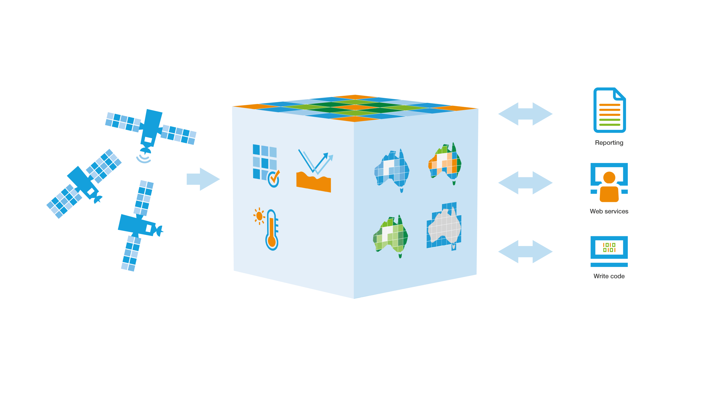

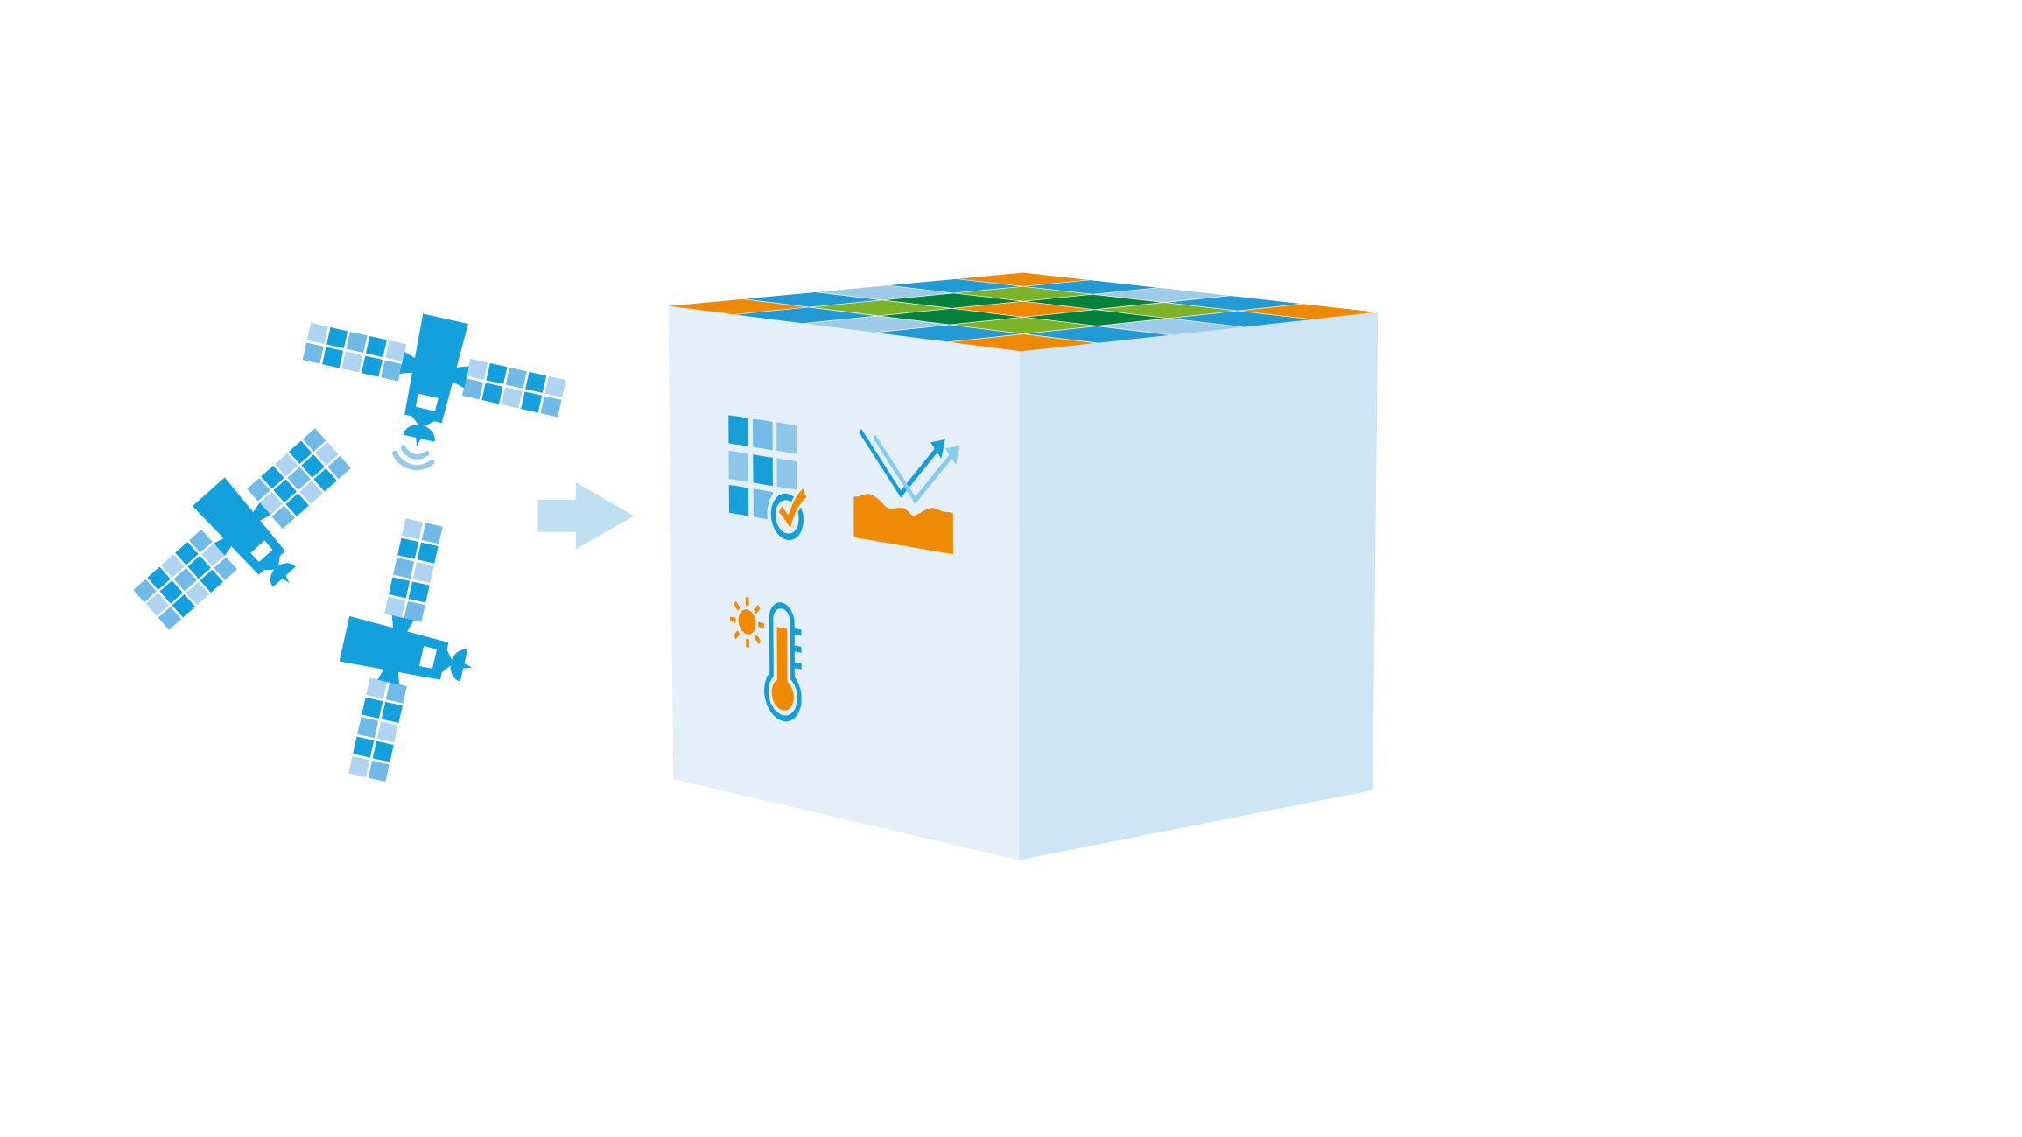






What is Digital Earth Australia?

Slide 7
Government Investment
Industry +
International
Science and Research
Government
> 2010
GA
Internal
2010
2012
ASRP
ULA
$3.5m
2012+
NCRIS
GA+CSIRO
AGDC
$5-6m/yr
2017-18
PSMF
DEA#1
+$15.3m
2018-19
2011-22
NPPs
Ongoing
DEA#2
+$36.9m
ASA
+$40m

Slide 8
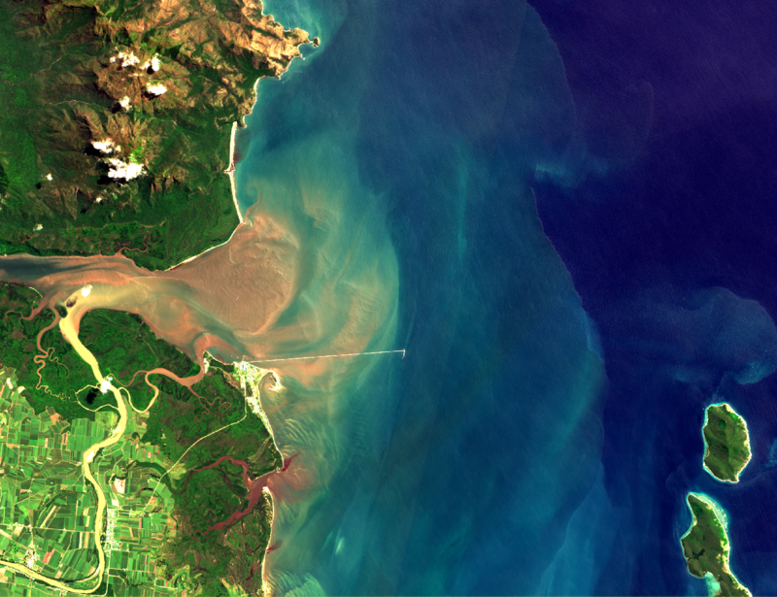
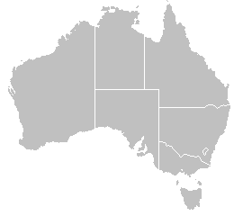
Sentinel-2A MSI
Ground Validation Support to CEOS Agencies
Acquisition of continuous land-based, and above-water radiometry + in-water optics
Lucinda Jetty, Queensland
6 km
Pinnacles, Western Australia

Slide 9
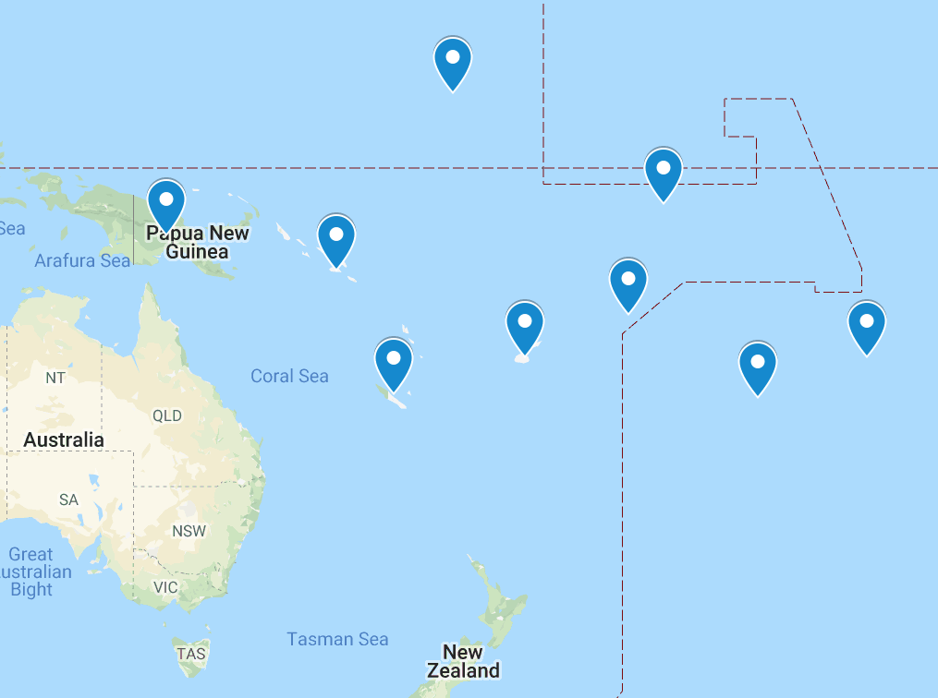
Pacific Island EO Platform
Consultation workshop on an EO platform to support Pacific Island Nations held jointly by Australia, Pacific Islands, European Delegation and France in Brisbane last week (11-12 Oct)
  Eight Pacific Island countries (nine invited)
  CSIRO, GA, CNES, Jaxa/Restec, GEO Blue Planet - NOAA represented
  Broader Australian and French government representatives including the French Ambassador to Australia
Strong thematic interest including land, oceans, climate and SDGs
  Fisheries, law enforcement, sea level, disasters, food security, water
Opportunity to promote EO uptake and SDGs, in a region which is generally underrepresented in a lot of CEOS and GEO activities
Challenges
  Knowledge of EO data, capabilities, limitations
  Fostering cross-regional coordination
  Capacity Building
  Satellite coverage, e.g. Copernicus
GEO Ministerial 2019 a potential milestone

Slide 10





SIT Chair 2020-2021
LSI-VC
Founding Partners
WGISS
WGCV
AHT SDGs
CEOS FDA
GEO ExCom

Slide 11
Thank you
Alex.Held@csiro.au – Director CSIRO Centre of Earth Observation, CSIRO Astronomy and Space Science, CSIRO
Jonathon.Ross@ga.gov.au - Director Earth Observation Planning and International Relations, Geoscience Australia

