Slide 1


Agency and Partner Updates
European Commission
Committee on Earth Observation Satellites
European Commission
CEOS Plenary 2018
Agenda Item 4.3
Brussels, Belgium
17 – 18 October 2018
Notes:
Rem:
Under agenda point 4.3 CEOS Agencies and Partners have the opportunity to report on updates of their EO programme. Each presentation is limited to max 10 min (about 7 min presentation and 3 min for Q&A). Presentations should address seed questions outlined in the invitation/agenda. These are:
the policy, scientific, and societal challenges driving the strategy and requirements of their Agency for the next 10 to 15 years and the degree to which CEOS’ thematic foci support these plans;
how CEOS as an organisation is supporting and prioritising engagement around the Agency’s requirements; and,
how CEOS activities related to standardisation (metadata and interoperability), quality control (cal/val), and data dissemination influence implementations in their Agency
It is proposed to first present in a nutshell the Space Strategy for Europe and the ‘high-level’ activities related to the Copernicus Programme. In this context the seed question could be addressed.
This could be complemented (assuming time permitting) by a couple of slides showing the state of play of the Copernicus Space Component and it’s possible expansion and evolution.

Slide 2
EU Space Strategy:
Copernicus Relevance
ensure programme stability and prepare the new Sentinel generations, on a user-driven basis, to continue delivering state-of-the-art services
address emerging needs related, in particular, to climate change/sustainable development and security and defence
continue to promote the uptake of Copernicus data and services and strengthen data dissemination including stimulating and supporting the development of space applications with a greater involvement of new actors from different domains (support to space entrepreneurs, space start-ups, facilitate the emergence of space hubs and clusters)
step up efforts to support space R&D activities, in cooperation with Member States and ESA, and review its strategic approach to boosting the competitiveness of the European space sector
pursue space dialogues with strategic international partners, e.g. through fostering the EU's contribution to international initiatives such as the Group on Earth Observation and CEOS.

Slide 3
Support and Benefits from CEOS
Forum for networking and establishing international partnerships
Establishing roadmaps for implementing coordinated observing systems
Gathering and consolidating observational requirements from global initiatives (GEO, UN bodies,..) and showcasing Copernicus assets through thematic WGs and AHTs
Establishing and benefitting from CEOS standards and methods for data pre-processing, dissemination, interoperability, and harmonization as well as quality control work (cal/val)
…….
Notes:
From the Copernicus ‘high-level’ activities it is obvious that CEOS as an organisation as well as activities pursued by CEOS working groups, virtual constellations and ad-hoc teams are in many aspects very relevant the EU Copernicus programme. This includes activities followed by the WGClimate and their cooperation with the Coordination Group for Meteorological Satellites (CGMS) pursuing the establishment of a GHG monitoring observation system from space, and activities followed by the Future Data Architecture revolutionizing the classical data dissemination and processing approaches, both followed closely as our Chair priorities during the last year.
In addition, work done by CEOS groups help us to consolidate observational requirements through gap analysis and showcasing Copernicus assets in global initiatives addressing societal challenges. This includes activities followed by the Space Data Coordination Group (SDCG) for Global Forest Observations Initiative (GFOI), the GEOGLAM group supporting the GEO Global Agricultural Monitoring, and the CEOS AHT on Sustainable Development Goals. Furthermore, Copernicus is greatly benefitting from CEOS work related to standardisation, interoperability and quality control. Just to name to important CEOS activity on the Atmospheric Correction Intercomparision eXercise (ACIX), the calibration reference sites (RadCalNet), the CEOS Analysis Ready Data (ARD) initiative and related data harmonisation efforts.
All this work is essential allowing users to utilize our assets in a complementary and synergistically manner.

Slide 4







Copernicus Space Component: State of Play
FULL, FREE AND OPEN
THE SENTINELS
Sentinel Mission and Status
Key Features
SENTINEL-1:
4-40m resolution, 3 day revisit at equator
2 Sats in orbit
Polar-orbiting, all-weather, day-and-night radar imaging
SENTINEL-2:
10-60m resolution, 5 days revisit time
2 Sats in Orbit
Polar-orbiting, multispectral optical, high-res imaging
SENTINEL-3:
300-1200m resolution, <2 days revisit
2 Sats in Orbit
Optical and altimeter mission monitoring sea and land parameters
SENTINEL-4:
8km resolution, 60 min revisit time
1st Launch in 2020
Payload for atmosphere chemistry monitoring on MTG-S
SENTINEL-5p:
7-68km resolution, 1 day revisit
1 Sat in Orbit
Mission to reduce data gaps between Envisat, and S-5
SENTINEL-5:
7.5-50km resolution, 1 day revisit
1st Launch in 2021
Payload for atmosphere chemistry monitoring on MetOp 2ndGen
SENTINEL-6:
10 day revisit time
1st Launch in 2020
Radar altimeter to measure sea-surface height globally

Slide 5
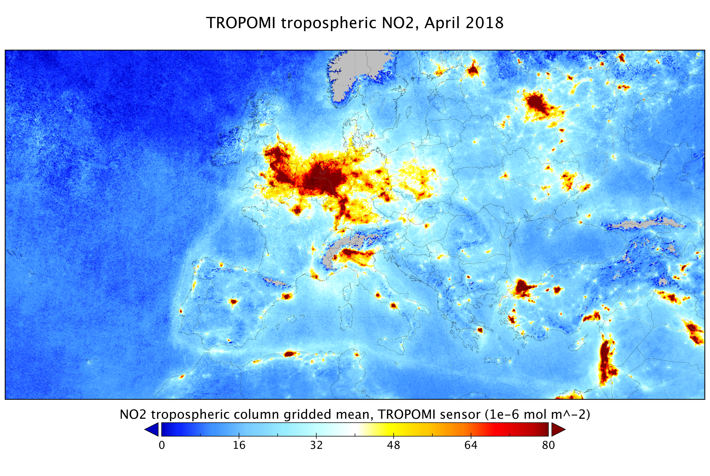

Slide 6

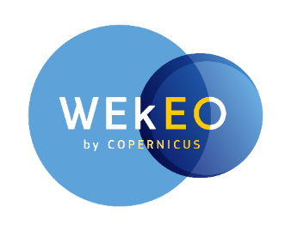



Copernicus DIAS Providers
‘Creodias – http://www.creodias.eu’ : Creotech (PL) with cloud provider CloudFerro (PL)
‘ONDA – http://www.onda-dias.eu’ : Serco (IT) with cloud provider OVH (FR)
‘SOBLOO – http://www.sobloo.eu’ : Airbus (FR) with cloud provider Orange (FR)
‘Mundiwebservices – www.mundiwebservices.eu’ : ATOS (FR) with cloud provider T-Systems (DE)
‘WeKEO – http://wekeo.eu’ : EUMETSAT, with Mercator Ocean and ECMWF
DIAS Showcase during Plenary breaks
Come and See!

Slide 7
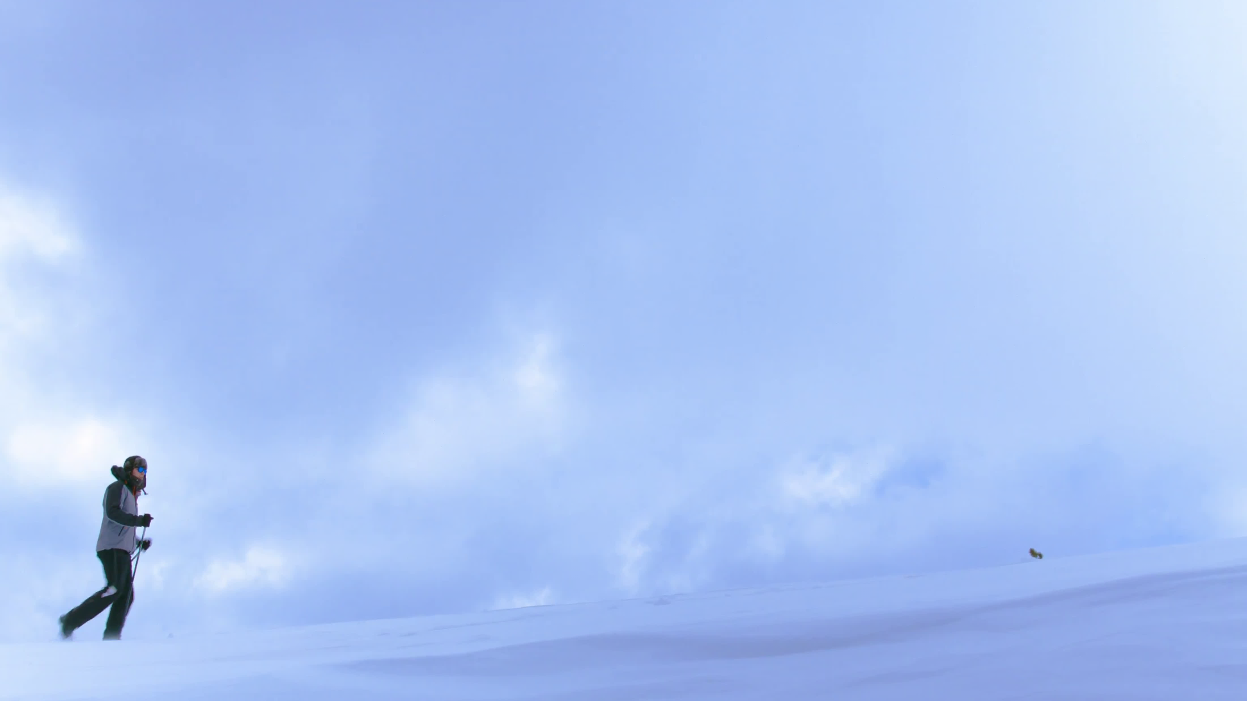
Copernicus Space Component Evolution
Next-Gen. missions will replace current & expansion missions
2014
Current Sentinels
Sentinel Next Generation
Sentinel Expansion
Copernicus for Security
Notes:
Sentinel Expansion
Shorter horizon; additional observation capabilities in support of emerging needs
Sentinel Next Generation
enhanced continuity of current (and expanded) observation capabilities to meet user requirements

Slide 8
Top priority: Stability of the programme and long term commitment
- (Enhanced) continuity of current data and services;
- Continuity of full, open and free data policy for the environmental domain;
•Additional services will be considered to meet emerging needs
- Climate change and sustainable development;
- Monitoring CO2 and other greenhouse gas emissions;
- Changes in the Arctic;
- Land use and forestry;
- Security and Defence: Improving the EU's capacity (border controls and maritime surveillance);
Policy Needs and stated priorities: Space Strategy for Europe

Slide 9
The (enhanced) continuity of existing observation capacity is the overarching priority;
Conclusions on major gaps :
CO2 measurements to estimate anthropogenic emissions (top priority)
High-Resolution Thermal observations
SAR L-band observations
Monitoring of sea ice and ice sheets in the polar region (PMR Imaging, Altimeter)
Hyper-spectral measurements
The results of these planned six studies will serve as input to iterate further the LTS but do not present any commitment of the Commission at this stage.
The next Copernicus Regulation will frame the implementation of the Copernicus Space Component in the next programme period and spell out the missions to be part of the future programme.

Slide 10
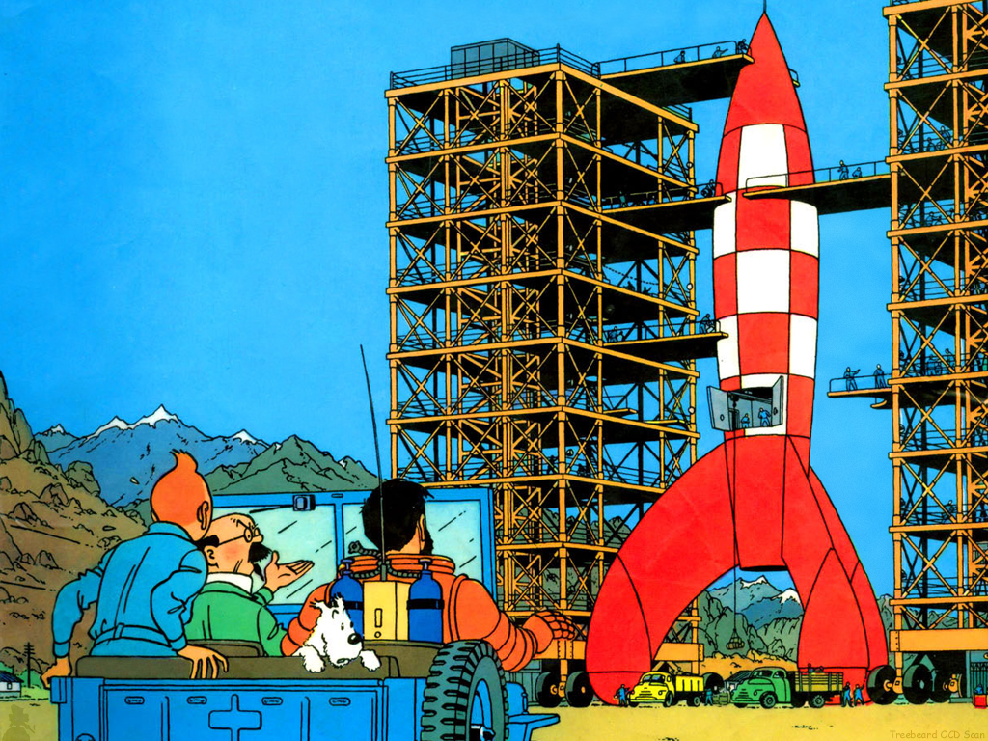

Disruptive Technologies?
We better could use it for another Sentinel launch

Slide 11
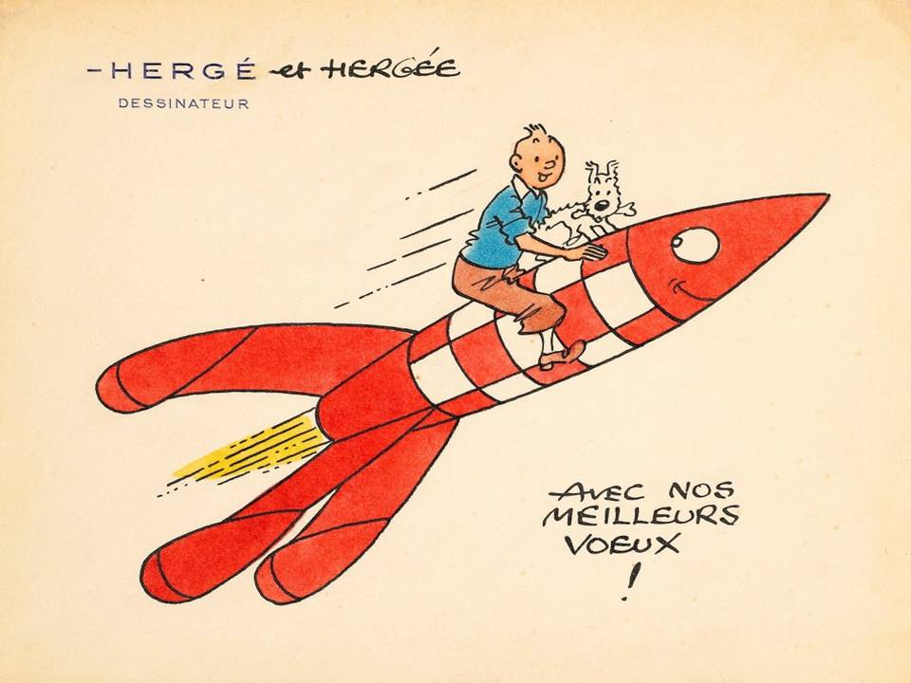
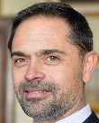
But look Philippe, its fun, too!!!!

Slide 12
BackUp Slides

Slide 13
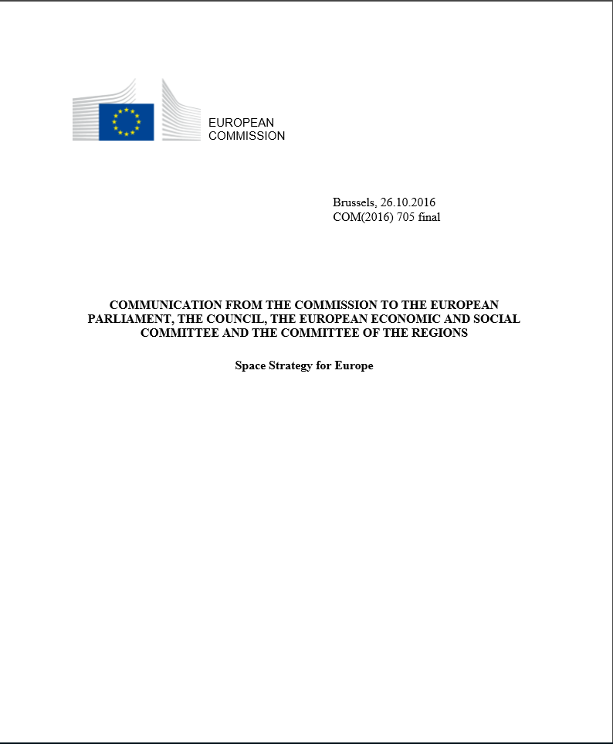
The Space Strategy for Europe
The Space Strategy for Europe addresses the strategic importance of Space for Europe in support of EU policies and political priorities.
These include:
  Competitiveness if our economy
  Migration
  Climate change
  Digital Single Market
  Sustainable management of natural resources
  Security and Defense, and
  reinforcing Europe’s role as a global actor and promoting international cooperation with a particular reference to CEOS
Notes:
The Space Strategy for Europe highlights 4 strategic goals:
MAXIMISING THE BENEFITS OF SPACE
FOSTERING A GLOBALLY COMPETITIVE AND INNOVATIVE EUROPEAN SPACE SECTOR
REINFORCING EUROPE’S AUTONOMY IN ACCESSING AND USING SPACE IN A SECURE AND SAFE ENVIRONMENT
STRENGTHENING EUROPE’S ROLE AS A GLOBAL ACTOR AND PROMOTING INTERNATIONAL COOPERATION
These 4 strategic goals drive the EU Space programmes and actions including those for the EU EO programme Copernicus (-> next slide)

Slide 14
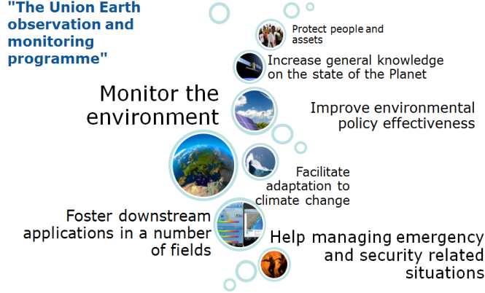
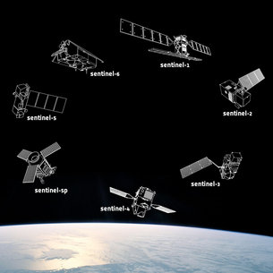
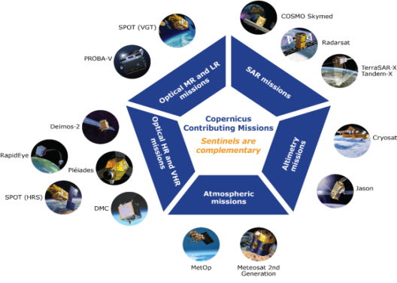
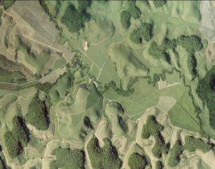


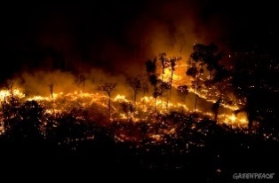
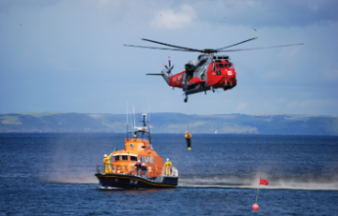

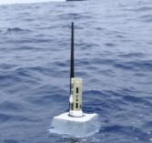
Copernicus Architecture
Space-based
6 services use Earth Observation data to deliver timely and reliable geo-information
Sentinels
added-value products
Contributing missions
ground-based

Slide 15
CSC Expansion Mission Candidates
( all currently in Phase A/B1)
Mission | Objective | Techn Concept | CEOS support
CO2 Mission | Paris agreement, anthropogenic CO₂ MRV support | VNIS/SWIR Spectrometer and multi-angle polarimeter, 4km2, 2-3 days revisit via a constellation | CEOS AC-VC White Paper on GHG
Thermal Mission | Addressing policies related to water and food security – EU Water Framework EU Directive, Common Agriculture Policy, UN SDGs, UNFCCC, UNCCD | 30-50 m, daily (goal) via a constealltion, 3-5 TIR bands & minimum VNIR/SWIR | Potential cross calibration /validation activities with Landsat, Trishna, Sentinel-3, preparation studies as part of Ecostress
Polar Ice and Snow Topographic Mission | Monitoring of critical climate signals: ice sheet (sea ice and land ice elevation and thickness), ice cap melting and sea level; Support applications related to coastal and inland waters; contribute to the observation of ocean topography. | Ku-band and Ka-band interferometric radar altimeter, a laser retro-reflector array, a GNSS receiver | Cal/Val (e.g. Altika and IceSat-2 when operational)
Passive Microwave Imaging Mission | Integrated EU Arctic Policy, sustainable development in and around the Arctic | multifreq.microwave radiometer (CMIR) which sustains AMSR2 type capability and SMAP/SMOS capability | Direct response to SST-VC Prevents gap in MW capability @~7GHz
Hyperspectral Mission | management of natural resources. Supports services for food security, agriculture and raw materials. | 400-2500nm; 10nm;<30m, 10d via a constellation; | Cal/Val, synergy with LSI-VC and OCR-VC for inland/coastal water
L-Band SAR Mission | vegetation cover, biomass and surface soil moisture. Enhanced monitoring polar regions (sea and land ice) and ground movement and deformation due to hazards. | L-band imaging SAR, full-pol, 5-30m, revisit TBD | Cal/Val, synergy with LSI -VC
Notes:
The slide shows Expansion Mission Candidates currently under study and their relationship to CEOS.
CSC is co-funded by the EU and ESA with complementary roles.
Proper funding through programme subscriptions by ESA Member States and by the EU within the next Multiannual Financial Framework (MFF) is a requisite for a successful implementation of the evolution scenario.

