Slide 1

FAO Frontiers from Space
Committee on Earth Observation Satellites
Douglas M. Muchoney, Ph.D.
Food and Agriculture Organization of the United Nations
CEOS Plenary 2018
Agenda Item 4.2
Brussels, Belgium
17 – 18 October 2018

Slide 2
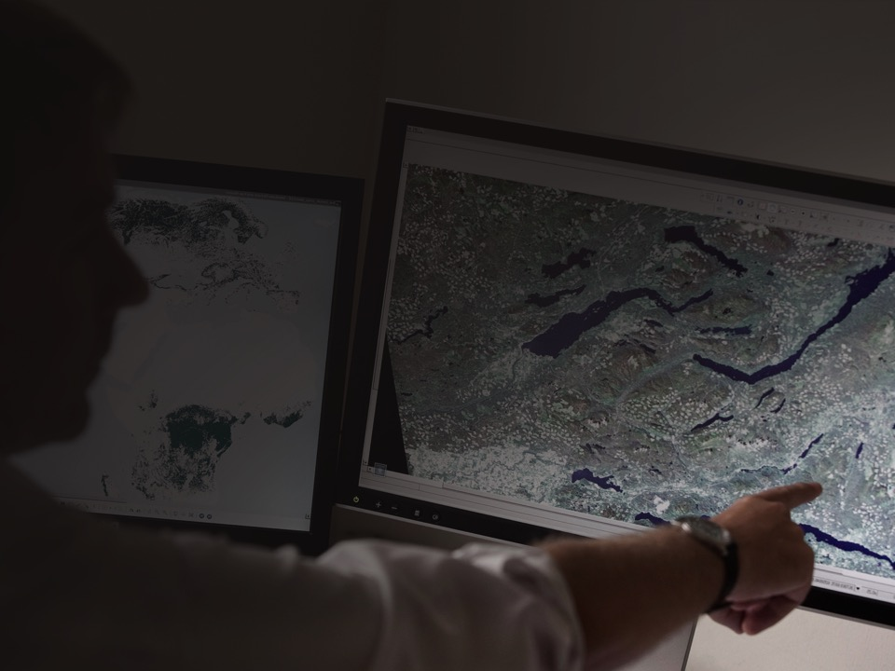
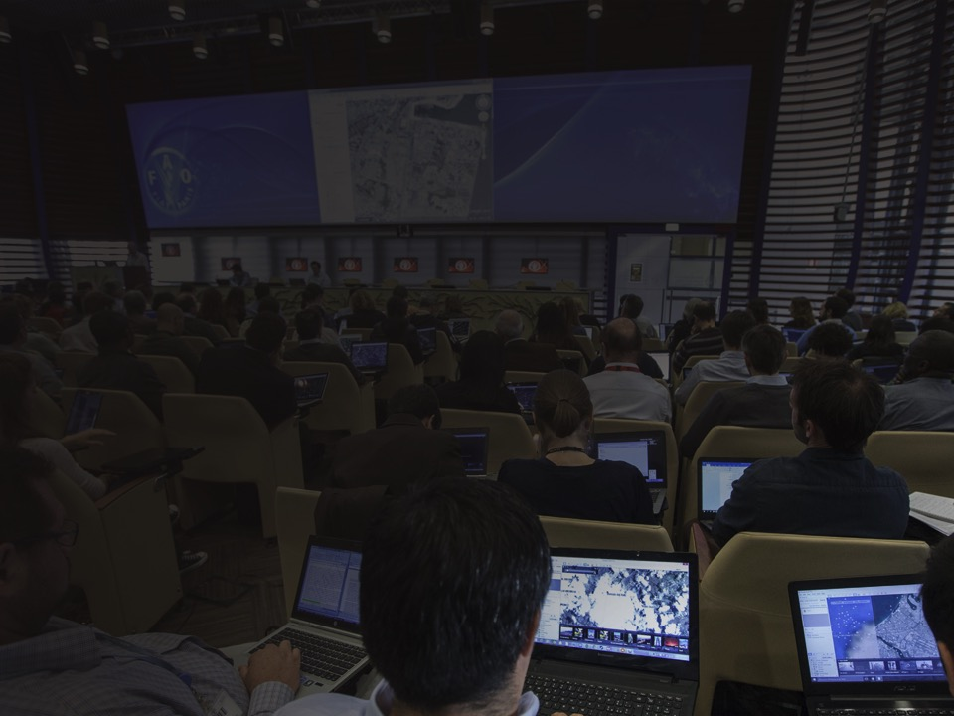

GEOSPATIAL UNIT (CBDS)
FAO helps countries implement appropriate geospatial solutions, that can assist their efforts to create sustainable food systems. This work is organized and delivered through projects and programs carried out both at HQ and regional, sub-regional, and national offices to ensure that best practices and standards are adopted and implemented.
The main areas of the work of CBDS include:
Climate change
Land resources
Agriculture monitoring and agro-ecology
Ecosystem and biodiversity monitoring
Disaster risk management

Slide 3
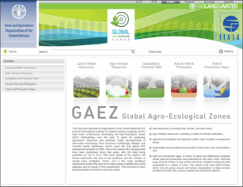
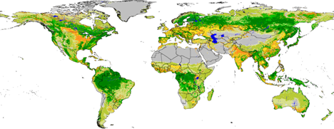
GAEZ - Global Agro-Ecological Zones
By FAO and the International Institute for Applied Systems Analysis (IIASA).
GAEZ database is publicly available through a WEB portal.
http://gaez.fao.org/Main.html
Notes:
The International Institute for Applied Systems Analysis (IIASA) and the Food and Agriculture
Organization of the United Nations (FAO) have been continuously developing the Agro‐Ecological
Zones (AEZ) methodology over the past 30 years for assessing agricultural resources and potential.
Rapid developments in information technology have produced increasingly detailed and manifold
global databases, which made the first global AEZ assessment possible in 2000. Since then global AEZ
assessments have been performed every few years, with the data being published on CD or DVD.
With each update of the system, the issues addressed, the size of the database and the number of
results have multiplied. GAEZ 2009 is the most ambitious assessment yet and the goal is to make
publicly available the entire database and all results of this assessment.
Interactive Web Application
Start query selection by choosing a main theme
Tips and hints are available to the user
Callouts and tooltips enabled
The submenus are enabled based on the user selections
Geographic areas filters enable to select the area of interest
Geographic filters enable further filtering based on the logical criteria

Slide 4
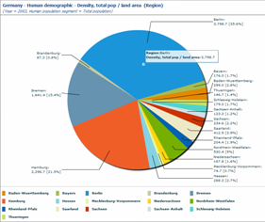
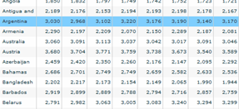
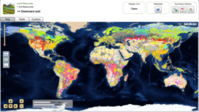
GAEZ Data Portal
www.fao.org/nr/gaez
Brief summary of content:
  5 thematic areas (Land and water resources; Agro-climatic resources; Suitability and potential yields; Actual yields and production; Yield and production gaps)
  > 300,000 global datasets at mainly 5 arc-minutes, also core layers at 30 arc-seconds
  11 crop groups, 49 crops, 92 crop types and 280 Crop/LUTs
  yield and production gap analysis for 17 crops/commodities
  5 water supply types
  4 Input levels (High, Intermediate, Low, Mixed)
  Historical 1961-2000, 30 year average (1961-1990) and Future, 2020s, 2050s, 2080s)

Slide 5
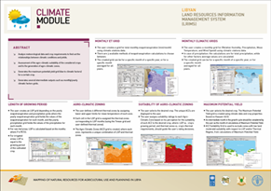
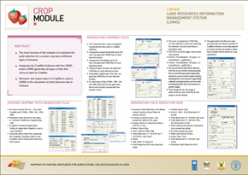
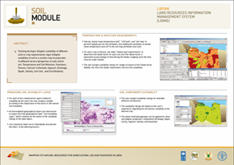
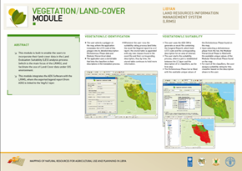
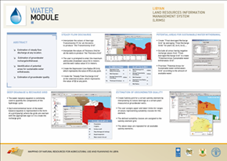
Land Resources Information Management System (LRIMS)
Integrated processing environment where physical and socio-economic data are analyzed;
Help identify sustainable land management practices;
Allows implementation of an integrated and interactive approach to land use planning;
Support for technicians and policy makers;
Enables assessment and modeling of land suitability and responses to potential agricultural production;
Developed and applied in Libya; Currently under development in Laos, Afghanistan and Macedonia
Notes:
LAND RESOURCES INFORMATION MANAGEMENT SYSTEM (LRIMS)
Assessment and modeling of land suitability and responses to potential agricultural process is the final and ultimate aim of the project. This is being achieved through the development of the Land Resources Information Management System (LRIMS), a data management and analysis tool which integrates various functionalities and methodologies into one processing environment (ESRI©ArcGIS and Spatial Analyst). LRIMS enables standardization and creation of harmonized complex databases using the GeoDatabase data model.
LRIMS is designed and developed based on FAO guidelines and methodologies for sustainable management of land resources. It implements an integrated and interactive approach to land use planning and participatory techniques, enabling assessment and modeling of land suitability and responses to potential agricultural production.
Data content
LRIMS includes key geographic datasets and related tabular data for agricultural planning, organized into groups of thematic layers such as climate, water, soil, topography, land utilization types, vegetation/land cover and socio-economic data. An action plan has been formulated for the collection of measurements to fill the data gaps
Applications
LRIMS provides a straightforward access to organizational data and metadata; contains some query, analysis and map-building capabilities and allows standardized analysis, monitoring and forecasting functionality. In addition, LRIMS allows assessments of the physical/socio-economic conditions of the land to be undertaken and the evaluation of the benefits and constraints of different options through the simulation of various scenarios.
MODULES
LRIMS is developed on a modular approach to allow maximum interoperability with a number of key elements and layers of information. LRIMS has 10 modules: Land Utilization Types, Climate, Water, Soil, Topography, Vegetation/Land Cover, Crop, Socio-Economic, Land Evaluation Suitability and Reporting Module. The last two modules allow users to produce alternative scenarios and generate reports.

Slide 6
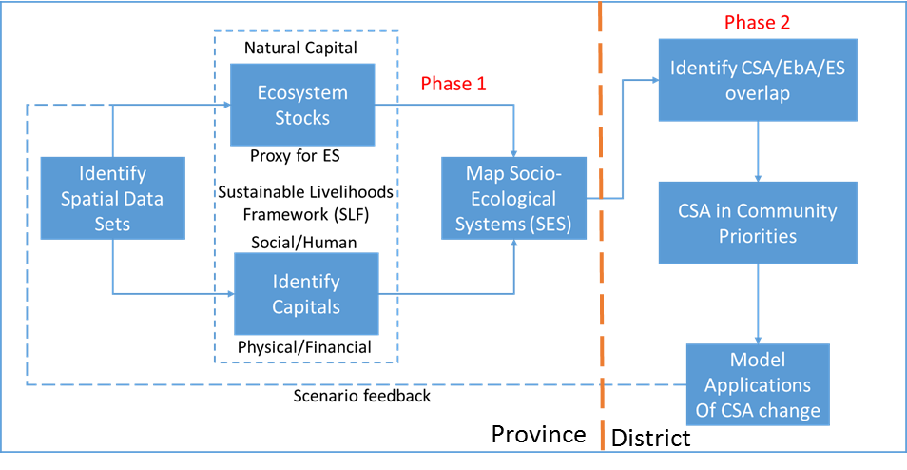
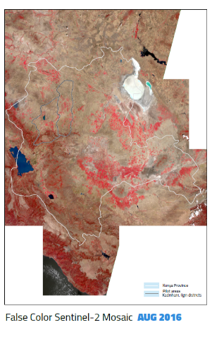
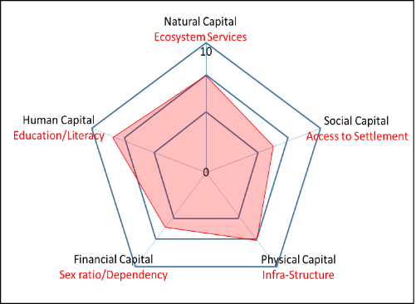
Socio-Ecological Systems in Central Anatolia
map the ecosystems
determine the ecosystem condition
determine relevant ecosystem services for provisioning and regulating services
select indicators or modelled outputs of the ecosystem services for which viable data are available
map the ecosystem services and service potential
Notes:
LAND RESOURCES INFORMATION MANAGEMENT SYSTEM (LRIMS)
Assessment and modeling of land suitability and responses to potential agricultural process is the final and ultimate aim of the project. This is being achieved through the development of the Land Resources Information Management System (LRIMS), a data management and analysis tool which integrates various functionalities and methodologies into one processing environment (ESRI©ArcGIS and Spatial Analyst). LRIMS enables standardization and creation of harmonized complex databases using the GeoDatabase data model.
LRIMS is designed and developed based on FAO guidelines and methodologies for sustainable management of land resources. It implements an integrated and interactive approach to land use planning and participatory techniques, enabling assessment and modeling of land suitability and responses to potential agricultural production.
Data content
LRIMS includes key geographic datasets and related tabular data for agricultural planning, organized into groups of thematic layers such as climate, water, soil, topography, land utilization types, vegetation/land cover and socio-economic data. An action plan has been formulated for the collection of measurements to fill the data gaps
Applications
LRIMS provides a straightforward access to organizational data and metadata; contains some query, analysis and map-building capabilities and allows standardized analysis, monitoring and forecasting functionality. In addition, LRIMS allows assessments of the physical/socio-economic conditions of the land to be undertaken and the evaluation of the benefits and constraints of different options through the simulation of various scenarios.
MODULES
LRIMS is developed on a modular approach to allow maximum interoperability with a number of key elements and layers of information. LRIMS has 10 modules: Land Utilization Types, Climate, Water, Soil, Topography, Vegetation/Land Cover, Crop, Socio-Economic, Land Evaluation Suitability and Reporting Module. The last two modules allow users to produce alternative scenarios and generate reports.

Slide 7
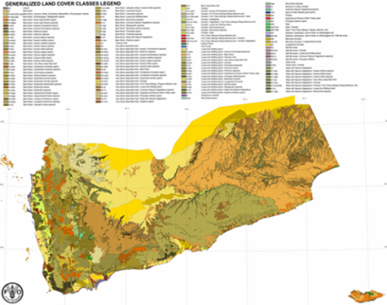
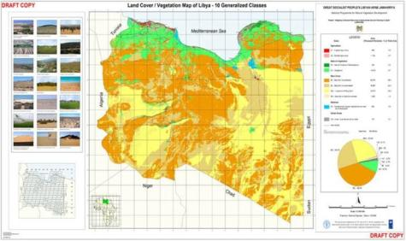
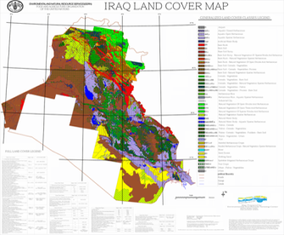
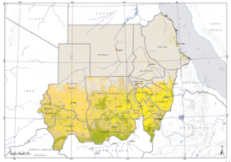
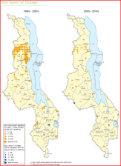
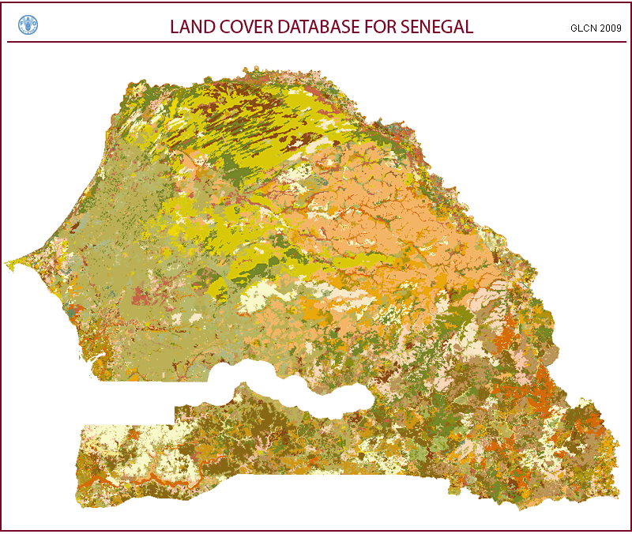
National mapping

Slide 8
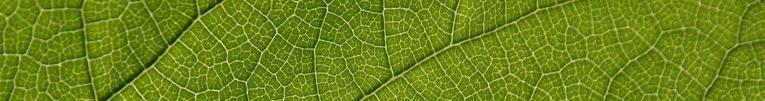

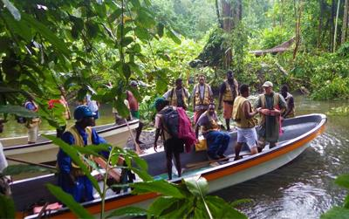
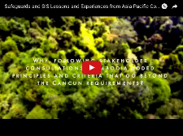

z
REDD+ support
UN-REDD
Established in 2008 by FAO, UNDP and UNEP – delivering as One UN
Supports over 60 developing countries in strengthening capacity to participate in REDD+ process and related implementation
US$ 280 M in donor contributions (Phase 1,2009-2015);
US$ 100 million delivered by FAO
Phase 2: 2017-2020
Other significant REDD+ projects:
In collaboration with the World Bank: Ethiopia, Sudan…
Capacity development support to remote sensing and field assessments through SEPAL, GFOI, Google Partnership, BMU, FAO-FIN…
Central African Forest Initiative: Norway, World Bank, UNDP
Greenhouse Gases Inventories, in collaboration with NRC and AG Department
Notes:
SEPAL= System for Earth Observation Data Access, Processing and Analysis for Land Monitoring
GFOI= Global Forests Observations Initiative, led by: Australia, Norway, the USA, FAO, and the Committee on Earth Observation Satellites (CEOS)
BMU= Federal Ministry for the Environment, Nature Conservation and Nuclear Safety, Germany

Slide 9
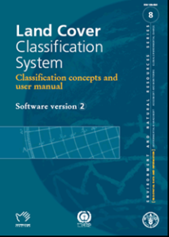
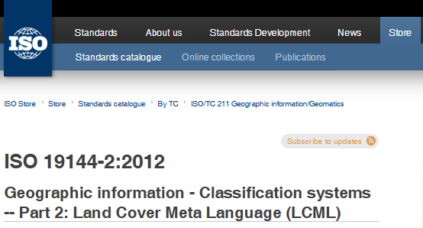
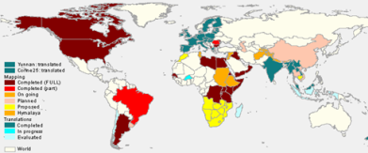
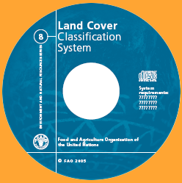
Land Cover Classification System
LCCS / LCML : Comprehensive methodology for description, characterization, classification and comparison of most land cover features identified anywhere in the world, at any scale or level of detail: basis for comparative classification. (6 UN official languages)
Created in response to a need for a harmonized and standardized collection and reporting on the status and trends of land cover

Slide 10
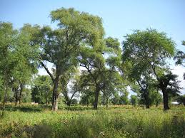










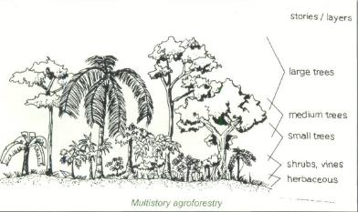




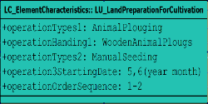




From land cover to land use (LCML to LCHML)
Notes:
10
10

Slide 11
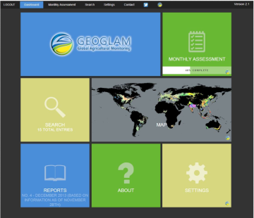
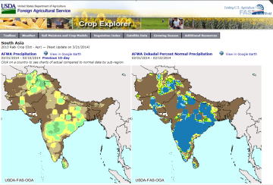
GEOGLAM
Monitoring Crop Production
In this context a global system to monitor and assess production is seen as an important decision making tool to:
  provide timely information on crop production and yield in a standardized and regular fashion at the regional to global level.
  provide estimates as early as possible during the growing season(s) and update the estimates periodically through the season until harvest.
Examples of current global crop estimation systems is GEOGLAM, which combines in-situ information, weather and satellite data in a convergence of evidence approach to estimate production and yield.

Slide 12









GFOI Partners
Founded under Group on Earth Observations (GEO) in 2011
  First work plan was 2012-13
  Review in 2016 led to development of Phase 2
Lead partners: currently Australia, CEOS, ESA, FAO, Norway, UK, USA, & the World Bank
Many other contributor including UNFCCC, IPCC, universities, technical and policy experts
Open to new partners.

Slide 13
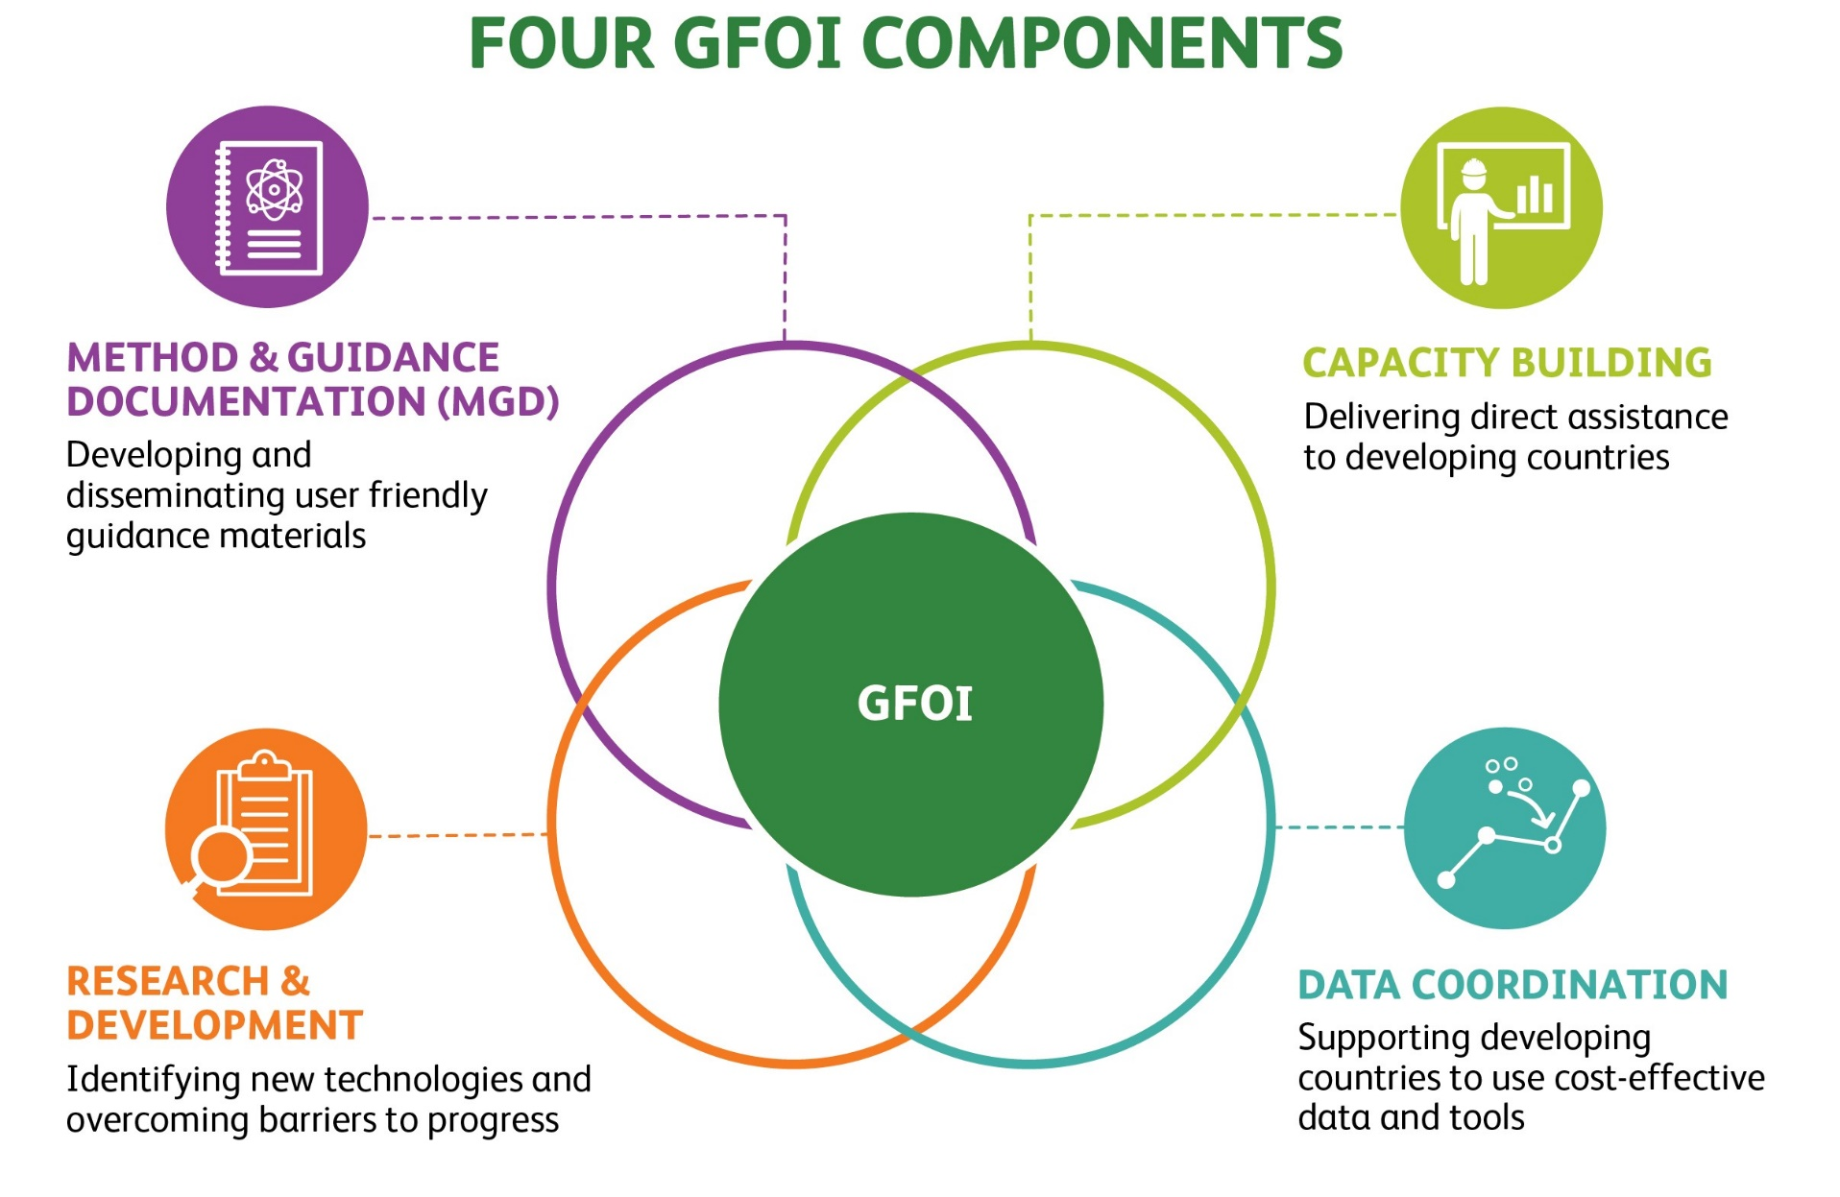

Slide 14
GFOI Phase II
Under its second phase, GFOI will:
  Focus on addressing country needs
  Develop improved mechanisms of coordination
  Align support to reporting and data needs
  Expand its membership
  Establish a new Data Component.

Slide 15
FAO Future Collaborations
Continued collaboration on GFOI, GEOGLAM, EO4SDG and EO4EA (w/ SEEAS) via SDCG et al.
Cloud computing, AI, Machine Learning…
Tool Development: SEPAL, OpenFORIS (including Collect Earth)
FAO Geospatial Framework
FAO Geospatial Technical Network

Slide 16
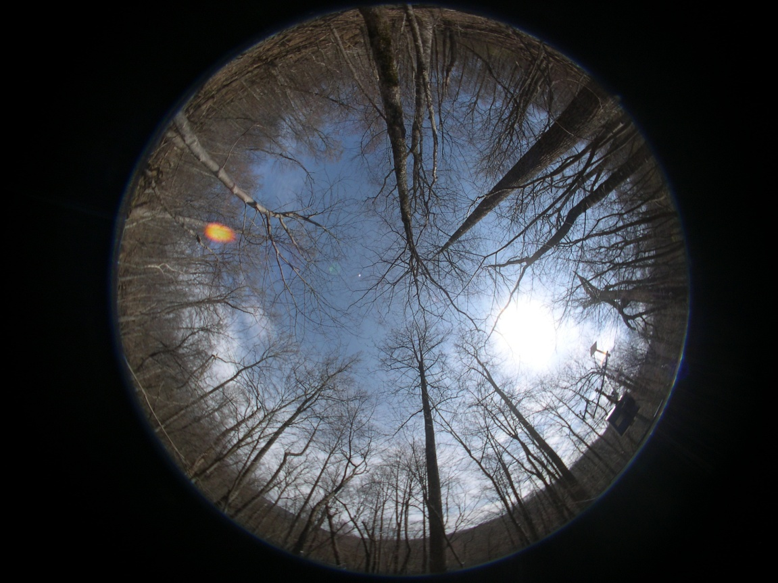
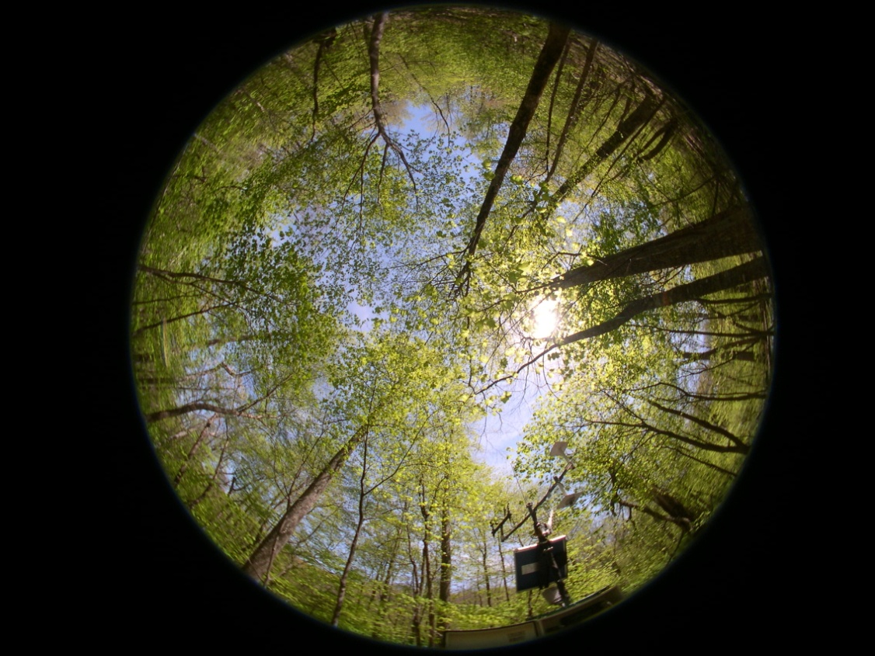
Thank you
Douglas Muchoney: douglas.Muchoney@fao.org
FAO Geospatial: www.fao.org/geospatial

