Slide 1

NOAA Agency Report
Committee on Earth Observation Satellites
Steve Volz, CEOS SIT Chair
National Oceanic and Atmospheric Administration (NOAA)
CEOS Plenary
Session 4, Agenda Item 4.2
Brussels, Belgium
16-18 October, 2018
Notes:
Session 4 of the 2018 CEOS Plenary (Agency and Partner Updates) will provide an opportunity for agencies to speak about their plans and strategy in relation to CEOS, as well as the benefits and expectations of CEOS from their agency perspective. Agencies are asked to comment on:
1) the policy, scientific, and societal challenges driving the strategy and requirements of their agency for the next 10 to 15 years and the degree to which CEOS' thematic foci support these plans;
2) how CEOS as an organization is supporting and prioritizing engagement around the agency’s requirements; and,
3) how CEOS activities related to standardization (metadata and interoperability), quality control (cal/val), and data dissemination influence implementations in their agency.

Slide 2
CEOS Chair Guidance for Presentations
Agencies are asked to comment on:
The policy, scientific, and societal challenges driving the strategy and requirements of their agency for the next 10 to 15 years and the degree to which CEOS' thematic foci support these plans;
How CEOS as an organization is supporting and prioritizing engagement around the agency’s requirements; and,
How CEOS activities related to standardization (metadata and interoperability), quality control (cal/val), and data dissemination influence implementations in their agency.

Slide 3
U.S. Policy Guidelines
National Essential Functions (8)
NEF
Sustaining
Operations
PMEF
DOC Primary Mission Essential Functions
PMEF Operations
NOAA PMEF Operations & Critical Path
Other NOAA Functions
PMEFs: Those functions that must be continuously performed to support or implement the uninterrupted performance of NEFs.
Source: Federal Continuity Directive 1 (FCD-1), Federal Executive Branch National Continuity Program and Requirements, January 17, 2017

Slide 4
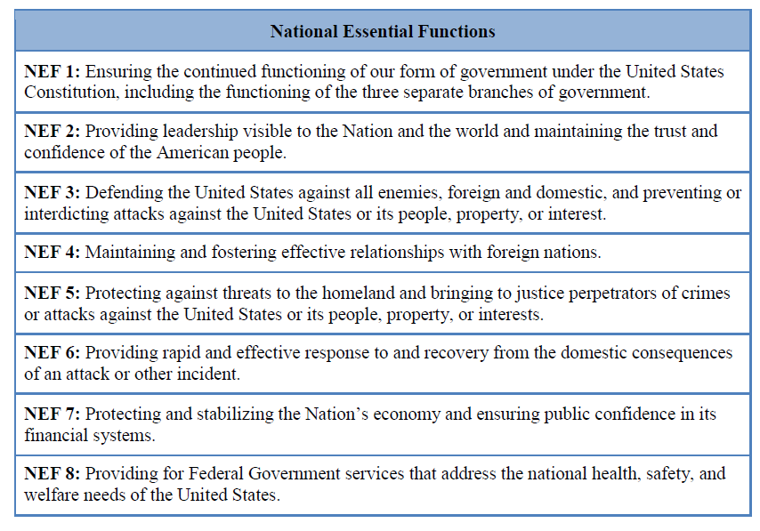
U.S. National Essential Functions
Source: Federal Continuity Directive 2 (FCD-2), Federal Executive Branch Mission Essential Functions and Candidate Primary Mission Essential Functions Identification and Submission Process, June 13, 2017

Slide 5
NOAA Policy Guidelines
NOAA supports two Department of Commerce (DOC) Primary Mission Essential Functions (PMEF)
DOC PMEF #2 – “Collect and provide the Nation with critical intelligence data, imagery, and other essential information for predictive environmental and atmospheric modeling systems and space-based distress alert systems by operating NOAA-controlled satellites, communications equipment, and associated systems.”
DOC PMEF #3 - “Provide the Nation with forecasts, warnings, environmental data, and expertise critical to public safety, disaster preparedness, all-hazards response and recovery, the national transportation system, safe navigation, and the protection of the Nation’s critical infrastructure and natural resources.”
Continuity of Observations
Archive of & Access to Critical Environmental Data
PMEFs: Those functions must be continuously performed to support or implement the uninterrupted performance of National Essential Functions (NEFs). (Federal Continuity Directive 1, January 17, 2017, page B-1)
For Official Use Only 5

Slide 6
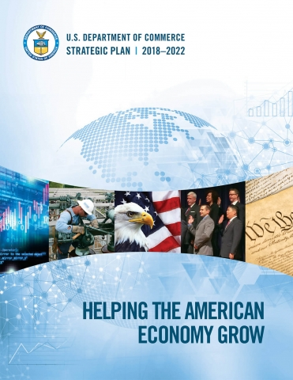
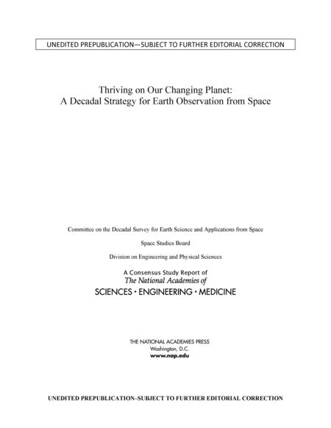
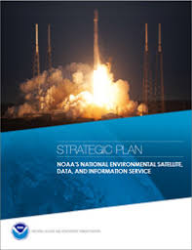
Current Policy Interpretation
Policy covers all PMEFs, plus direction to:
  Encourage growth in the commercial
  space sector
  Provide information to enhance economic
  development
  Reduce the impact of severe weather
  events
  Respond to Congressional direction
  Consideration of National Academy
  Surveys and observations
Our approach is defined by:
  Established NOAA Consolidated User
  requirements
  NESDIS strategic plan, and
  NESDIS Satellite Observing System
  Architecture (NSOSA) analyses
2018 Decadal Survey

Slide 7
The NESDIS Strategic Plan
1. Continuity, observations & information
We have to deliver without interruption the data and observational products our Users require.
We must ensure the space and ground assets continue to pace the state of the art, are secure, and deliver the necessary information to meet
User needs.
We must maintain a vibrant and capable workforce within and trusted partnerships globally to meet our
Users’ needs.
2. Architecture & Gap Analyses
3. Collaborations

Slide 8
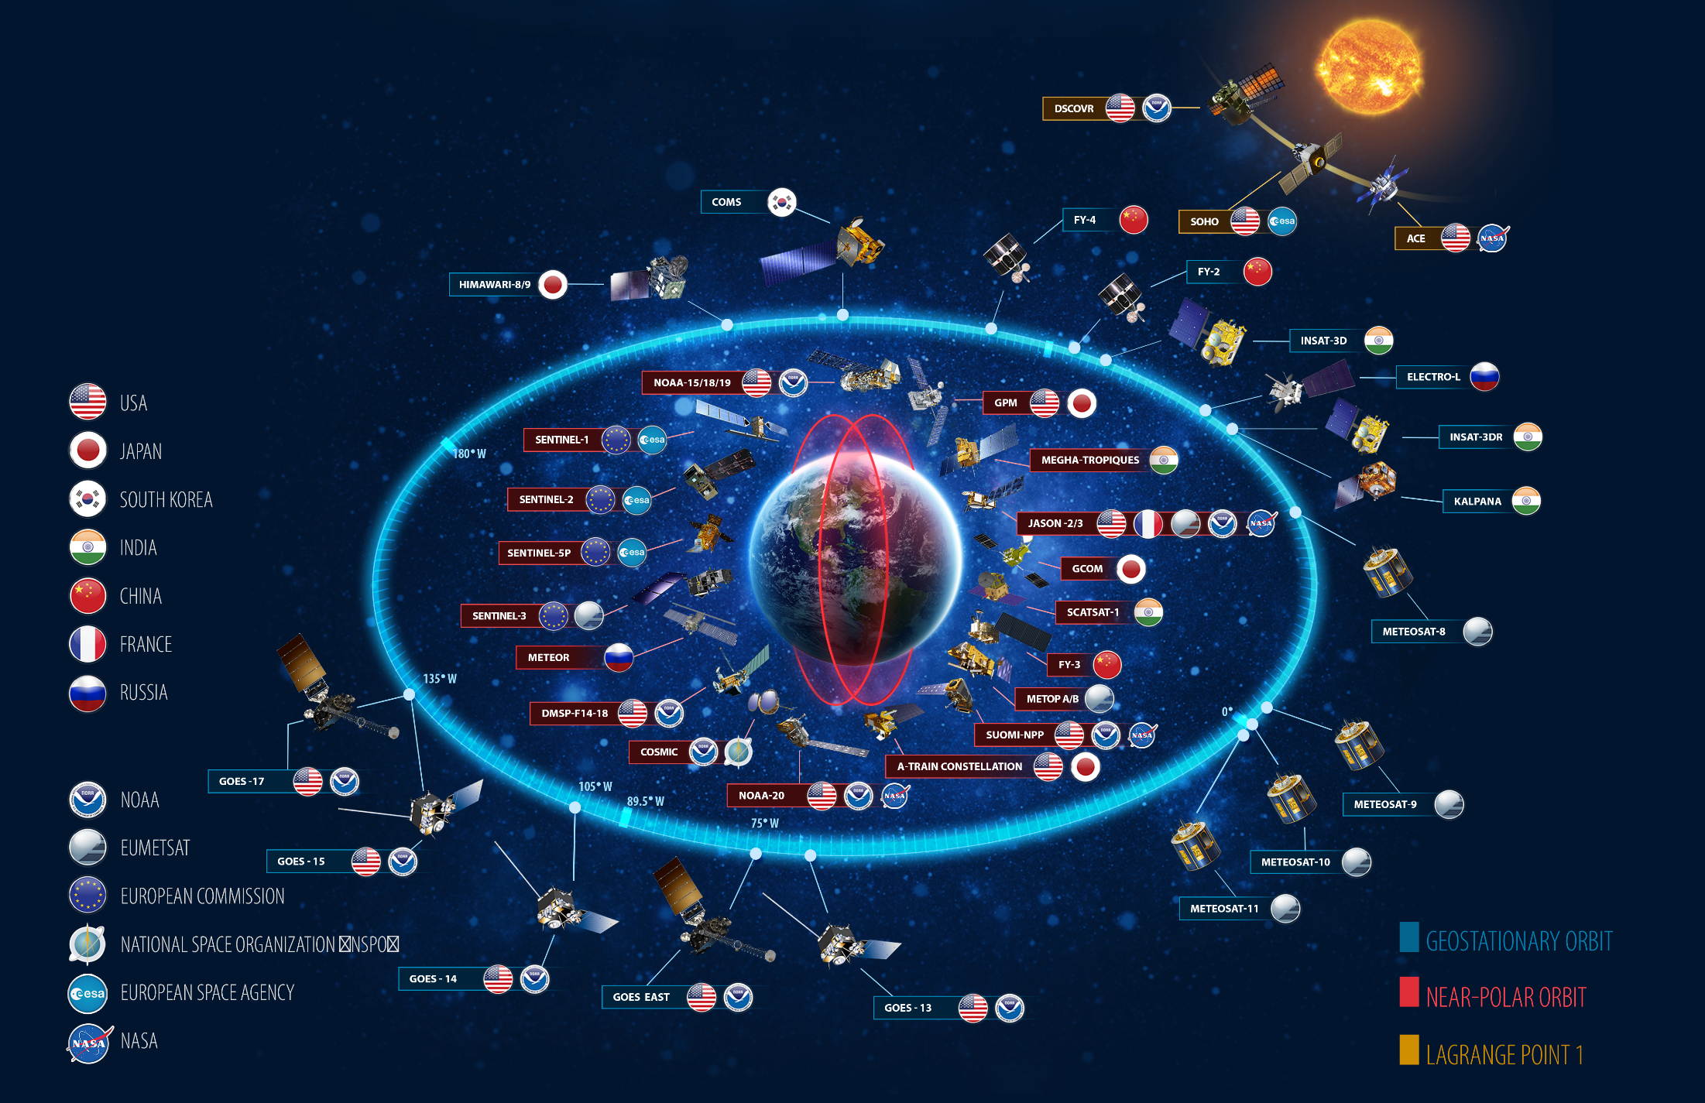
1. Continuity Must Leverage Partnerships
CEOS constellation planning and focus on common
data formats and standards across multiple
measurement types makes sharing possible.
    - WGISS, FDA, VCs
Notes:
NOAA Assets Meet ONLY a portion of our system needs
Leveraging a Global Constellation
While NOAA operates many satellites, no one country alone can afford to effectively monitor the entire planet. Instead, NOAA partners with the international community to leverage data from satellites around the world, providing a more complete understanding of our ever changing planet.
Lines are increasingly blurred: National/International, Research/Operational, GEO/LEO (CEOS brings these all together)

Slide 9
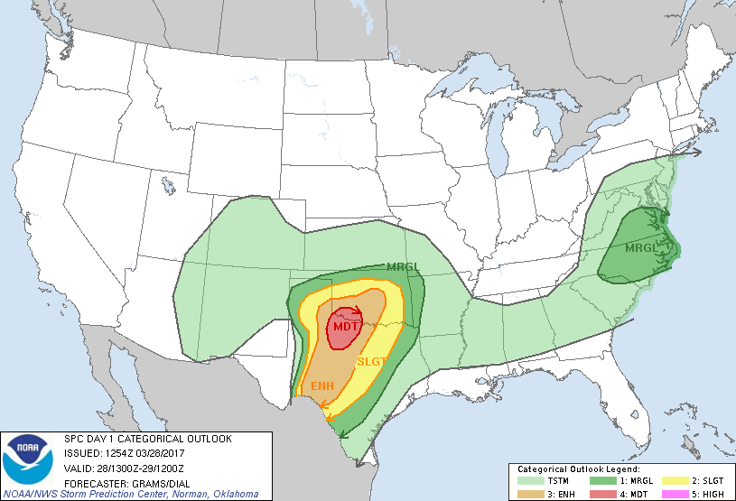
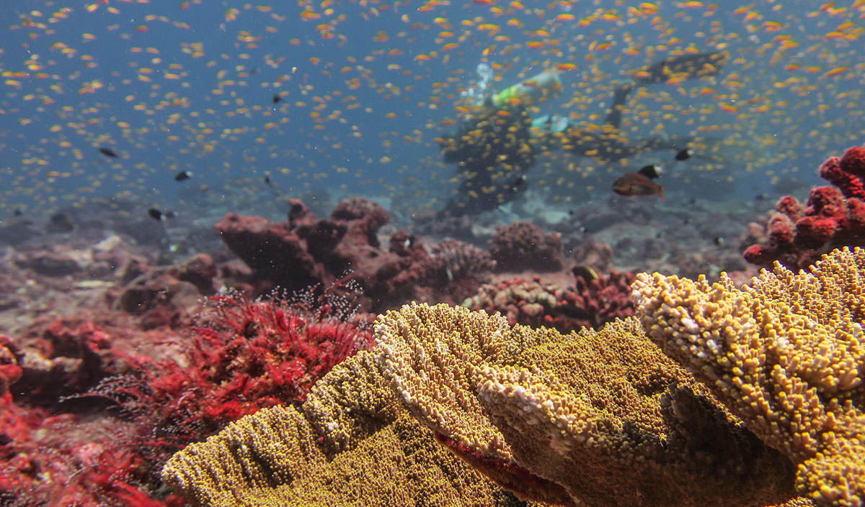
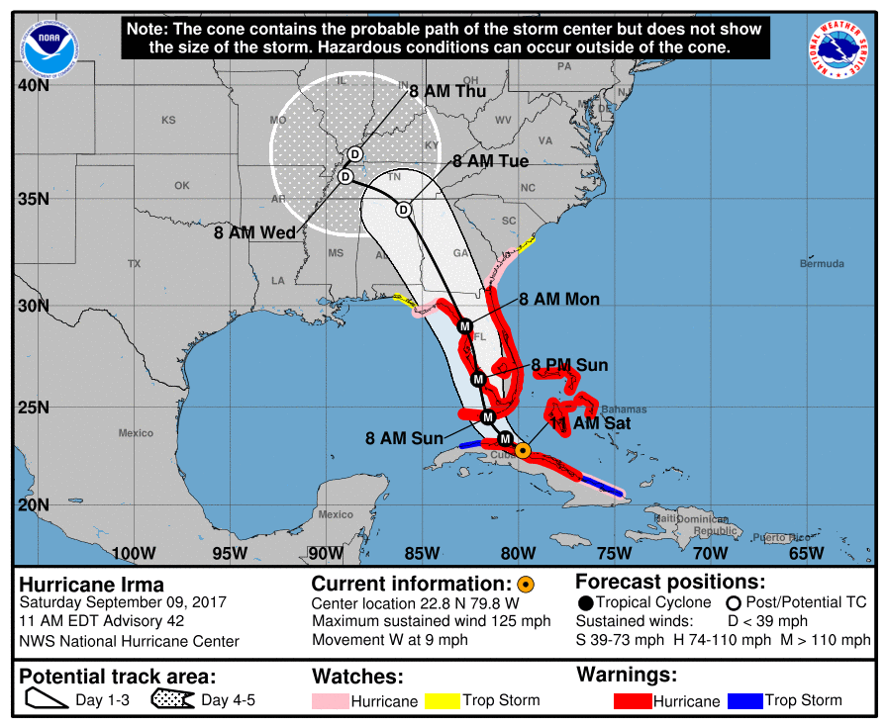
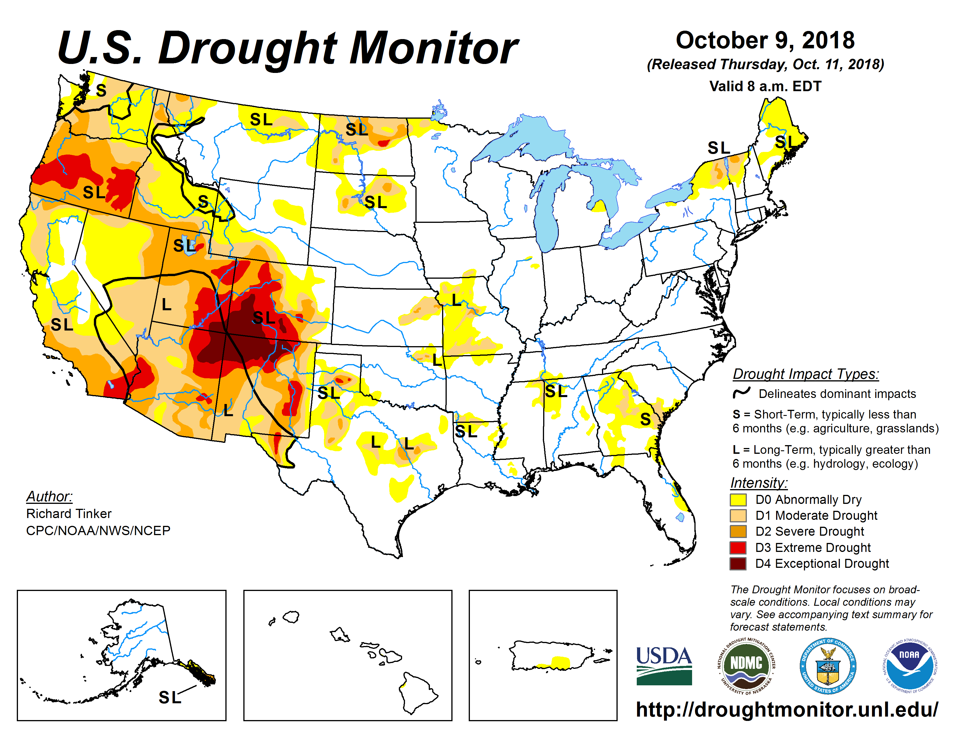
2. NOAA Architecture Study Intended to Inform New System Options
NSOSA study examines NOAA’s future space segment architecture options
  Which observation functions should be allocated to which orbits?
  How do we account for partner contributions, now and into the future?
  Which observation functions should be improved?
  What will future commercial or partner systems provide?
Addressing NOAA operational needs, from defined requirements
  Observations that result in warnings, watches, baseline weather and space weather forecasts, and ocean or fisheries actions
CEOS Shared databases provide accurate current understanding of the global observing system
  MIM Database, EO Handbook, WG Cal/Val, VC Constellation analyses
Notes:
NOAA SATELLITE OBSERVING SYSTEM ARCHITECTURE (NSOSA) STUDY
· NESDIS conducted the NOAA Satellite Observing Systems Architecture (NSOSA) Study to inform NOAA's future space segment architecture decisions. The study concluded at the end of last year.
· NESDIS’ objective is to evolve to a more mission-effective, integrated, adaptable, and affordable portfolio while responding to changing technology, emerging partnerships and evolving observation requirements.
· NOAA will need to replenish our current satellites in 10–15 years, around 2030, and it takes up to that long to design and deploy new systems.
· The NSOSA study provided a cost-benefit analysis of over 100 constellation options, driven by user needs, emerging space business models, and ability to meet core mission capabilities.
· Options that demonstrated high cost-benefit performance were a mix of U.S. Government satellites and hosted payloads in geostationary orbit, partially disaggregated low Earth orbiting systems, mixed resolution payloads and update rates, commercial services and GNSS-RO data buys.
· The NSOSA study is pre-decisional. It doesn’t tell NOAA what acquisition decisions to make, but instead informs how we make them.
· NOAA has engaged with the public as it seeks to make decisions informed by NSOSA study results. NOAA is seeking to engage with industry, find ways to develop innovative capabilities, new partnership opportunities and business models that may inform NOAA's path forward, including through an RFI for demonstration payloads that could rideshare on our JPSS-2 launch.

Slide 10
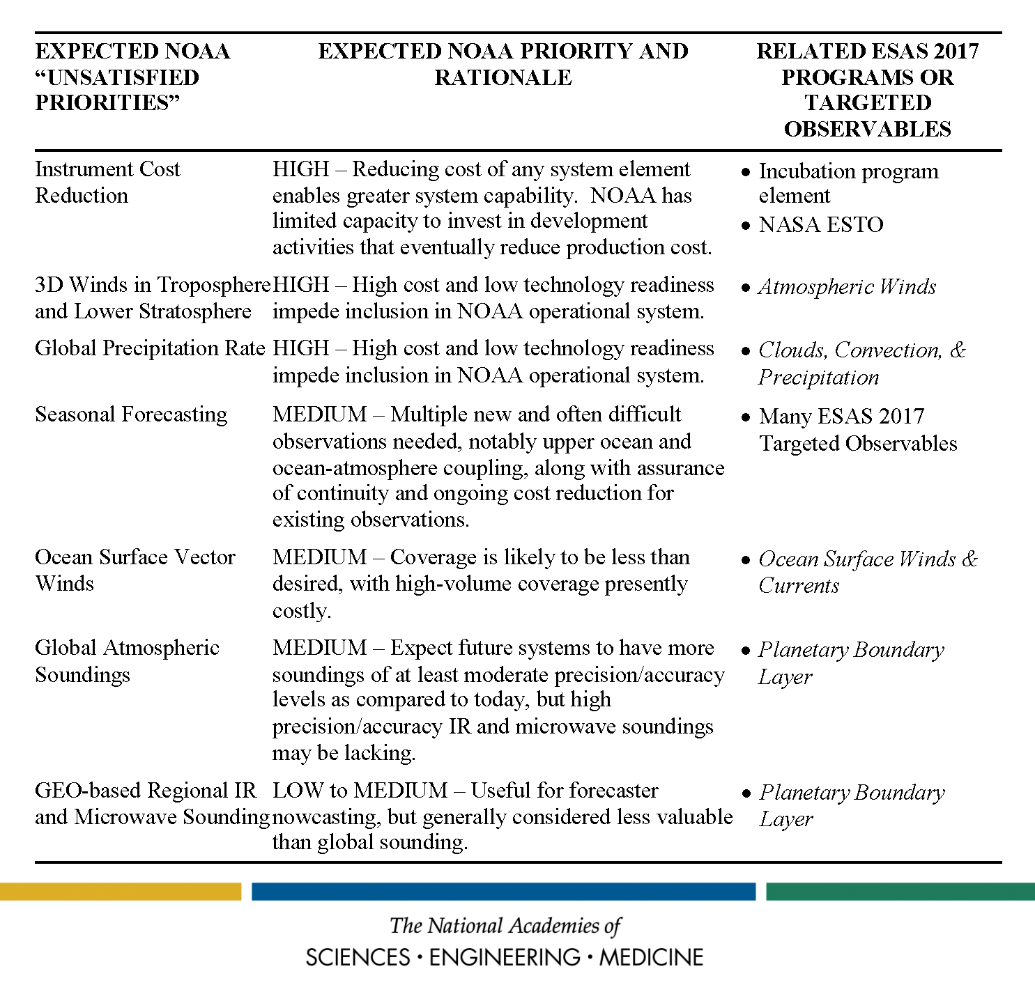
3. Collaborations
NAS Decadal Survey recommended a close coordination with NASA on technology development, to develop
new observing system technologies, and
to make better use of research
observations
But collaboration extends to all EO
partner agencies, for legacy and future
observations
  Lidar winds
  Hyperspectral Soundings
  Imaging Microwave, …
CEOS Constellation projections and gap
analyses point to what is planned, what
is needed, and what is possible.
CEOS Agency leadership sharing of plans allows for long range shared observations.
Notes:
NOAA Approaches to addressing Decadal Survey Recommendations
NOAA’s future satellite architecture planning assumed partner contributions and considered operational partner and commercial data on equal footing with NOAA-produced data
NESDIS is piloting a Secure Ingest capability to increase our ability across the board to ingest both partner and commercial data securely
The NESDIS budget restructure will allow NOAA to take advantage of partner observations as plans and missions develop and launch without requesting a separate funding line from Congress
The Commercial Weather Data Pilot continues to allow NOAA to demonstrate new commercial data as they become available
Through the NOSC, NESDIS is working to systematize prioritization of data and products needed from NOAA satellite, partner, and commercial sources to support NOAA user needs.
This approach assumes regular access to and ingest of multiple sources of data, rather than seeing partner or commercial data sources as occasional one off opportunities.

Slide 11
NOAA Activities On Metadata Standardization and Data Dissemination
Developed collaboratively by the international data management community and provides the underlying data management framework for collection and granule level discovery.
Same methodology is applied to NOAA’s OneStop Data Discovery Portal for U.S. user community
CEOS OpenSearch
Best Practice
Document
The International Directory Network (IDN) and CEOS-WGISS Integrated Catalog (CWIC) provides unified data discovery across CEOS agencies.
NOAA’s contributions to the Catalog provide value to the community and enhance the value of NOAA’s own data archive.
The International
Directory Network
Notes:
The CEOS OpenSearch Best Practices (http://ceos.org/document_management/Working_Groups/WGISS/Interest_Groups/OpenSearch/CEOS-OPENSEARCH-BP-V1.2.pdf) was developed collaboratively by the international data management community and is implemented within NOAA's OneStop Data Discovery Portal (https://data.noaa.gov/onestop/#/) and underlying data management framework for collection and granule level discovery
The International Directory Network (IDN) and CEOS-WGISS Integrated Catalog (CWIC) provides unified data discovery across CEOS agencies and NOAA is an important contributor of data collections and granules to those systems

Slide 12
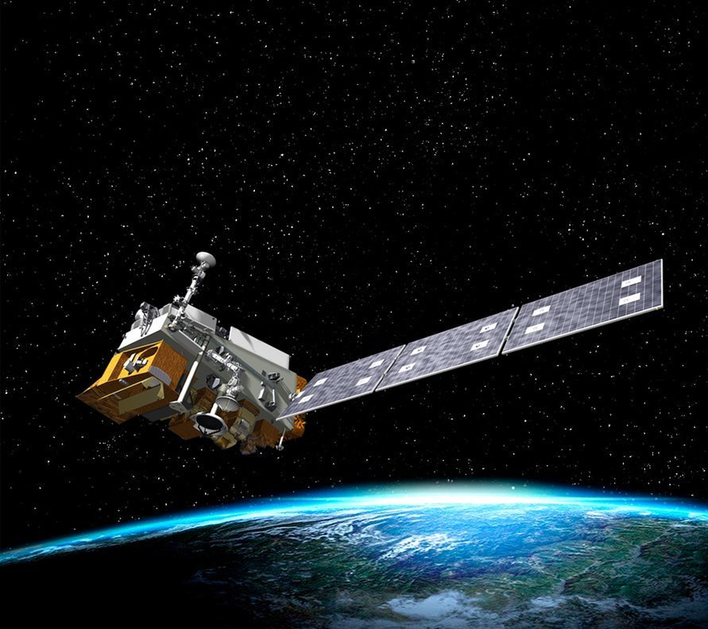
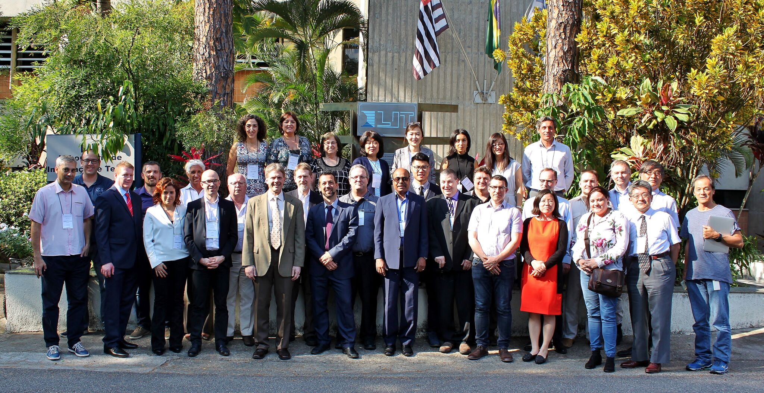
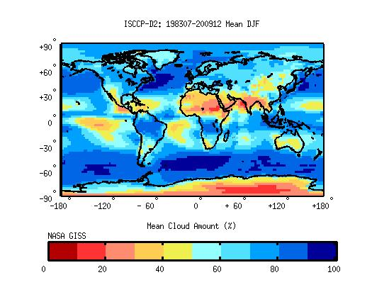
CEOS Activities
Related to Cal/Val at NOAA
CEOS endorsed
Solar Spectrum
WGCV-43
Joint w/WGISS
ISCPP
Notes:
NOAA/NESDIS/STAR scientists are active participants of CEOS cal/val activities in CEOS/Working Group on Cal/Val (WGCV) and its subgroups
We endorse the basic principles set forth in the Quality Assurance for Earth Observations (QA4EO) developed by the CEOS/WGCV.
A specific example is the use of CEOS endorsed solar spectrum in operational calibration which has been implemented in NOAA-20/VIIRS; we also adopted procedures developed by the WGCV Land Product Validation(LPV) subgroup in the JPSS land product cal/val.
We support sustained intersatellite calibration working closely with CEOS partners, including ESA, NASA, JAXA, EUMETSAT, and other agencies.
BOTTOM IMAGE: We also sponsored CEOS working group meetings including the WGCV, and Atmospheric Chemistry subgroup NOAA is using CEOS site data in part to calibrate and validate its International Satellite Cloud Climatology Project (ISCCP) climate data record (see Rossow and Ferrier 2015, and Inamdar and Knapp 2015). These maps show the average regional distribution of cloud and surface properties for each of the four seasons, where the names apply to the northern hemisphere seasons. This image shows Clud amount during winter months.

Slide 13
THANK YOU
Committee on Earth Observation Satellites
Notes:
Session 4 of the 2018 CEOS Plenary (Agency and Partner Updates) will provide an opportunity for agencies to speak about their plans and strategy in relation to CEOS, as well as the benefits and expectations of CEOS from their agency perspective. Agencies are asked to comment on:
1) the policy, scientific, and societal challenges driving the strategy and requirements of their agency for the next 10 to 15 years and the degree to which CEOS' thematic foci support these plans;
2) how CEOS as an organization is supporting and prioritizing engagement around the agency’s requirements; and,
3) how CEOS activities related to standardization (metadata and interoperability), quality control (cal/val), and data dissemination influence implementations in their agency.

