Slide 1
CEOS Analysis Ready Data for Land (CARD4L) Status Update (For Information)
Steve Labahn (USGS), LSI-VC Co-Lead
LSI-VC Co-Leads: Susanne Mecklenburg (ESA) and Adam Lewis (GA)
2018 CEOS Plenary
Agenda Item 5.3
Brussels, Belgium
16-18 October 2018

Slide 2
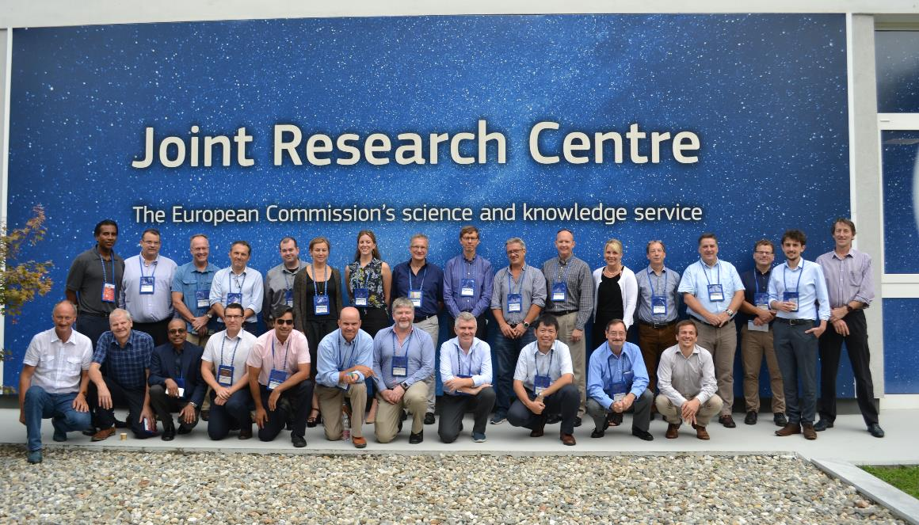
LSI-VC / SDCG for GFOI / GEOGLAM Joint Meeting

Slide 3
LSI-VC / SDCG for GFOI / GEOGLAM Joint Meeting – Key Outcomes
CARD4L Specification / Assessment
Agreed on near-term and annual process for updating CARD4L Product Family Specifications (PFS)
Reviewed plan for further SAR PFSs: backscatter, polarimetric, and interferometric
Agreed on WGCV peer review process for CARD4L product assessments
Strategy / Promotion
Agreed that a broader CEOS ARD strategy increasingly appears to be needed; SIT Vice-Chair adopting this topic (agenda item #5.4)
Refining CARD4L information notes and will prepare communication package
Progressing the CARD4L stocktake and will publish this information online
Interoperability
Preparing definitions for terms supporting Moderate Resolution Sensor Interoperability (MRI)
Reviewed lessons learned from Planet ARD workshop (August 2018)
GEO-LEO case study progress was presented (agenda item #5.6)
Organization
Identified that key overlaps exist between SDCG for GFOI, GEOGLAM, and LSI-VC on CARD4L pilots and user community links
Agreed on joint position for SDCG for GFOI and GEOGLAM continuity and relation to LSI-VC going forward (agenda item #6.8)
LSI-VC-7: 14-15 February 2019, Hanoi, Vietnam – Hosted by VNSC

Slide 4
ARD Key Take-aways
Analysis Ready Data (ARD) are no longer just a desire of global users, but is now becoming a requirement and an expectation
Data Cube pilots are an ideal way to prove the benefits of ARD, as every pilot is using ARD
Most global users (not scientists or commercial groups) DO NOT desire, or feel comfortable, making their own ARD, but want it provided
Growing interest exists in radar data, but few users understand its benefits or know how to use this data
Data Cube pilots are a great place to demonstrate open source radar algorithms on ARD
CEOS needs to make it easier for global users to get ARD

Slide 5
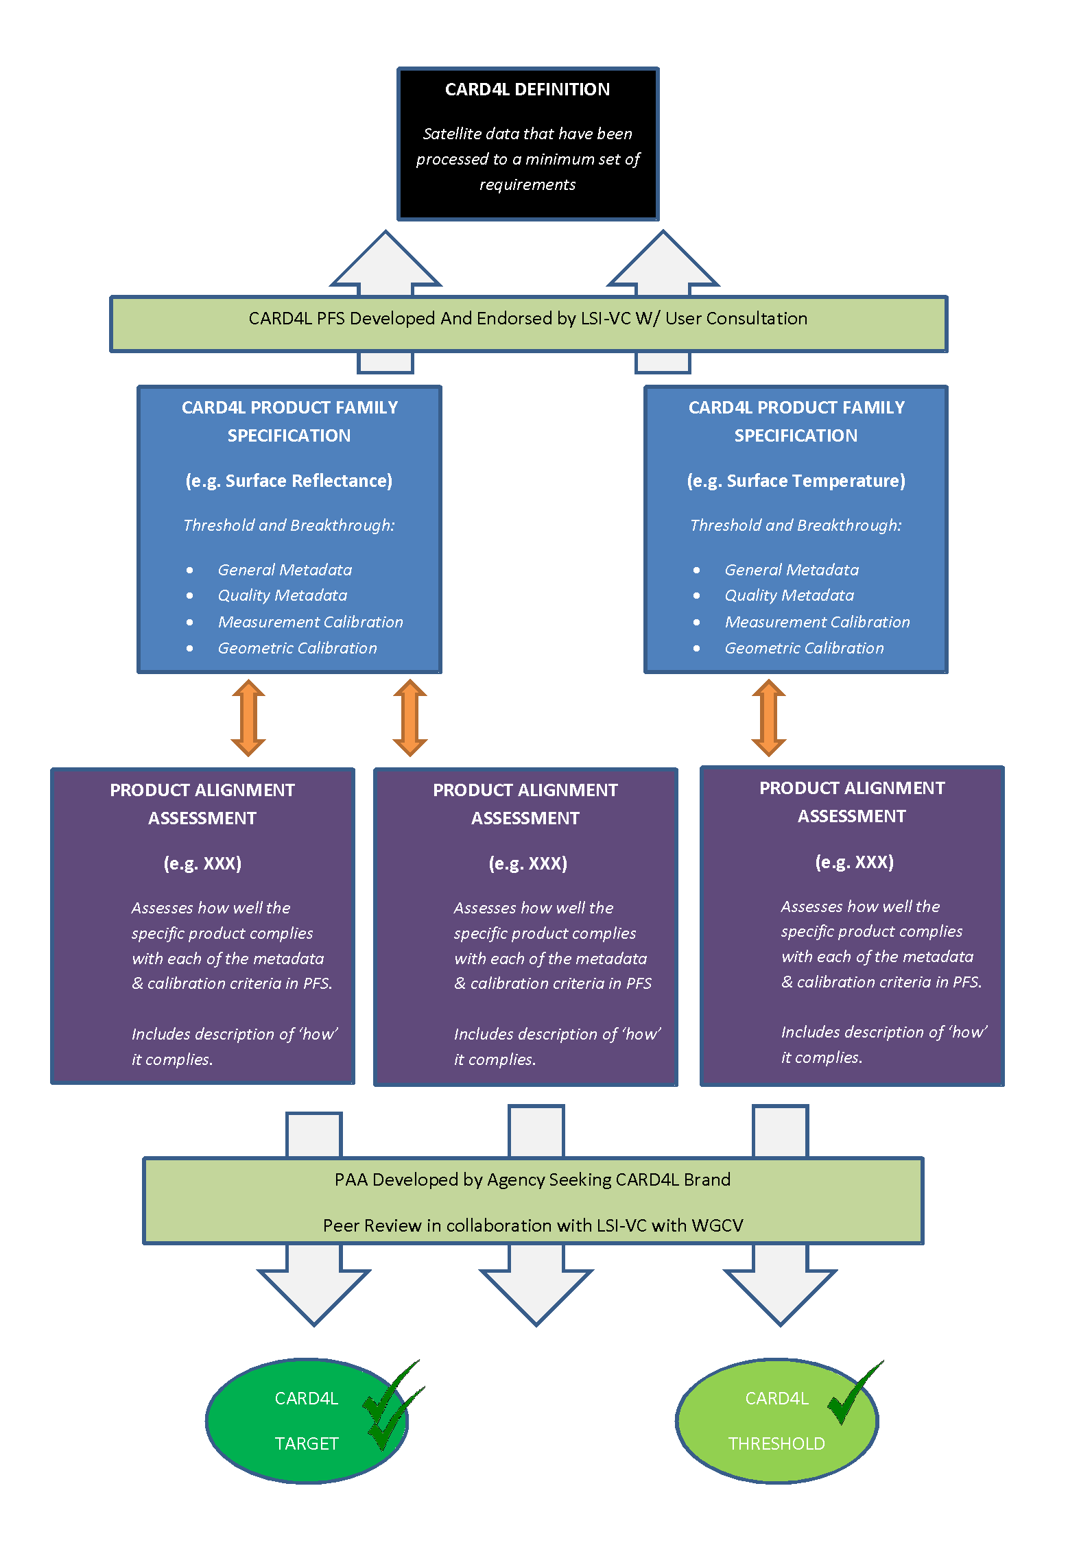
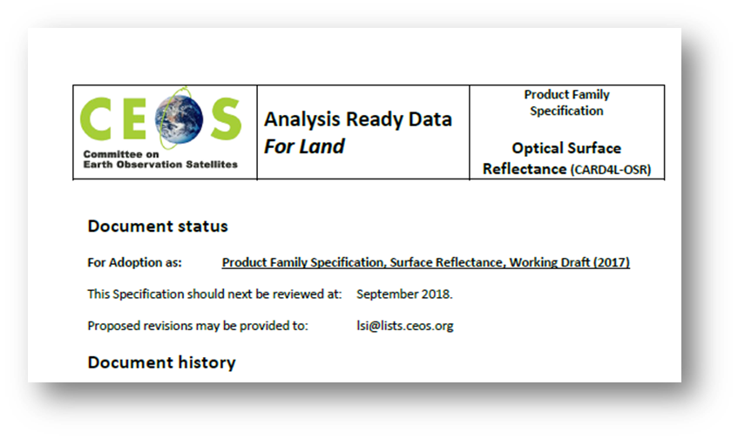
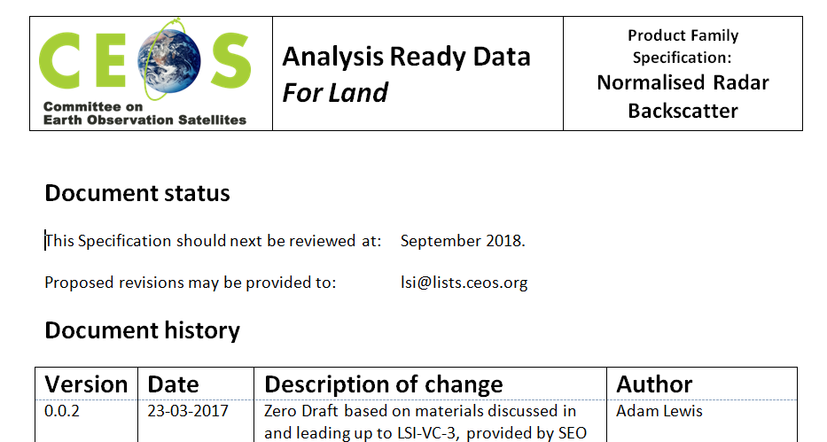
CARD4L Framework
CARD4L Definition
Product Family Specifications (PFS)
First Product Family Specifications
Optical Surface Reflectance CARD4L-OSR)
Surface Temperature (CARD4L-ST)
Normalized Radar Backscatter (CARD4L-NRB)
Product Family Specifications are technical documents
Further PFSs for Radar products are currently under discussion
Polarimetric covariance
Polarimetric decomposition
INSAR LOS
INSAR Coherence
Geocoded SLC specs

Slide 6
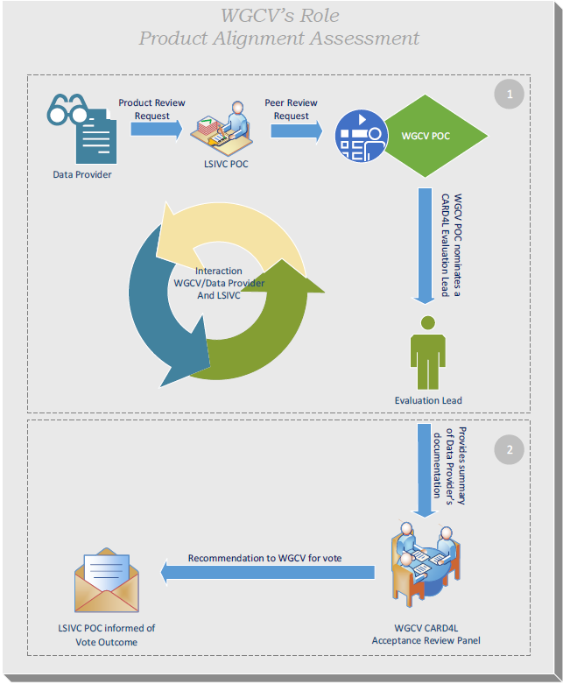
Proposed WGCV CARD4L Assessment Process (WGCV-44)

Slide 7
Proposed PFS Future Steps
PFSs/Month
Sep 2018
Oct 2018
Dec 2018
Jan 2019
Feb 2019
Onward
Surface Reflectance
Self-assessment process/ESA (S2)/USGS (Landsat)
Surface Temperature
Discuss updates/LSIVC6
Radar Backscatter
Present latest version at LSIVC6
Self-assessment process (JAXA)
Additional Radar PFS
Drafts presented at LSIVC6
Drafts open for review
First versions finalized
SAR ARD definition Team disbanded
Nov 2018
Self-assessment process (USGS)
Feedback from WGCV
Feedback from ESA/USGS/JAXA/GA
self-assessment incorporated
Documents circulated to the LSIVC list
Present refined SR/ST/RB versions at LSIVC7
for endorsement/present additional RADAR PFS
PFSs Stability
Updates will be carried out as necessary but no more than once a year
Incorporate user survey
and Planets workshop Feedback
Notes:
Establish a maintenance plan

Slide 8
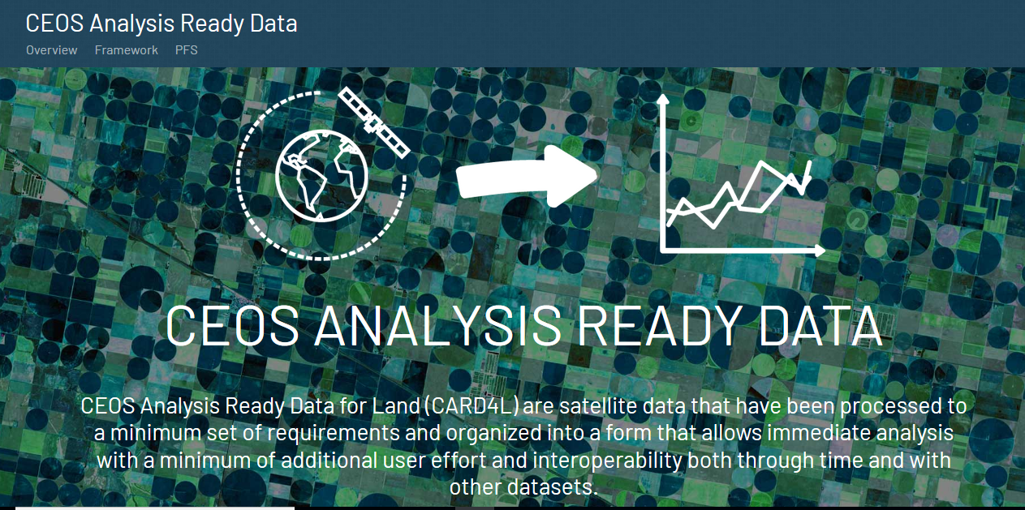
CARD4L Website
http://ceos.org/ard/

Slide 9
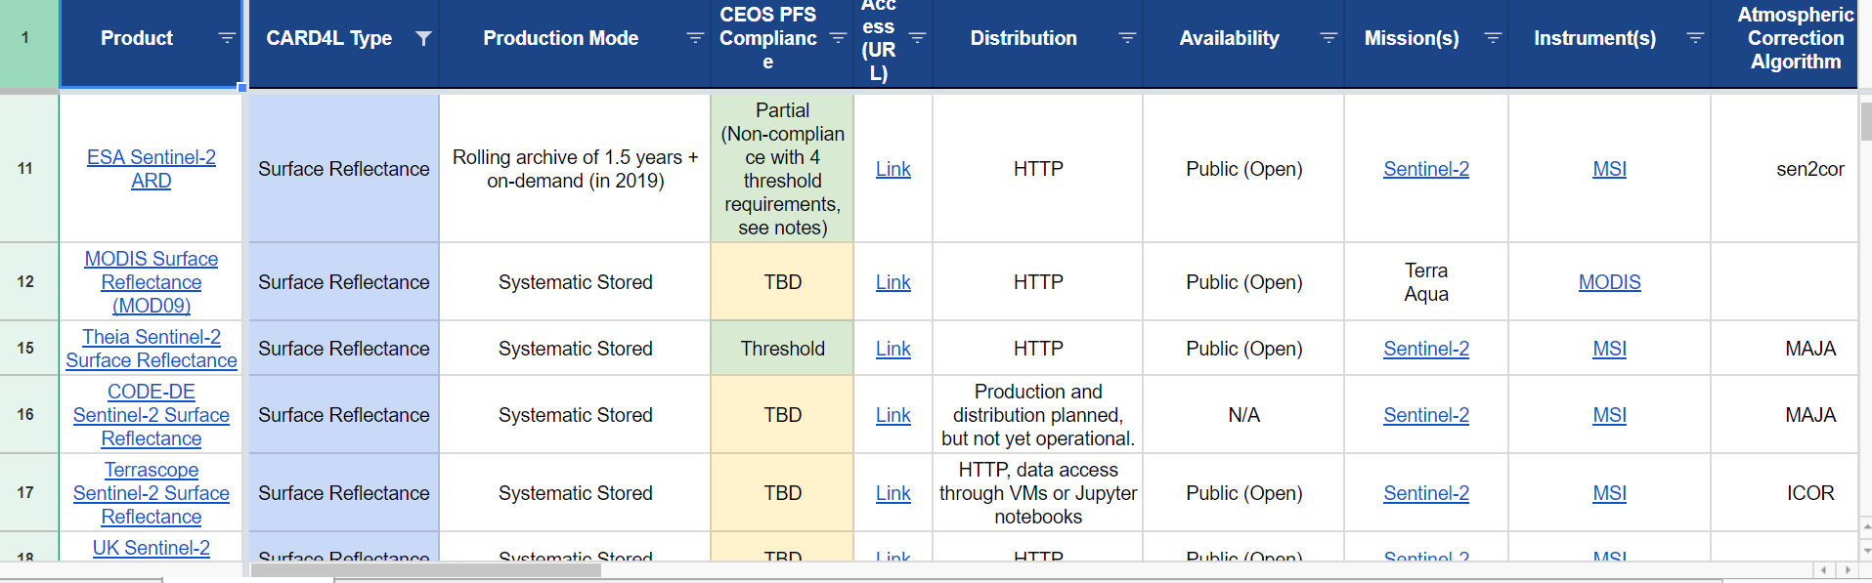
CARD4L Product Stocktake
CARD4L product stocktake is underway
for internal use until CARD4L products are achieved

Slide 10
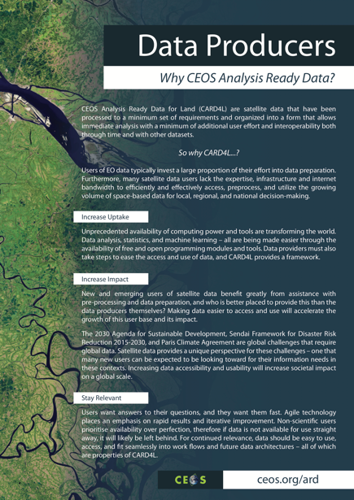
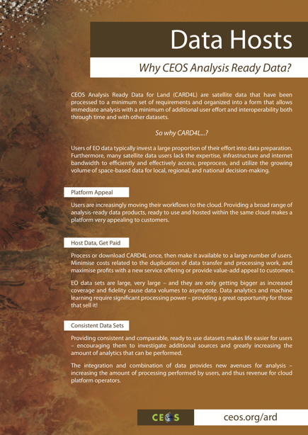
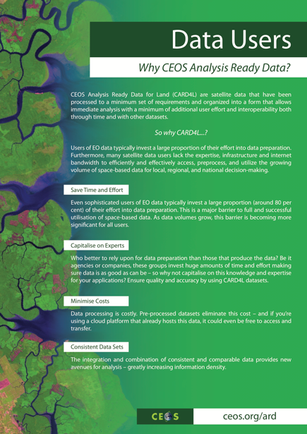
CARD4L Information Notes
Intended to inspire users and convince data providers and data hosts to adopt CARD4L.

Slide 11
Deliverables
Number | Title | Completion Date | Progress Report
FDA-07 | Product Specifications in accordance with the CARD4L Framework | 2018-Q1 | September 2018: All three initial Product Family Specifications (PFS) (surface reflectance, surface temperature, radar backscatter) have been completed and are now at the trial assessment stage. Up to five additional SAR PFS are currently under development: polarimetric covariance, polarimetric decomposition, interferometric line-of-sight, interferometric coherence, and geocoded SLC; however, these might be consolidated down to just three PFS. FDA-07 is now considered complete.
VC-30 | Interoperability case study for Landsat and Sentinel-2 | 2018-Q4 | September 2018: LSI-VC has had no MRI task lead since last year, and only bilateral activities are ongoing. There is a broad spectrum of definitions of "interoperable". An agreed and documented definition is needed. It was agreed that an action to formalise what we mean by "interoperable" is necessary before further work can be done on VC-30. A new task will be established in the 2019-2021 CEOS Work Plan to do this, and the due date for VC-30 will be changed to Q4 2019.
VC-31 | Evaluate CARD4L among target user communities | 2018-Q4 | September 2018: LSI-VC engaged a range of stakeholders (including the GFOI, GEOGLAM, and Open Data Cube communities) via a survey to gather feedback on CARD4L. 22 responses were received, yielding substantial feedback for the annual updates of the PFS as well as on the CARD4L concept in general.
VC-32 | CARD4L Product Assessment Framework | 2018-Q3 | September 2018: The general process for assessing a dataset as CARD4L (with peer review provided by WGCV) has been agreed, as well as the process for updating and maintaining the Product Family Specifications. Trial assessments are being undertaken by USGS and ESA (surface reflectance and land surface temperature) and JAXA (SAR backscatter) to test and refine the process. Steps are now being taken to better promote the CARD4L concept to potential users, data producers, and data hosts.
VC-33 | Maintain the CARD4L Product Family Specifications (PFS) | 2018-Q4 | September 2018: The process for updating and maintaining the Product Family Specifications has been agreed. Additional SAR PFS are currently under development. VC-33 is a perpetual action that will likely remain open.

Slide 12
Deliverables
Number | Title | Completion Date | Progress Report
VC-34 | CARD4L Engagement Strategy | 2018-Q3 | September 2018: In 2017-18, LSI-VC has promoted CARD4L through a number of forums, including by publishing in the proceedings of IGARSS and adding references to CARD4L in journal articles on the calibration and validation of Landsat and Sentinel data. LSI-VC has also engaged with industry in conferences (e.g., Pecora 2017), industry workshops (e.g., UK Catapult workshop, September 2017; and the Planet ARD workshop, August 2018). The following approach has been agreed for CEOS ARD promotion going forward: Develop an information pack capturing the key value of CARD4L, using the CARD4L information notes as a basis. Communicate actively with the commercial sector using the information pack and networks including UK Catapult, DIAS providers, and EARSC. Increase communication with remote sensing agencies, scientists, and commercial providers through the ESA Living Planet Symposium, IGARSS, the ESA Ground Segment Coordination Body (GSCB), and other forums such as the World Geospatial Forum. Act on the suggestions from the CARD4L survey. Promote datasets via the CEOS ARD website (i.e., the CARD4L stocktake) and also through the relevant WGISS systems (e.g., Connected Data Assets (CDA)). LSI-VC has agreed that the constituent tasks written in VC-34 are important, but no overarching strategy telling us how to go about these tasks is needed. There will be a 2019-2021 CEOS Work Plan task on "CEOS ARD Promotion", but there will be no mention of a "strategy document".
VC-36 | Monitoring MRI implementation examples | 2018-Q4 | September 2018: LSI-VC decided to close CEOS Work Plan task VC-36 and create a new task on preparing a discussion paper on the definition of "interoperability". It was agreed that an action to formalise what we mean by "interoperable" is necessary before further work can be done on VC-36 (and VC-30). VC-36 is now closed.
VC-37 | CEOS Information Tool Improvements | 2018-Q4 | August 2018: The SEO has been working with ESA and Symbios to develop improvements to the CEOS MIM Database that will allow enhanced gap analyses. The new features will allow custom queries for current and future mission parameters and allow more detailed gap assessments. In the past, much of the MIM data was not in a database format (only in text fields) so queries were limited. This task should be complete by late 2018.

