Slide 1

Report from WG Disasters
Committee on Earth Observation Satellites
Simona Zoffoli, ASI
Chair Working Group on Disasters
CEOS Plenary 2018
Agenda Item # 6.3
Brussels, Belgium
17 – 18 October 2018

Slide 2
WG Disasters … at a glance
GEO Initiatives
GSNL
GEODARMA
CEOS DRM Observation Strategy
Volcano Demonstrator
Seismic Hazard Demonstrator
Recovery Observatory
Landslide Pilot
Cross-Cutting Activities
GeoHazards Lab

Slide 3
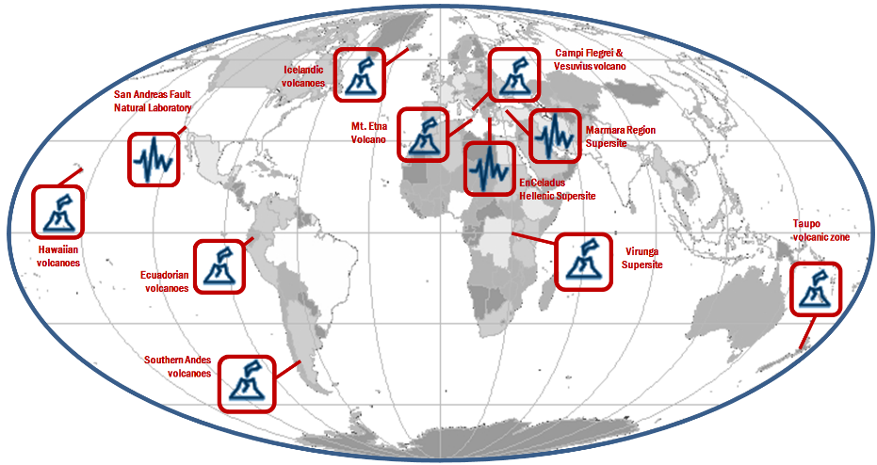


GSNL: the 2018 network
Courtesy of Stefano Salvi (INGV)
Chair of the Supersites Advisory Committee
Notes:
GSNL network is composed of ten Peranent Supersites and one Natural Laboratory

Slide 4
GSNL: key activities in 2018 (DIS-10)
Supersite Periodic Review process
  Biennial report from Iceland, Marmara, Etna, Vesuvio & Campi Flegrei Supersites
  Positive evaluations from Agencies with comments and remarks to Supersite coordinators (meeting at WG Disasters n.10)
  WG Disasters supports the continuation of Iceland, Marmara, Etna, Vesuvio & Campi Flegrei Supersites
Good progress on the Virunga Supersite (approved at Plenary 2017)
Plans for 2019: review Hawaii, New Zealand and Ecuador Supersites

Slide 5
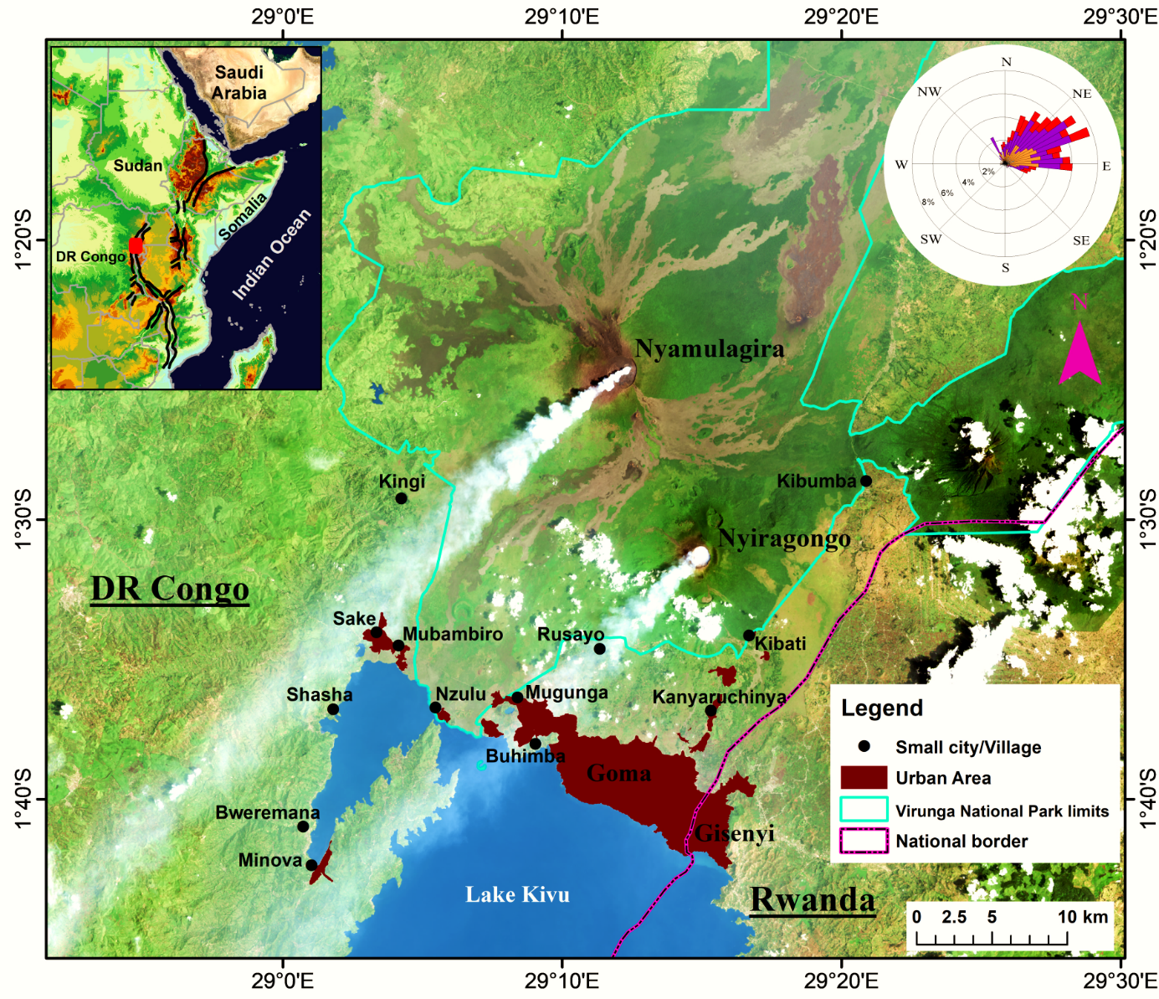



Virunga Supersite

Slide 6
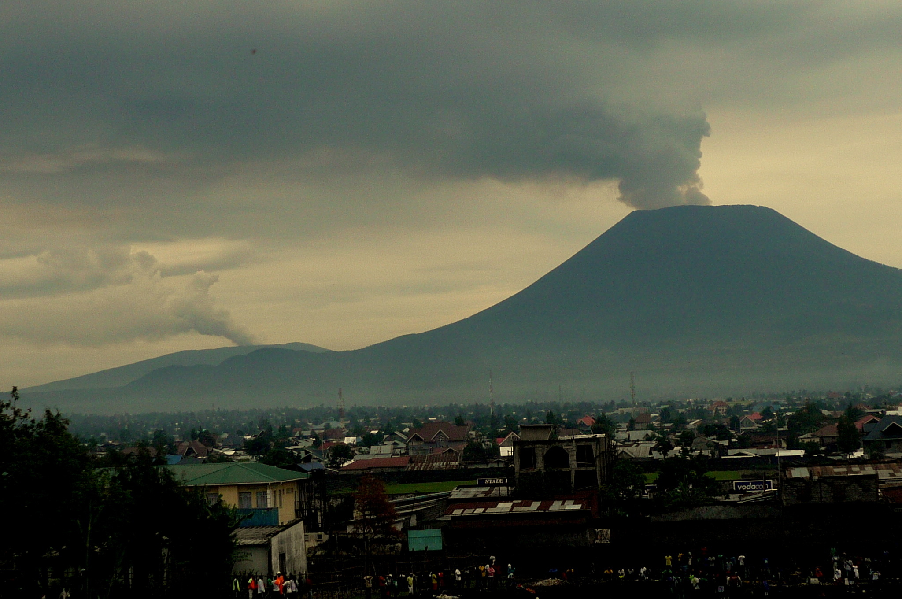
Nyirangongo
Nyamulagira

Slide 7
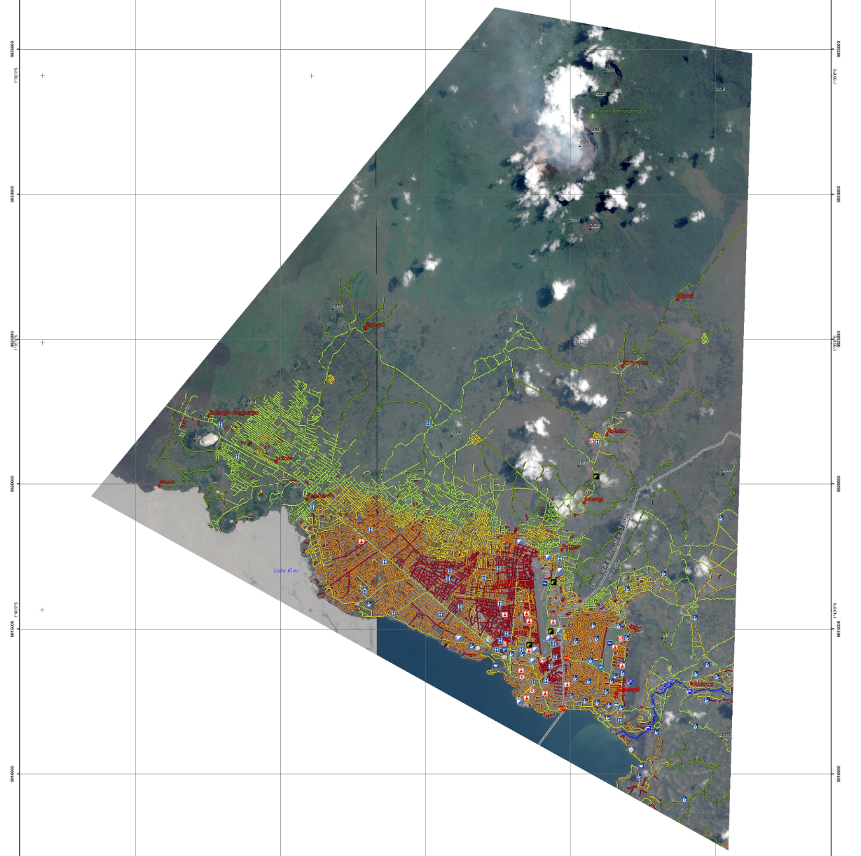
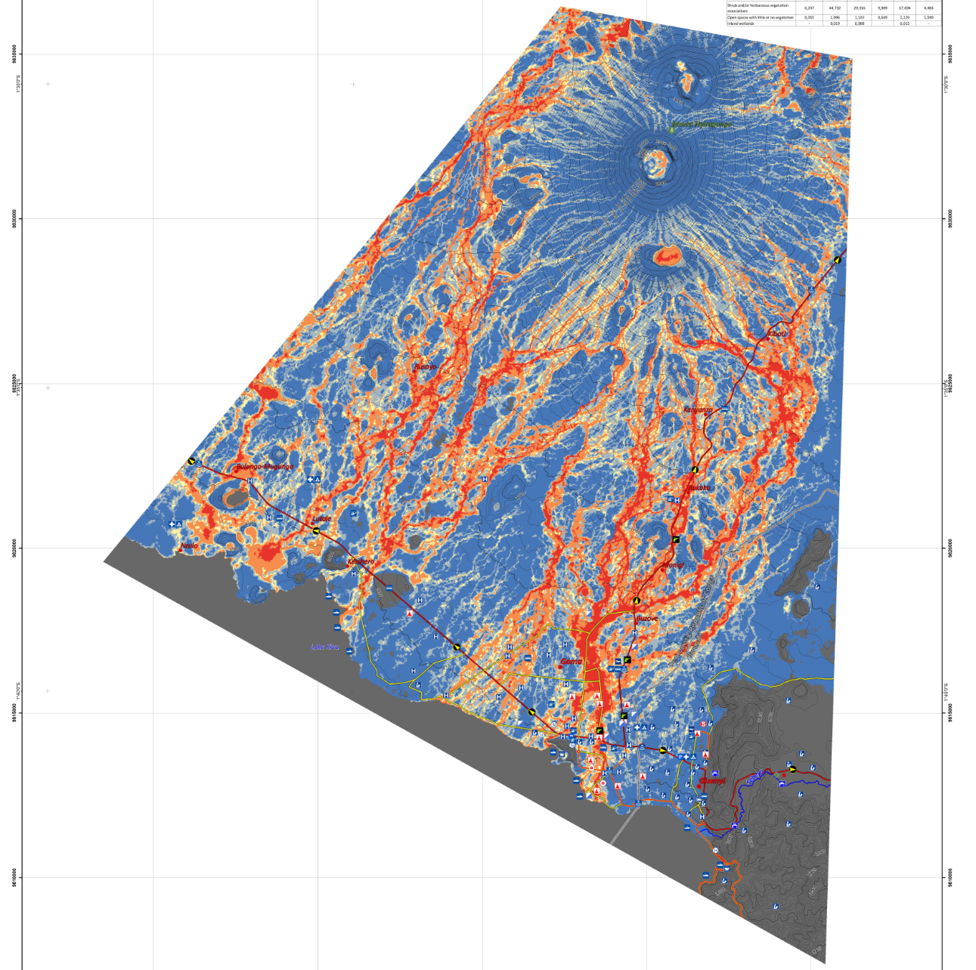
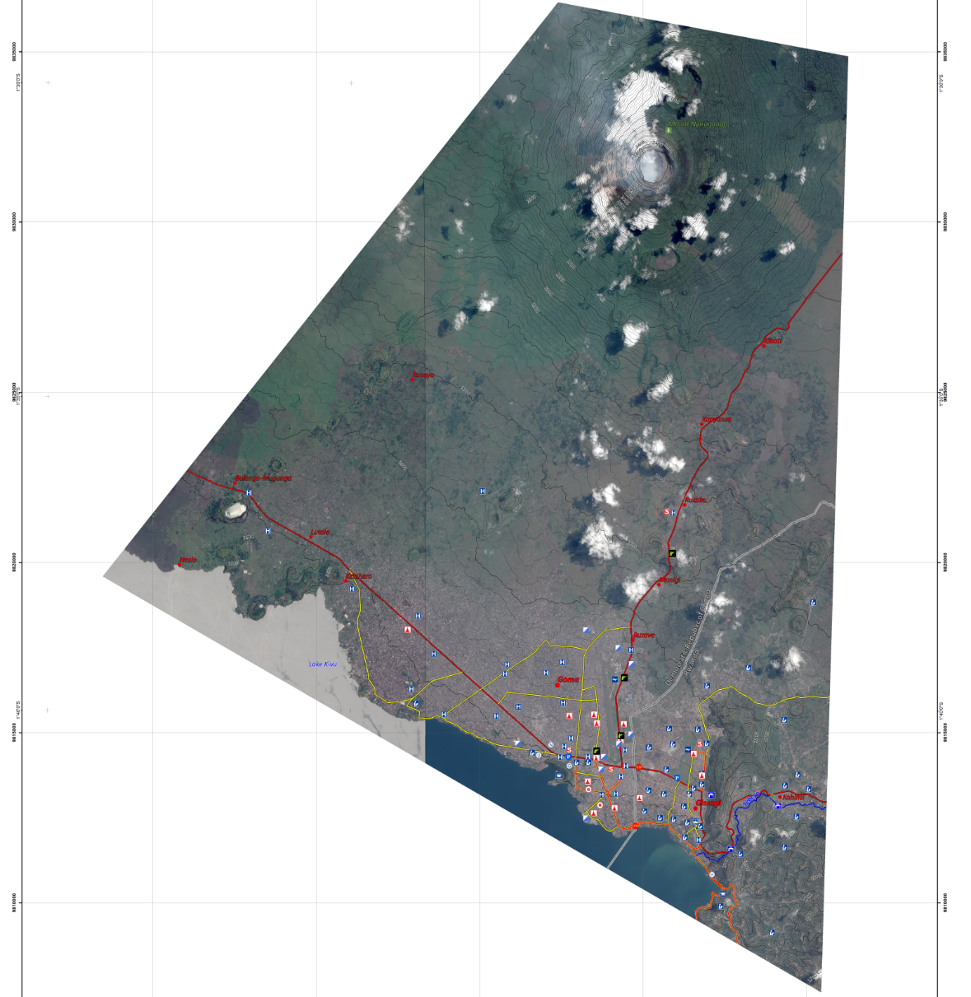
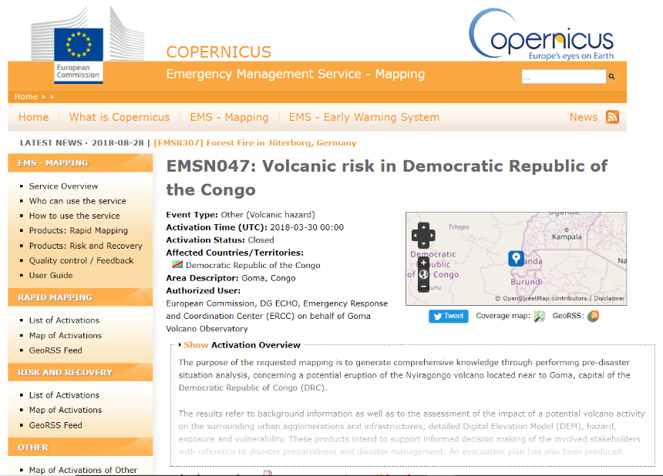
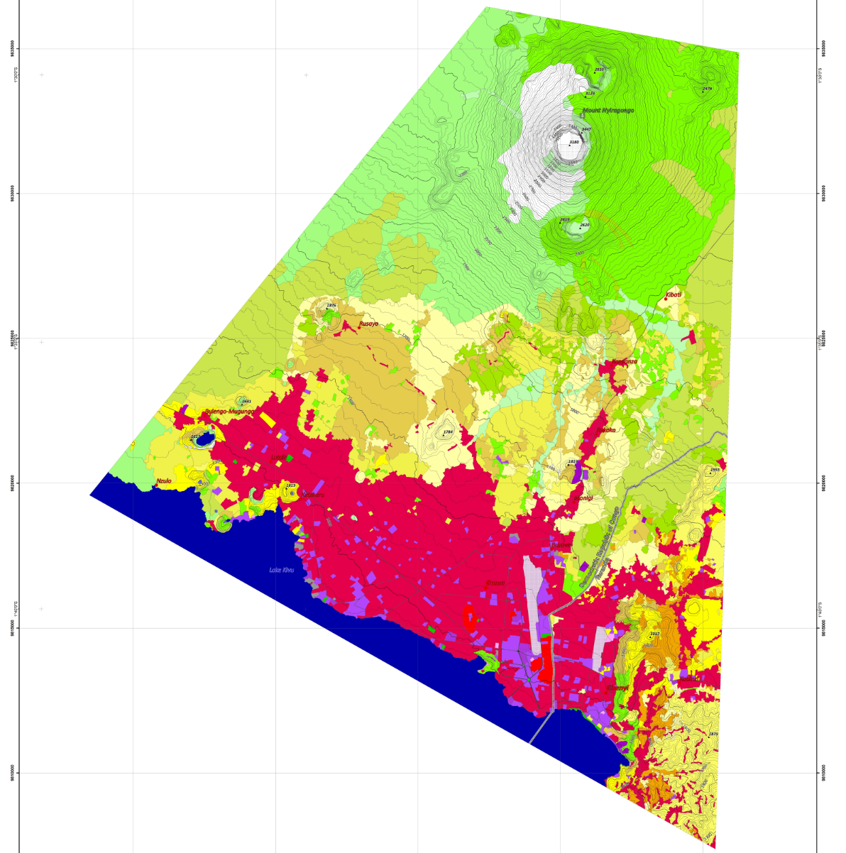





Copernicus Emergency (EMS) Risk & Recovery Map Activation
4. Transportation Network Vulnerability
3. Lava Flow Hazard Map
2. Land Use and Land Cover Map

Slide 8
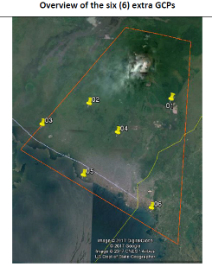
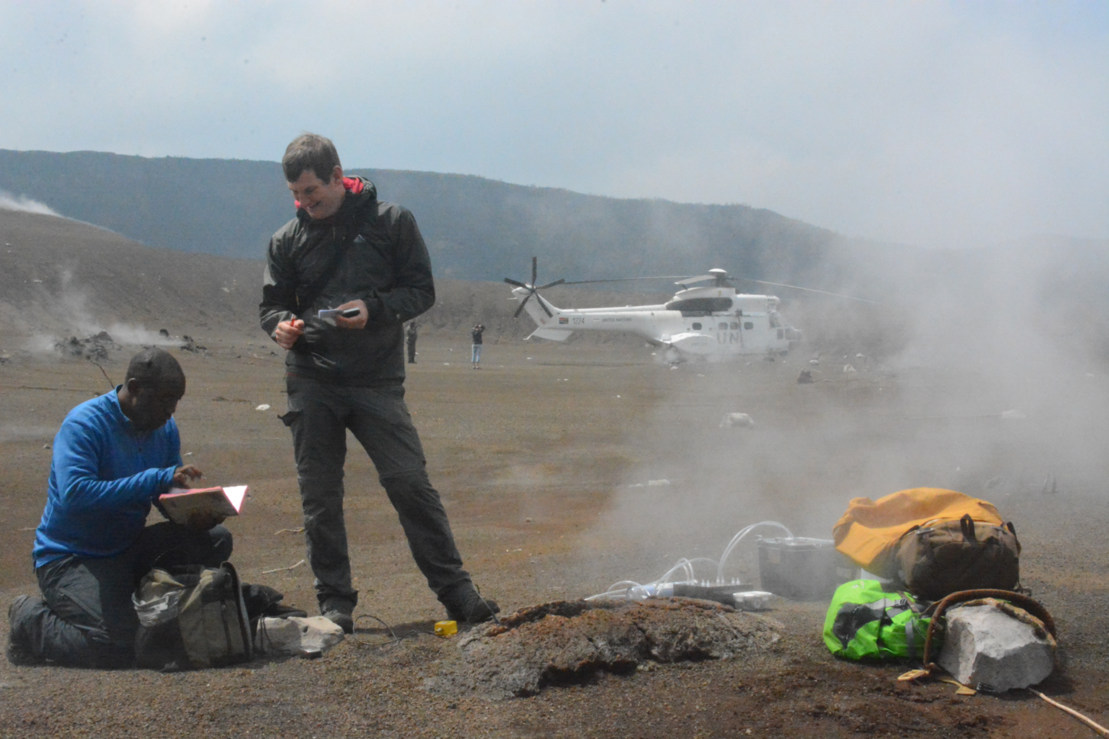
Acquisition of field data and HR images (Pleiades & COSMO-SkyMed)

Slide 9

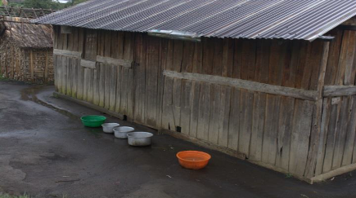
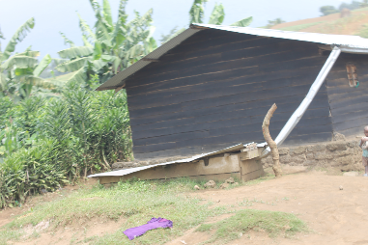
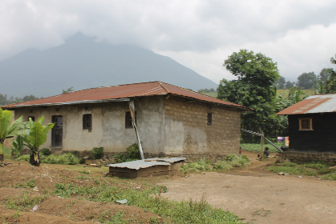
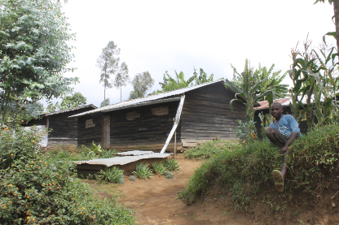
Rain plumes-interactions and water pollution

Slide 10
Hawaii Supersite
Permanent Supersite since 2012 with large support from many space agencies.

Slide 11
Hawaii Supersite
Kilauea eruptive activity in 2018
“Space data formed a crucial component of the eruption response” –
M. Poland, USGS, Hawaii PoC

Slide 12
Assessing surface deformation over broad areas
Sentinel-1 interferograms - initiation of the lower East Rift Zone dike intrusion

Slide 13
Tracking changes in surface characteristics
TerraSAR-X amplitude images of the lower East Rift Zone of Kīlauea Volcano from before, during and near the end of the 2018 eruptive activity. The data capture the development and subsequent degradation of a lava channel (indicated by dark sinuous lines).

Slide 14
Collapse of the summit caldera
Cosmo-SkyMed amplitude data from before (left) and after (right) collapse of Kīlauea’s summit caldera. Images are registered to a LIDAR DEM, which has no data in areas that are black. Red circles indicate the locations of the Hawaiian Volcano Observatory (HVO) and Volcano House hotel on the rim of Kīlauea caldera

Slide 15
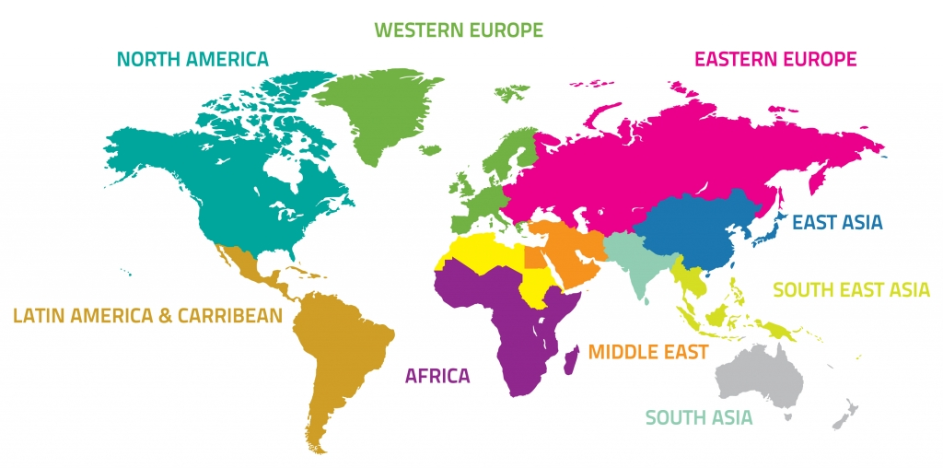

GEO-DARMA (DIS-15)
Foster the use of EO information for Disaster Risk Reduction (DRR) through the implementation of end user priorities in line with the Sendai Framework in three regions: South-East Asia, Latin America/Caribbean, and Africa.
Identification of users needs and DRR priorities per region
For each region:
Types of hazards,
DRR Issues to be solved,
Initial countries

Slide 16
GEO-DARMA: Progress in 2018
GEO-DARMA SC 2, November 2017:
  Terms of Reference of SC approved;
  Regional assessments for Asia and Africa reviewed and approved; six project proposals received for Asia/Africa.
GEO-DARMA SC 3, January 2018:
  Project proposals: four projects reviewed and tagged for further development.
CEOS WG Disasters 9 – March 2018
  Four projects presented in detail and comments received from WG members; discussion on data initiated
CEOS SIT – April 2018
  1st GEO-DARMA project approved – NRT Flood Monitoring in Myanmar
GEO-DARMA SC 4 – 20 May, 2018 in Mexico
CEOS WG Disasters n.10
  Approved data provision by Space Agencies

Slide 17
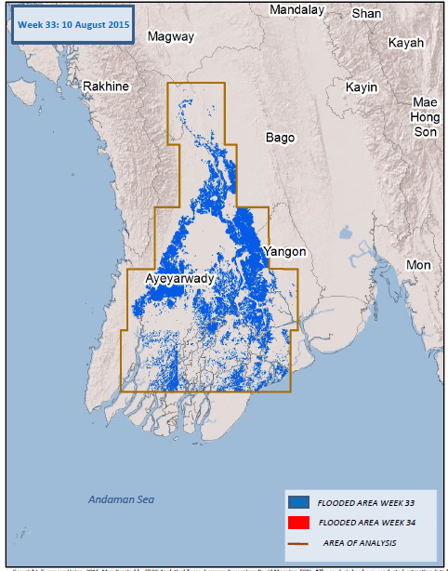
Flood Mapping in Myanmar
Championed by Asian Disaster Preparedness Centre (ADPC);
Part of larger international SERVIR network;
Incorporates new data types, faster service delivery, higher resolution flood maps, capacity building;
First GEO-DARMA test area will be in Myanmar, then Mekong lower basin;
Vision to extend to larger SE Asia area if successful.

Slide 18
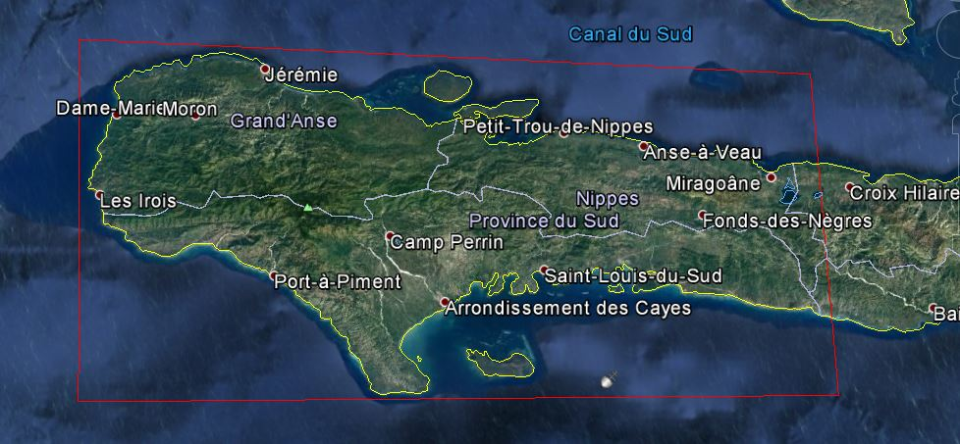
Recovery Observatory (DIS-12)
Triggered after the Hurricane Matthew in October 2016
Demonstrate the value of using satellite Earth Observations to support Recovery from a major disaster:
  near-term (e.g. support to PDNA process);
  long-term (e.g. major recovery planning and monitoring, estimated to be from 1 to 3 years

Slide 19
RO Thematic Products
Produit | Utilisateur-clef | Elaboration | Données satellites
Buildings | CIAT/ Planning Ministry | SERTIT, Copernicus EMS | Pléiades, WV
Land Use | ALL | CNIGS/CNES | Orthophotos, Sentinel-2
Forest | ONEV /Environnement Ministry | Copernicus EMS | S2, Spot6/7, Optique THR
Agriculture | Agriculture Ministry | Copernicus EMS | Sentinel-2, SPOT
Macaya Park Monitoring | ANAP / ONEV / Env. Min. | Copernicus EMS SERTIT | Optic THR, radar THR
Suivi bassins versants | ONEV/ Agriculture Ministry | CIMA Foundation | MNT 1m/20cm and radar THR
Terrain Motion / Mining career | BME / Public Work Ministry | EOST, ASI | CSK, Pléiades, Spot6/7
Vector Borne Disease | Heath Minister/ OMS | NOAA | L8, Images NOAA + statistic needs
Air pollution | ONEV / Ministère Santé | NASA | S5P Tropomi Interest pronounced

Slide 20
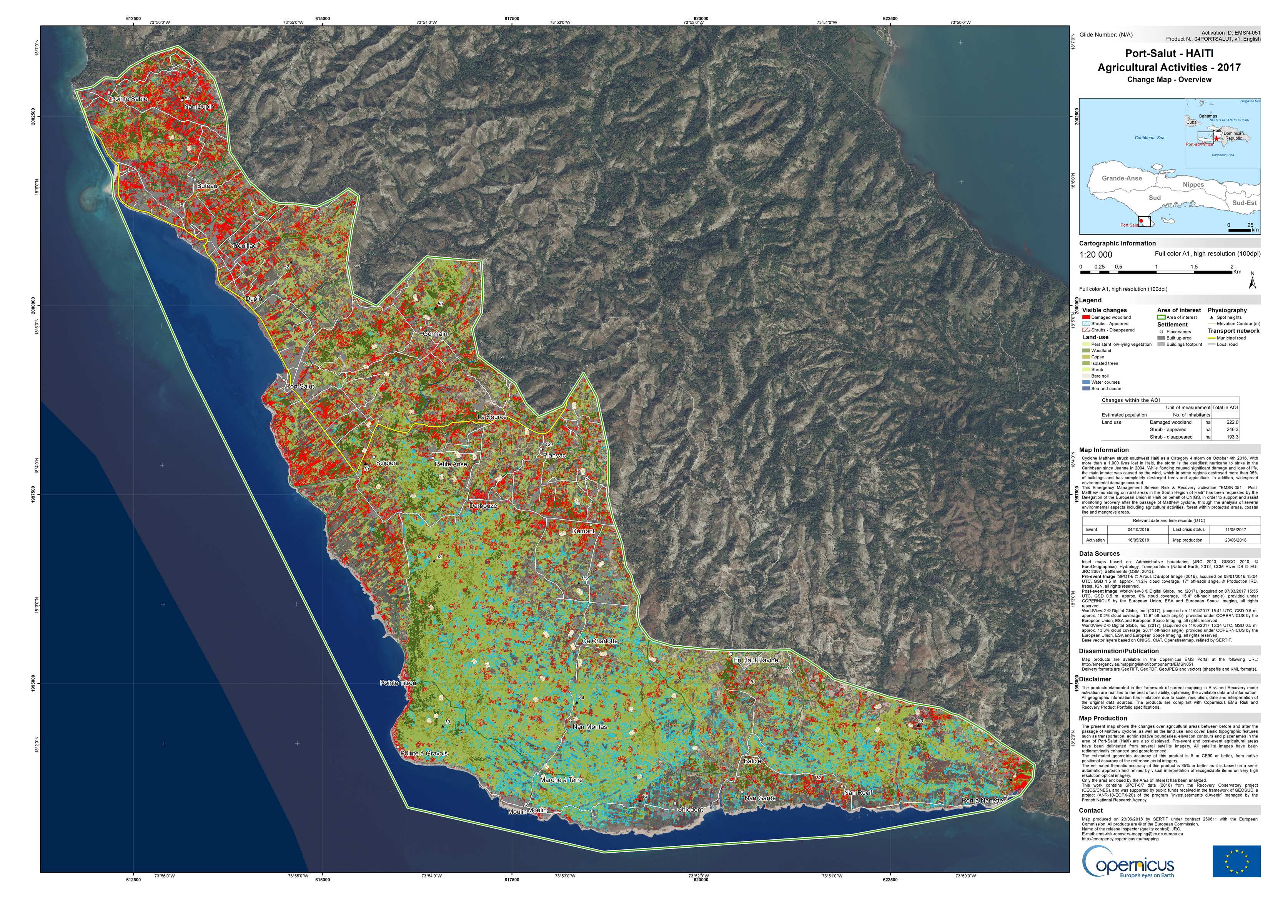
RO: Copernicus EMS contribution

Slide 21
RO key elements in 2018
Continued engagement of space agencies (ASI, CNES, DLR, ESA, NASA, NOAA)
Activation of the Copernicus Risk and Recovery Service by the Delegation of the European Union to Haiti
Drafting by Haitian partners of a Capacity Development Plan
Writing the Thematic Product Development Plan
A week of mission in Haiti with two user workshops: user feedback, new needs, cap building
Special session at UR2018 Mexico and proposal to LPS2019
Coordination meetings with UNOSAT, WG CapD
Starting discussion on a generic RO concept
Proposal for a White paper for a Generic RO Observatory

Slide 22
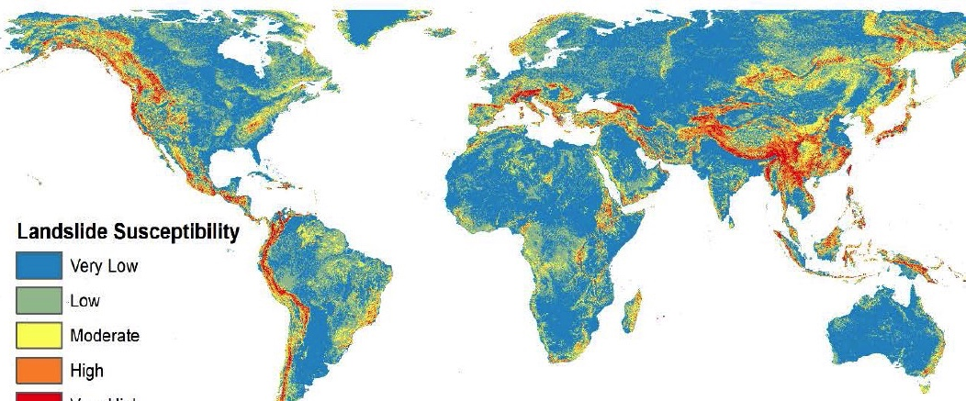
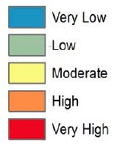
Landslide pilot update (DIS-16)
PNW
Nepal
China
Caribbean
EAR
Global Landslide Susceptibility
1:2M
Stanley & Kirschbaum (2015)
Continuation of data provision from Space Agencies
Preliminary results on Nepal, Pacific Northwest, Africa, Caribbean and China
Ongoing research in the study sites to develop new methodologies for processing SAR and optical data
Launch of https://landslides.nasa.gov and work with the GEP have greatly expanded the potential for inventories being shared across geographic areas

Slide 23
Volcano and Seismic Hazard Demo Update
New initiatives endorsed at SIT-33 based on pilot results
Main targets:
  provide data and capabilities to generate EO based scientific information to be released to decision makers for seismic hazard assessment and volcano risk reduction
  Support local capacity building to broaden the use and acceptance of advanced EO products by geoscience centres and academia and facilitate end users with their interpretation.
Data plan: consolidated and agreed with the Space Agencies

Slide 24
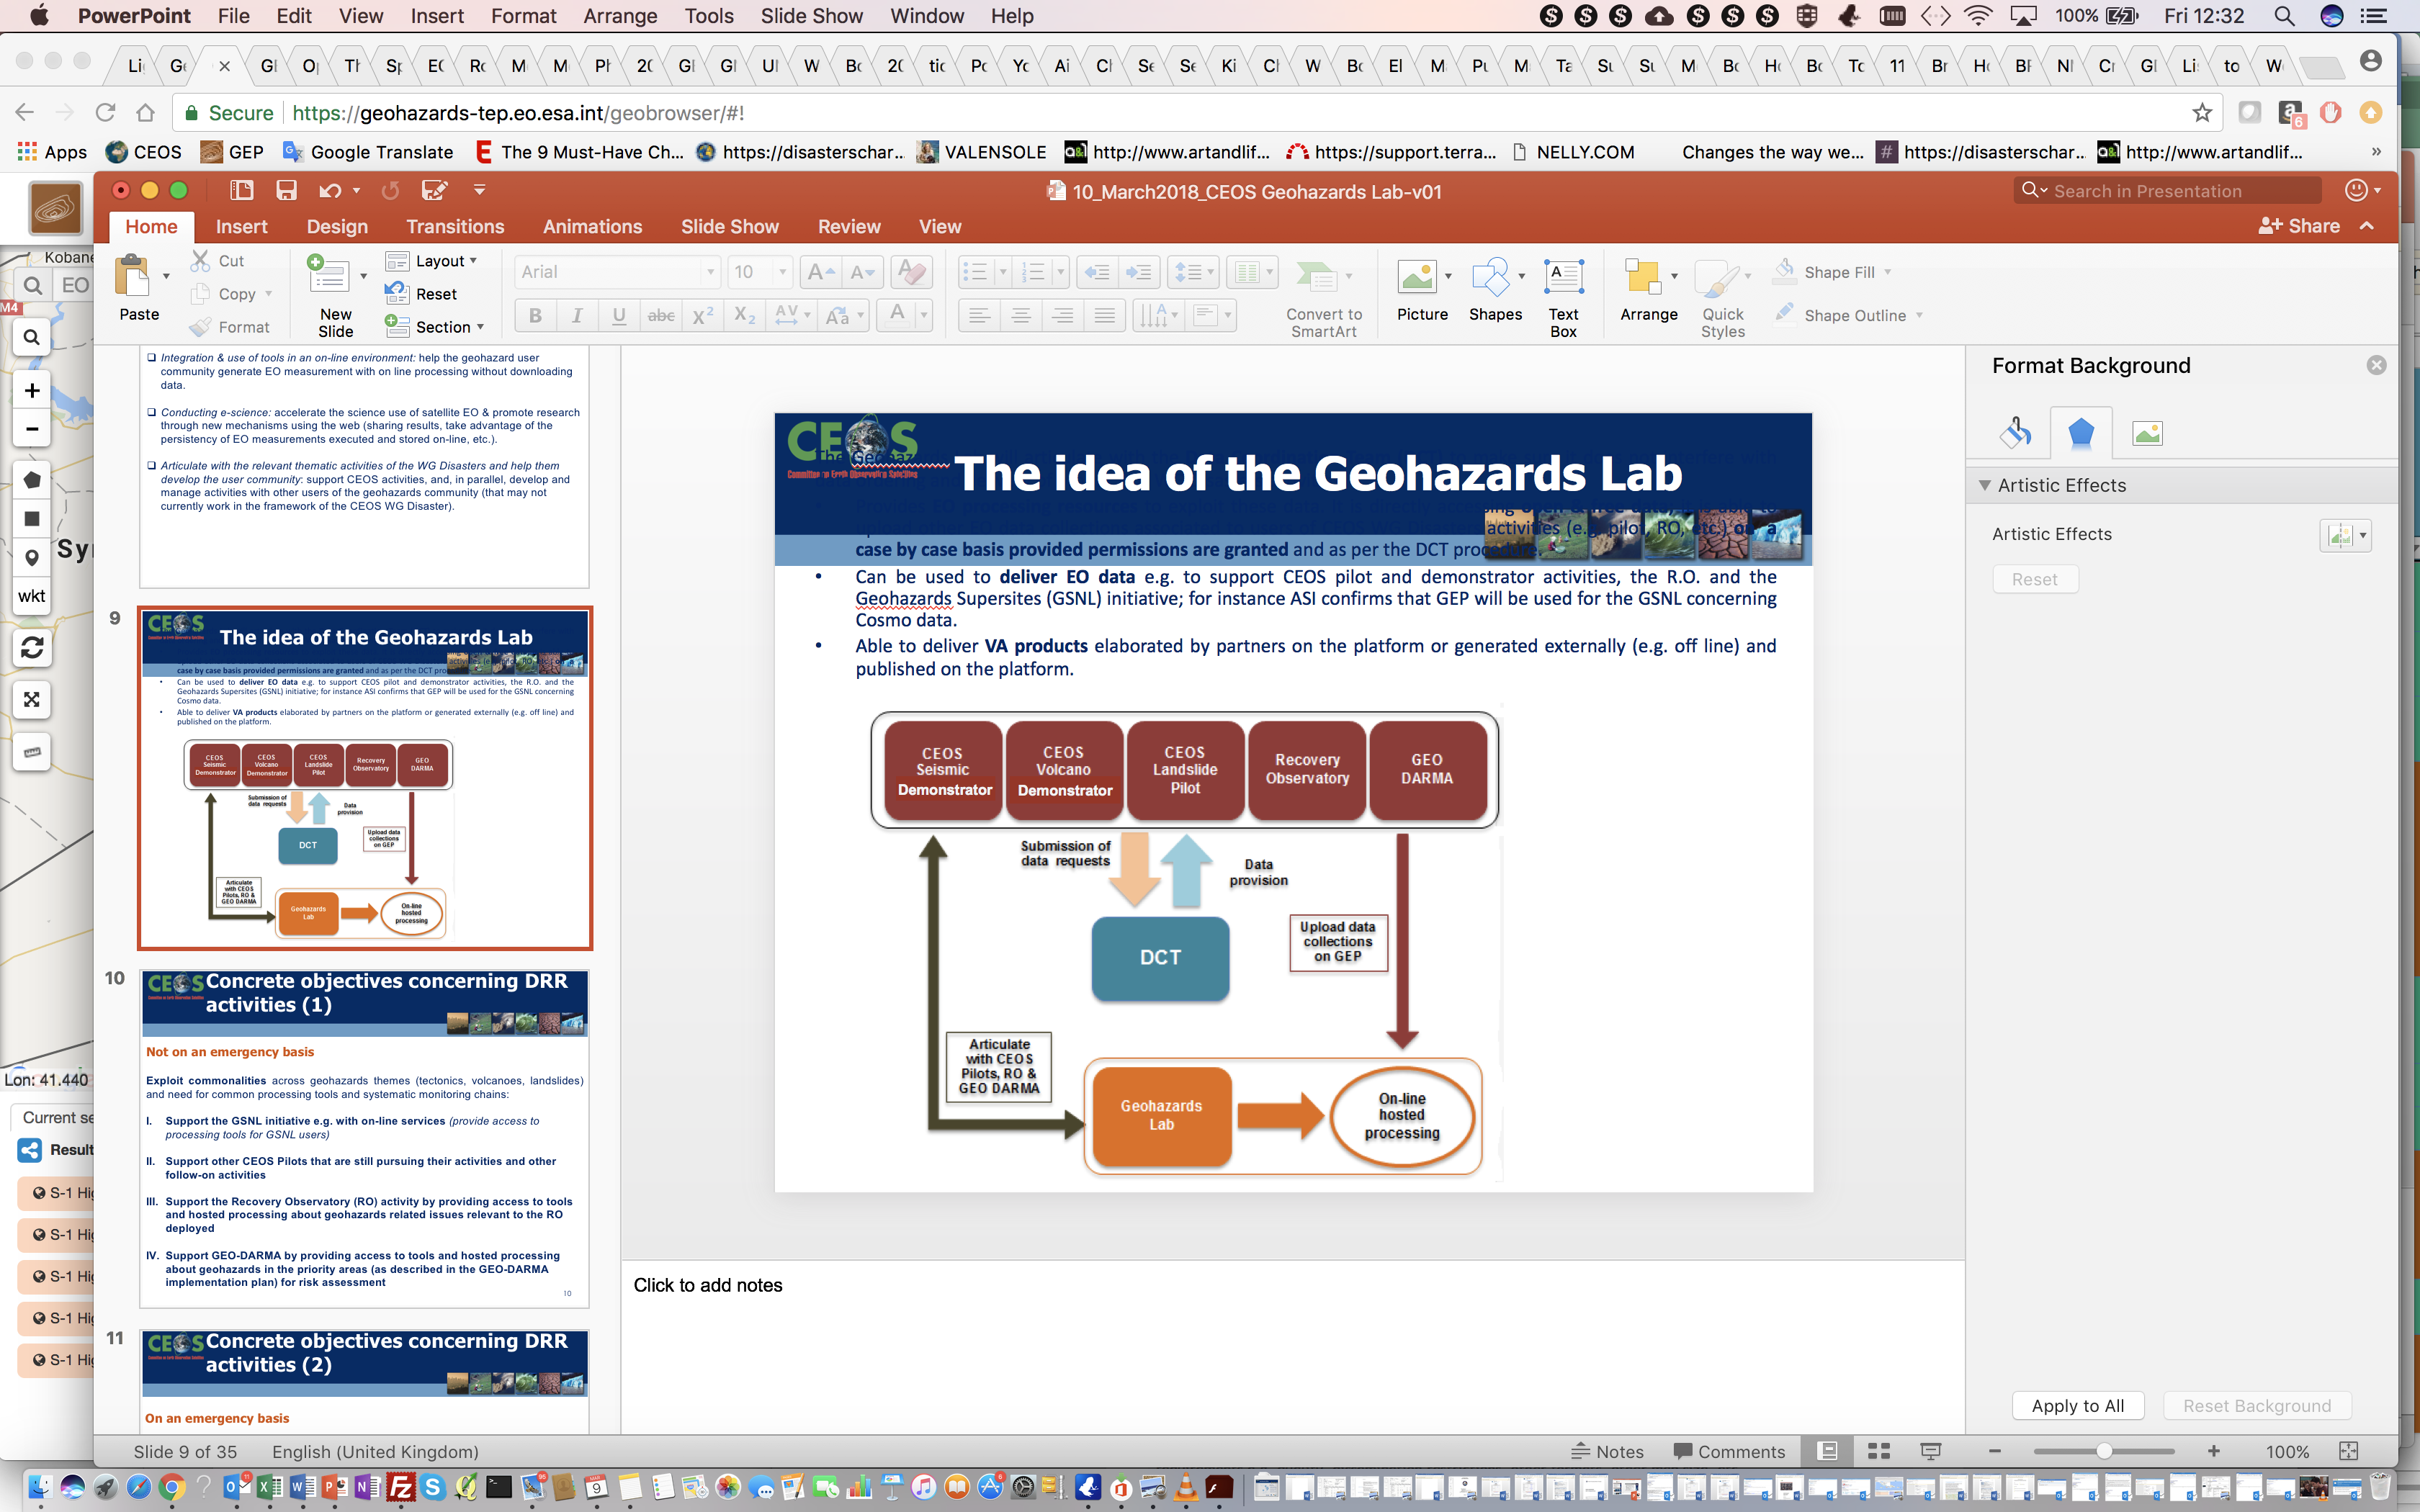
Geohazards Lab
A platform with federated resources to access, process and publish satellite EO data and derived products
Goal: Provide data access and a processing and e-collaboration environment to exploit EO data to assess geohazards and their impact
Geohazards
Office

Slide 25
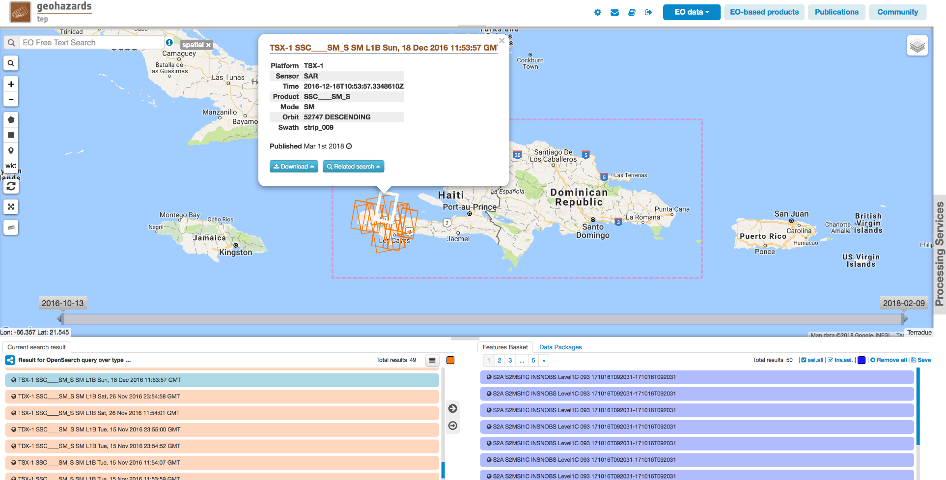
Geohazard Exploitation Platform
Support CEOS WG Disasters initiatives with data storage, data access, hosting processing and on line tools.

Slide 26

Geohazards Office
An activity of scientific animation within the Geohazards Lab
Geohazards Lab
ESA
CNES
ASI
DLR
GeoHazards Office Goals:
Liaise with the geohazards community to promote their results when using the Geohazards Lab resources
Develop collaboration with experts to harmonize and improve acceptance of platform based EO techniques
Demonstrate and showcase hosted processing services for terrain motion mapping
Academic
Institutions
Research
Centers
CEOS WG Disasters
CEOS WGISS
GSNL
nextGEOSS
GEODARMA
Geo
Hazard
Office
GEP
Civil Protection
Local Authorities
Geological
Surveys
Re-Insurance

Slide 27
Reference to the workplan
Observations for Disasters Objectives/Deliverables: 2018-2020
Objective/Deliverable | Projected Completion Date
DIS-10: Implementation of data coordination for the GEO-GNSL initiative | Q4 2020
DIS-12: Report on survey of donors for post-2017 operation of a Recovery Observatory | Q4 2018
DIS-15: Support for GEO-DARMA identification of major hazards and DRR issues for each selected region | Q2 2018
DIS-16: Report on Landslide Pilot and follow-on actions. | Q4 2019
DIS-17: Demonstrators Implementation Plan | Q2 2018
ON TRACK
+ 6 months
+ 12 months
ON TRACK
COMPLETED
Plan to update the workplan to reflect the new activities

Slide 28
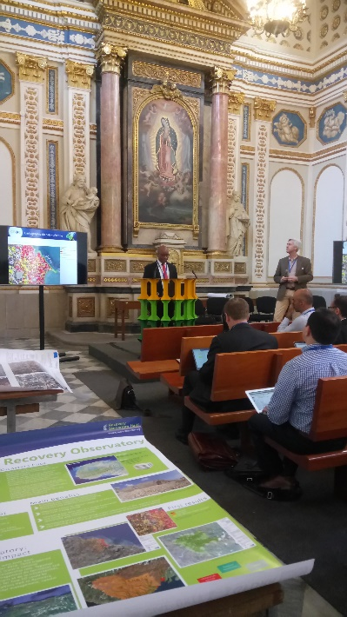
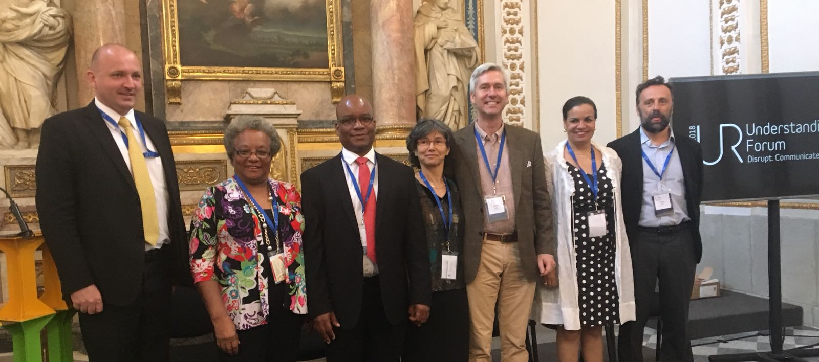
Communication and Outreach
Understanding Risk Forum, Mexico, 2018
City on Volcanoes, Italy, 2018
Proposed sessions to:
  Living Planet Symposium, Italy, 2019
  EGU, Austria, 2019
CEOS WG Disasters Web Pages update

Slide 29
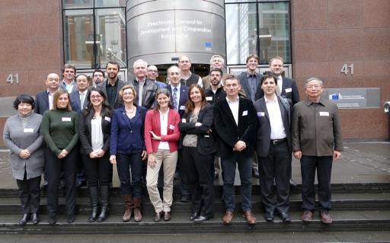
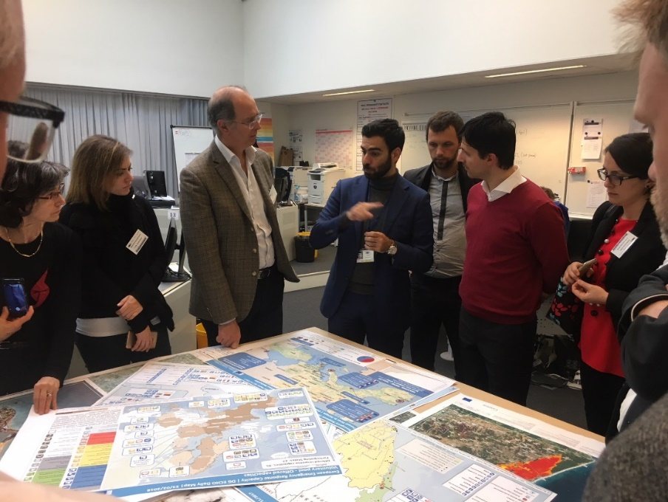
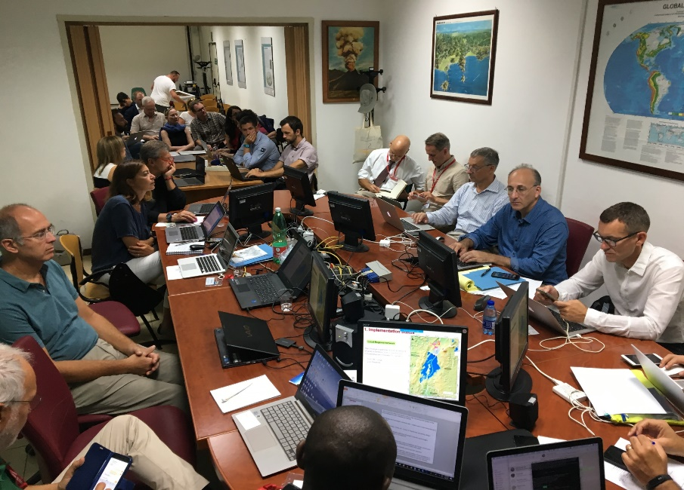
2018 Meetings
EC, Brussels, Marc, 13-15, 2018
INGV, Naples, September, 5-7, 2018

Slide 30
Chairmanship handover
November 2017 – November 2019
Chair: Simona Zoffoli (ASI)
Vice Chair: David Green (NASA)
November 2019 – November 2021
Chair: David Green (NASA)
Vice Chair: asking for proposals by Agencies

Slide 31

THANK YOU
CRED. Natural Disasters 2017. Brussels: CRED; 2018 EM-DAT file dated 02/07/2018.
Centre for Research on the Epidemiology of Disasters (CRED)
Institute Health and Society, Université Catholique de Louvain

