Slide 1

UK Space Agency Update
Committee on Earth Observation Satellites
CEOS Plenary 2019
Agenda Item 4.3
Ha Noi, Viet Nam
14 – 16 October 2019

Slide 2


The UK Space Agency is the UK policy lead for satellite Earth Observation. The Earth Observation and Climate policy team is responsible for:
Development and implementation of satellite Earth Observation and climate vision and policy and to support upstream and downstream EO activity in the UK;
Funding UK programmes within the ESA Programme Board for Earth Observation (PBEO), the Committee on Earth Observation Satellites (CEOS) and other national and international forums;
Delivering the CEOI, Space4Climate, bilateral programmes, data and education programmes etc;
Advising Defra on the space and data elements of GEO and Copernicus and the Met Office on EUMETSAT.

Slide 3
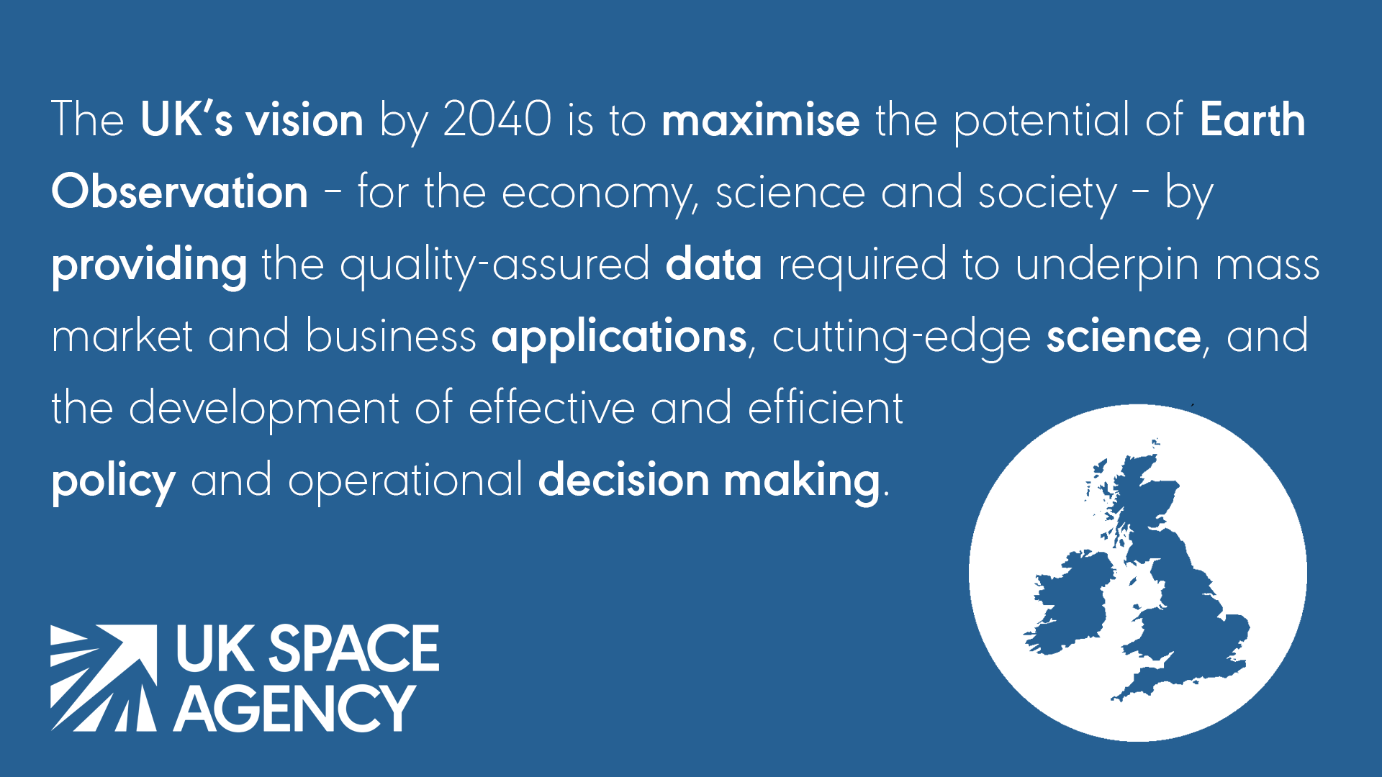
https://www.gov.uk/government/publications/living-planet-symposium-13-17-may-2019

Slide 4
EO in the UK
Many activities across the whole value chain : EO services support £92 billion of UK GDP, boasting a 25% annual growth rate.
UK Space Conference (24-26 September 2019 in Newport, Wales) attracted 1,600 delegates and had sessions of EO data, Climate and SDGs.
UK the first G7 country to put our Zero Emission target in law – we intend to monitor this with trusted EO data. Nominated to host COP-26 in Glasgow is 2020.
Developing small sat launch capability in UK.
Founding member of Space Climate Observatory.
Current focus is on ESA Ministerial in November – funding for the next few years of EO activity.

Slide 5
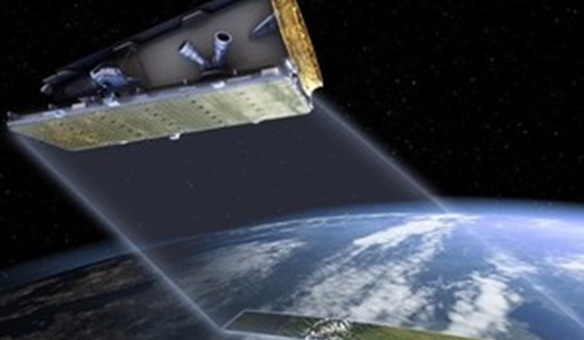
NovaSAR
NovaSAR-1- a small low cost S Band Synthetic Aperture Radar (SAR) designed and built SSTL, Airbus and AIR supplied by Honeywell Aerospace.
Launched 16 September 2018 from India.
Commercial mission owned by SSTL. The technology grant from UKSA allows the UK a 15% share of the data for R&D.
Sharing agreements being discussed including with Italy (ASI) and CEOS activities.
Mission partners Australia (CSIRO), India (ISRO) and The Philippines (DOST)
NovaSAR-1
Technology demo of Low cost SAR

Slide 6
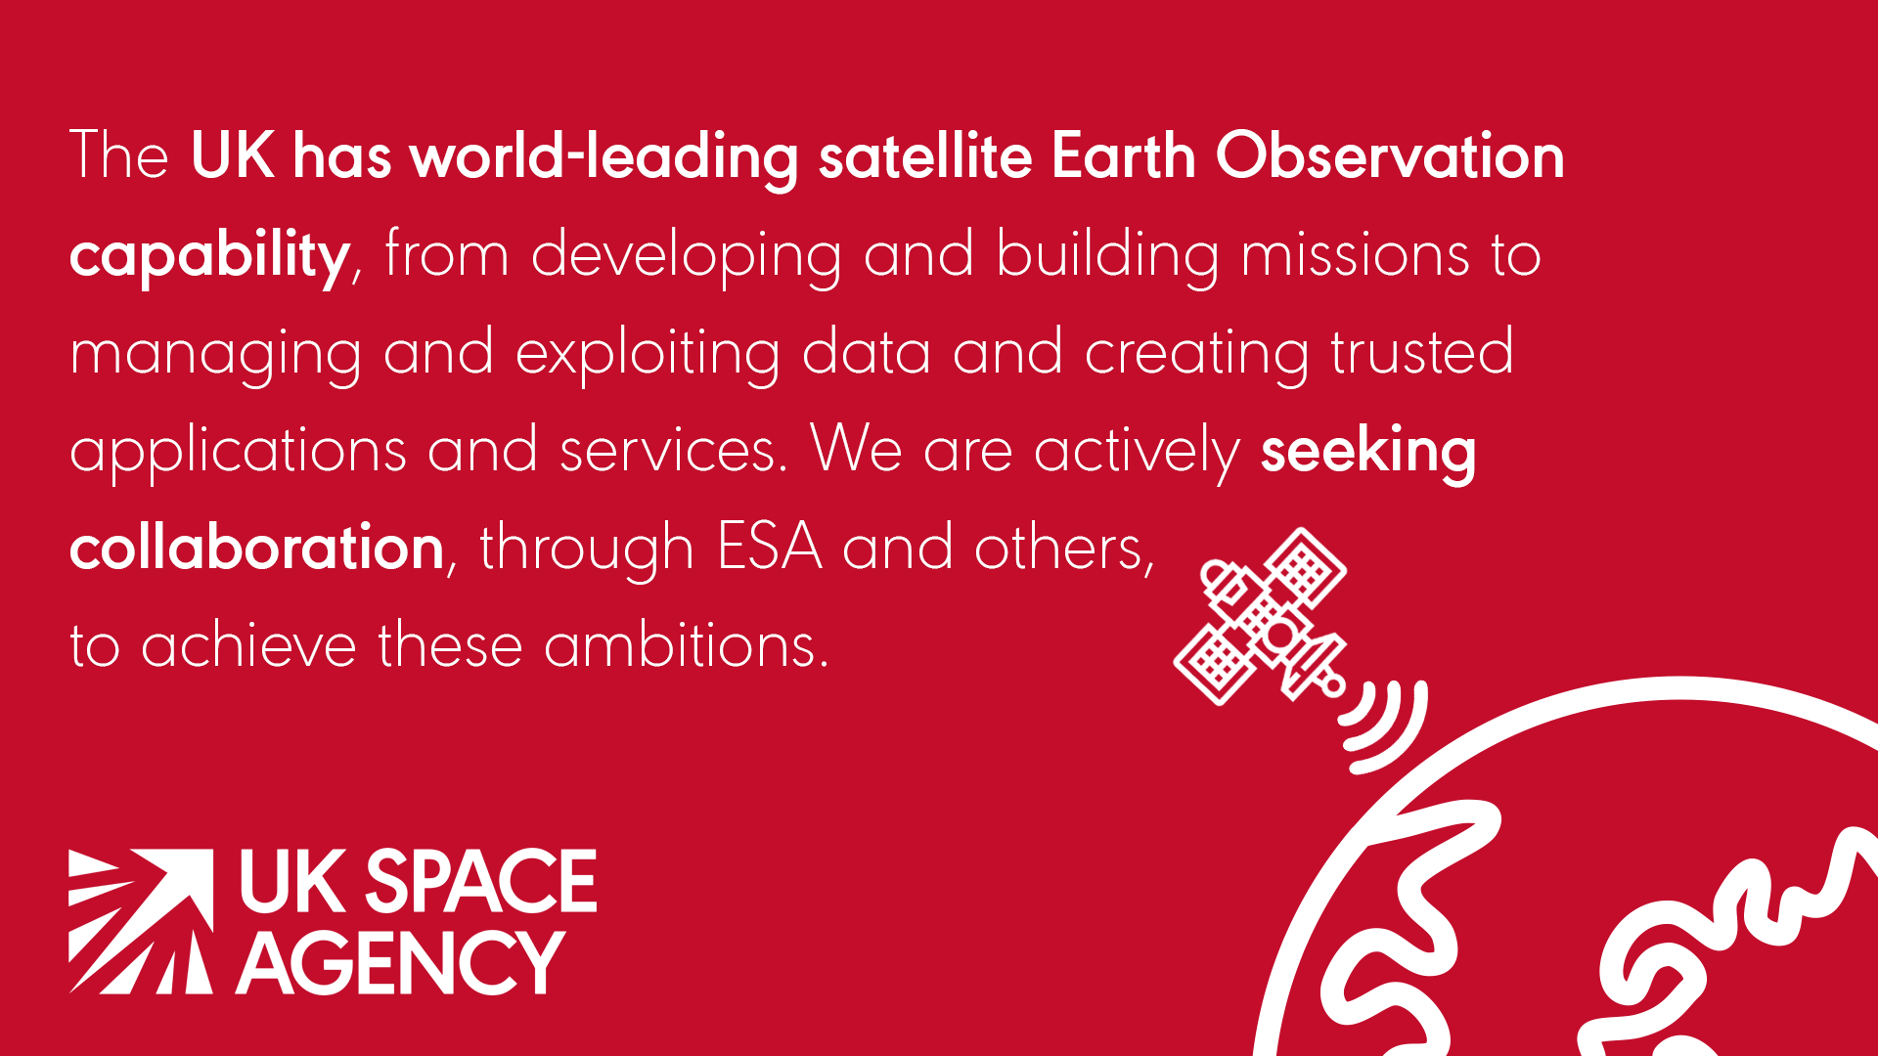

Slide 7
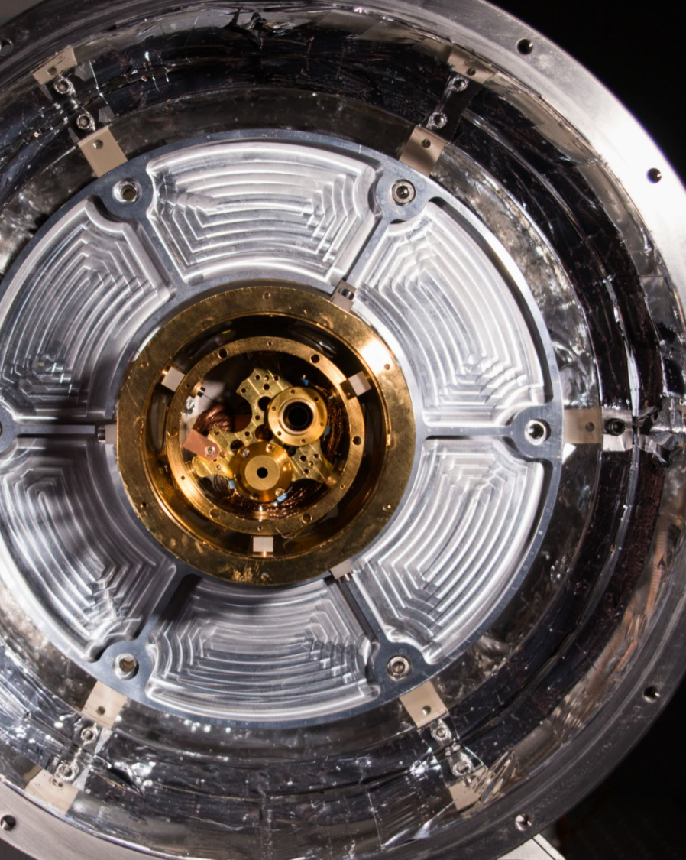
TRUTHS (Traceable Radiometry Underpinning Terrestrial-& Helio-Studies) proposed ESA mission.
TRUTHS will establish the first elements of a space-based climate and calibration observatory to help provide society with trustable evidence, facilitating a timely and economically and socially sustainable international mitigation and adaptation strategy

Slide 8
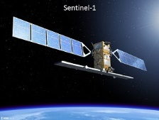
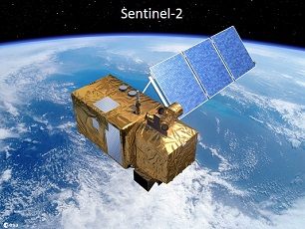
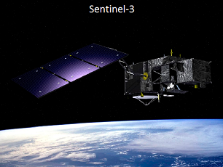
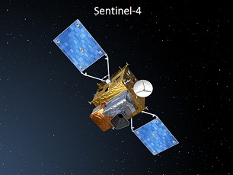
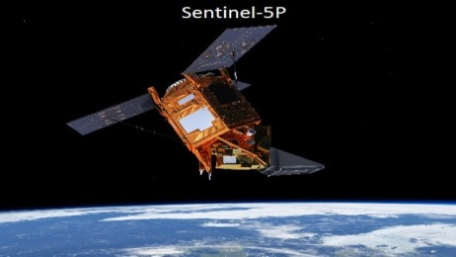
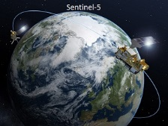
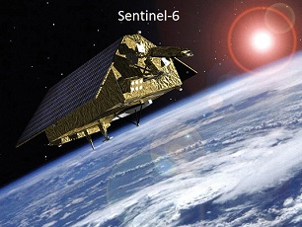
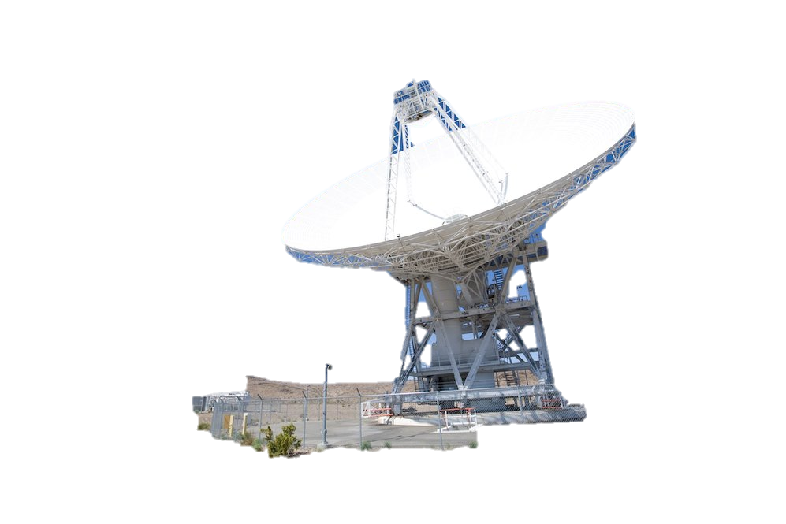

Copernicus Services
Copernicus Data
Processing & Archiving Centres
Receiving Stations
The UK has made significant science and financial contributions to the development of the Copernicus programme through ESA, the EU and EUMETSAT and intends to continue to do so.

Slide 9
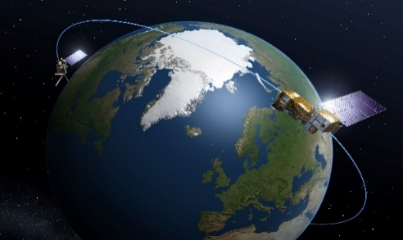
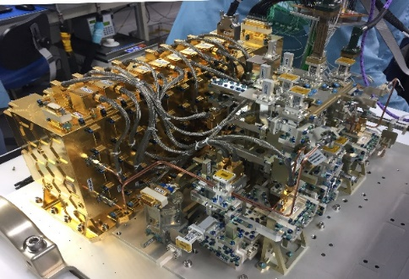
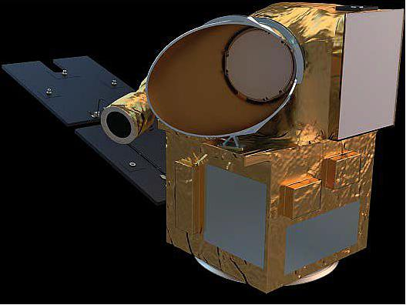
International Collaboration
Our co-operation with CNES is an example of the successful collaboration in Earth Observation missions that these international partnerships facilitate. Together UKSA and CNES have supported work on three important climate and weather monitoring missions:
IASI-NG is a key instrument for the second generation MetOp satellites. With financial support provided by UKSA, Leonardo UK have developed cutting edge infrared sensors, often described as the eyes of the instrument, key to its improved weather forecasting capability.
SWOT is a NASA-led mission to make the first global survey of the world’s surface waters and oceans. UKSA provided funding for Honeywell UK to develop and build a duplexer for the mission, a vital component to route radar signals around the satellite at a power of 1,500W – a level never seen in this kind of device. UKSA is also supporting UK scientists to be involved in the calibration of the mission for Estuarine environments.
MicroCarb is a CNES-led mission to monitor carbon fluxes. As a mission partner the UK is undertaking a suite of activities including the Assembly Integration and Testing (AIT), the batteries, and ground segment, as well as being part of the mission science preparation and essential calibration and validation.
AIT has begun in Harwell, UK
MetOp Second Generation © ESA-P. Carril 2012
SWOT Duplexer built by Honeywell UK
Artist impression of MicroCarb satellite © Airbus DS

Slide 10




International Partnership Programme
IPP is a five-year, £152 million programme using data and technology to solve specific challenges across the globe.
IPP will benefit over seven million people in 29 developing countries through the 112 international partnerships it has formed, including government ministries, research institutes/academia, NGOs and private sector. IPP consortiums have trained over 1,200 people in developing countries on using space solutions to address development challenges.
ODA-compliant, providing a measurable and sustainable benefit.
show the cost-effectiveness and additional benefit of space-based solutions and applications over terrestrial systems.
develop valued and sustainable partnership arrangements which lead to growth opportunities
contribute to the continued strength of the UK’s space sector, building on it’s unique strengths to deliver aid objectives

Slide 11
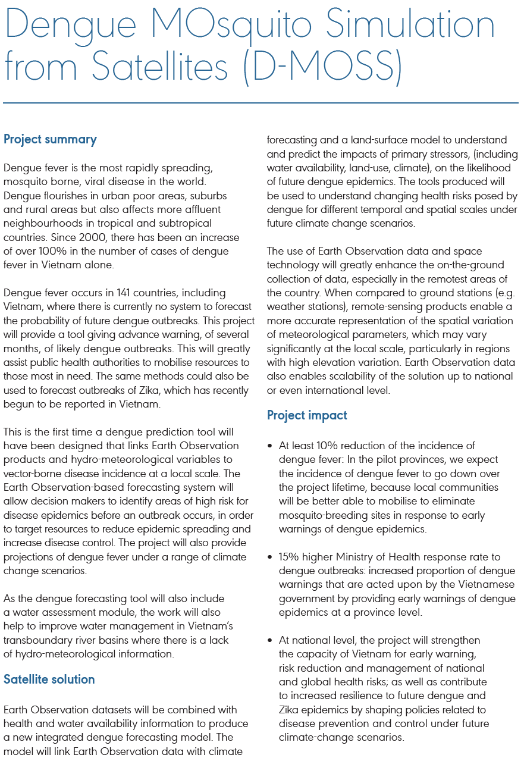


Slide 12
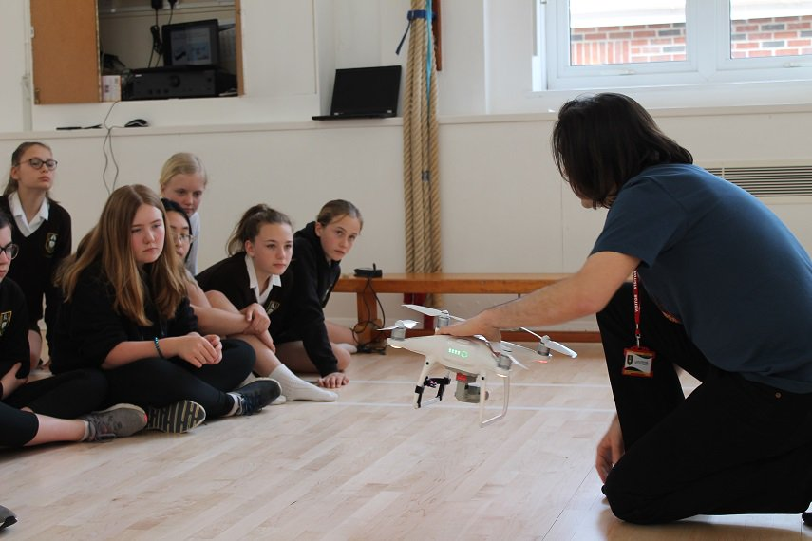
We inspire the next generation
EO-Pi: Exploring the science behind Earth Observation
University of Edinburgh and Plymouth Marine Laboratory development of innovative teaching tools covering Earth Observation science and climate monitoring.
Use of thermal imaging drone and Raspberry Pi units to allow students the opportunity to collect and apply real data to build models and images.
SPIN. The Agency’s Space Placements in Industry (SPIN) programme supports post graduate students to have paid work experience in the sector including in EO jobs. Around 30% have secured posts within the company they were placed with and around 70% have secured employment across the sector more generally.

Slide 13

What we did in CEOS in 18/19
Demonstrate Analysis Ready Data (ARD) in three areas of the CEOS specified standards to showcase the quality of the data in collaboration with non-specialist users.
Hosted a Climate Benchmark workshop in September 2019 in UK (through chair of EGCV subgroup IVOS).
Hosted a “Working Internationally in EO” event to engage wider UK community, and held CEOS/GEO sessions at conferences.
Proposed TRUTHS mission as an ESA mission

Slide 14
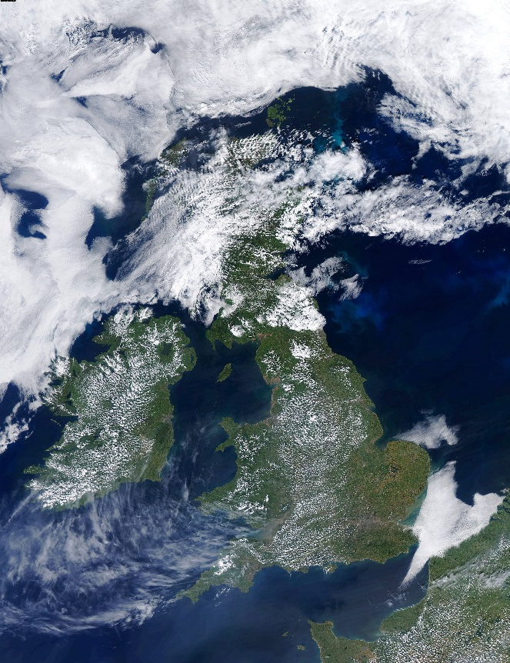



The UK at GEO Week, Nov 2019
A UK delegation will be at GEO Week 4-8th November led by Department for Environment, Food & Rural Affairs and the UK Space Agency
Industry and academia will be represented
Part of the EuroGEO stand, Plenary, Ministerial, Industry Track and Side Events
GEO provides an important platform to collaborate and demonstrate the benefits of Earth observations across the globe. Its focus on open data has done much to promote Earth observations to users both domestically and internationally to the benefit of society.

