Slide 1
Working Group Calibration & Validation
Cindy Ong, CSIRO, WGCV
Akihiko Kuze, JAXA, WGCV
CEOS 33rd Plenary 2019
Session 5.1
Hanoi, Vietnam
14 – 16 October 2019

Slide 2
Status of WGCV’s Contribution to CEOS Work Plan
Deliverable | Q3 2019 | Q4 2019 | Q1 2020 | Q2 2020 | Q3 2020 | Q4 2020 | Q1 2021 | Q2 2021 | Q3 2021 | Q4 2021
CV-3 (pre-flight workshop) | Strong community interest. Joint GSICS/WGCV letter signed, workshop Q2 Q3 2020. Key aspect GHG sensors. | Due date extended to Q3 2020
CV-9 (RadCalNet) | Ongoing task renewable each year |  | Ongoing task renewable each year
CV-14 (CMIX) | On track for delivery. 9 teams participating & have delivered their results over 5 evaluation datasets (Landsat-8 & Sentinel-2 scenes). Results currently being evaluated & will be published & discussed in 2nd ACIX II-CMIX WS (3-5 December 2019, ESA/ESRIN) (https://earth.esa.int/web/sppa/meetings-workshops/hosted-and-co-sponsored-meetings/acix-ii-cmix-2nd-ws)
CV-15 (L1 inter-operability) | Solar reference spectrum completed, WGCV/GSICS SI-traceable workshop, community white paper & proceedings to be published early 2020
CV-17 (Continental SR) | Report distributed to community
CV-18 (GHG ref standards) | Apr 2019 meeting discussed TCCON. Workshop planned Q1 2020. Formal invitations distributed. |  | Extension to Q3 2020 (NB. Links to GHG)
CV-19 (biomass pro) | On track to be completed
FDA-12 (CEOS product inventory) | Work in progress as part of CARD4L peer review, CV-15 & WGISS/WGCV cooperation on QI |  | Deadline extended to Q2 2020 after WGCV46 meeting in March 2020
CARB-16 (biomass SS) | On track to be completed

Slide 3
WGCV’s Roles in GHG Road Map
WGCV ACSG
  Identify best practices for prelaunch calibration of CO₂ and CH₄ concentration sensors and
  facilitate the exchange and harmonization of approaches and reference standards (CV-18, CV-9)
  Identify best practices for on-orbit calibration of GHG sensors and
  disseminate standards including solar, lunar, and surface vicarious validation sites (CV-3, CV-9, CV-15)
  Define an operational validation approach
In collaboration with GSICS
  Coordinate efforts to develop operational cross-calibration approaches based on prior work in AC-VC and WGCV

Slide 4
Field Surface Reflectance “Round-Robin” (S3R) inter-comparison exercise, and development of community endorsed SR validation protocols
A joint effort to test user-based differences in surface reflectance fiducial reference measurements used for validation of current SR satellite products, and to ensure consensus on field protocols and global SR validation protocols
Work Plan:
  Perform RR inter-comparison exercise of SR for:
  - Testing user-based differences in surface reflectance measurements (including instrument and operator biases as well as measurement collection procedures);
- Helping design field measurement protocols and validation methodology that are clear and can be easily applied by all users; and
- Ensuring international buy-in and consensus on the field measurement protocols and global SR validation methodology developed.
  Organize two workshops before and after RR for discussion on protocols, field experiment and outcomes
  Publish RR inter-comparison results
  Develop protocols for global SR validation (field radiometry, drones, others)
Outcome:
  Report summarising the S3R inter-comparison results
  Peer reviewed article co-authored by all participants who wish to publish the outcomes of the activity.
  SR validation protocols including field measurements and drones for CEOS WGCV LPV/IVOS endorsement.
Period: 2020 – 2021
  Experiment Call (Q2 2020)
  First Workshop (Q4 2020)
  S3R exercise (Q2 2021)
  Second workshop (Q3 2021)
  S3R inter-comparison report (Q4 2021)
  SR validation protocol (Q4 2021)
Contributing Entities: ESA, GA, NPL, CSIRO, IVOS, LPV
Funding support: ESA Earthnet (FRM4Veg project)
CV-17
Notes:
Inter-comparison exercise represents a joint effort to test user-based differences in surface reflectance fiducial reference measurements used for validation of current SR satellite products, and to ensure consensus on field protocols and global SR validation protocols. It is a continuation of CV-17, including the use of drones and extending to other biomes/conditions and conducted in the framework of the ESA FRM4Veg project. These objectives shall be achieved inviting the scientific community to a “Round Robin” inter-comparison exercise and two international workshops to discuss the design of the S3R exercise and the main outcomes. In addition, the fiducial reference measurements collected during the exercise will serve to validate SR ARD products.

Slide 5
Second Biomass Retrieval Intercomparison Exercise BRIX-2
Joint effort to intercompare biomass mapping algorithms using standardised test cases.
Objectives:
  Provide an objective, standardized comparison and assessment of biomass retrieval algorithms developed for the BIOMASS, NISAR and GEDI missions, and fusion of these mission datasets.
  Establish a forum to involve scientists in the development of retrievals that have so far not been part of the biomass community.
  The adoption of vetted validation standards and methods to compare biomass estimates to reference datasets (e.g. field plots or airborne lidar biomass maps).
  Collect inputs from the biomass user and scientific community on data formats and characteristics towards the generation of Analysis Ready Data.
Outcome:
  The evaluation will be done by ESA/NASA, following standards from the CEOS LPV protocol. This should guarantee a fair evaluation. ESA/NASA will release a report to the participants summarising the evaluation results.
  Evaluation scripts available. This allow people to repeat the experiment and compare their results against the published ones.
  The results should easily be adapted for publication as a peer reviewed article co-authored by all participants who wish to publish the outcomes of the activity.
Period: 2020 – 2021.
  Experiment Call Q12020.
  First Workshop (Target: Q3 2020)
  Results Submission Deadline (date of first workshop + 6 months?)
  Results Evaluation Report (date TBD)
  Second workshop (date of first workshop + 9 months)
Contributing Entities: LPV, ESA, NASA (JPL, University Maryland)
With contribution from Scientists team involved in BIOMASS, GEDI, NISAR
Notes:
Joint effort to intercompare biomass mapping algorithms specifically for biomass mapping used for current and future spaceborne missions.
These objectives shall be achieved by making available standardised test cases (based on airborne campaign and spaceborne simulated data), inviting the scientific community to develop and apply retrieval algorithms based on this test case, and finally compare and evaluate the performance of submitted results.

Slide 6
New: SAR Supersites for multi-mission SAR radiometric / geometric calibration, cross-calibration & validation
Justification
  Multiple upcoming SAR missions;
  Capability to support multi-mission SAR calibration / validation would facilitate an independent verification of data quality (radiometric, geometric)
  Ongoing discussion between NASA, GA for NISAR L-band calibration, ISRO interest for S-band calibration noted with implications for NovaSAR calibration; Other interested
Objectives
  Define a set of criteria / requirements and characteristics for setting up SAR supersites (similar to RADCALNET);
  Need to cater for multiple calibration validation and observation requirements e.g. CRs, transponders, PARCs, left / right looking, temporal stability;
  A model of sustainable operations be central to SAR supersites;
Definition of the work plan with resources and timelines to be prepared by the SAR subgroup for discussion at the CEOS SAR SG Nov 2019 meeting in Frascati;

Slide 7
New: Digital Elevation Inter-Comparison
Objective: state-of-art global DEMs based on a set of harmonized metrics
Scope and Products to be included: All datasets which have at least continental coverage and are available under a free & open data policy, including latest versions of
  NASADEM (NASA, JPL, most recent decent of the SRTM product line, eventually also NGA’sTFRMv4)
  AW3D30 (JAXA, f&o version of the Japanese ALOS based global DEM)
  ASTER-GDEM, (METI, NASA)
  TanDEM-X90, (DLR, free version for scientific of the TanDEM-X mission)
  Copernicus DEM90 (EC/ESA, f&o version of WorldDEMTM, the commercial version of TanDEM-X procured by Airbus)
Q4 2019 |  | Q1 2020 |  | Q2 2020 |  |  | Q3 2020 |  | Q4 2020
 | Phase I EOI, approach agreement, test case selections
 |  |  | Phase II X-comparison & workshop
 |  |  |  |  | Phase III Feasibility testing & global roll out
 |  |  |  |  |  |  |  | Phase IV Comparison metric agreement & results publication

Slide 8
New: Ocean Surface Wind Vector Standards & Metrics
Objective: defining standards and metrics to enable cross calibration/comparison between scatterometers and wind retrieval approaches;
Collaboration between Microwave SG and Ocean Surface Vector Wind –VC
VC-15 “OSVW Standards and Metrics” revival following agreement at quarterly SIT teleconference for this activity to be renewed as collaboration between OSWV-VC and WGCV MSSG;
Collaborators: KNMI, EUMETSAT, ICM, NSOAS, NSSC
Other potential collaborators: NOAA, ISRO
Timeline: TBA

Slide 9
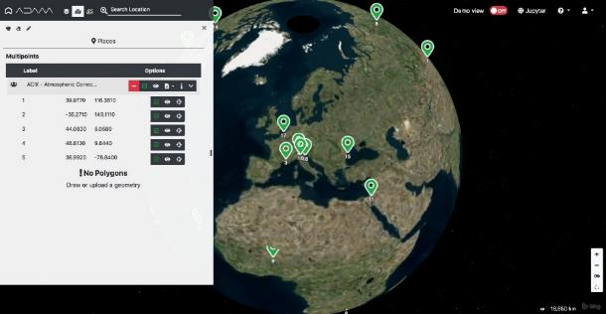
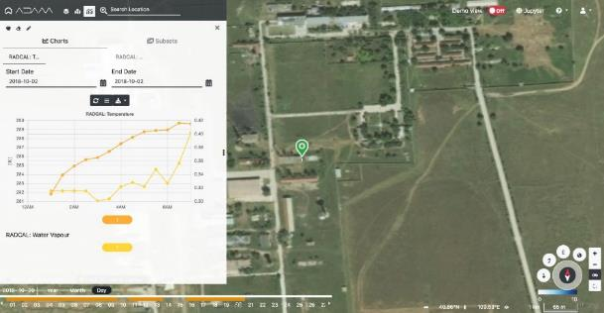
Building on collaboration between WGCV & WGISS
Concurrent in-situ & satellite data availability on ESA Cube
Demonstration with RadCalNet & ACIX, LPV
Resolve challenges with inconsistencies with LPV supersites
Extension to other validation sites?
Data Formats, processing, etc.
Access to WGCV beta testers
ARD SR data available for site on ODC
Field data uncertainties
Satellite data uncertainties
Potential appln: new S3R, BRIX-2, DEMIX WPs, GHG
Potential appln: new SAR SS

Slide 10
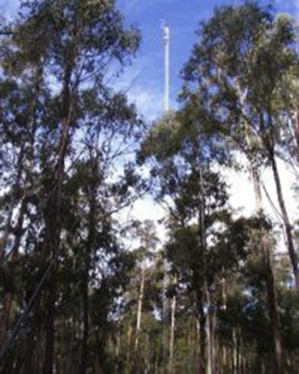
WGCV activities contributing to future SIT chair initiative
CEOS WGCV LPV joint biomass & supersite meeting 2-6th March 2020, Canberra Australia
  Bring together, explore & build on synergies of supersite & biomass validation protocol;
  Recommendations of the biomass protocol;
  TERN supersites for EO validation;
  Australian use case for biomass missions and relevance of TERN network for biomass validation;
  Co-operation between international network (FORESTGEO, FORESTPLOTS, etc.);
  Interoperability and access of data from sites such as TERN supersites, GBOV, FRM4Veg, etc.
Field trip, 4th March 2020, Tumbarumba, Australia
  Assessment of sites and demonstration of biomass & other relevant CEOS WGCV LPV protocols at LPV supersite / TERN supersite;

Slide 11
Resources Requirements
Opening for vice-chair position;
Europe is the next on list of the rotation but any nominations from qualified candidates will be considered;
Interested candidates please contact cindy.ong@csiro.au or kuze.akihiko@jaxa.jp

Slide 12

Questions?

