Slide 1
CEOS Analysis Ready Data (ARD) Strategy
Committee on Earth Observation Satellites
A. Lewis (SIT Co-Chair)
CEOS Plenary 2020
Agenda Item #4.2
22 October 2020

Slide 2
Session Overview and Expected outcomes (30 min)
Overview
Review progress on the CEOS ARD Strategy tasks
Updates on expanding CEOS Analysis Ready Data beyond the land domain
CEOS Interoperability Terminology
CEOS ARD: Involving the Private Sector
Outcomes/Decisions
Agreement to form small team to review the CARD4L Framework and propose changes that make it amenable to additional PFS for non-land domains
Endorsement of the CEOS Interoperability Terminology v1.0
Endorsement of the CEOS Analysis Ready Data – Involving the Private Sector paper

Slide 3
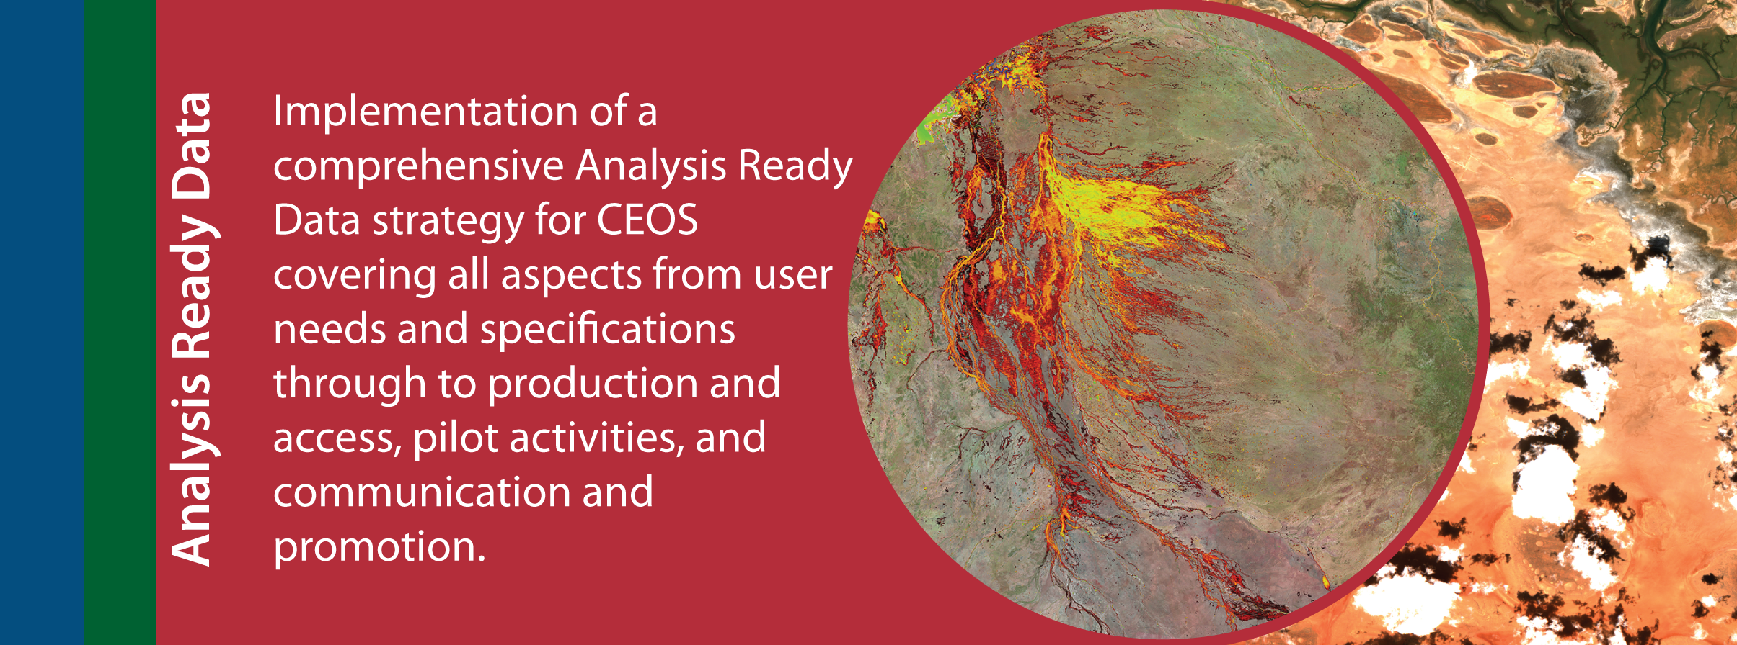
SIT Chair Priority:
Analysis Ready Data
Early Progress on CEOS ARD Strategy (endorsed at Plenary 2019)
PFS (product family specifications) progress
ARD Private Sector Engagement Paper
Interoperability terminology report
Pilots: DE-Africa

Slide 4
SIT Chair Priority:
Analysis Ready Data
Early Progress on CEOS ARD Strategy (endorsed at Plenary 2019)
PFS (product family specifications) progress
ARD Private Sector Engagement Paper
Interoperability terminology report
Pilots: DE-Africa

Slide 5
CEOS ARD Strategy

Slide 6
Analysis Ready Data Priority
Highlights
PFS progress: SR, ST, NRB, PR reviewed and endorsed; Interferometric and Geocoded SLC SAR in development; Aquatic Reflectance PFS in development and LIDAR terrain and canopy height PFS under discussion.
First CARD4L complaint Datasets: USGS Landsat Collection 2 SR & ST and ESA Sentinel-2 SR currently being assessed.
Cooperative processes established (LSI-VC & WGCV) to assess and peer-review datasets.
ARD beyond land: CEOS-COAST uptake of ARD, draft PFS for Aquatic Reflectance, provisional Aquatic Reflectance product from USGS.
Terminology report for endorsement at CEOS Plenary: LSI-VC and WGIS collaboration.
CEOS Analysis Ready Data – Involving the Private Sector paper for endorsement at CEOS Plenary.
ARD Website new materials: 1st ARD Webinar, ARD frequently asked questions, samples of CARD4L complaint datasets - coming soon and table of dataset compliance - work in progress.
Communication & Promotion: 2nd ARD webinar series (Nov 2020), IGARSS 2020 paper and ARD session, engagement with Standards - Participation in OGC’s TESTBED16 ARD activity.
DE Africa data flows (Sentinel-2, Landsat, Sentinel-1): continental coverage of CEOS ARD (CARD4L compliant where possible), Industry is playing key roles in production (Sinergise, Element-84)

Slide 7
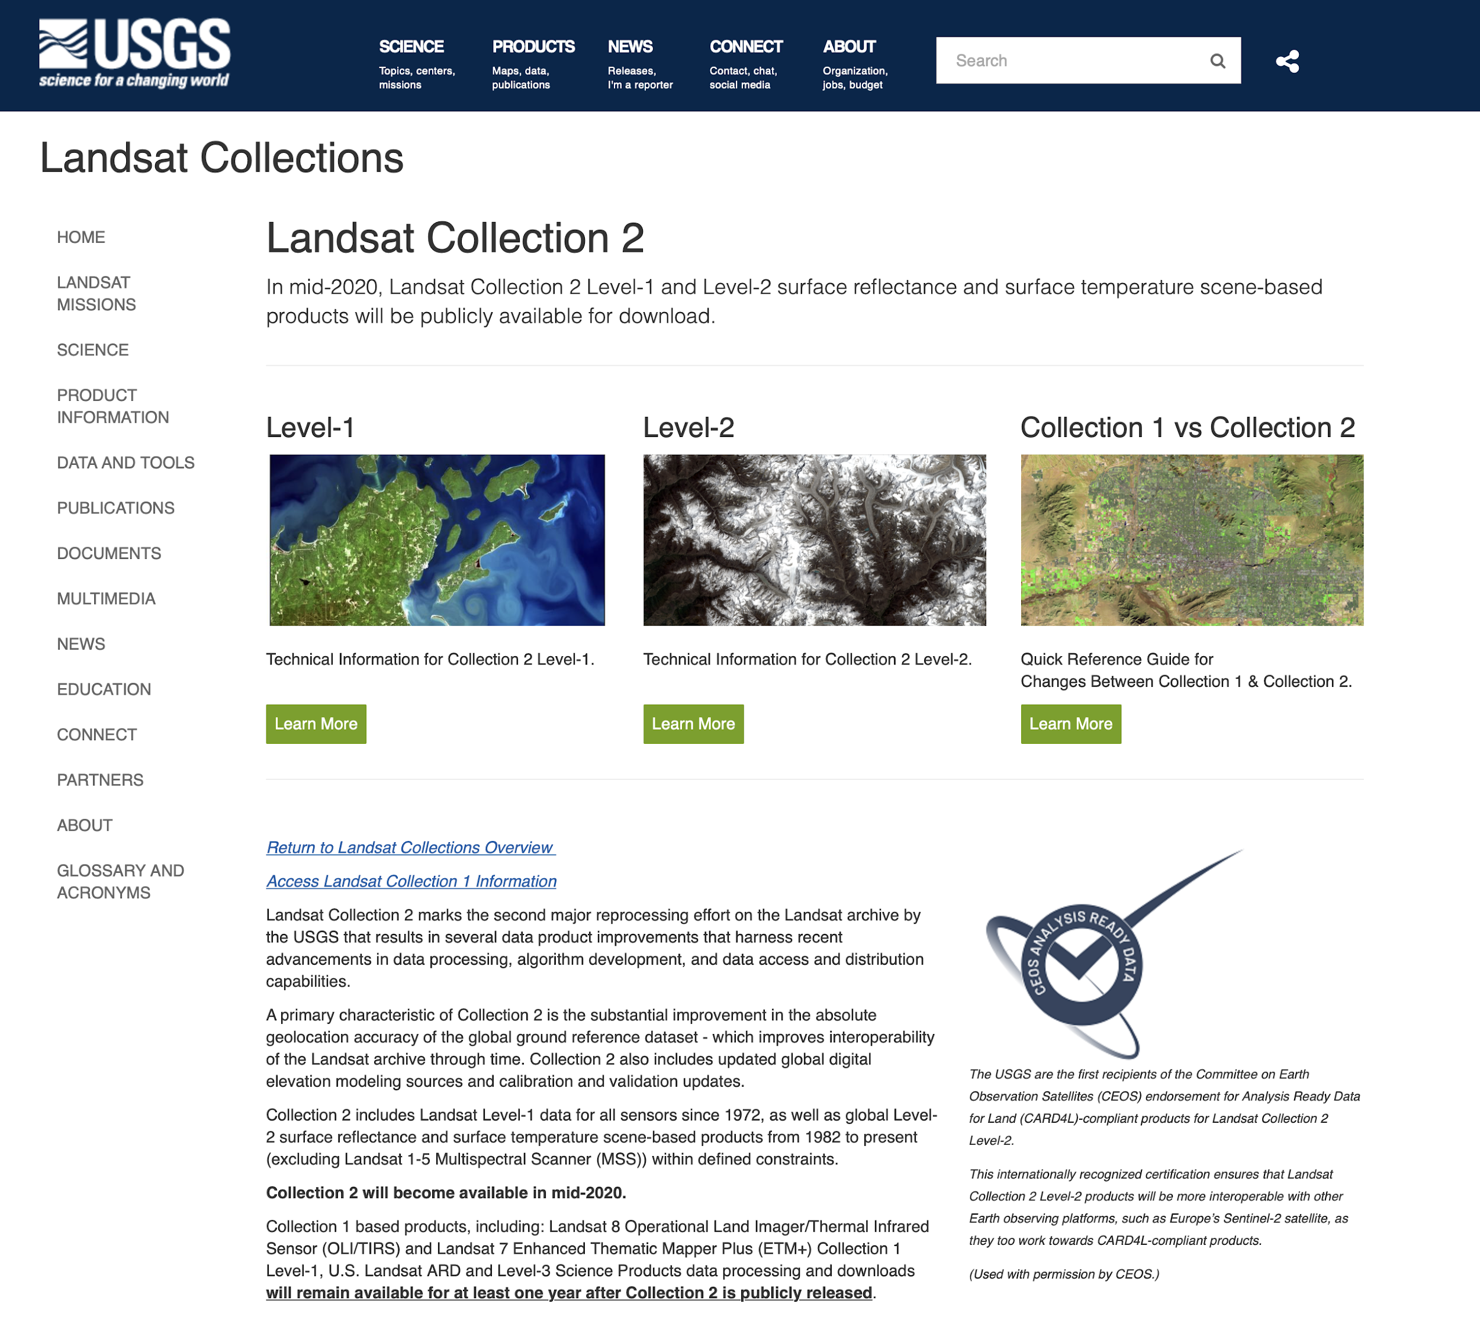
Analysis Ready Data Priority
Highlights

Slide 8
CEOS Analysis Ready Data (ARD) Strategy
Committee on Earth Observation Satellites
Edward M. Armstrong¹ Adam Lewis², Diego Loyola³, Vardis Tsontos¹, Paul M. DiGiacomo⁴, Chris Barnes⁵
¹ NASA Jet Propulsion Laboratory, California Institute of Technology, USA
² Geosciences Australia, Australia
³ DLR, Germany
⁴ NOAA NESDIS, USA
⁵ USGS, USA
CEOS Plenary 2020
Agenda Item # 4.2
20 – 22 October 2020

Slide 9
Introduction
CEOS SIT Tech Workshop 2020 held a session “ARD Beyond Land” (2.2 on agenda)
Four talks presented new or different perspectives on CARD4L from different science disciplines or communities
SST-VC ARD Perspectives
AC-VC possible contributions to CEOS ARD in the Atmosphere domain
CEOS COAST and CEOS ARD
Aquatic Reflectance
Based on these presentations potential recommendations for improving, updating or adapting the CEOS CARD4L Product Family Specifications (PFSs) emerged
Other CEOS stakeholders have also expressed interest in the ARD specification

Slide 10
Introduction (continued)
Present initial high level findings, and recommendations from stakeholders (one slide each)
Outline a proposal for a working group ARD framework review
Expected outcome of this activity and report to CEOS Plenary 2021

Slide 11
SST and other ocean disciplines
Primary issues of concern. Potential review candidates:
Applying CARD4L to Level 2/3 satellite data
Pixel Size / Spacing Requirement
Time for L3 observations
Specify additional metadata conventions or vocabularies (CF, ACDD, other ISO etc.)
Improving uncertainty metadata
Improving variable provenance
Some existing factors not applicable
Geometric correction
Should there be Flexible Scoring (beyond Pass/Fail)
Should all requirements and factors carry Equal Weight?
Consider services for ARD transformation

Slide 12
CEOS COAST & ARD
What: Successful realization and utilization of trans-boundary Analysis Ready Data (ARD) will be one of the unifying factors & primary engines that drives the COAST effort forward (NB: heritage/non-ARD data sets are of vital importance as well)
Why: Because there have been significant challenges to date, and more so great opportunities looking ahead, in bridging and coordinating geophysical satellite data across the land-sea (~aquatic) interface, as well as in situ and diverse biological (and ultimately socio-economic) data sets – ARD provides a common framework!
Need: Build out ARD pipelines, especially having the COAST relevant datasets across CEOS in a proper self describing state is necessary to bring them to ARD readiness and availability for COAST pilot efforts.

Slide 13
Atmospheric Discipline
Most atmospheric composition instruments are sampling systems, not imagers
The usability of Atmospheric Level-2 products as ARD is limited, Level-3 (gridded data) and Level-4 (fluxes, sources/sinks) are needed to create more useful ARD products
TROPOMI/Sentinel-5 Precursor L2 products already follow well established standards
(netCDF format, CF convention, metadata at product and single measurement level, etc.)
Considerable work is needed to adapt and extend the CARD4L Framework to the Atmosphere domain including reactive gases, aerosols and greenhouse gases
CARD4L Description Document and Atmospheric Products
Applicable sections (e.g. General and Quality Metadata)
Not Applicable sections (e.g. Atmospheric Correction)
CARD4L PFS Requirements and Atmospheric Products
Applicable requirements (e.g. Metadata/Traceability, )
Not Applicable requirements (e.g. Geometric Correction)
Generic names needed for other requirements (e.g. Measurement, Uncertainty)
Independent Geophysical Validation is performed regularly for Atmospheric products
Should Independent Geophysical Validation be a requirement for ARD?

Slide 14
Aquatic Reflectance
Aquatic Reflectance CARD4L PFS currently in development
Lead by: Nima Pahlevan (NASA) & Chris Barnes (USGS/ KBR)
Coordinated by: Andreia Siqueira (GA)
Expert Review Panel from the aquatic user community have discussed the following AR PFS requirement topics:
Should Bidirectional reflectance distribution function (BRDF) correction be a requirement, and if so, at which level - Threshold or Target?
Sun Glint correction required at the Threshold level (per pixel flag), but for the Target level add an uncertainty estimate
Sky Glint should be treated the same as Sun Glint
Adjacency atmospheric effects should be a requirement at the Threshold level
Vegetation surface effects should be a requirement at the Target level
Next steps
Consolidate feedback, tech edit and distribute final draft AR PFS to LSI-VC for review
Review and endorse final AR PFS at LSI-VC-11 (target)

Slide 15
CEOS COVERAGE and ARD
COVERAGE seeks to provide more integrated access to interagency data products from the 4 ocean VCs and in-situ data providers in support of science & applications for societal benefit
Conformance to Earth Science data interoperability standards is foundational to ARD
Self-describing file formats (nc, HDF), metadata standards (CF, ACDD), common vocabularies (e.g. GCMD, CF-standard names)
General emphasis on higher level data products sharing common structural characteristics
Minimize extent/complexity of transformations needed to get data in more consistent ARD form
ARD implies high quality, validated data
Systematic and random sources of measurement error are understood
Uncertainty is quantified and represented in the data product
Systems & value-added services facilitating access to ARD in support of applications
Role of Web-services in transforming and delivering native data in ARD form for applications
The application context & target user matters when defining/designing AR Data & Systems
eg. Applications requiring performant Analytics services enabled by “AR-Storage” – i.e.. cloud optimized data formats.

Slide 16
CARD4L CEOS review proposal and outcome
Form a small team within CEOS amongst Virtual Constellation participants and other interested stakeholders (e.g., CEOS COAST, COVERAGE and others welcome) to:
Review and prioritize top concerns and recommendations for improving and extending CEOS ARD framework
Propose additional documentation for updating or refining the existing Product Family Specifications
Expected outcome
Improved PFSs that can be used by other science communities besides Land and Radar
PFSs that can be adapted to other satellite processing levels
PFSs that can interoperate with existing ARDs
Final Report out to CEOS Plenary 2021 on findings and implementation recommendations
Including advisory notes (e.g. on file formats) in the Framework
Advice on the future coordination between the VCs and WGISS on ARD

Slide 17
Decisions
Decision: Consider forming a small team to review the CARD4L Framework and propose changes that make it amenable to additional Product Family Specifications (PFS) for non-land domains
Decision: Endorsement of the CEOS Interoperability Terminology v1.0
Decision: Endorsement of the CEOS Analysis Ready Data – Involving the Private Sector paper

Slide 18
CEOS Interoperability Terminology
Committee on Earth Observation Satellites
Dr. Robert Woodcock, CSIRO, WGISS Chair
LSI-VC, WGISS, WGCV, WG Disasters, COAST...
CEOS Plenary 2020
Agenda Item 4.2
20 – 22 October 2020

Slide 19
What is Interoperability?
CEOS Interoperability Terminology:
…the terms Analysis Ready Data (ARD), interoperability, and harmonization are often used and, to a large extent, used inconsistently
Interoperability represents a continuum of compatibility for products, services, algorithms.
“Making an unmanageable situation a manageable one” – or keeping it that way.

Slide 20
CEOS Interoperability Terminology Report
Five ARD terms are defined in this document:
Analysis Ready Data (ARD)
CEOS ARD for Land (CARD4L) Products
Interoperable Products
Harmonised Products
Fused Products
🡪 CEOS EAIL: Demonstrate via Jupyter Notebook examples for EO Analytics
Notes:
Analysis Ready Data (ARD)
An Analysis Ready Data (ARD) product is generated from raw data and processed so that it can be used without the need for further processing to be applied by user. This definition is intentionally broad to cover a large range of processing levels and possibilities. There is, however, a minimum processing requirement to be an ARD-compliant product: the data must be processed to a geo-referenced projection to enable the position identification within the data product.
CEOS ARD for Land (CARD4L) Products
CEOS Analysis Ready Data for Land (CARD4L) Products are a subset of all ARD products and have been processed to a specified minimum set of requirements and organized into a form that allows immediate analysis with a minimum of additional user effort and interoperability both through time and with other datasets.
Interoperable Products
Interoperable Products refers to a set of two or more ARD products which are sufficiently documented to enable processing across a continuum of geometric and/or radiometric standards to permit direct quantitative comparison.
This definition is intentionally broad and covers a large range of processing levels and possibilities but is constrained at one extreme by a minimum processing requirement for an ARD product: that the data is geometrically processed to a geo-referenced projection to enable the identification of the position of the acquired data.
Harmonized Products
Harmonized Products refers to a set of two or more interoperable ARD products, which have been processed to common geometric and/or radiometric levels to enable direct comparison between the products.
Fused Product
A Fused Product is a derived data product produced by merging two or more fully interoperable products. The derived data product contains values created from the merged data into a new single data product. While the input data may be provided with the fused product for reference, the input data are no longer independent data products in the new fused product. Therefore, it is not possible to go "backward" to recover the initial data products using the fused product.

Slide 21
CEOS Interoperability Terminology Report
Three Cloud data format terms for ARD:
Cloud-friendly
Cloud-native
Cloud Data Access API
Develop Best Practice Guides on:
Cloud Data Formats
CEOS Data Discovery and Access in the Cloud

Slide 22
CEOS Interoperability Terminology Report
Three types of Analysis Interoperability:
Executable code – black box service, same API
Source code - Same source, different systems
Algorithm - multiple implementations, same result
🡪 Validate Data Cube Interoperability in the Earth Analytics Interoperability Lab ecosystem for CEOS projects

Slide 23
Decisions
Decision: Consider forming a small team to review the CARD4L Framework and propose changes that make it amenable to additional Product Family Specifications (PFS) for non-land domains
Decision: Endorsement of the CEOS Interoperability Terminology v1.0
Decision: Endorsement of the CEOS Analysis Ready Data – Involving the Private Sector paper

Slide 24
CEOS ARD: Involving the Private Sector
Committee on Earth Observation Satellites
A. Siqueira & A. Lewis Geoscience Australia,
SIT Chair Team
CEOS Plenary 2020
Agenda Item #4.2
22 October 2020

Slide 25
Overview
The paper addresses the Task 2.4 of the CEOS Analysis Ready Data Strategy.
The paper was first circulated in March 2020 for comments and presented at SIT35 and SIT TW 2020.
The paper has been well received and we have received feedback from ESA, Catapult, NOAA, GEO Sec and the LSI-VC community.
The paper presents an initial evaluation of the views from the private sector on how the CEOS community needs to engage to take CARD to the next level.
The paper provides an overarching rationale and possible next steps to engage with data providers, data hosts and data users in the private sector.

Slide 26
Paper Recommendations and Next Steps
Recommendations
Establishing mechanisms for constructive and appropriate engagement with the private sector.
Avoid unnecessary barriers to participation (from industry) in the CARD discussion and processes.
Provide appropriate documentation on the various aspects of the CARD initiative.
Identify a CEOS ARD framework process for assessing private data products for compliance with Specifications.
Move CEOS concepts into the broader standards discussion to be more inclusive of the private sector.
Next Steps
Continue to share Information on CEOS Analysis Ready Data to build support
Understand the Industry Perspective
Engage Industry in Specifications

Slide 27
Decisions
Decision: Consider forming a small team to review the CARD4L Framework and propose changes that make it amenable to additional Product Family Specifications (PFS) for non-land domains
Decision: Endorsement of the CEOS Interoperability Terminology v1.0
Decision: Endorsement of the CEOS Analysis Ready Data – Involving the Private Sector paper

