Slide 1
CEOS Three-Year Work Plan Status Update and Priorities for 2014
Kerry Ann Sawyer
CEOS Executive Officer
All Work Plan Objectives/Deliverables
CEOS SIT Technical Workshop
CNES, Montpellier, France
17th-18th September 2014

Slide 2
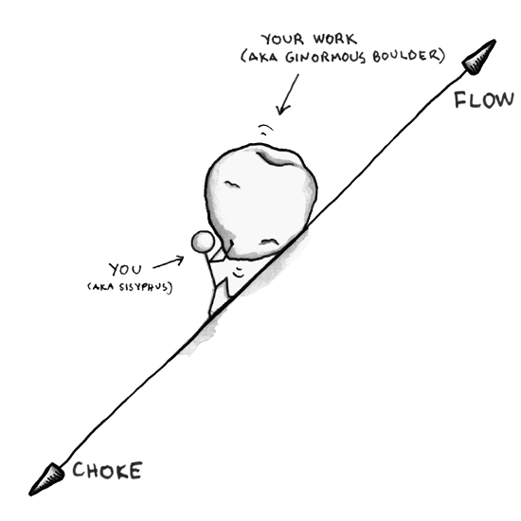
Overview
  This presentation is for INFORMATION.
  But that still means you should be paying attention, please.
OVERVIEW
CEOS 2014 Priorities and Achievements
CEOS 2014-2016 Work Plan Status Update
Update of the 2013 OPEN Actions and Update of CEOS Actions Tracker
Timeline for annual update to
the Three-Year Work Plan
  Yes, seems like we just finished
  the first Work Plan…and we did!
Image: www.gigaom.com

Slide 3

Souvenons Nous…
CEOS Agencies will continue and enhance their cooperation to respond effectively to Earth observation users needs in the areas of climate monitoring and research, carbon observations, food security, disaster risk management, capacity building, and data availability and access.
In a joint effort with the Coordination Group for Meteorological Satellites (CGMS), development and provision of climate data records, in support of climate monitoring, research, and services;
Coordinated space-based observations to support the effective monitoring and management of the worlds’ forested regions to support any future international climate agreement, including Reducing Emissions from Deforestation and forest Degradation, sustainable forest management, conservation and carbon enhancement (REDD+);
Implementation of the 1st phase of the acquisition strategy for supporting the monitoring of agricultural production at national, regional and global levels which is complementary to the Agricultural Market Information System (AMIS) initiative;
Implementation of a strategy for observing and assessing the global carbon cycle;
Application of space-based Earth observations to support research in biodiversity, the world’s oceans, and an improved understanding of the global water cycle; and
Strengthened support to the disaster management community through both the creation of a new CEOS Working Group on Disasters and the development of a global observation strategy.
La déclaration de Montréal
Notes:
“Let’s reminisce”
We have translated these “expressions of cooperation” into…next slide…

Slide 4
Expected Outcomes for 2014-2016
The expected outcomes for 2014-2016 reflect the ongoing and emerging priorities of CEOS, as characterized by its internal decision making and external commitments. They are intended to focus on improved Earth observation (EO) systems coordination and enhanced data access for key global programs and initiatives.
The main outcomes are described for the following nine thematic areas for the period 2014-2016:
  Climate Monitoring, Research, and Services (Agenda 8 & 17)
  Carbon Observations, Including Forested Regions (Agenda 13 & 11)
  Observations for Agriculture (Agenda 14)
  Observations for Disasters (Agenda 8 & 16)
  Capacity Building, Data Access, Availability and Quality (Agenda 6, 8 & 9)
  Advancement of the CEOS Virtual Constellations (Agenda 6, 7 & 9)
  Support to Other Key Stakeholder Initiatives (Agenda 11)
  Outreach to Key Stakeholders (Agenda 15, 16, & 17)
  Organizational Issues (Agenda 18 & 19)
4
Notes:
…these expected outcomes that are the backbone of the CEOS 2014-2016 Work Plan ongoing and emerging CEOS priorities.

Slide 5

2014 CEOS Priorities and Achievements
Support design/production/release of first CEOS Three-Year Work Plan
  Focus on objectives and deliverables associated with timescales and assigned responsibilities
  Provide sound and shared basis for measuring our progress in a multiannual perspective
  Will be updated annually by the CEO under the guidance of the CEOS Chair, and in consultation with the CEOS Strategic Implementation Team Chair, CEOS Secretariat, CEOS Working Groups, Virtual Constellations, Ad Hoc Teams, the CEOS membership at large, and CEOS’s external stakeholders
  Shall be consistent with and mutually supporting of other CEOS guiding documents
Just three months ago
  2014-2016 CEOS Work Plan released on 5 June 2014
Eighty (80) Objectives/Deliverables for 2014-2016
Notes:
But there are technically 94 Objectives/Deliverables because some occur multi-year.

Slide 6

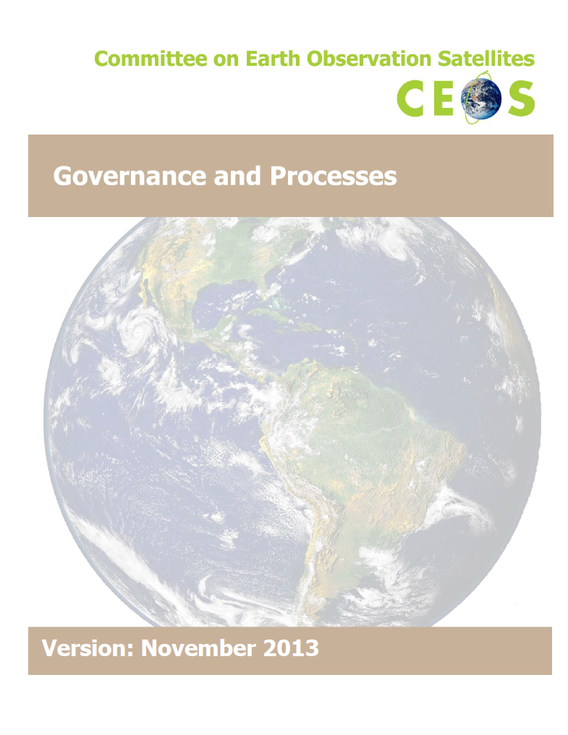

2014 CEOS Priorities and Achievements
Governance: implementation of agreed post-CEOS Self-Study (CSS)
Final output of the CSS is a set of strategic documents that will guide CEOS in the Future
  CEOS Terms of Reference (ToR)
  CEOS Strategic Guidance (SG) (~10-year)
  CEOS Governance and Process (GP) (~5-year)
  Element ToRs for CEOS Chair, SEC, SIT Chair, CEO, SEO
Oversee adherence to agreed criteria for reviewing activities
  Alignment with CEOS strategic goals
  Benefit to internal and/or external stakeholders
  Feasibility and Affordability
Make sure that these criteria are systematically
applied when deciding on new proposed activities

Slide 7
For 2014…
There are 36 Objectives/Deliverables projected to be completed:
  Four (4) Climate Monitoring, Research, and Services (CMRS-X)
  Four (4) Carbon Observations, Including Forested Regions (CARB-X)
  One (1) Observations for Agriculture (AGRI-X)
  Five (5) Observations for Disasters (DIS-X)
  Six (6) Capacity Building, Data Access, Availability and Quality (DATA-X, CV-X)
  Four (4) Advancement of the CEOS Virtual Constellations (VC-X)
  Two (2) Support to Other Key Stakeholder Initiatives (BON-X, POL-X) (No report at SIT Tech Workshop on these two Objectives/Deliverables)
  Five (5) Outreach to Key Stakeholders (OUT-X)(No report on one - Newsletter)
  Five (5) Organizational Issues (ORG-X) (Three are already CLOSED!)
  The intent of this SIT Technical Workshop is to get an updated status on remaining 30 Objectives/Deliverables to confirm CEOS achievement of 2014 Priorities

Slide 8
Translation of Work Plan to Spreadsheet

Slide 11
2013 Actions – Still Hanging Around
2013 Actions that can be mapped to 2014-2016 Objectives/
Deliverables
Therefore, recommend closing these 2013 Actions

Slide 12
2013 Actions – Uh Oh
2013 Actions that have no status and/or no apparent corresponding 2014-2016 Objective/ Deliverable

Slide 13


What’s Ahead for 2015…
Does the fun continue?
Does the cast return for a second run?
…or does the cast run away as fast as they can?
Why is
everyone
running away?
It’s the
2015-2017
Work Plan!!!
WGs, VCs,
ad hoc Teams
CEO

Slide 14
CEOS 2015-2017 Work Plan Timeline
  NOW: “Offending entities” (you know who you are – please refer to slide 12) please provide closure/disposition of 2013 CEOS-GEO Actions.
  Mid-November: begin gathering inputs from WG Chairs, VC Co-Leads, and Ad hoc Team leads to update and identify key objectives and activities for 2015, 2016-2017 with all external stakeholders. Also participate in the GEO-XI Plenary meeting where the CEO will capture GEO’s priorities for the coming three years.
  Early December: CEOS-GEO Coordination meeting will occur where we will discuss both CEOS and GEO priorities and identify synergies where CEOS can support GEO.
  Early January: after the Coordination meeting, prepare a draft Work Plan to reflect inputs from CEOS entities and outcomes from the November GEO Plenary and the December CEOS-GEO Coordination Meeting.
  Mid-January: share the draft Work Plan with the Working Groups, VCs, and Ad hoc teams; receive comments and inputs from entities.
  Late January: Share the draft Work Plan with the CEOS Secretariat.
  Early February: Incorporate and reconcile CEOS SEC comments and share the Work Plan with the CEOS Principals for virtual endorsement IAW Governance and Processes.
  Mid-February: Publish the final version of the CEOS 2015-2017 Work Plan

Slide 15

Merci

