Slide 1
CEOS
Ad Hoc Working Group on GEOGLAM Report – Part 2
Michel Deshayes, GEO
Inbal Becker-Reshef, Alyssa Whitcraft, UMD
SIT Workshop Agenda Item 14
CEOS 3-year Work Plan Thematic Areas
CEOS SIT Technical Workshop
CNES, Montpellier, France
17th-18th September 2014

Slide 2
Outline
Crop Monitor for AMIS
New activities and funded projects
JECAM activities
GEOGLAM website
GEOGLAM Governance :
  Implementation Team
  Steering Committee
Notes:
THE FIRST BULLET COULD JUST BE GEOGLAM ACTIVITIES
WHY IS WMO ACTIVITIES HERE? IN CASE I WOULD PUT THEM SEPARATE AS A MINOR BULLET- BUT SHOULD BE RELEVANT TO GEOGLAM
YOU DON’T MENTION MANY OF THE GEOGLAM SUCCESS AND PROGRESS WITHIN THE PAST YEAR
HOW MUCH TIME DO YOU HAVE? WHEN IS YOUR PRESENTATION.

Slide 3

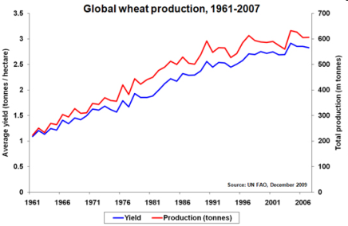
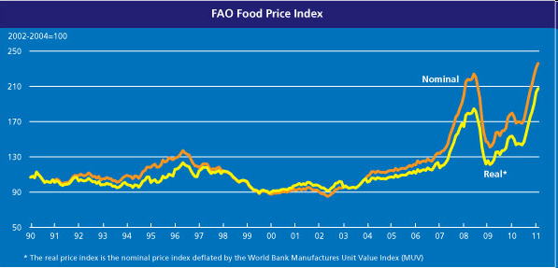
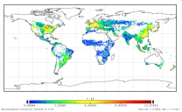











GEOGLAM & AMIS
Two initiatives to increase information availability, quality and transparency :
GEOGLAM : improve information on supply (GEO)
GEO-GLAM
AMIS : improve information on markets (FAO)
Supply
Prices
Demand
Politicies
Finance
Stocks
Trade
UNITED NATIONS
HLTF Food Security
AMIS

Slide 4
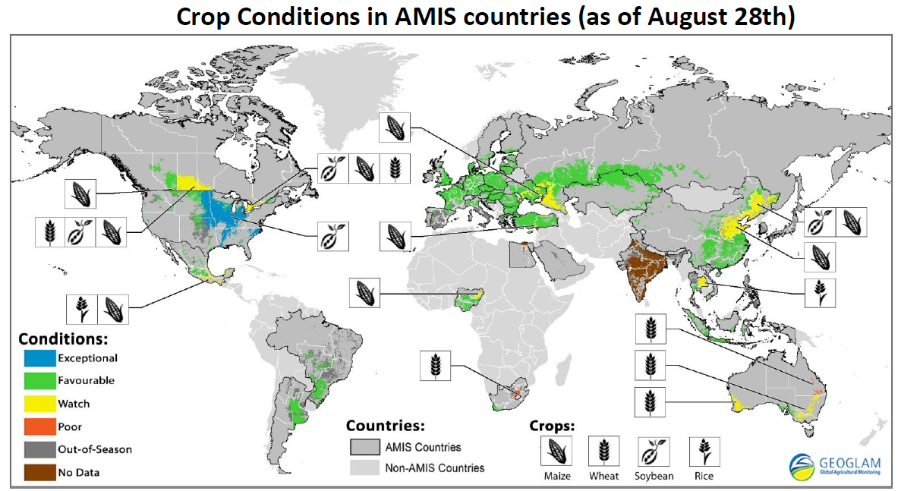
Crop Monitor for AMIS (1/2)
Crop Monitor for AMIS: 1 Year Operational !
From June 2014 : New presentation of results (1/2)
  a. A global map for the 4 AMIS crops (Maize, Wheat, Soybean, rice)
Map of end August 2014

Slide 5
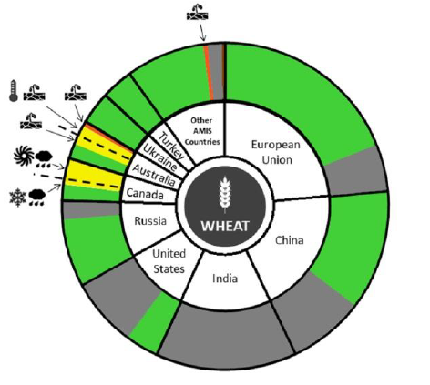
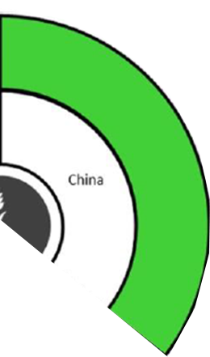
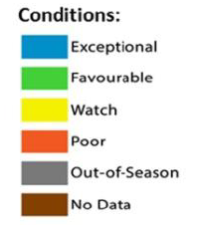
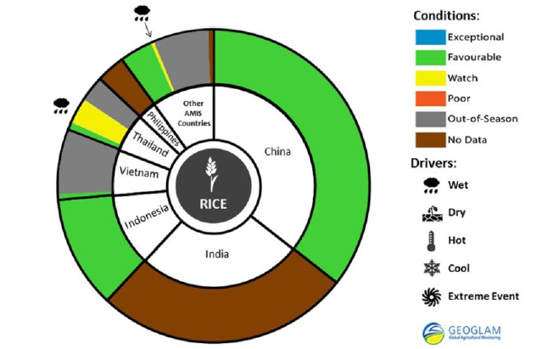
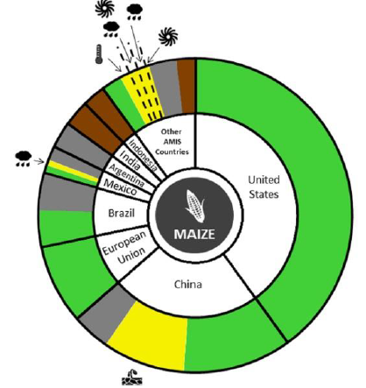
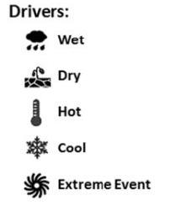
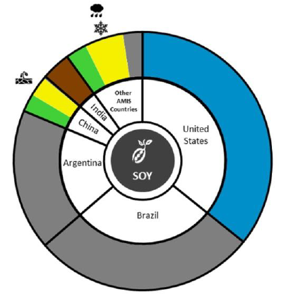
Crop Monitor for AMIS (2/2)
From June 2014 : New presentation of results (2/2)
b. 4 synthetic pie-charts
  sectors proportional to countries average share of world production
  sectors with colors according to local crop conditions
  symbols to explain reasons for bad conditions
Wheat
Rice
28 August 14
Maize
  + Upcoming 1 year Crop Monitor review
  Discussion on expanded partnership with AMIS
  Exploring possibility for Countries at Risk Crop Monitor
Soybean

Slide 6
New activities & Funded Projects (1/3)
Recently Funded Projects:
  Bill & Melinda Gates Foundation STARS – Tanzania, Bangladesh, Mali- contribution to GEOGLAM
  EC SIGMA FP7
  ESA Sentinel-2 for Agriculture
  NASA : funding for UMD coordination of Crop Monitor
  + renewed funding for participation on CEOS Ad Hoc Team
Launch of US-GEOGLAM Office within USDA
Note: Strong CEOS support to GEOGLAM
favors GEOGLAM funding and development
Notes:
DO YOU MENTION ANYTHING ABOUT THE CROP MONITOR PROGRESS AND VERY SUCCESSFUL RELATIONSHIP WITH AMIS? FOOD OUTLOOK FEATURE ARTICLE, ETC.
UPDATE ON SIGMA?

Slide 7
New activities & Funded Projects (2/3)
RAPP – Rangeland and Pasture Productivity Monitoring
  Main / Important food source in large regions of the world
  48% world biomass consumed by grazing animals (Herrero, 2013)
  Action under Australian leadership (CSIRO)
  2nd Workshop held in Paris, 23-24 July –
  Objectives: Develop community, identify pilot areas, identify key EO data sets, discuss interface global pasture monitoring system
  3rd workshop to be held in the next 6 months
Countries at Risk Monitoring
  Ongoing projects : FEWS-NET, GIEWS, JRC-FS, CropWatch-FS
  Initial prototyping by FEWSNET of Crop Monitor for Countries at Risk
  1st meeting: Frascati (Feb.), next meeting: Addis (Oct.)

Slide 8
New activities & Funded Projects (3/3)
Under discussion with WMO :
  A closer cooperation with CAgM (Commission for Agricultural Meteorology),
  at the initiative of its President, Prof. B-L Lee
  June: 1st meeting in GEO Sec. with Prof. Lee (WMO ExCom66)
  November: GAMOS conference, Jeju (Korea), 22-25 Nov
    GAMOS = Global Agro-Meteorological Outlook Service Alliance through S2S-AgModel Linkages
  Terms and deliverables of future collaboration to be discussed
    e.g. WMO S2S: Subseasonal to Seasonal Prediction Project
2nd GEOGLAM Session, American Geophysical Union, San Fco, Dec. 2014
  Talks reflect growing breadth and maturity of GEOGLAM projects – including RAPP

Slide 9
JECAM activities (1/2)
JECAM Meeting, July 20-23, Ottawa
Meeting Objectives:
  Review of JECAM sites progress
  CEOS space agencies and commercial data provider presentation and discussion
  Discussion of current and planned collaborative initiatives to address GEOGLAM research needs
  Review and discussion of Minimum Data Set (MDS) guidelines
  (EO and in-situ)
  Workshop sessions on SAR and sampling frameworks
  Discussion of the way forward and the creation of MDS sites

Slide 10
JECAM activities (2/2)
JECAM Meeting Actions and Outcomes
  Endorse JECAM Minimum Data sets (MDS) guideline documents for EO and in-situ datasets
  Refined data requirements for CEOS
  Work with space agencies to open up data licensing to entire JECAM community to support MDS concept
  Developed working group to develop and implement cross-site SAR experiment
  Reviewed, updated and agreed upon list of JECAM research priorities to support GEOGLAM

Slide 11
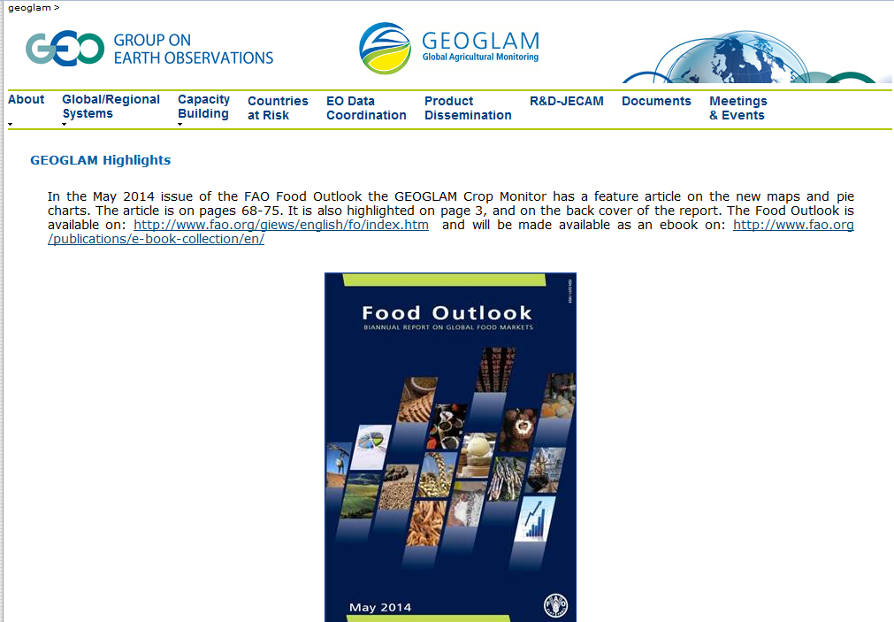
GEOGLAM website
GEOGLAM website online
  http://earthobservations.org/geoglam
  Limits : constrained by WMO rules (html based)
  Project : a new, CMS-based website
    CMS : Content Management System, content // structure
    Possibility of decentralised updating,
  Planned for release before Dec. 2014 (French funding)

Slide 12
GEOGLAM Governance (1/2)
GEOGLAM Governance, with two bodies:
  Implementation Group
  Steering Committee
Implementation Group / Implementation Plan
  Implementation Group set up in July 2014, together with launch of Implementation Plan review
  Group of 14 scientists (from 12 institutes)
  First version of revised IP due for end Sept/early Oct.
  To be further discussed in the Beijing IP meeting, 22-24 Oct. (just before Beijing SIGMA meeting)
Notes:
It is my (AKW) sense that this is a VERY big concern for CEOS… they want to see a clear method of implementing GEOGLAM, and a clear vision for what will happen to GEOGLAM in 2017 in what we have currently (if imprecisely) called the “operational phase.” Emphasize that we are working on this internally within GEOGLAM (e.g. Beijing IP meeting), and that we will draw on experiences learned from GFOI.

Slide 13
GEOGLAM Governance (2/2)
Steering Committee
  Focus is on high level members, with an interest in GG and able to help mobilize funds when a decision is taken
  Preliminary discussion with partners in US, EC, China, Russia
  First list of SC members in GEO Sec.
  Developing Terms of Reference for the SC (see below)
ToR for GEOGLAM governance
  Updating the Terms of Reference for the whole GG governance
  Taking benefit from GFOI experience
  Will be finalised in Beijing IP meeting

