Slide 1
CEOS Information Management
CEOS Work Plan Ref: OUT-3 & OUT-6
Presented by: Kim Holloway
Systems Engineering Office (SEO, NASA)
CEOS SIT Technical Workshop 17-18 September, 2014
Hosted by CNES in Montpellier, France
Agenda Item 18

Slide 2
Information Management
The old CEOS website
The new CEOS website
CEOS & Social Media
The CEOS Database

Slide 3
The Old CEOS Website
6 years old
> 600 visitors/week
LOTS of content
35K visitors in the last year (63% new)
Needs an architectural & aesthetic update
Notes:
CEOS Information Hub
Most of our new visitors come from the U.S. India, France, the UK, Germany, Canada, China, Italy, Japan, and Brazil, respectively.

Slide 4
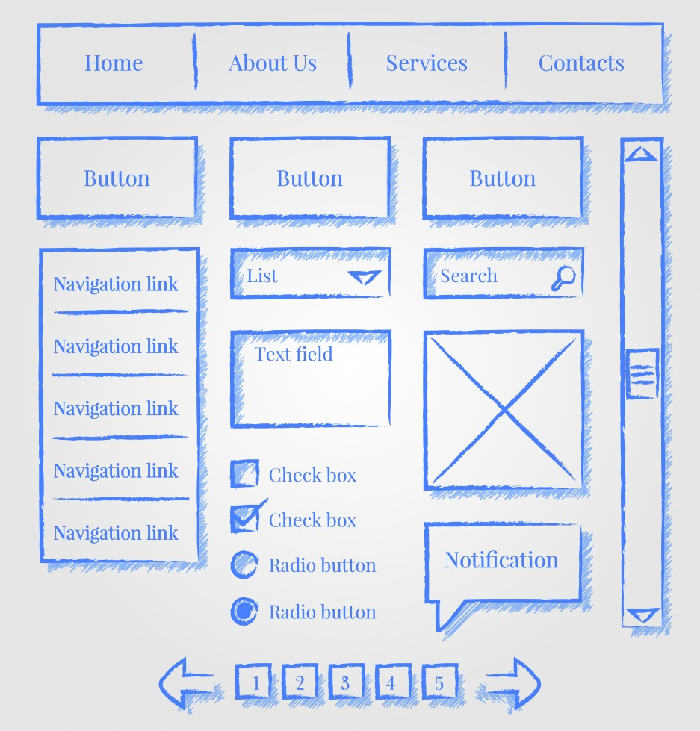
CEOS Website – New
Over the next month:
Implementing new architecture
Finalizing aesthetics
Moving content
Plenary = Showtime
Notes:
Announced at SIT-29 that we’d be redesigning the CEOS Website
Conducted a community survey for opinions/feedback on what you like about the current site and what new features might interest you
Redesigned the underlying architecture and graphics of the site
Solicited biweekly feedback from a group of CEOS volunteers
Over the next month:
Implementing the underlying architecture
Finalizing graphic design elements
Moving content into the new site
By Plenary: reveal a functioning new version of the CEOS website

Slide 5
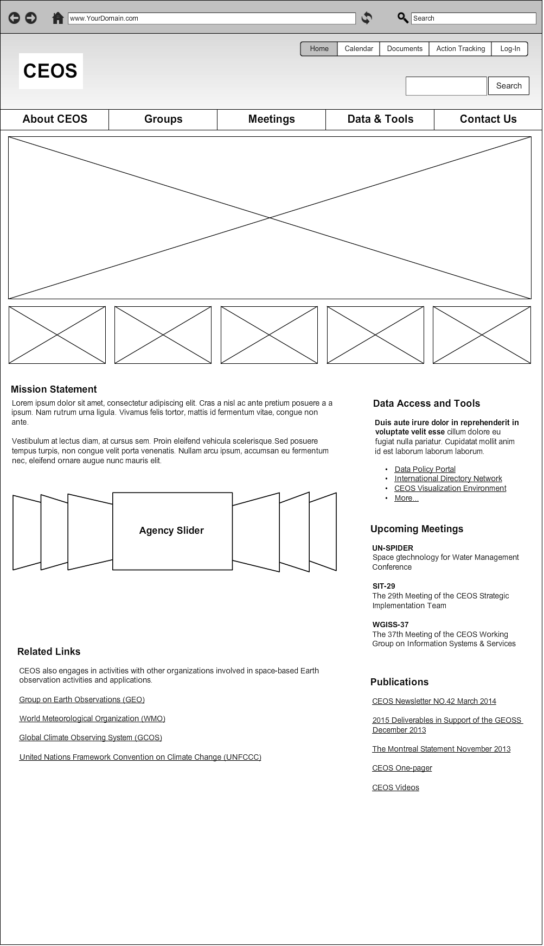
CEOS Website – New

Slide 6
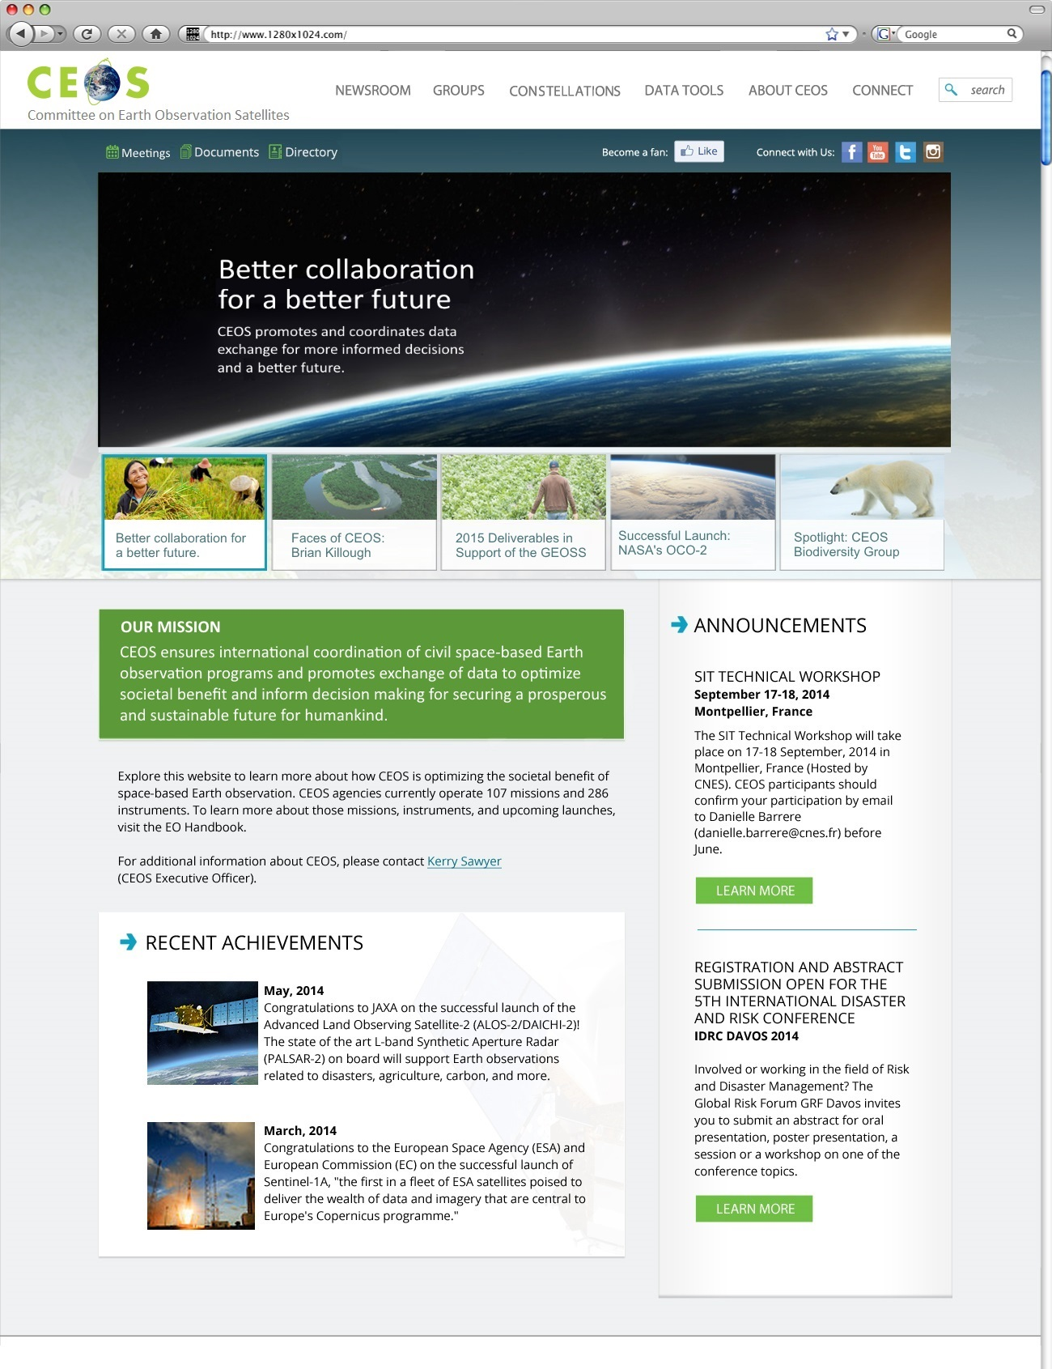
CEOS Website – New

Slide 7
Document Management System
Ideal Capabilities:
Part of the website
Log-in for access
File up/download
Document search
Version tracking
Collaborative editing
Document publication procedure compliance

Slide 8
Action Tracking Tool
Ideal capabilities:
Part of the website
Full table or single action view
Historic action archive
Keyword search & column sort
CEOS Work Plan Objective/Deliverable details
Live POC status reporting/editing

Slide 9
Meeting Registration
Ideal capabilities:
Part of the website
SEO creates the page & announces the meeting
Information sent directly to meeting facilitators
Major internal CEOS meetings only

Slide 10
Social Media
What’s the Point?
Social media is where the world discovers that CEOS is the world’s thought leader in satellite Earth observations.
Notes:
Social media:
online content created by people
uses technology to fuse sociology and technology
shifts away from traditional one-way communication
shifts toward two-way communication: dialogue
changes how people discover, read, collaborate and publish news and information
reduces barriers and allows people to connect and form relationships for personal, political, and business use
get our information out there and interact with, listen to, and engage the public, our colleagues, our stakeholders, and even our future partners and member Agencies.
Social media is where the world discovers that CEOS is the world’s thought leader in satellite Earth observations.
https://cent.blob.core.windows.net/exhibitions/pdfs/ngotips.pdf?sfvrsn=2

Slide 11
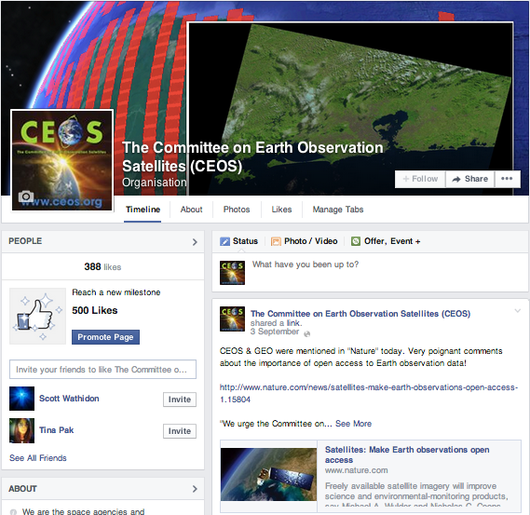
Social Media
1.3 billion people use Facebook…
394 “Likes” on our Facebook page.
We are also on Twitter & LinkedIn.
facebook.com/socialceos

Slide 12
Social Media
We can do better…
news
photos
humor
publications
articles
links
questions
Become a contributor!
ideas
recent achievements
Notes:
The website and social media are a concerted effort. Send me your:

Slide 13
CEOS Database Status
2014 Update Survey
Responses received from 27 CEOS agencies (no response from 5)
23 new mission records added, 117 existing records updated
44 new instrument records added, 156 existing records updated
Currently features operating or planned for launch in the next 15 years:
267 Earth observing satellite missions
784 instruments
Thanks to all agencies for their ongoing support to the annual updates

Slide 14
CEOS Database Status
2014 Enhancements
Thematic connections and reference to GCOS-related content
GCOS ECVs, Actions
CEOS response to GCOS
ECV Inventory (good cooperation with SEO, in response to CEOS 2014-2016 WP, action OUT-5)
Links through to related CEOS DB mission / instrument content
Additional coordination and cooperation with WMO/OSCAR team on ensuring consistency and optimising mission information sharing, to improve the quality of information provided to user community
Minor improvements and fixes to the website
Added search parameters to mission / instrument tables

Slide 15
CEOS Database Status
2014 Release and 2015 Activities
The updated database and website will be released in October prior to Plenary
Planning underway for a print handbook focused on WCDRR, to be released in March 2015
Focused on disasters without the full mission / instrument tables
The regular database survey cycle is planned starting in April-May 2015

Slide 16
The End
Thank You!

