Slide 1
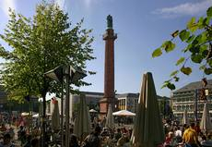
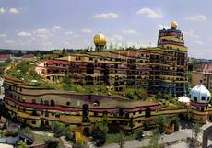
SIT CEOS Technical Workshop - Eumetsat, Darmstadt, Germany - 17th, 18th September, 2015
Welcome to the CEOS SIT Technical Workshop in Darmstadt
For any information, please ask
Sylwia Miechurska - +49 160 747 36 90
Many thanks to Alain RATIER, Paul COUNET for welcoming the CEOS SIT Technical Workshop and the EUMETSAT team, Sylwia, Carina and Rowanna, Sergio, Jan and Walter for their support.
The wifi password is only available for one equipment (computer, phone,…).
Please, switch off your microphone if not used.
Please, if not already done, give your presentation material
to Mireille.

Slide 2
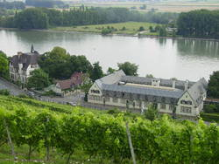
17th September
10.45 - 11.15 Group photo and coffee break (Atrium)
12.35 - 13.35 Lunch buffet (near the Council room,
hosted by Eumetsat)
15.10 - 15.25 Coffee break (near the Council room)
17.00 End of the meeting
17.30 - 21.30 Bus departure at the main entrance of Eumetsat
for the Louis Guntrum vineyard visit and dinner
18th September
9.00 Beginning of session 3
10.30 - 10.45 Coffee break (near the Council room)
12.00 - 13.00 Lunch/buffet (specific area near the Council room,
hosted by Eumetsat)
15.00 End of the workshop

