Slide 1
Committee on Earth Observation Satellites
Working Group on Capacity Building and Data Democracy
Eric C. Wood, USGS
Jane Olwoch, SANSA
SIT Workshop Agenda Item #7
CEOS Action / Work Plan Reference
CEOS SIT Technical Workshop
EUMETSAT, Darmstadt, Germany
17th – 18th September 2015

Slide 2
Outstanding SIT Actions
In most cases when space agencies and programmes are started, there are high expectations from governments to the local staff, but without adequate capacity, experience or local preparedness in terms of adequate technology for data acquisition, processing and dissemination; something that already exist in most CEOS agencies.
This proposal requests that CEOS consider becoming more active in the role of providing advice and giving support to emerging space agencies.

Slide 3
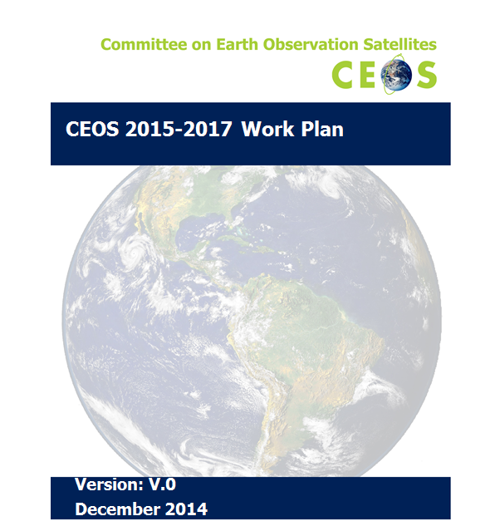
CEOS 2015-2017 Work Plan

Slide 4
WGCapD Summary of Activities 2015-2017
Activity | Progress/Status | Future Activity
CB-1: Conduct a series of Digital Elevation Model (DEM) regional workshops | First workshop completed (March 2015). Second completed (May 2015) (Q2 2016) | Workshops in Asia and W. Africa to follow

Slide 5
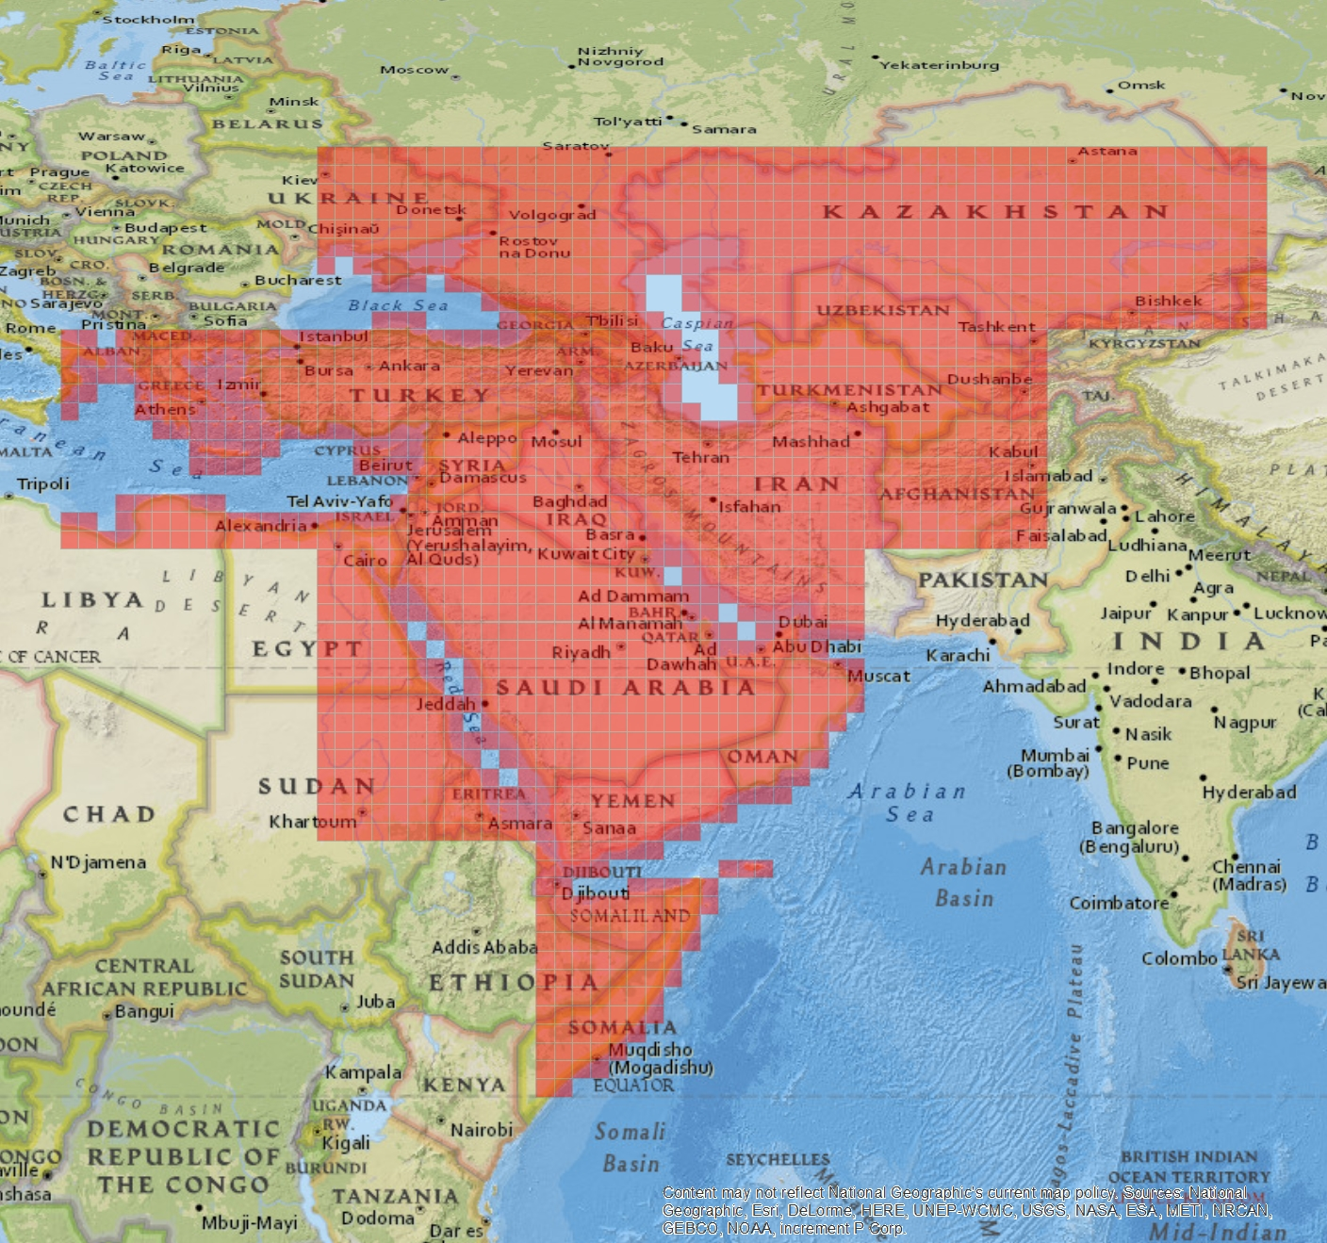
Final SRTM Data Release
4TH and final release of NGA’s 30m SRTM elevation data
“Middle East”

Slide 6
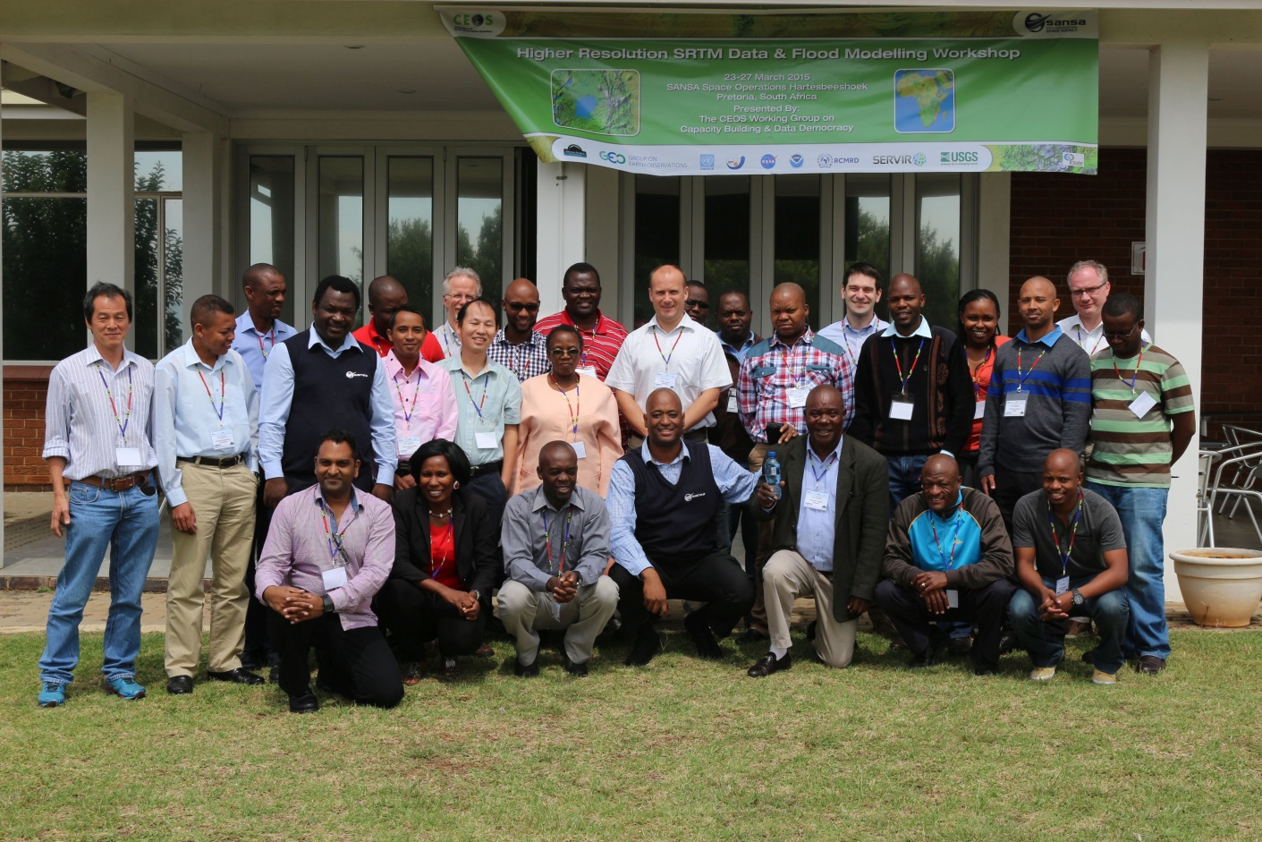
SRTM Workshop , Pretoria, South Africa
23 -27 March, 2015
22 participants,
18 from outside South Africa.
Sponsors are SWF, GEO Secretariat, and UNOOSA
Thanks to Patrick O’Brien (NOAA), Phila Sibandze (SANSA), and the CEOS Team

Slide 7
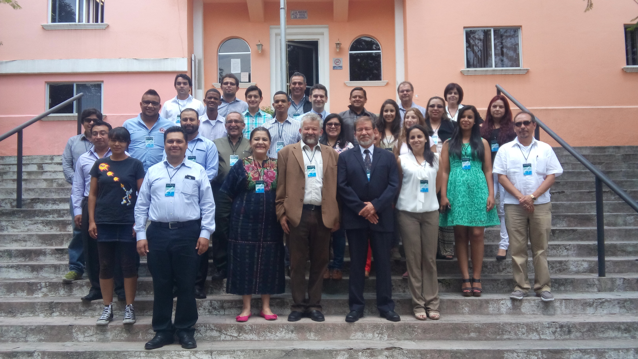
SRTM Workshop , Puebla, Mexico
25 -29 May, 2015
Attended by 27 participants from 11 countries in Latin America
Sponsors are MCTP, SWF, GEO Secretariat, CRECTEALC, and INAOE

Slide 8
CEOS WGCapD SRTM-2 Workshops
 | Host
Date | Institution | Location
March 23-27, 2015 | SANSA | Pretoria, South Africa
May 25-29, 2015 | CRECTEALC | Puebla, Mexico
Spring, 2016 | ICIMOD/SERVIR (??) | Kathmandu, Nepal
TBD, 2016 | TBD (AGEOS, Gabon??) | West Africa

Slide 9
WGCapD Summary of Activities 2015-2017
Activity | Progress/Status | Future Activity
CB-2: Provide practical EO education for students and teachers | CEOS WGCapD endorses but does not support K-12 EO education activities (Q4 2017) | Proposal between SANSA, DLR, ESA to combine forces in future is being discussed.

Slide 10
WGCapD Summary of Activities 2015-2017
Activity | Progress/Status | Future Activity
CB-3: Develop a long term Capacity Building Strategy | First discussions were during undertaken at the Group Annual Meeting #4 in Pretoria. | To be presented prior to SIT 31
(Q4 2015)

Slide 11
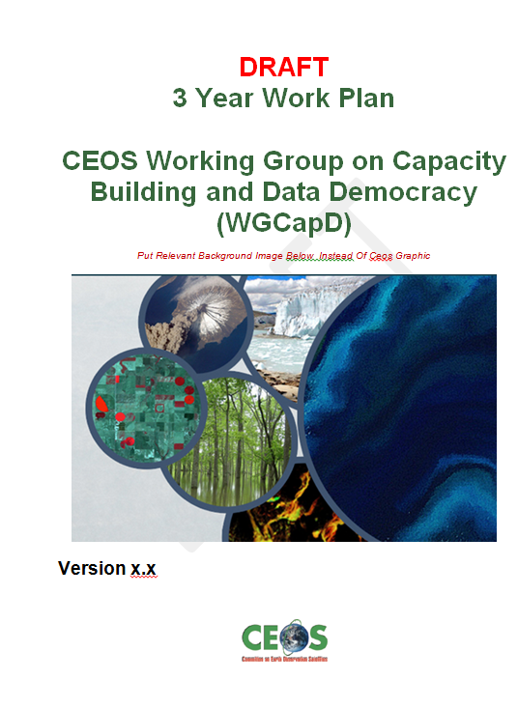

Slide 12
WGCapD Draft 3 Year Workplan Planned Outcomes
Increase access to data, products, and tools and ability to use them;
Build awareness of new missions and datasets, and how to use the latter within the context of existing datasets;
Increase the capacity of the WGs/VCs to provide their own capacity building (vs CapD doing it for them); and
Improve communications and coordination between Agency and WG/VC/CapD capacity building and education activities as well as related international activities

Slide 13
WGCapD Summary of Activities 2015-2017
Activity | Progress/Status | Future Activity
CB-4: Collaborate with GEO in the development and implementation of the GEOCAB Portal | CEOS Capacity Activities have been added. Established. (Q4 2017) | Sustainability of the Portal still not defined but there are internal discussions in WGCapD and GEO.

Slide 14
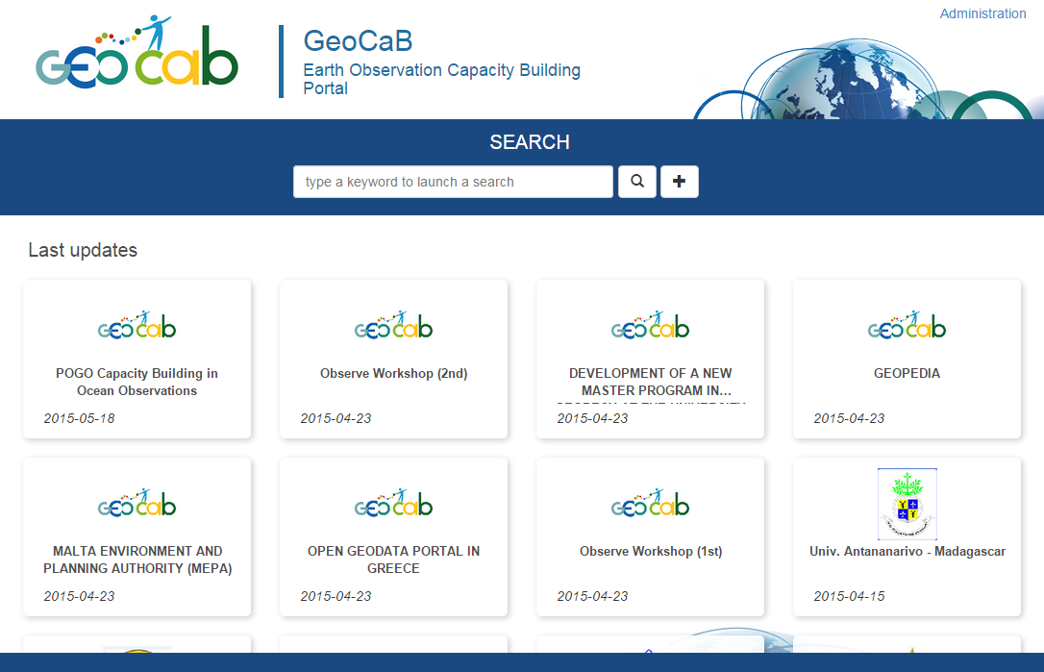
GEOCAB Portal

Slide 15
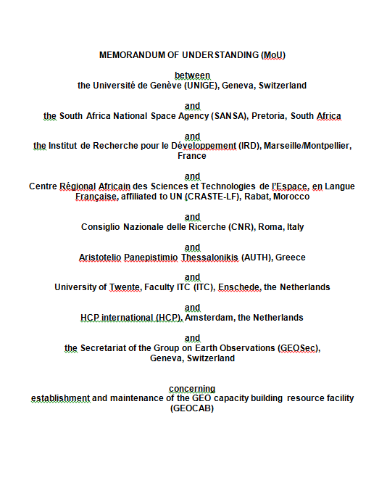
GEOCAB MOU
“It is further recalled that the international Committee on Earth Observation Satellites, CEOS, has expressed its formal support for this initiative and will engage space agencies to participate.”
“The intent of this agreement is to provide a mechanism for UNIGE, SANSA, IRD, CRASTE-LF, CNR, AUTH, ITC, HCP, CEOS WGCapD and GEOSec to more easily work together in mutually progressive and supportive activities which do not compromise either party or their relations with other parties not named in this agreement.”

Slide 16
WGCapD Summary of Activities 2015-2017
Activity | Progress/Status | Future Activity
CB-5: Implement the TanDEM-X Edu Project | Not started due to unavailability of Data | DLR /SANSA are still interested but need to wait until the required data is processed to be utilized for CB activities
(Q3 2016)

Slide 17
WGCapD Summary of Activities 2015-2017
Activity | Progress/Status | Future Activity
CB-6: Capacity Building for Disaster Management - Pilot Course | INPE and ISRO in charge Webinar Series: from 7 April to 26 May | There is already an announcement on CEOS Website
(Q4 2015)

Slide 18
WGCapD & WGDisasters Distance Education Course
Webinar Series on Remote Sensing Technology for Disaster Management
(INPE and ISRO)
http://ceos.org/meetings/wgcapd-distance-education-2015/
Comprehensive series of 8 introductory webinars that address the use of remote sensing technology for DM.
What makes this course unique?
Offered free of charge
Provides access to expertise from space agencies around the world
Links participants to a global network of experts and policymakers
Creates awareness about CEOS and the International Charter for Space and Major Disasters
Provides access to datasets and useful tools available from CEOS Members
Builds skills on Disaster Management (DM)

Slide 19
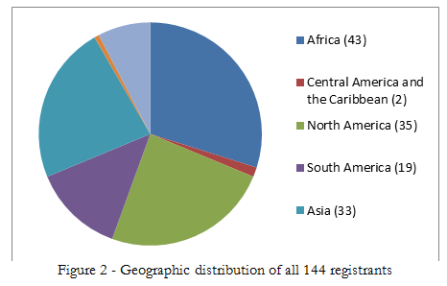
Developing an Online Approach to Capacity Building
Webinar Course Development - 2015

Slide 20
WGCapD Summary of Activities 2015-2017
Activity | Progress/Status | Future Activity
CB-7: Release of web-based newsletters and other outreach materials | Not yet started | WGCapD will significantly increase its communication through key channels such as its newsletter and list-serves, including promotion of appropriate material and activity of other CEOS Entities.
(Q4 2017)

Slide 21
WGCapD Summary of Activities 2015-2017
8
Activity | Progress/Status | Future Activity
CB-8: Web based archiving and distribution of CEOS EO webinars | Not yet started | A series of webinars will be developed, drawing on presentations and materials already under development by other CEOS Entities. These webinars will be made easily available through the CEOS website
(Q4 2017)

Slide 22
WGCapD Summary of Activities 2015-2017
Activity | Progress/Status | Future Activity
CB-9: Strengthening AfriGEOSS | Communicating with GEO and ID-02. | Work with GEO to determine the capacity building activities necessary to strengthen AfriGEOSS, as well as, assist in establishing the capacity building component of AfriGEOSS itself.
(Q4 2017)

Slide 23
New Activities
Highlight CEOS:
CEOS Exhibit at GEO Plenary / Ministerial
ESA/DLR webinar series on European SB EO (proposed)
Support VC WG
e.g., LSI, SEO and other ARD/data cube partners
Collaborate with other CB activities/practitioners
CSA, Civil Security: Understanding the Risks, Preventing Disasters, and Mitigating the Impacts with Earth Observation
CRETEALC , VLAB, ESA, VCs
Data Democracy;
AfriGEOSS, AmeriGEOSS
Directed webinar series

Slide 24
GEO XII Plenary / GEO Ministerial
Mexico City, Nov 9 – 13, 2015
Assisting SEO with CEOS Exhibition Booth
Focus #1: Missions launched by CEOS since the last GEO Ministerial Summit (January 17, 2014)
Focus #2: New datasets released by CEOS
Focus #3: Major contributions from CEOS to GEO (support of GEO flagships and SBAs)
Themes: limate change, disaster response, deforestation, and food security
Represent CEOS, USGEO and USGS at the AmeriGEOSS and AfriGEOSS Side meetings

Slide 25
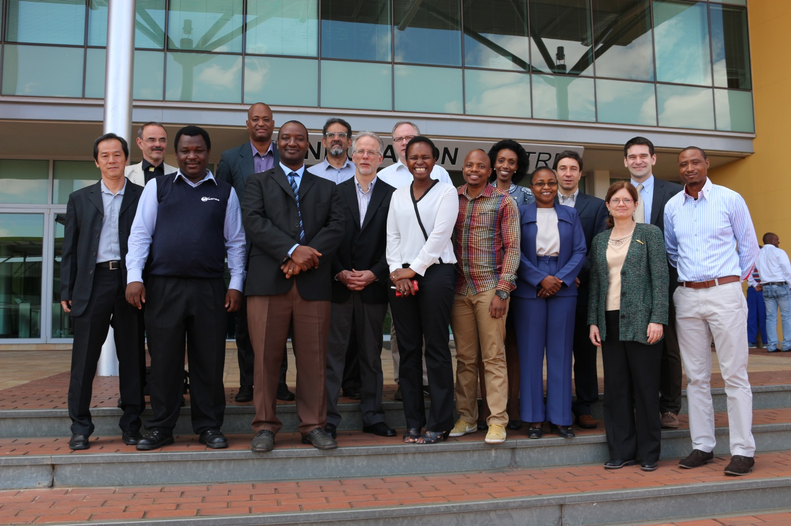
4th WGCapD Annual Meeting , Pretoria 18-20 March, 2015
Present DLR, NASA, ESA, USGS, INPE, NOAA, UNOOSA, RCMRD, and SANSA.
ISRO, GEO, VLab (WMO-CGMS), SWF, NASA-SEO, NOAA, CRECTEALC (Mexico) and IRD attended virtually
Next meeting:
NASA Langley, Virginia, US
(tentative)

Slide 26
WGCapD Leadership 2016-2017
Eric Wood (USGS) will complete his tenure as WGCapD Chair at the 29th CEOS Plenary
Jane Olwoch (SANSA), present Vice Chair, will assume the
role of Chair at that time
Senthil Kumar (ISRO/IIRS) is being proposed as the next Vice Chair.

Slide 27
Thank you
Eric Wood
Chair
Jane Olwoch
Vice Chair

