Slide 1
CEOS Ad Hoc WG on GEOGLAM
Committee on Earth Observation Satellites
Selma Cherchali, CNES
Brad Doorn, NASA
SIT Tech Workshop 2016 Agenda Item #15
CEOS Strategic Implementation Team Tech Workshop
Oxford, UK
14th-15th September 2016
Notes:
Edit

Slide 2
Status of GEO Coordination
SBA = “Food Security and Sustainable Development”
GI-01: GEOGLAM-Global Agricultural Monitoring and Early Warning
GEOGLAM Secretariat is composed of 1 full time + 2 part-time individuals
GEO Lead on Agriculture SBA / GEOGLAM Program Coordinator
Brazilian (INPE) and now French (MinAg) contribution – 2011-Present, on a full-time basis
Program Scientist/Crop Monitors Coordinator
US (NASA) contribution – 2015-Present, on a part-time basis
Program Scientist/EO Data Coordination Lead [Alyssa Whitcraft]
US (NASA) contribution – 2015-Present, on a part-time basis
Active on CEOS Ad Hoc WG
Participates in LSI-VC to help coordinate around agricultural requirements
Efforts to connect with CEOS WGCapD
GEOGLAM Secretariat is still below “critical mass” – working on concept paper with specific requests and necessary budget
Notes:
Overview of GI-01
The task comprises 7 components:
Monthly production of a Global Crop Monitor bulletin (for wheat, maize, rice and soya) and delivery to AMIS Secretariat (Agricultural Market Information System);
Development of a Global Rangelands and Grasslands Monitoring System (RAPP, Rangeland and Pasture Productivity)
Development of an Crop Monitor for Early Warning in charge of monitoring crops in countries subject to periodic food security crises
Coordination of Capacity Building activities to enable new countries to develop EO-based crop monitoring activities
Coordination of the international Joint Experiment for Crop Assessment & Monitoring (JECAM), to coordinate R&D activities to improve crop monitoring methods
Keeping close links with Committee of Earth Observations Satellite (CEOS) to maintain an efficient access to EO imageries
Ensure delivery of EO-based information for agricultural monitoring in developing countries through the GeoNetCast network
Activities for 2016
The plans for 2016 and onwards include dedicated additional efforts addressing components 2, 3 and 4, namely:
The RAPP (Rangeland and Pasture Productivity) Activity, through accurate forecasts of pasture and rangelands productivity and variability, aims at an improved global understanding of risk across all pastoral landscapes as impacted by climate and land use change.
The Early Warning Crop Monitor (EWCM) intends to coordinate an open, timely and accurate monitoring of agricultural production in chronically food deficit countries to better anticipate food crises (users: FAO, WFP, UN-HLTF, aid agencies…)
Capacity Building activities in new countries will allow these countries to benefit from EO-based information to better monitor their agricultural production, and therefore make better decisions in their agricultural planning.

Slide 3
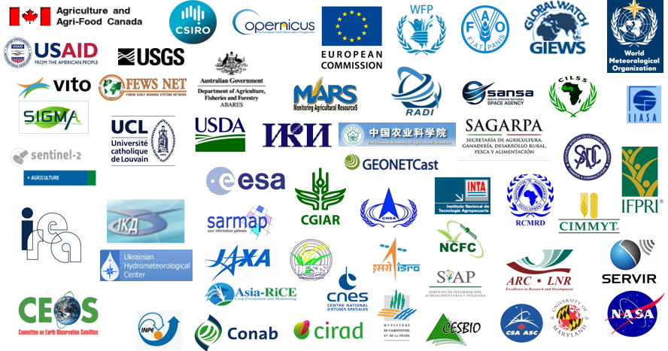
Users of EO Data Coordinated and Derived Information
Primary Users of EO Data | Secondary Users of Derived Information
GEOGLAM Community of Practice Crop Monitor participants (countries & major early warning entities (e.g. WFP, FAO GIEWS, USAID FEWS NET, JRC MARS)) National Monitoring Agencies | Agricultural Market Information System (AMIS) Food policy and food aid agencies National Ministries of Agriculture Commodities marketeers

Slide 4
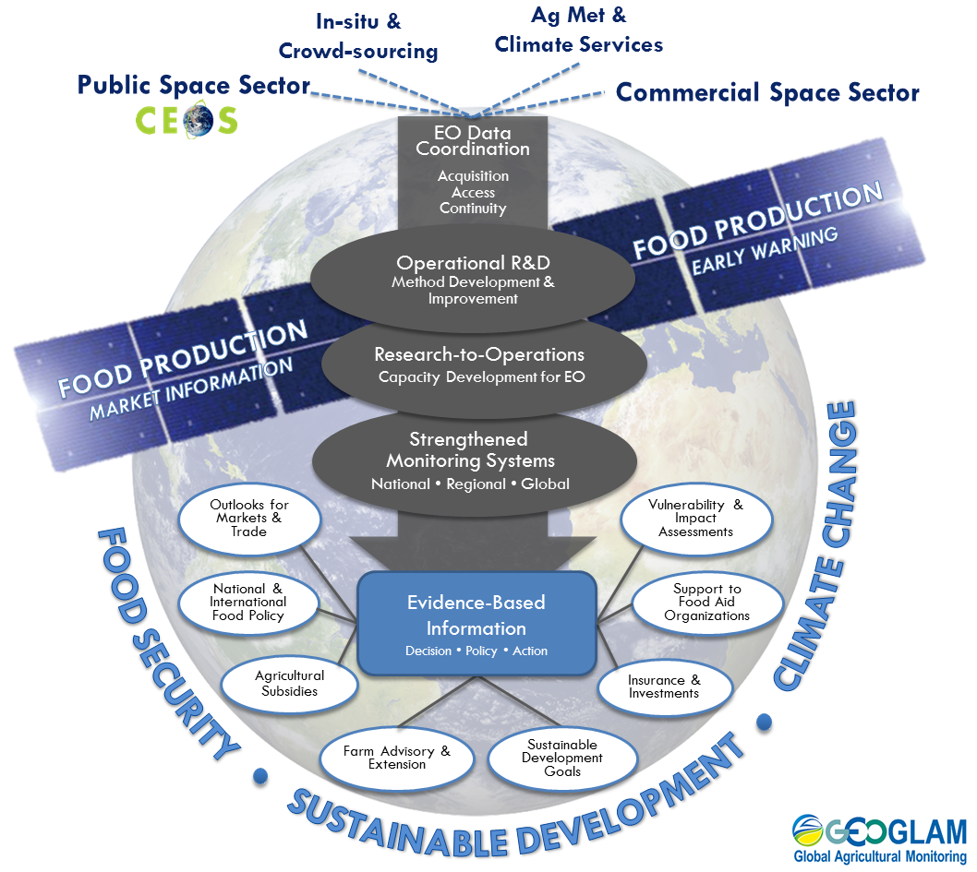
New, Draft
Organizational
Framework for
GEOGLAM
Notes:
New “workflow” of GEOGLAM - GEOGLAM’s over-arching goal is to enhance the international community’s capacity to lever Earth observations to produce and disseminate timely, accurate, reliable, and actionable information on food production for both stabilizing markets and providing early warnings of food shortages. GEOGLAM’s structure follows a logical flow from coordinated, continuous acquisition of and access to multi-source Earth observation data, through the development and technology transfer of best-practices for monitoring to operational monitoring systems, with the end goal being strengthened national, regional, and global agricultural monitoring systems. GEOGLAM thus fosters and sustains a “System of Systems” that provides evidence-based information to facilitate and inform decisions, investments, actions, and policy in the realms of food security, agricultural markets, and within the broader context of climate change and sustainable development.

Slide 5
Main GEOGLAM News
(Q2/Q3 2017)
G20 Ag Ministers Communique
GEOGLAM’s important contribution to AMIS acknowledged via unanimous vote for GEOGLAM by AMIS Steering Committee & Secretariat
2nd Advisory Committee Meeting – June 2016
Relevant to CEOS: data coordination at core (CEOS data as key input, among others) – reflected in new framework [previous slide]
Notes:
- This is from the G20 ag ministers… the final G20 language is pending the November meeting.

Slide 6
Main GEOGLAM News (2/3)
(Q2/Q3 2017)
Interaction with LSI-VC – application of GEOGLAM’s EO Data Requirements Development and Evaluation Framework for other land applications
Our 4th international Rangeland and Pasture Productivity (RAPP) workshop took place in South Africa (city of Tshwane, Pretoria), late June 2016.
GEOGLAM Latinoamérica: training event in June 2016 in Bogota spurring interest for new usership of EO for agricultural monitoring
GEOGLAM launching “AfriGLAM”
Discussions with CEOS WG CapD
Proposed meeting between CEOS WG CapD/GEOGLAM at CEOS Plenary in Brisbane
Capacity Development – e.g. South Africa “AfriFarms”

Slide 7
Main GEOGLAM News (3/3)
(Q2/Q3 2017)
CNES supports Asia-RiCE activities in GEOGLAM (Thuy LeToan, CESBIO)
Securing EO observations and data access (Sentinels, ALOS, SPOT, Pléiades, VENUS)
Coordinating experiments across sites (SAR and optical EO for rice monitoring and yield estimation)
Coordinating in-situ data collection and for cross validation
Capacity building on the effective use of SAR data through training and joint workshop
Contribution to the workshop/meeting in Ho Chi Minh 17-19 Oct 2016 .
Helping establish JECAM site (s) for Asia-RiCE
JAXA proposes to set up the super site in Mekong delta for Asia-RiCE, in cooperation with CNES, VNSC, and other partners and the site should also be a JECAM site

Slide 8
Key Priorities for 2016-17 (1/3)
Upcoming “reboot” of GEOGLAM EO Data Requirements
Refining the table to account for evolution of “best practices” and new data streams; RAPP data requirements;
Incorporating in situ and agro-met with space-based EO req’s toward “Methods & Guidance” type documentation for GEOGLAM
Including community effort to define “analysis ready data” for agricultural monitoring applications
Beginning at JECAM meeting (Kiev, Oct 2016), culminating in Q2 2017 session (TBC: ESRIN, May 2017)
Starting after Q2 2017 meeting, CEOS Ad Hoc WG on GEOGLAM and LSI-VC to participate in the re-evaluation of GEOGLAM EO data requirements, including RAPP requirements. CEOS to review the outcomes at the next Plenary (2017).

Slide 9
Key Priorities for 2016-17 (2/3)
First prototype of Data Cube in progress for GEOGLAM RAPP
Continued effort needed around issues of accessing and implementing EO data
and expanding usership of EO data
GEOGLAM to continue working with LSI-VC & CEOS SEO on data dissemination and access issues relevant to agricultural monitoring
Action: Continued support from CEOS for these efforts – especially the prototyping of a Data Cube for agricultural monitoring.

Slide 10
Key Priorities for 2016-17 (3/3)
Commercial engagement – also a priority from the GEOGLAM AC
Three basic types of private/commercial entities for GEOGLAM:
Data providers
IT/computational industry
agricultural industry “value-added”
Action: CEOS and GEOGLAM to begin a discussion on guiding principles for engaging the commercial space sector, including a value proposition for each entity involved.
CEOS engagement
points of entry

Slide 11
Backup materials

Slide 12
How can CEOS help?
FROM CEOS SIT-31
Establish mechanisms and processes for meeting GEOGLAM requirements:
Facilitating GEOGLAM access to SAR, duty-cycle limited, or restricted datasets
Continued user demand for free & open datasets
Pre-processing into analysis-ready data products (example of S2 and S1 data)
Developing data services solutions to efficiently distribute and manage data, such as SDMS and Data Cube solutions
Increase EO data utilization by non-traditional users, especially in countries with poor internet connection, computational power, EO-utilization
WG CapD training and capacity development with GEOGLAM
Consider Data Cube options, further develop “analysis ready data” framework
Facilitate access to data in support of generating improved baseline datasets (crop masks and crop calendars)
Increasing COVE tool archive links to support archive analyses
Establishing mechanism to secure data for 3-5 year updates
Engage GEOGLAM in mission planning stages
In Progress
AGU Session w/
WG CapD
Participation
Pending Data Request Submissions from
GEOGLAM
Ongoing Request

Slide 13
Usership Characteristics & Requirements for Data Cube & CARD4L
Usership
Characteristics
Requirements for
Effective Use of EO
Already using EO
4. Easy-to-implement tools
3. Access & Connectivity
2. Analysis-Ready Data
Higher Capacity
More Access
Developed IT
1. Data management
Lower Capacity
Less Access
Under-developed IT
New EO Users
Notes:
[access in this diagram means internet connectivity and/or issues just discovering/accessing the data]
Although users can find themselves anywhere along these three characteristic continuums…
Lower capacity users typically also have less access to the data and less developed IT infrastructure
Higher capacity users typically also have better access to the data and more developed IT infrastructure
And, the lower the capacity/access/IT, the more requirements they have in order to be able to effectively use EO (the blue figure is a bit like a tiered Venn diagram)
A country with little IT infrastructure and bad connectivity will need help with items 1-3, and possibly also 4
A country with good capacity and good access may not have great IT infrastructure – and could really use help with 1 & 2
A country, for example Canada, that is on the cutting edge of using remote sensing EO for agriculture, has great access, and has really good IT still needs help with data management (only 1 requirement) – they have requested a Data Cube of their own!

