Slide 1

Water Constellation Feasibility Study
Committee on Earth Observation Satellites
JAXA
SIT Tech Workshop 2016 Agenda Item #17
CEOS Sstrategic Implementation Team Tech Workshop
Oxford, UK
14th-15th September 2016

Slide 2




GEOSS Water Strategy
and CEOS Water Strategy
The GEOSS Water Strategy renews the observational component of the community’s efforts to communicate the needs of the Water community within the framework of GEOSS.
CEOS Water Strategy Implementation Study Team (WSIST) prepared the CEOS Water Strategy to the GEOSS Water strategy recomendations.
CEOS Plenary 2016, Kyoto, decided on extention of WSIST for one year to implement the CEOS Water Strategy actions including the water constellation FS.
IGOS Water
Theme report
April 2004
GEOSS 10 Year
Implementation Plan
February 2005
GEOSS Water
Strategy
January 2014
CEOS Water
Strategy
October 2015
Notes:
Slide page 2 shows how GEOSS Water Strategy evolved from IGOS Water Theme to GEOSS 10 year IP and then GEOSS Water Strategy for more than 10 years with a single goal of realizing global water cycle observing system.

Slide 3
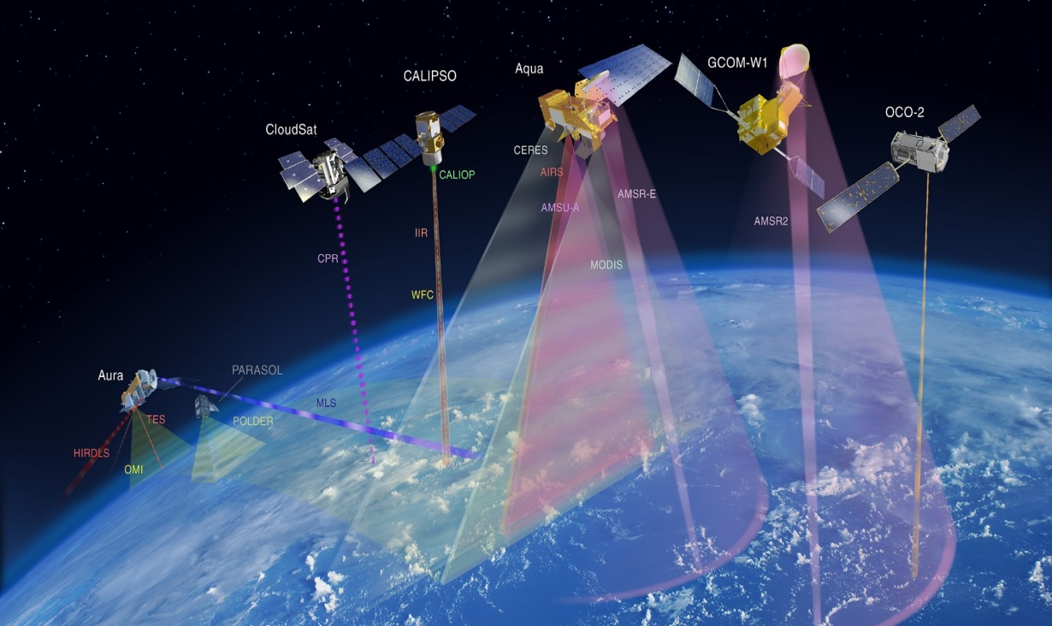
Water Constellation FS
GEO Water Strategy Recommendation C1:
The feasibility of developing a Water-Train satellite constellation should be assessed. This suite of satellites would be modelled after the A-Train, providing a space segment of an observation system that would capture all fluxes and stores of the water cycle using a diverse suite of platforms and instruments. This system would operate as a Virtual Water Cycle Constellation.
The A-Train
Notes:
Page 7 GEOSS Water Strategy recommendations are quire articulate as to how FS can be made.
This is the study on feasibility of developing a Water-Train satellite constellation. It should modeled after A-Train. It provides satellite observation system to capture all flexes and stores of water cycle using diverse suite of platforms and instruments. It would operate as a Virtual Water Constellation.

Slide 4
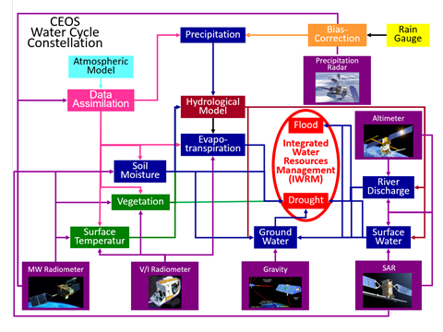
Integrated Water Observation System
Courtesy:
Prof. Koike
Notes:
Page 15 is Prof. Koike’s integrated water observation system diagram.
Land Assimilation Model combines all the parameter data.
Prof. Koike considers the benefits of integrated observation system can be demonstrated for flood and drought prediction.

Slide 5
Requirements
Most recent user requirements “US-09-01a: Critical Earth Observations
Priorities-Water Societal Benefit Area” were reviewed.
In addition, GCOS-ECV requirements and WMO Statement of Guidance
(SOG) were reviewed.
Table 1.1. GEO Water SBA requirements for precipitation

Slide 6
Gap Analysis –
MWI Mission Timeline

Slide 7
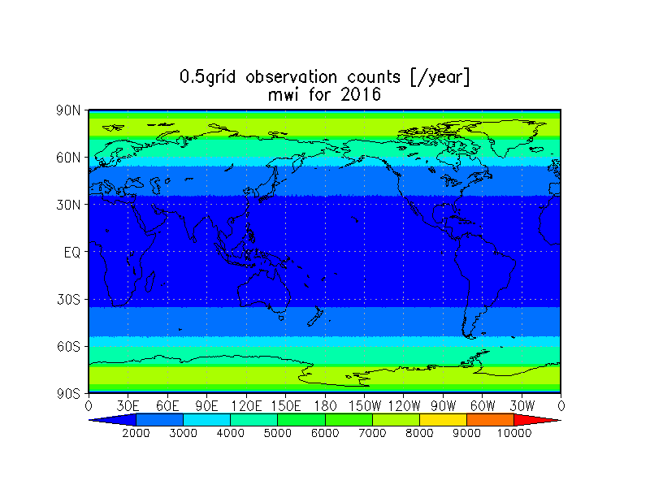
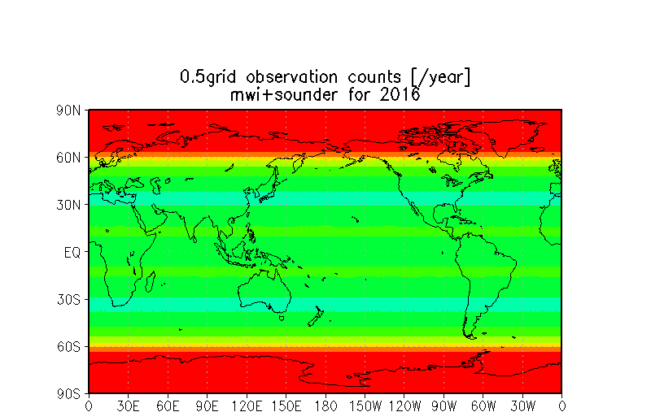
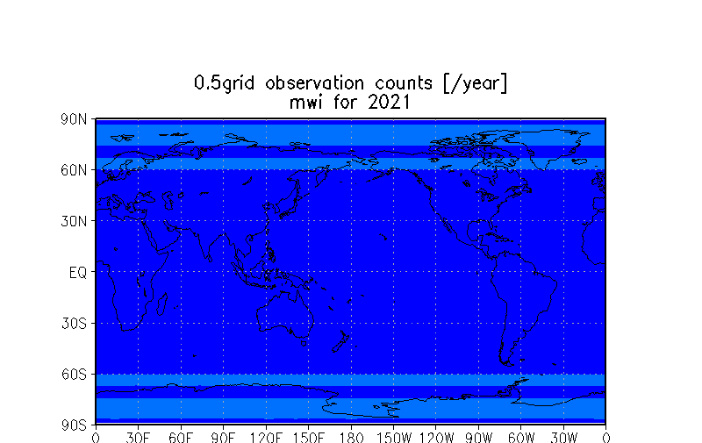
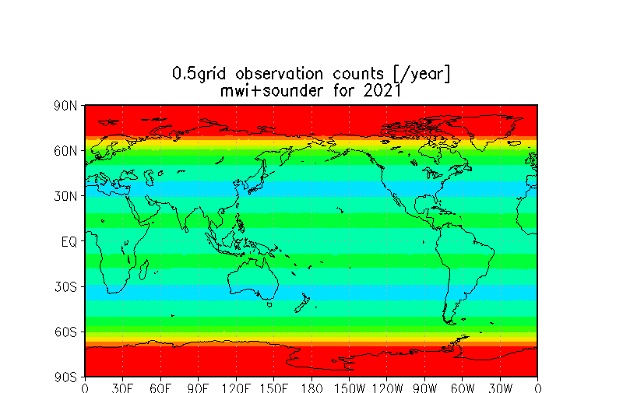
Sampling Analysis
Figure 3.1.2 Precipitation observation sampling analysis in 2016 and 2021.

Slide 8
Synergies among Variables
Precipitation (P)
  Very closely connected with soil moisture and evapotranspiration (ET)
  provides input to river discharge(RD), surface water storage(ST) and groundwater (GW)
Soil moisture (SM)
  Observation at 6 AM is ideal because of low land surface temperature
  37GHz MW data is critical to retrieve soil moisture from L/C/X band data
Evapotranspiration (ET)
  Indirectly observed by soil moisture and land surface temperature
  Pairs of cloud-free land surface temperature images are required
River discharge (RD)
  SWOT has a potential to provide river water level at major rivers
  Optical sensor and SARs are useful for flood extent monitoring
Surface water storage (ST)
  SWOT plans to monitor water levels of lakes and reservoirs.
Groundwater (GW)
  GW are connected with SM and ET in data assimilation

Slide 9
Observation synergies for
Water Resource Management
Water Applications Needs benefitting from synergies
Sensors and technologies’ synergies |  | P | SM | ET | RD | ST | GW
 | P |  | Irrigation water allocation and scheduling | Water balance Irrigation water allocation and scheduling | Water allocation and treatment | Water allocation Dam operation | Water Recharge
 | SM | Radar LST MWI |  | vegetation growth | Discharge predict for allocation | Leakage from reservoirs | Aquifer water availability
 | ET | High res LST | High res LST LC Maps |  | TBD | Storage water loss | Aquifer water availability
 | RD | Radar | Radar | TBD |  | Storage change and refill strategy | In mountains, GW discharge
 | ST | Radar | Soil Type and profile map | Surface temp | Altimetry water level |  | Aquifer recharge
 | GW | TBD | Data assimilation | Soil type and profile map | Soil type and profile map | Data assimilation
 | Observe vation synergies | Radar, High res LST, MWI | High res LST, LC Maps, Radar, Soil maps, Data assimilation | Surface temp/LST, LC maps, Soil maps, | Radar, Altimetry Soil type and profile map | Radar, soil maps, Surface temp. Data assimilation Altimetry | Data assimilation, soil maps

Slide 10
Proposed Water Constellation
Instruments requirement for observing a water variables considering synergies of
other variable observations are shown in the following.
Instrument
 | PR | MWI | MWAS | TIR | OPS MODIS/Landsat | Radar L/C/X | Alti. | Gravity | Remarks
P | 〇 35.5GHz | 〇 | 〇 | 〇 |  |  |  |  | MWI is strongly preferred than MWAS, TIR.
SM |  | 〇 37GHz is critical |  | 〇 |  | 〇 Lband preferred |  |  | MWI+TIR, MWI+Radar can improve accuracy, resolution.
ET |  | 〇 |  | 〇 | 〇 |  |  |  | Pairs of cloud-free TIR images are needed.
RD |  | 〇 |  |  | 〇 | 〇 | 〇 |  | Improvement of altimeter sampling is needed.
ST |  |  |  | 〇 | 〇 | 〇 | 〇 |  | ditto
GW |  |  |  |  |  |  |  | 〇 | SM and ET are closely related with GW in data assimilation.
Variable

Slide 11
Proposed Water Constellation (con’d)
Necessary components for water constellation already exist in existing and
future plans.
  MWI constellation is a key component for retrieving precipitation, soil
  moisture and ET. Prospective gaps of FO missions of AMSR-2, DMSP-19/
  SSMI, SMOS and SMAP need to be addressed.
      TIR, optical and L/C/X band radars can be optimized to contribute to observations of SM, ET, RD and ST.
      Revisit time of SWOT type missions need to be improved for monitoring river discharge and surface water storage.
      GRACE type missions should be continued for groundwater monitoring.
      Data assimilation systems should be developed to use actual data in a more optimal way.

Slide 12
Draft Recommendations for
CEOS Plenary Decision
It is recommended that the 30th CEOS Plenary decides; ‐to endorse the CEOS Water Constellation FS report
- to consider next steps by the April 2017 CEOS SIT meeting to address recommendations of the water cycle FS and remaining CEOS Water Strategy actions (C2 to C9)

Slide 13
FS Contributors
WSIST members
Selma Cherchali (CNES)
Jared Entin (NASA)
Ralph Ferraro (NOAA)
Bob Kuligowski (NOAA)
Kerry Sawyer (NOAA)
John W. Jones (USGS)
Marie-Josee.Bourassa (CSA)
Arnold Dekker (CSIRO)
Jono Ross (GA)
Bojan Bojkov (ESA)
Chu Ishida (JAXA)
GEO/IGWCO experts
Rick Lawford
Toshio Koike (U.Tokyo)
Xiwu Zhan (NOAA)
George Huffman (NASA)
Matt Rodell (NASA)
Wolfgang Grabs (bafg)
Many other experts
Great contribtuion of the WSIST members and IGWCO experts are
very much appreciated !

Slide 14
Proposed Major CEOS actions
Out of 55 recommendations of GEOSS Water Strategy, CEOS takes the lead in addressing “Advancing satellite data acquisition”.
C1: FS on Water Constellation
C2. C3 : participation in GEO water vapor and cloud activity
C4, C5: participation in the development of precipitation white paper
C6: coordinate LST missions toward improved ET estimation
C7, C8, C9 : CEOS agency activities already cover these.
C10: FS on hyperspectral satellite mission on water quality measurement
CEOS supports external activities, including:
E5: define soil texture map requirements and communicate them to IGWCO
E8: participate in GEO activities to define a global framework for surface water storage monitoring
Notes:
Out of 24 recommendations, the CEOS leads addressing C1 to C10 “Advancing satellite data acquisition” recommendations.
Two FS are included C1 for Water Constellation FS and C10 for hyperspectral satellite water quality measurement mission.

