Slide 1
CEOS Preparations for GEO-XIII
Committee on Earth Observation Satellites
CEO Team
SIT Tech Workshop 2016 Agenda Item #19
CEOS Strategic Implementation Team Tech Workshop
Oxford, UK
14th-15th September 2016

Slide 2
When too much GEO is not enough!!!

Slide 3
Who, When, Where
GEO-XIII is the first Plenary following the endorsement of the GEO Strategic Plan 2016-2025.
St Petersburg, Russian Federation.
7-10 November 2016 (The week after CEOS Plenary …)
CEOS Delegation
Name | Position | Role in Delegation
Frank Kelly (USGS) | 2017 CEOS Chair | Head of Delegation
Jonathon Ross (GA) | Executive Officer | Deputy Head of Delegation
Steven Labahn (USGS) | 2017 CEOS Chair Team
Marie-Josee Bourassa (CSA) | Deputy Executive Officer
Brian Killough (NASA) | CEOS Systems Engineering Office | Manager, CEOS Exhibition
More generally, others from the CEOS ‘family’ will be present
(Stephen Briggs and Ivan Petiteville from ESA, Astrid Koch from EC, possibly Steve Volz from NOAA … others?)

Slide 4
Objectives (extract)
Reflect upon implementation of the GEO Strategic Plan 2016-2025 and the Mexico City Ministerial Declaration.
Showcase Flagships, Initiatives and Foundational Tasks as success stories, inviting additional contributions.
To strengthen engagement … with a focus on NGOs, Foundations, Development Banks, UN Organizations and with the commercial sector … [through] GEO’s Engagement Strategy.
To approve the 2017-2019 Work Programme.
To identify common challenges, trends and/or gaps faced by the community.

Slide 5
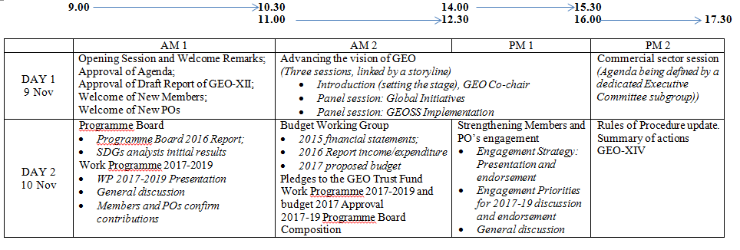
Current Draft Agenda
​No general session for reading of Member/PO Statements.
Special panel sessions on 'implementation of the GEOSS' and ‘Flagships’.
Session for confirming new contributions.
​There are some interesting topics:
The GEO Engagement Strategy and Engagement Priorities.
Commercial Sector engagement.
GEO engagement with the SDG agenda.

Slide 6
Preparation required
‘Think piece’ for panel session on GEOSS implementation (1-2 pages) | What discussions would we like to see? What might we like them to ask?
Written Statement | What key points do we wish to make? Strat plan progress? Engagement strategy?
Identification of new contributions | Arising from the Chair initiatives?
Guidance on key issues | Engagement Strategy Role of commercial sector Engagement with SDGs
Soon
P-2 weeks
Plenary
Plenary

Slide 7
Engagement objectives
One
Establishing GEO as a unique international organization that ensures that Earth observation (EO) underpins global decision-making.
Two
Ensuring strong advocacy for broad, open data policies and practices
Three
Establishing GEOSS as a global reference for Earth observation systems, data and information

Slide 8
Approach
Principles-based
Strategic engagement actions will: - Be challenge-centred, with a strong policy drive, grounded on real-world decision needs of actual users - Favour direct collaboration with key decision makers and actual implementers to maximise effectiveness - Focus on actual results and outcomes, showcasing what is already providing tangible results to policy/decision makers (as in the case of Global Initiatives such as GEO-GLAM, GFOI or GEO-BON) - Build on existing strengths, interests and capacities of the GEO community, creating a win-win scenario to ensure their follow-up and sustainability - Be primarily focused on a few priorities identified by ExCom, while ensuring a balanced coverage of the users’ needs in all GEO Societal Benefit Areas to ensure alignment with the GEO Strategic Plan

Slide 9
Approach
Who does what
Members and POs will:
Reach and activate internal users.
Act as GEO ambassadors; Lead/contribute to engagement activities.
Community involved in tasks will:
Help link with users to understand requirements
ExCom will:
Identify strategic priorities driven by the international agenda
PB will:
Map GEO competencies against priorities; promote gap filling
GEOSEC will:
Develop and drive multi-annual engagement plans
Undertake preliminary engagement

Slide 10
The key point
Engagement plans will be structured according to the priorities selected by ExCom. In order to ensure a swift drafting process and monitoring, only high-level actions (i.e. tools described in 5.1) will be described in the plan according to the following items:
Objective of the action, linked to a strategic priority defined by ExCom and to the Work Programme
Relevant Engagement Strategy objective(s)
Target stakeholders
Expected outcomes, linked to the Expected Results in the SP
Key Performance Indicators, linked to the Indicators in the SP
Timeline and milestones
GEO actors involved, including potential incentives for their participation and a preliminary estimation of the resources involved

Slide 11
Thoughts?

Slide 12
Thoughts on strategic topics
How is GEO going with implementing the Strategic Plan and Mexico City Declaration?
Is the shift to the ‘new way of working’ happening (rapidly enough)?
Better connections with big global agendas?
Launching a global effort towards SDGs?
Are the key groups (UN institutions, Dev Banks etc) being engaged?
Communicating the value of what GEO does?
Driving support for sustainment of observing systems?
Extending engagement with statistical agencies?
Thoughts on GEO’s engagement with the commercial sector?
What common challenges, trends and/or gaps do we want to highlight?

Slide 13
New contributions to highlight?
Working Groups?
Virtual Constellations?
Arising from Chair Initiatives?
Non-Met Apps
Future Data Architectures
Progress in implementing cross-cutting strategies?
Carbon
Water
New efforts in support of GFOI, GEOGLAM, BluePlanet …

Slide 14
Pathway from here
Thoughts from you will be used to frame …
‘Think Piece’
Drafted by SIT Chair Team and CEO Team, in collaboration with Chair Team, Incoming Chair Team and SIT Vice Chair Team
Endorsed by SIT Chair for submission in the next few weeks.
Written Statement
Drafted by SIT Chair Team and CEO Team, in collaboration with Chair Team, Incoming Chair Team and SIT Vice Chair Team
Discussed at SEC-213 for (hopefully) endorsement for submission
Interventions by the Head of Delegation in session
Guidance to be discussed at Plenary, to enable the latest information to be taken into account.

Slide 16
Approach
How is it done
Sustain – actions focused on maintaining continued productive engagement with those Members and POs already active in GEO. Use to locate lessons learnt.
Enhance - strengthening engagement with those are not sufficiently contributing. Understanding of the reasons hindering full engagement and specific activities or action plans to overcome these barriers.
Expand - actions focused on increasing the number and variety of active partners.

