Slide 1
Essential Climate Variables (ECVs) and the ECV Inventory
Jörg Schulz (EUMETSAT) – WGClimate Vice-Chair
Alexandra Nunes, Peter Albert, Marie-Claire Greening
CEOS/CGMS Agencies staff
Domain Support Teams
WGClimate Members
SIT Technical Workshop
Session 4, Item 18
September 13th, 2017

Slide 2
ECV Inventory – Context
Action Plan & Creation of conditions to deliver CDRs (CMRS-16)
ECV Inventory
(CMRS-14)
Gap Analysis & Recommendations
(CMRS-15)
ECV Inventory provides verified information on Climate Data Records available/planned from CEOS & CGMS satellite missions or their combination on an GCOS ECV product basis;
Together with mission data bases it can be used to identify missed opportunities and missing missions;
ECV Inventory establishes traceability with respect to GCOS principles, guidelines and requirements for ECVs;
ECV Inventory has high potential for usage by many;
We very much acknowledge the support for the Inventory from the EC.

Slide 3
Achievements
Build up a web based ECV Inventory based on a questionnaire enabling assessment of compliance to GCOS climate monitoring principles, guidelines and numerical requirements;
Populated the ECV Inventory with the support of ~100 individuals in the agencies;
Verified the content of the Inventory with respect to completeness and consistency of the information in one-to-one interactions;
Developed a procedure to perform gap analysis on the ECV Inventory and used it to identify all missing ECVs and ECV products;
Started to analyse the reasons for missing products including addressing the missions used and needed;
Prepared and deployed a tool to identify shortcomings in data records with respect to GCOS principles, guidelines and requirements;
Performed the analysis on shortcomings with the support of domain expert teams.

Slide 4
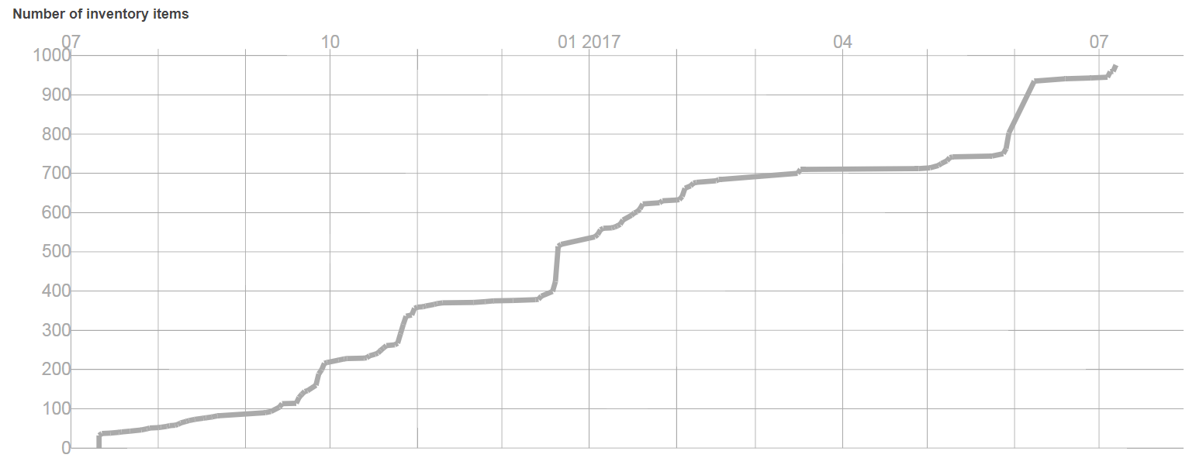
ECV Inventory Population
Close of new data inputs
 | Known | Unknown
Known | Verified content of the ECV Inventory (95%). | Known climate data records that did not became part of the ECV Inventory.
Unknown | Partly or not verified content of the ECV Inventory (5%). | Climate Data Records that may exist but are not known by the WGClimate.

Slide 5
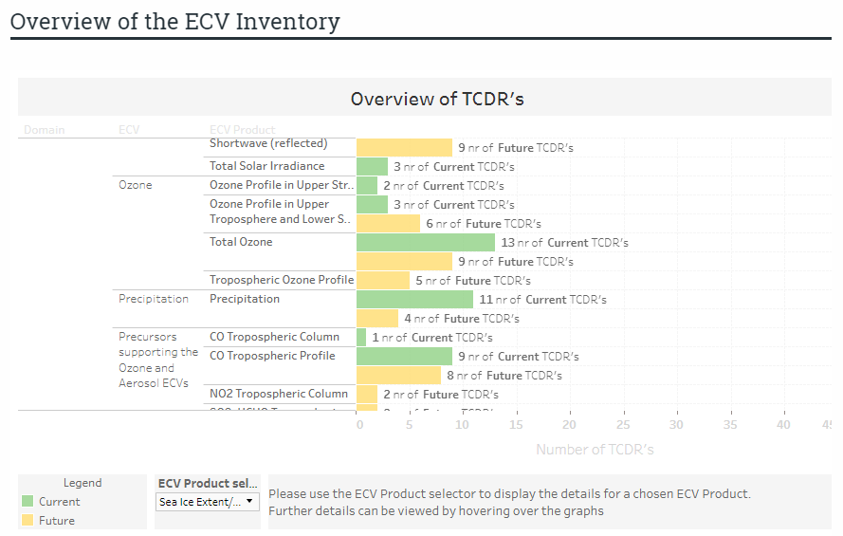
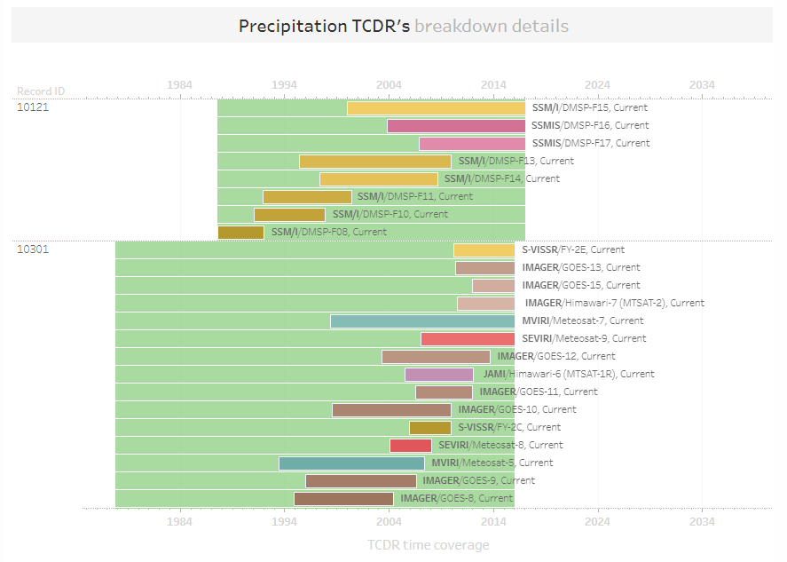
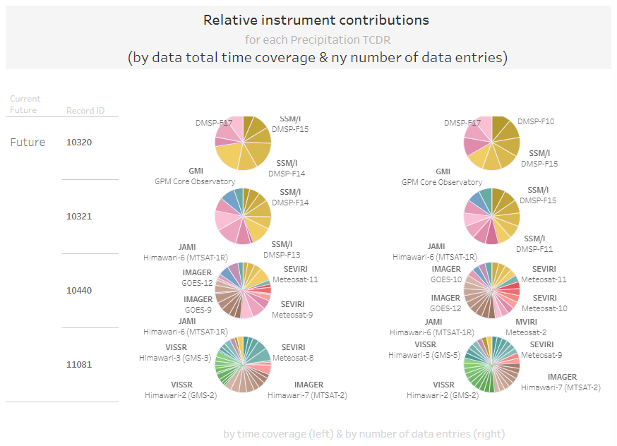
ECV Inventory provides detailed view for each data record

Slide 6
Example: Ocean ECV Products
In total the Inventory covers 27/29 (GCOS-154, 2011) and 30/35 (GCOS-200, 2016) ECVs.

Slide 7

Potential to identify missed opportunities and missions
Total gap on sea surface salinity;
Is this due to incompleteness of the Inventory?
    No “known-unknowns” at time of snapshot (know now that delivery of Sea-surface Salinity CDRs is planned under ESA CCI+);
Is this because existing data sets are not considered to be CDRs?
  Yes, time series are short and intercomparison of various satellite SSS products revealed discrepancies that prompt for further understanding of retrieval errors;
Is this because there was no mission in the past or is in the future?
  No for the past, yes for the future. No agency has a planned mission beyond SMAP and SMOS.

Slide 8
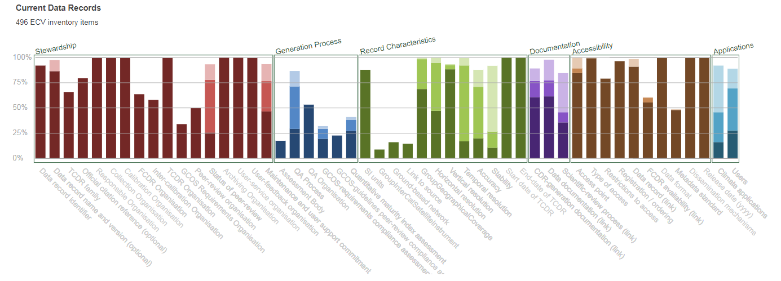
Addressing shortfalls wrt. GCOS
This analysis can be done down to the single data record.

Slide 9
Issues
Activity to build up the ECV Inventory took much longer than expected;
  Needed time to get organised within the agencies to provide the support to the population of the Inventory;
  Population of the Inventory was hard work and took time;
  The verification step is crucial and requires interaction between responders and Inventory host and took a lot of time for the large number of records;
Gap analysis is confronted with a huge amount of data records to establish baseline and will use domain expert teams to achieve correct results;
Gap analysis for individual ECV Products uses information from mission data bases (CEOS MIM and WMO OSCAR) for an analysis of missed opportunities and missions. Observed some technical issues including diverging nomenclature between GCOS, MIM and OSCAR. Will address this with MIM support team.

Slide 10
Way forward
Integrate first summary findings from the gap analysis into the GCOS IP response as answers to GCOS Actions 11 and 12;
Publish the ECV Inventory V2.0 on http://climatemonitoring.info/ in October 2017;
Continue the analysis of the inventory content at the ECV product level based on a prioritised list of ECV products;
Submit a more complete gap analysis report including recommendations/actions referring to V2.0 to CEOS SIT-33 for endorsement;
Perform a lesson learnt exercise and derive future way of working with the Inventory;
Work with WGISS to assess and ensure the data discovery and accessibility in the Inventory;
Support WMO workshop ECV Inventory Use for Climate Monitoring from Space.

Slide 11
Tentative approach for the future
The ECV Inventory V2.0 and analysis of it ends the activities creating a first baseline;
It is planned to gradually update the Inventory including the verification of the new entries;
Once a year the Inventory is baselined with a new version number and used for an updated gap analysis and action plan;
WGClimate plans to provide the updated documents each year for endorsement;
This process would keep the Inventory as up to date as possible and has the ability to address items of priority to CEOS and CGMS in the analysis;
The actual and older versions of the verified Inventory will remain available from the web user interface.

Slide 12
Credit to the ECV Contributors

Slide 13
Credit to the Gap Analysis Teams
Atmosphere | Wenying Su | NASA (LARC)
 | Stefan Bojinski | WMO
 | Daniel Vila | INPE
 | Rainer Hollmann | DWD (EUMETSAT CM SAF)
 | Richard Ekman | NASA HQ
 | Lei Shi | NOAA
 | Alisa Young | NOAA
 | Ken Knapp | NOAA
 | Albrecht van Bargen | DLR
 | Regis Borde | EUMETSAT
 | Ad Stoffelen | KNMI (EUMETSAT OSI SAF)
Ocean | Stein Sandven | Nansen Environmental and Remote Sensing Center
 | Ewa Kwiatkowska | EUMETSAT
 | Francois Montagner | EUMETSAT
 | Walter N. Meier | NASA JSIDC
Land | John L. Dwyer | USGS
 | Stephen Plummer | ESA
 | Isabel Trigo | IPMA (EUMETSAT LSA SAF)
 | Walter N. Meier | NASA JSIDC

