Slide 1
Space Agency Response to the GCOS IP
Pascal Lecomte
CEOS/CGMS Agencies staff
Domain Support Teams
WGClimate Members
SIT Technical Workshop
Session 4, Item 19
September 13th, 2017

Slide 2
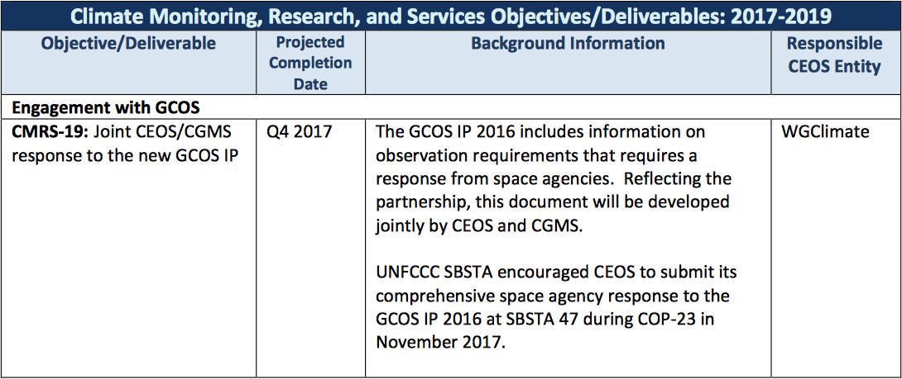
2017-2019 CEOS Work Plan

Slide 3
Context
The GCOS Implementation Needs (GCOS IP) was
Approved by the GCOS Steering Committee at its 24th meeting in Guayaquil, Ecuador, in October 2016 and
submitted to the UNFCCC at COP22, Marrakesh November 2016.
UNFCCC SBSTA encouraged CEOS to submit its comprehensive space agency response to the GCOS IP 2016 at SBSTA 47 during COP-23 in November 2017.
WGClimate has been tasked to prepare this response on behalf of Space Agencies
The Space Agency Response to the GCOS IP shall be presented to the UNFCCC secretariat roughly a month ahead of the COP-23/SBSTA-47 … October 6th 2017
Where are we now :
Inputs received.
Consolidated into Version 0.111
Complete review of the document at WGClimate #8 earlier this week.

Slide 4
Outline as presented at CEOS SIT 32
Targeting a 20-30 pages document
Broad Context (10-15 pages)
“Soft Actions” and Cross cutting actions
Calibration , Validation, Assessment, Data integration and Intercomparison.
Detailed Implementation (6-9 pages)
Terrestrial (2-3 pages - Grouped in meta-Actions)
Oceanic (2-3 pages - Grouped in meta-Actions)
Atmospheric (2-3 pages - Grouped in meta-Actions)
Meta-response to the Product Requirement Table (3 pages)
Support the feed back process to GCOS
Annex-1 Responses to detailed Actions – Coordinated Action Plan

Slide 5
Writing Team (list to be consolidated)
Broad Context – Pascal Lecomte (ESA)
ESA Pascal Lecomte
EUMETSAT Jörg Schulz
EUMETSAT Robert Husband
EC Mark Dowell
ESA Ed Pechorro
Atmospheric Chapter – Stephan Bojinski (WMO)
CNES Carole Deniel
NOAA Steven Goodman
DLR Albrecht von Bargen
INPE Daniel Vila
DWD Rainer Hollmann
NOAA Jeff Privette
EUMETSAT Kenneth Holmlund
NOAA Mitch Goldberg
METEO FRANCE Pierre Tabary
NASA Wenying Su
JAXA Misako Kachi
Oceanic Chapter – Chris Merchant (UKSA)
ESA Craig Donlon
EUMETSAT Hans Bonekamp
JAXA Hiroshi Murakami
NASA Paula Bontempi
NOAA Paul DiGiacomo
NOAA Eric Leuliette
INPE Milton Kampel
Terrestrial Chapter – John Dwyer (USGS)
ESA Simon Pinnock
ESA Stephen Plummer

Slide 6
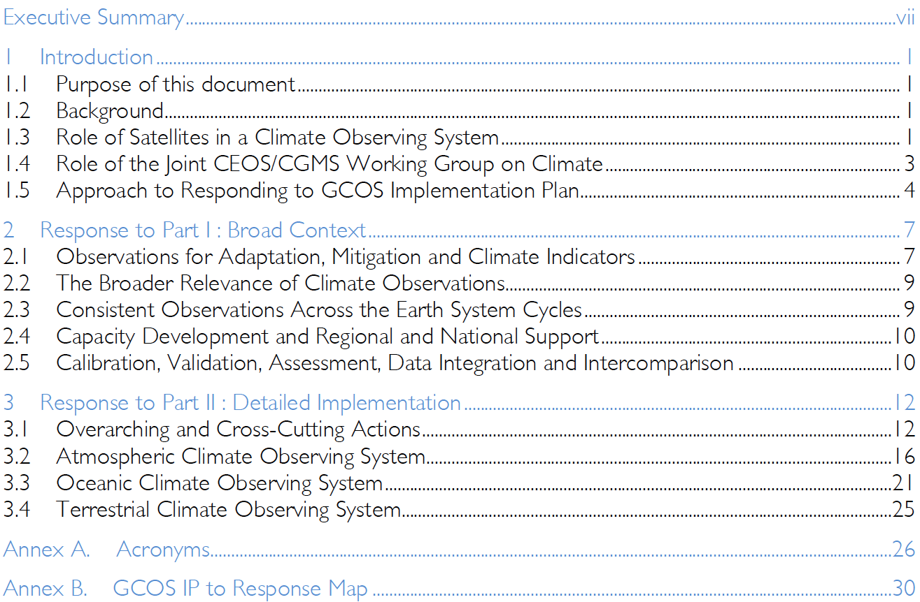
Document Structure Table of Content

Slide 7
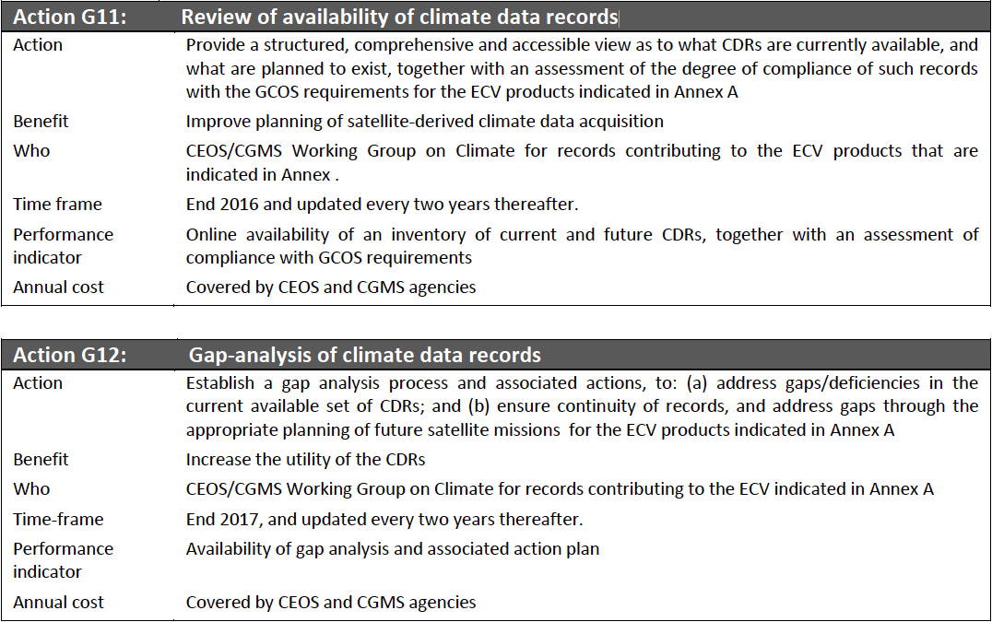
ECV Inventory and Gap Analysis

Slide 8
ECV Inventory and Gap Analysis
The Response will include in particular answers to GCOS Actions 11 and 12.
Therefore WGClimate doesn’t plan to submit the Gap Analysis directly to SBSTA as a report but to include a summary in the Space Agency Response.
Such a report would anyway be too technical for SBSTA so a summary in the response is sufficient.

Slide 9
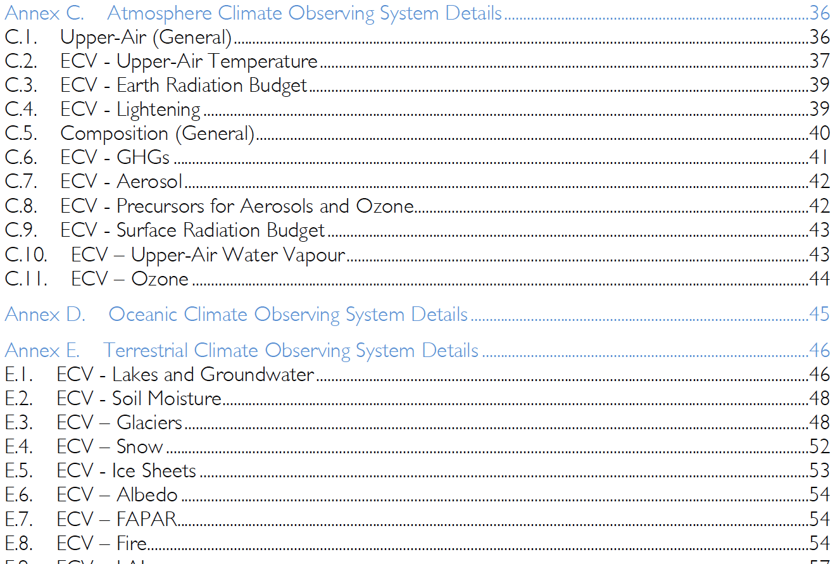
Technical Annex
The Space Agency Response to the GCOS IP will be complemented by a Technical Annex giving more scientific details on the responses to each relevant action.
This annex will be issued in March 2018 in time for the SBSTA 48.

Slide 10
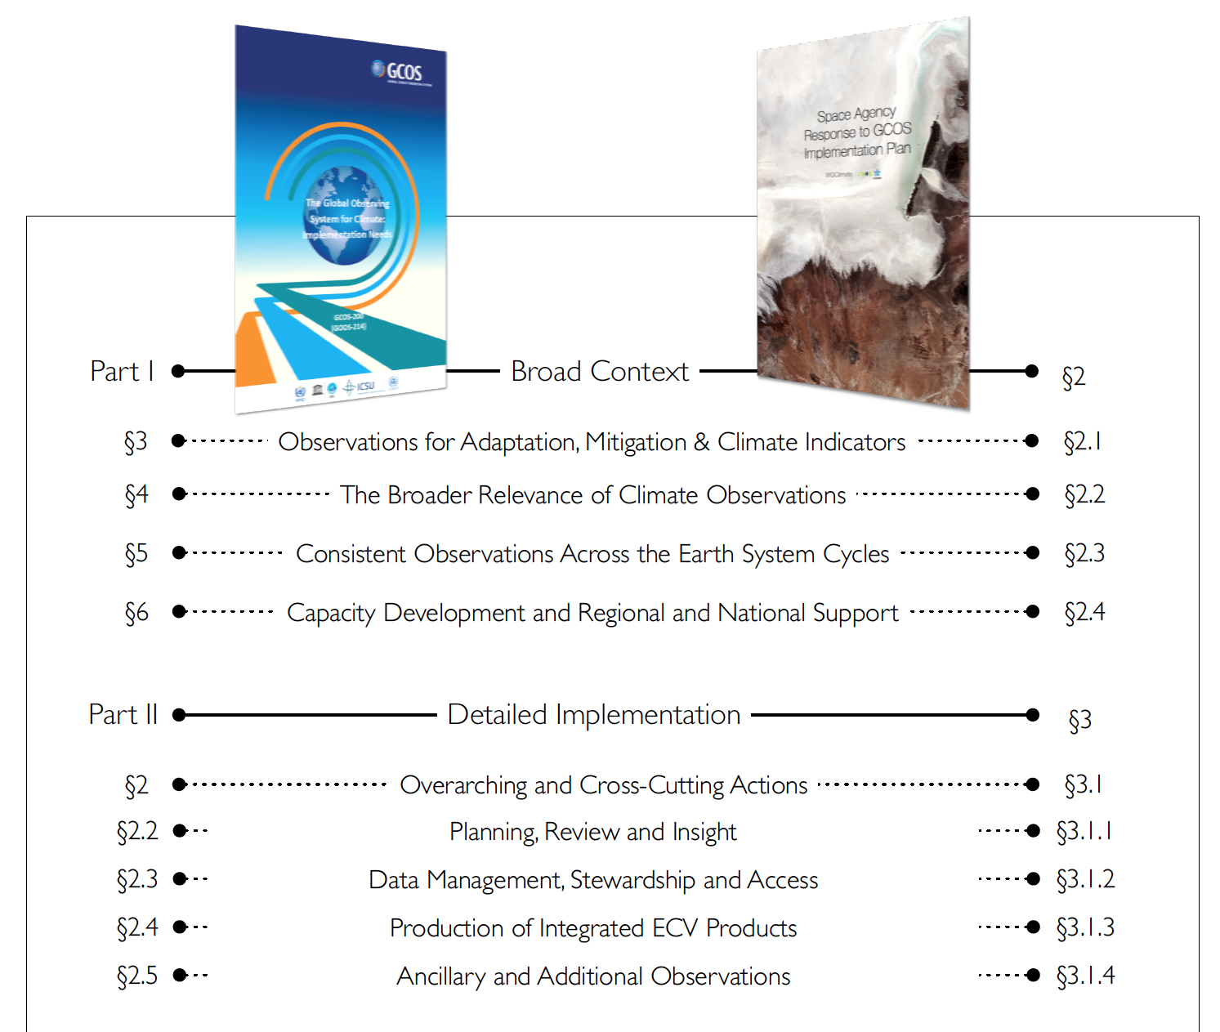
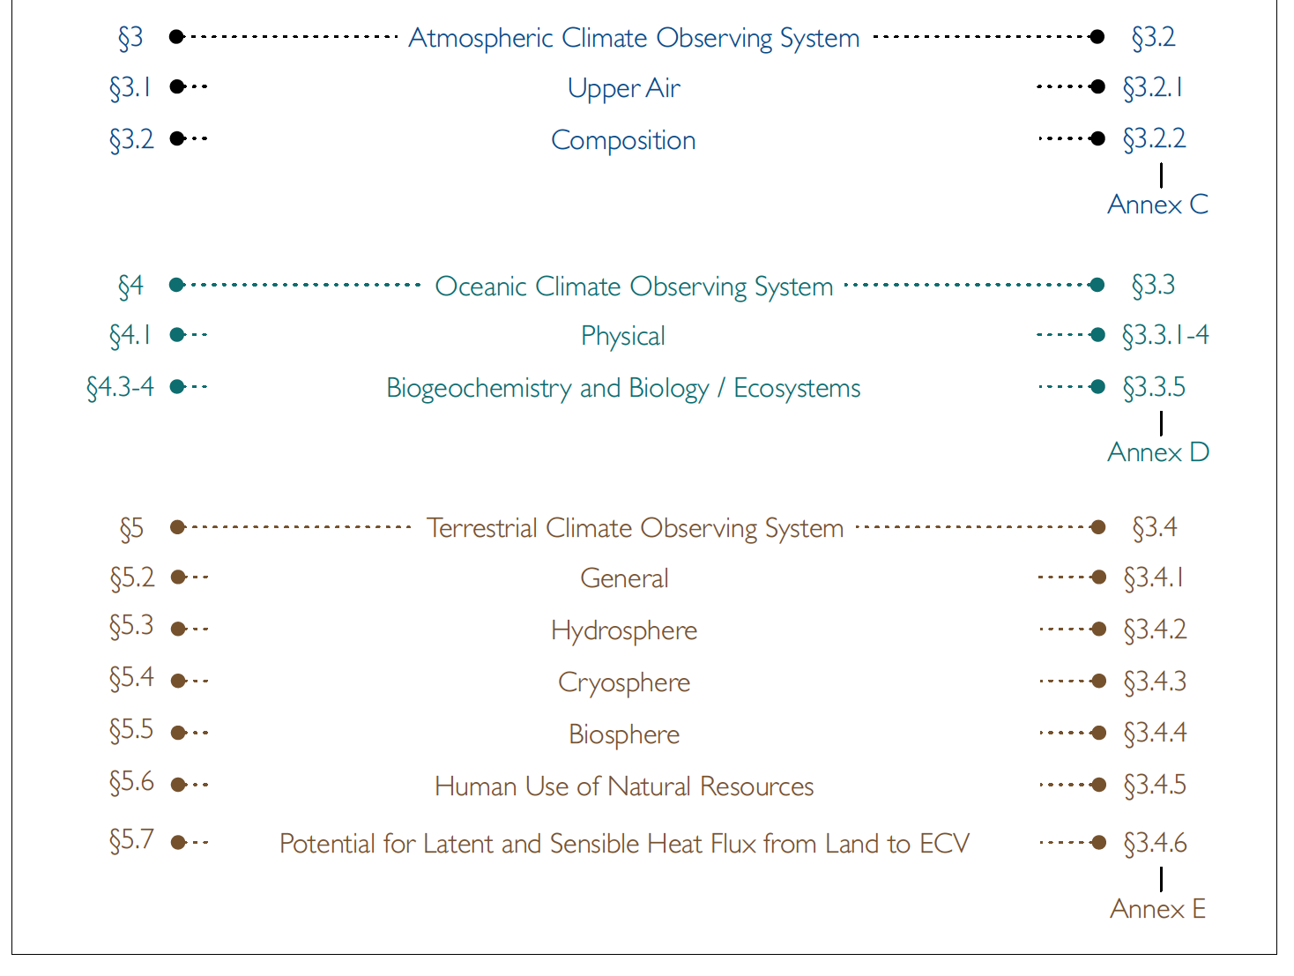
Mapping to GCOS IP

Slide 11
Next steps
Completion of the Executive summary by September 18th.
Document ready for review by CEOS and CGMS September 25th.
Review process by CEOS and CGMS (2 weeks) through the CEOS sec and the CGMS secretariat.
Same process as in 2012 for the previous version of the Space Agency Response.
Document to be sent to UNFCCC secretariat by 6 Oct 2017
Presented at COP-23/SBSTA-47: 6 Nov 2017

