Slide 1

Preparations for the 2017 CEOS Plenary
Committee on Earth Observation Satellites
Dr. Frank Kelly, USGS
SIT Tech Workshop 2017 – Agenda Item #26
ESA/ESRIN, Frascati, Italy
13th-14th September 2017

Slide 2

31st CEOS Plenary
18-20 October 2017
Holiday Inn Rapid City-Rushmore Plaza
505 North Fifth Street
Rapid City, South Dakota, USA 57701
http://ceos.org/meetings/31st-ceos-plenary/
  Includes agenda, meeting guide, other information
Online registration closes 15 October 2017
  Make hotel reservations online at:
https://www.ihg.com/holidayinn/hotels/us/en/rapid-city/rapcc/hoteldetail?
Group code: WX8
Rate: $89 USD plus tax
Room block expires on 15 September 2017
Transportation:
Hotel offers a complimentary airport shuttle; call +1 (605) 348-4000 to request the shuttle
Hotel is a 15-20 minute ride from the airport (12 miles, 19km)
Rental car options are available at the airport

Slide 3
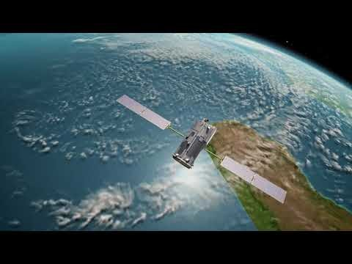
31st CEOS Plenary

Slide 4
31st CEOS Plenary
Week At A Glance
 | Arrive in Rapid City (or Sioux Falls for optional EROS Center Visit)
17 October | EROS Center Visit in Sioux Falls (optional) Transport from hotel to EROS Center Tour EROS Center (8 am) Transport to Rapid City (late-morning)
18 October | Side Meetings (optional) Welcome table and coffee available beginning at 7:30 am Side Meetings – Dakota Ballroom salons Welcome Reception – Black Hills Ballroom – 6:30 pm to 10:00 pm – Beverages and local cuisine
19 October | Plenary Welcome table and coffee available beginning at 7:30 am Plenary Session – Dakota Ballroom Evening Dinner – Journey Museum, 222 New York Street, Rapid City, SD 57701 – 6:00 pm to 10:00 pm Walking distance from hotel but will have a dedicated Holiday Inn shuttle available from 6:00 to 10:00 pm Includes social time, entertainment, and buffet dinner Museum tour available / gift shop will be open
20 October | Plenary Welcome table and coffee available beginning at 7:30 am Plenary Session – Dakota Ballroom
21 October | Excursions (optional) Black Hills Tour with stops at Crazy Horse and Mt. Rushmore (8am-3pm) – Lunch provided Evening Bus Trip to Deadwood (5pm-10pm) – Dinner non-hosted
 | Depart from Rapid City

Slide 5
31st CEOS Plenary
  Weather
Average daytime temperatures are a high of 59° F (15° C) and a low of 34° F (1° C)
Things to Do
Rapid City and the Black Hills offer many beautiful attractions, both indoor and outdoor. If you enjoy museums, shopping or hiking, Rapid City and the Black Hills have numerous options:
Join the Rapid City bike trail right outside the hotel for biking, walking, or running
Visit Memorial Park/Berlin Wall Exhibit (directly south of Holiday Inn-Rushmore Plaza)
Hike Black Elk Peak (formerly Harney Peak) (elevation 7,244’) (2,208 meters)
Visit Prairie Edge Trading Co & Galleries
Tour US President downtown sculptures
Visit Wall Drug with free ice water
Drive through the Badlands and behold Mother Nature’s beauty
Drive Iron Mountain Road with unique architectural features called pigtail bridges and one lane tunnels with a view of Mount Rushmore
Visit Custer State Park & Wildlife Loop
Travel to Devils Tower National Monument in Wyoming
Visit the Mammoth Site of Hot Springs
View many more attraction options at Rapid City Visitor Bureau:
  https://www.visitrapidcity.com/things-to-do

Slide 6
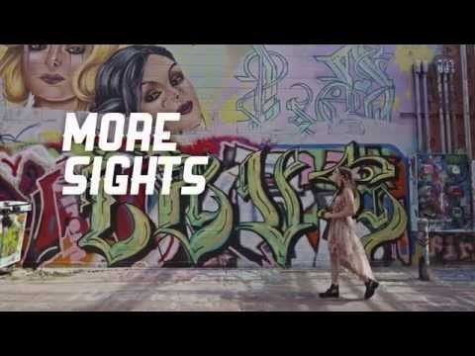
31st CEOS Plenary

Slide 7
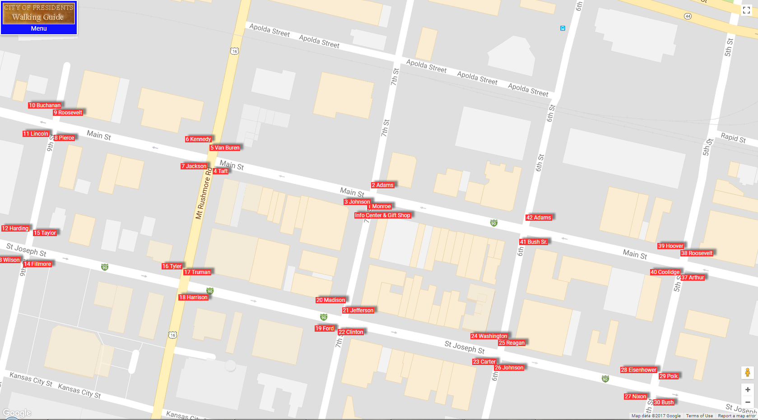
31st CEOS Plenary
  Rapid City and Black Hills Area Maps
  Downtown Rapid City Map
  https://www.visitrapidcity.com/sites/default/files/pdfs/RC_Downtown%20Map%202017_1.pdf
  City of Presidents Walking Guide
  http://presidentsrc.com/map.html

Slide 8
31st CEOS Plenary
  Rapid City and Black Hills Area Maps
  Rapid City Map
  https://www.visitrapidcity.com/sites/default/files/pdfs/RC%20Map%20Update%202017.pdf
  Black Hills Area Map
  https://www.visitrapidcity.com/images/data/files/Black-Hills-Map-1.pdf

Slide 9
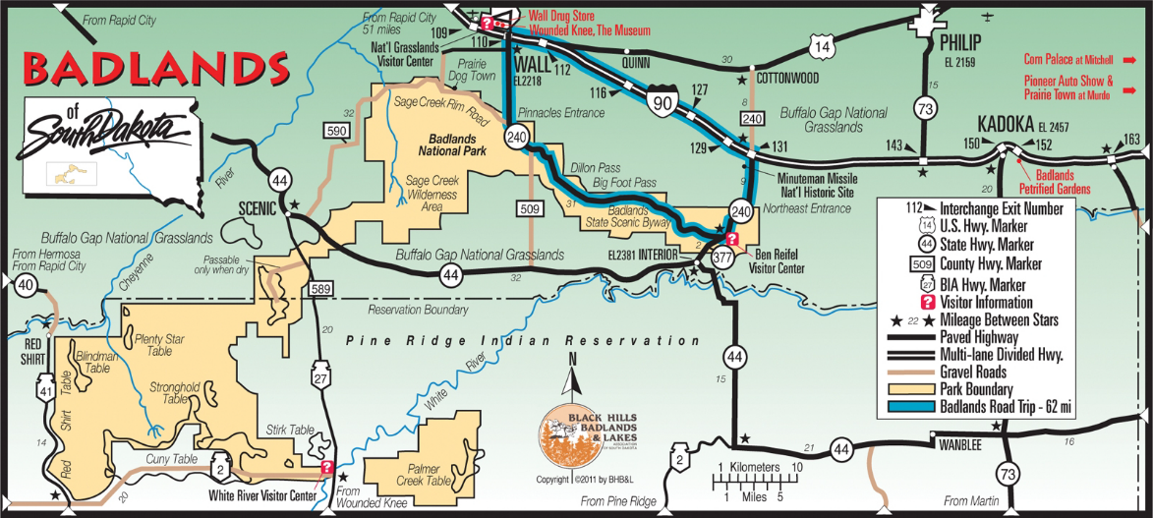
31st CEOS Plenary
  Rapid City and Black Hills Area Maps
  Badlands Map
  https://www.visitrapidcity.com/images/data/files/Badlands-area-map.pdf

Slide 10
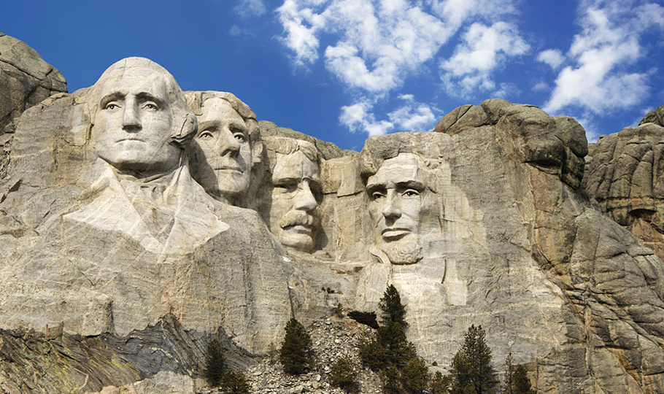
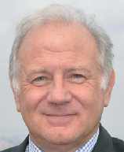
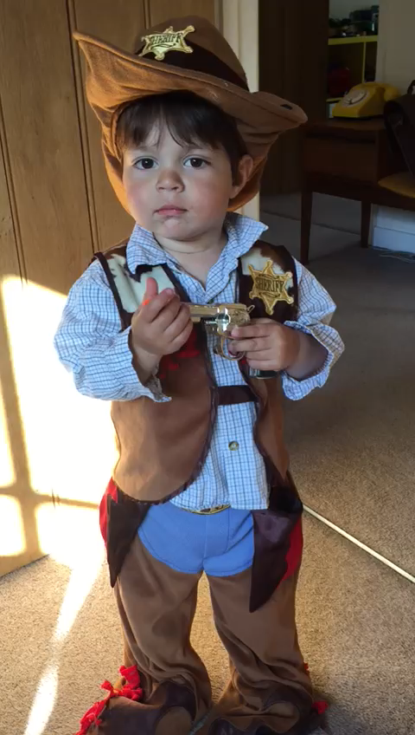
31st CEOS Plenary

