Slide 1
CEOS Chair FDA Big Data Workshop
Committee on Earth Observation Satellites
European Commission
CEOS 2018 Chair team
SIT-TW
13th September 2018

Slide 2
Range of agency activities
Integration of cloud services to:
Improve efficiency of operations
Develop user-base
Significant transitional risks need to be mitigated in the process
Application & infrastructure transfer to cloud
Learning how to use cloud services
Avoiding vendor lock-in
Analyses Ready Data & Data Cube services seen as key components
Increasing adoption of free, full and open data policies as they have positive impact

Slide 3
Understand approaches taken
Presentation and analyses through discussion of different agency approaches – good level of mutual understanding achieved
In general different approaches for core tasks and user-uptake efforts
Cloud services can play a role in both
Core tasks seen by agencies in public service provision, data quality, stewardship and archiving
ARD
is seen by most as catalyst
approach differs across agencies

Slide 4
Indentify best practices
Need for common architectural model and terminology confirmed
Proposal from Chair to adopt ESA-proposed model
Rich inventory for user management approaches compiled by WGISS and shared
Data cubes recognised as facilitating uptake by new user communities
Significant cost and performance optimisations possible through intelligent choice of cloud services
ARD domain – significant progress perceived; need to keep momentum

Slide 5
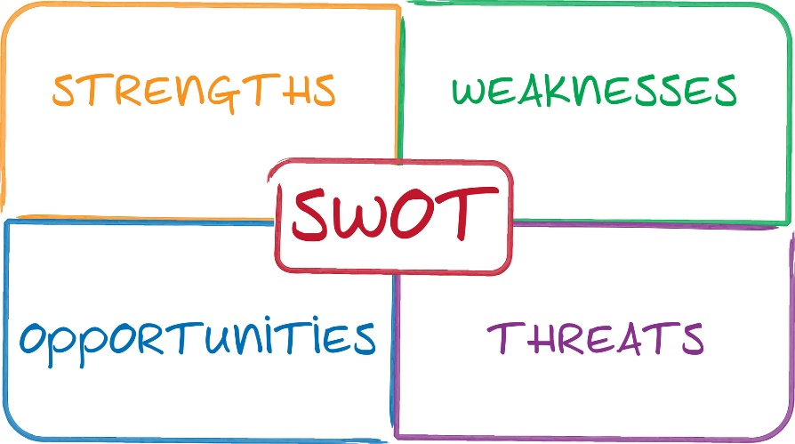
Elements for SWOT analyses
Significant expansion of user communities are recorded
Advanced user metrics key for success
Regulatory burdens for cloud service procurement – even in US
Information security is major challenge & drives implementation
Need to keep inhomogeneous ARD implementation in check
Challenges to CEOS agencies by private sector require clear delimitation of core roles
Need to prepare for future data rates
Vendor lock-in is major issue

