Slide 1

Working Group on Information Systems and Services (WGISS)
Committee on Earth Observation Satellites
Mirko Albani, ESA, WGISS Chair
CEOS 2018 SIT Technical Workshop
Session 3: Data, Agenda Item #3.5
EUMETSAT, Darmstadt, Germany
13 – 14 September 2018

Slide 2
WGISS Structure
WGISS
Chair, Mirko Albani, ESA
Vice-Chair, Robert Woodcock, CSIRO
WGISS Principals
  AOE/CAS: Guangyu Liu
  CCMEO: Patrick King
  CNES: Richard Moreno
  CONAE: Homero Lozza
  CSIRO: Robert Woodcock
  DLR: Katrin Molch
  EC: Astrid Koch
  ESA: Mirko Albani
  EUMETSAT: Michael Schick
  GA: Simon Oliver
  GSDI/HUNAGI: Gabor Remetey
  INPE: Lubia Vinhas
  ISRO: Nitant Dube
  JAXA: Yosuke Ikehata
  NASA: Andrew Mitchell
  NOAA: Martin Yapur
  NRSCC: Chuang Liu
  RADI: Lizhe Wang
  ROSCOSMOS: Pavel Tischenko
  USGS: Kristi Kline
  UKSA: Christopher McQuire
WGISS Secretariat
Michelle Piepgrass, ESA
WGISS Infrastructure Services Project
Martin Yapur, NOAA
Preservation and Stewardship
Data Stewardship Interest Group (Mirko Albani, ESA)
Discovery and Access
WGISS Connected Assets System Level Team (Yonsook Enloe, NASA)
- IDN (Michael Morahan, NASA)
- FedEO (Andrea Della Vecchia, ESA ; Yves Coene, ESA)
- CWIC (Yonsook Enloe, NASA)
- OpenSearch II (Andrea Della Vecchia, ESA; Olivier Barois, ESA)
Interoperability and Use
Interoperability Interest Group (Robert Woodcock, CSIRO; Richard Moreno, CNES)
- Future Data Architectures (Robert Woodcock, CSIRO; Richard Moreno, CNES; Kristi Kline, USGS)
- Carbon Portal (Martin Yapur, NOAA)
- Open Source SW and Tools (Iolanda Maggio, ESA)
Technology Exploration Interest Group
(Chris Lynnes, NASA; Yosuke Ikehata, JAXA)
Notes:
WGISS promotes collaboration in the development of systems and services that manage and supply Earth Observation data;
The activities and expertise of WGISS span the full range of the information life cycle from the requirements and metadata definition for the initial ingestion of satellite data into archives through to the incorporation of derived information into end-user applications.
WGISS Structured around four interest groups plus WISP project.

Slide 3
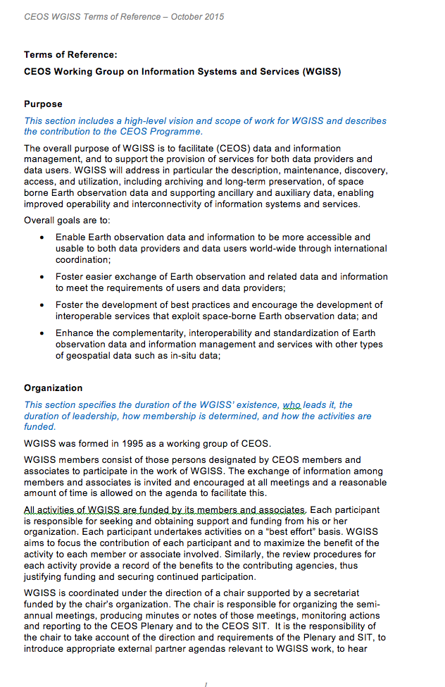
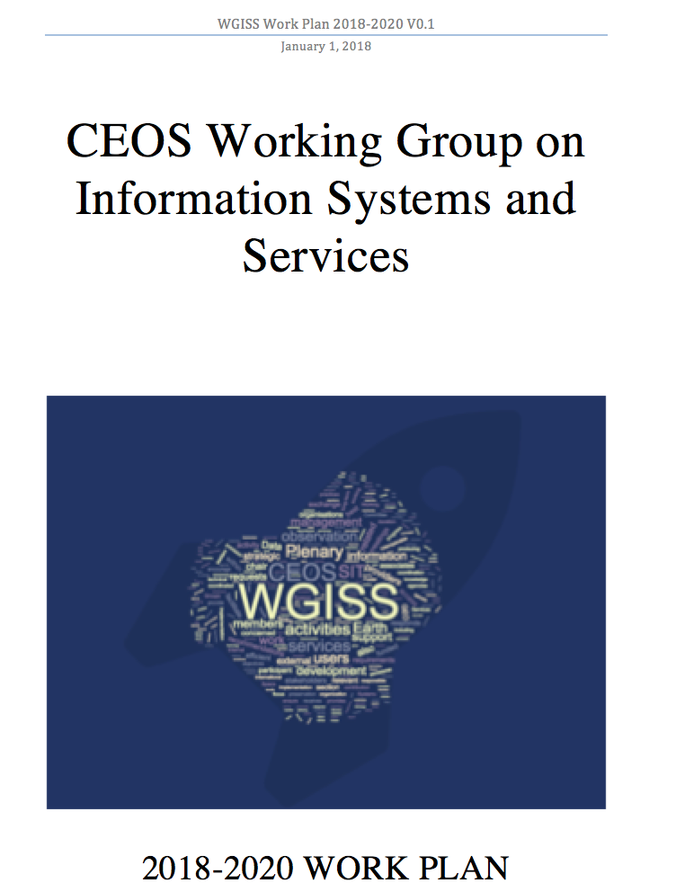

WGISS Work Plan
WGISS Work Plan defines activities and outputs needed to achieve WGISS objectives and CEOS Work Plan assigned actions

Slide 4

Outline
Data Stewardship Interest Group
WGISS Connected Data Assets System Level Team
Interoperability and Use Interest Group (including FDA)
Technology Exploration Interest Group
Cooperation within and outside CEOS
CEOS 2018 – 2020 Work Plan Action Items

Slide 5
Data Stewardship Interest Group
WGISS accomplishes its Data Preservation and Curation efforts through the Data Stewardship Interest Group (DSIG)

Slide 6
Data Stewardship Best Practices
Document Tree
EO Data Stewardship
Cooperative Framework
Policy Documents
CEOS Agencies EO Space Data Sets
Applied to
Data Purge Alert Procedure & White Paper
Recommended / Reference
Individual organizations'
policies (stewardship, access, ...)
Should be applied by
CEOS Agencies
Recommended /
Reference
Technical Documents
Reference Model for Data Stewardship
Glossary of Acronyms and Terms
General guidelines and best practices
Support
Preservation Workflow
EO Data Preservation Guidelines
Preserved Data
Set Content
Associated Knowledge Preservation
WGISS Maturity Matrix
Persistent Identifiers Best Practice
Guidelines and best practices on specific topics
Technical implementation procedures
EO Data Set
Consolidation Process
…
Image Source: http://eastenders.wikia.com/wiki/File:Under-construction.png

Slide 7
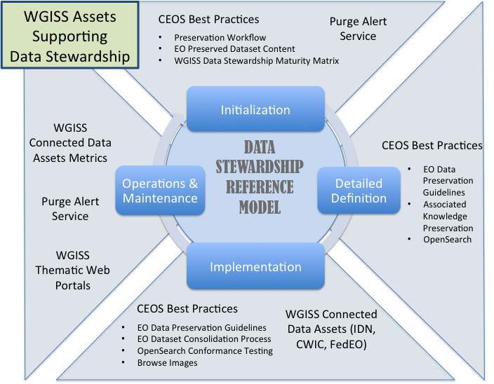
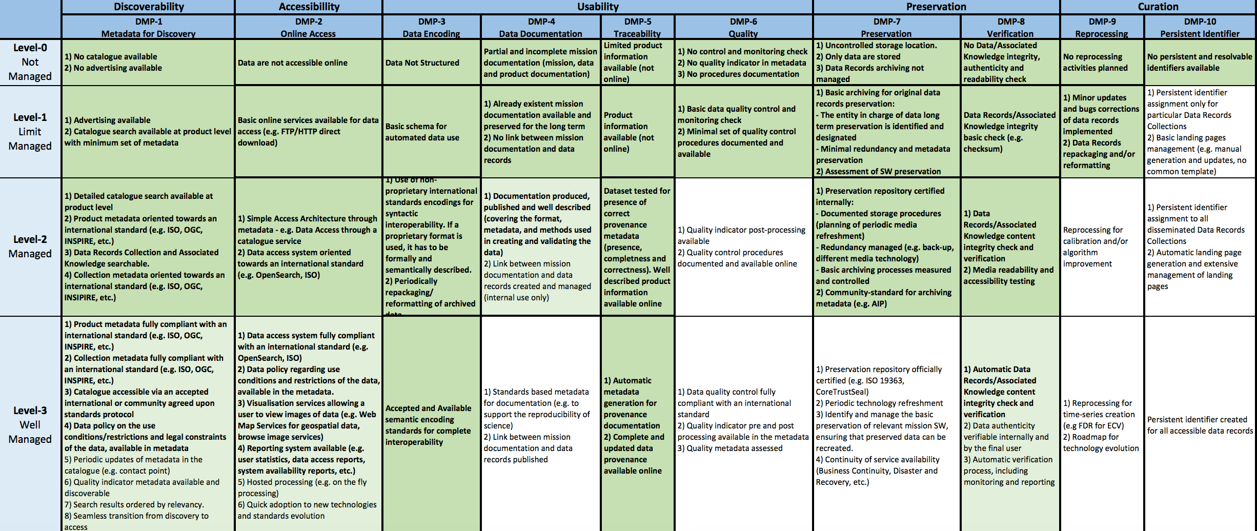
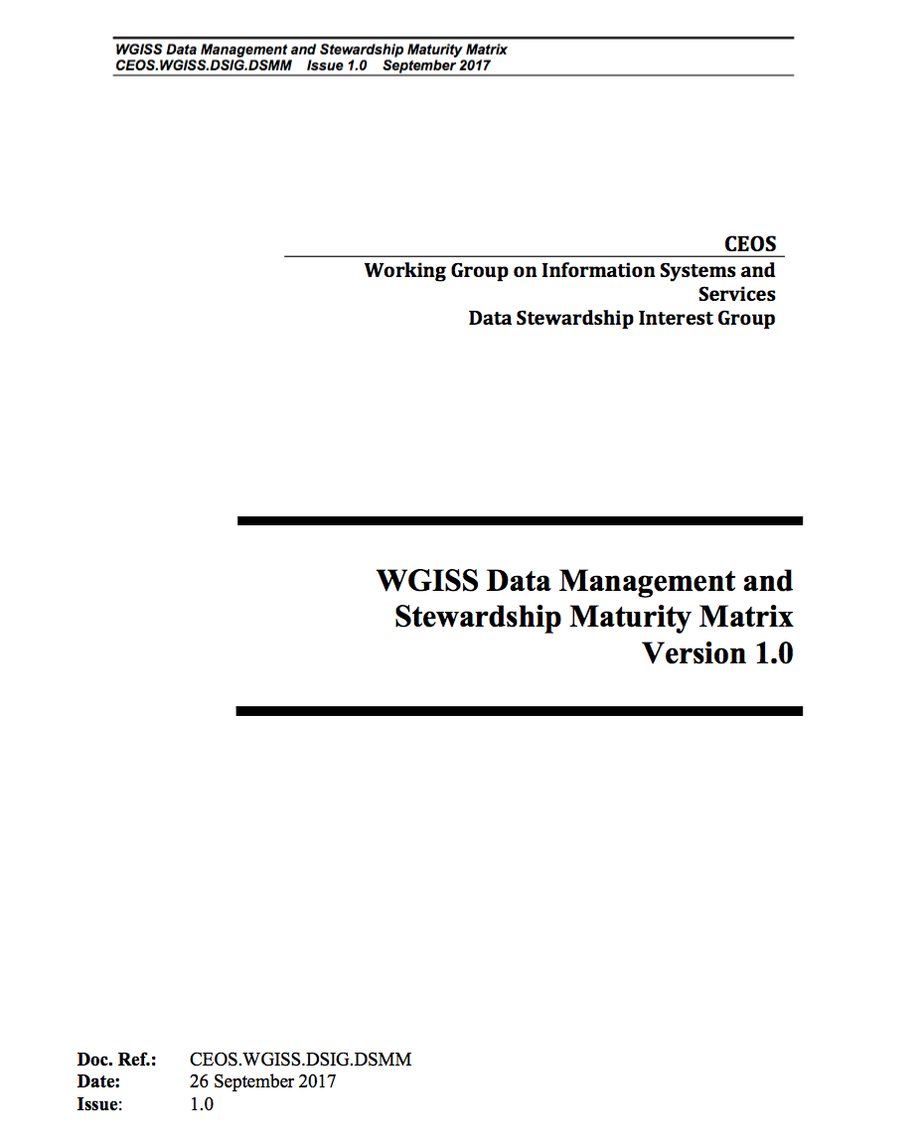
Data Stewardship Interest Group
Latest Outcomes
Reference Model for Data Stewardship and WGISS Maturity Matrix
WGISS Maturity Matrix

Slide 8


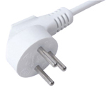
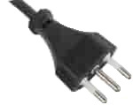

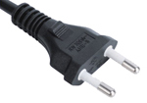
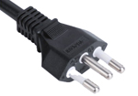





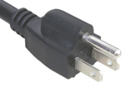



Discovery & Access
Architecture
  CWIC
  FedEO
  IDN
  Open Search II
Connected Data Assets

Slide 9
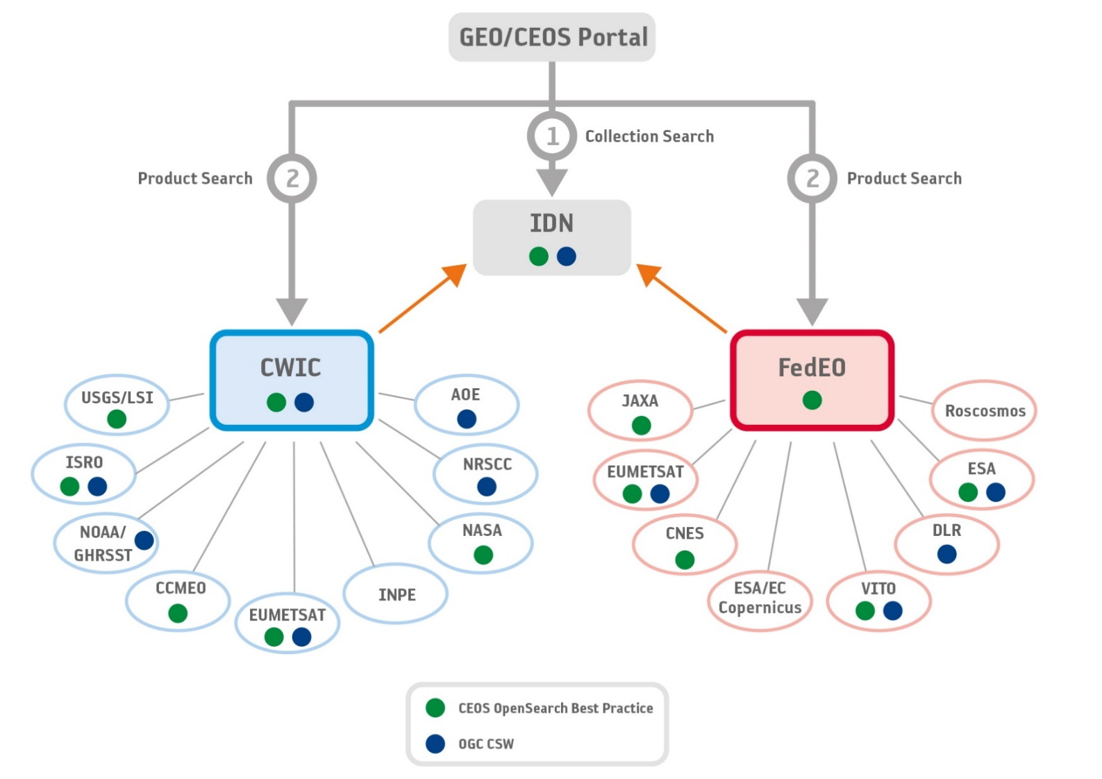
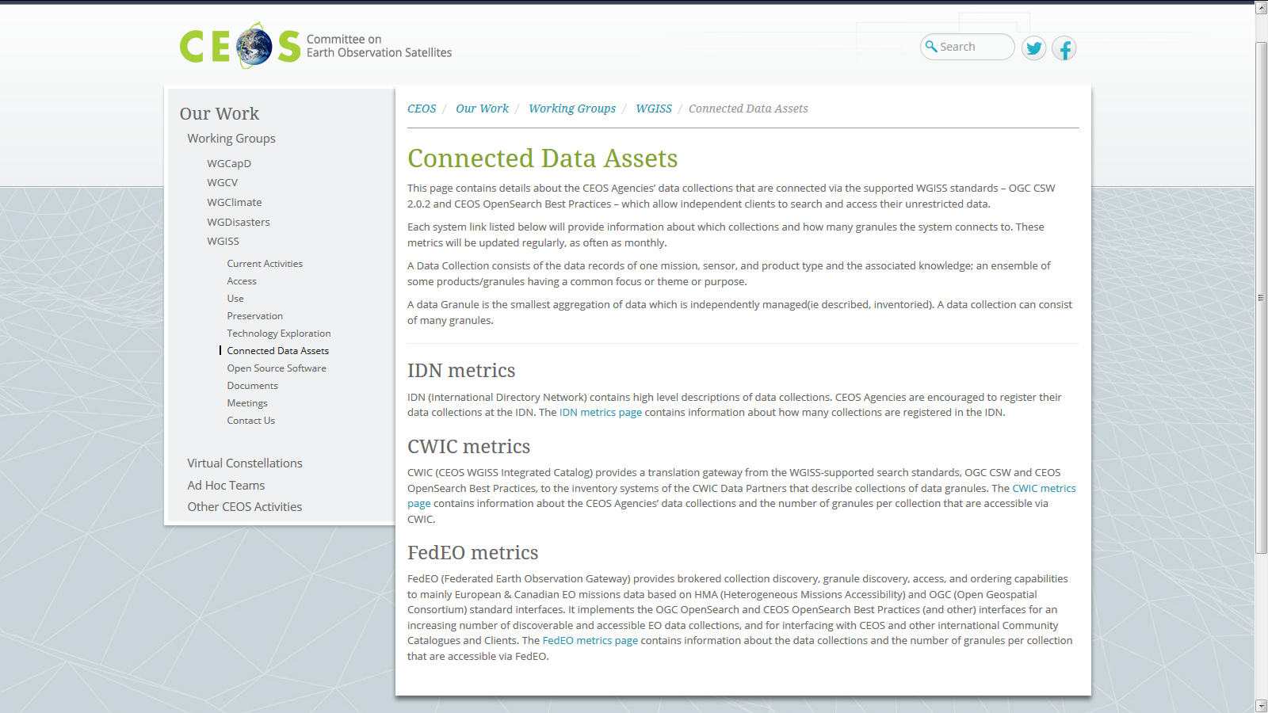
Discovery and Access
WGISS Connected Data Assets (CDA)
Relying on CWIC/IDN/FedEO, provides a single entry point for external clients to discover and access CEOS agencies data
Search over 32,000 collections in the IDN
Access over 5000 collections with associated over 300+ million granules (granule search)
  DATA-2: Full representation of CEOS Agency datasets in the IDN and accessibility via supported WGISS systems and standards

Slide 10
Discovery and Access
WGISS Connected Data Assets (CDA)
System Level Team (SLT) coordinates maintenance and operations.
Client Portals:
  GEOSS Platform (GEOPortal and DAB)
  AMERIGEOSS Data and Services Portal
  ESA EOPortal
  COVE Tool
  CEOS Carbon Portal
Being enlarged with new partners and continuously populated with additional data collections, e.g.:
  ECVs/CDRs in coordination with WGClimate, COVERAGE Team and Carbon Team
  ESA Heritage and Earth Explorer Missions (11 million granules)
  NOAA One Stop (over 100 million granules)
  National Remote Sensing Center of China (NRSCC) now active participant in WGISS CDA (35 millions granules)
Example IDN: DIF-9 to DIF-10 Transition Schedule
(2017-2018)
Sent Provider DIF-9 to DIF-10 QA/Triage Reports.
May 1, 2018
Start migrating existing non-NASA EOSDIS DIF-9 records to DIF-10.
2019 (First quarter)
Plan to have all metadata records transition.
  DATA-8: Maintain and evolve WGISS Connected Data Assets Infrastructure and Systems
Notes:
WGISS Connected Data Assets Operational Systems (IDN, CWIC, FedEO):
Is maintained and operated in coordination among different agencies (System Level Team) and implements the OpenSearch Interoperability Best Practice defined in WGISS.
Provides a single entry point for GEO (GEOPortal) to discover and access CEOS agencies data.
Is being enlarged with new partners and continuously populated with additional Collections (e.g. ECVs/CDRs inventories from WGClimate).

Slide 11
ECVs/CDRs Discovery and Access through WGISS Systems
913 ECV/CDRs from ECV Inventory V2.0
CURRENT
FUTURE
496
417
288 in IDN via CWIC
4 in IDN via CNES
  DATA-9: ECVs/CDRs Discovery and Access through WGISS Systems
204 not in IDN
Progress and next steps
Providers and PoCs responsible of the 204 datasets not registered in IDN preliminarily contacted
First batch of datasets will be addressed and registered by Q4 2018
Second batch will be addressed in coordination with WGClimate in the frame of ECV Inventory update to V3. Completion by Q4 2019
Notes:
Objective: facilitate discoverability and accessibility of ECV Products and space-born CDRs relevant for the CEOS Carbon Action via WGISS Interoperability Systems & Standards (FedEO/CWIC/IDN, OpenSearch).
Approach: start from results of WGClimate Questionnaire for ECV Inventory population; tailoring for Carbon Action and gaps identification wrt data records already discoverable/accessible through WGISS systems.
Additional Resources: support from WGClimate and experts for priorities setting; activities at data providers’ side to be carried out by relevant entities.
496 out of 913 considered (417 out of 913 not considered because future collections).
288 out of 496 registered in IDN with granule/product accessible via CWIC infrastructure
4 out of 496 registered in IDN with IDN granule/product accessible via CNES infrastructure
204 out of 496 not registered in IDN

Slide 12
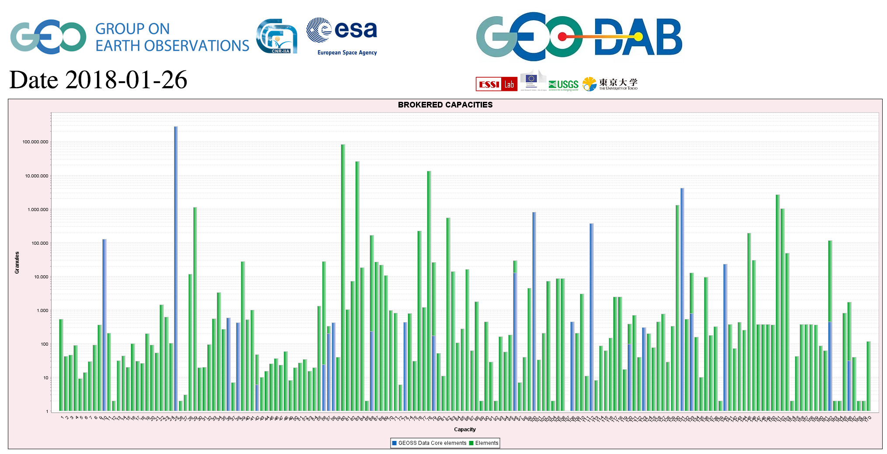
CEOS data in GEOSS
  DATA-12: CEOS data holdings reported in GEO
CWIC
FedEO

Slide 13

Support from data providers
Please register your
data in the CEOS IDN

Slide 14
Interoperability and Use
Interest Group
Purpose: to serve as a forum for exchange of technical information and lessons-learned experience about current and trending software technologies, services and other WWW / Internet related software technologies.

Slide 15
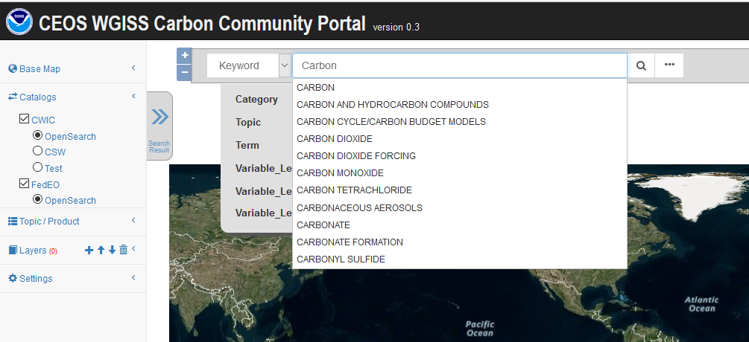
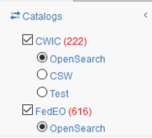
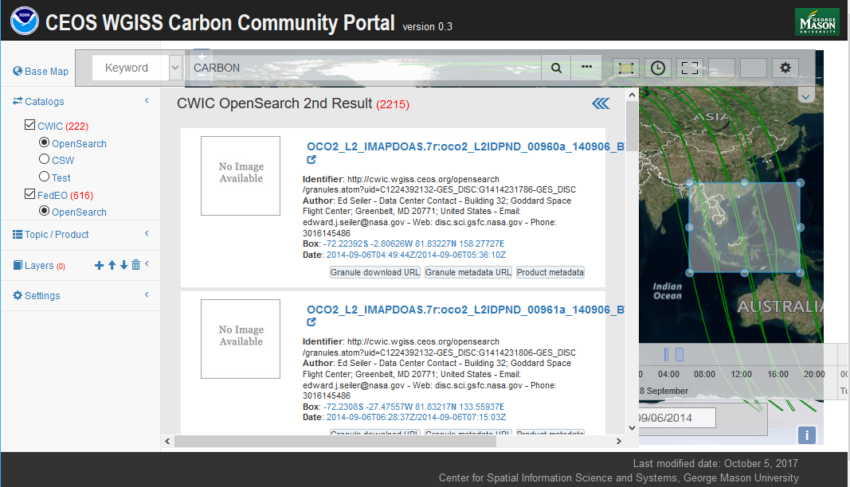
WGISS Carbon Community Portal
  CARB-15: Carbon Data Portal prototype
Keywords (auto-completion with IDN Science Keywords)
Return records from both CWIC and FedEO
Notes:
Objective: Implement a prototype carbon data portal to facilitate the discoverability and accessibility of ECV products and space-borne CDRs. The portal will seamlessly access data both in CWIC and FedEO to provide necessary data and services to the carbon science community of both CEOS and GEOSS.
Approach: prototype developed by WGISS in coordination with CEOS Carbon Team and WGClimate Carbon (requirements and use cases provision/validation).
Status: Several iterations held between WGISS and Carbon teams. Carbon Portal latest version (August 2018) with Carbon Team for review/feedback.
Next steps: 1) Improve discoverability of ECV/CDR key datasets for Carbon Community and functionalities based on received feedback; 2) Open-up portal to wider user community to gather additional feedback (target end October 2018).

Slide 16
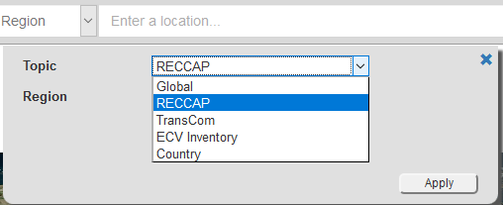
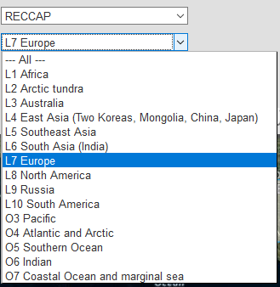
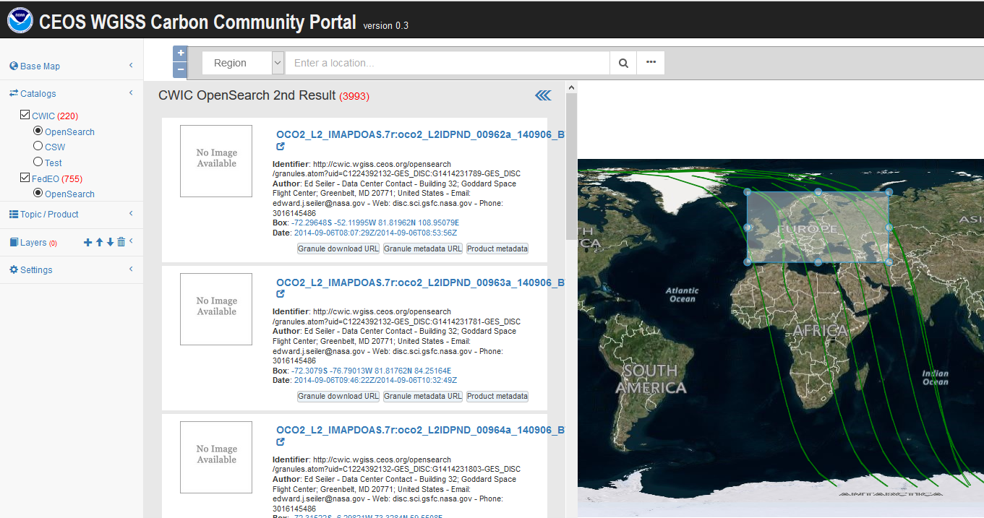
Carbon Regions of Interest and Topics
Special regions
  Global
  RECCAP
  TransCom
  Country Names
  ECV Inventory
Temporal Searches: support for time range and specific date
Pre-defined topics/datasets:
  Atmospheric Carbon
  Ecosystem Carbon
  Ocean Carbon
  Mixed-Theme Carbon

Slide 17
Interoperability and Use
FDA Themes supported via WGISS
CEOS Analysis Ready Data (ARD)
  Develop and provision CARD4L-compliant optical and/or SAR products
  Examine ARD for ocean and atmosphere domains
Interoperable Free and Open Tools
  Continue supporting the CEOS Data Cube (CDC) initiative
  Demonstrate new technologies through ongoing support of ‘pilot projects’ and consideration of alternate candidate architectures
Data, Processing, and Architecture Interface Standards
  Develop standards for pixel-level data discovery, access, and common analytical processing requests (e.g., cloud free mosaics of ARD) exploiting EO satellite data among various CEOS exploitation platforms
Analytical Processing Capabilities
  Prototype portable web-based analytical processing APIs/Web Services that work across CEOS exploitation platforms in full computing environments for time series and other analysis
User Metrics
  Develop a data use metrics framework through which agencies can contribute to how EO data is being used, rather than just downloaded data quantities
Block A: Analysis Ready Data, CARD4L and interoperable products
Block B: Agency roles in stimulating EO “use-environments”
BLOCK B
BLOCK C
Block C: Earth Observation Resources Analysis and User Metrics

Slide 18
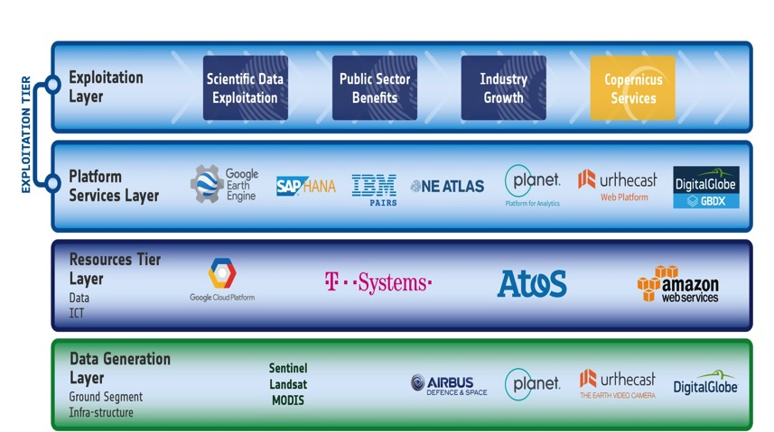
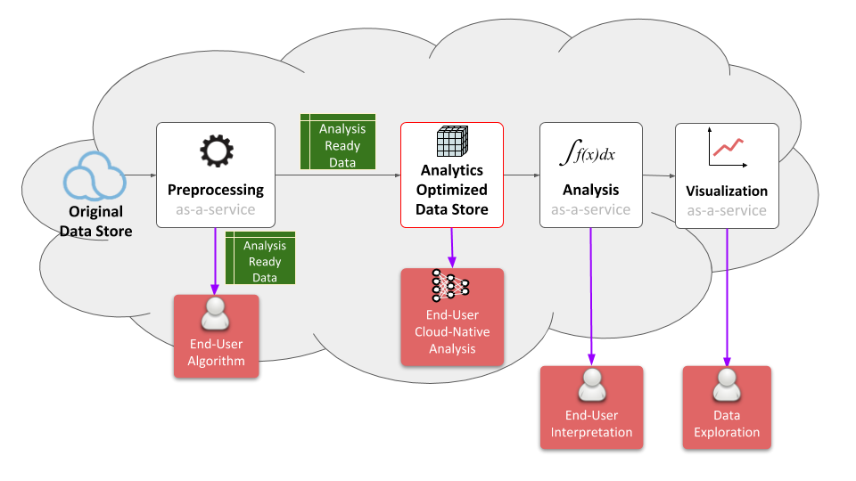
FDA Common Description
White Paper
  FDA-8: Establish a common description of Future Data Architecture functional blocks and identify interfaces and interoperability approaches (support FDA AHT)
Multiple viewpoints into the evolving FDA landscape:
  Enterprise, Information, Computation, Engineering, Technology
Building on WGISS Discovery and Access Infrastructure with a system wide view
Emphasis on what is changing: Analysis, Cloud, consumer EO
Notes:
WGISS is supporting the FDA ad-hoc team in the drafting of a white paper on to establish a common description of Future Data Architecture functional blocks and interfaces
There is large consensus that a common architectural model and terminology will:
facilitate interagency dialog
enable identification of interfaces
enable work on standardisation once interfaces identified
So we are working on a unified pretty diagram based on 5 viewpoints to convey all the necessary knowledge.
Building on WGISS Discovery and Access Infrastructure with a system wide view
Emphasis on what is changing: Analysis, Cloud, consumer EO
Technology and Engineering viewpoints link directly to the open source software and FDA inventory activities.

Slide 19
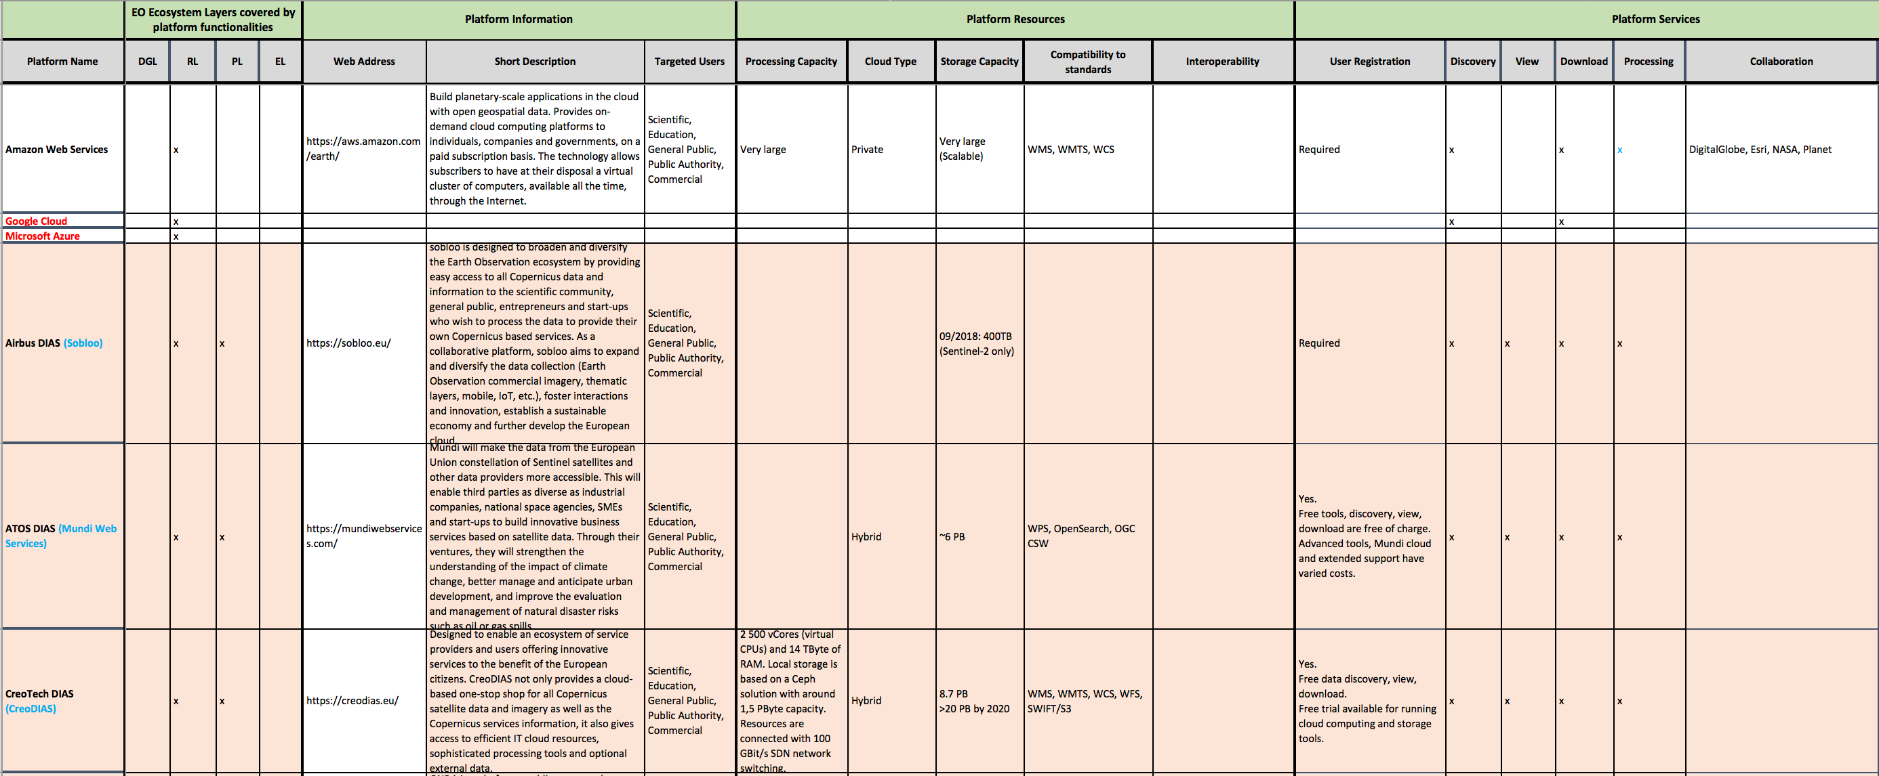
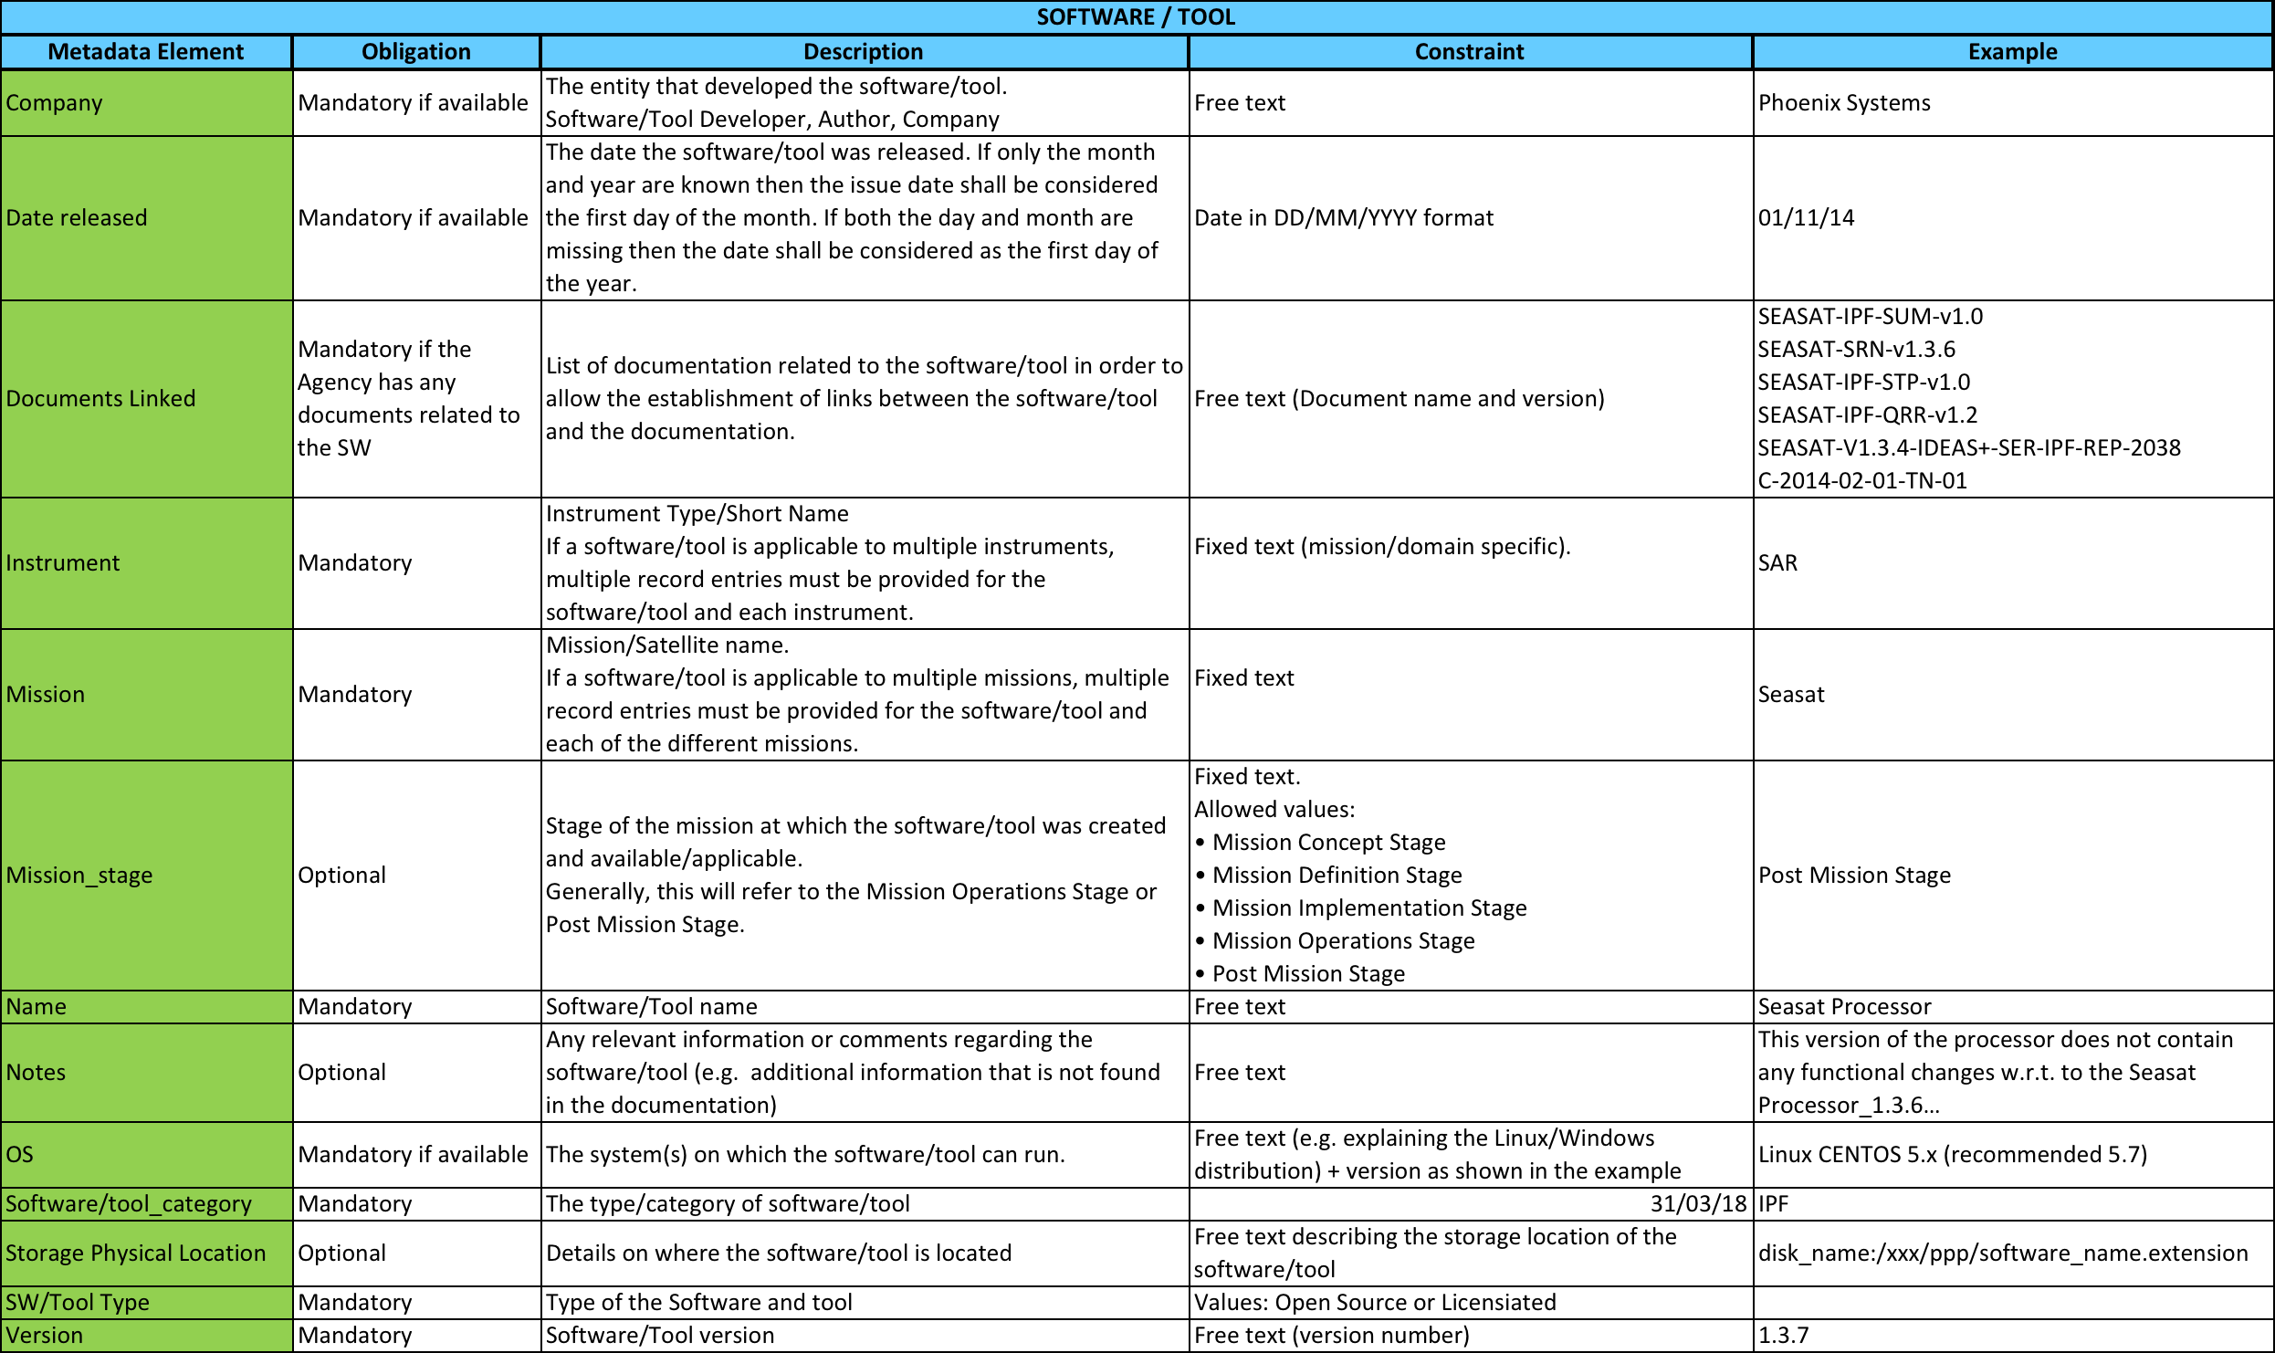
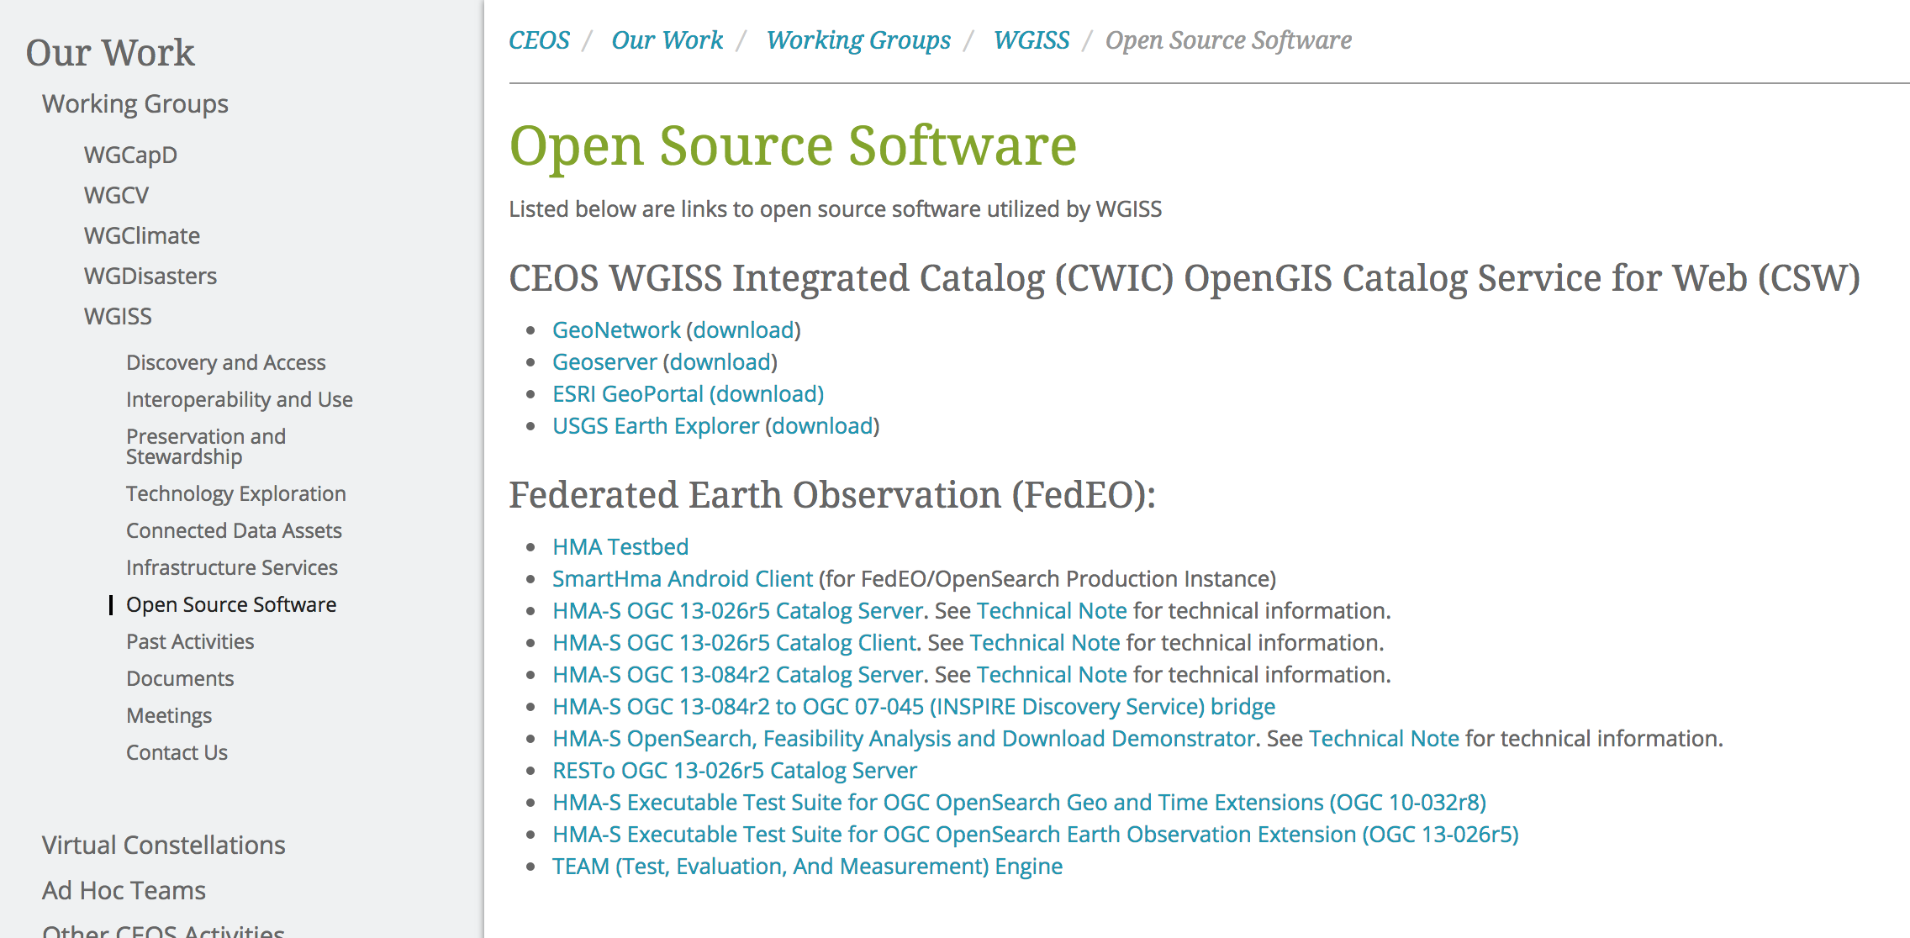
Inventories: 1) FDA Elements; 2) Open Source SW and Tools
  FDA-9: Inventory and characterize existing FDAs operated by both public and private entities
Template defined in coordination with FDA-AHT
Inventory being filled-up with information collected from different sources
  FDA-10: Inventory of CEOS agencies (Open Source) Software and Tools and implement a mechanism for discovery and access
Template defined
Inventory being filled-up with information collected from WGISS members
Notes:
Consensus that an inventory of “EO use environments” is a useful exercise that will provide insight into the EO ecosystem

Slide 20
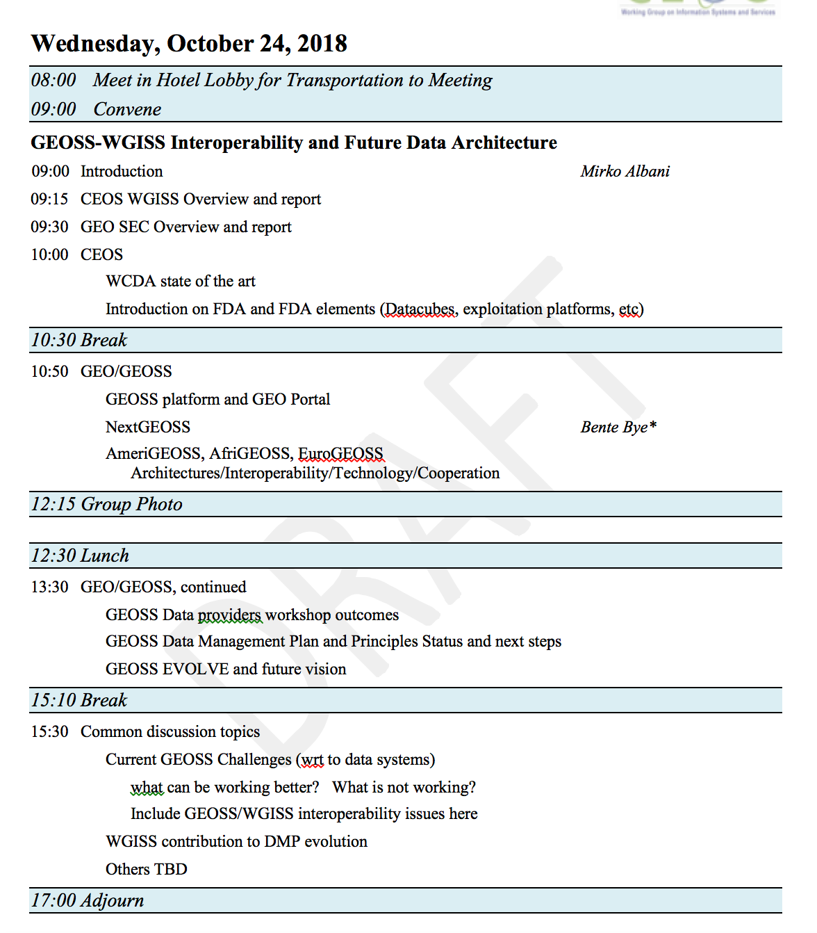
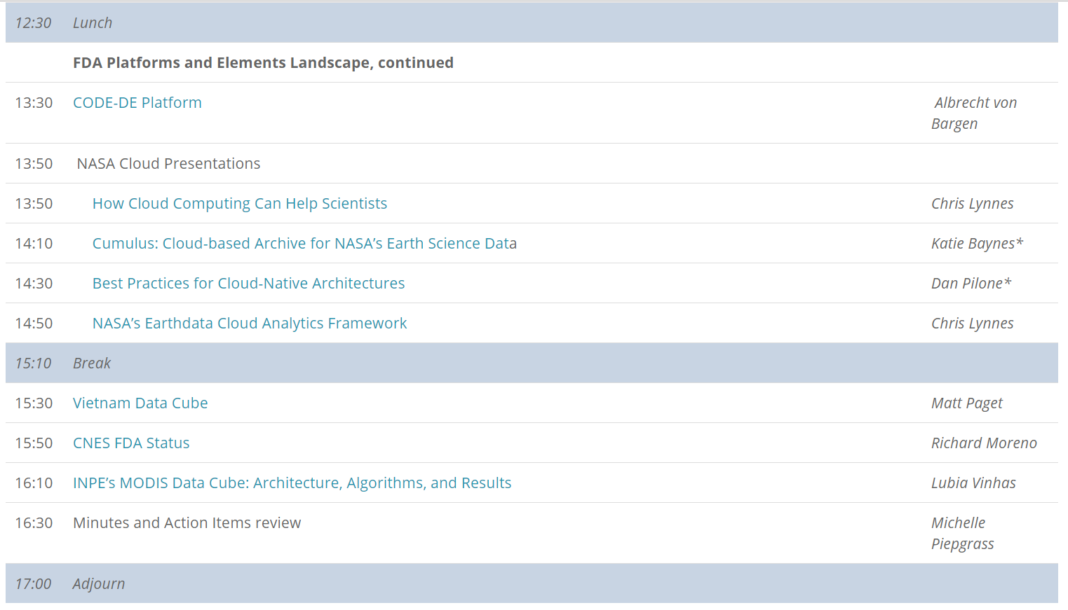
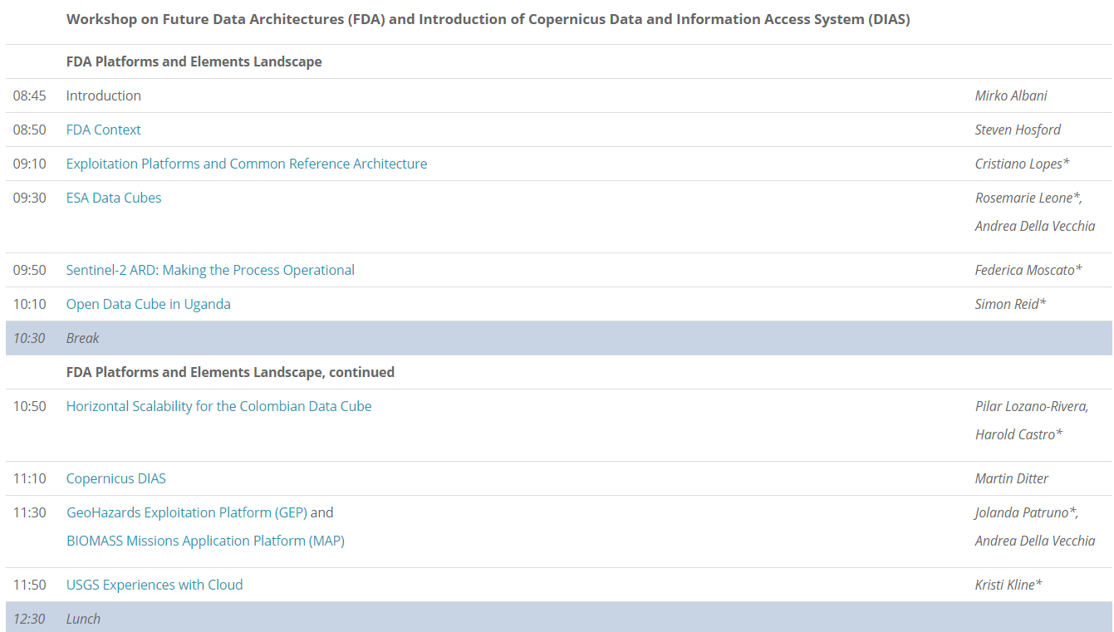


FDA Workshops
  FDA-11: Organize sessions/workshops on FDA systems pilots and interoperability projects (with FDA AHT)
http://ceos.org/meetings/wgiss-45/

Slide 21

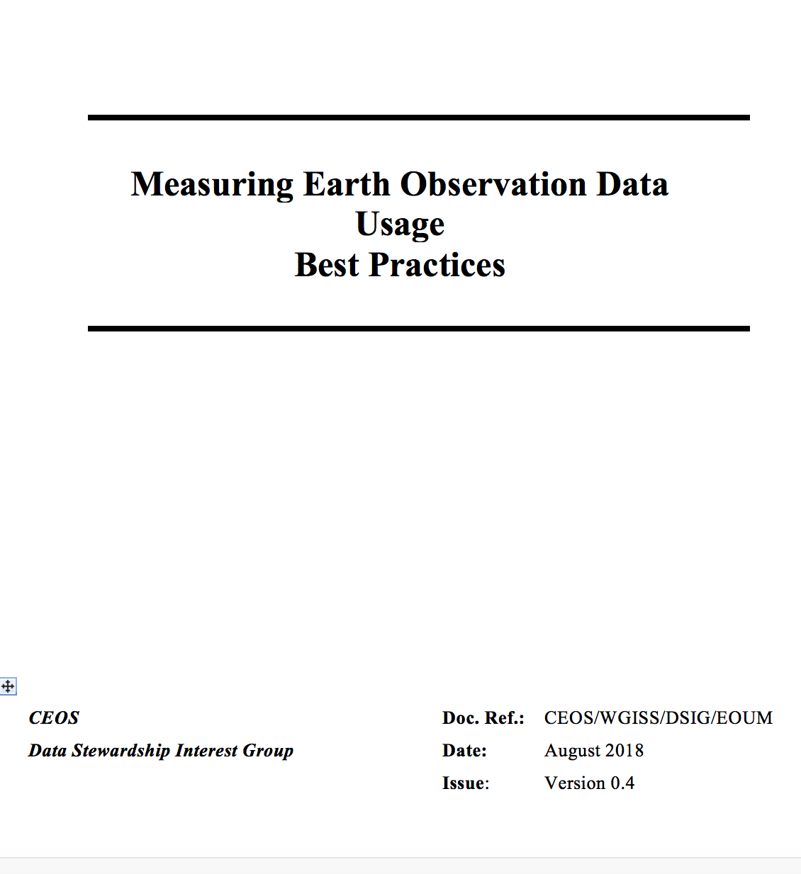
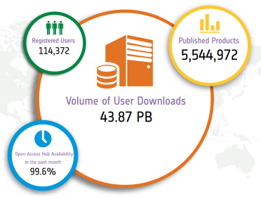
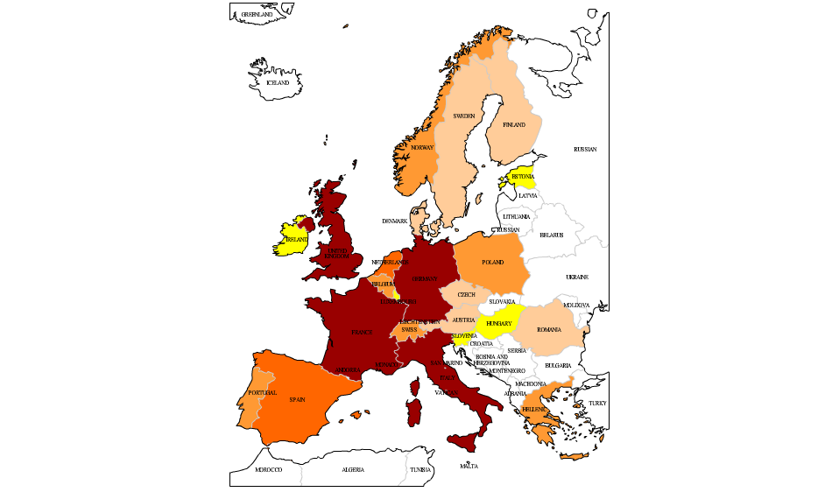
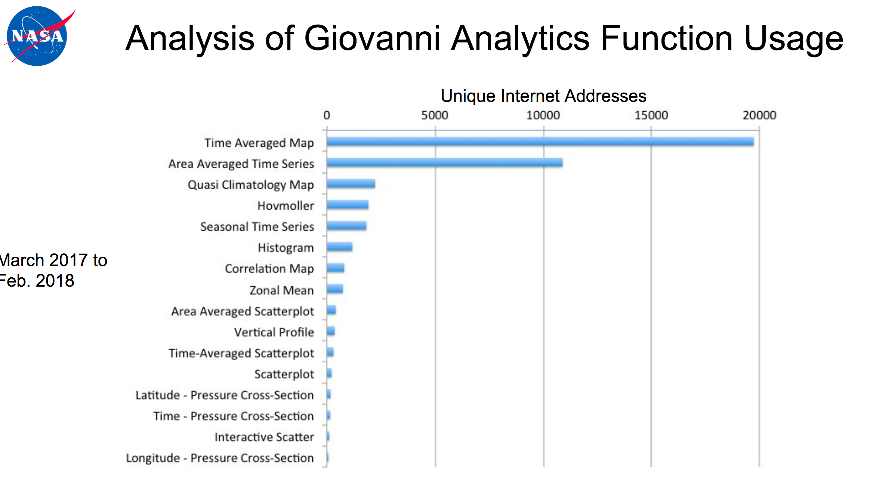
EO Data Usage Best Practice
  FDA-13: Develop a User Metrics Best Practice
EO Data Metrics
Web/Platform Metrics
User Engagement Metrics
User Satisfaction Metrics
1-100
100-199
200-399
400-799
>800
Number of user projects
Notes:
USER METRICS CONCEPT OVERVIEW
Objectives and needs – Why
Data Usage Metrics Categories – Which
Data Usage Metrics Collection – When and How
USER METRICS DEFINITION
Assumptions
User Metrics Description
User Metrics Formatting
Earth Observation Data Offering Metrics
Web and Platform Metrics
User Engagement and Satisfaction Metrics
USER METRICS FROM THIRD PARTIES
ANNEX A – Examples of statistics and INDICATORS
ANNEX B - List of Software for Statistics and User Metrics generation

Slide 22
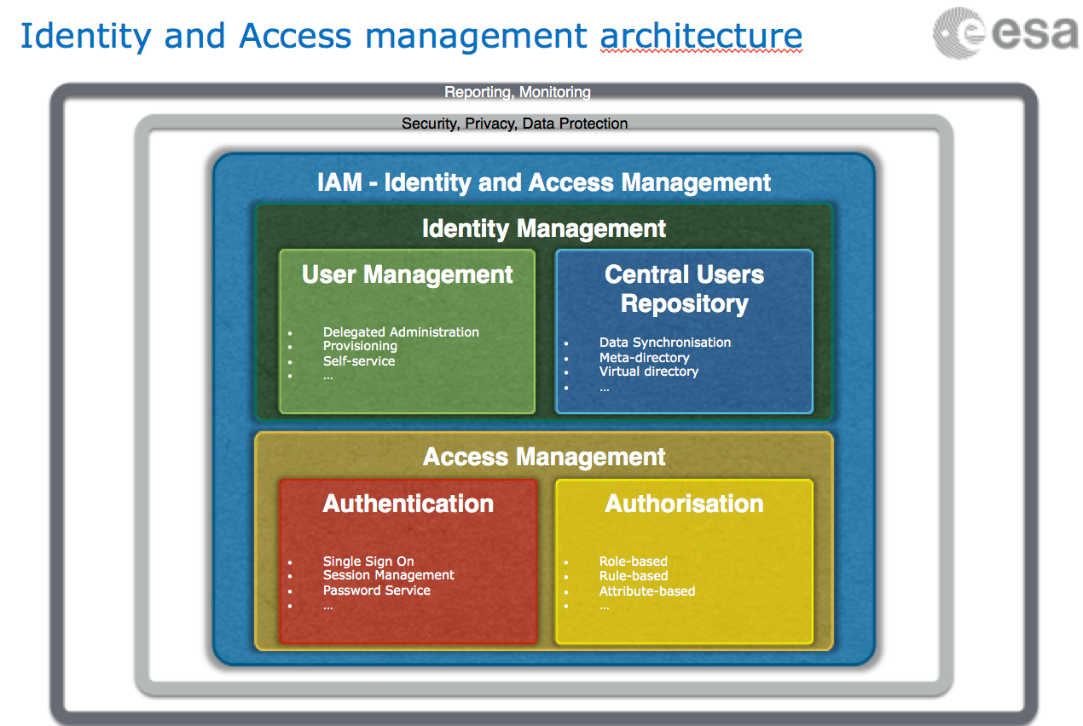
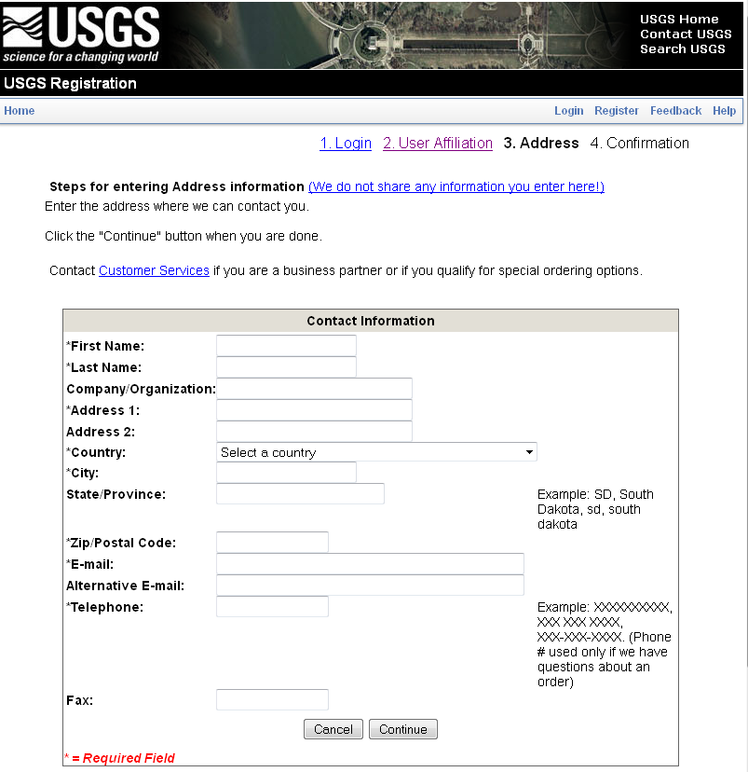
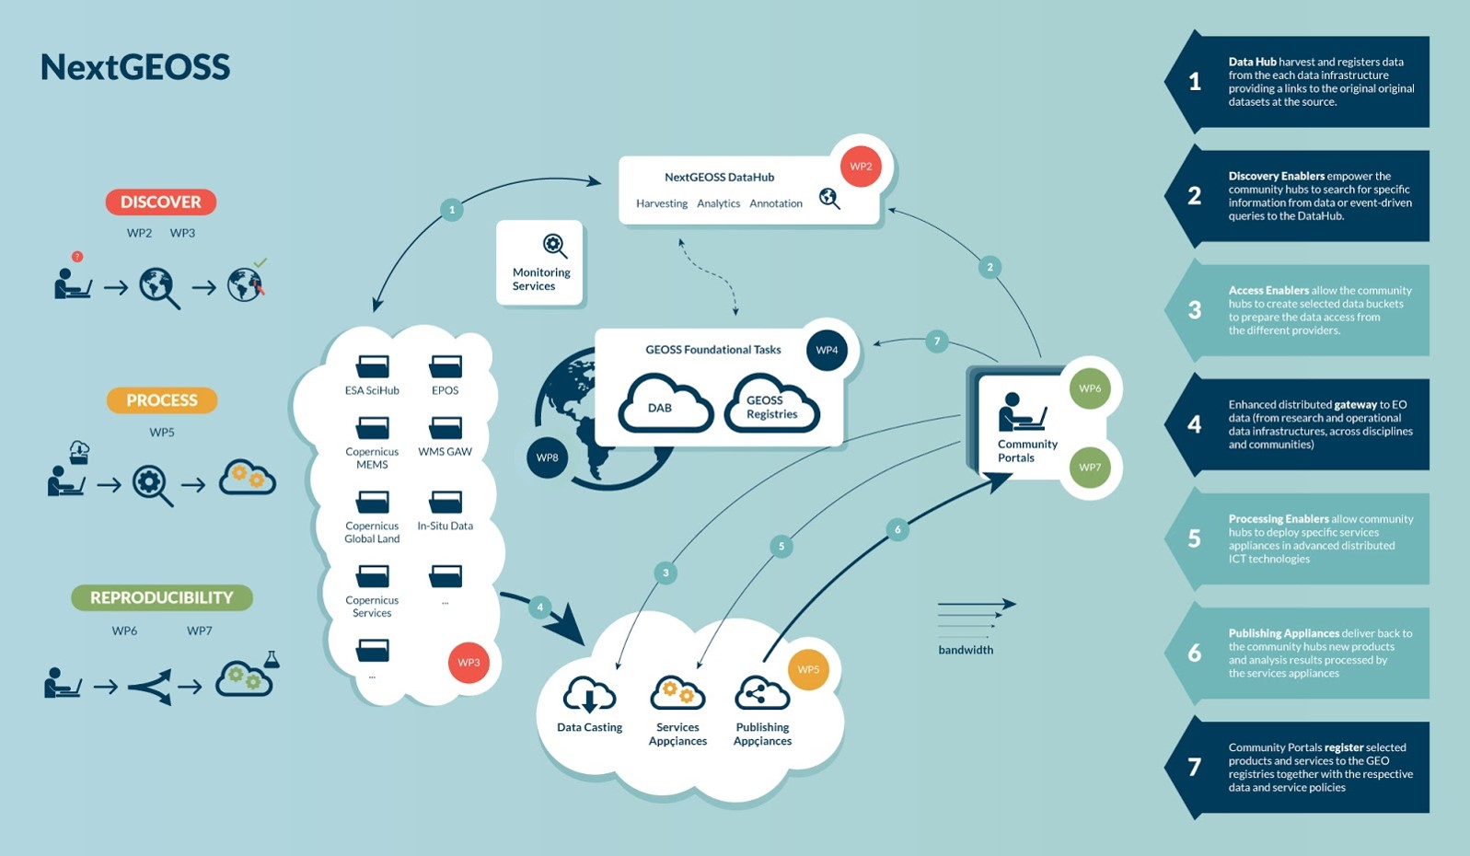
Federated Identity Management (SSO) White paper
  DATA-14: Develop a White Paper on Single Sign-On (SSO) authentication

Slide 23

Technology Exploration
Interest Group
Purpose: to serve as a forum for exchange of technical information and lessons-learned experience about current and trending software technologies, services and other WWW / Internet related software technologies.

Slide 24

Technology Webinars
Relevancy Ranking of Data Search Results
  14th of March 2017
    Stefano Nativi (GEOSS EVOLVE)
    Chris Lynnes and James Norton (NASA)
Data Cubes for Large Scale Data Analytics
  19th of June 2017
    Rob Woodcock (CSIRO)
    Brian Killough (CEOS SEO)
Burgeoning Role of Python for Earth Observation Data Analysis
  22nd of August 2017
    Syed Rizvi (Open Data Cube)
    Rich Signell (USGS)
    Alber Sanchez (INPE)
The OGC Coverage Standards Suite: Introduction and Overview
  19th of January 2018
    Dr Peter Baumann (Rasdaman)
Scrum and scale agile methods
  31st of July 2018
    Ms. Dana Shum (Raytheon NASA)
Joint webinars and advertising with:
  WGCapD
  NextGEOSS
  GEOSS Evolve
  Federation of Earth Science Information Partners (ESIP)
http://ceos.org/ourwork/workinggroups/wgiss/technology-exploration/
  DATA-11: Data and Technology Exploration webinars and workshops
FDA-5: Promote awareness of FDAs (support WGCapD)

Slide 25
WGISS Cooperation

Slide 26
Cooperation with other groups
CEOS Carbon Team - Ongoing development of prototype Carbon Portal (CARB-15)
WGClimate - Ongoing review of ECV inventory to ensure CDRs access through WGISS Connected Data Assets Infrastructure (DATA-9)
WGDisasters – Opportunities: generic recovery observatory highlighted as possible cooperation area during WGDisasters meeting#10, to be further discussed.
WGCV – Ongoing around four different topics:
  Data Formats and Interoperability in the framework of FDA
  Quality Indicators in Discovery Metadata
  CEOS Data Cubes and CEOS Test Sites Data Access in support of WGCV Activities
  Standardization and Best Practices

Slide 27
Cooperation with other groups
Virtual Constellations - Opportunities: addressed at VC-WG day – update the inventory of Virtual Constellations datasets and ensure discoverability/accessibility through WGISS Connected Data Assets infrastructure
WGCapD - Ongoing: WGISS Technology webinars and FDA events publicized through WGCapD (DATA-11 & FDA-5)
SEO - Ongoing: COVE tool harvesting metadata from WGISS Connected Data Assets Infrastructure
CGMS - Ongoing: Working Group (WG) IV Global Data Dissemination
ESIP - Ongoing: exchange of information and best practices on data stewardship
Notes:
WGISS best aligns with CGMS Working Group (WG) IV Global Data Dissemination. Many members of WGISS (e.g. NOAA, NASA EUMETSAT etc) are also members of CGMS. In the past, WGISS members have participated in WG IV to respond to CGMS action items. As an example, in response to CGMS action item # A44.03 (identify how far WGISS Interoperable standards were adopted), WGISS provided a list of CEOS agencies who have implemented CEOS Opensearch Best Practices: EUMETSAT, NASA, ESA, CNES, USGS, JAXA, ISRO (NRSC) and CCMEO.

Slide 28
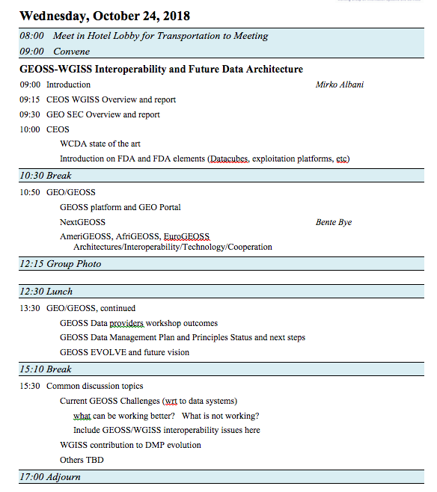
Cooperation with other groups
GEO - Ongoing:
  GEOSS Platform accessing WGISS CDA infrastructure for CEOS agencies data discovery and access
  WGISS contributing to GEOSS-EVOLVE initiative
  Participation & support to GEOSS Data Providers
  Workshops (e.g. “User Metrics” session, May 2018)
  Contribution to CEOS booth at GEO Plenary
  WGISS represented in NextGEOSS Advisory Board
  and Working with NextGEOSS on federated
  authentication technology solutions
  Joint Workshop on GEOSS-WGISS
  interoperability and FDA at WGISIS#43
  and upcoming WGISS#46

Slide 29
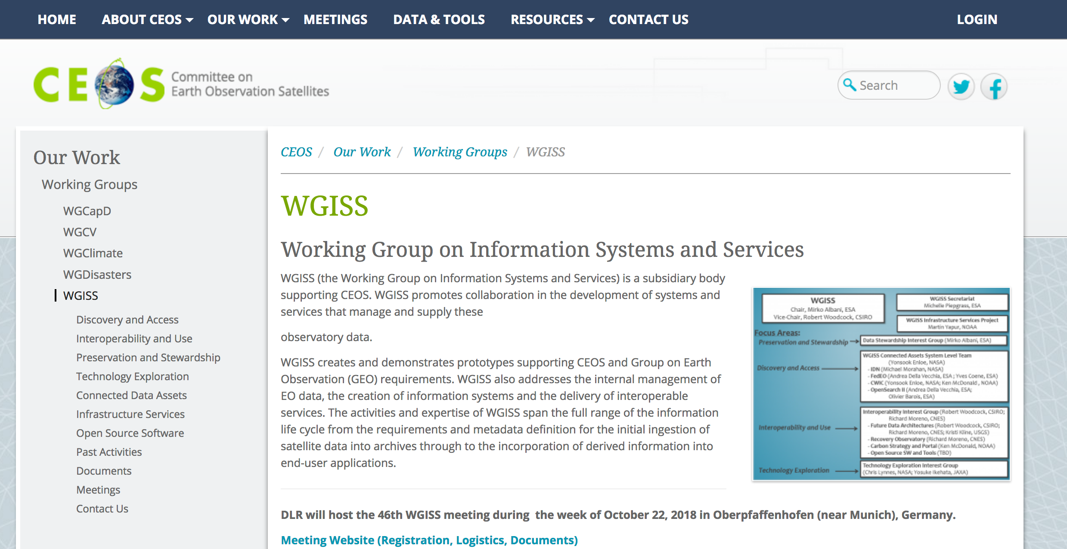
WGISS Information
http://ceos.org/ourwork/workinggroups/wgiss/

Slide 30
WGISS Health Status
Interagency coordination working well, good cooperation spirit
Healthy participation to meetings (average 20 people)
  Some members attending all meetings (e.g. NASA, NOAA, USGS, CNES, ESA, CSIRO, JAXA, RADI, AOE CAS, HUNAGI)
  Others attending sporadically depending on meeting location and topics under discussion
  Stable participation from all agencies would increase WGISS activities impact and capability to respond to CEOS 2018-20 Work Plan
  Organization of targeted events during WGISS weeks proved to attract more participants (e.g. CEOS/GEO technical workshop, FDA)
  Promotional material being developed and actions being undertaken to enlarge engagement

Slide 31

Vice Chair Nomination
WGISS Vice Chair Nomination for the period October 2019 – October 21

Slide 32
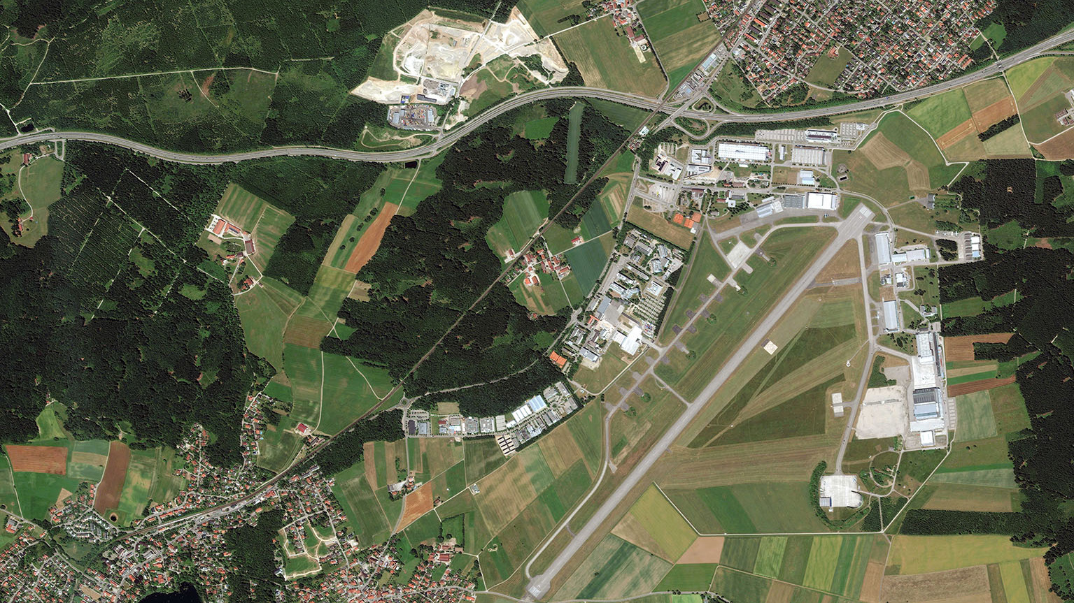
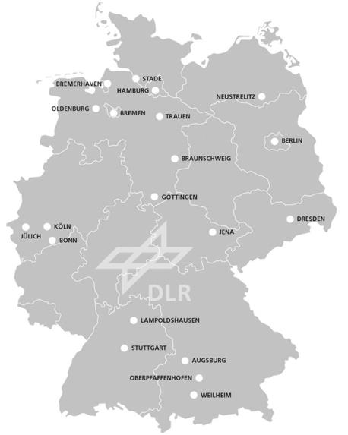

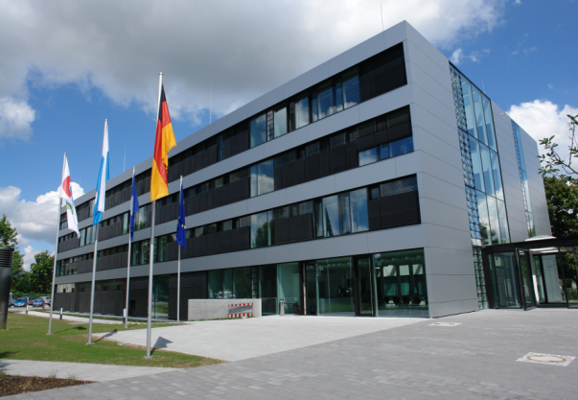
Upcoming Meetings
WGISS#46 hosted by DLR - Oberpfaffenhofen, Germany (October 2018)
  CEOS/GEO FDA and Interoperability Workshop
WGISS#47 – March/April 2019, hosted by NOAA
DLR-Oberpfaffenhofen
near Munich, Germany
Munich 30 km →
Oberpfaffenhofen
DLR Earth Observation Center

Slide 33

Contact:
Mirko.Albani@esa.int

