Slide 1
WMO Realignment -
What do Changes to
WMO Structure Mean to CEOS ?
Werner Balogh
WMO Space Programme Office
2019 CEOS-SIT-TW
Fairbanks, Alaska, US
9-12 September 2019

Slide 2
Contents
WMO Governance Reform
WMO and CEOS
Other Key Cg-18 Outcomes
WMO Space Programme Updates
Backup Slides

Slide 3
I. WMO Governance Reform

Slide 4



Reform Objectives
Effectiveness and efficiency
Seamless and integrated approach
Increase value
for society
Engagement of Members and Partners
Earth System
approach
WMO
acting as one
Agile and responsive
to new challenges

Slide 5
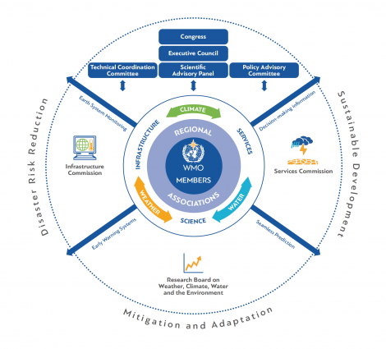
Cg-18 Adopted New WMO Structure
See https://public.wmo.int/en/governance-reform

Slide 6




WMO Strategic Plan 2020-2030
VISION 2030
A world where all nations, especially the most vulnerable, are more resilient to the
socioeconomic impact of extreme weather, climate, water and other environmental events, and
empowered to boost their sustainable development through the best possible weather, climate and water services
OVERARCHING PRIORITIES
Preparedness for, and reducing losses from hydrometeorological extremes
Climate-smart decision-making to
build resilience and adaptation to climate risk
Socioeconomic value of weather, climate, hydrological and related environmental services
CORE VALUES
Accountability for Results
and Transparency
Collaboration and Partnership
Inclusiveness and Diversity
1
2
3
4
5
LONG-TERM GOALS
Services
Better serve
societal needs
Infrastructures
Enhance Earth system observations and predictions
Science & Innovations
Advance targeted research
Member Services
Close the
capacity gap
Smart
Organization
Strategic realignment of structure and programmes
STRATEGIC OBJECTIVES
FOCUSED ON
2020-23
Strengthen national multi-hazard early warning/alert systems
Broaden provision of policy- and decision-supporting climate, water and weather services
Optimize observation data acquisition
Improve access to, exchange and management of Earth system observation data and products
Enable access and use of numerical analysis and prediction products
Advance scientific knowledge of the Earth system
Enhance science-for-service value chain to improve predictive capabilities
Advance policy-relevant science
Enable developing countries to provide and utilize essential weather, climate, hydrological and related environmental services
Develop and sustain core competencies and expertise
Scale up partnerships
Optimize WMO constituent body structure
Streamline WMO programmes
Advance equal, effective and inclusive participation

Slide 7







Enhanced Collaboration with Partners
Joint bodies
Working arrangements
Programmes/Projects
More interaction and collaboration with
partners from all relevant areas
Etc., etc., etc …
See e.g. https://public.wmo.int/en/governance-reform/joint-wmo-ioc-collaborative-board

Slide 8
II. WMO and CEOS

Slide 9
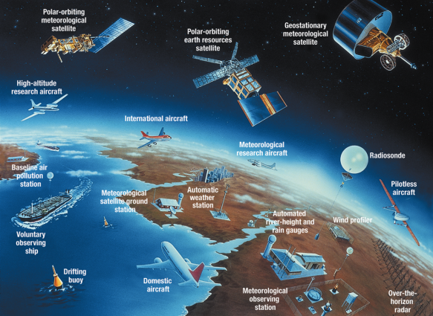
WMO Integrated Global Observing System

Slide 10
WMO Application Areas - Earth System Approach
1) | Global numerical weather prediction
2) | High-resolution numerical weather prediction
3) | Nowcasting and very short range forecasting
4) | Sub-seasonal to longer predictions
5) | Aeronautical meteorology
6) | Forecasting atmospheric composition
7) | Monitoring atmospheric composition
8) | Atmospheric composition for urban applications
9) | Ocean applications
10) | Agricultural meteorology
11) | Hydrology
12) | Climate monitoring (GCOS)
13) | Space weather
14) | Climate science
See http://www.wmo.int/pages/prog/www/OSY/GOS-RRR.html

Slide 11
Vision for WIGOS in 2040
Backbone system with specified orbital configuration and measurement approaches (Group 1).
Backbone system with open orbit configuration and flexibility to optimize the implementation (Group 2).
Operational pathfinders, and technology and science demonstrators (Group 3).
Additional capabilities (Group 4).
See https://www.cgms-info.org/Agendas/WP/CGMS-47-WMO-WP-02

Slide 12
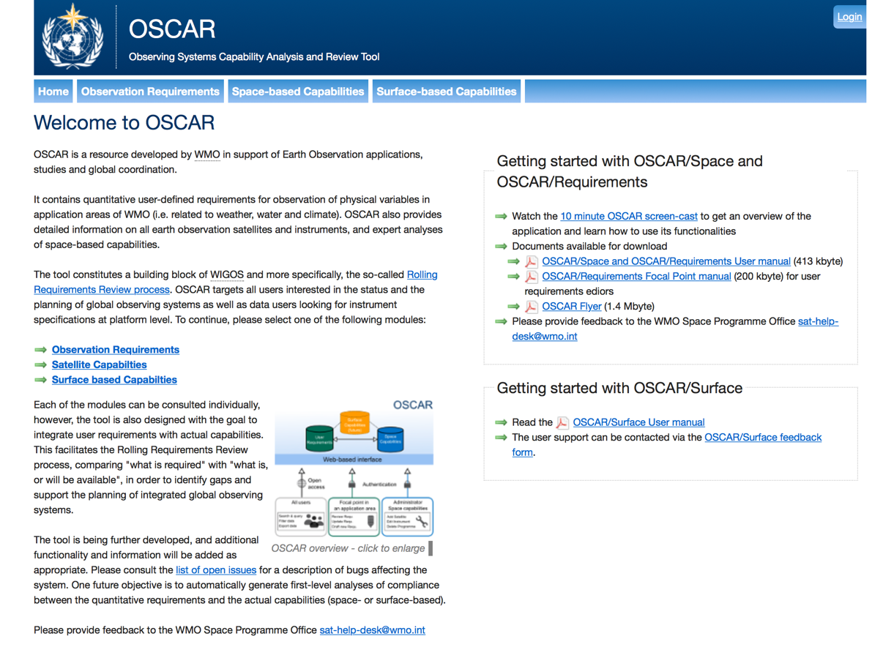
Observing System Capability Analysis and Review Tool
See http://oscar.wmo.int

Slide 13
WMO and CEOS
CEOS essential to support implementation of Earth System Approach
WIGOS, WIS and DPFS-new are core elements of Earth System Watch (ESW), such as GOS, GTS and DPFS were core elements of World Weather Watch (WWW)
CGMS supported and made possible WWW
CGMS and CEOS active participation will be required to enable ESW and to implement 2040 Vision
First step may be to formalize procedures for CEOS input to OSCAR and for finding ways to harmonize MIM and OSCAR

Slide 14
Other CEOS-WMO Points of Interest
WMO is interested in CEOS perspectives on plans aligned with the Ocean Decade Goals (see https://www.oceandecade.org/) as well as the GOOS 2030 Strategy
High Mountain Summit, Switzerland, from 29 to 31 October 2019 (see https://highmountainsummit.wmo.int).
  Members of the Polar Space Task Group (PSTG) have been invited to attend and contribute to this high-level dialogue
  See http://www.wmo.int/pages/prog/sat/pstg_en.php
Strengthening WGCapD and WMO-CGMS VLab collaboration

Slide 15
Conclusions
WMO has adopted Earth System Approach
WIGOS, WIS and DPFS-new are core elements of Earth System Watch (ESW)
Need for closer engagement and re-definition of WMO-CEOS partnership
First step is to develop a working process to ensure that CEOS agencies provide updated information to OSCAR/Space in a frequent and effective manner

Slide 16
http://www.wmo.int/sat

Slide 17
III. Other Key Cg-18 Outcomes
(Relevant to Observations)

Slide 18
Selected Cg-18 Outcomes
34 | Global Basic Observing Network (GBON)
35 | WMO Integrated Global Observing System station identifiers
36 | Amendments to the Technical Regulations (WMO-No. 49), Volume I, Part I – WMO Integrated Global Observing System, and to the Manual on the WMO Integrated Global Observing System (WMO-No. 1160)
37 | The WMO Integrated Global Observing System transition to operational status commencing in 2020
38 | Vision for the WMO Integrated Global Observing System in 2040
40 | Members’ contribution to the actions specified in the Implementation Plan for the Evolution of Global Observing Systems, in the context of the future WMO Integrated Global Observing System Implementation Plan
42 | Radio frequencies for meteorological and related environmental activities
46 | Future collaboration between WMO and the Intergovernmental Oceanographic Commission on facilitating oceanographic observations in coastal regions in support of Earth system prediction and climate services
See https://library.wmo.int/index.php?lvl=notice_display&id=15822 (WMO No.508)

Slide 19
Selected Cg-18 Outcomes
47 | Ocean observations in support of Earth system prediction, and WMO support to the Global Ocean Observing System Strategy 2030 (including Tropical Pacific Observing System 2020)
49 | Antarctic Observing Network
50 | Pre-operational phase of the Global Cryosphere Watch
51 | Implementation of the architecture for climate monitoring from space
52 | Strategy for the Virtual Laboratory for Education and Training in Satellite Meteorology 2020–2024
53 | Four-year plan for WMO activities related to space weather 2020–2023
54 | Implementation plan of the regional operational subproject for space-based monitoring of weather and climate extremes in East Asia and the Western Pacific
55 | Emerging data issues
56 | Data policies and practices
See https://library.wmo.int/index.php?lvl=notice_display&id=15822 (WMO No.508)

Slide 20
37(Cg-18) – WIGOS Operational
National WIGOS implementation:
Implementation of the Global Basic Observing Network and the Regional Basic Observing Networks;
Operational deployment of the WIGOS Data Quality Monitoring System;
Operational deployment of Regional WIGOS Centres;
Further development of the OSCAR databases and integration with other system elements;
Fostering a culture of compliance with the WIGOS technical regulations;
See https://www.wmo.int/pages/prog/www/wigos/documents/WIGOS_Newsletter_Vol5_N3_July2019_v1.0.pdf

Slide 21
IV. WMO Space Programme Updates

Slide 22
CIMO Guide Update 2018 edition
CIMO Guide Volume IV, 2018 edition, is now published and available in WMO library in all WMO official languages.
CEOS Members may wish to review and provide feedback to WMO.
Next revision to be published 2020.
See https://library.wmo.int/index.php?lvl=notice_display&id=12407

Slide 23
WMO Annual Reporting to UNCOPUOS
Sixty-second session (12-21 June 2019)
WMO Statements (also noting CEOS Work) under
  General Exchange of Views
  Space and Climate Change
See http://www.unoosa.org/oosa/en/ourwork/copuos/2019/index.html

Slide 24
V. Backup Slides

Slide 25
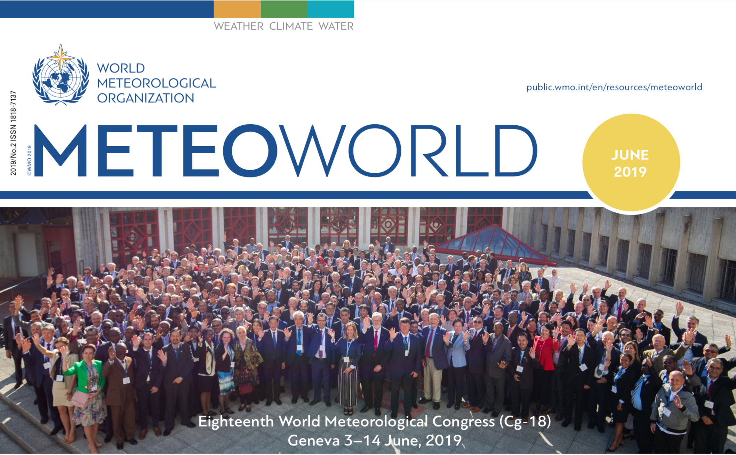
18th World Meteorological Congress
See https://library.wmo.int/index.php?lvl=bulletin_display&id=3977

Slide 26
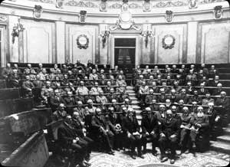

CONSTITUENT BODY REFORM (CBR)
1873
2050
WMO for the 21st Century

Slide 27




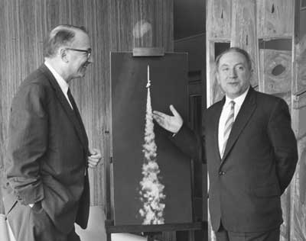

Global Developments
1940s
1950s
1960s
1970s
1980s
1990s
2000s
2010s
2020s
INTERNATIONAL AGENDA
United
Nations
WMO
UNEP
Second World
Climate Conference
IPCC
UNFCCC
Global Climate
Observing System
First World Climate
Conference
World Climate
Conference-3
INTERNATIONAL FRAMEWORKS
Montreal
Protocol
Kyoto
Protocol
UN Millennium Development Goals
Sustainable Development Goals
Sendai Agreement
Paris Agreement
Hyogo Framework
SOCIAL
TRENDS
Rise of Modern Environmentalism
Rise of Sustainable Development Movement
Social License
(local communities and stakeholders)
ECONOMIC & POLITICAL
TRENDS
Privatization
Sustainability, less government spending
Government Owned and Operated
Globalization
Global Financial Crisis
International Geophysical Year
Global Ozone Observing System
1st Measurements of CO2
World Weather
Watch
4th International Polar Years
1st
Climate
Models
1st
Numerical Weather Predictions models
Global Framework for Climate Services
Background Air Pollution Monitoring Network
Polar Prediction Project
SCIENTIFIC
TRENDS
Global Atmospheric Research Program
Effects of Doubling CO2 Concentration on the Climate of a General Circulation Model
Seamless Prediction
Numerical Weather Prediction
WMO Integrated Global Observing System
TIROS-1,
1st Weather Satellite
1st direct measurements of Earth’s radiation budget
Global Atmosphere Watch
THORPEX
Year of Polar Prediction
TECHNOLOGY
TRENDS
Airborne and Shipping Geophysics
Satellite Revolution
Digital Revolution
Internet and Smart Mobile
Crowdsourcing
CO₂ levels passed 400 ppm

Slide 28
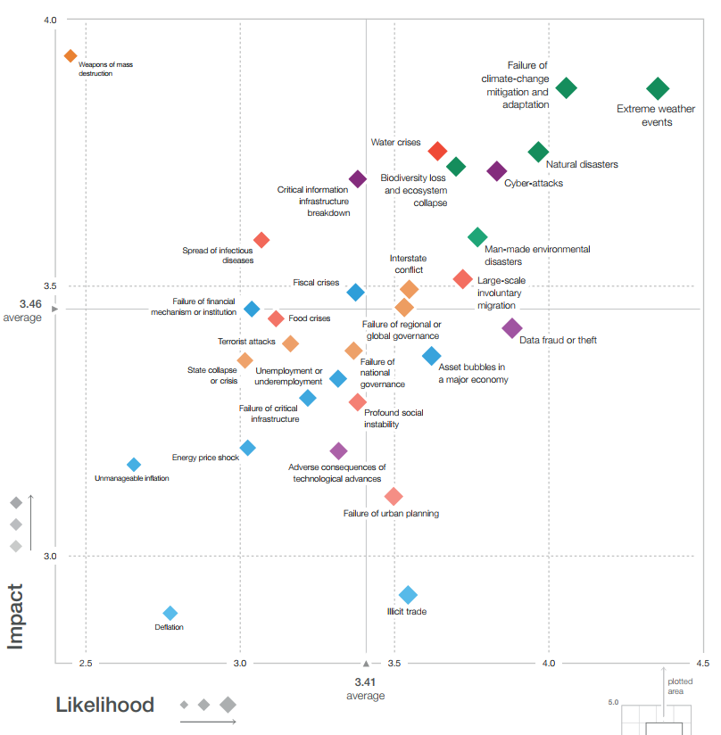
Highest Risks for World Economy
Failure of climate change mitigation and adaptation
Extreme weather events
Water crises
Natural disasters
Biodiversity loss and ecosystem collapse
Cyberattacks
Interstate
conflict
Man-made environmental disasters
Large-scale involuntary migration
World Economic Forum Global Risks Landscape 2019

Slide 29






Alignment of WMO Structure
Strategic Plan Long-term Goals | Global Lead/Regional Expertise | Executive Council Policy, Coordination, Integration, Foresight
1
Services
Services
Commission
Policy Advisory Committee
2
Infrastructures
Infrastructure
Commission
Technical
Coordination
Committee
3
Science &
Innovations
Research
Board
Scientific
Advisory Panel
4
Member
Services
Regional
Associations
+ Inter-agency coordination
mechanisms
5
Smart
Organization
More Strategic, Enhanced Services,
Optimal Support
■ Established by EC-70
■ EC-70 Recommendations to Congress (intergovernmental)
■ EC-70 Recommendations to Congress for new science bodies (non-intergovernmental)

Slide 30
Enhanced Role for Regional Associations
Congress / EC
Scientific and technical communities
Political and economic regional groups
Regional requirements, needs and priorities
Technical solutions
Standards, guidance
TECHNICAL
COMMISSIONS
REGIONAL
ASSOCIATIONS
National/regional experts
Expertise, assistance, efficiency, innovation
Implementation Process

Slide 31



Standing Committees
Earth observing systems and measurement networks
Methods of observations, measurements
and instrumentation
Data, products and information exchange
and life cycle management
Data processing for applied Earth system
modelling and prediction
Infrastructure Commission


Slide 32



Standing Committees
Aeronautical meteorological services
Marine meteorological and oceanographic services
Agrometeorological and climatological services
Hydrological services
Public services and disaster risk reduction

Services
Commission
!

Slide 33
Technical Commissions
Technical Coordination Committee
Normative work, systems and services
Exploratory work, innovation
Standing Committee
Standing Committee
Standing Committee
Study Group
Study Group
Expert Team
Expert Team
Expert Team
Expert Team
Expert Team
Expert Team
Expert Network
Note: Lines indicate reporting
See https://public.wmo.int/en/our-mandate/how-we-do-it/technical-commissions

Slide 34
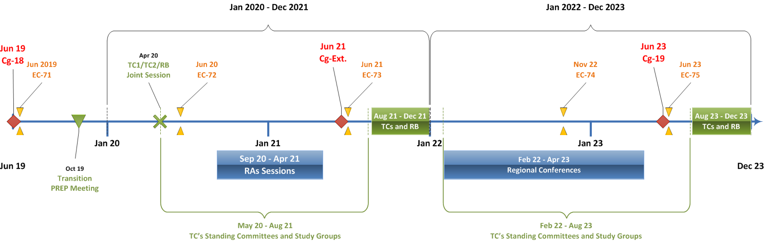
Timeline

Slide 35
Proposed WMO-GEO Key Collaboration Areas
Development of common protocols and methods to facilitate free and open data access wherever possible;
“ Big data” and related emerging issues, e.g. regarding the role of the private sector in Earth observations;
Further exploitation of the synergy of the WMO Information System (WIS) global and national infrastructure (GISCs, DCPCs and NCs) and the GEO Common Infrastructure (GCI);
Joint activities to quantify and highlight the socioeconomic benefit of Earth observations;
Joint activities to identify and document user needs for information for decision-making and Earth observations.
48th GEO Executive Committee Meeting
Geneva, Switzerland (23 Jul - 24 Jul 2019)

Slide 36
WMO-CEOS Partnership
Continue implementing Architecture for Climate Monitoring from Space – acknowledge resolution
Enhance CEOS involvement with RRR process, towards implementing Vision for WIGOS in 2040
Enhance partnership with CEOS in selected application areas
  Agricultural applications (GEOCLAM)
  Hydrological Applications
  Polar and High-Mountain Regions
Work towards integration of CEOS data management activities with WIS 2.0
CEOS SIT-34
Miami, US (23 Jul - 24 Jul 2019)

Slide 37
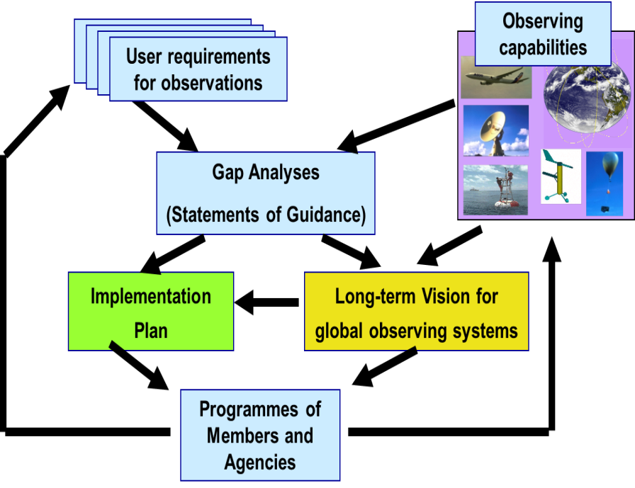
Rolling Review of Requirements
OSCAR/Space
OSCAR/Surface
OSCAR/
Requirements
WIGOS Vision 2040

Slide 38
OSCAR/Space and CEOS
A large problem is with the collection of information on the status of satellites and instruments. The persistent lack of this information undermines the accuracy of the Gap analyses in OSCAR/Space, since too many satellites continue to be carried forward in the timeline bars, perhaps inactive since long.
This problem has been addressed in CGMS-47-WMO-WP17b that concludes with proposing the Action “CGMS members and observers to provide updated information on the status of their satellites and instruments following the instructions and tables attached to the working paper”.
However, the tables attached to CGMS-47-WMO-WP17b were limited to programmes managed by CGMS members and observers.
In addition, the contents were referring to the information as recorded in early May 2019. A new document (July 2019) has been prepared and is herewith submitted to the CEOS Secretariat
Responses from CMA, ISRO, JAXA, KARI and NASA are needed.

Slide 39
OSCAR/Space and CEOS
OSCAR/Space essential for RRR (gap analysis, observing system design)
Need to engage non-CGMS CEOS agencies
CEOS agencies requested to provide missing information in response to OSCAR/Space inquiry from July 2019
Engagement through WMO OSCAR/Space Support Team?

