Slide 1

WG Disasters
Committee on Earth Observation Satellites
Simona Zoffoli, ASI, WG Disasters Chair
David Green, NASA, WG Disasters Vice-Chair
CEOS SIT Technical Workshop
Session and Agenda Item # 4.6
Fairbanks, Alaska, USA
11 – 12 September 2019

Slide 2
Overview
WG Disasters Work Plan 2019-2021
  All deliverables running as planned, except one year extension requested for Landslide Pilot
New 2019 Engagements: CSA, CSIRO, NOAA
Open Actions from SIT and Plenary: None
Items for 2019 CEOS Plenary:
  WG Disasters ToR review and endorsement

Slide 3
CEOS Work Plan 2019-2021
WG Disasters: 9 deliverables related to the main initiatives
  GEO Initiatives
    GSNL, DIS-10 Data coordination for GSNL
    GEODARMA, DIS-15, Identification of DRM priorities
  CEOS WG Disasters DRM Initiatives
    Landslide Pilot, DIS-16, Final report
    Recovery Observatory, DIS-12 (early evaluation), DIS-22 (final rep.)
    Volcano Demonstrator, DIS-18 (annual report)
    Seismic Demonstrator, DIS-21 (2019 report)
  CEOS WG Disasters Cross-cutting Initiatives
    GeoHazards Lab, DIS-19 (e-collaboration, Q3 2019), DIS-20 (Q1 2020 standardize)
WG Disasters has no open SIT and Plenary actions. Coordination with NOAA and WGCapD on the GEO-LEO Initiative

Slide 4
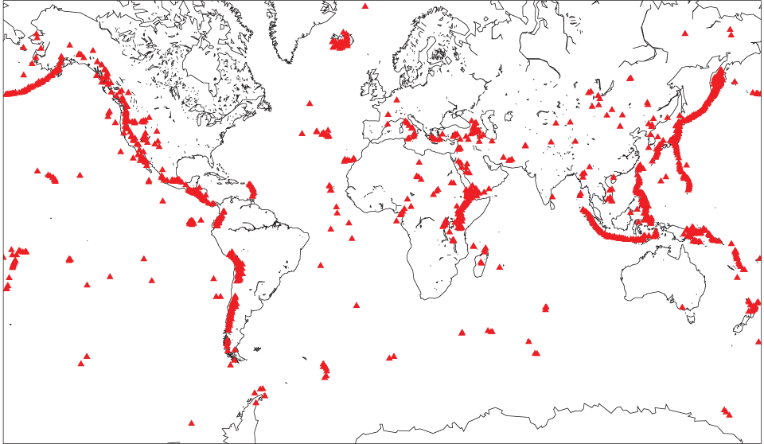

Volcano Demonstrator
Volcano Demonstrator, DIS-18
International Leads:
Susanna Ebmeier, Mike Poland
Latin America Lead: Matt Pritchard
Africa Lead: Juliet Biggs
SE Asia Leads: Yosuke Aoki, Ian Hamling
Volcano Pilot Latin America: 2014-2017
Volcano Demonstrator :
Latin America, Africa & SE Asia 2019-2021

Slide 5
Volcano Demonstrator
Fill gaps in current monitoring
Focus on use of diverse wavelengths:
supplementing C-band with X and L.
Aims
Expand use of satellite remote sensing for volcano monitoring
Research link between volcanic unrest and eruption from satellite observables
Supporting capacity building initiatives to increase the uptake of satellite imagery
International coordination of satellite tasking to maximise its usefulness to volcano observatories
Integration of InSAR (primary Volcano Demonstrator datasets) with degassing and thermal satellite data
Remote Sensing Workshop in May 2020 at Cities on Volcanoes including funded places for volcano observatory scientists

Slide 6
Volcano Demonstrator
Aims
Expand use of satellite remote sensing for volcano monitoring
Research link between volcanic unrest and eruption from satellite observables
Supporting capacity building initiatives to increase the uptake of satellite imagery
International coordination of satellite tasking to maximise its usefulness to volcano observatories
Long term goal:
to demonstrate the necessity and viability of international coordination of satellite tasking for volcano monitoring (after polar science community)

Slide 7
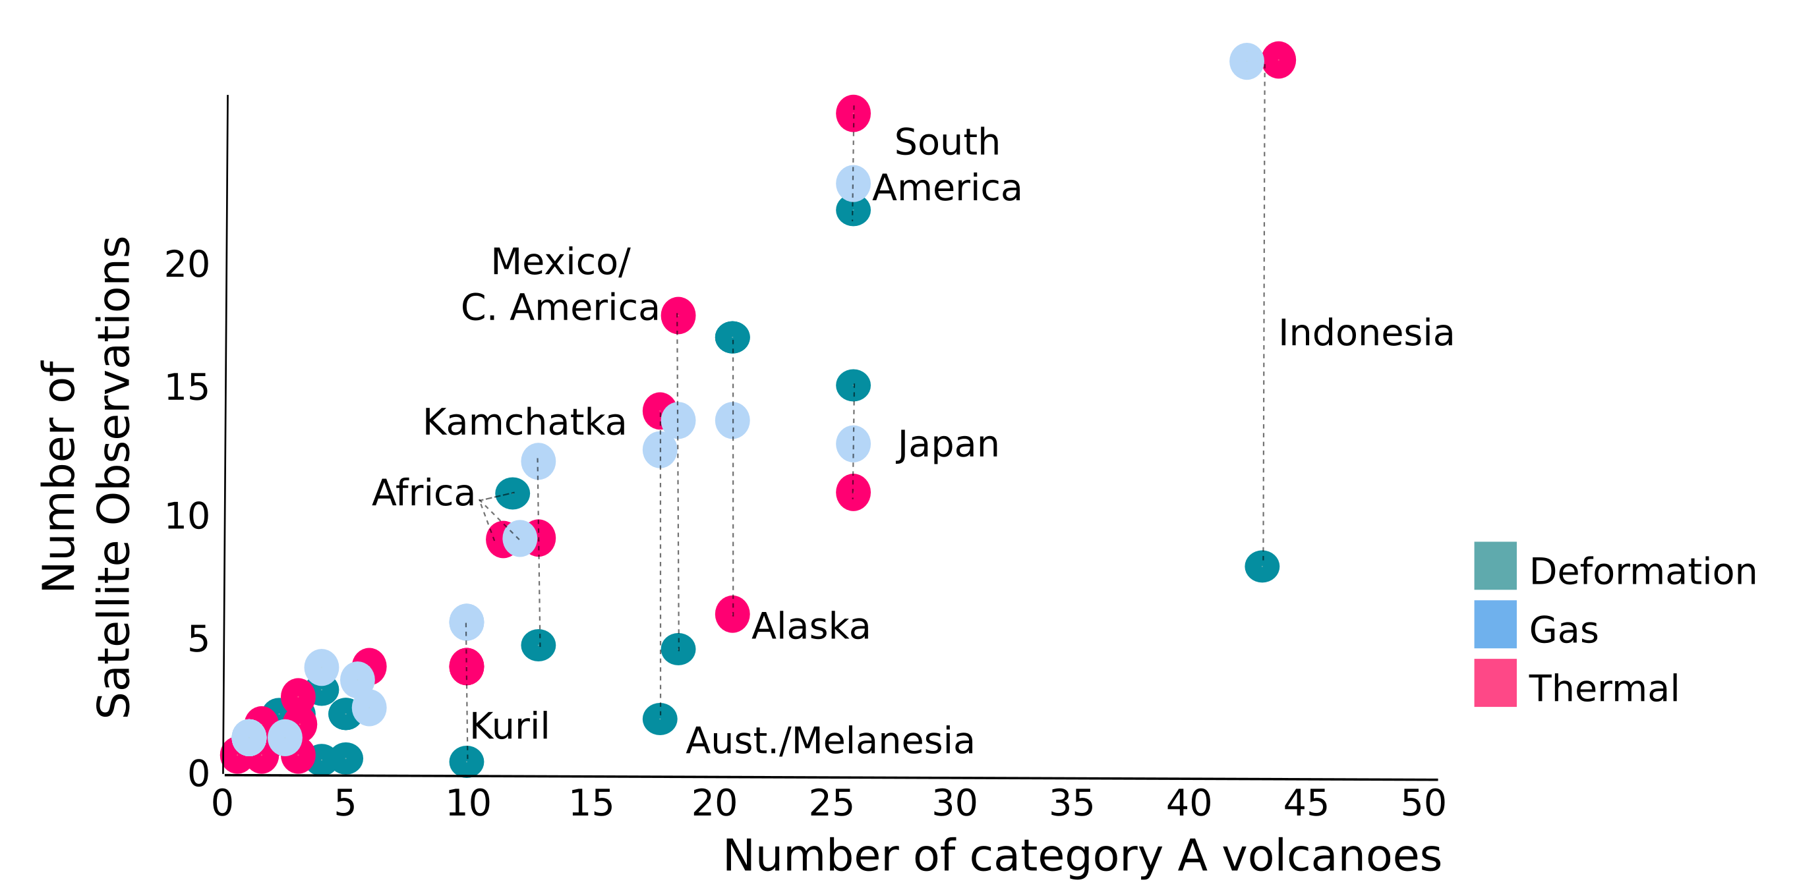
Volcano Demonstrator
Observation Gaps
Pritchard et al., in prep

Slide 8
Volcano Demonstrator
2019 Progress and Outcomes
• Implementation plan submitted to WG in June 2019
• First data orders in for Latin America and SE Asia (Fuego, Uluwan & others)
• Regional leads in place (and some initial discussions regarding SE Asia in Leeds and Tokyo)
• Emails to scientific and volcano observatory community to promote engagement
• Teleconferences to define strategy for data ordering are in progress

Slide 9
Volcano Demonstrator
2018 eruption of Fuego, Guatemala
Application of radar backscatter to detect fresh deposits and quantify
Figures: Edna Dualeh, PhD researcher Leeds
Fresh pyroclastic flow deposits altered by successive lahars (volcanic mud flows)

Slide 10
Seismic Hazards Demonstrator
Objective | Projected Completion Date | Background Information
DIS-21: Deliver and report on the results of the Seismic Demonstrator | Q1 2020 | Deliver and report on the results of the period Q3 2018-Q4 2019, including report on the newly- reached geoscience centers and end users supported by the Demonstrator.
Interest from new users: University of Oxford (UK) and IPGP (France) are interested to participate in the Demonstrator
Pleiades data provided to University of Leeds, first results to be presented at the 12th CEOS WG Disasters :
                over Central Asia, to address the UN sustainable cities and communities global challenge by improving our understanding of earthquake hazard for three major cities along the northern Tien Shan mountains in Kyrgyzstan and Kazakhstan that have been struck by huge earthquakes in the past.
            over Palu, to assess the potential of Pleiades for deriving the Palu fault rupture offsets through both the urban city and rural environment
Pleiades data requested by University of Leeds for Ecuador and Nepal, to support the GSRF Hubs, aiming to derive models of multi-hazard risk to inform urban development planning.

Slide 11
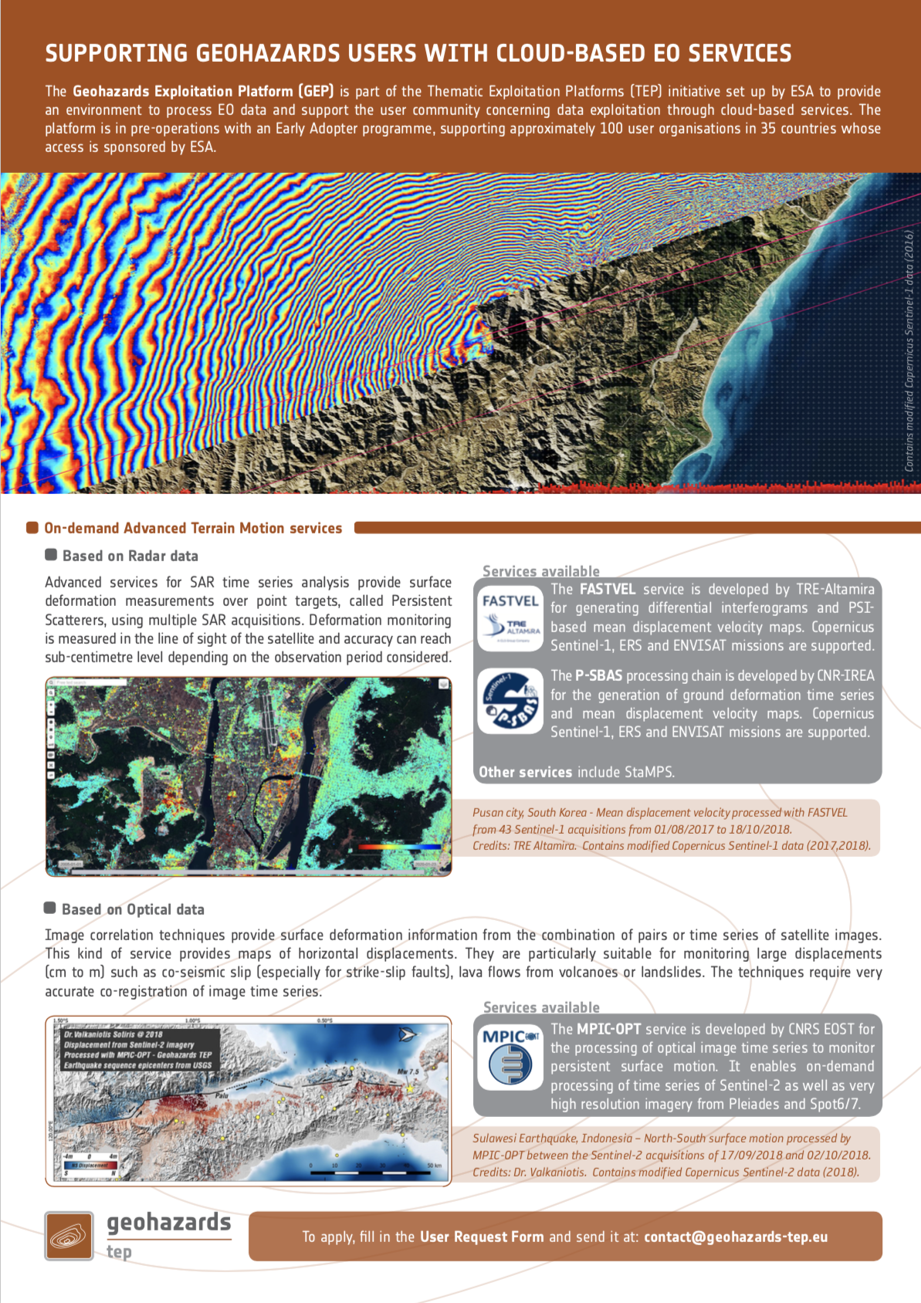
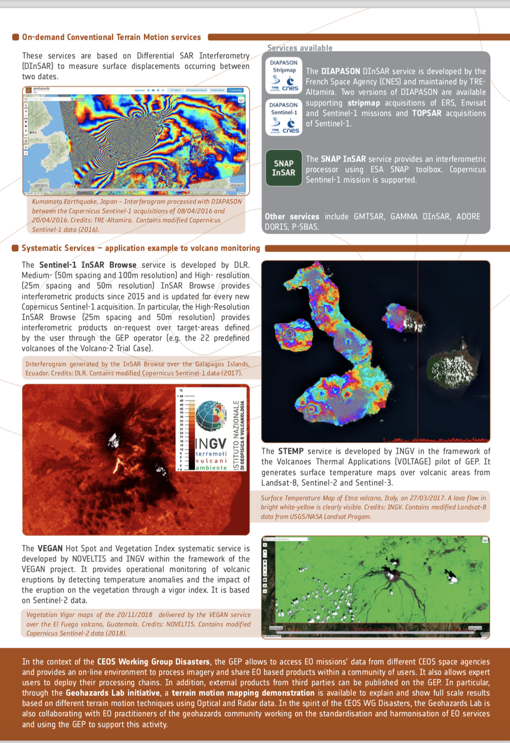
Geohazards Lab
Objective | Projected Completion Date | Background Information
DIS-19: Promote e-collaboration for broader acceptance and use of EO techniques and products by the geohazards community. | Q3 2019 | Promote the concept of e-collaboration so that EO experts (as well as non-EO scientists that are newly introduced o EO) familiarize with EO techniques and products. The following activities have been foreseen: circulate a brochure to promote EO services on GEP to the EPOS user community, develop a Terrain Motion Demonstration on GEP, identify users as part of the GEP Early Adopter programme (intention to reach 100 users) and organize benchmarking activities to address capabilities, drawbacks and complementarities of EO monitoring.
DIS-20: Pursue the standardization of geohazards EO-products | Q1 2020 | Identify a framework for standardization of geohazards related EO-products to achieve acceptance by the EO community and decision makers
Brochure prepared and disseminated on how the Geohazards Exploitation Platform supports users from the geohazards community with cloud-based EO services (DIS-19)
Terrain Motion Demo made available on GEP https://geohazards-tep.eu/geobrowser/?id=terrainmotion_demo (DIS-19)
Publication on benchmarking activities for landslide EO techniques and services published (DIS-19)
DIS-20 is on-going, a survey focusing on EO products and formats to be circulated among geoscience centres within 2019.
Brochure

Slide 12
Geohazards Lab
Integration of services
Final steps of integration of the SNAP Cosmo-SkyMed service (GUI interface set up): first service able to process Cosmo-Skymed data to be made available shortly
SNAP StaMPS service: integration on-going
Sentinel-1 SBAS service is available on the Geohazards Exploitation Platform. The service was tested over several regions and updates have been implemented to the new version.
Outreach and Capacity building
GLab and the geohazards Exploitation platform were presented at the IGARSS conference in Japan (July 2019)
SNAP StaMPS service to be presented at the Φ-week at ESRIN, Italy (September 2019)
Abstract submitted for GLab presentation at the MDIS Workshop in France (October 2019)
SNAP StaMPS training to be organised for the participants of the MDIS Workshop in France (October 2019).

Slide 13
Haiti Recovery Observatory (RO)
Progress since SIT-34
National and Local User Workshops held in Haiti in Port-au-Prince and Jeremie in May 2019.
Strong support for RO work voiced at national level but also from participating municipalities.
Work has begun on legacy planning and capacity building, identifying major elements to be sustained and developed post 2020.
Major Capacity building effort in 2019 and 2020 including training on Sentinel-2 based land classification product development (IOTA-2) and SAR (Sentinel-1 and CSK) processing; 2-3 Haitians will spend 3 months in Italy; further training in Haiti.
Linkages being made between Haiti RO outputs and new programmes – Haiti National Environmental Information System and WB agricultural projects.
Haiti RO Early Evaluation will be completed by end September, including interviews with key stakeholders and user and partner survey. Results to be posted @ www.recovery-observatory.org

Slide 14
Generic RO
Progress since SIT-34
CEOS and World Bank co-chaired session on use of satellites for recovery during World Reconstruction Conference -4 in Geneva in May 2019.
Advocacy Paper presenting the state-of-the-art on usage of satellite data for recovery after major disasters completed as draft – currently under peer review before WB electronic publication. Paper co-authored by CEOS/World Bank/GFDRR/EU/UNDP and aims to serve as background for future generic recovery observatory (G-RO).
Concept paper on G-RO under development; working discussion held in May at World Reconstruction Conference 4 and further discussion planned Q4 at UNDP HQ.
G-RO ad hoc team planning demonstrator for 2021-2023 period, building on lessons learned from Haiti RO.

Slide 15
Workplan Deliverables Status
Action | Due | Initial Description | Comment/Status
DIS-12: Report on Haiti RO Early Evaluation by local users and international organizations | Q3 2019 | WGDisasters will develop a survey of initial results of the Recovery Observatory from the perspective of institutional donors, and include outlooks on possible inclusion of additional hazards and the sustainability of Recovery Observatory activities for 2018 onwards. The findings of this survey will be presented in a lessons learned report in mid 2019 (after 3rd Series of User Workshops) to enable timely consideration by CEOS Agencies. | Will be completed end September 2019. Very positive feedback during evaluation process.
DIS-22: Final Haiti RO Report | Q1 2021 | Final report on Haiti RO | Request to move final report forward to Q3/4 2020 to provide earlier update and background for future G-RO activity.
DIS-12: no action from SIT required. To be presented to Plenary for information.
DIS-22: request to move due date to Q3 2020 for presentation to SIT and Plenary.

Slide 16
GSNL Biennial Reports from
Permanent Supersites for 2019-2020
 | Supersite | Biennial report due
1 | Hawaiian volcanoes | 25-Oct-20(4th)
2 | Icelandic volcanoes | 5-Nov-19 (3rd)
3 | Etna volcano | 9-Apr-20 (3rd)
4 | Campi Flegrei/Vesuvius volcano | 9-Apr-20 (3rd)
5 | Western North Anatolian Fault | 9-Apr-20 (3rd)
6 | Taupo Volcano | Submitted 15-Apr-19 (3rd)
7 | Ecuador volcanoes | Submitted 15-Apr-19 (3rd)
8 | Corinth Gulf/Ionian Islands | 8-Nov-20 (2nd)
9 | San Andreas Fault NL | Submitted 27-Apr-19 (1st)
10 | Southern Andes volcanoes | 19-Oct-19 (1st)
11 | Virunga volcanoes | 19-Oct-19 (1st)

Slide 17
Status of GSNL Activities
Scientific monitoring and research continue as planned at the Supersites. Results are presented at WG Disasters meetings twice per year.
All submitted reports have been accepted so far. DIS-10
Volcano Supersite monitoring is in general the most productive, given the frequent unrest episodes. DIS-19
Some tens of scientific papers stimulated by CEOS image data have been published. DIS-19
Nearly 4000 images per year provided to the Supersites (in addition to fully open data). DIS-10
The GSNL coordination is providing training and remote processing support to some Supersites where these capacities are not available.
ESA provides processing and data management support through its Geohazards TEP.
A proposal for a multihazard Supersite in Peru has been submitted. DIS-10
A proposal for a volcano Supersite in Kamčatka is in preparation.

Slide 18
GEO-DARMA
Progress since SIT-34
GEO-DARMA 5th SC meeting held May 2019. 2 Asian and 1 African project under development for 2020.
Bilateral discussions during Global Platform meeting in Geneva May 2019, with outreach to Latin American and Caribbean partners. Agreement in principle to work with UNDRR Americas, CDEMA, CEPREDENAC and Andean Community on Regional Assessment for Latin America/Caribbean.
1st draft regional assessment for LAC completed summer 2019 and under review.
Action | Due | Initial Description | Comment/Status
DIS-15: Support for GEO- DARMA identification of major hazards and DRR issues for each selected region | Q2 2019 | GEO-DARMA will seek independent identification of disaster risk management priorities at regional level by authoritative regional institutions in line with the priorities from the Sendai Framework for Disaster Risk Reduction 2015-2030. This task will require the active support of major stakeholders in the field of disaster risk management at global, regional and national levels in order to implement a series of pilot projects. | Final regional assessment (LAC) currently under review. Two previous regional assessments completed in 2017 (Africa and Asia).

Slide 19
Landslide Pilot
Outputs & Deliverables
1. Report on recommended practices for the combined exploitation of SAR and Optical imagery and technologies for landslide detection, mapping and monitoring”. (Objective A)
Status: research is ongoing in the study sites to develop new methodologies for processing SAR and optical data, several papers in progress or preparation on this topic. Cosmo-Skymed Tasking over Trishuli basin will be an extremely valuable dataset to be used by the research community.
2. Report on effective methodologies and strategies for considering multi-hazard and cascading aspect of landslides through multi-temporal landslide mapping from multiple triggers (leveraging information/interactions with the volcano, flood and earthquake pilots) (Objective A-C)
Status: ALADIM software is incorporated into the GEP, which allows researchers to characterize landslide inventories using new methods, research on SAR activities is still in the early stages and publications are being prepared on this effort
3. Landslide event inventory and activity (monitoring) maps produced using optical and SAR imagery and technologies, and their combination, for selected case studies / geographical areas. (Objectives B-C)
Status: Launching of https://landslides.nasa.gov and work with the GEP have greatly expanded the potential for inventories being shared across geographic areas (See next slides)
4. Report on end user engagement strategies and characterize enablers, challenges, barriers to effective transfer of information, knowledge and technologies. (Objective D)
Status: While preliminary recommendations may be provided by the end of this pilot, we feel the deliverable will be best suited for a follow-on demonstrator phase given the current status of the research and delays in obtaining data for this effort. A paper is being prepared for peer-review.

Slide 20
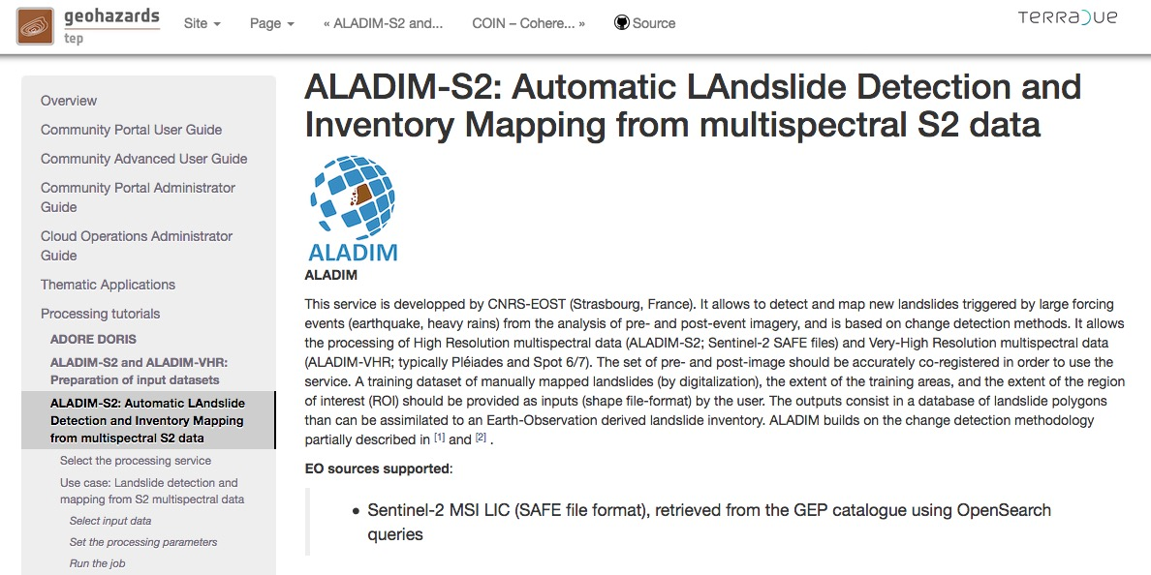

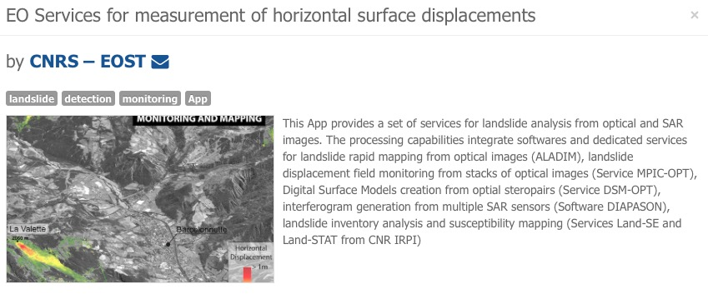
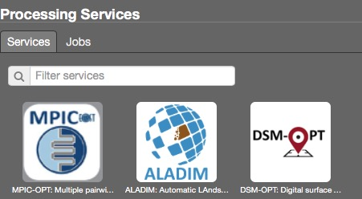
ALADIM service available on ESA GEP (working for S2, pending for VHRO)

Slide 21
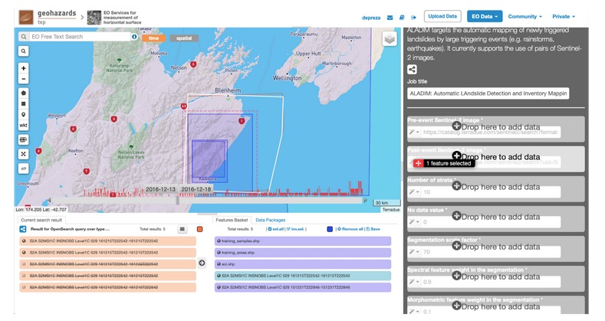
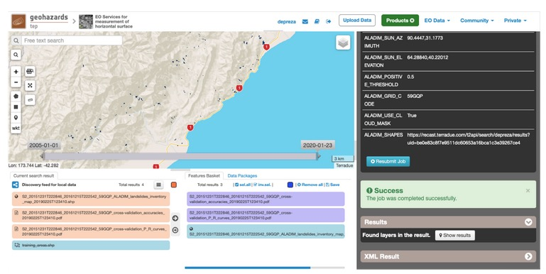
ALADIM service available on ESA GEP
(working for S2, pending for VHRO)
Image catalogue and selection of Region of Interest
Results: polygons corresponding to possible landslides

Slide 22
WG Disasters ToR review
Current ToR approved in 2013 when the WG Disasters was created
WG Disasters reviewed the ToR, i.e. sections: 1) Objectives and 2) Structure and Procedures
New ToR shared within CEOS leadership for discussion at SIT TW
Propose to endorse at the next Plenary

Slide 23
WG Disasters ToR review
Main changes:
  Introduced high level objectives with clear reference to Sendai Framework for Disaster Risk
  Emphasis on
    “Understanding Risk” (hazard, exposure, and vulnerability)
    User driven approach
    Multi hazard type
  Role of Data Coordination Team

Slide 24
Blue Planet Collaboration
Follow up action to assess areas of shared interest and opportunity, including data access and visualization
  Dialogue 8/12 identified EO for coastal risks
    Modeling and mapping of coastal reef-lined islands prone to flooding and inundation
      Combining improved satellite-derived model parameters and bathymetry data
      Areas of interest include Caribbean and South Pacific developing island nations
    Oil spill monitoring and response in coastal and marine ocean areas
      Combining satellite-derived model parameters, UAS, and other marine/coastal data detection
      Areas of interest include Caribbean, Baltic and Arctic seas and coasts
    Possible cross-cut on polar coastal ice, snow and flooding activities

Slide 25
GEO / LEO Progress
GEO/LEO participants and members of the WGDisasters team have met virtually in a series of conference calls following the last SIT gathering in Miami – emphasis in discussions have been on how to explore integration of SAR as a LEO contribution.
GEO/LEO and WGDisasters see opportunities for collaboration:
  Identify a small number of impactful flood events with known, rich volumes of GEO/LEO and complementary SAR data
  Identify additional past cases and new, unfolding cases emphasizing availability of multi-frequency and new SAR missions
Bring together GEO/LEO optical and additional SAR maps to explore practices for combining their information.
  Leverage ongoing work in the community to infer water depth from extent mapping to improve mapping of impacts
Explore integration opportunities with CEOS ARD Strategy, Data Cube, WGISS and WGCapD efforts.

Slide 26

Thank you!

