Slide 1
AHWG GEOGLAM
Bradley Doorn & Philippe Maisongrande
CEOS 2019 SIT Technical Workshop
Session and Agenda Item 6.2
Fairbanks, Alaska, USA
11 – 12 September 2019

Slide 2












GEOGLAM Updates
“…once the geospatial data are created, they can be used many times to support a multiplicity of applications”
- United Nations (2015)
Policy landscape has shifted since 2011, and GEOGLAM is evolving
  Our (4x renewed) G20 mandate is still the core of the program
  Including evaluating linkages to SDGs, Sendai, and Paris Accords
    Maximizing the value of investments in EO data
AMIS formally requested GEOGLAM observe countries where there is high uncertainty in production forecast. NASA Harvest in its capacity as host to the Crop Monitor Coordination Team will be working on this topic.
New website forthcoming

Slide 3
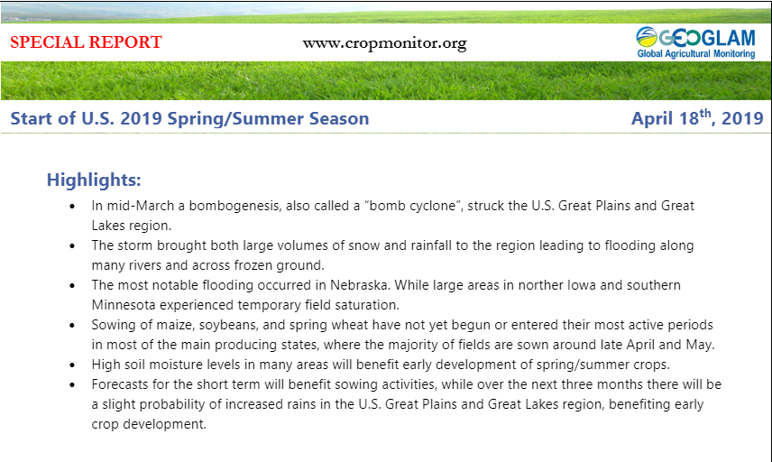
New GEOGLAM Activities + Updates
2019 Requirements Reboot: Complete!
  Integrated, holistic
  User-driven, research-substantiated
  Acquisition, access, adoption
New: Crop Monitor Special Reports
  Mid-month updates as needed
New: Capacity Development Coordination Team
  Already coordinating with WGCapD
  Invite more participation
Essential Agricultural Variables for GEOGLAM Working Group Established
  White paper of framework and initial variables established
Upcoming 5-day GEOGLAM Meeting
  Hosted by UCL, Belgium
  2 days ExCom (21-22 Oct)
  2 days EAVs (23-24 Oct)
  1 day CapDev (25 Oct)

Slide 4
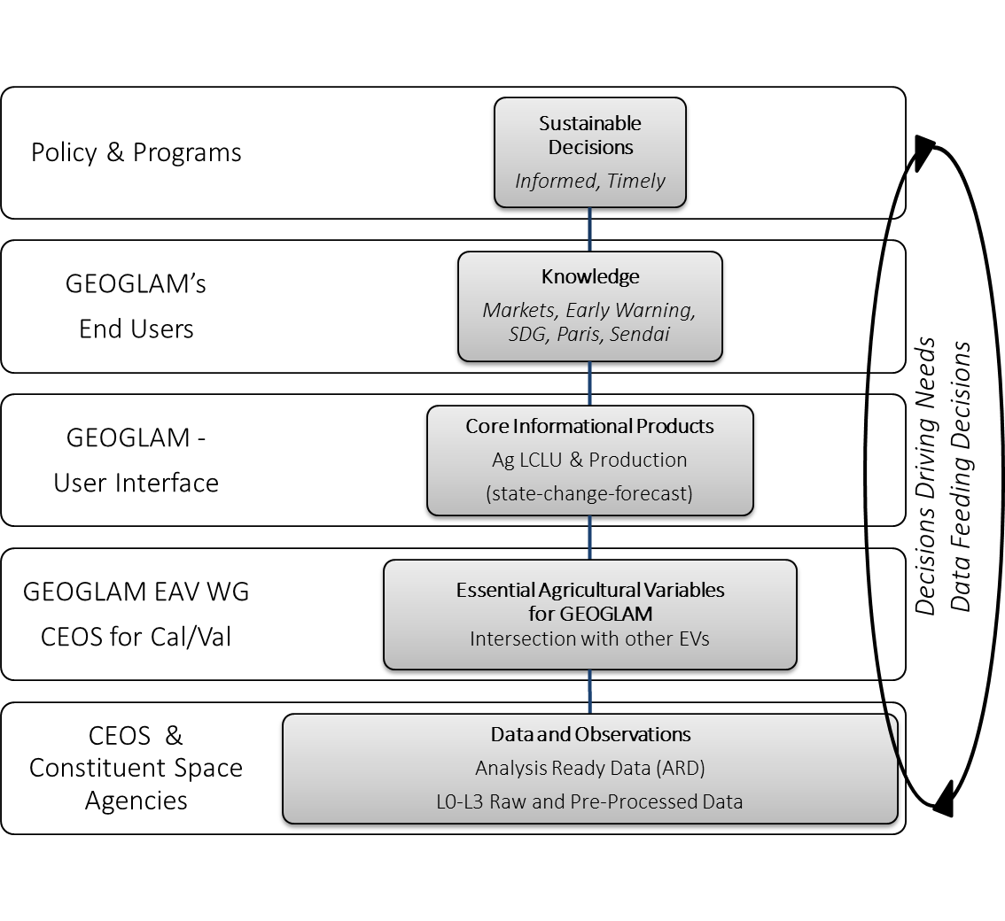
CEOS Response to GEOGLAM Requirements
Document at www.ceos.org
Structured as requirements + CEOS response
Most items are “submitted to the record”
  Updated table (next)
  Data priorities
  For awareness, that EAVs for GEOGLAM are coming
    Proposed work area with WGCV LPV at that time

Slide 6
CEOS Actions
Why GEOGLAM-CEOS?
EO data core to GEOGLAM activities. GEOGLAM Shares:
  Agricultural monitoring observation requirements
  AgMon EO data and processing requests
  AgMon implications for future missions
GEOGLAM provides to CEOS an opportunity for interaction with “next users” and hear “end user” needs – sharing of experiences that enrich individual agency activities
The GEOGLAM AHWG has been effective; foundations are laid; but there is much more to do….
Plenary endorsement of CEOS Response to GEOGLAM Requirements
- Pending final responses from members of LSI-VC and others
Future of AHWG:
- Propose transitioning from AHWG to a GEOGLAM SubGroup under LSI-VC
Notes:
GFOI and GEOGLAM observation requirements overlap
GEOGLAM EO Coordination Team is the major EO activity. They interact with CEOS space agencies and even subgroups.
New SubGroup would facilitate communication to the CEOS community about EO-GEOGLAM activities(e.g. GEOGLAM is getting growing requests to begin establishing hyperspectral requirements for Ag).
New SubGroup would also communicate back to GEOGLAM about CEOS activities/plans.

Slide 7

Questions?

