Slide 1

GEO-LEO Activities Update
Committee on Earth Observation Satellites
Mitch Goldberg, NOAA,
CEOS 2019 SIT Technical Workshop
Session and Agenda Item 7.1
Fairbanks, Alaska, USA
11 – 12 September 2019
Notes:
Ceos operations in the global community. How are users changing.

Slide 2
Update & CEOS Coordination Trajectory
SIT34: Update on CGMS Flood Pilot Study
Residency in WGDisasters to integrate synthetic aperture radar and to better utilize the global constellation with focus on coastal flooding.
Residency in WGCapD - Capacity Building, Training, Data Access, etc
SIT34: Land Surface case study to promote Analysis Ready Data to enable interoperability between GEO-LEO.
No commitment to conduct study. However, development of case study design/concept by LSI-VC and SIT Chair Team was useful to demonstrate integration of existing structures and initiatives within CEOS.

Slide 3
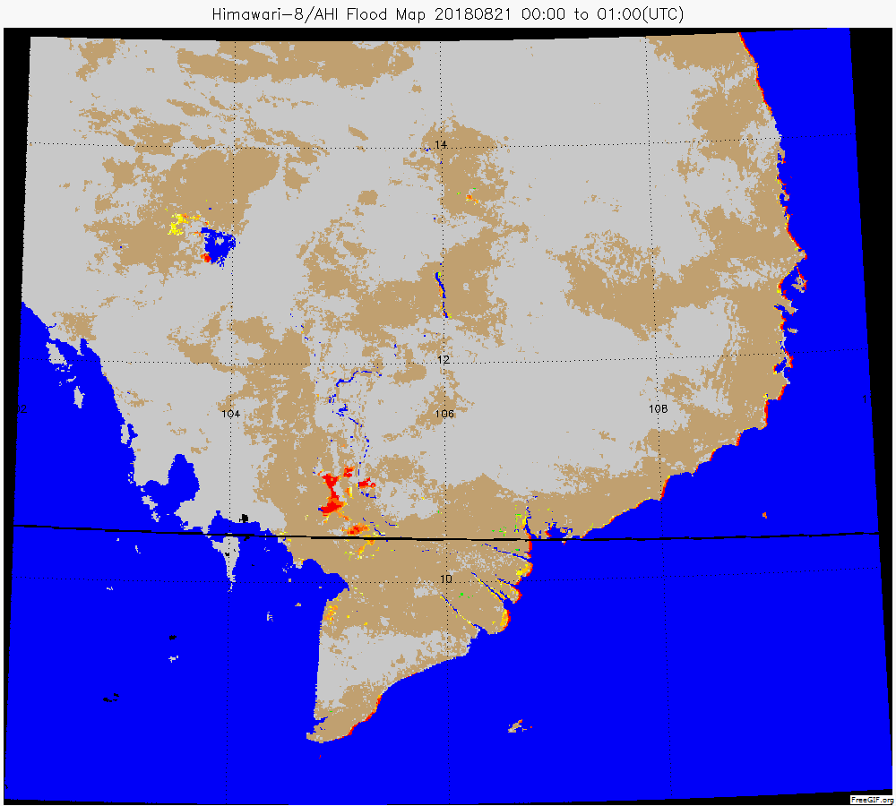
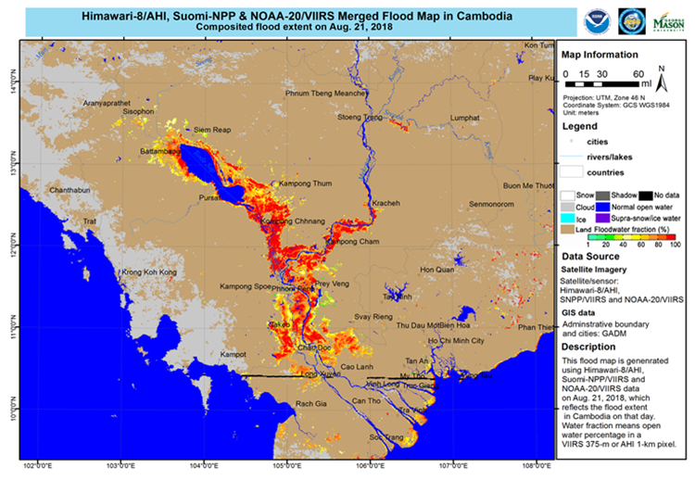
CGMS Flood Pilot Study
Background
NOAA demonstrated new flood mapping capabilities from JPSS and GOES-R – now used routinely by NWS and FEMA and a new NOAA requirement
CEOS chair (from Australia CSIRO) initiated a study of Non-Meteorological Applications from Geostationary Satellites e.g. floods, fires, aerosols.
The CEOS report emphasized the importance of GEO and LEO synergy
CGMS reinforced the importance to integrate GEO into existing LEO NMA activities
CGMS pilot study with NOAA and CMA leading demonstration of operational satellites
Aggregation of Flood “pixels” using AHI
JPSS + AHI Composite Flood Map

Slide 4
Progress since SIT34
NOAA updated their Flood Mapping website to include GEO/LEO for both JMA- AHI and NOAA- ABI
  Supports our NOAA users (operational requirements)
  Supports the CGMS pilot study which includes WMO coordinated evaluation stage by National Meteorological and Hydrological Services (NMHSs) with anticipated outcome to include in WMO Satellite Data Requirements and access via GEONETCAST
  Supports CGMS WMO VLAB training
  Supports WGDisasters and WGCAPD activities

Slide 5
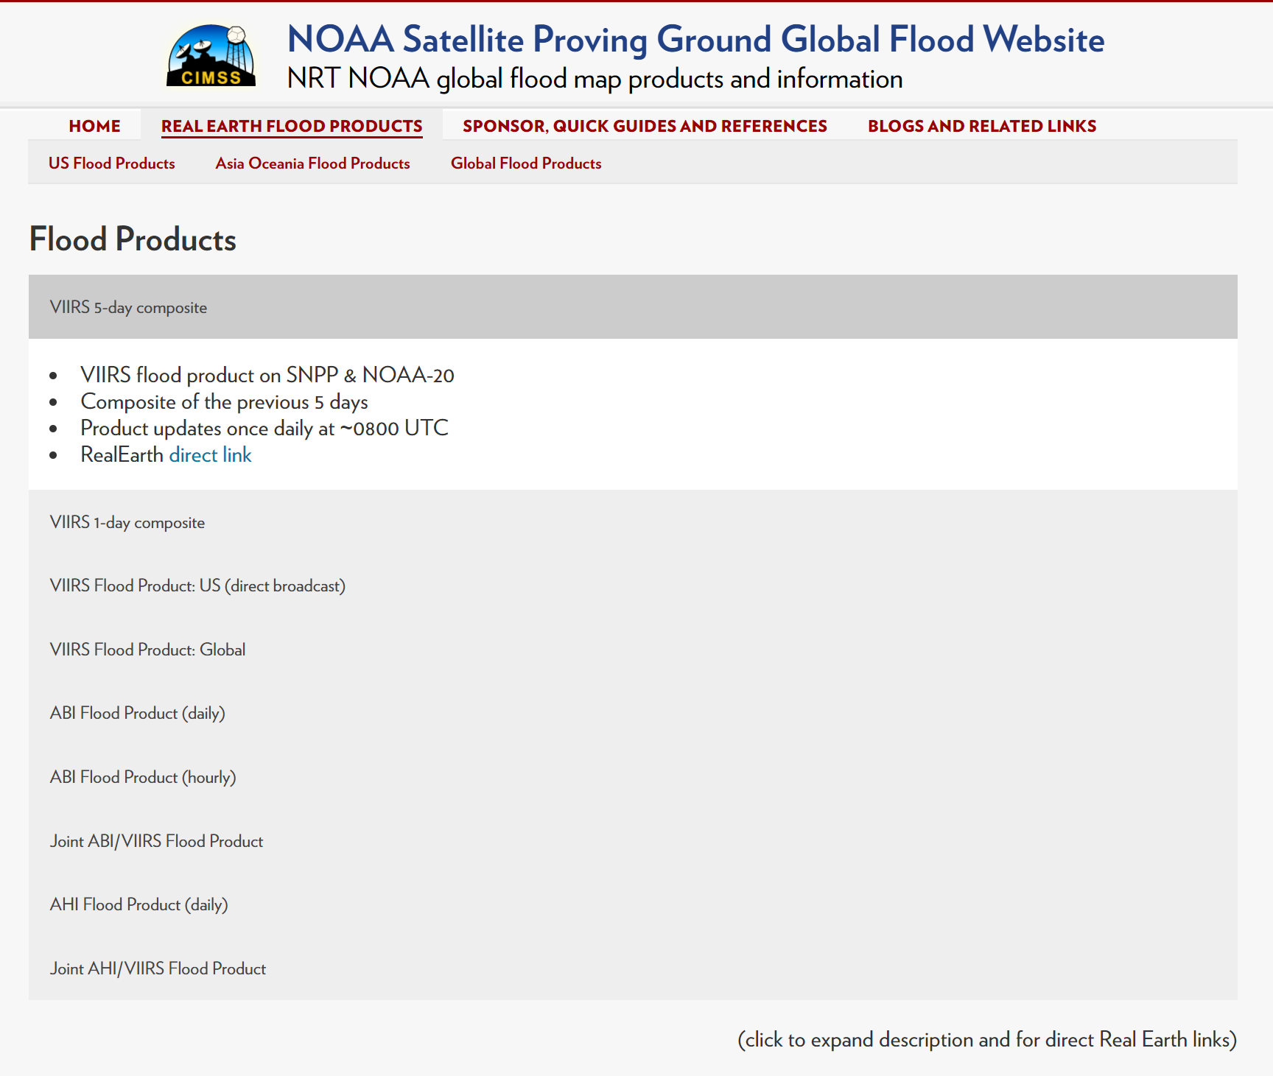

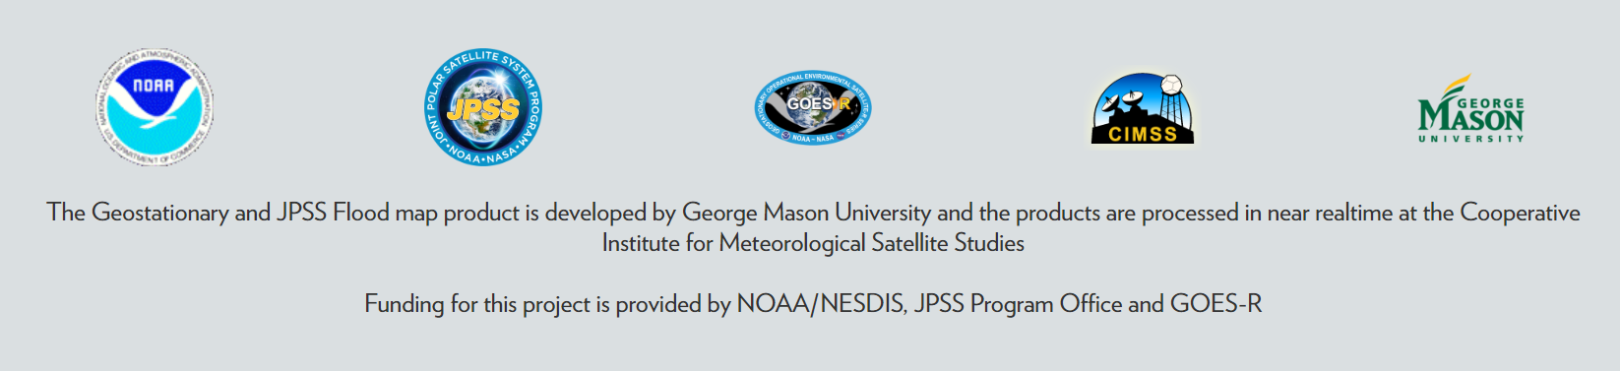
Global LEO/GEO (VIIRS, ABI, AHI)
Flood Mapping Website

Slide 6
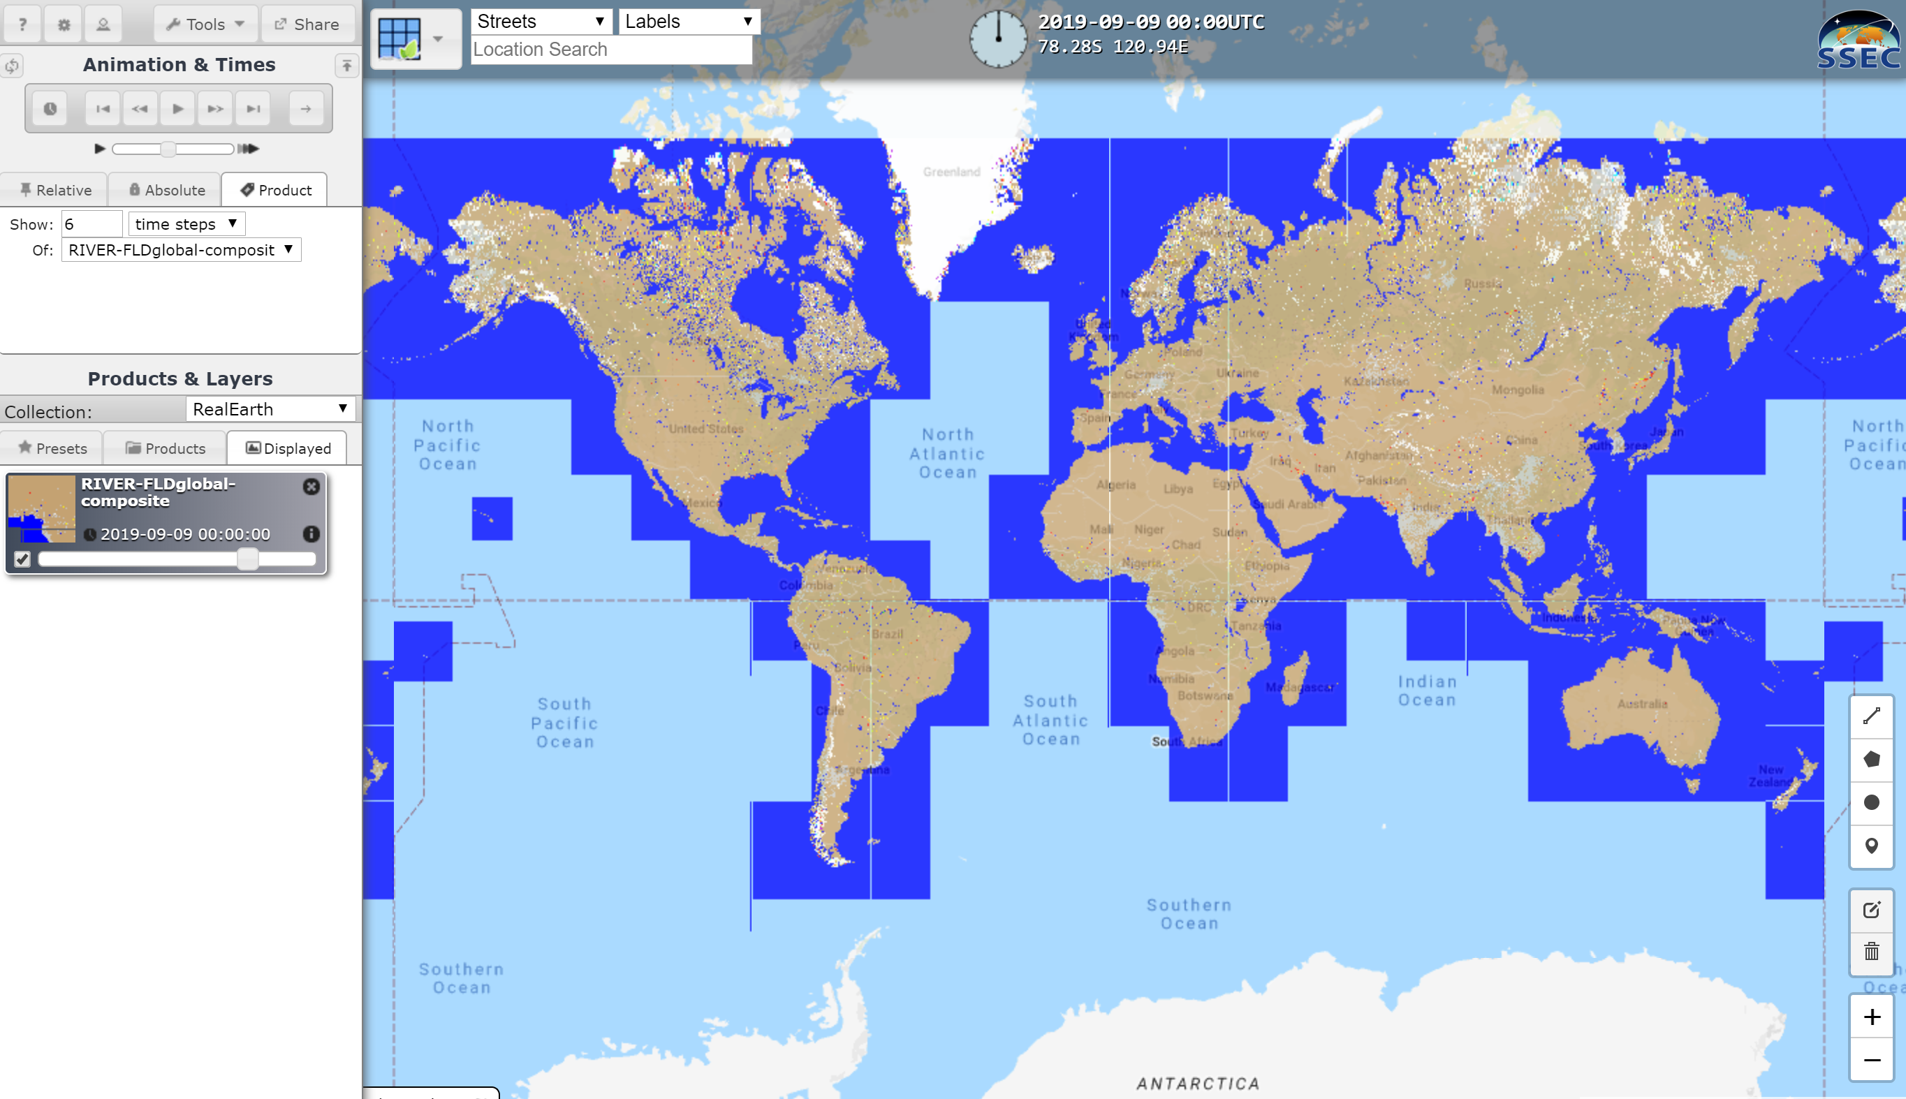
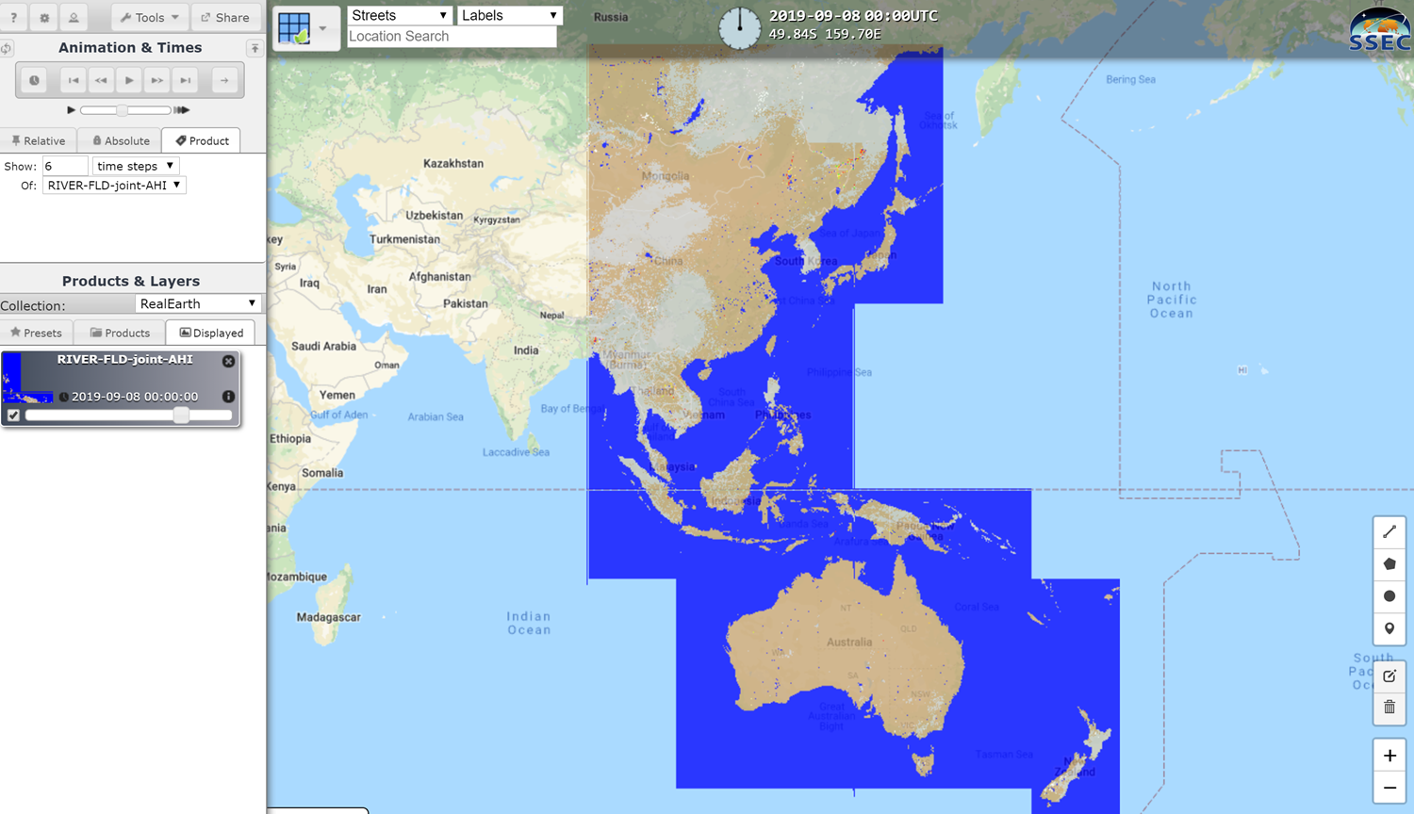
VIIRS 5 day composite &
VIIRS/AHI daily composite
VIIRS 5 day composite
VIIRS/AHI daily composite

Slide 7
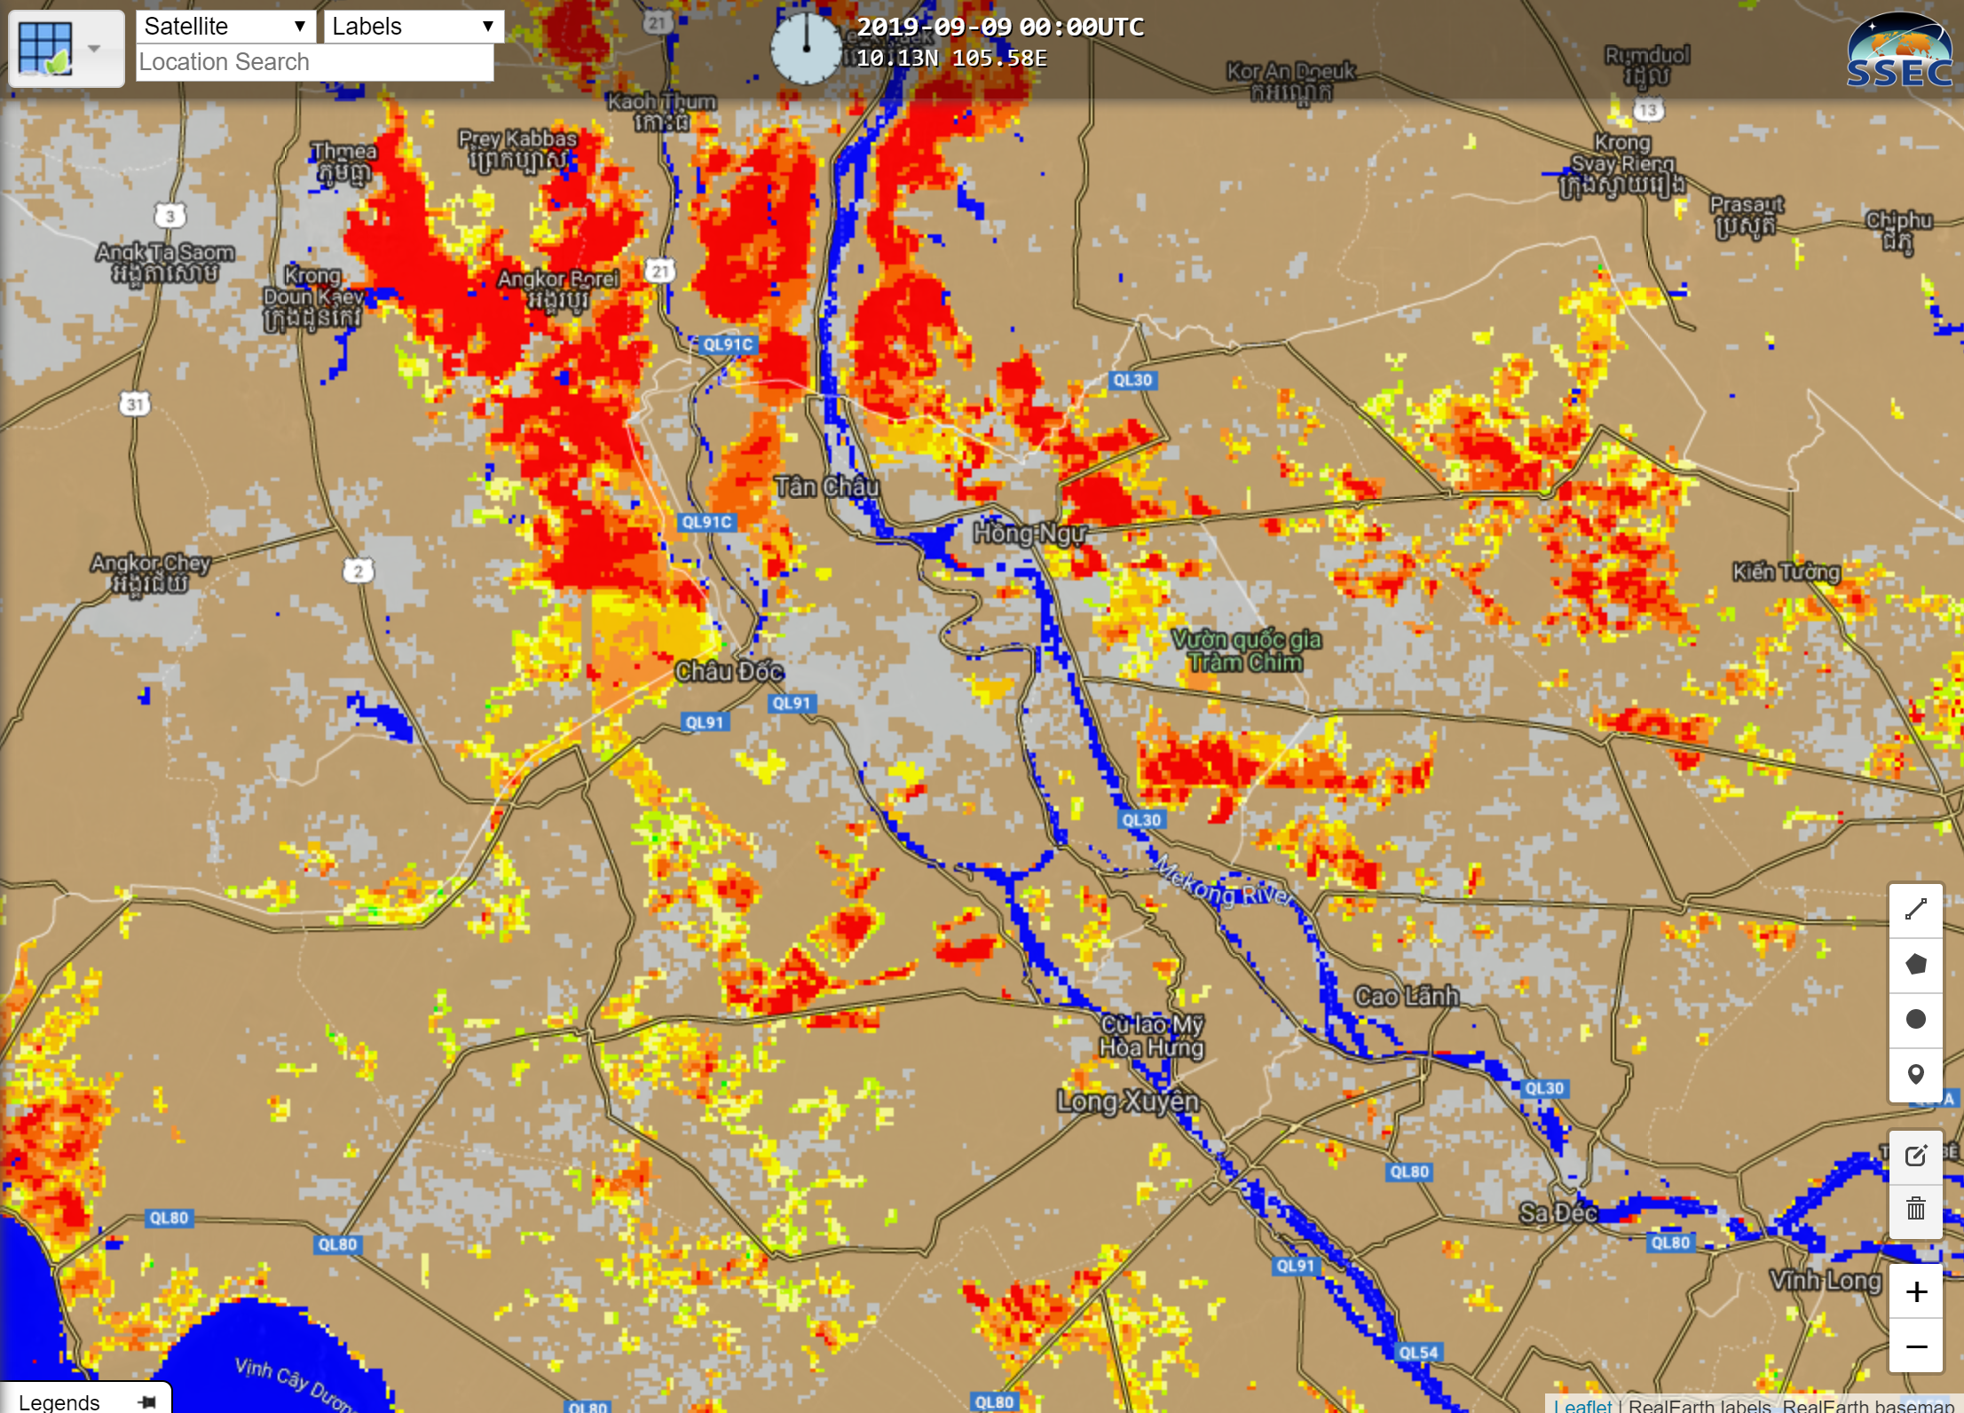

Slide 8
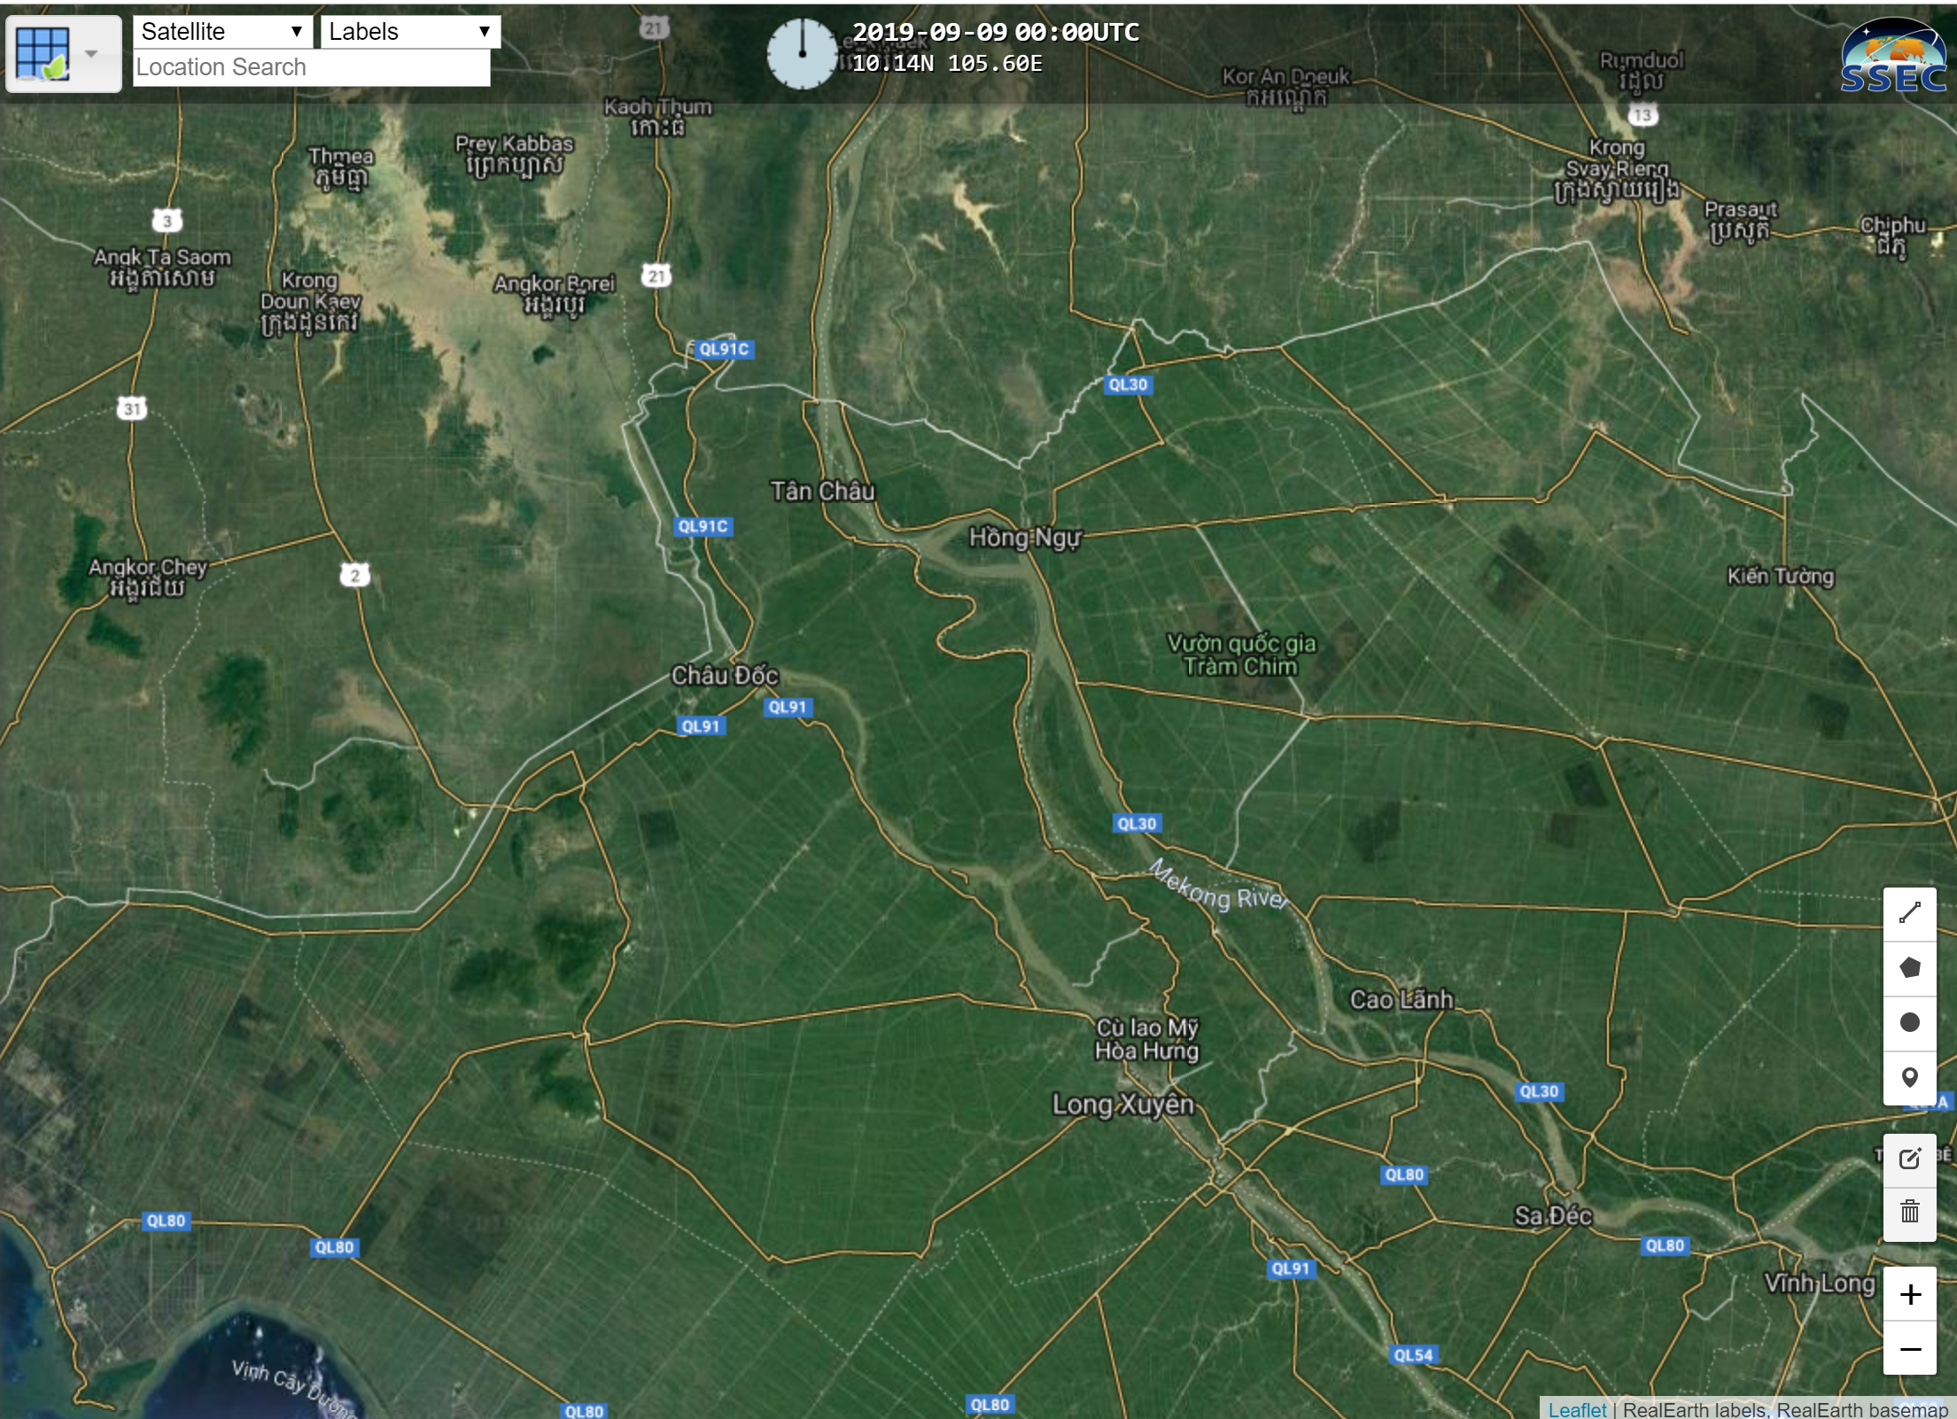

Slide 9
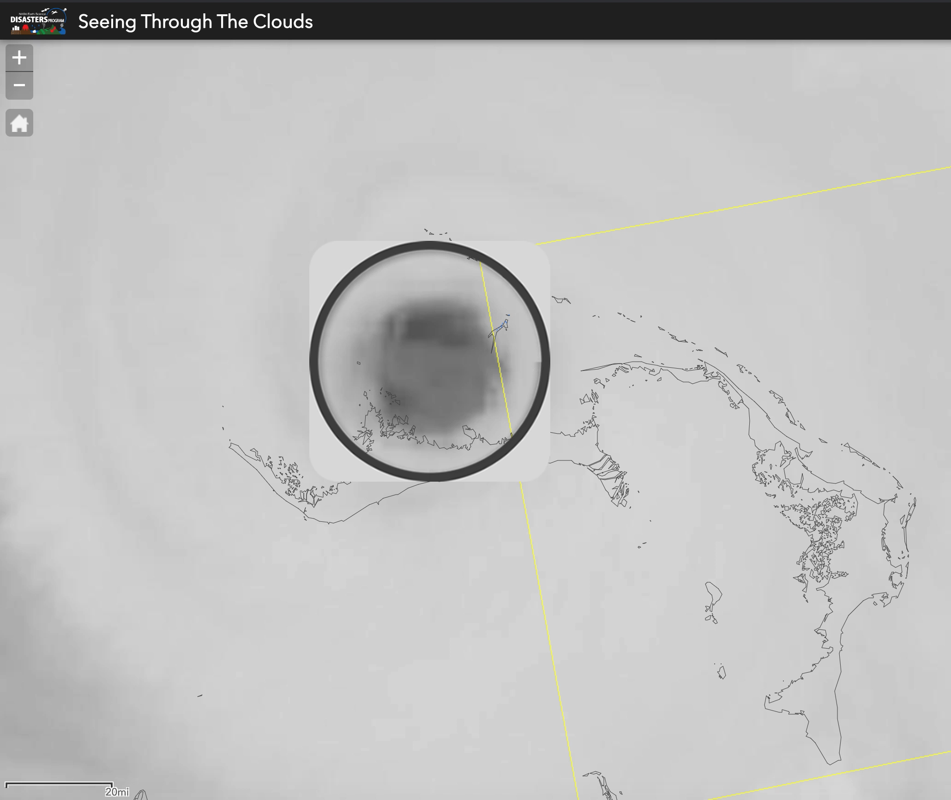
SAR Integration and Relevance
Synthetic aperture radar is beneficial for its ability to penetrate through most clouds and precipitation
wavelength dependent
Here, a movie captures Hurricane Dorian in the Bahamas, where clouds prevented a view of the surface – at the same time, ESA Sentinel-1 observations were acquired that helped to produce a change detection-based flood map.
SAR also provides phase measurements complimentary to backscatter, and combined these offer approaches to mapping water and damage extent complimentary to optical approaches.
Multi-frequency SAR (X, C, S, L) are increasingly available to exploit for these purposes.

Slide 10
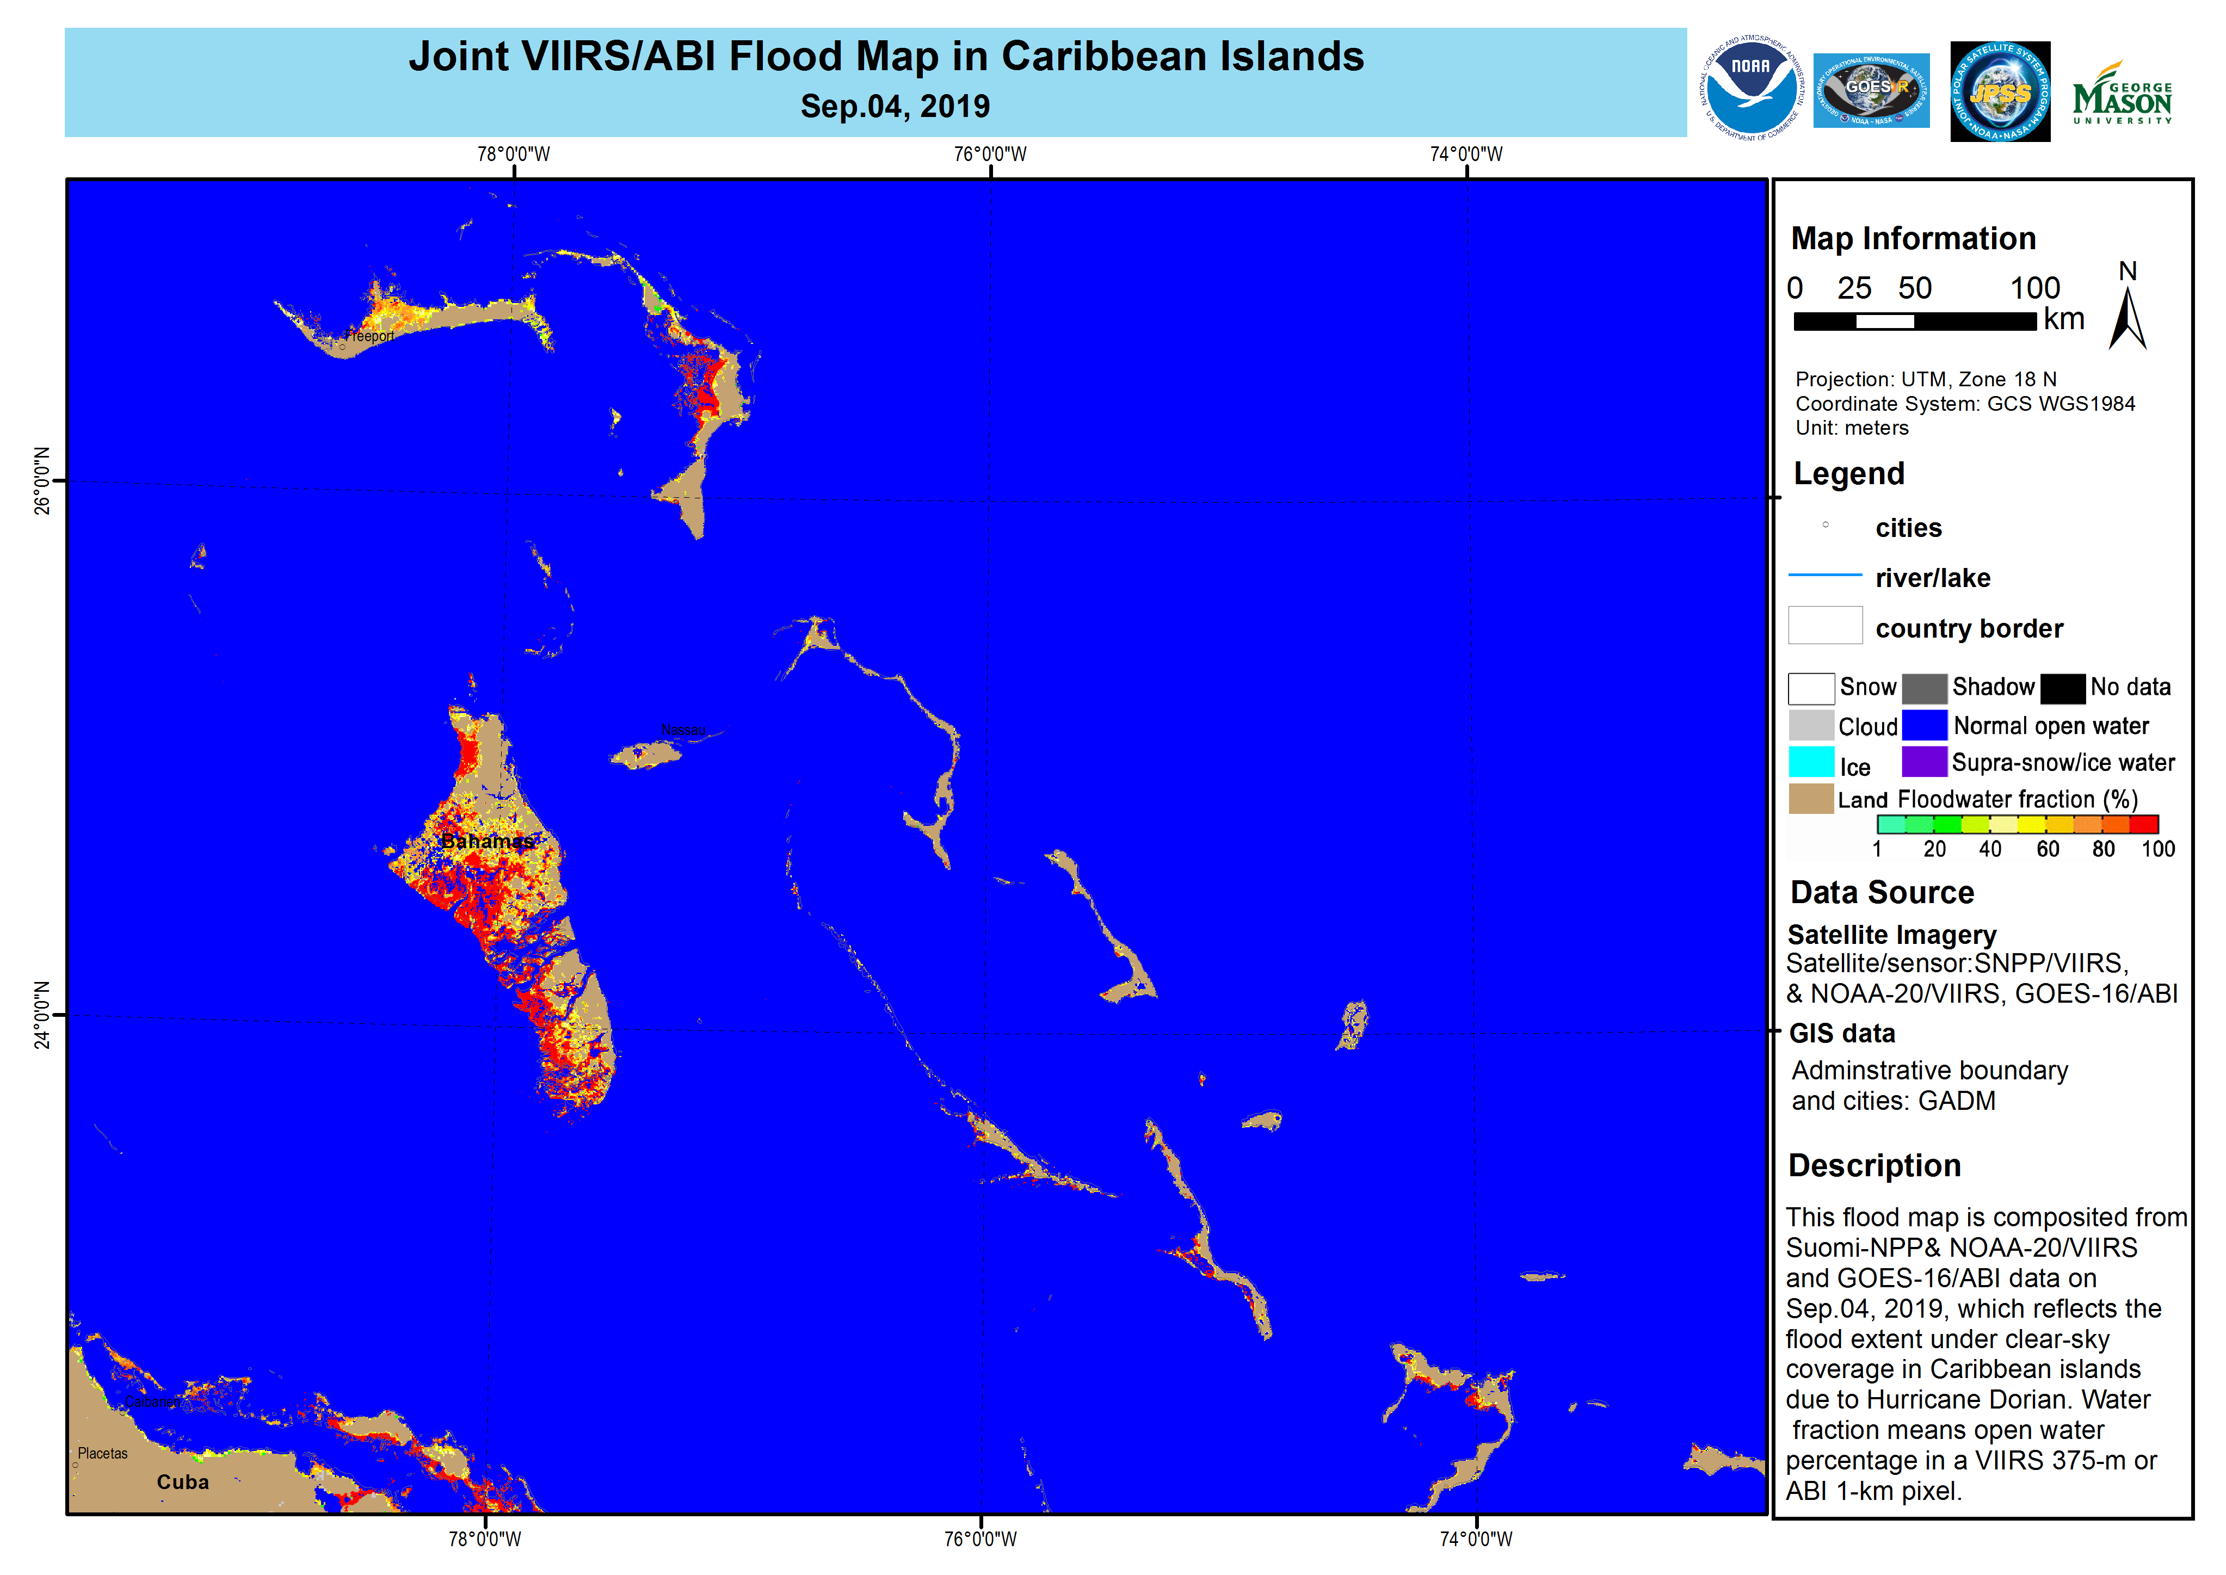

Slide 11
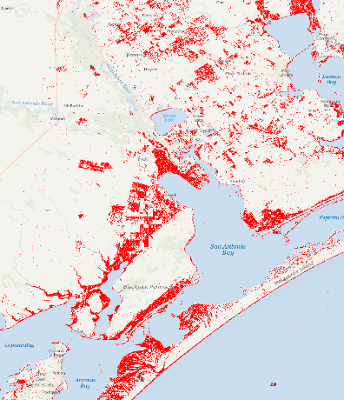
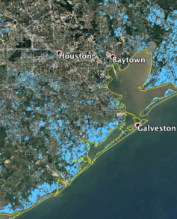

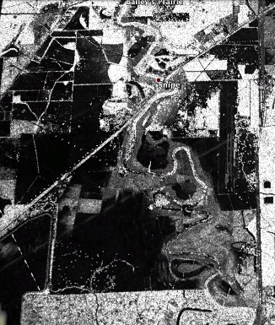
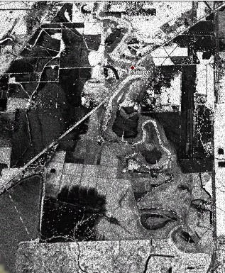
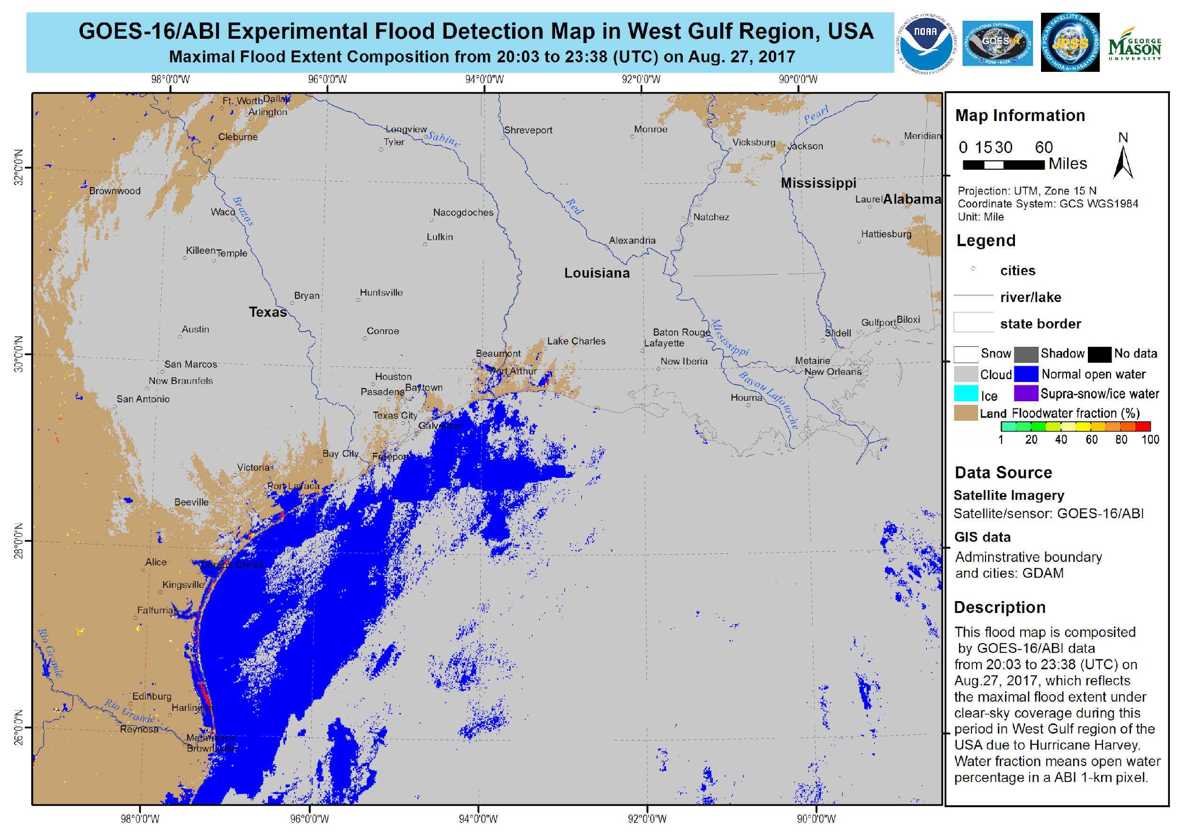
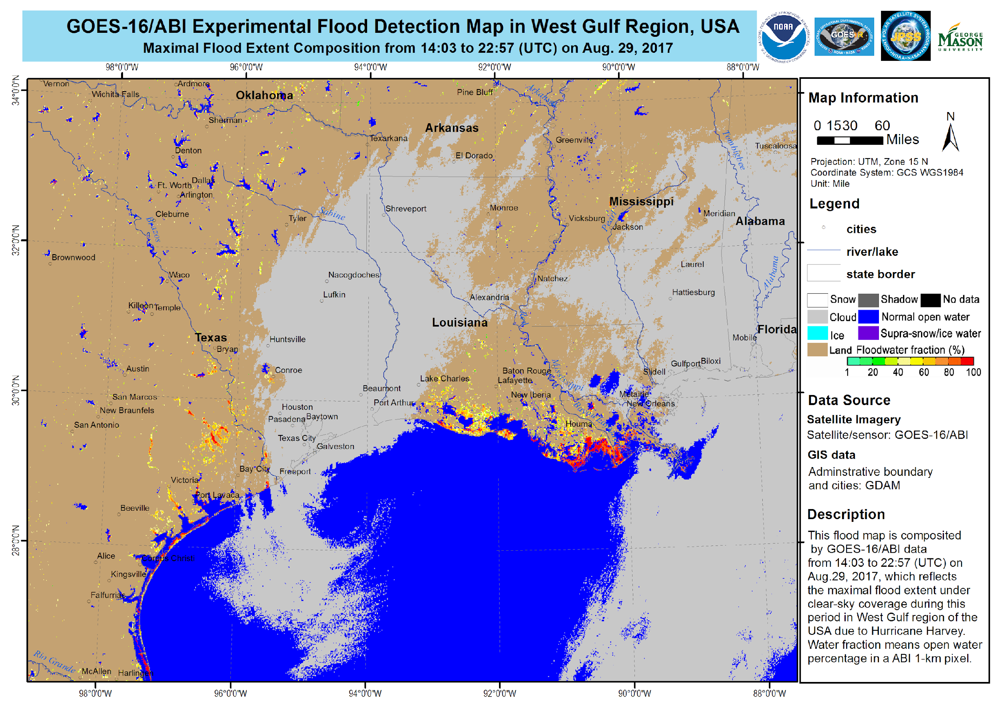
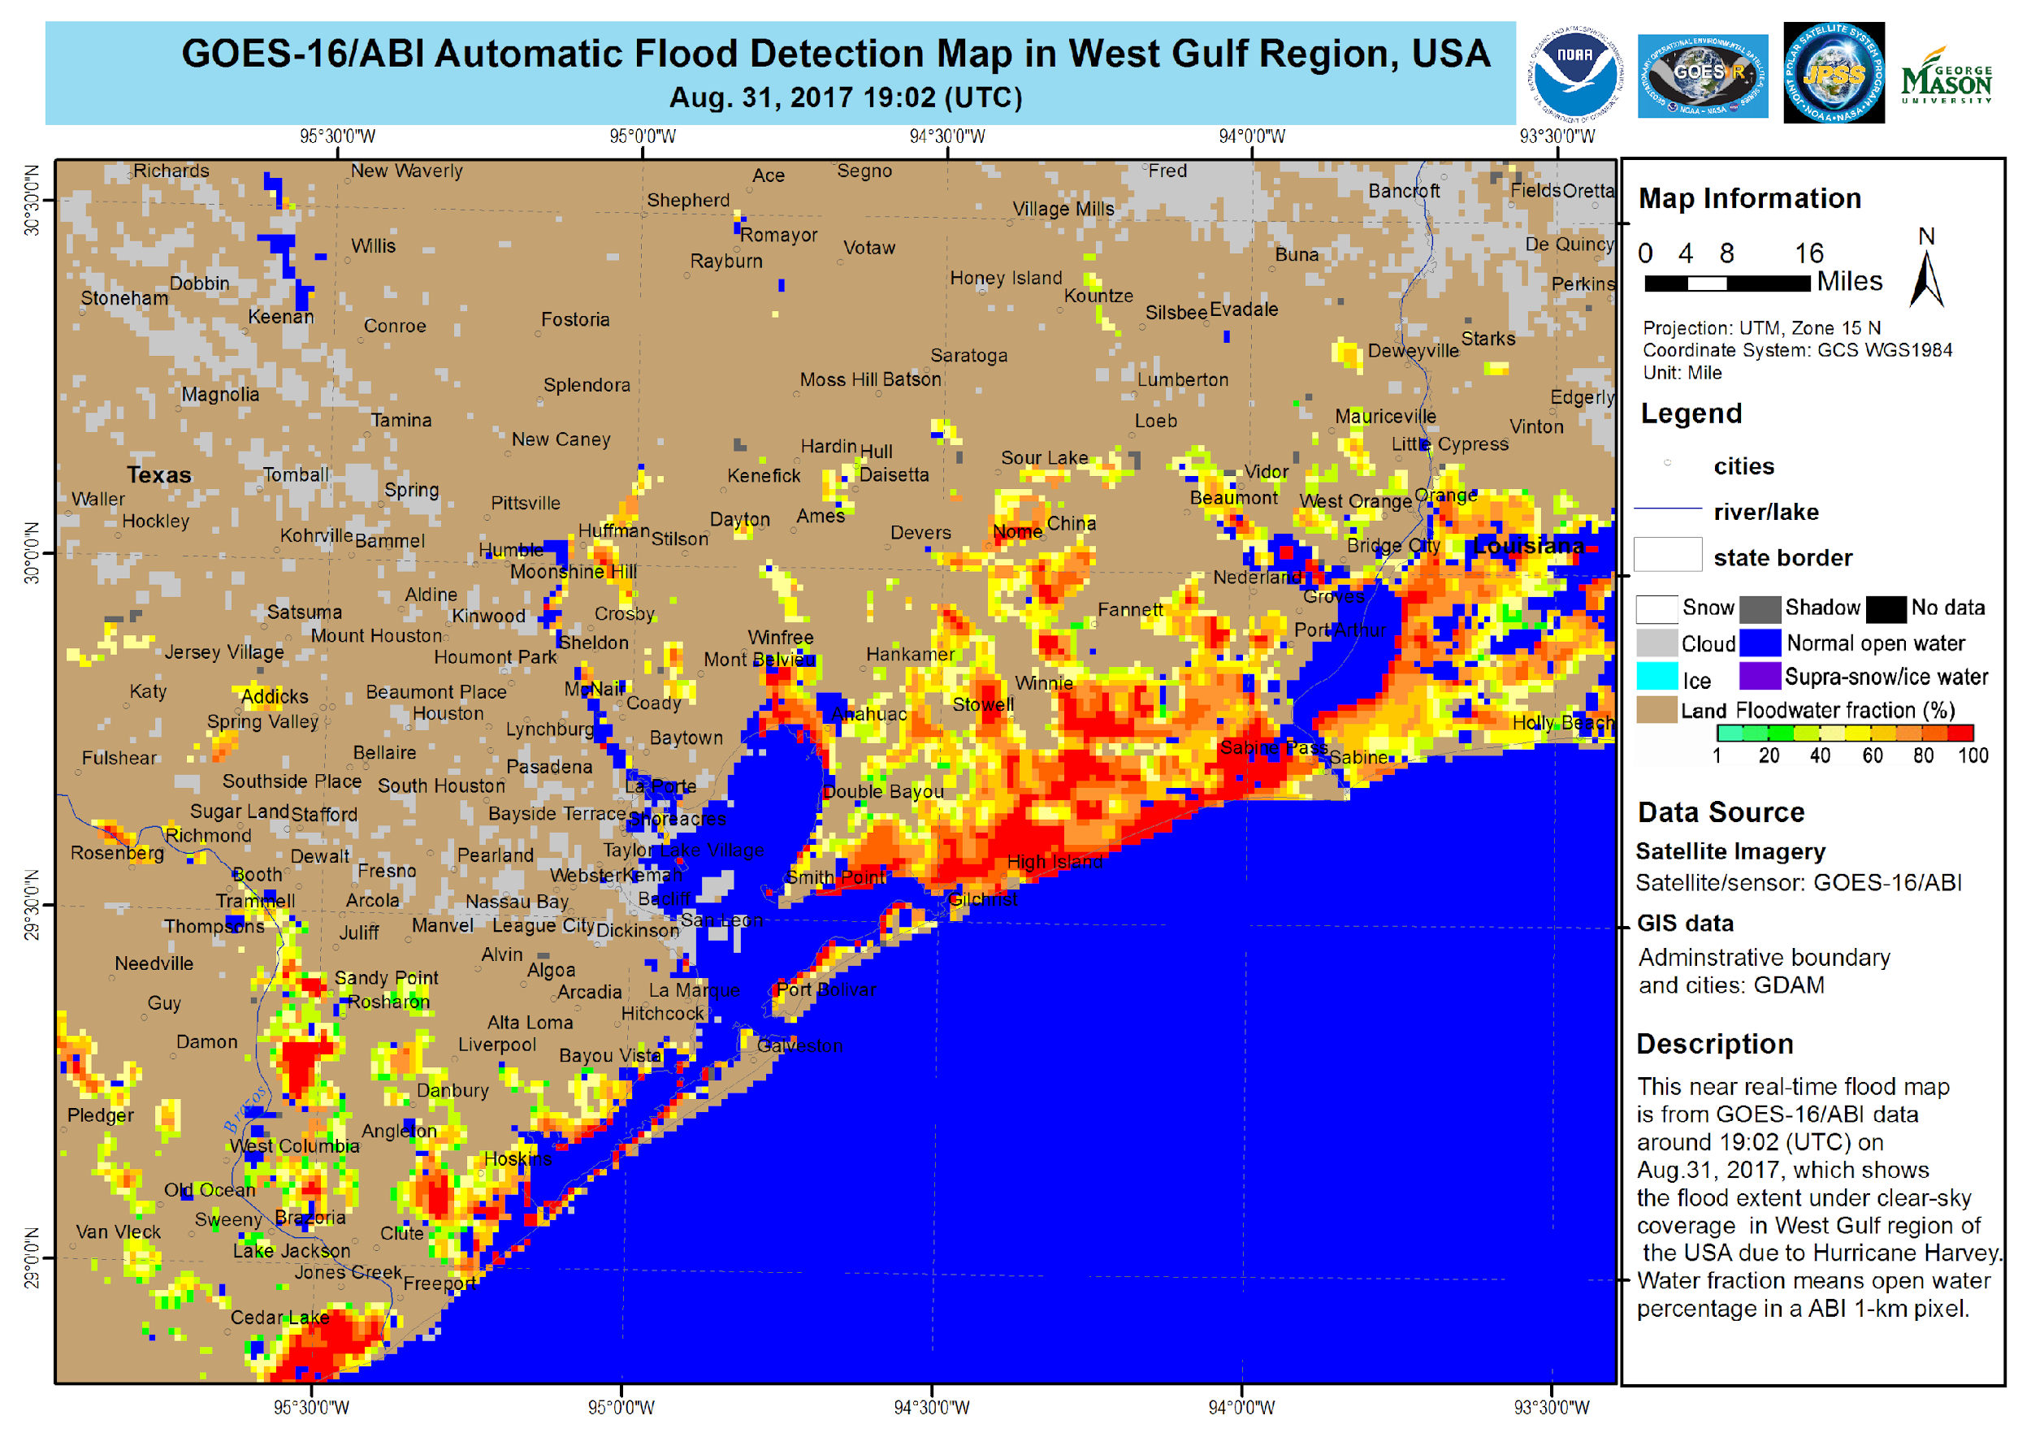
Combined Value of LEO/GEO and SAR
Charter/RadarSat-2 Flood Map
Sentinel-1 JPL/ARIA
Sentinel 1A
ARIA Flood Proxy Map
(Hurricane Harvey)
SAR provides cloud and under-vegetation views of water, but often with additional data latency and infrequent repeat passes: constellation approaches are highly valuable!
increased flooding from 9/1-2
Multi-agency collaborations around remote sensing response to Harvey
ALOS-2 JPL/ARIA
9/1/17
9/2/17
August 23
8/26
8/27
8/28
8/29
8/30
8/31
September 1
←UAVSAR Flights→
9/4
LEO/GEO provide routine coverage, limited by cloud cover – their combination provides multiple opportunities to revisit and reassess!

Slide 12
Summary
CGMS responded to the CEOS call for LEO/GEO applications with the CGMS pilot study demonstrating the use of operational satellites with VIS/NIR/IR imagers for flood mapping.
  Outcome - operational services at NOAA and CMA
  Software freely available for local use: NOAA and CMA LEO satellites have direct broadcast, and JMA, CMA, KMA NOAA have geostationary real-time broadcast.
Since SIT34 there has been excellent coordination between the CGMS pilot study and WGDisasters by introducing SAR as a critical component.
Future international demonstration coordination, including SAR integration could be a joint CGMS/CEOS activity. CEOS focus on demonstrations, value, and CGMS (and WMO) for operational pathways, requirements, operating manuals, etc.

Slide 13
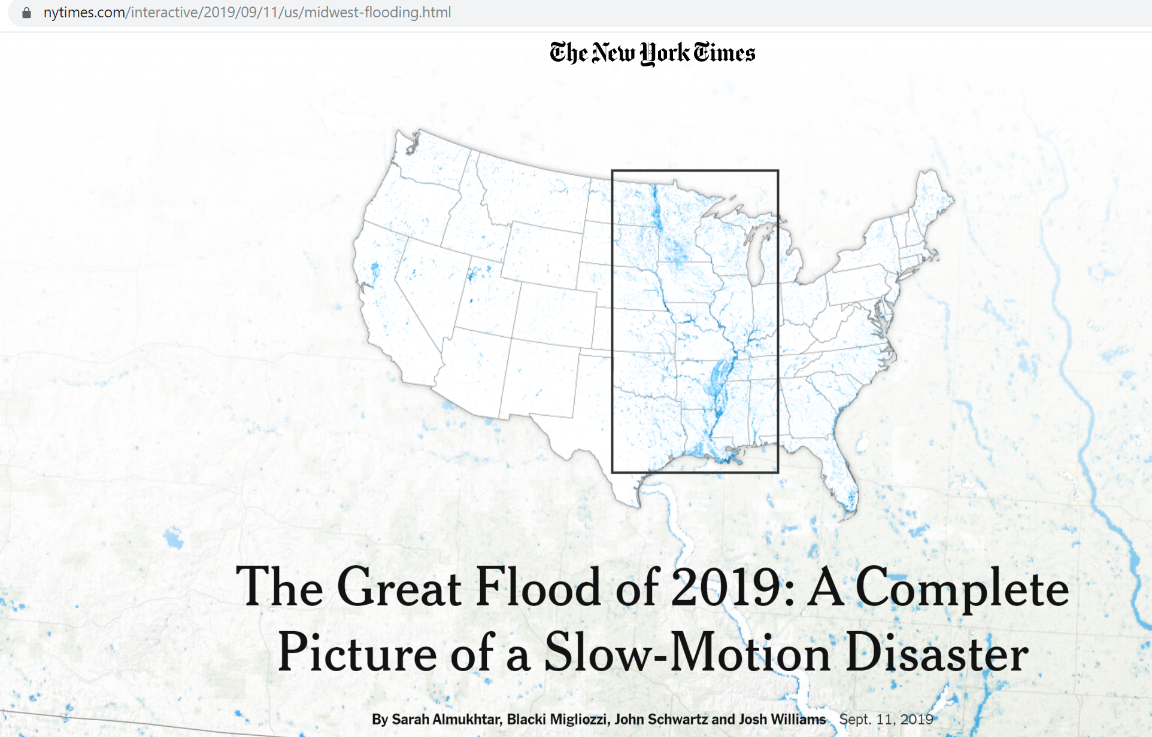
New York Times article used VIIRS flood mapping software
https://www.nytimes.com/interactive/2019/09/11/us/midwest-flooding.html

Slide 14
Next Steps: Using Existing Mechanisms and Structures
Within CGMS and WMO, Flood Mapping evaluation by NMHSs and WMO Region Satellite Data Requirements Working Groups
WGDisasters proposed GEO-LEO SAR Integration Pilot
WGCapD capacity building and training
SIT Chair interest in continuing focus with dedicated pilots and demonstration projects
  Possible Coastal Mapping in Pacific Region

Slide 15

Questions?

