Slide 1
Data Cubes as an Analysis Ready Data Tool
Brian Killough, NASA, SEO
CEOS 2019 SIT Technical Workshop
Session 7, Agenda Item 7.2
Fairbanks, Alaska, USA
11 – 12 September 2019

Slide 2
Strategic Direction
What is the goal of the Data Cube initiative?
From the Open Data Cube (ODC) website ... The ODC seeks to increase the value and impact of global Earth observation satellite data by providing an open and freely accessible exploitation architecture. The ODC project seeks to foster a community to develop, sustain, and grow the technology and the breadth and depth of its applications for societal benefit.
The “ultimate” goal ... foster a network of regional interoperable satellite data cubes to support a diverse set of global users and drive the uptake of Analysis-Ready Data (ARD)
Who does the Data Cube support?
Users = Governments, Ministries, Researchers, Statistical Offices, Commercial
What are the key features of the Data Cube?
Free, open source software, cloud computing compatible, analysis-ready datasets, time series analyses, data interoperability, application algorithms
Lowers “barrier to entry” with a focus on non-traditional users in developing countries
What are the alternatives to the Data Cube?
Google Earth Engine, Rasdaman ... less control or commercial connections
Traditional downloads ... slow and costly, growing data volumes cause issues

Slide 3
Analysis Ready Data
CEOS, thru the LSI-VC, is coordinating the specifications for analysis ready data (ARD) products. There is great interest in the user community and they recognize CEOS as the lead.
ARD is no longer a desire of global users, but is now becoming a requirement and an expectation!
ARD will help increase the use and impact of satellite data and remove the data workflow burden on less experienced data users.
Most of the ARD is stored on cloud-based systems which allows easy connections to the Open Data Cube (ODC) infrastructure
The combination of CEOS ARD (data) and the ODC (tool) is seen as an end-to-end contribution from CEOS to the user community
CEOS Analysis
Ready Data
+
=

Slide 4
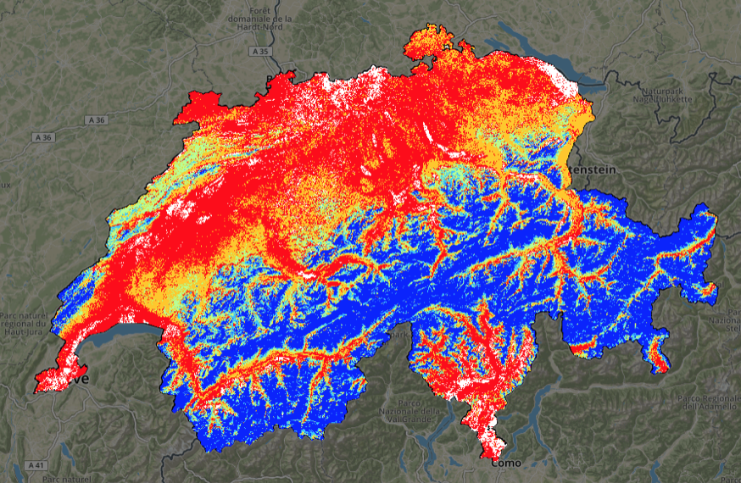
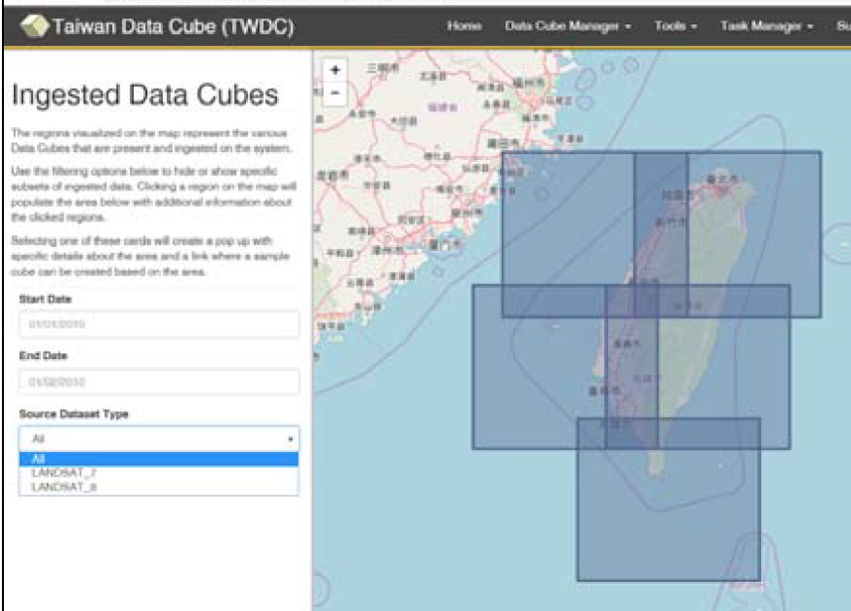
Data Cube Prototypes
Since the start of the Open Data Cube project, there have been many examples of successful adoption of this technology to exploit the use of CEOS ARD and create impactful products.
UNEP and the University of Geneva created the first time series snow cover map of Switzerland
Taiwan used their Data Cube to study Typhoon damage and recovery and manage their own Formosat satellite ARD

Slide 5
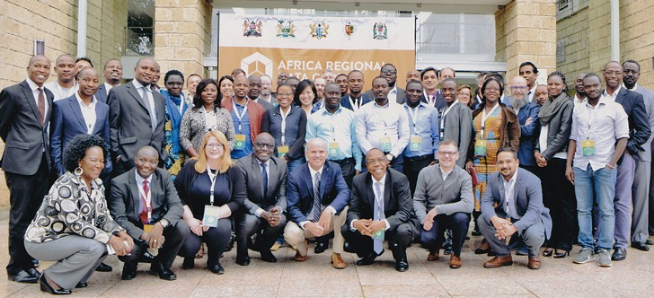
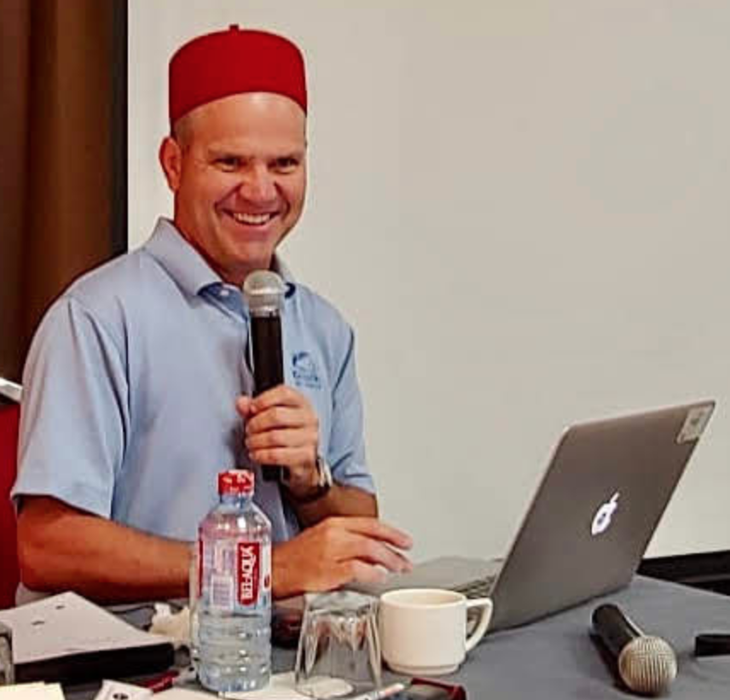
Africa Regional Data Cube
The African Regional Data Cube (ARDC) project was launched in May 2018 for 5 countries (Kenya, Tanzania, Sierra Leone, Senegal, Ghana). Based on Landsat, Sentinel-1 and ALOS data.
Supported by CEOS (lead + technical support), Amazon (donated cloud services) and GPSDD (Global Partnership for Sustainable Development and Data) - (training + management support).
Multiple web-based remote and face-to-face training sessions since May 2018
Initial country use-cases include agriculture, flooding, urbanization, deforestation and illegal mining.
Focus on Government and Statistical Agencies with growing interest across the countries
Your SEO “at work” in Ghana

Slide 6
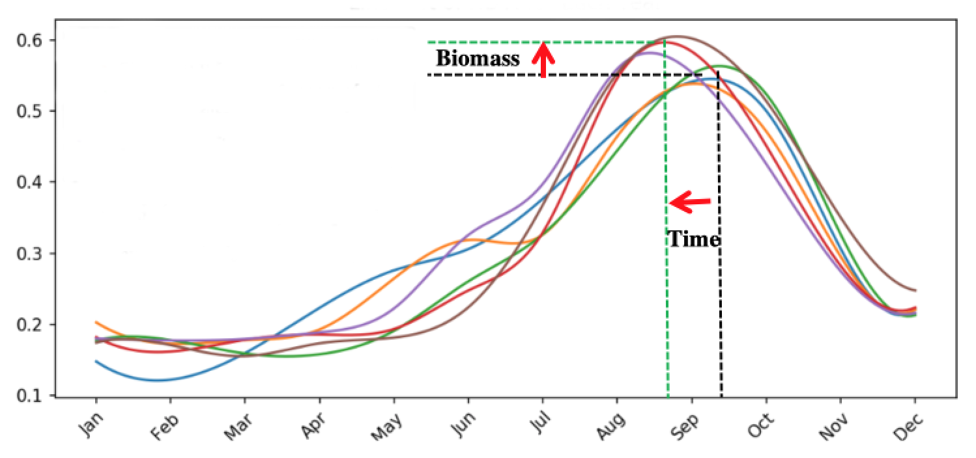
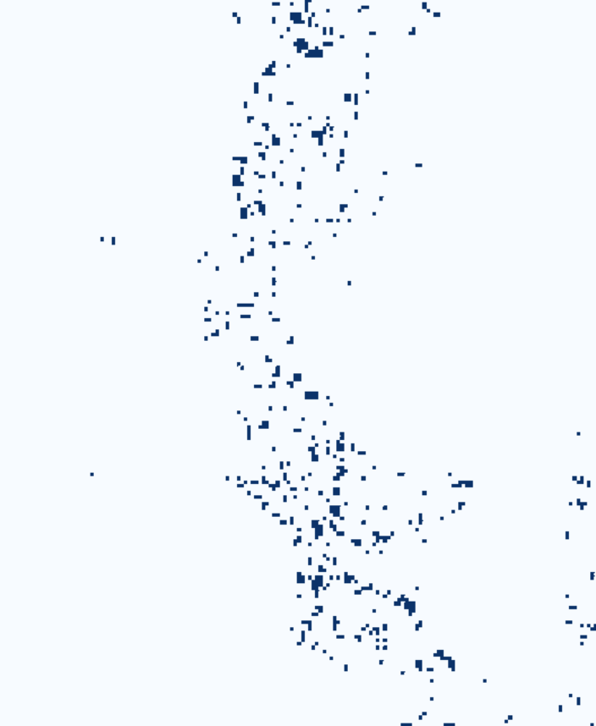
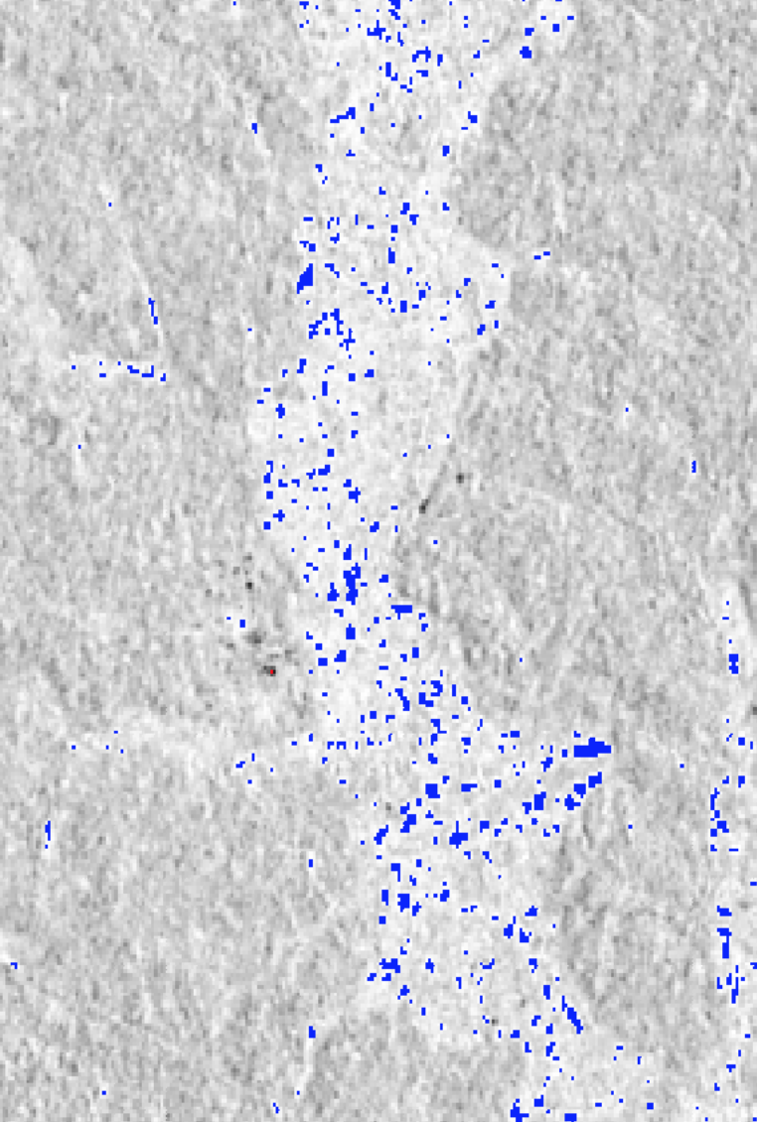
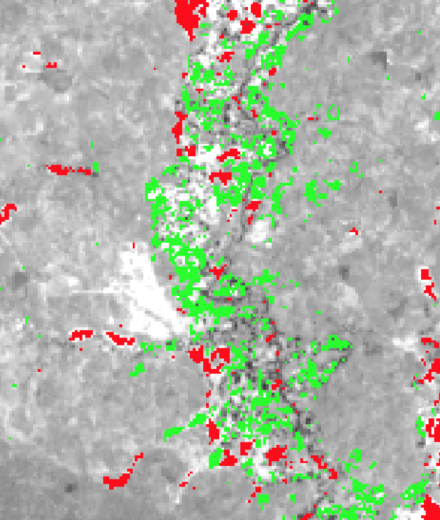
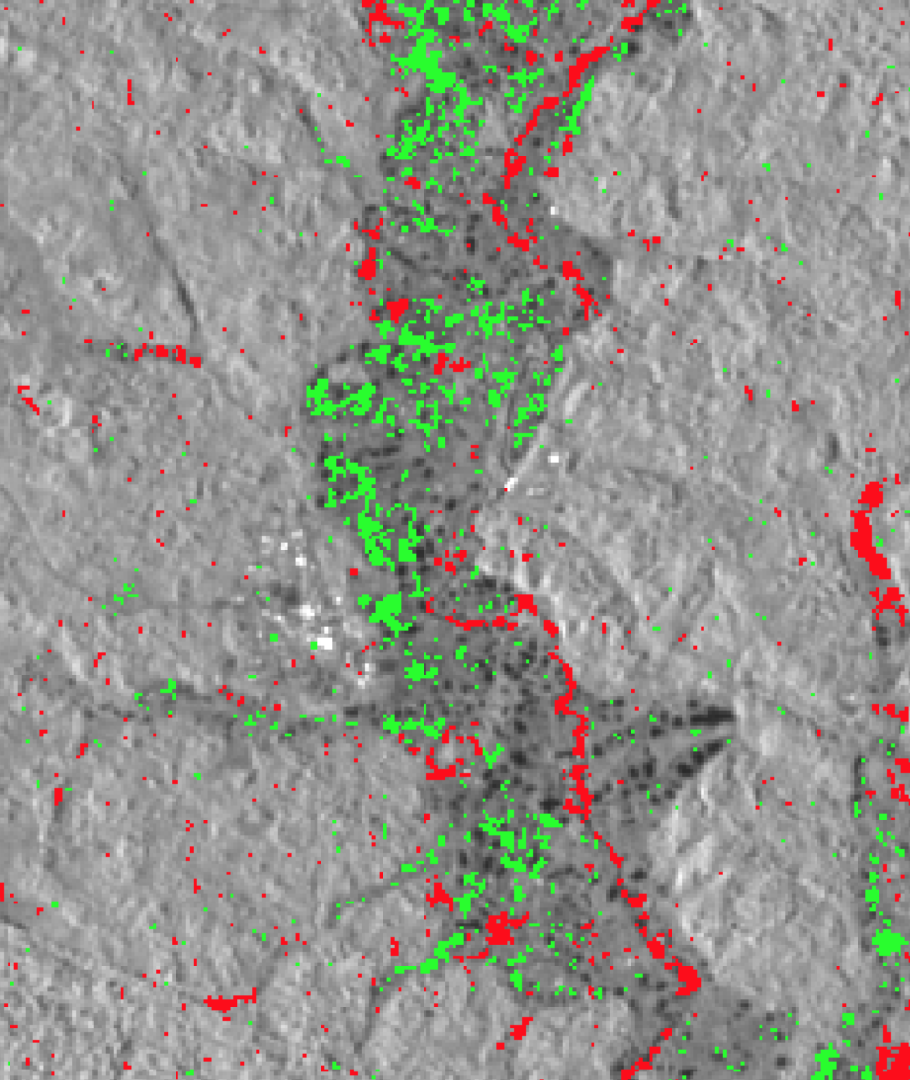
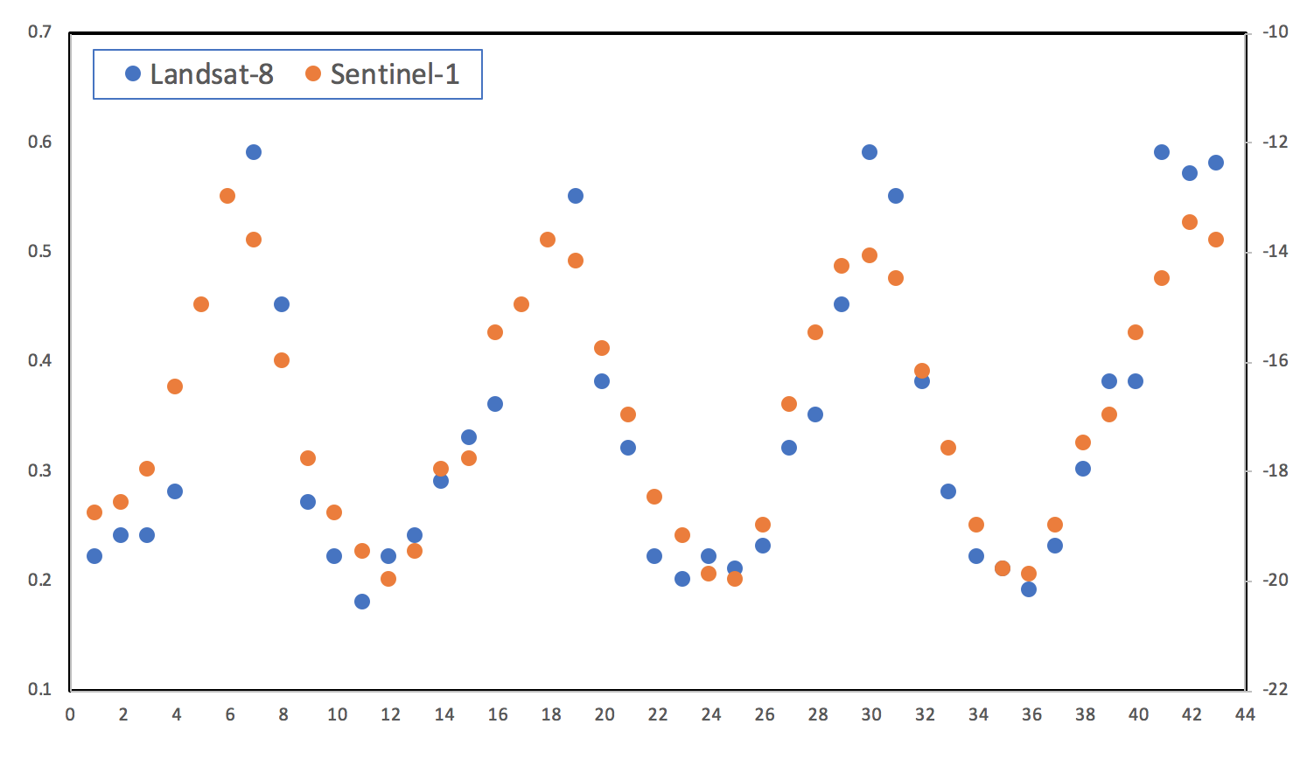
Ghana Use Cases
The Ghana government is learning how to use interoperable Sentinel-1 and Landsat ARD to search for illegal mining and measure land change
Ghana agriculture scientists are studying the impact of new crop varieties and cultivation methods
NDVI Phenology shows increased biomass (yield) and earlier harvest
Detection of water bodies in May 2017 using Landsat (left) and Sentinel-1 (right)
Detection of vegetation loss (red) and vegetation gain (green) from 2015 to 2018 using Landsat (left) and Sentinel-1 (right)
Landsat and Sentinel-1 phenology curves show similar response

Slide 7
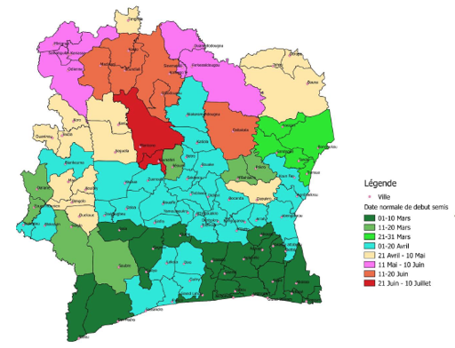
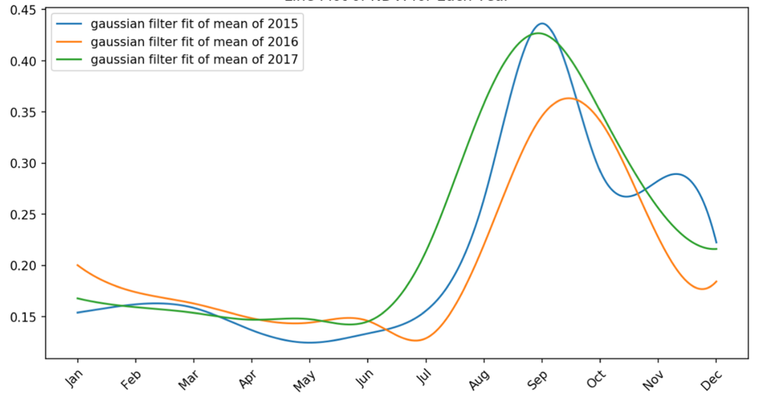
Testimonials
Start of Season variability for Maize in Ghana
NDVI Phenology for Millet Crops Measured yields in 2015 and 2017 were 5% higher than 2016 which is confirmed by the phenology data.
Senegal Government Agriculture Statistician ... This work enables the estimation of crop yields in Senegal and will enable the government to improve the reliability of agricultural statistics in the calculation of SDG indicator 2.4.1 related to the proportion of land productive and sustainable agricultural
Ghana Government – Head of Geospatial Unit With climate variability a threat to food security .... a clear understanding of crop growth cycles, beginning and end of sowing periods, etc., constitute critical parameter inputs that are currently not available.

Slide 8
Digital Earth Africa
The success of the ARDC pilot project has led to an expansion of the effort to an operational platform for all of continental Africa
Digital Earth Africa was commenced in mid-2019 with > $20M of initial donor funding.
DE-Africa will host a targeted side event at GEO Week on Nov-5 in Canberra, Australia

Slide 9
GEO-Amazon Project
GEO awarded $1.5M of Amazon Cloud credits to developing countries to support hosting, processing and analysis of EO data for sustainable development.
CEOS participated in the review of the proposals.
21 proposals were awarded.
15 projects plan to use CEOS satellite data (mostly Landsat and Sentinel) and 5 projects plan to use the Open Data Cube.
To date, the SEO has interacted with Kenya (KALRO agriculture organization), Mexico (INEGI statistical agency) and Ukraine (Space Research Institute) to provide support for data acquisition and Data Cube setup. The support level has been low at this time.

Slide 10
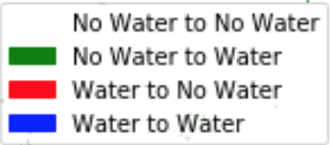
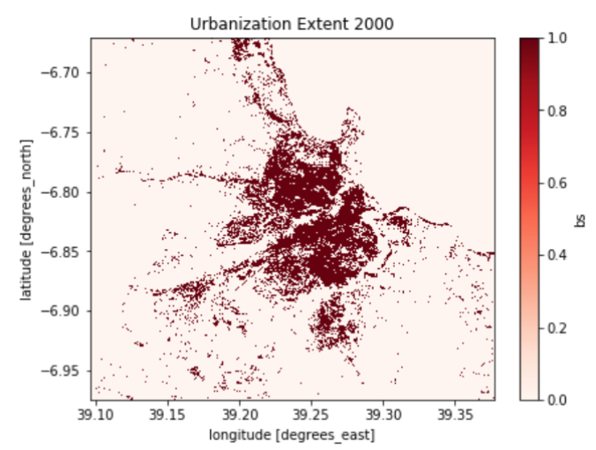
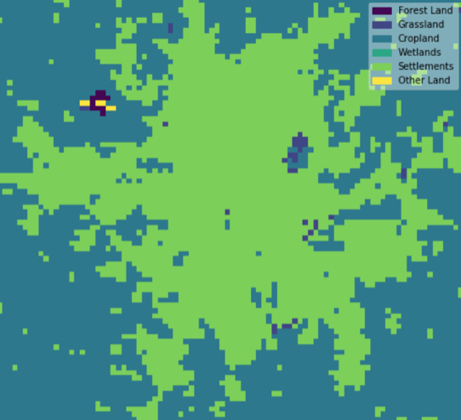
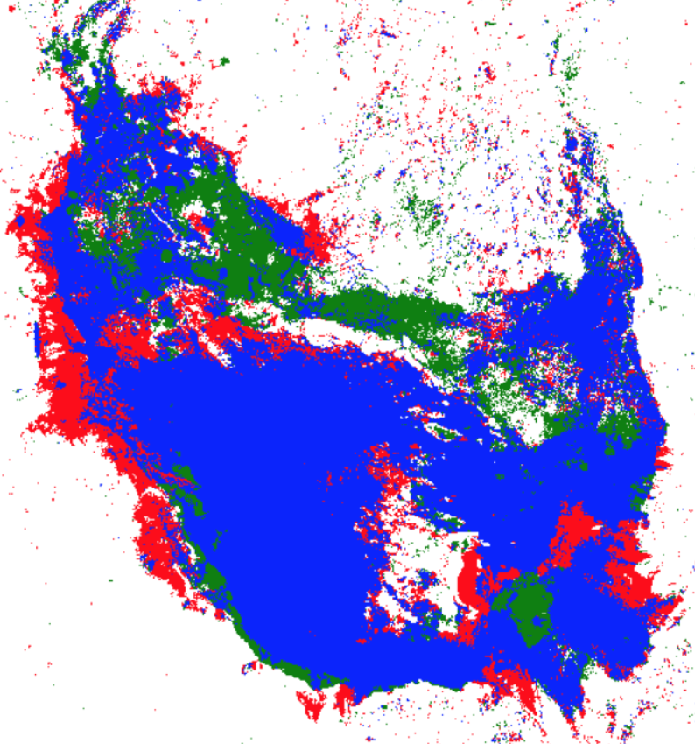
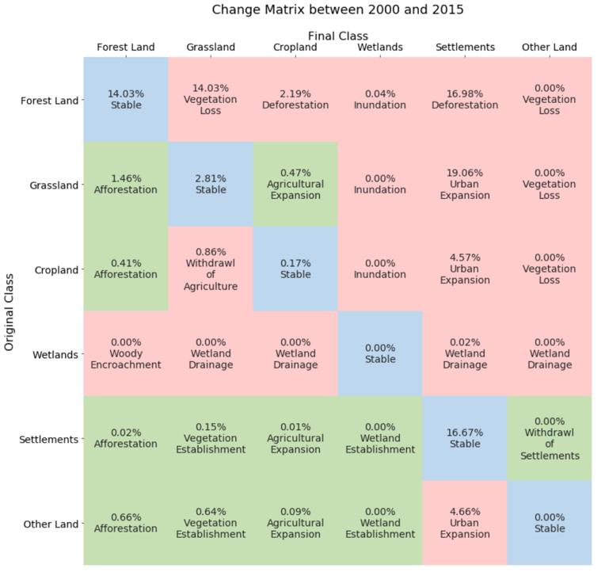
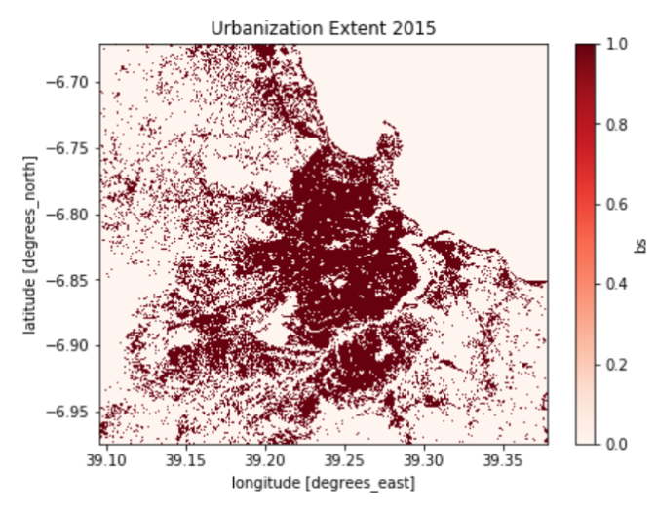
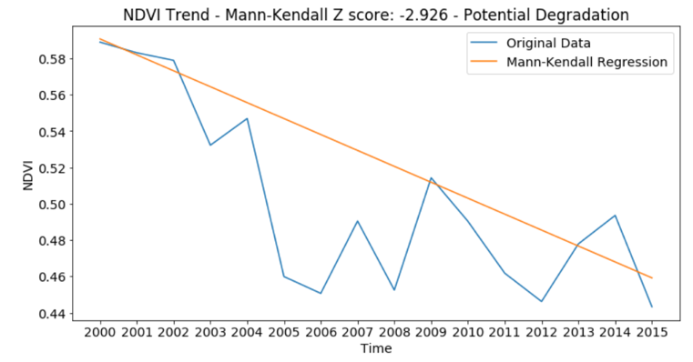
Support to SDGs
SDG 6.6.1 Water Extent
SDG 11.3.1 Urbanization
SDG 15.3.1 Land Degradation
Water Extent = Algorithm based on Landsat time series water detection using the Australian WOFS method. Can be easily used to support SDG reporting and is consistent with UN methodology and the JRC Global Surface Water Explorer.
Urbanization = Evaluating the use of thresholding with NDBI and Fractional Cover. Also linked to GPWv4 population data. Better urban maps are needed to train and test classification. Working with UN-Habitat and Trends.Earth and evaluating the Impervious Surface Index.
Land Degradation = Initial testing using ESA-CCI data (300m) and FROM-GLC data (30m) training data. Results include a change matrix to identify degradation and an NDVI trend. Methods follow the UNCCD “Good Practices” document.

Slide 11
What is the future?
Work with LSI-VC to develop ARD specifications, promote the use of ARD and demonstrate its value through Data Cube prototypes and projects
Support to SDGs through the development and sharing of algorithms connected to CEOS ARD
Support to Digital Earth Africa to demonstrate large-scale use of CEOS ARD with a common data analysis infrastructure (data cube)
Work with ESA (Albrecht Schmidt) to improve access to Sentinel ARD for global data cube users
Connect the Data Cube to Google Earth Engine ... huge community of users and algorithms
Connect with SEPAL to support GFOI ... an alternative infrastructure option
Work with GEOGLAM to create a Landsat-based version of the Crop Monitor ... University of Maryland has started work
Explore options to work with the ocean community for land/water coastal boundary analyses
Explore connections to new and diverse datasets (e.g. NISAR, OLCI, Lidar, PACE)

