Slide 1
Open Data Cube (ODC) for the Sustainable Development Goals (SDGs)
Brian Killough, NASA, CEOS SEO Adam Lewis, GA, DE-Africa
CEOS SIT Technical Workshop 2020
Session 2.1, Item #4 - ODC for SDG
7-11 and 14-18 September 2020

Slide 2
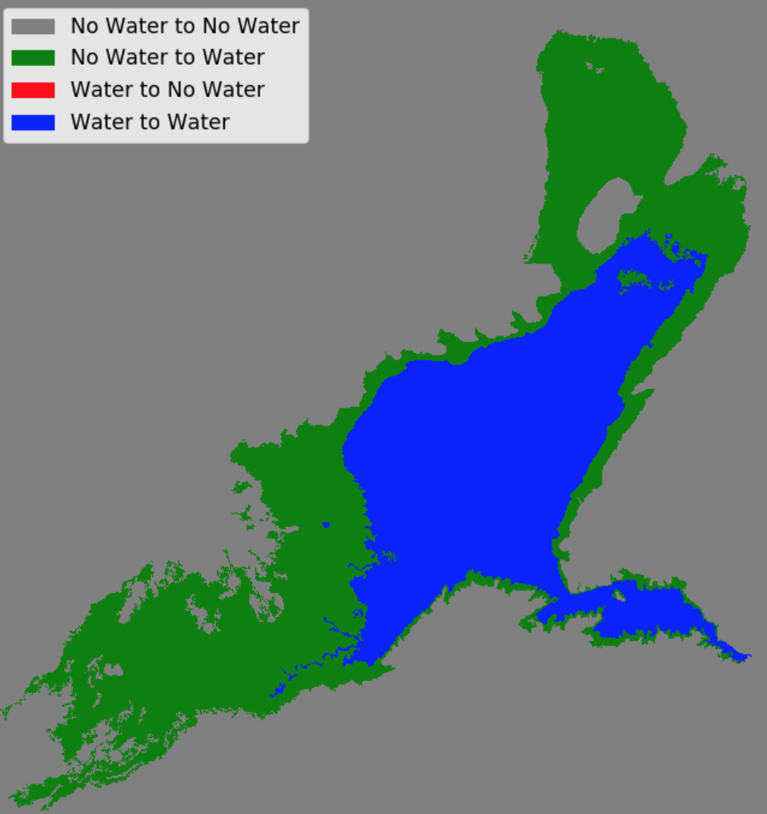
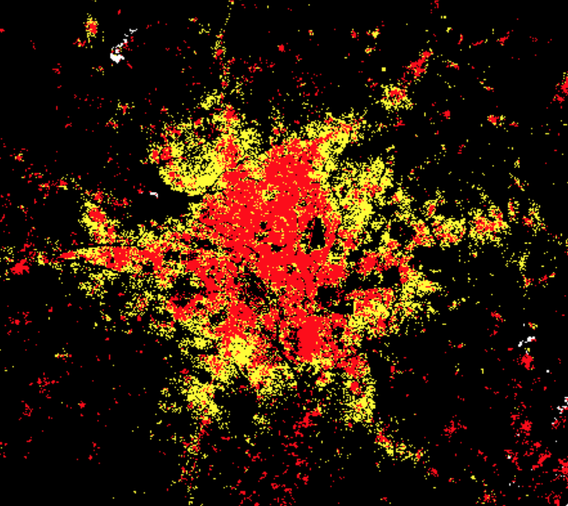
SEO Progress
SDG 6.6.1 Water Extent
SDG 11.3.1 Urbanization
Water Extent (6.6.1) = Current algorithms use Landsat-8 time series data and the Australian WOFS water detection method. Investigating the addition of Sentinel-1 (S1) and Sentinel-2 (S2) data for increased temporal sampling of dynamic water bodies. Ready to support SDG reporting and consistent with UN methodology.
Urbanization (11.3.1) = Currently using three urban threshold algorithms (NDBI, ENDISI, FC). Classification performance (compared to GHSL) varies by region, but yields accuracy over 90% in many cases. Local digitized urban maps can be used, if available. Future testing will include S1 data (no clouds) and S2 data (higher resolution) to improve results.
Land Degradation (15.3.1) = No significant progress since late 2019. Working with the SDG team (e.g. Philip Frost, INMAP) on algorithms and datasets. Future testing will include S2 data (better 10m resolution) and the Copernicus VITO land cover product (better 100m classification resolution).
Mtera Reservoir, Tanzania
Maximum water extent from 2015 to 2016. The regions in green are increased water and the regions in blue are unchanged.
Kumasi, Ghana
Urban extent from 2000 (red) to 2015 (yellow) using Landsat data and the ENDISI algorithm. Comparisons with GHSL data yielded a 95% overall accuracy and an 87% F1 score.

Slide 3
Next Steps for the SEO
Release a new free/open “Amazon ODC Sandbox” by October 2020. This will allow users to test the SDG algorithms anywhere in the world! Initially it will use the global Landsat ARD archive and eventually will add Sentinel-2 ARD.
Develop and release a free/open “Google ODC Sandbox” by the end of 2020. This will use Google Cloud and Earth Engine global datasets.
The two “Sandbox” concepts (noted above) will be advertised as an “Open Earth Alliance” activity which is a new GEO Community Activity focused on Open Data Cube exploitation. In addition, these concepts will be discussed with GEO to manage the number of users and utilize cloud credits from Amazon and Google.
Continue testing and enhancements to the existing SDG data cube notebooks and also add and improve training resources (documentation and videos).
Progress the production of Sentinel-1 ARD to generate data cubes on-demand. Continue to discuss plans for global data production and hosting of that data on public clouds.
Add all of these resources to the EO4SDG Toolkits.

Slide 4
Digital Earth Africa
DE Africa is providing access to the data and tools for countries and actors in Africa to address SDGs and other resource questions.
A broad range of use-cases is arising according to user interest - there is appetite for EO based methods. However, local ownership of methods is important
A target for CEOS SDG team could be to deliver practical and transparent methods that can be extended and applied through data cube platforms.
The following slides are a ‘whirl-wind tour’
with acknowledgement to Dr Ken Mubea

Slide 5
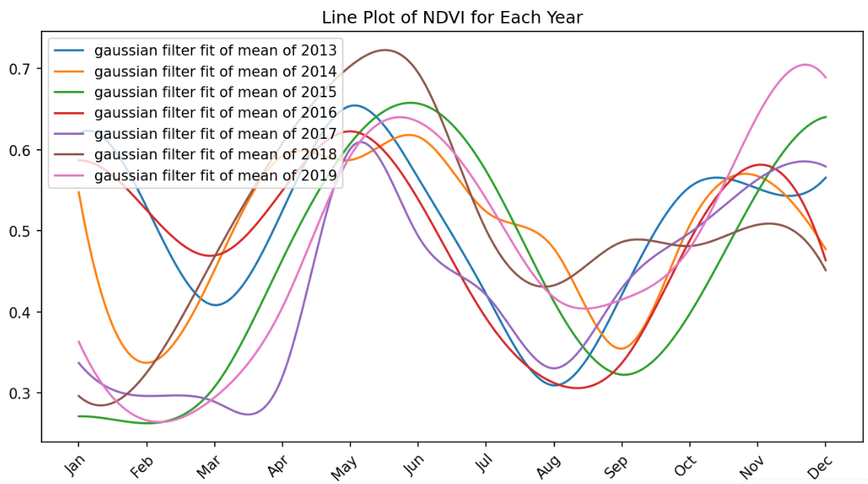
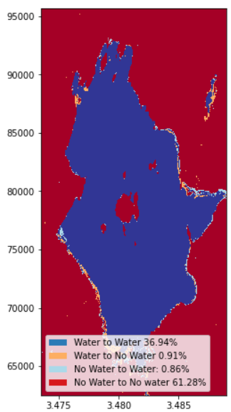
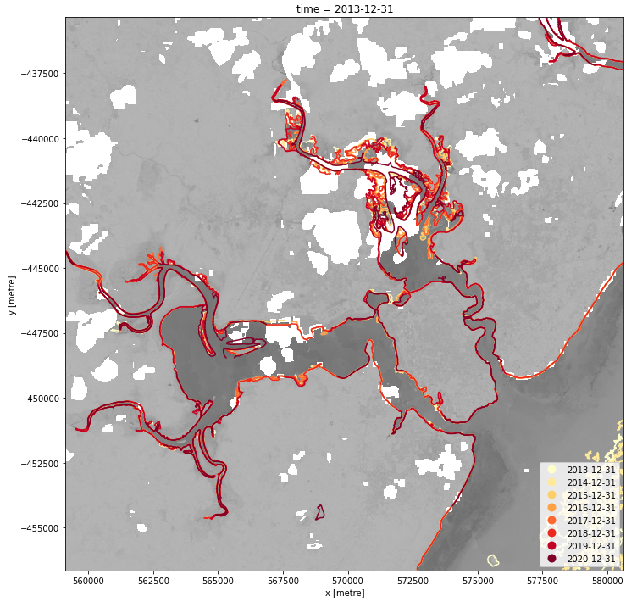
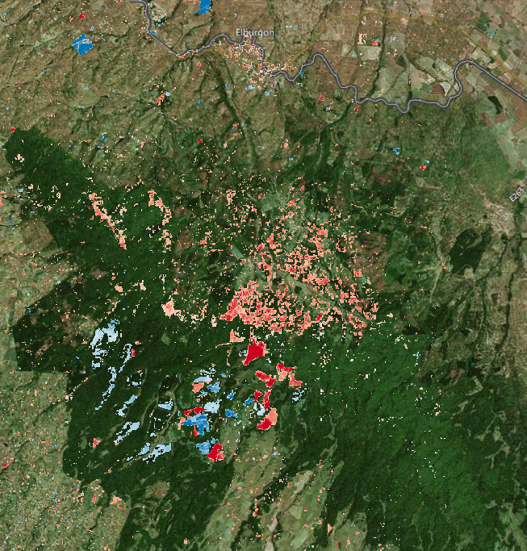
Digital Earth Africa use cases
Agriculture
Water extent
Urbanisation
Coastal erosion
Deforestation

Slide 6
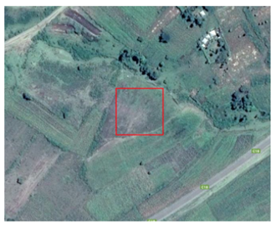
Agriculture – SDG 2.4.1 and Big Four Agenda – Food security
Mapping soy bean farming in western Kenya - Support to KALRO
High potential ecological zone of Western Kenya with average rainfall of 1000mm.
DE Africa provides an overview of the soy vegetation phenology.
High yields are observed towards April to June and November - December. This is after March-April-May (MAM) long rains and October-November-December (OND) 2018 Short rains respectively.
This information can be used for decision making regarding optimised planting, location, optimised fertilization, and yield forecasting based on historic and current climate conditions

Slide 7
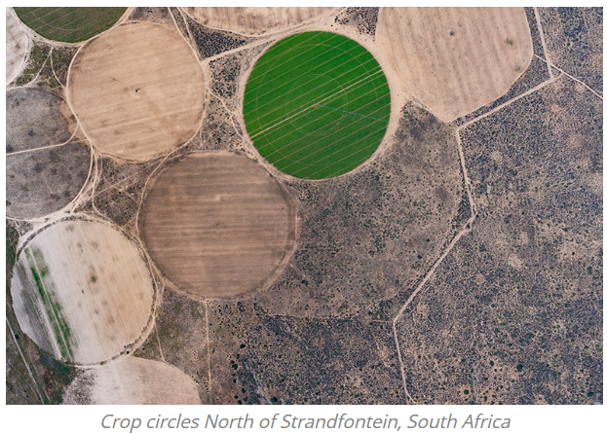
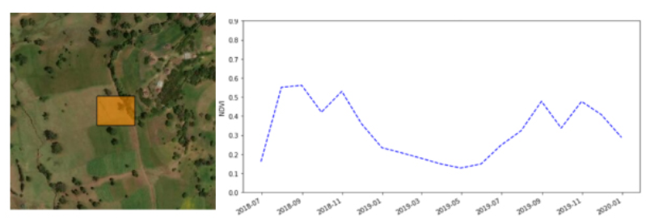
Agriculture – Crop mask development – Food security
Co-designing product development to address food security in Africa
To help address this rise in food insecurity and support SDG2 (zero hunger), the Digital Earth Africa (DE Africa) Technical Advisory Committee endorsed a cropland area map as the next product to be developed by the program.
The Task Team includes:
The Regional Centre for Mapping for Resource Development
Group on Earth Observations Global Agricultural Monitoring Initiative
Ghana’s National Disaster Management Organization
The Global Partnership for Sustainable Development Data
African Regional Institute for Geospatial Information Science and Technology
The Sahara and Sahel Observatory
AGRHYMET Regional Centre
Comparative benefits to existing cropland products
provide a consistent up-to-date map using the latest satellite data
be reproduced annually, rather than once-off
be a ready to use service accessible through the DE Africa platform, rather than running through software
provide continental coverage
have high spatial resolution of 10m
be co-designed with African partners to fit their needs
https://www.digitalearthafrica.org/co-designing-product-development-address-food-security-africa

Slide 8
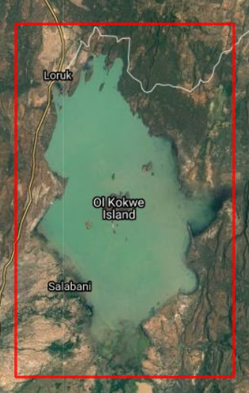
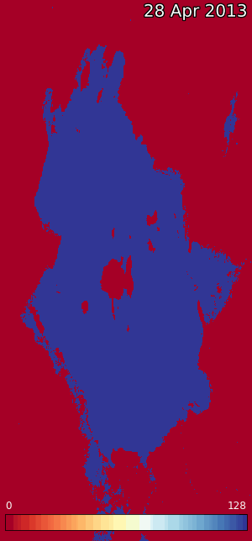
Lake Baringo – water extent – SDG 6.6.1
Lake Baringo
A critical habitat and refuge for
birds and fauna. Water levels
have been fluctuating due to
extreme weather events:
droughts and floods.
A 7 year time series (2013 to
2020) showing the % time that
every pixel has observed water.

Slide 9
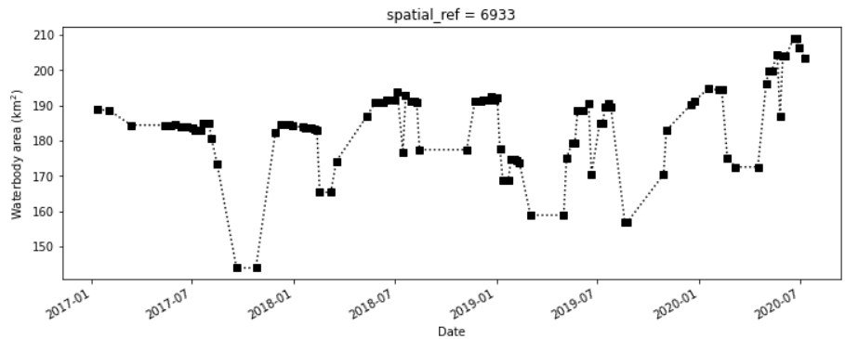
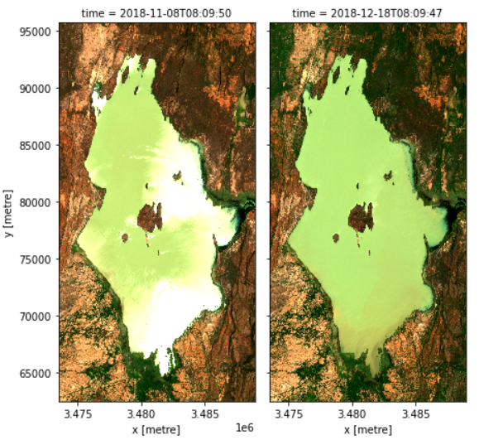
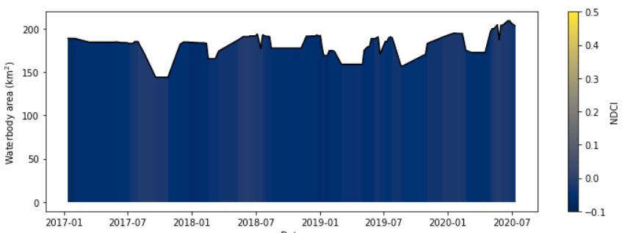
Lake Baringo – water quality – SDG 6.3.2
Lake Baringo
A critical habitat
and refuge for
birds and fauna.
Algal blooms are associated with the presence of chlorophyll-a in waterbodies. Sentinel 2 from European Space Agency shows changes in Chlorophyll using the the normalised difference chlorophyll index (NDCI).
Slight concentration of chlorophyll based on NDCI compared to Lake Nakuru
A 3 year time series (2017 to August 2020) showing the NDCI.

Slide 10
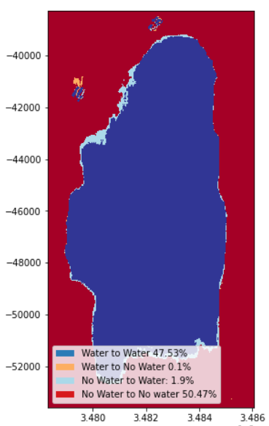
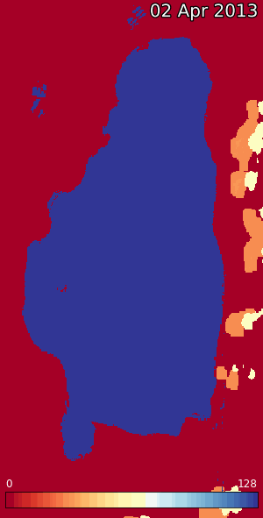
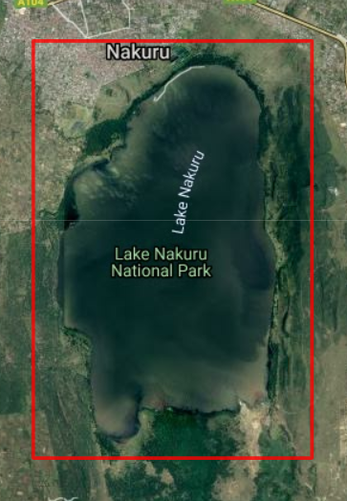
Lake Nakuru – water extent
Lake Nakuru
A critical habitat and refuge for
birds and fauna. Water levels
have been fluctuating due to
extreme weather events:
droughts and floods.
A 7 year time series (2013 to
2020) showing the % time that
every pixel has observed water.

Slide 11
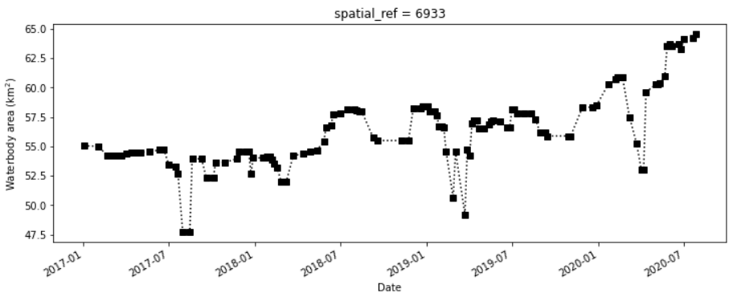
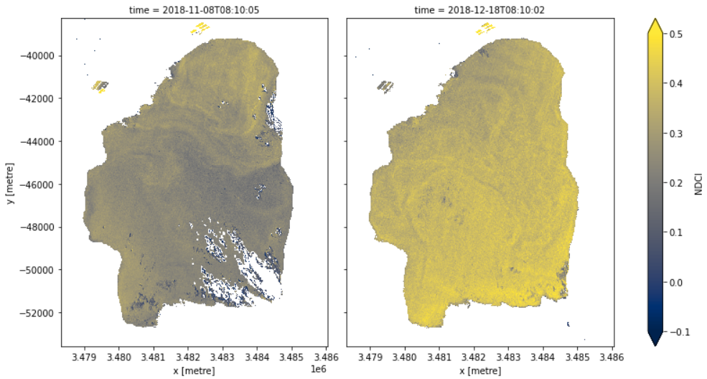
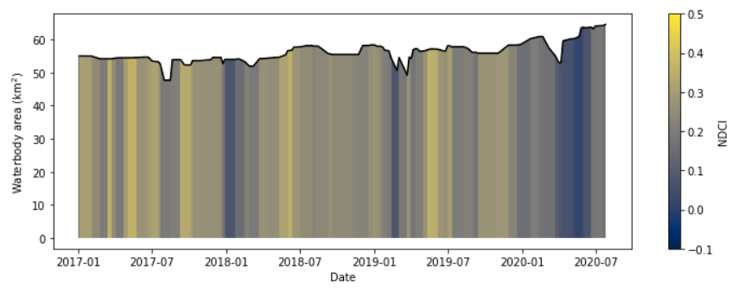
Lake Nakuru – water quality – SDG 6.3.2
Lake Nakuru
A critical habitat
and refuge for
birds and fauna.
Algal blooms are associated with the presence of chlorophyll-a in waterbodies. Sentinel 2 from European Space Agency shows changes in Chlorophyll using the the normalised difference chlorophyll index (NDCI).
Higher concentration of chlorophyll based on NDCI compared to Lake Baringo
A 3 year time series (2017 to August 2020) showing the NDCI.

Slide 12
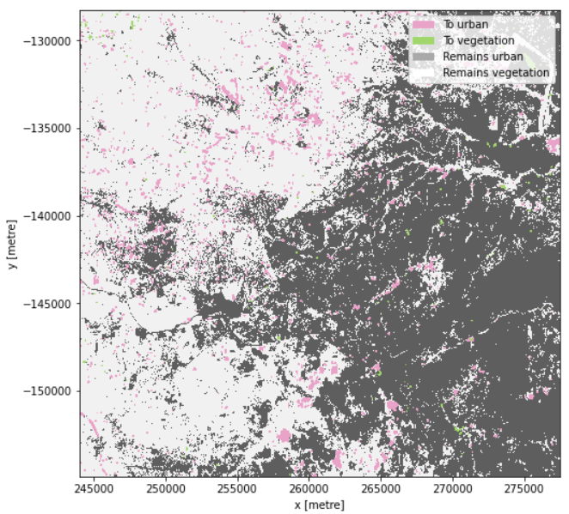
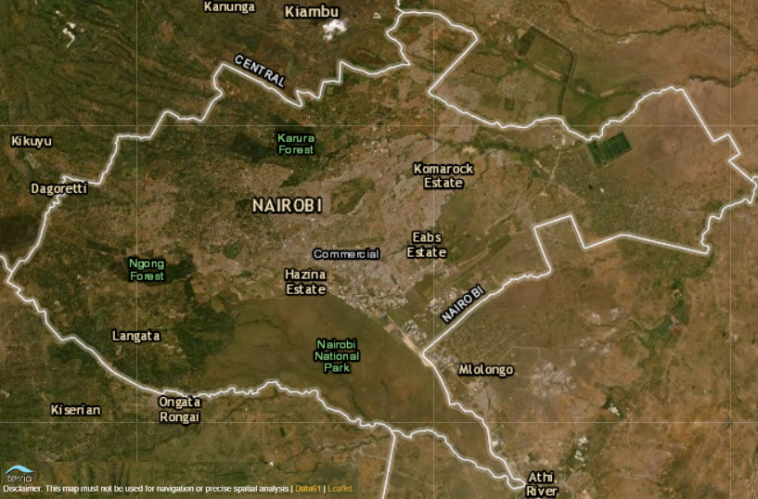
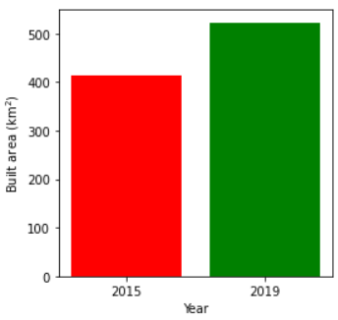
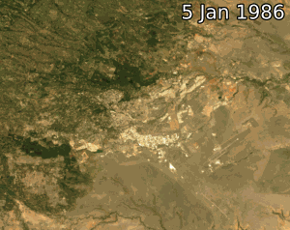
Urbanisation in Nairobi – SDG 11.3.1
Nairobi has experienced rapid urban growth. Monitoring urbanisation is important tool in land and natural
resource management in support of SDGs 11.3.1 and Kenya’s Big Four Agenda. The results below show a 5 year
time analysis (2015 to 2019)
Higher concentration of chlorophyll based on NDCI compared to Lake Baringo
Urbanisation in 2019

Slide 13
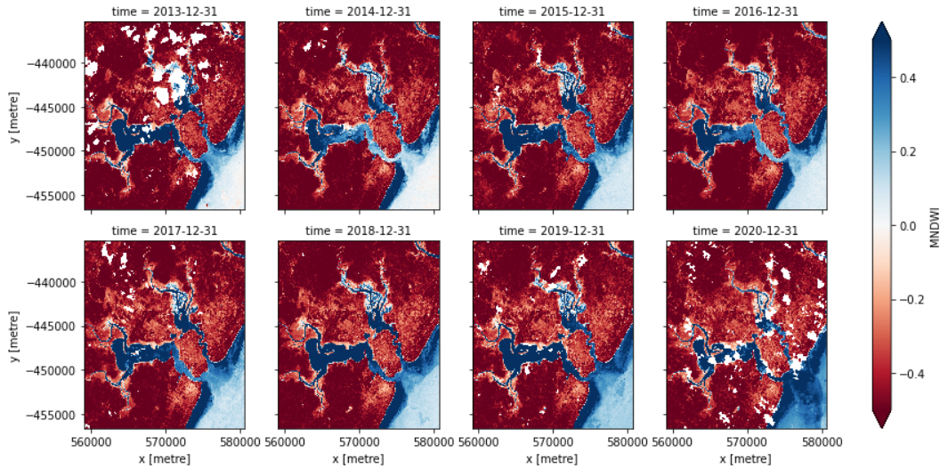
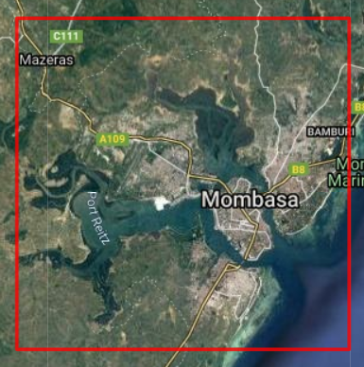
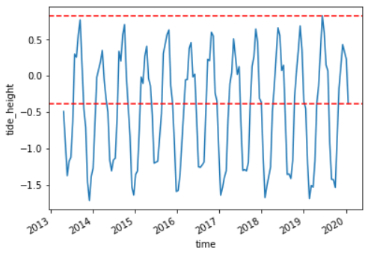
Coastal change - Mombasa
Mombasa has experienced coastal erosion over time. Monitoring the coastal line is critical to conservation of
marine life and mangroves, which provide livelihood to many communities.
DE Africa provides assessment of tide heights and using Digital Elevation Model to map the changes in coastal line from Jan 2013 to Jan 2020
min and max tide heights

Slide 14
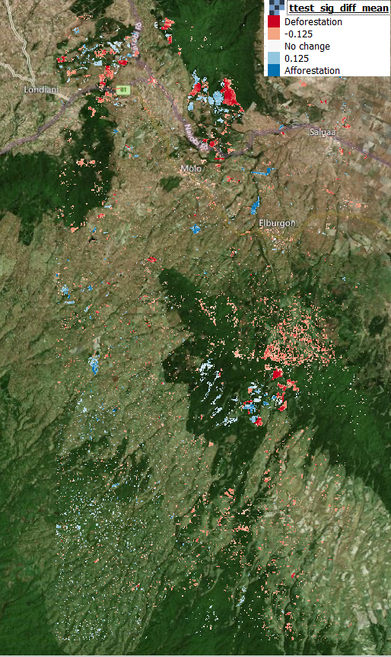
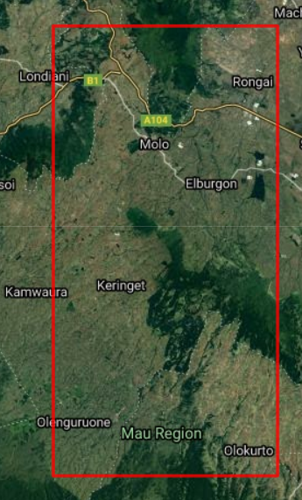
Monitoring deforestation – Maasai Mau Forest
Maasai Mau forest has experienced deforestation over the last
decades. Earth observation provides an opportunity to monitor
deforestation over time. DE Africa provided an analysis of six years from
Jan 2013 to Jan 2020
is shown below
Significant deforestation in Olenguruone

Slide 15
Getting help
GitHub wiki: github.com/digitalearthafrica/deafrica-sandbox-notebooks
Slack: opendatacube.slack.com/
Edward Boamah
Technical Manager
E: edward.boamah@digitalearthafrica.org
Kenneth Mubea, PhD
User Engagement Manager E: kenneth.mubea@digitalearthafrica.org
Crop mask https://www.digitalearthafrica.org/co-designing-product-development-address-food-security-africa

