Slide 1
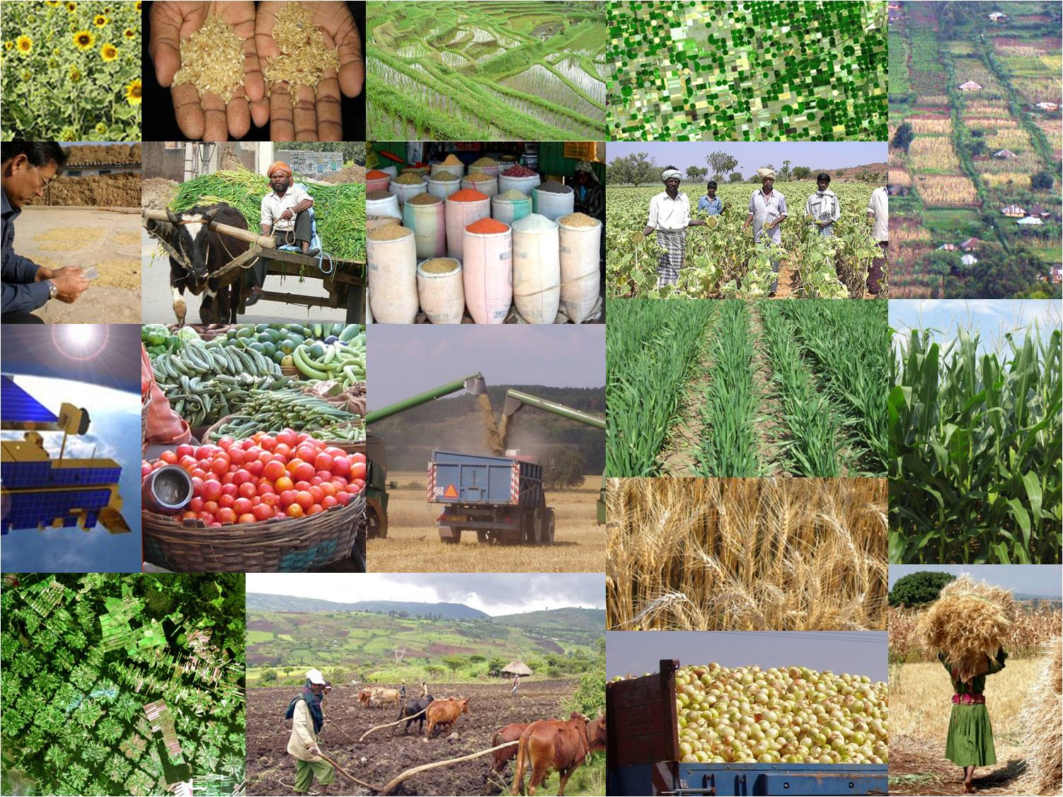



GEO Global Agricultural Monitoring
GEOGLAM
Chris Justice on behalf of the
GEO Agricultural Monitoring Community of Practice

Slide 2





















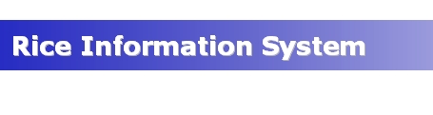

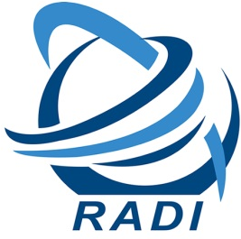



















GEO Agriculture Monitoring Community of Practice an open community of Data Providers, Brokers and Information Users
Initiated under the GEO Agricultural Monitoring Task in 2007
and now focused on GEOGLAM

Slide 3
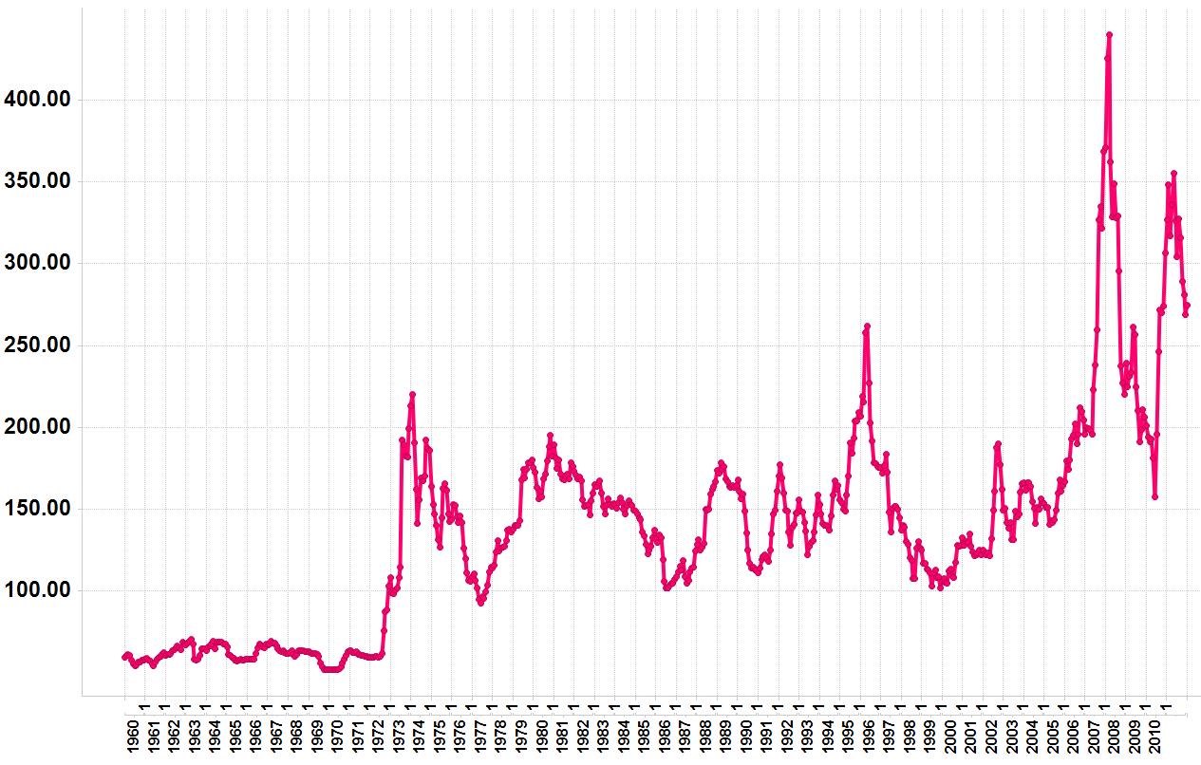
Context for GEOGLAM
Monthly Wheat Prices 1960-2011($/Metric Ton)
Source: World Bank
2008 Price hikes
Droughts:
Australia & Ukraine
2010/11 Price hikes
Drought:
Russia
1971/2’s price hike
Drought: Russia
Landsat 1 Launched (1972)
Nominal wheat price in US $/metric Ton
Notes:
World prices of wheat, rice, corn, and soybeans rose 226% from 2002 2008
Between June of 2010 and May 2011 price of wheat increased by over 80%
The 2010/11 price increases have pushed an additional 44 million people into poverty (FAO)
2011 Horn of Africa drought left over 13 million in need of food aid (FAO)
2012 crop prices for major crops increased rapidly in past few months

Slide 4

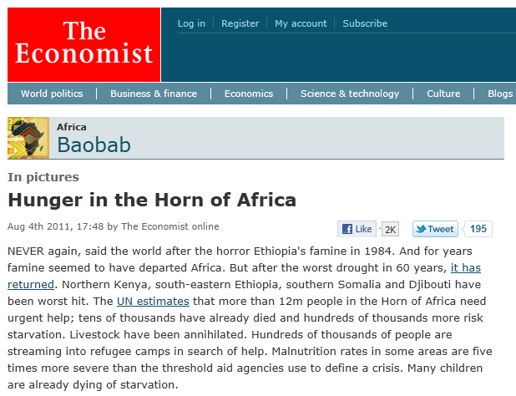
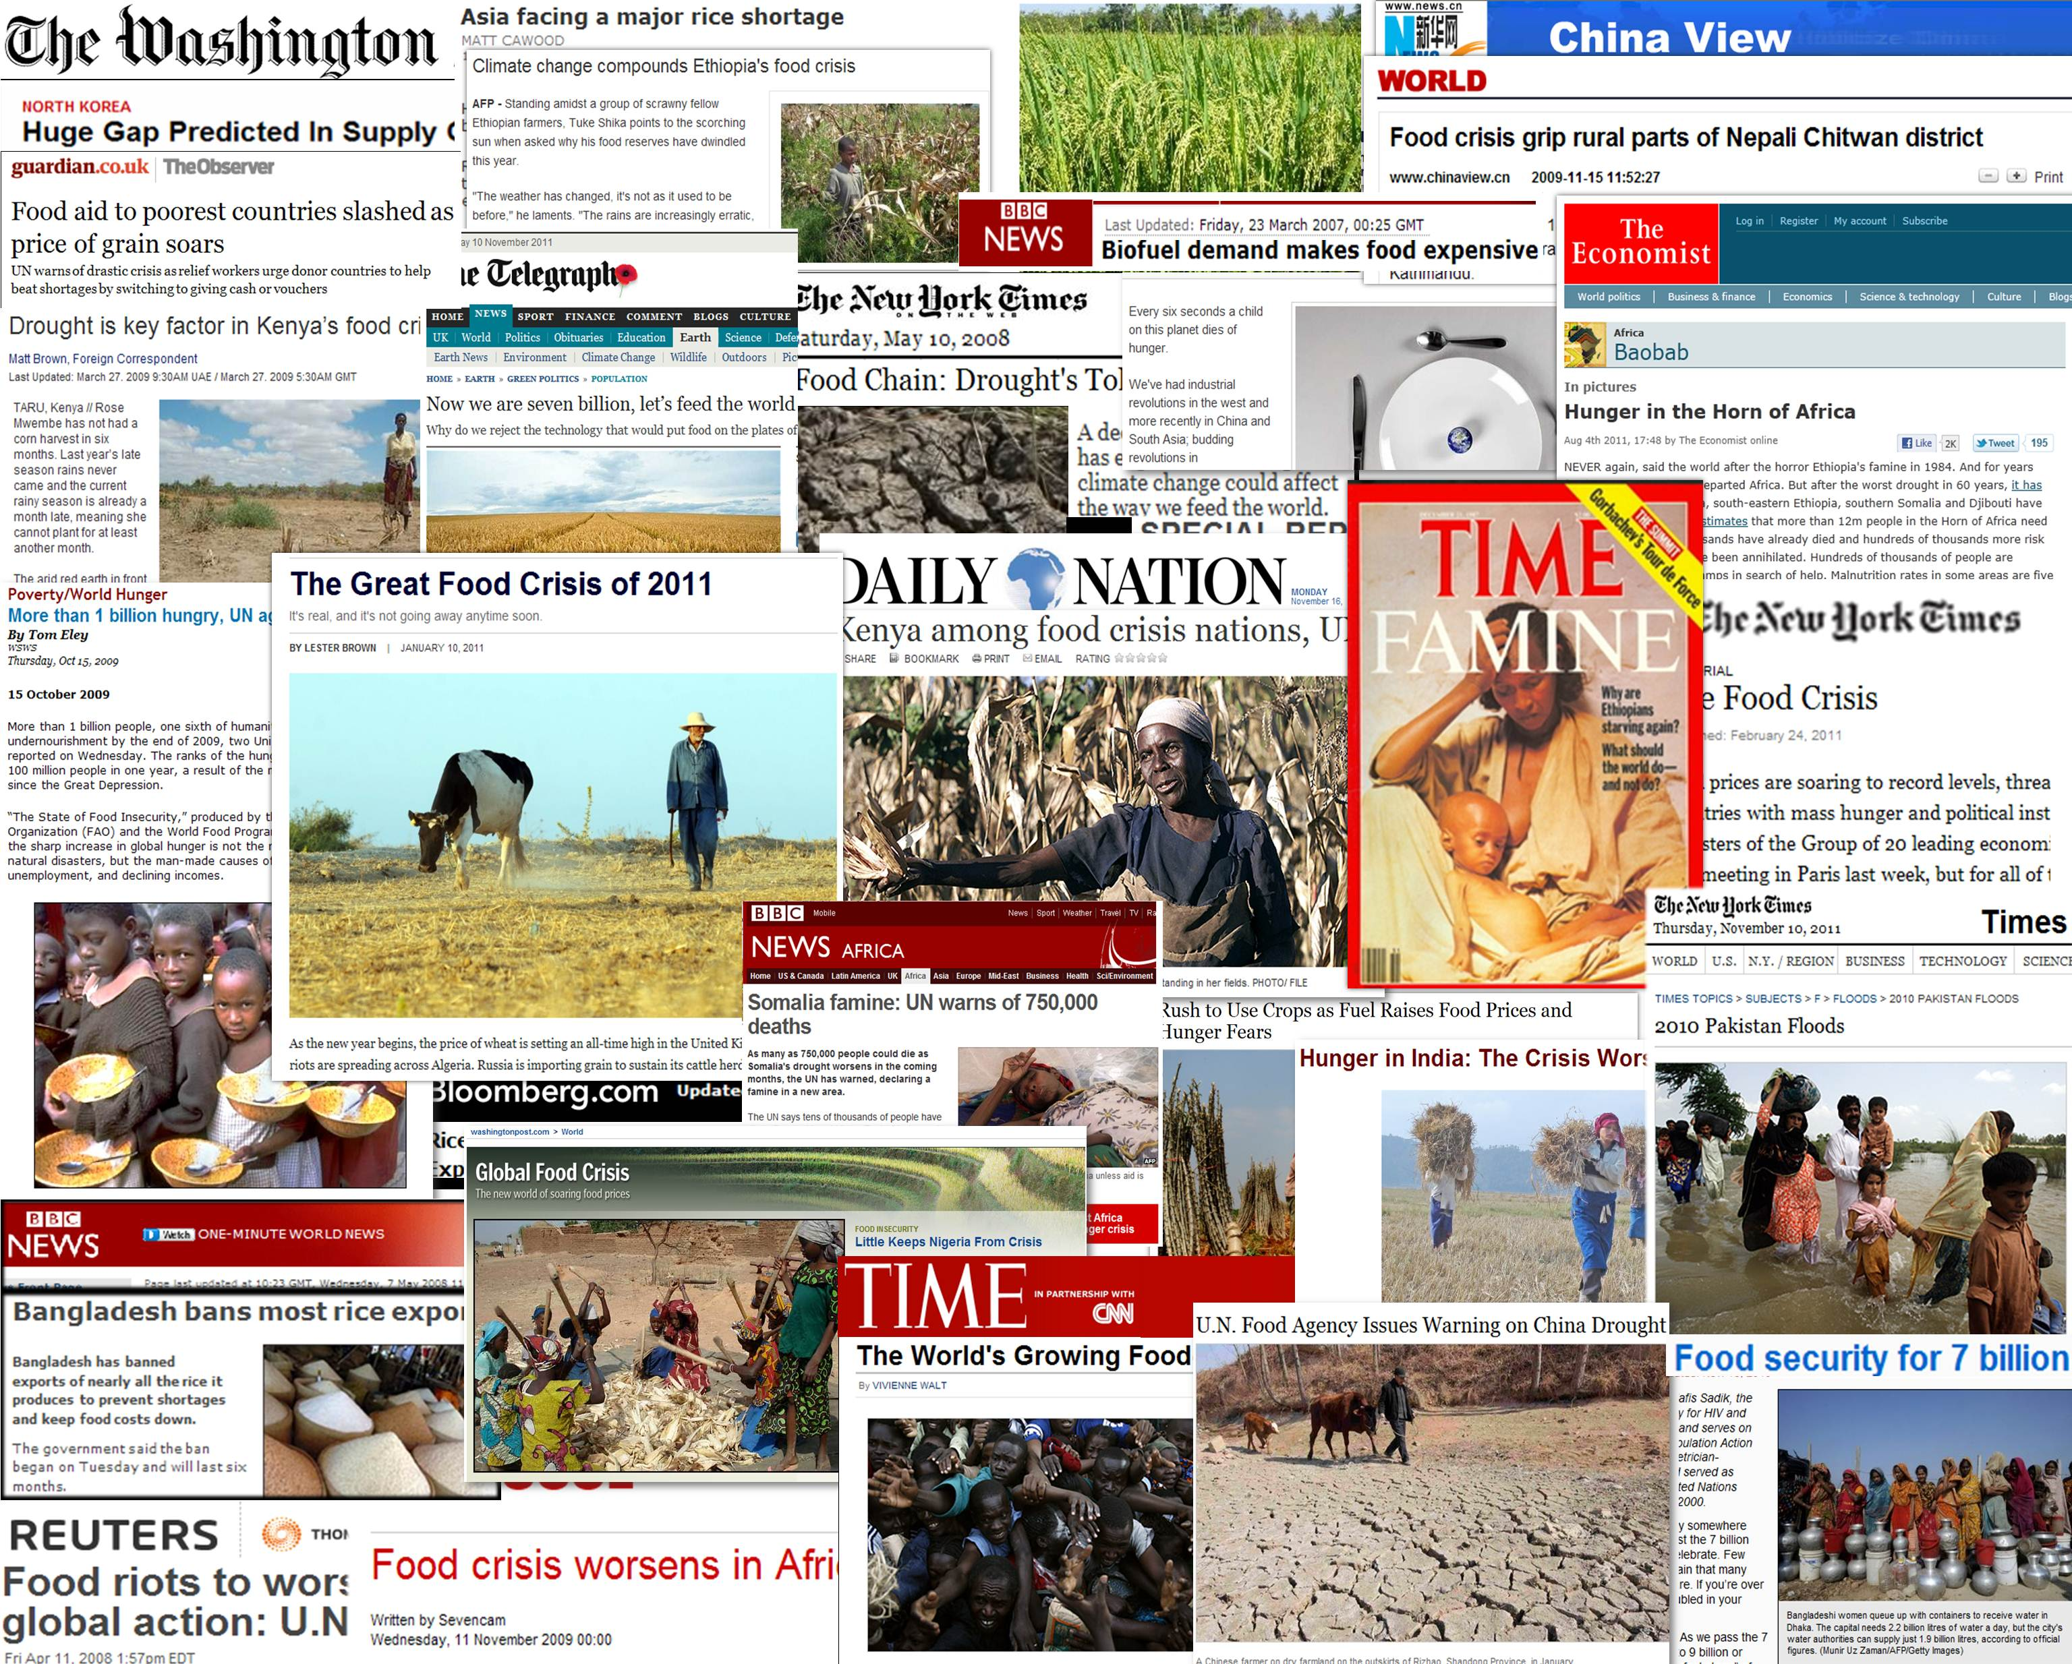


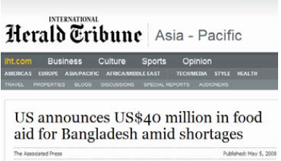
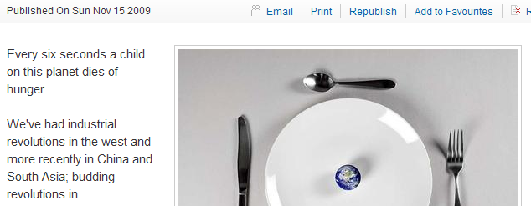
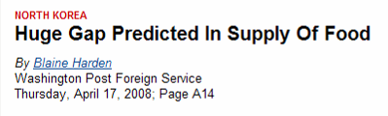
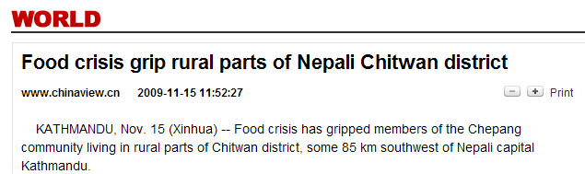
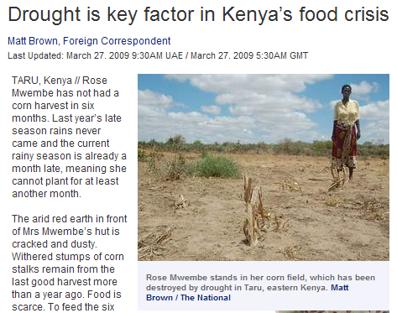
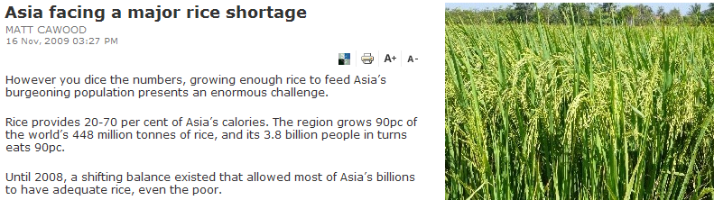
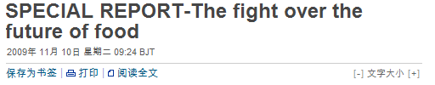

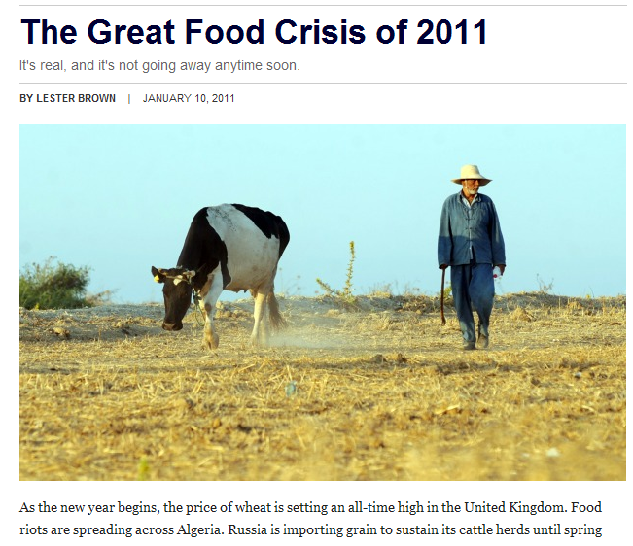
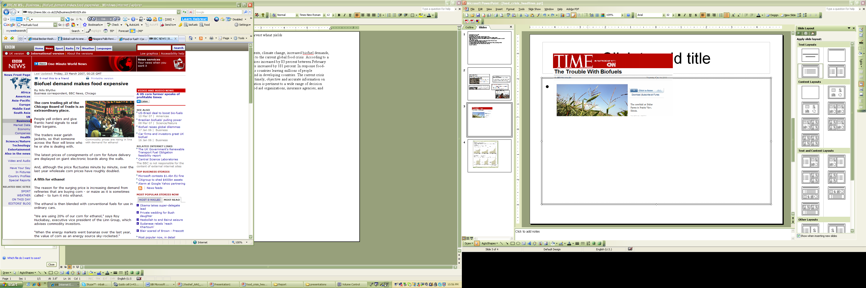

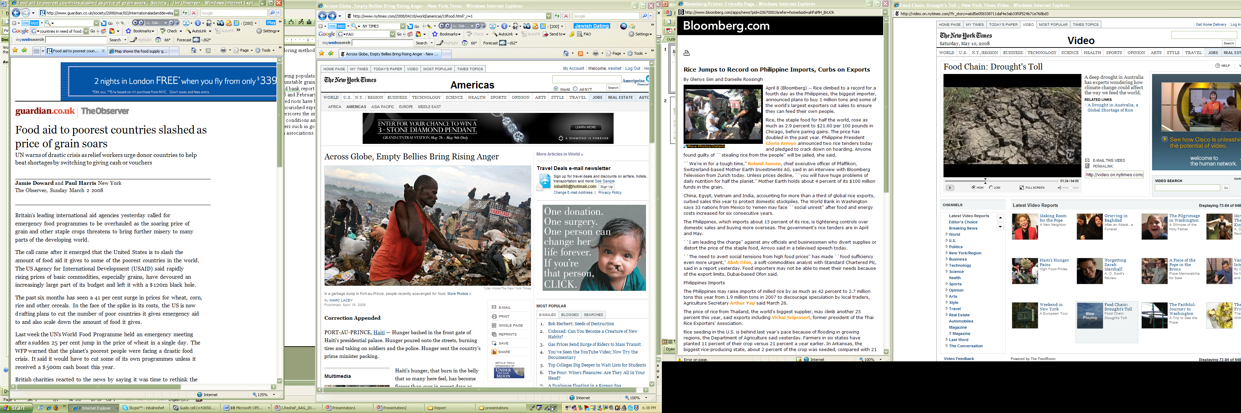




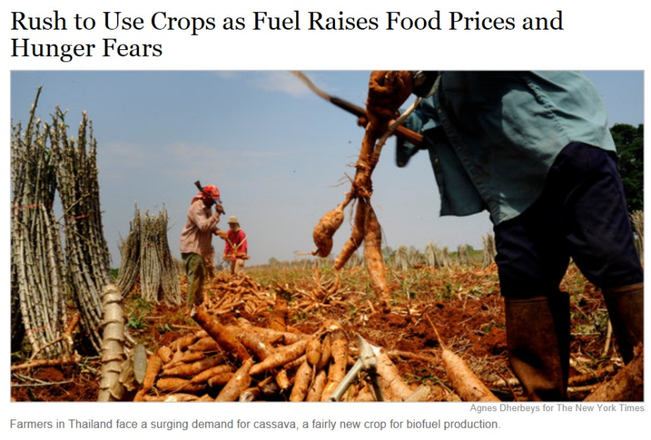
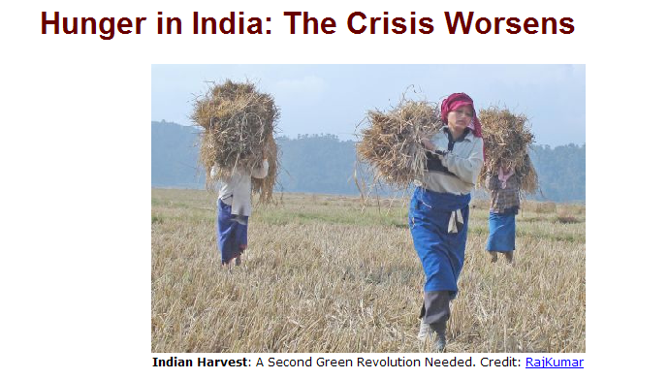

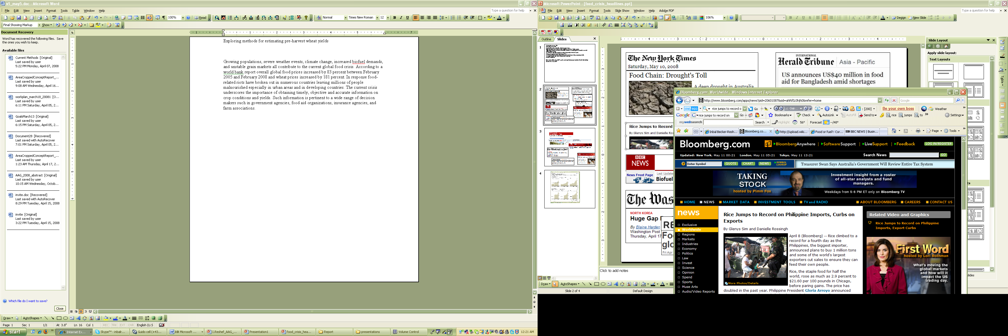

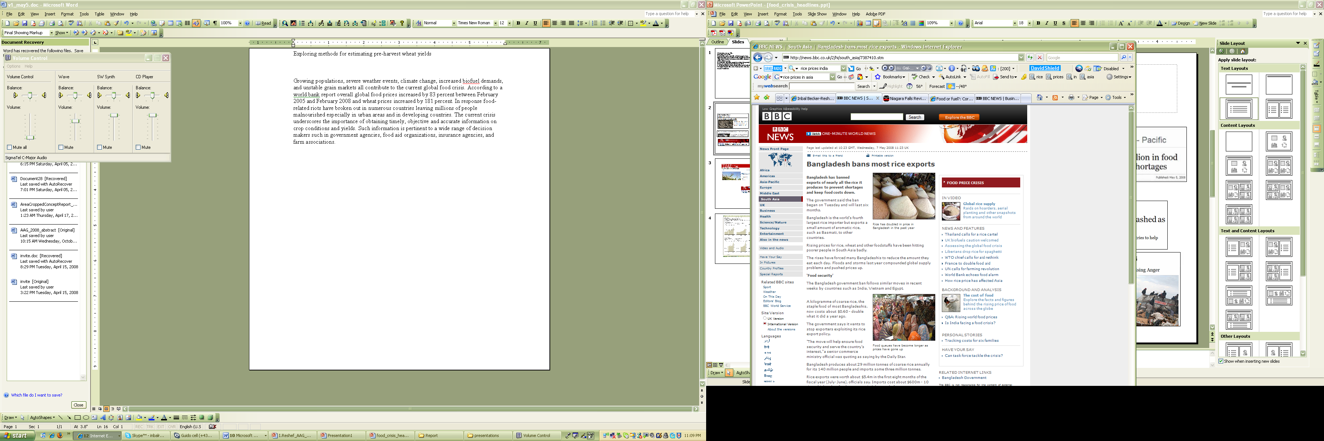
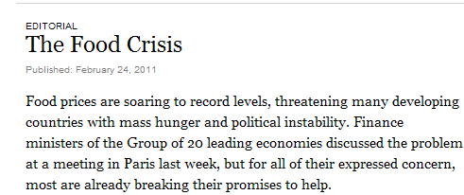

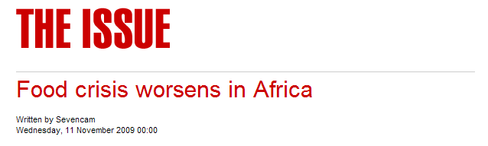
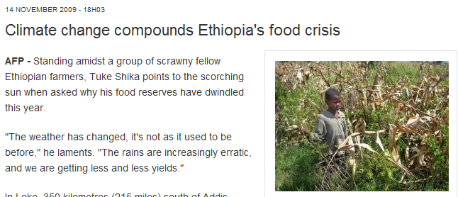
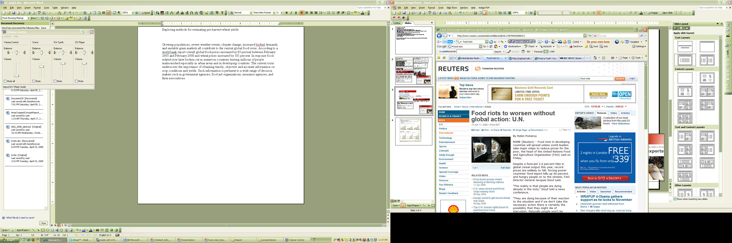
Notes:
There is a lot of attention to food in recent years concerning global food in particular in response to food price volatility.
This problem is not going away especialy recognizing that to feed the world need to increase production by 70%

Slide 5
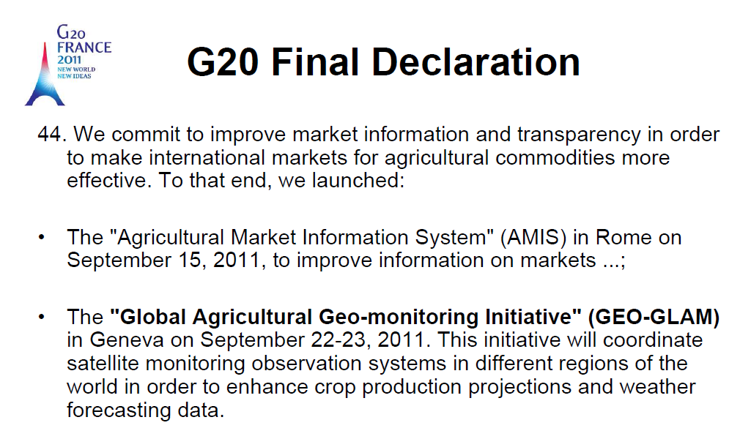
Policy Framework for GEOGLAM
The G20 Cannes Summit (November 2011) Action Plan on Food Price Volatility and Agriculture
Reaffirmed GEOGLAM commitment at the 2012 G-20 Los Cabos Declaration & in Agriculture Ministers Report

Slide 6

G20 GEOGLAM Goal:
To strengthen the international community’s capacity to produce and disseminate relevant, timely and accurate forecasts of agricultural production at national, regional and global scales through the use of EO
Outcome: an improved and more harmonized systems of systems taking advantage of new satellite assets and methods and a higher level of international coordination
GEOGLAM is implemented in the framework of GEO
Notes:
Supporting existing ag monitoring efforts working w/ the operational agencies and organizations

Slide 7
Why This Matters: Looking Forward
Agriculture Faces Major Challenges in this Century
Increasing pressures on agricultural land and production from:
  Increased severe weather events and climate change
  Population growth & changing diets
  Fuel vs. Food vs. Feed
  Limited water and suitable arable land
Higher price volatility for major grains
Commodity markets are increasingly linked (good and bad)
Rising fuel prices impact food prices (transport, fertilizer)
NEED TO INCREASE GLOBAL PRODUCTION BY 70% BY 2050 TO MEET DEMAND (FAO)
→ Data and tools for monitoring and reliably forecasting production are essential for anticipating market imbalances and enhancing policy responses
Notes:
????

Slide 8


GEOGLAM Components
4. EO DATA COORDINATION
5. METHOD IMPROVEMENT through R&D coordination (JECAM)
6. Data, products and INFORMATION DISSEMINATION
Stakeholders
Governments
AMIS
FAO
The 26th CEOS Plenary – Bengaluru, India - 24-27 October, 2012

Slide 9
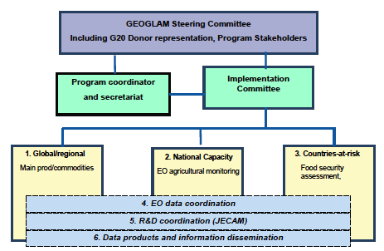
GEOGLAM Governance

Slide 10
Organization and Roles
Steering Committee
  Stakeholder Program Steering and Donor Coordination
Program Coordinator (Secretariat at the GEOSec)
  Program coordination, fund raising and management, program reporting and outreach
  Chair of Implementation Committee
  Ex Officio member of the Steering Committee
Implementation Committee
  Coordination across Implementation Teams
  Reporting to and discussion with the SC on progress and future developments
  Coordination with AMIS and other Partner programs
Implementation Teams
  representation from the individual project/ activities
Projects w. Project Leads
  projects contributing to meeting the GEOGLAM goals

Slide 11
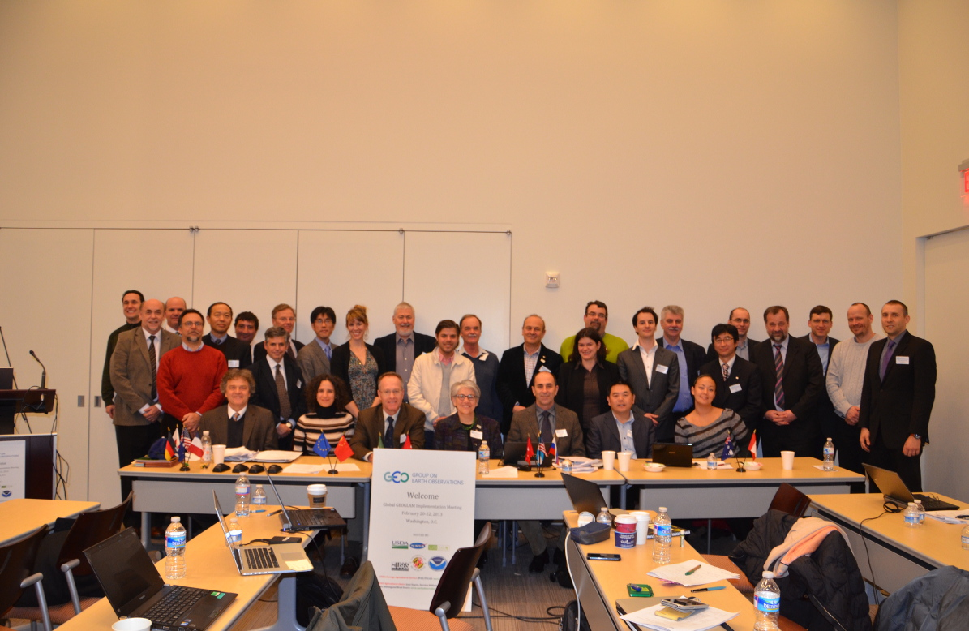
GEOGLAM Planning Meeting
Washington DC, February 2013
Refining the phased GEOGLAM phased implementation

Slide 12
GEOGLAM Phased implementation across all components
Phase 0 (P0) 2011-2013 Foundation Activities
Phase 1 (P1) 2013-2015 Demonstration & Early Feasibility
  Build on existing activities
  Initiate Pilot Projects
Phase 2 (P2) 2014 – 2016 Review and Expansion
  Continue/Complete Phase 1 Activities
  New Starts
Phase 3 (P3) 2015- 2017 Pre-Operational
  Completion of Phase 1 / 2 Projects
  Geographic Expansion
Operational Phase 2017 >
Notes:
In response to GEO Excom & CEOS

Slide 13
GEOGLAM Demonstration & Early Feasibility
Phase 0 > Phase 1
Examples by Component

Slide 14
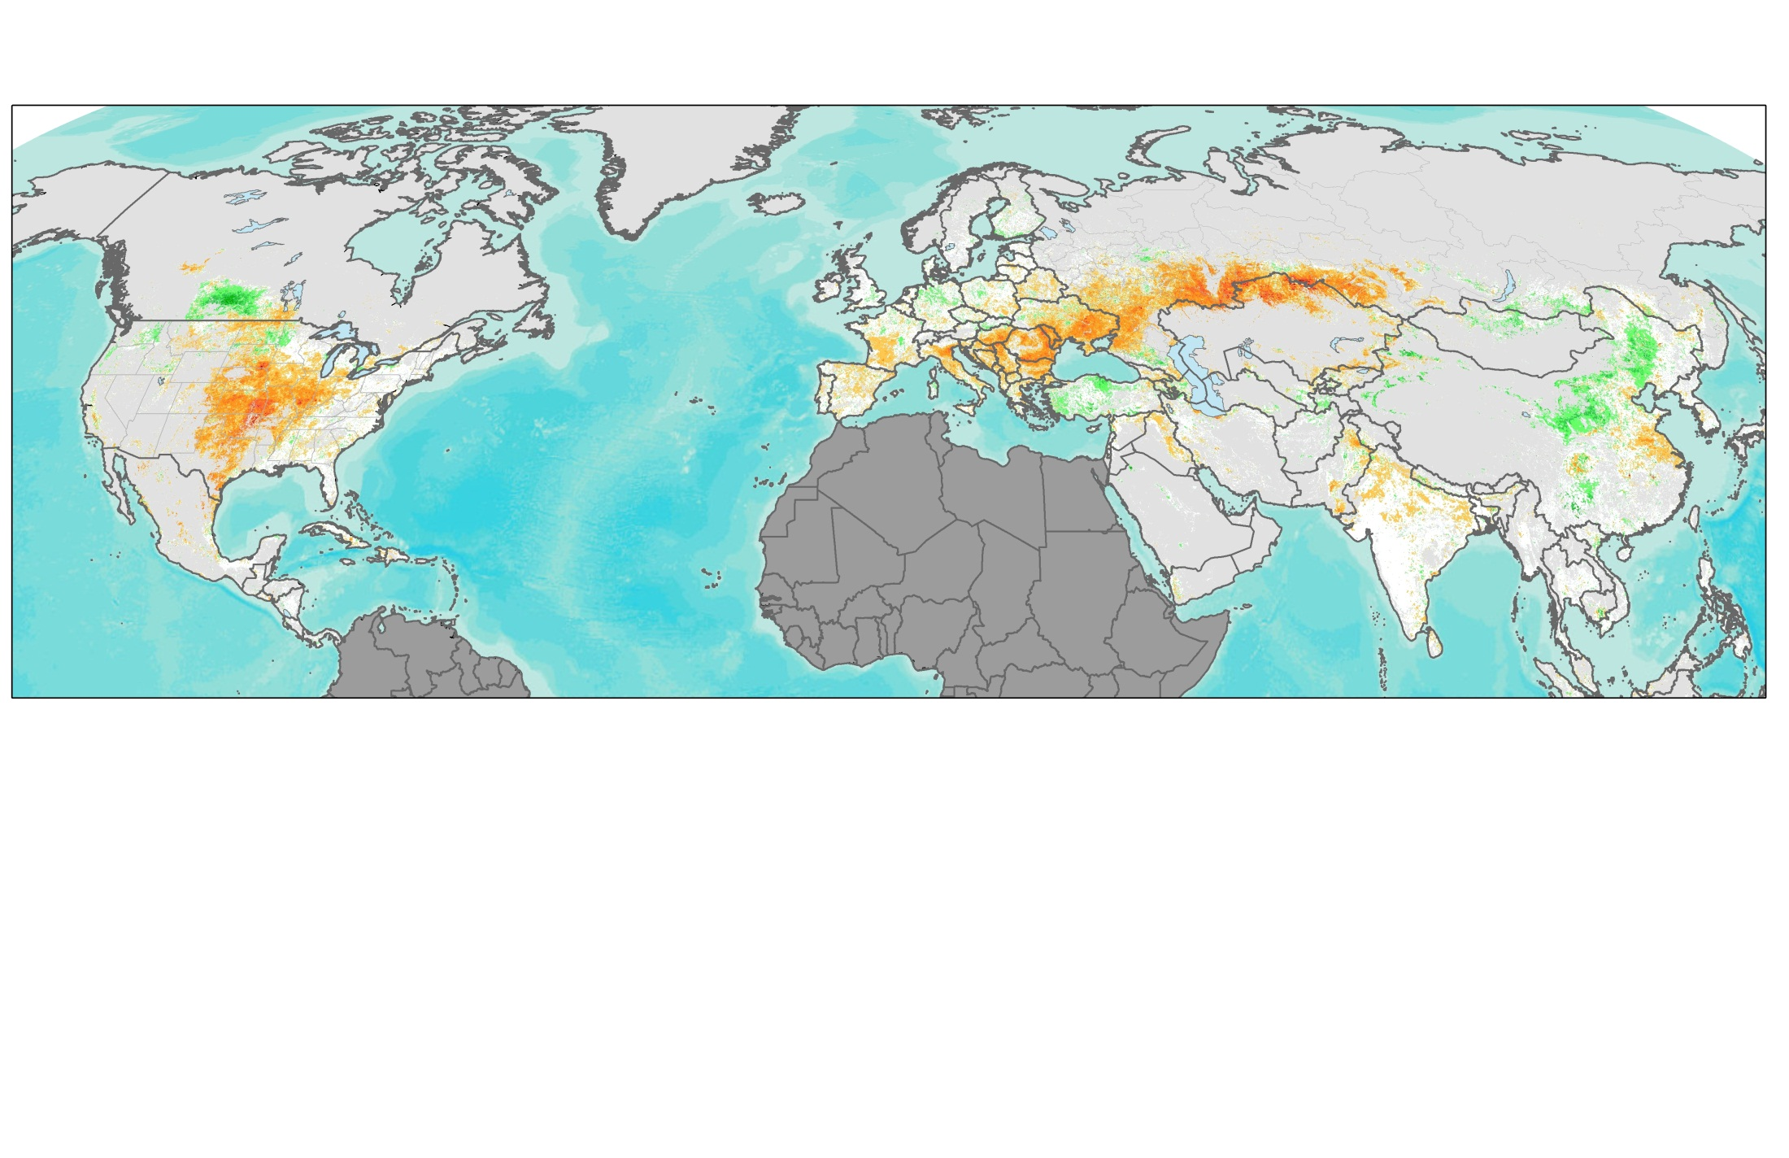
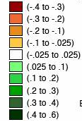
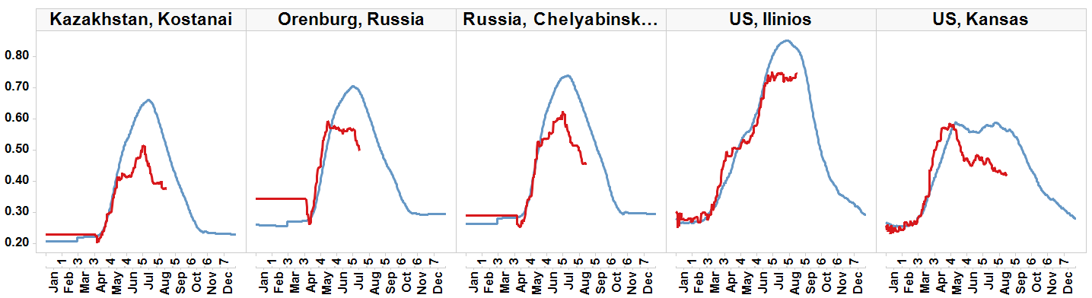
Component 1
Crop Condition Global Outlook: Building International Consensus
Assessment of Crop Conditions in Northern Hemisphere- input to AMIS
Canada
Russia
Ukraine
Kazakhstan
USA
China
Crop NDVI Anomaly
India
Non Cropland
Not shown
-0.4 0 0.4
Worse than normal
normal
Better than normal
Russia, Orenburg
Spring Wheat
Spring Wheat
Spring Wheat
Corn/
Soy
anomaly
Winter Wheat/ Corn
anomaly
anomaly
NDVI
anomaly
anomaly
Current season crop development (2012)
Crop NDVI Anomaly, August 13th, 2012
Average season development (2000-2011)

Slide 15
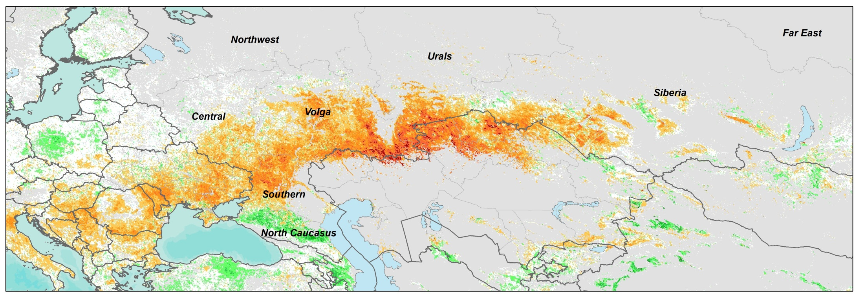
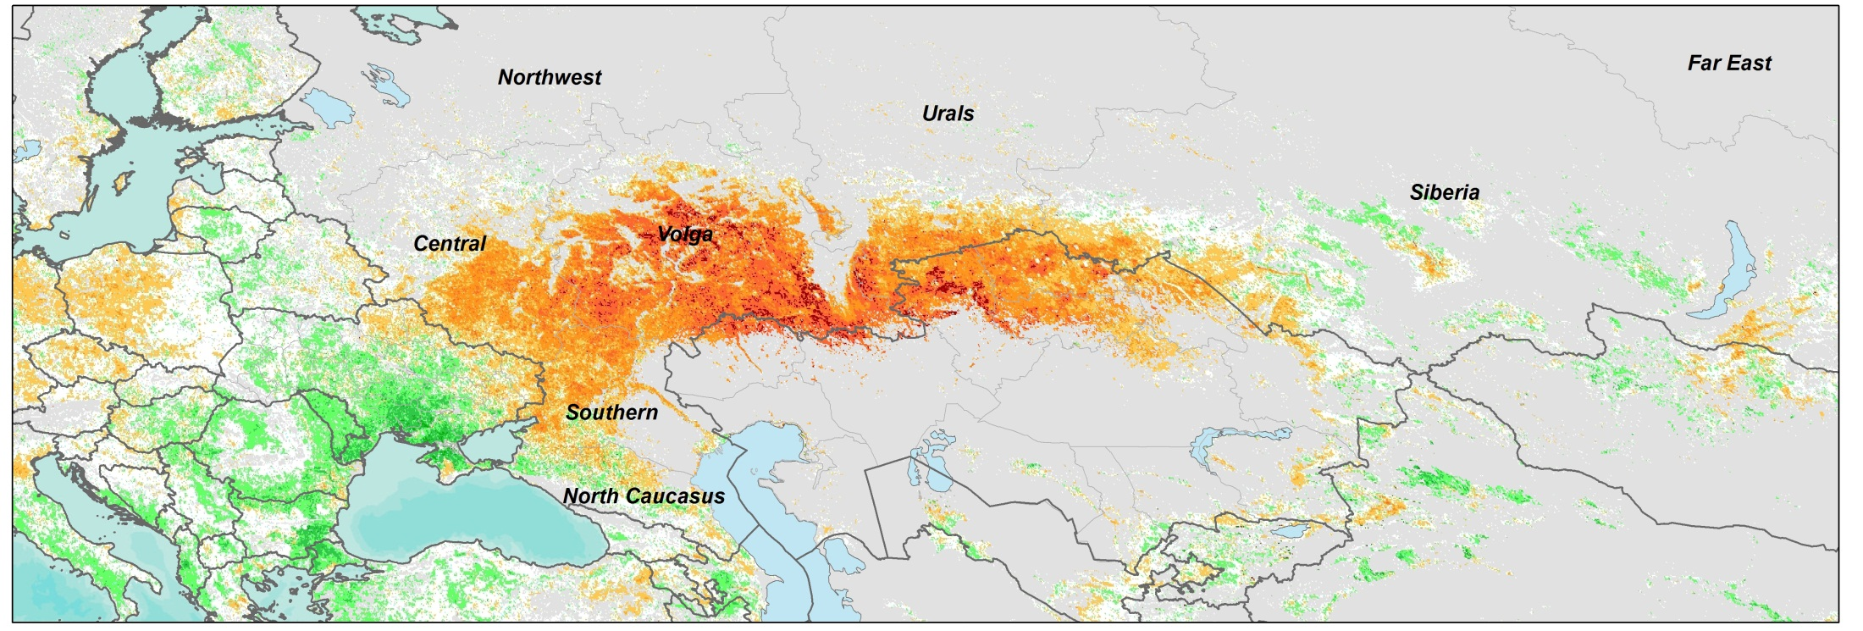
Component 1 - Phase 1 : N. Hemisphere Crop Outlook for AMIS 2012
Crop Condition July 17, 2012
Russia Production 38MT = 32%
Ukraine Production 15.5 MT = 30%
Kazakhstan Production 10.5 MT = 53%
2012 drought affecting crop production in Russia, Ukraine, Kazakhstan
Comparing the 2012 Black Sea Region Drought to the 2010 Drought
Crop Condition During the 2010 Russian Drought: (July 17 2010)
Vegetation Anomaly during the 2010 Russian drought, when grain production decreased by 30% and wheat prices rose over 80% in 6 months
Notes:
RELATIONSHIP BETWEEN ndvi AND PRODUCTION

Slide 16
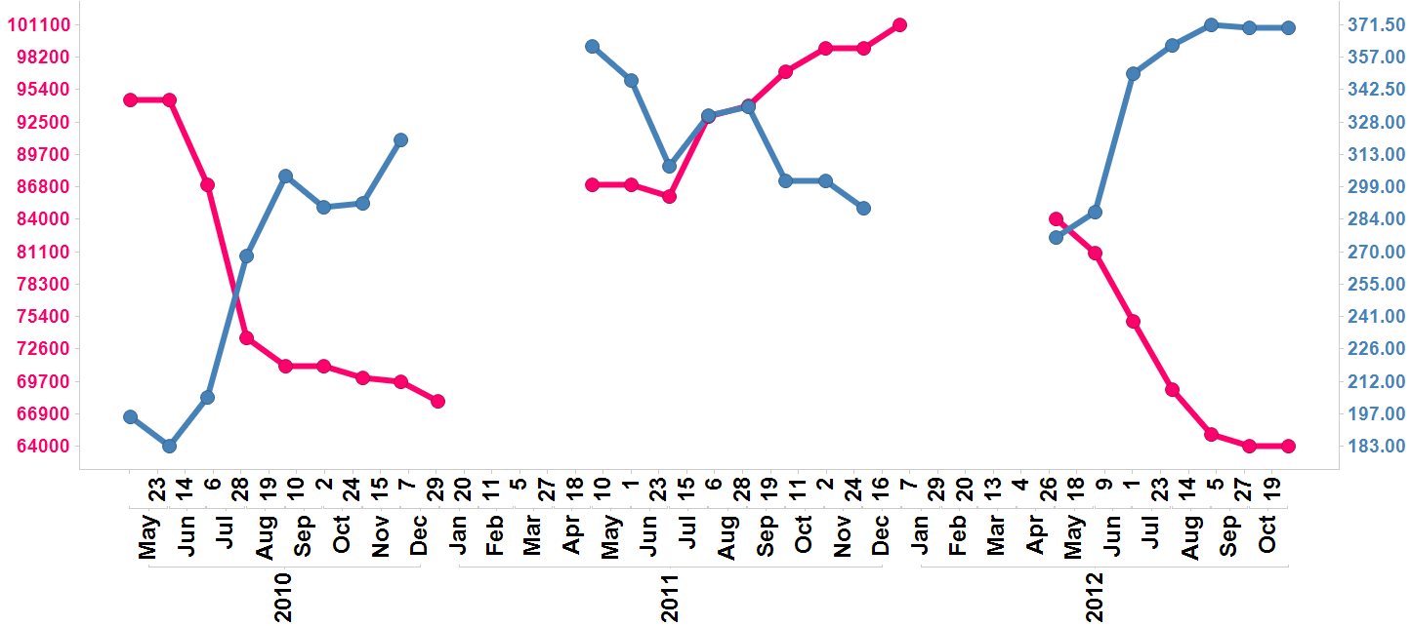
Aggregation of Wheat Production Forecasts from Main Wheat Export Countries vs. International Market Price
2010-2012
Price ($/Ton), Production Forecasts 1,000 MT
Final Estimate
2012
2010
2011
Becker-Reshef et al.

Slide 17
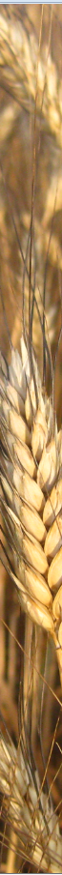
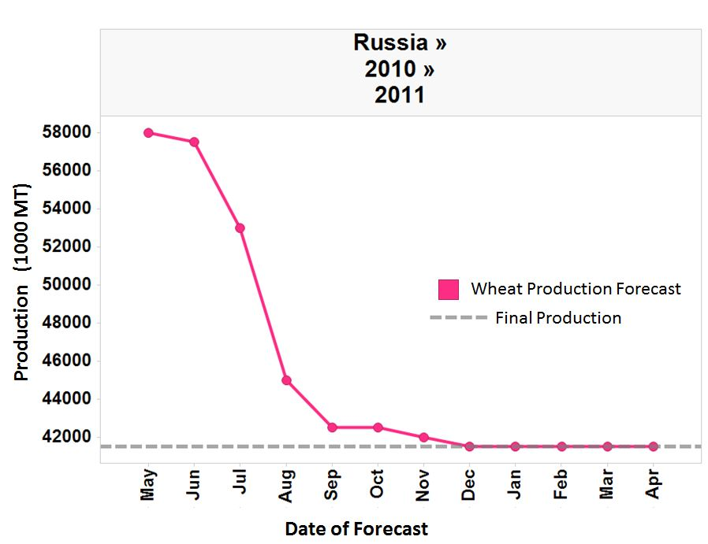
GEOGLAM Goal of Timely Information on Crop Production using repeatable scientific methods to augment current operational procedures
Critical Period
for EO
Harvest
Final Estimate
Points to the current advances in near real time EO data

Slide 18
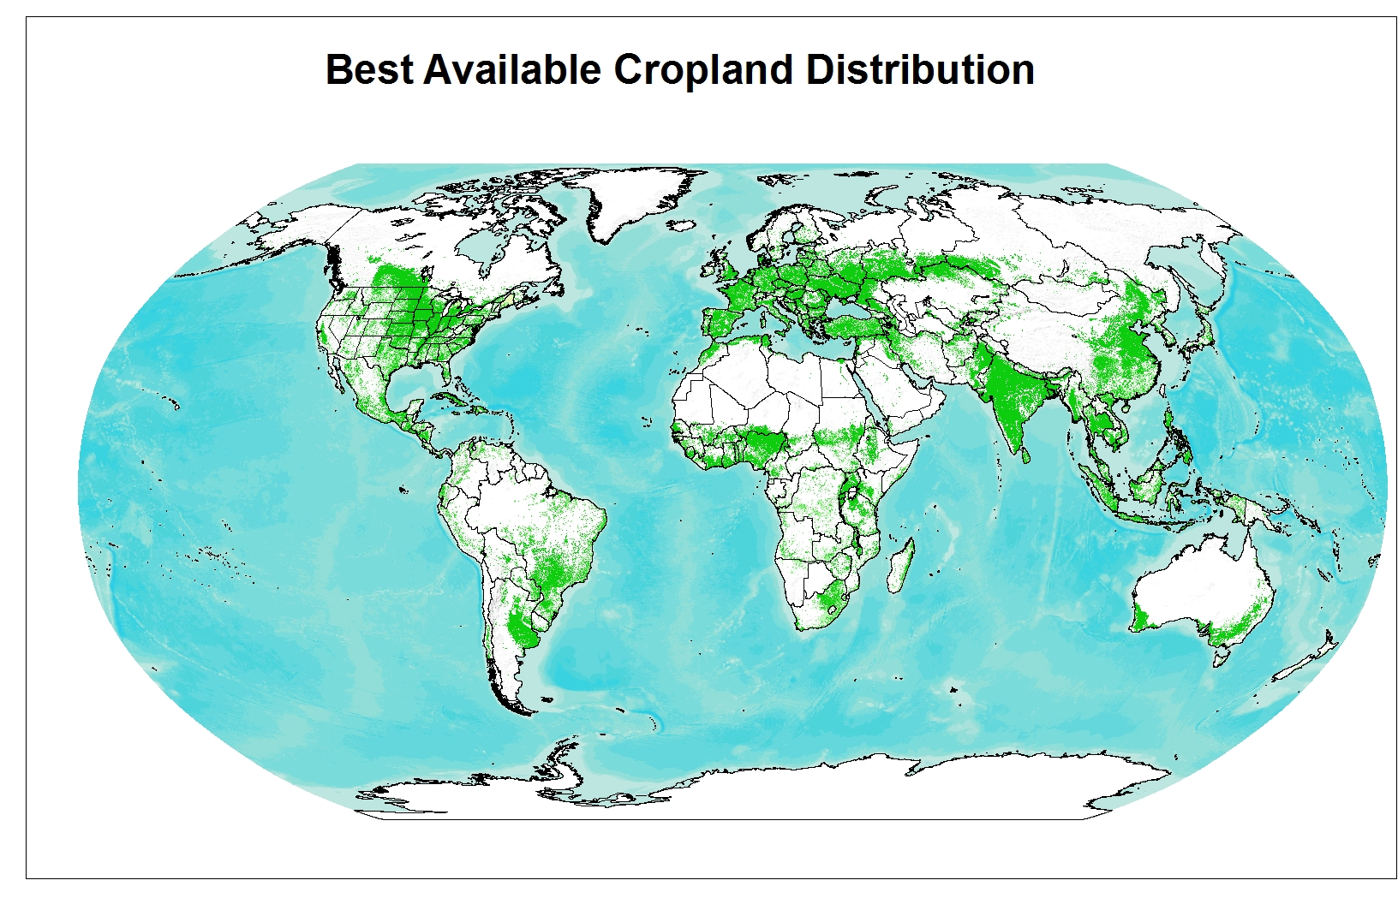
Component 1 - Baseline Data Sets
Current Cropland Distribution:
best available from existing satellite-derived sources
Source: IIASA, Fritz et al. Beta Version 1

Slide 19
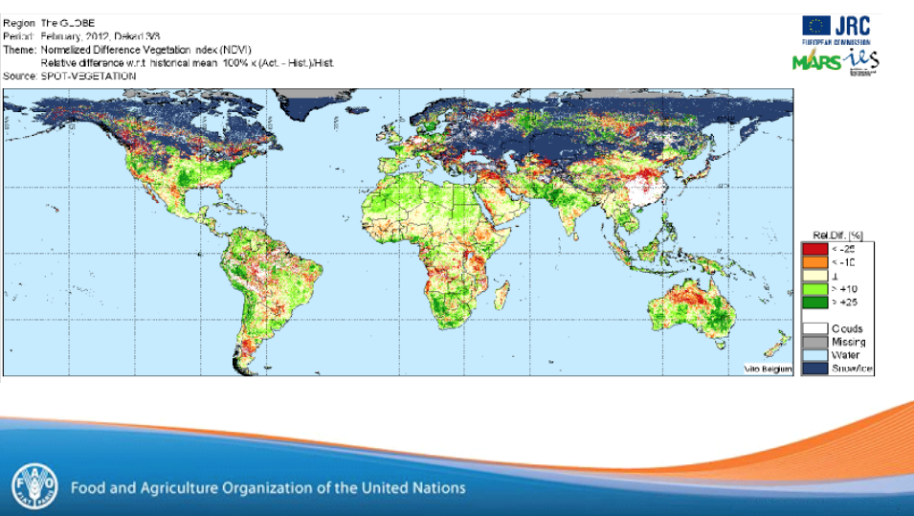
Transferring JRC MARS Monitoring Capabilities to UN FAO GIEWS
Component 1

Slide 20
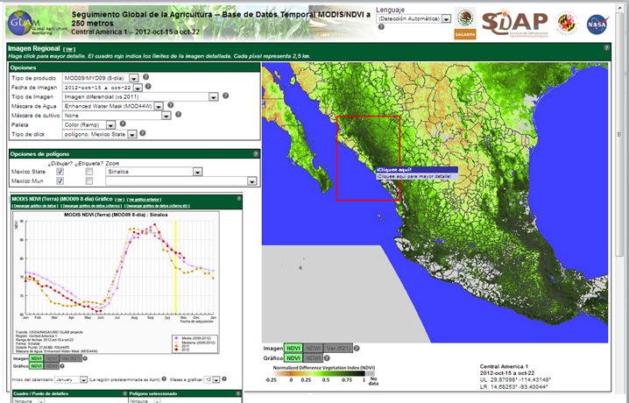

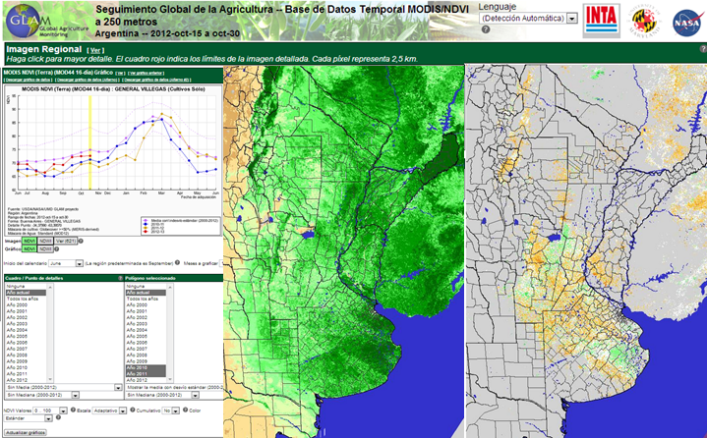
Component 2:
National Capacity
Building
Argentina and Mexico Examples:
Developing National EO Crop Condition
Monitoring Systems
Notes:
DEMO of transition capacity to phase 1 countries-

Slide 21
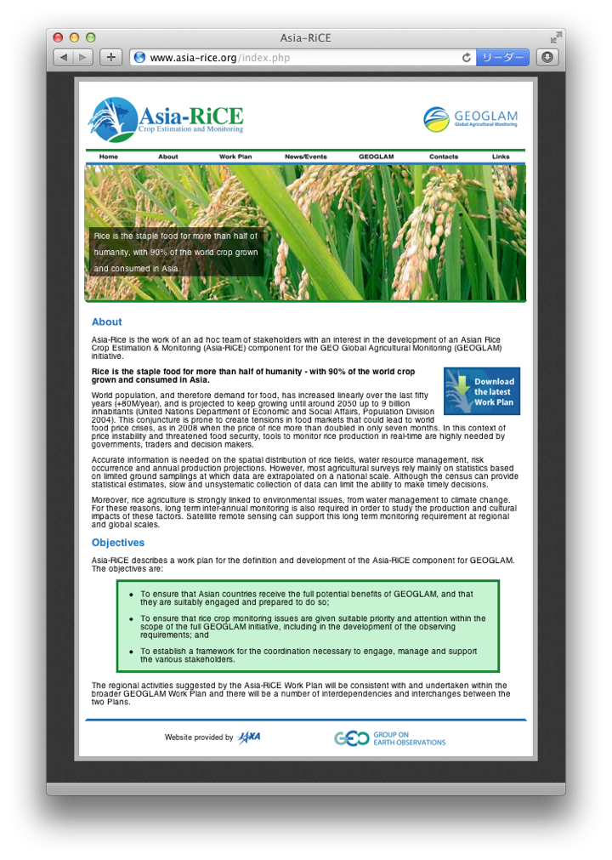
Asia RiCE: implementation plan
Component 2
Phase 1: Pilot activities of rice crop monitoring for Agricultural and rural statistics in Thailand / Lao/ Philippines/ Vietnam/ Indonesia/ India
- Technical demonstration sites used for proof of concept and early results
Phase 2: Implementation of Asia rice crop activity in Asia including regional and regional workshops and capacity building
*** ISRO will serve as a co-lead of technical demonstration site coordination including RiSAT data provision with JAXA
*** Regional workshop may be co-located with other related activity as ADB, ESCAP, etc.
Early warning information dissemination JAXA will continue to provide agro-meteorological information
using AMSR-2/GCOM-W and TRMM/GPM
http://www.asia-rice.org

Slide 22

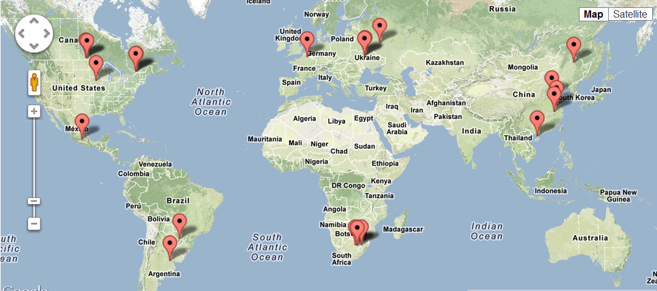
Component 5 Data and Method Inter-comparisons
JECAM activities are being undertaken at a series of study sites which represent many of the world’s main cropping systems
15 sites currently exist, at least 5 new in development, 3 emerging
Phase 0 - Pilot activity for CEOS data acquisition
Sites in development
Notes:
Report – item 31, sig work going on, jecam scientific background..

Slide 23
Information Products
Component 4 - Defining Observation Requirements
Identifying Information and Product Types
EO Data Products
Crop outlook / Early warning
Area estimate
Yield forecast
Production estimate
Food Sec/vulnerability report
Statistics reports
Cropland mask /Pasturelands
Ag practices
Crop condition indicators
Crop type
Biophysical variables
Environmental variables (soil moisture)
In-situ Weather

Slide 24
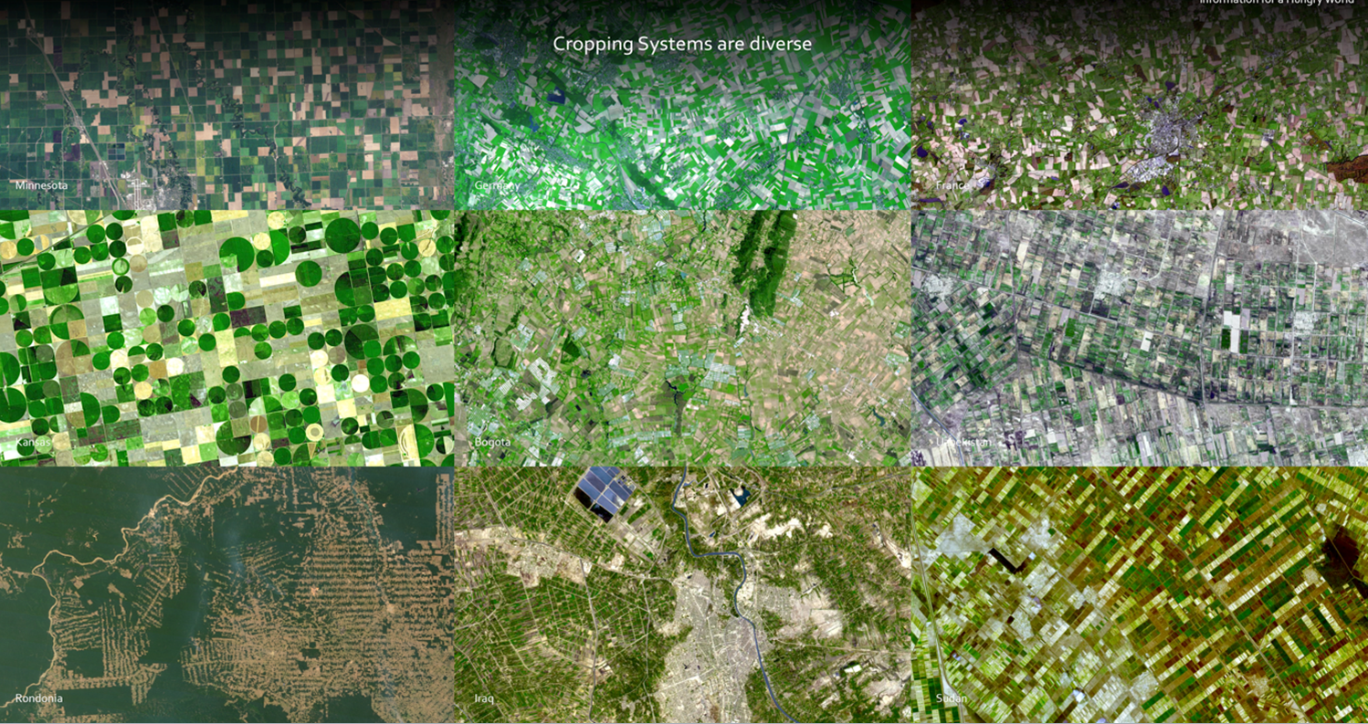
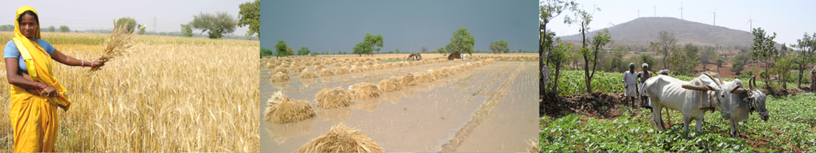
Recognition that cropping systems are inherently diverse which dictates the monitoring observations and methods

Slide 25
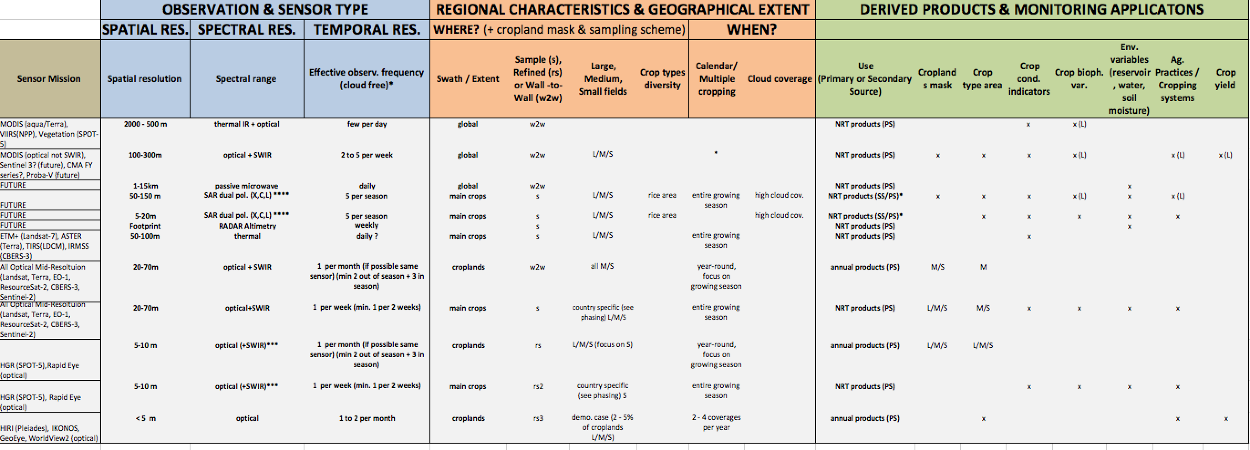
GEOGLAM / CEOS: EO Data Requirements Table
Component 4 -Defining Observation Requirements
  developed taking into consideration the observation needs, the derived products they will
  serve, and regional specificities; CEOS-GEOGLAM July 2012 Montreal)
Component 4 Phase 1: Defining Observation Requirements
How often ?
Where?
When?
For What?
spatial & spectral
Notes:
THE SEO has the volumetric assessment – item #31-d
The baseline data layers for guiding these have been developed- in order to support the volumentric analysis- GEOGLAM produced these to facilitate the volumetric assessemnt

Slide 26
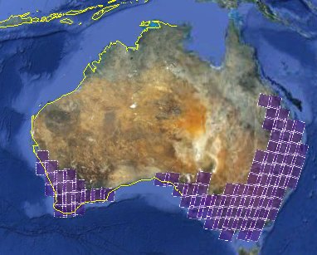
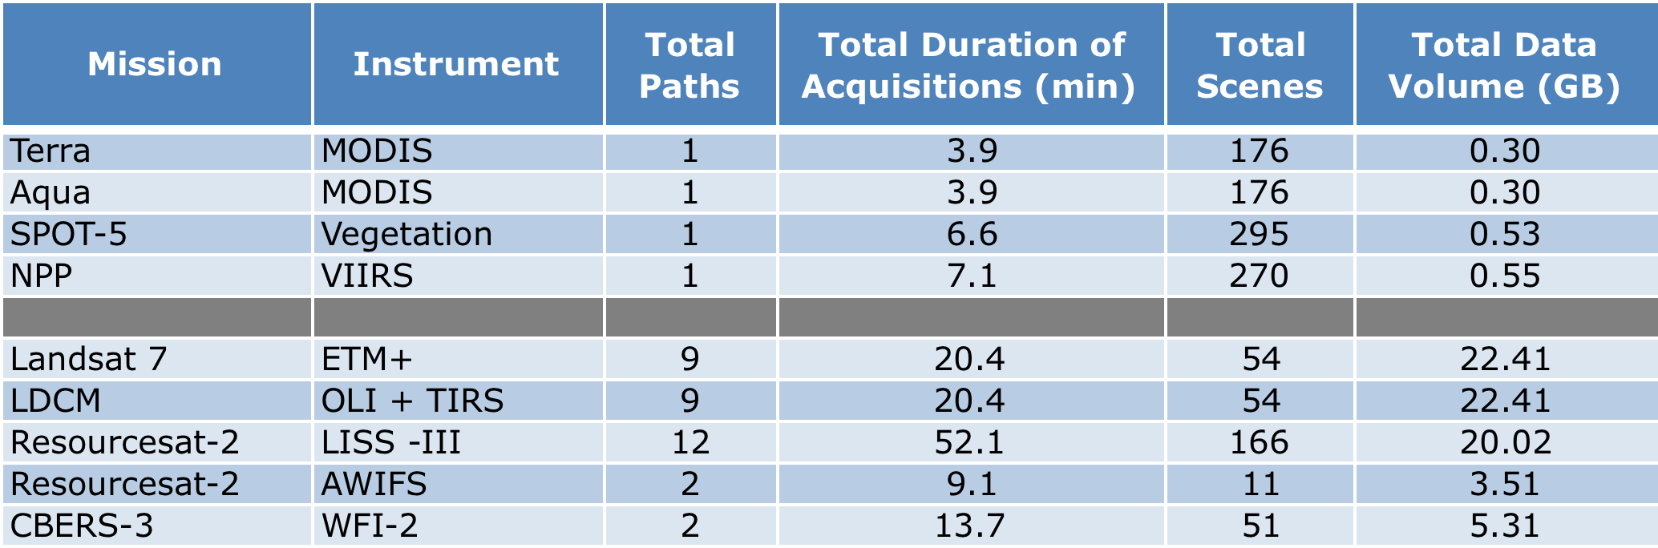
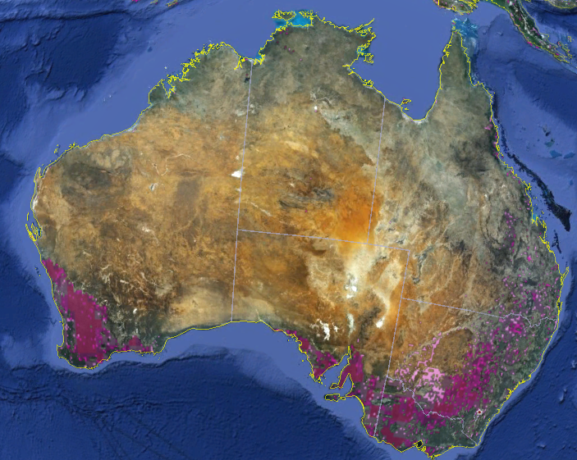
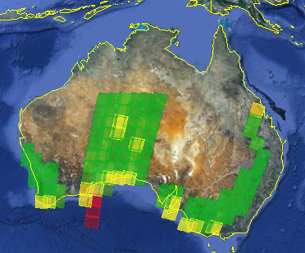
Component 4 -Defining Observation Requirements
CEOS SEO Support to GEOGLAM
Data Acquisition Planning and Analysis
Crop Masks, Crop Calendars
Cloud Statistics (MODIS and ISCCP)
Data Volume (# paths, duration, # scenes)
Landsat Coverage
54 scenes
Crop Mask (wheat)
Cloud Assessment

Slide 27
Phased Implementation of EO Component 4
Phase 0: Foundation Activities (2011-2013 ) Completed
  Developing approach, strategy & obs. Requirements
  Targeted program outreach – regional workshops and partnerships
  Development of baseline datasets & and initiate pilot activities
Phase 1: Demonstration & Early Feasibility Phase (2013 - 2015 )
  Focused on 7 countries (4 large producer, 3 small producers) +1 Region
  Initial volumetric assessments
  Focus on available Optical and SWIR + Regional SAR (Asia Rice)
Phase 2: Assessment & Expansion (2014 –2016)
  Pilot global sampling strategy for the main producers
  New countries (~ 5)
  New missions (Global SAR & sentinels)
  Sampling strategy for at risk region- initiated
Phase 3: Pre-Operational (2015-2017)
  Expand to all large producer countries (global producer sampling)
  3-5 small producers TBD
  New missions acquired and new products
  Validation/evaluation

Slide 28
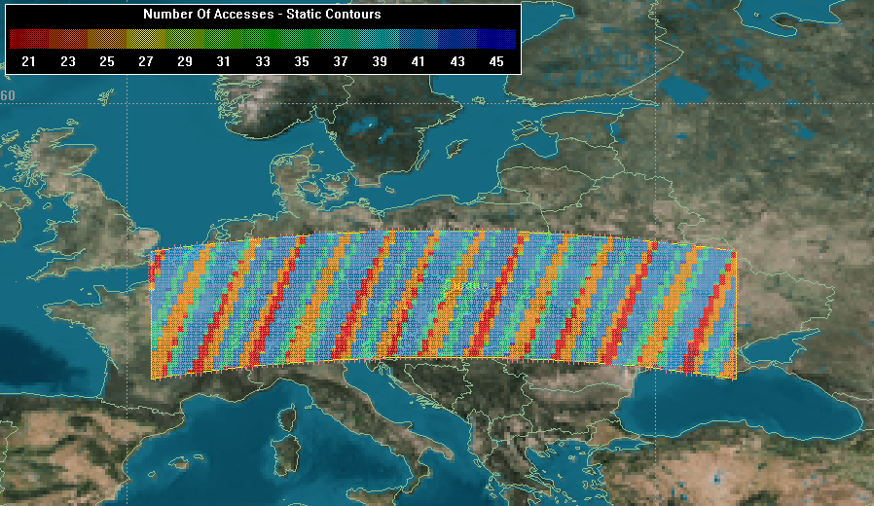
Developing Inter-operable Sentinel-LDCM Datasets for Agriculture Monitoring
Component 4
Longitude: 1.4 → 34.6
Latitude: 44.4 → 51.6
The large number of blue colored bands (>41 accesses) indicate that the revisit interval over the majority of the region is on the order of 2 days.
The picture shows the potential number of times LDCM and the Sentinel 2 satellites accessed areas on the ground over an 80 day period of time.
  21 accesses indicates a maximum revisit interval of ~3 days 19 hours
  46 accesses indicates a minimum revisit interval of ~1 day 18 hours
NASA, ESA, CESBIO

Slide 29
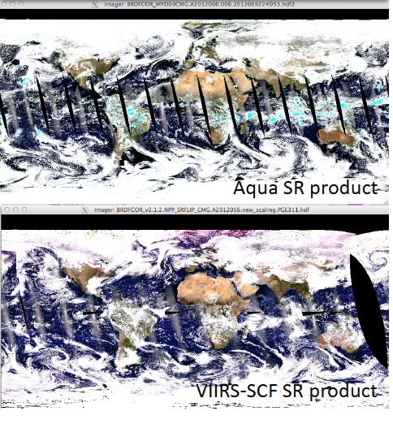


Component 4
  JPSS VIIRS / MODIS inter-operabilty
  for agricultural monitoring
Vermote et al.

Slide 30
Sampling Strategy
Component 4
  Preference is for wall to wall coverage of agricultural regions BUT
  - recognizing this is not feasible for all GEOGLAM regions with high acquisition frequency, especially given cloud cover during growing season.
  A nested stratified, multi-resolution sampling approach is being developed as an alternative
    allows for more frequent acquisitions over selected sites that are statistically representative of entire area
  NASA has indicated intent to fund initial design of sampling approach

Slide 31

Example of Multistage Sampling
Argentina high, medium and low soybean strata using MODIS 250m
Red=high (>19.8%), orange=medium (7.2-19.8%), yellow=low (0.5-7.2%)
Component 4 Hansen, Di Bella et al

Slide 32

Landsat (30m) sample blocks (S1)
3-4 acquisitions during growing season
Component 4 8%), orange=medium (7.2-19.8%), yellow=low (0.5-7.2%)
Red=high (>19.8%), orange=medium (7.2-19.8%), yellow=low (0.5-7.2%)

Slide 33

RapidEye (5m) sample blocks- S2
Component 4 8
8
Red=high (>19.8%), orange=medium (7.2-19.8%), yellow=low (0.5-7.2%)

Slide 34
Examples of GEOGLAM Phase 1 Support:
US
NASA
  Global Soy Area Estimation
  GEOGLAM operations
  Drought monitoring system prototype
  Wheat Yield Forecasting prototype
  Global Sampling approach
  USDA
  Pakistan Capacity Building
  GLAM Operation w. NASA
Japan:
  Asia Rice Initiative (Asian Development Bank)
China:
  GEO Agriculture- MOST, indication will support GEOGLAM 2014
Canada
JECAM office and Implementation
EU FP 7
  9 Million Euro Call in Process
France
  GEOGLAM operations- secondment of project coordinator
Gates Foundation
  Interest in supporting Africa capacity building activities
Germany (Min. Food and Ag…)
Indicated interest to support
Argentina (Ministry of Ag)
National capacity building initiative
Mexico (SIAP)
National capacity building initiative
World Bank
interest to support national capacity building as requested
Russia / FSU - regional workshop planned
Notes:
Funding of core activities
Funding of regional implementation
Current activities contributing to GEOGLAM

Slide 35
Summary
GEO Ag Community of Practice established and has a consensus
Political support for GEOGLAM at a high level
National institutional participation established and growing
GEOGLAM Governance structure established
Phased approach for implementation developed (following GEO and CEOS guidance)
International and national funding support exists and is growing
Early successes (Phase 0 completed) > Phase 1 under way
Working closely with CEOS Ad Hoc Advisory Working Group
  Has forced a clear articulation of community observation requirements !
  Mapping GEOGLAM requirements to CEOS capabilities through an iterative process to ensure realistic expectations & scope
  Significant progress by CEOS SEO and GEOGLAM in developing the EO requirements
  Build upon lessons learned from GFOI and explore synergies and linkages with GFOI

Slide 36
GEOGLAM Way Forward with CEOS
GEOGLAM would like a formal endorsement of the phased implementation approach from CEOS and that CEOS will support the GEOGLAM implementation (CEOS Plenary 2013)
We are off to a very good start with CEOS – the Ad Hoc WG has been extremely helpful and we are making real progress in matching requirements to capabilities
We recommend that the CEOS Ad-hoc working group continue to work with GEOGLAM to ensure a manageable and effective implementation > e.g. establishing a SDCG GEOGLAM
GEOGLAM cannot be successful without coordinated space agency involvement - CEOS is the right partner for this GEO Activity
GEOGLAM provides a highly visible and feasible opportunity for CEOS to make an impact on using EO for societal benefit in an important and politically relevant sector

