Slide 1
CEOS Information Management
Kim Keith Systems Engineering Office (SEO) SIT-29 Meeting
CNES, Toulouse, France 9th-10th April, 2014
Notes:
Hello!
My name is Kim, and I am part of the CEOS Systems Engineering Office, or the SEO. My primary duties in the SEO are CEOS communications and outreach related, and I‘m here today to talk to you about CEOS Information Management.

Slide 2
CEOS Information Management
Objectives:
Discuss our current strategy
Discuss problems
Propose solutions
Discuss next steps
Notes:
The objectives of this presentation are to:
discuss our current strategy for managing CEOS information.
to discuss problems with our current strategy
to propose some solutions we came up with
and to discuss next steps

Slide 3
CEOS Information Management
Objectives:
Discuss our current strategy
Discuss problems with our current strategy
Propose solutions
Discuss next steps
Notes:
Let’s start with our current strategy.

Slide 4
Current Strategy
The CEOS Website:
who we are & what we do
data portals
software tools
documents/publications
meeting materials
Notes:
CEOS has tons of information to manage, and our primary strategy for doing that is the CEOS website.
The SEO did a complete website overhaul in 2008, making aesthetic improvements and including features that made it usable and flexible.
It’s been six years since we did that. In that six years, we’ve at least quadrupled the site’s content, the organization continues to grow and evolve, and we’ve learned a lot about what you and external entities need from the CEOS website.
The CEOS website:
tells the world who we are and what we do
contains information about our structure, members, working groups, and constellations
provides access to our various data portals and software tools, and
stores all of our documents, publications, and past meeting presentations.

Slide 5
CEOS Information Management
Objectives:
Discuss our current strategy
Discuss problems
Propose solutions
Discuss next steps
Notes:
Let’s take a look at our current strategy and what kinds of problems we’re dealing with.

Slide 6
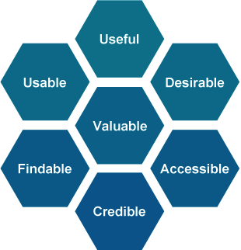
Current Website Problems
Wow!-factor.
Usability and findability
Outdated
Notes:
There are several areas where we can significantly improve the CEOS website.
First, it’s important to consider what kind of impression people get about CEOS when they visit our website.
This site is our primary means of conveying CEOS to the world. We want users to come to ceos.org and say, “Wow! CEOS has it together. They are doing amazing things.”
Right now, when users come to the site, I’m afraid that they aren’t immediately impressed.
Another important problem is that our large content volume has completely overgrown our navigation scheme. So the site’s usability and findablity of information is lacking – you can’t always find the information or the documents you need very quickly, especially if you are not part of CEOS and don’t speak the CEOS language.
The third problem, is that even though the site allows us to go in and edit the content, our community didn’t really buy into that capabiility, so much of the content isn’t current.

Slide 7
CEOS Information Management
Objectives:
Discuss our current strategy
Discuss problems with our current strategy
Propose solutions
Discuss next steps
Notes:
So what are some possible solutions?

Slide 8
Proposed Solutions
Website redesign:
updated look and feel
reorganized information architecture
improved user interface
interesting feature stories
meeting registration
integrated document management system
Notes:
To improve the CEOS information management strategy, the SEO proposes to do a complete website redesign.
This redesign will upgrade the site’s look and feel with new graphics and features that convey that CEOS is modern, technical, and unique. It will also restructure the underlying information architecture and the user interface to support usability and findability for both internal and external CEOS users.
We also propose to implement a plan for ongoing content updates, such as adding recent news items to the home page, to include video interviews of CEOS participants on topics, such as the importance of satellite Earth observations for addressing various applications.
One major feature we would add is a meeting registration capability, so that you can register for CEOS meetings right on our website.
Another critical update will be the integration of a document management system – a way to organize, store, and retrieve CEOS documents while maintaining version control and adding findability. As a part of this system, we would implement a numbering strategy for CEOS documents to help keep them organized and manageable well into the future.
Both the meeting registration and document management capabilities are brand new features for CEOS.

Slide 9
CEOS Information Management
Objectives:
Discuss our current strategy
Discuss problems with our current strategy
Propose solutions
Discuss next steps
Notes:
So what’s next?

Slide 10
Next Steps
We invite the CEOS Plenary &
SIT Chairs to put together a steering committee for feedback throughout the redesign process.
Notes:
First, we recognize that it’s useful to have a few CEOS eyes on the work we do to make sure the new site adequately addresses CEOS User needs. For that reason, we invite the CEOS Plenary and SIT Chairs to put together a steering committee for feedback throughout the redesign process - perhaps just four telecons between now and the Plenary - if you think that would be useful.
Please let us know during the next SEC call if you’ve decided to participate in this format. If not, that’s okay too.

Slide 11
Next Steps
CEOS community survey
Content inventory
Information architecture design
Updated graphics
Implement new site by Plenary 2014
Notes:
The most critical next step is to conduct a CEOS community survey, and this is where we need help from everyone.
This survey will be very SHORT, so it won’t take much of your time. Your inputs to this survey are NECESSARY to determine the BEST way to move forward with website revisions. This is your vote on how the site turns out. So when you receive the email, please do the short survey.
As an incentive, if you complete the survey by the deadline, we will enter you into a drawing for a prize at the CEOS Plenary. So, watch out for the survey in your inbox around April 17th, and responses will be due by the end of the following week, on April 25th.
The next step is to do a content inventory of the current site to assess how best to redesign the information architecture.
We are working on some ideas for updated graphics and features for the site.
And we’d like to see this new site go live by the Plenary.

Slide 12
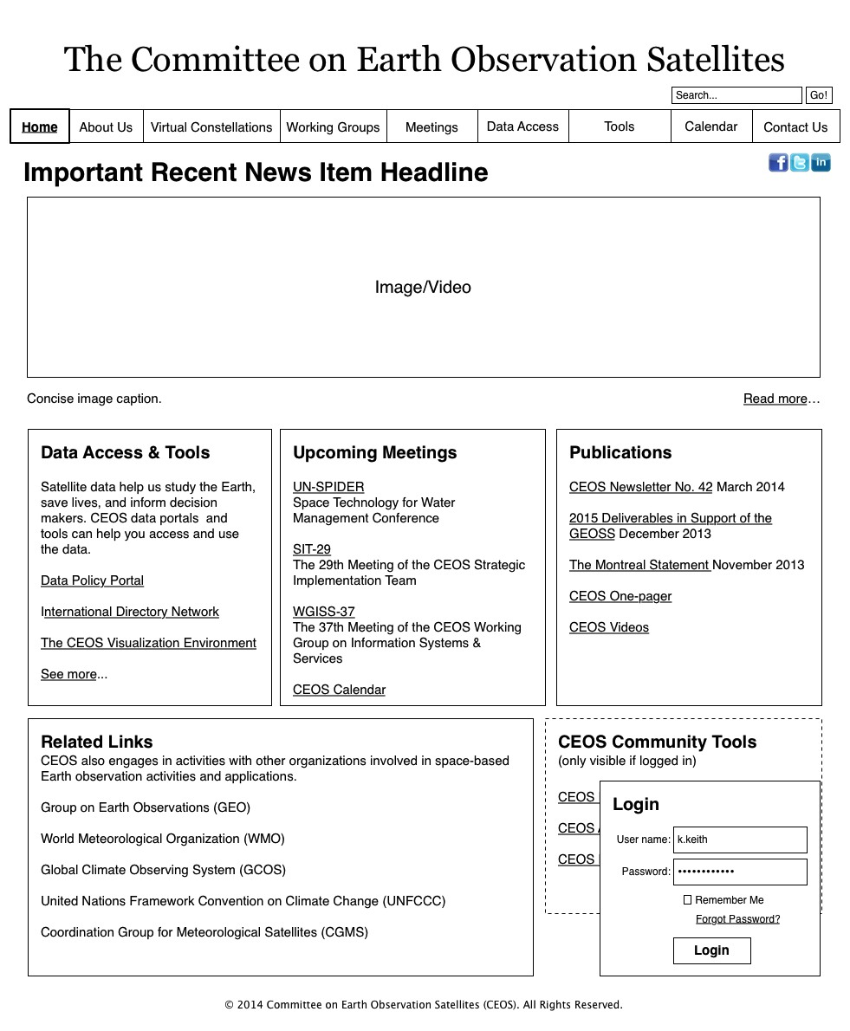
Notes:
Just to give you an idea of what some of this underlying information architecture work looks like, I put together a wireframe of what could be an improved design for the site. This image is just about possible structure, not graphics.
Some improvements consolidate our menus into a top navigation to decrease clutter and enhance findability.
So, this is just a draft idea, but you can see how it simplifies the site and makes it less overwhelming.

Slide 13
Notes:
And this is the same image but scrolled down to see the bottom half. It shows where we could include related links and a login to access CEOS Community Tools, such as the new document management system and action tracking tools.

Slide 14
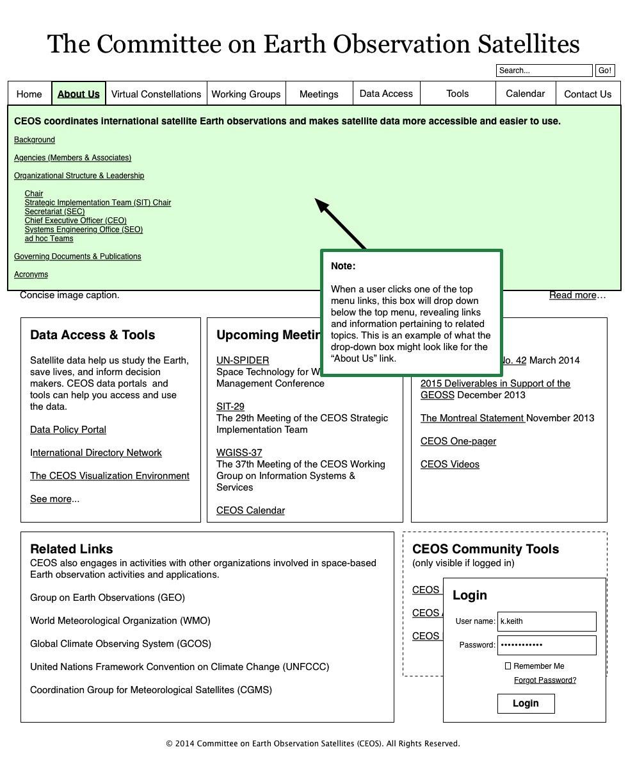
Notes:
And then what you see highlighted in green here is JUST AN IDEA of how we could offer a menu structure that doesn’t take up so much real estate on the home page.
For example, clicking on “About Us” in the top menu could reveal this drop-down submenu that includes all of the CEOS background, membership, and governance information.
And all of the navigation and the content is written using terminology that is understandable by both CEOS and non-CEOS people .
So again, these are just initial ideas that we came up with, but we can’t make decisions until we get the survey results from all of you.

Slide 15
Questions & Comments
Actions:
Contact me about the Strategy Team
kim.e.keith@nasa.gov
Please respond to the survey
to win the prize
Questions? Comments
Concerns?
Notes:
That’s all I have for you today.
If you were proposed to be a strategy team member and you are willing, please contact me. If I have a Working Group or VC volunteer in the room today, please speak up.
Please respond to the survey if we send it.
Any questions or comments?

Slide 16
Questions & Comments
Notes:
Thank you!

