Slide 1
Agencies’ response to DRM pilot EO data requirements
Ivan Petiteville (ESA, Chair WGDisasters)
Stéphane Chalifoux (CSA, Vice-Chair WGDisasters)
Andrew Eddy (Secretary, WGDisasters)
CEOS Action 27-11 CEOS SIT-29 Meeting
CNES, Toulouse, France 9th-10th April 2014

Slide 2
Pilots Overview
Pilot | Team Co-Leads | Deliverables
Floods | NASA, S. Frye NOAA, B. Kuligowski | Global Flood Dashboard (single access for multiple existing systems) Three regional pilots showcasing end user benefit of frequent high spatial resolution observations (Caribbean, Southern Africa, Mekong/Java)
Seismic Risks | ESA, P. Bally DLR, J. Hoffmann | Demonstrator for EO-based global strain map (main focus on Turkey, Himalayas and Andes) Exploitation platform for large data set analysis (strain map, supersites) Rapid scientific products for 4 to 6 earthquakes per year (>M5.8)
Volcanoes | USGS, M. Poland ASI, S. Zoffoli | Demonstrate feasibility of systematic global monitoring in regional arc (Latin America) Develop new EO-based monitoring products at supersites Real-time in-depth monitoring of one ‘100-year’ category major eruption
2

Slide 3
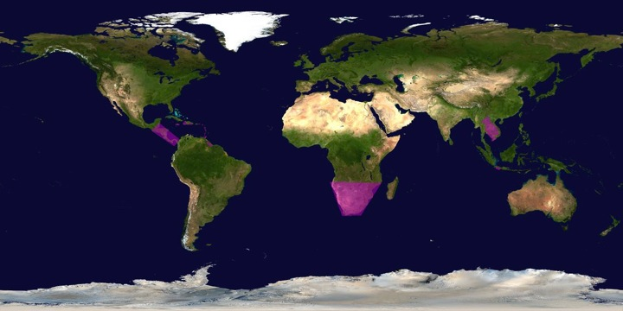
Target areas for Flood Pilot EO data
Develop flood monitoring products for flood mitigation, warning, response and recovery in the Caribbean/Central America, Southern Africa and Southeast Asia. Use these regional pilots to validate/calibrate lower resolution global flood products and to develop capacity in region.

Slide 4
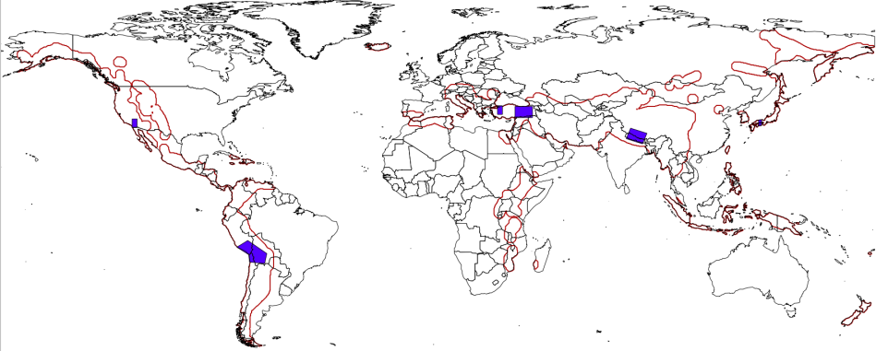
Target areas for Seismic Pilot EO data
Portions (in purple) of the global seismic belt including the Alpine-Himalayan Belt (incl. Turkey, Iran, Tibet, etc.), subduction zones in South America, with validation sites in Southern California, Western Turkey and Southern Japan. Gradually extend to red zones beyond current pilot.

Slide 5
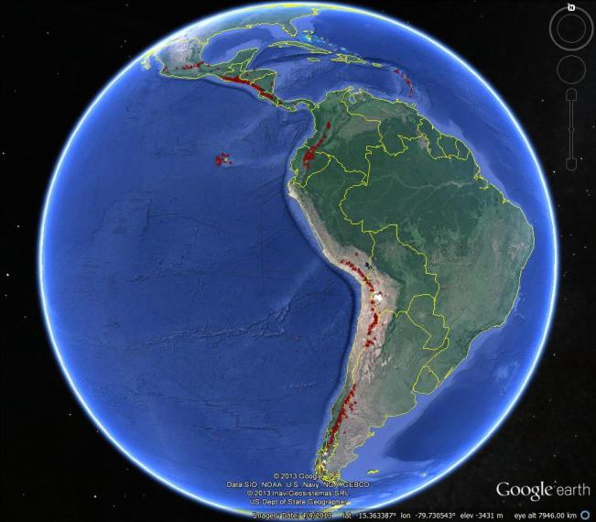
Target Areas for Volcano Pilot EO data
Notes:
Latin America was chosen for the regional component because:
1) the volcanoes are situated in a diversity of environments (from rain forest to high-altitude desert), providing a good test of the capabilities of different types of satellite data in different settings,
2) volcanic activity is abundant, including deformation with no eruption (e.g., Lazufre) as well as persistent eruptive activity (e.g., Tungarahua, Arenal, Reventador, Villarica),
3) explosive eruptions that disrupt air travel are likely over the course of the three-year pilot and have occurred frequently in the past (e.g., Cordon Caulle, Chaiten, Guagua Pinchincha), and
4) volcano observatories and monitoring agencies in Latin American countries would directly benefit from the additional resources that this pilot will make available. It is hoped that the regional study will demonstrate that EO data can help to identify volcanoes that may become active in the future (i.e., provide a forecasting ability) as well as track eruptive activity that may impact populations and infrastructure on the ground and in the air, ultimately leading to improved targeting for permanent EO-based observations and in-situ volcanic monitoring efforts.

Slide 6
Response to Pilots:
Strategic EO Data Acquisition Plan
Detailed EO Requirements for each pilot approved at last Plenary
Pilot definition included types of data required, frequency of observations and polygons of interest, etc
Pilot EO Requirements submitted to Data Coordination Team made up of representatives from CEOS agencies
Assessment of EO Requirements between last Plenary and SIT-29 by each individual agency
Agencies’ responses analysed and consolidated by Data Coordination Team and pilot Leads. (WGDisasters meeting # 1, Montreal 17-19 March)
Analysis included trade-offs between pilots (e.g. Pleiades data to be used in priority for volcanoes and seismic hazards), synergies across pilots (volcanoes and seismic hazards) and possible overlaps with other major initiatives (GEOGLAM, GFOI in S-E Asia, Supersites)

Slide 7
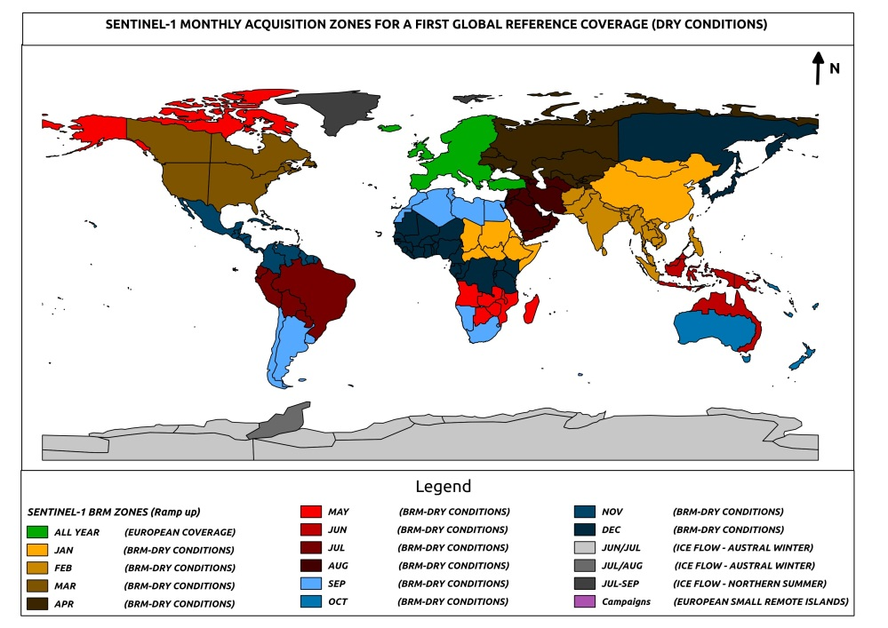
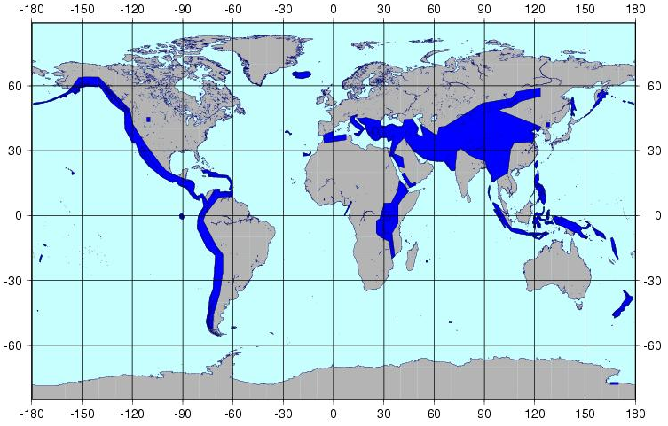
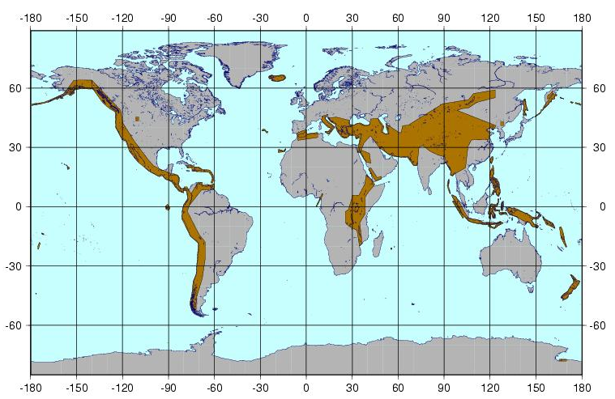
Analysis from Space Agencies

Slide 8
Data Contributions* from CEOS Agencies (1/3)
CEOS Agency | Flood Pilot | Seismic Pilot | Volcano Pilot
ASI Proposed contribution under review. | Approximately 300 CSK images/year/pilot over three years, in addition to existing GSNL commitments. Priority given to archived imagery. NRT images for rapid science products under Flood Objective B, Seismic Objective C (1-2 events/year) and Volcanic Objective C (1 major eruption) to be evaluated on case by case basis.
CNES NRT imagery request being discussed with commercial partner | SPOT World Heritage Archive made available to pilots (1000s of SPOT-5 archived images) with five-year rolling buffer. Up to 50 Pleiades images/year/pilot over three years. Commitment to be finalized after discussions with industrial partner. Night-time SPOT-5 imagery during 2014. ANR KalHaiti data base over Haiti.
CSA Review against commercial conflict required. | About 500 RSAT-2 products to support the Flood Pilot until November 2016 (end of the Pilot). More than 400 RSAT-2 products to support GSNL i.e. Hawaii (ongoing) and Iceland (in negotiation with MDA). Potential access to Volcano Watch Background Mission over Latin America (archived RADARSAT-2 products). Data for rapid science products for Seismic and Volcano Pilots evaluated on case-by-case basis: contribution of 40 RSAT-2 products for Event Supersite: Sinabung Volcano, Indonesia.
*contributions are in addition to existing GSNL contributions and International Charter data made available during or after activation

Slide 9
Data Contributions* from CEOS Agencies (2/3)
CEOS Agency | Flood Pilot | Seismic Pilot | Volcano Pilot
ESA Sentinel-1 launch April 2014. Six months commissioning. Sentinel-2, SMOS. | Sentinel-1 gradually made available starting with pilot targets in 2014 when these converge with baseline observing strategy. +20000 scenes over Italy, Japan, California, Turkey & Greece the first year overall for 3 pilots | Sentinel-1 gradually made available starting with pilot targets in 2014 and with the goal to cover priority areas of Objective A for 2016 – 10s of 1000s of images | Sentinel-1 gradually made available starting with pilot targets in 2014 and with the goal to cover priority areas of Objective A for 2016, especially when these converge with seismic areas
DLR Proposed contribution under review. Review against commercial conflict required. | 200 TSX scenes over three years; access to TanDEM Elevation Model without data transfer (through viewer) being considered | Assessment of validation areas and data volumes (Objective A) under way. Possible access to TanDEM Elevation Model without data transfer being considered. | 400 TSX scenes over three years (under Obj. A); contribution to Obj. C to be evaluated after eruption; access to TanDEM Elevation Model for erupting volcano being considered.
JAXA Proposed contribution under review. ALOS-2 launch May 2014. | 100 ALOS-2 products/year/pilot made available for promotion/demonstration; additional data available at marginal cost of $100/scene; barter arrangements for further data requests under review. Acquisitions requested are covered by ALOS-2 Basic Observation Scenario
*contributions are in addition to existing GSNL contributions and International Charter data made available during or after activation

Slide 10
Data Contributions from CEOS Agencies (3/3)
CEOS Agency | Flood Pilot | Seismic Pilot | Volcano Pilot
NASA EO-1 estimated end of life 2016 | 300 EO-1 images/year 2014-2015 | JPL/ARIA to provide rapid processing for 2-4 events/year under Objective C | Hyperion data for lava temperature and structure information (approx. 100 images/year 2014-2015)
NOAA | Precipitation products; flash flood warning system in regional pilot areas | N/A | Atmospheric data products over Latin America
USGS Further tasking of Landsat-8 possible if required | Landsat-8 imagery | Landsat-8 imagery | Night-time tasking of Landsat-8 over 19 active volcanoes in Latin America
*contributions are in addition to existing GSNL contributions and International Charter data made available during or after activation

Slide 11
How data will be exploited – flood pilot
Geographic Area | Product | Value Added Partner
Haiti | Flood extent maps, flood risk maps, landslide maps, flash flood guidance / threat maps, integrated risk assessment platform | SERTIT, CIMA, INGV, Altamira, CIMH, RASOR FP7, NOAA/HRC
Other Caribbean islands, Central America | Flood damage maps, change detection products, co-registered map overlays | CATHALAC, CIMH, NASA/GSFC
Namibia | Flood extent maps, flood warning products, co-registered map overlays | Namibia Hydrology Dept, Namibian Water Authority, NASA
Zambezi basin | Flood extent maps, flood forecast models, flood hazard maps, flood depth forecasts | Lippmann Institute (PAPARAZZI, HAZARD, WATCHFUL), DELTARES, NASA/JPL
Mekong | Flood extent maps, flood risk maps, flash flood guidance / threat maps | Mekong River Commission, NASA, NOAA/HRC, USGS, University of South Carolina, Texas A&M
Java (Bandung, Jakarta, Cilacap) | Flood risk maps, subsidence maps tied to flood risk, tsunami risk maps (Cilacap only), flood extent maps | SERTIT, Deltares, CIMA, Altamira, INGV, RASOR FP7
Products used by: national end users, civil protection agencies, World Bank, Red Cross, River Commissions (Kavango, Zambezi, Mekong)

Slide 12
How data will be exploited – seismic pilot
Activity | Product | Value Added Partner
Wide extent monitoring for strain map generation | Interfermetric processing (conventional InSAR and PSinSAR) to derive strain rate estimates based on deformation measurements; Generation of fault mapping products; EO based urban footprint to support exposure mapping as supporting information for seismic risk analysis. | COMET+, ISTerre
Geohazard Supersites and Natural Laboratories | Interfermetric processing (conventional InSAR and PSinSAR) to derive interseismic, co-seismic and post-seismic deformation mapping products; Generation of surface fracture mapping products to support modelling of seismic sources and possibly map some large aftershock in the surroundings. | Various over each supersite and event supersite, on best efforts basis
Rapid generation of science products | Interfermetric processing (conventional InSAR and PSinSAR) to derive co-seismic and post-seismic deformation mapping products; Generation of surface fracture mapping products to support modelling of seismic sources and possibly map some large aftershock in the surroundings. | INGV, JPL/ARIA
Products used by: academia and researchers, civil protection agencies…

Slide 13
How data will be exploited – volcano pilot
Activity | Product | Value Added Partner
Regional volcanic monitoring in Latin America | Terrain deformation products over 300 volcanoes to identify unsuspected activity; weekly monitoring of 19 active volcanoes; thermal anomaly detection; atmospheric products during eruptions; ash dispersal and ash cover maps. | Bristol University, Cornell University, Open University, NOAA, Buenos Aires and Washington VAACS
Development of new methodologies and products for intensive monitoring over supersites | Using GSNL data collects over the volcano supersites, the CEOS pilot will develop and validate new monitoring protocols for active volcanoes and generate products that could be used for global monitoring of holocene volcanoes after the pilot period. | USGS, INGV, University of Iceland
Major volcano eruption 2014-2016 | Pre-event deformation products if data available over volcano selected, to examine retroactively the benefit of deformation mapping in precursor phase Co- and Post-event deformation Co- and Post-event products for ground (ash cover, thermal monitoring etc.) Co- and Post-event atmospheric products (ash dispersal, SO2 monitoring etc.) | USGS/VDAP, Bristol, Cornell and others depending on eruption location
Products used by: national end users, civil protection agencies, volcanic observatories in Latin America, VAACS

Slide 14
Response to Pilots:
CONCLUSIONS
Majority of contributions (open & free data) confirmed by Agencies. Some options still being worked (e.g. alternatives addressing some data policies constraints.
Main issue: data contributions are for R&D activity; should some activities become operational after 2016, funding is required to ensure sustainability
Consolidated response from space agencies very positive; volume of EO data & products confirmed is similar or greater to what was initially provided for Forest Carbon Tracking and for JECAM.
Main objectives of each pilot can be reached with the firm contributions announced.
On-going refinement for data; some specific imaging requirements being reconsidered given trade-offs between agencies: how to best exploit synergies?

Slide 15
Decision
CEOS Plenary Action to WGDisasters: Prepare for approval the strategic data acquisition plan in response to the flood, seismic hazard, and volcano pilots’ EO requirements.
Requested decision: CEOS Principals are asked to endorse the strategic data acquisition plan prepared by the relevant CEOS Agencies, in response to the flood, seismic hazard, and volcano pilots’ EO requirements.

