Slide 1
Ocean Surface Topography Virtual Constellation
Committee on Earth Observation Satellites
J. Lambin, CNES
SIT-30 Agenda Item #7b
CEOS Action / Work Plan Reference
30th CEOS SIT Meeting
CNES Headquarters, Paris, France
31st March – 1st April 2015

Slide 2
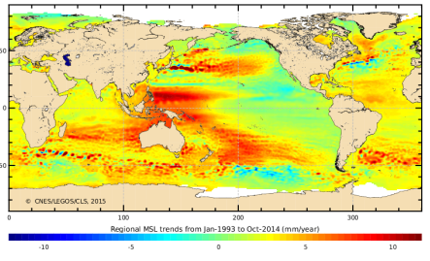
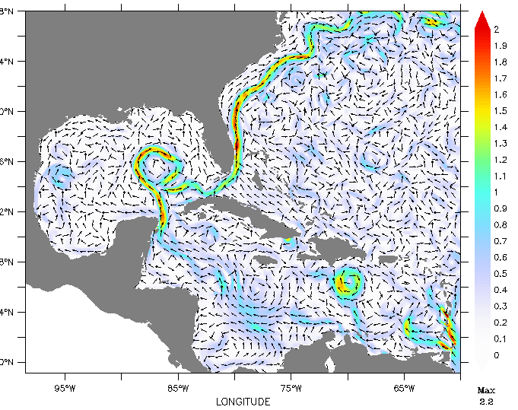
Altimetry: what for?
Mean surfaces: geoid, mean dynamic topography
Mean Sea Level trends
Marine meteorology wind, waves
Ocean dynamics: eddies, fronts, currents…

Slide 3
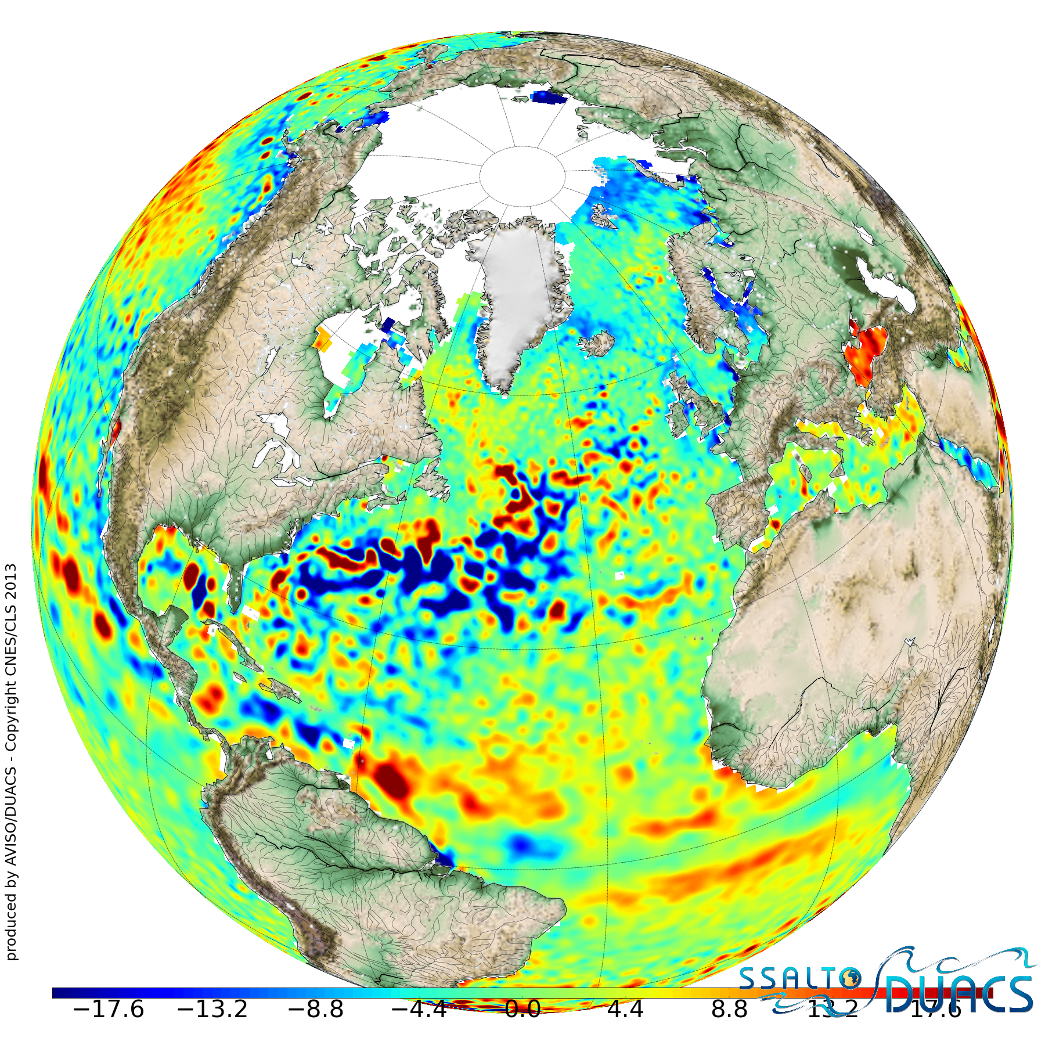
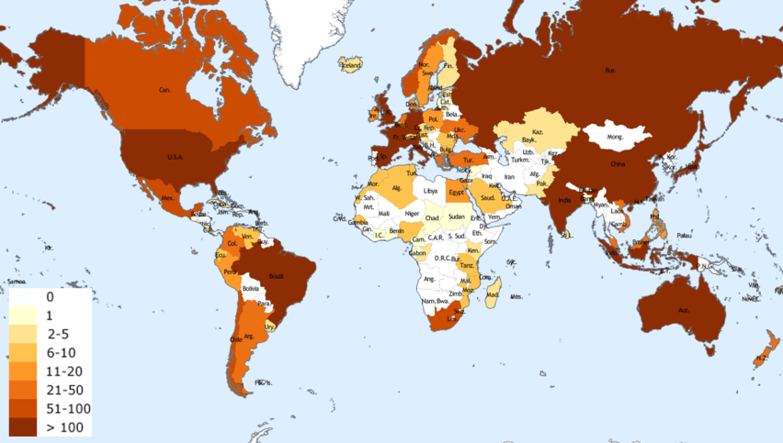
OST-VC
Inter-agency cooperation at work in altimetry
Altimetry is a 1-D measurement aiming a measuring the 2D sea surface topography and its time variations:
require constellation of at least 4 satellites with careful intercalibration
require level 3-4 products transfoming 4-satellite profiles into maps
=> requirements expressed in CEOS OST-VC Document “The Next 15 Years of Satellite Altimetry” http://www.ceos.org/images/OST/SatelliteAltimetryReport_2009-10.pdf
As of today, 4 altimetry missions are operating:
OSTM/Jason-2 (reference mission), NASA/CNES/EUMETSAT/NOAA
Cryosat-2 (ice mission with ocean capability), ESA
Hy-2A, CNSA/NSOAS
SARAL /AltiKa, CNES/ISRO
Heterogeneous programmatic set-up, but multi-mission products freely available in NRT through AVISO/DUACS
http://www.aviso.altimetry.fr: > 5000 registered users

Slide 4
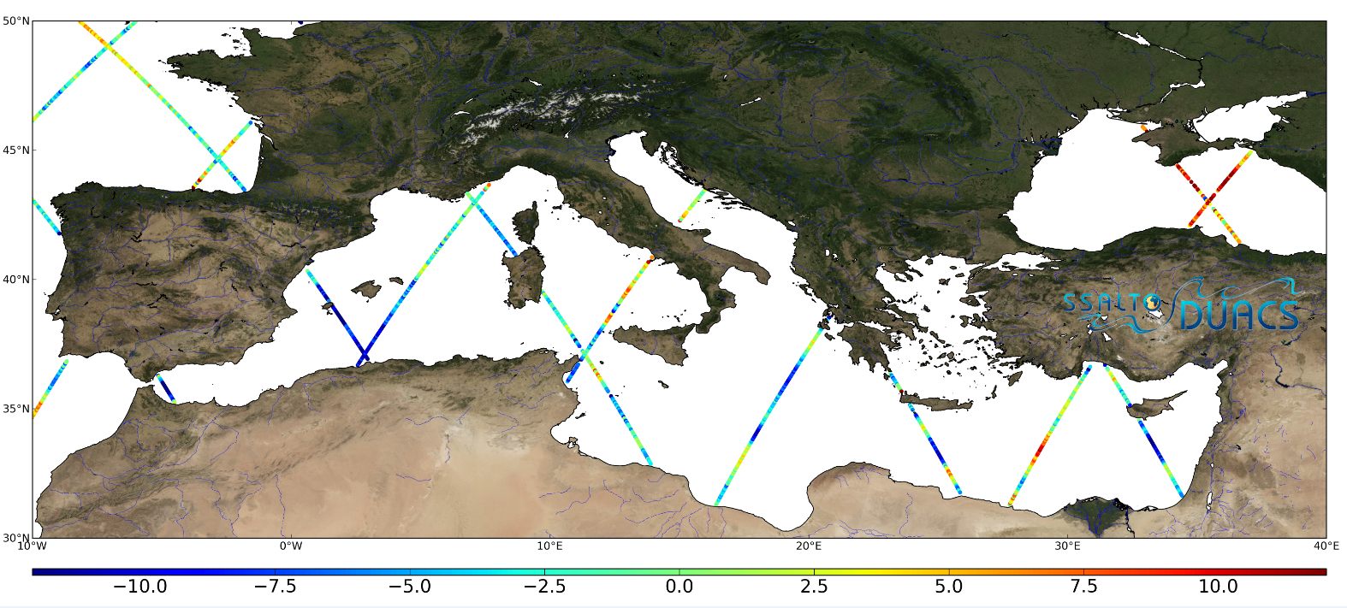
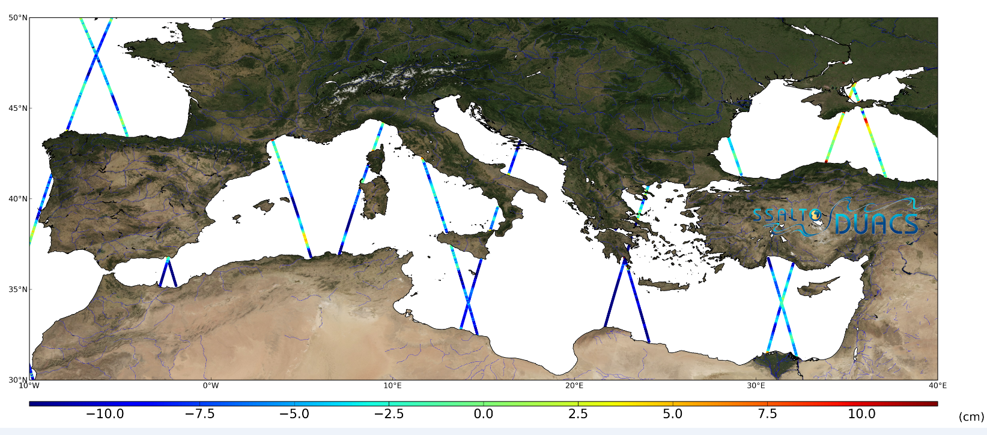
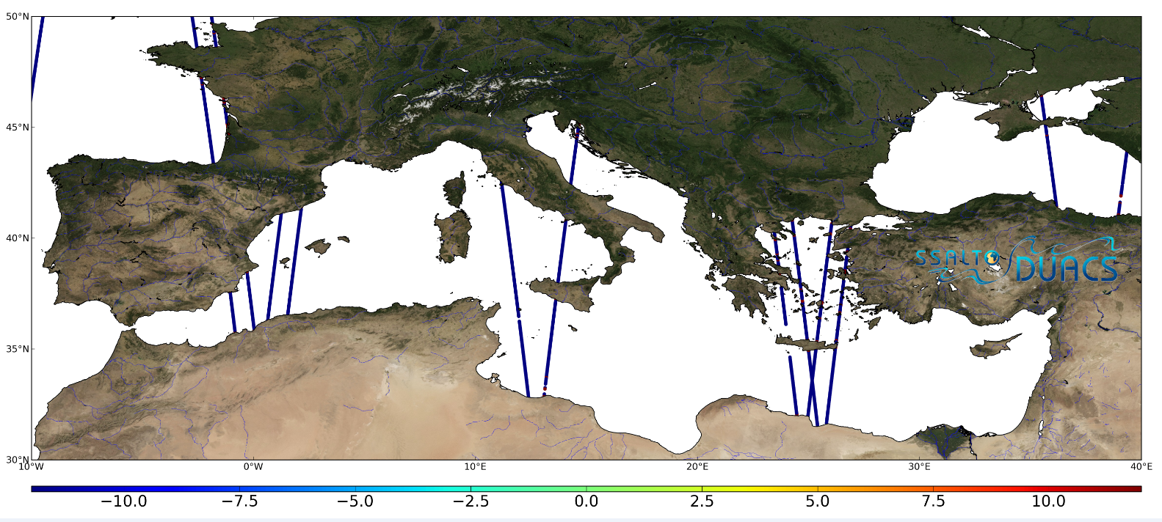
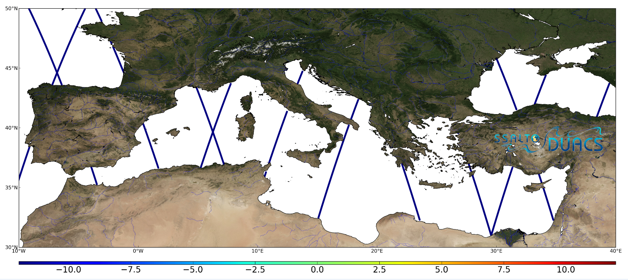
Uncalibrated individual missions
OSTM/Jason-2
SARAL/ AltiKa
Cryosat-2
Hy-2A

Slide 5
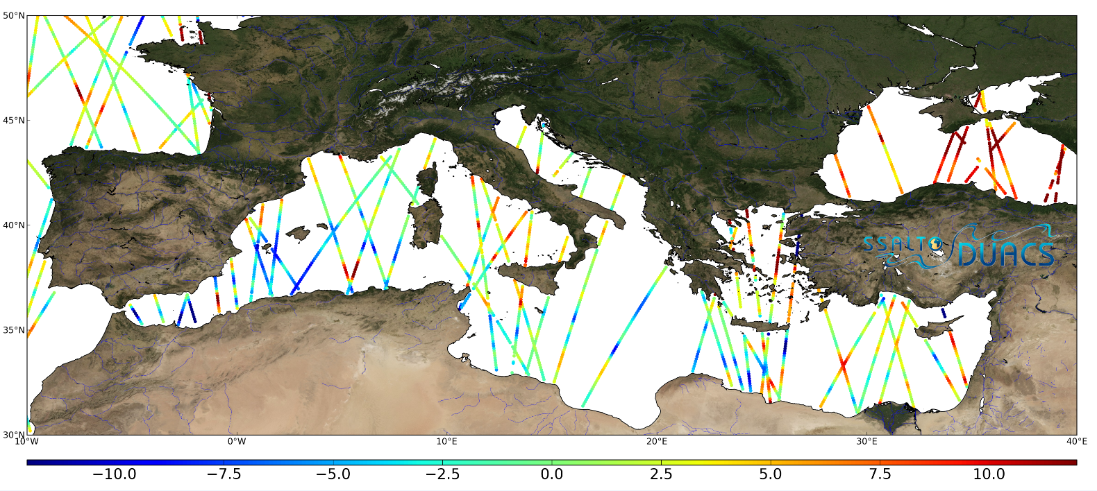
After intercalibration
Level 3 – Sea Level Anomaly (cm)

Slide 6
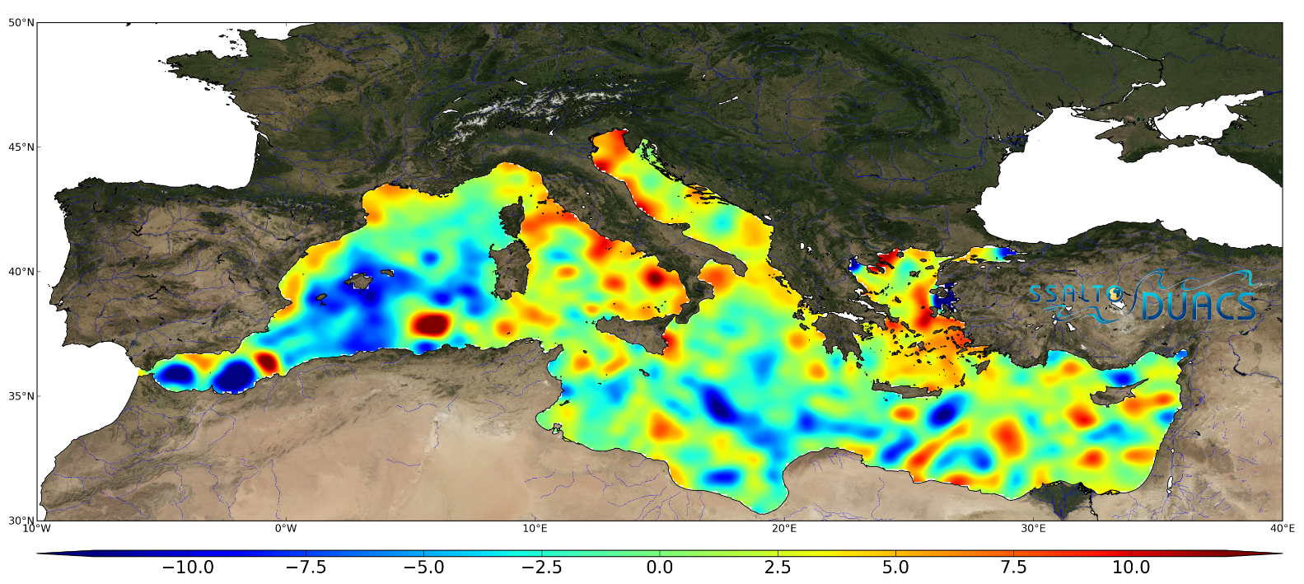
1D-2D mapping
Level 4 – Sea Level Anomaly (cm)

Slide 7
Highlights
European Union approves COPERNICUS programme:
Secures Sentinel-3 series
Sentinel-6/Jason-CS (+ contribution to Jason3)
Step towards Jason-CS / Sentinel 6
EU and ESA programs OK (Sentinel-6
EUMETSAT program still to be decided
US side not approved yet (NASA/NOAA)
Mission extensions: Cryosat-2 (ESA) , Hy-2A (CNSA/NSOAS)
SWOT program phase B decision (NASA/CNES

Slide 8
2014 status
Launch
Date
10
11
12
13
14
15
16
17
18
19
20
21
22
23
24
Reference Missions - Higher Accuracy/Medium Inclination
12/01
Jason-1 France/USA
Lost
Jason-3 Europe/USA
06/08
JASON-2 Europe/USA
Jason-CS A/B Europe/USA
Complementary Missions - Medium Accuracy/Higher Inclination
03/02
ENVISAT Europe
Lost
Sentinel-3A Europe
Sentinel-3C/D Europe
Sentinel-3B Europe
SARAL France/India
HY-2A China
HY-2B China
CRYOSAT-2 Europe
02/98
GFO USA
GFO-2 USA
Lost
Broad-Coverage Mission
SWOT USA/France
COMPIRA Japan
Recentl
In operation
Approved
Proposed

Slide 9
Current status
Launch
Date
10
11
12
13
14
15
16
17
18
19
20
21
22
23
24
Reference Missions - Higher Accuracy/Medium Inclination
12/01
Jason-1 France/USA
Lost
Jason-3 Europe/USA
06/08
Jason-CS /Sentinel-6 A/B Europe/USA
JASON-2 Europe/USA
Complementary Missions - Medium Accuracy/Higher Inclination
03/02
ENVISAT Europe
Lost
Sentinel-3A Europe
Sentinel-3C/D Europe
Sentinel-3B Europe
SARAL France/India
HY-2A China
HY-2B China
HY-2C China
CRYOSAT-2 Europe
02/98
GFO USA
GFO-2 USA
Lost
Broad-Coverage Mission
SWOT USA/France
COMPIRA Japan
Recentl
In operation
Approved
Proposed

Slide 10
Interaction with OSTST
OSTST: Ocean Surface Topography Science Team
Initially set up by NASA/CNES for TOPEX & Jason-1
Science team => approx. 80 teams contributing to altimetry: cal/val, orbit determination, instrument processing, NRT applications, sea level change
Current team selected in 2012 through a NASA/CNES/EUMETSAT call. => renewal 2015/2016
Informal but strong links with COSTALT, CCI (ESA), SARAL science team (ISRO/CNES)
Annual meetings each fall: 300-400 participants (typically 1/3 US, 1/3 French, 1/3 other..)
Discussions on-going for OSTST evolution:
Less mission-specific, broader support => closer to CEOS?

Slide 11
Actions…
VC‐11: Updated OST CEOS Constellation User Requirements Document (URD)
Will encompass SAR mode altimetry (1D- high res)
Target: Q3 2015
VC‐12: Catalog of Cal/Val infrastructure
Cal-val plans from Jason-3, Sentinel-3 missions finalized and coordinated
Use of those cal/val infra possible for other missions: to be discussed at OSTST
Target Q2 2015
VC‐13: Reprocessing strategy for TOPEX/Jason‐1 missions
On-going: reprocessed data have been delivered to expert users for validation and study of impact wrt mean sea level trend => report expected in June.

