Slide 1

ECV Inventory and
Climate Architecture
Committee on Earth Observation Satellites
Joint CEOS/CGMS Working Group on Climate
SIT-31 Agenda Item #8
CEOS Strategic Implementation Team
ESA/ESRIN, Frascati, Italy
19th-20th April 2016

Slide 2
WGClimate
WGClimate activities and their associated actions are:
  Coordinate implementation and further development of the Climate Monitoring Architecture establishing and maintaining the ECV Inventory to enable the provision of a coordinated medium to long term action plan for implementation
  External Reporting to UNFCCC/SBSTA and GCOS
  CEOS Reporting
  CGMS Reporting

Slide 3
ECV Inventory Development
The objectives associated with ECV Inventory development are intrinsic to the fulfilment of the core objectives assigned to WGClimate in its Terms of Reference, and form a pivotal asset in the implementation of the Climate Monitoring Architecture. The activity is predicated on the concept of the “Inventory Development Cycle”.
Each WGClimate Chair has the objective of completing one inventory development cycle within their respective terms, with each development cycle corresponding to a series of CMRS actions, leading to a baseline version of the ECV Inventory.
Notes:
CMRS: Climate Monitoring, Research and Service

Slide 4
ECV Inventory - Cycle #2
Stage #1:Collection of New & Updated Information from Data Providers
Stage #2: Data Incorporation and Quality Control
Stage #3: Gap Analysis
Stage #4: Action Plan
CEOS ECV Inventory
V2
Reference Assessment
Process
ECV Gap
Analysis V2
Mitigation
Plan and
Actions V2

Slide 5
Other Activities
Reporting to CEOS
    Update of the ECV Inventory
    Analysis report on new Climate Change Treaty (COP-21)
Reporting To CGMS (#44 Biot-France June 2016)
  Actions:
    FCDR Inventory
    Interoperability Standards
Reporting to SBSTA
    WGClimate Chair will be present at SBAST-44 as part of the ESA delegation and has been invited to present WGClimate activities.
Interface with GCOS
    Supporting the Definition of the New GCOS IP (planned end 2016)
    Prepare the CEOS response to the new GCOS IP (planned end 2017)

Slide 6
ECV Inventory - Content
Technical Baseline for New Implementation
What is the ECV Inventory and why is it important
Analysis of Cycle #1 Inventory Status
Structure of Cycle #2 Inventory
Example of questionnaire entry
ECVs, ECV Products and Physical Quantity
Complementary Activities
Schedule

Slide 7
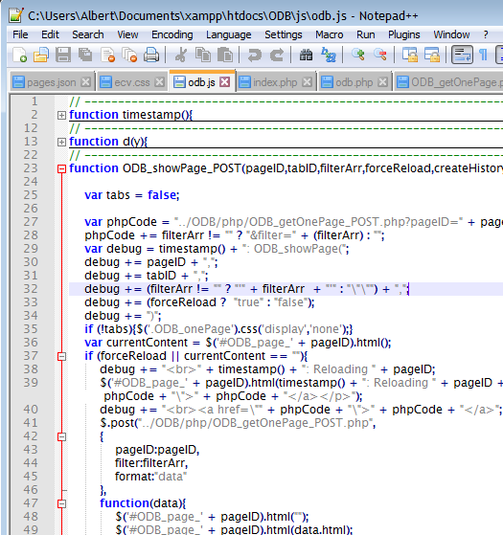

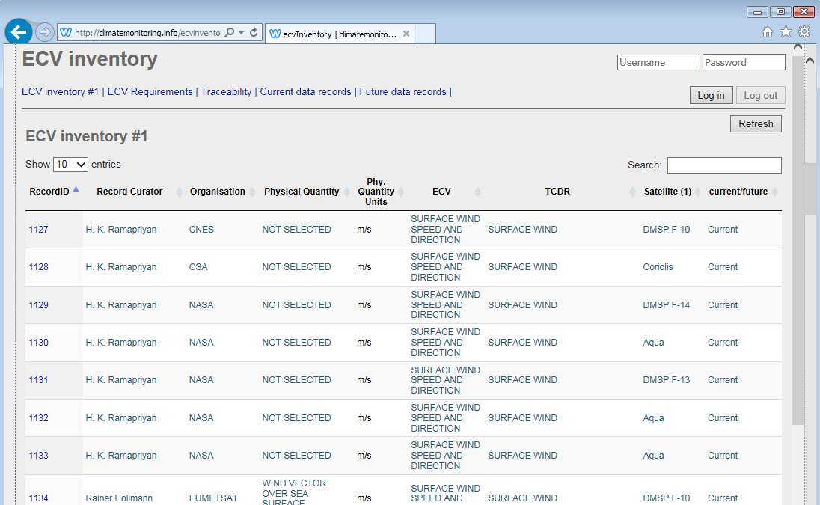
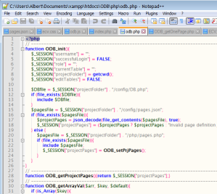
Technical baseline for new implementation
Webserver, Database, User Interaction
Apache, MySQL, PHP (server), JavaScript (Client)

Slide 8

Database tables
Table | Content | Access restrictions
ECV | ECV Inventory Cycle #1 | Read-only, publicly avilable
ECV_2 | ECV Inventory Cycle #2 | Editable, during verification only available to dataset providers and WGClimate
ECV_requirements | GCOS ECV Requirements | Read-only, publicly available
Satellites_instruments | List of satellites and instruments | Available through drop-down lists
Items_sat_data | Relationship table ECV_2 ← → ECV_requirements | Available through edit form
ECV_list | List of ECVs, ECV produc ts and Physical quantities | No access, internally used for dropdown lists
History | Log-table for history registration | No access
Users | User management for log-in and dataset edit rights management | No access

Slide 9
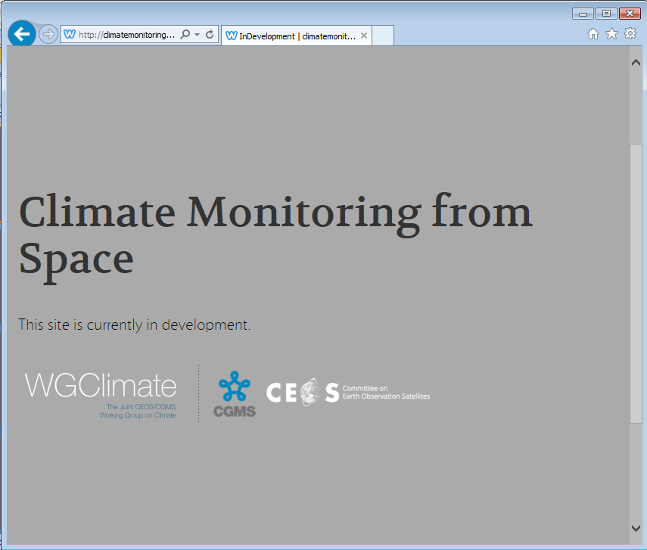
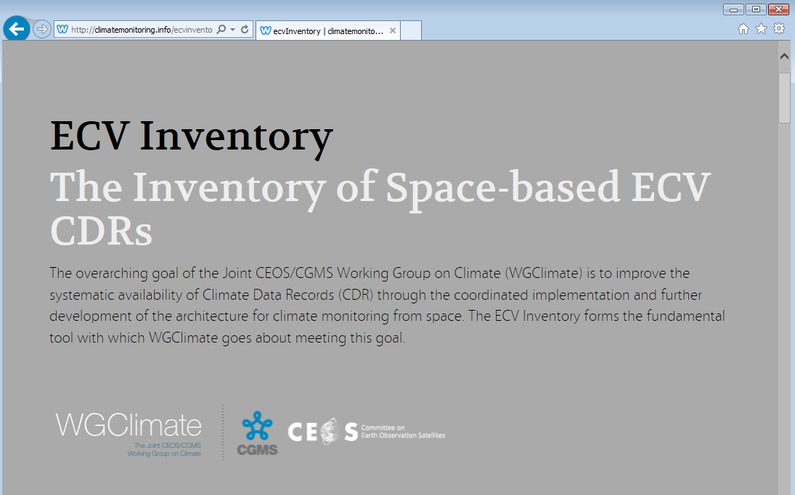
Integration with WGClimate Website
ECV inventory is displayed as integral part of the WGClimate website
http://climatemonitoring.info/wgclimate
Integration via <iframe> allows independent development and maintenance

Slide 10
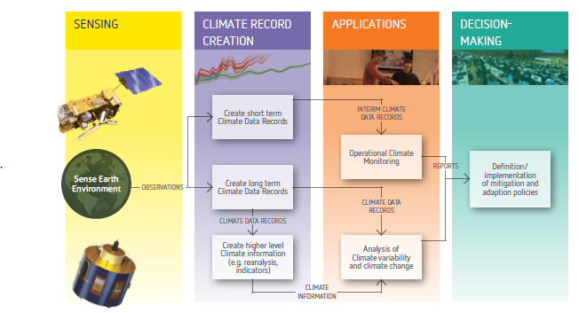
The Architecture for Climate Monitoring from Space
Implementation coordinated by
Joint CEOS/CGMS Working Group on Climate (WGClimate)

Slide 11
Importance of the ECV Inventory
Based on a questionnaire it describes the current and planned monitoring capability on an ECV basis;
Provides specific information per data record (some being not part of meta data);
Establishes traceability with respect to GCOS principles, requirements and guidelines;
Directly supports gap analysis by its structure.
ECV Inventory
Reference Assessment Process
Gap Analysis & Recommendation
Action Plan
Creation of conditions to deliver CDRs

Slide 12
Usage of the ECV Inventory by WG Climate
Description of current and future monitoring capability on an ECV basis allows easier response to e.g. GCOS IP (may suffer from mismatch after update but discussion on ECV list in GCOS not finished);
Combined perspective of the logical and physical views of the architecture should enable the definition of an optimum “macroscale” space system configuration and its components;
Used at the ECV/product level to identify gaps and shortfalls as well as to provide recommendations for action;
Formulation of a coordinated action plan to address recommendations;
Trigger for the medium‐term activities that need to be undertaken to sustain the long‐term implementation of the architecture.

Slide 13
Potential Usages of the ECV Inventory beyond WGClimate
Can inform data record users with a public repository of verified information on what is available and how to access the data;
Can inform climate services on what to use;
Can inform data providers on competitive situations;
Can inform developers with whom to collaborate;
Can inform reviewers of proposals for new CDRs if it is worth investing ...

Slide 14
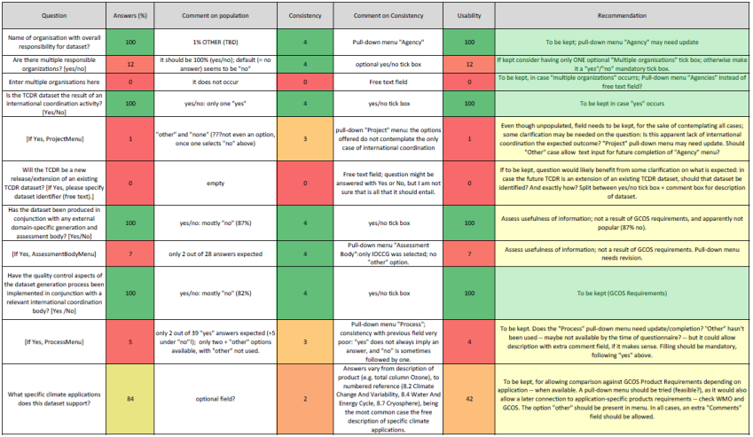
ECV Inventory Cycle #1
Analysis

Slide 15
Rationale
Lessons learnt from Cycle #1
Proposed approach for Cycle #2
  Unpopulated / poorly populated fields
  Inconsistent / insufficient input of information
  Potentially missing data records
  Difficult assessment for future improvements of questionnaire
  Clear distinction between current and future partly lost in implementation
  Revision of questionnaire
  Guide to the Questionnaire
  Direct engagement of POCs per data record
  Finding right PoCs via WGClimate members engagement
  1-to-1 interactions between ‘questioner’ and ‘responders’
  Clear split into two questionnaires

Slide 16
Questionnaire Structure I
Current
Future
Notes:
Stewardship of the record - with questions aimed at exposing both the administrative and technical arrangements
for the stewardship of the record;
b) Generation Process of the record - with questions aimed at exposing the degree to which this generation
process complies with the provisions described in [RD-1];
c) Record Characteristics - with questions aimed at ensuring (inter alia) that there is sufficient information to
establish whether the record satisfies the technical requirements defined in [RD-2];
d) Documentation of the record - with questions aimed at ensuring that the minimum documentation needs
defined in [RD-1] are met;
e) Accessibility of the record - with questions aimed at ensuring that appropriate access to the data set is available,
as defined in [RD-1];
f) Applications of the record - with questions aimed at exposing the envisaged usage of the record.

Slide 17
Questionnaire Structure II
6 Categories feeding gap analysis
Stewardship
15 Questions
Generation Process
5 Questions
Current
Record Characteristics
14 Questions
Documentation
3 Questions
Accessibility
7 Questions
Applications
1 Question

Slide 18
Questionnaire Structure III
6 Categories feeding gap analysis
X
Stewardship
13 Questions
Generation Process
5 Questions
Future
X
Record Characteristics
12 Questions
Documentation
3 Questions
Accessibility
3 Questions
Applications
1 Question
Same questionnaire structure but less questions and different tense.

Slide 19
Example for Questionnaire Entry
Question #6 (Calibration organisation)
Question:
Which organisational entity is responsible for calibrating the satellite observations?
Description:
The answer to this question is in most cases the name of the space agency operating the satellite and/or instrument that provides for instance pre-launch or on‐board calibration during the during the lifetime of the instrument(s). However, in case that a specific re-calibration of the instrument data leading to a FCDR has been performed, another agency may take the responsibility of providing an updated calibration of the individual instruments. If several entities are involved they should all be mentioned in the answer by stating full name(s) and acronym(s).
This question is associated with GCOS-143 [RD-4] guidance #2 which reads that the GCOS Steering Committee recommends that data producers pay attention to the “Application of appropriate calibration/validation activities”. It is also associated with the GCOS-143 [RD-20] GCMP #15 which reads that “On-board calibration adequate for climate system observations should be ensured and associated instrument characteristics monitored.”
This question should not be confused with question #8 (section 3.1.8), which focuses exclusively on the inter-calibration of different instruments.
Stage:
Stewardship – Generation – Process – Record – Characteristics -Documentation – Accessibility - Applications
Explanation of the question
Link to GCOS principles, requirement and guidelines
Indication of area for gap analysis process

Slide 20
ECVs, ECV Products and Physical Quantities
  Satellite Supplement to the GCOS IP defines ECVs and ECV Products for which quantitative requirements are given;
  Unfortunately, these definitions are not consistent throughout the Satellite Supplement, but we need to be pragmatic;
  We constructed a list of ECV, ECV Product and Physical Quantity to overcome it.
ECV
ECV Product
Variable/ Parameter
Top of atmosphere ERB longwave
Top of atmosphere ERB shortwave (reflected)
Surface ERB longwave
Surface ERB shortwave
A7.1
Earth radiation budget (top-of-atmosphere and surface)
Earth Radiation Budget
A7.2
Total and spectrally resolved solar irradiance
Total solar irradiance
Solar spectral irradiance

Slide 21
Our change ...
ECV
ECV Product
Physical Quantity
A7.1 Top of atmosphere ERB longwave
A7.2 Top of atmosphere ERB shortwave (reflected)
A7.3 Surface ERB longwave
A7.4 Surface ERB shortwave
Upward Longwave Radiation at TOA
Upward Shortwave Radiation at TOA
Surface ERB Longwave
Downward Longwave Radiation at Surface
Upward Longwave Radiation at Surface
Surface ERB Shortwave
Downward Shortwave Radiation at Surface
Upward Shortwave Radiation at Surface
Earth Radiation Budget
A7.5Total solar irradiance
A7.6Solar spectral irradiance
Total solar irradiance
Solar spectral irradiance
This allows to include individual ERB component data records even if specific flux components do not exist today.

Slide 22
Complementary Activities
Hosting of the ECV Inventory
Development of Further ECV Inventory Capabilities
Development / Promotion of Case Studies
Development and Maintenance of a WGClimate Web Site

Slide 23
Schedule
Objectif/Deliverable | Background Information | Target Date
Cycle #2 – Stage #1 | Collection of New and Updated Information from Data Providers | Sep. 2016
Cycle #2 – Stage #2 | Data Incorporation and Quality Control | Nov. 2016
Cycle #2 – Stage #3 | Gap Analysis | Feb. 2017
Cycle #2 – Stage #4 | Action Plan | Jun. 2017
Comp. Activity #1 | Hosting of the ECV Inventory | Dec. 2016
Comp. Activity #2 | Development of Further ECV Inventory Capabilities | Feb.2019
Comp. Activity #3 | Development / Promotion of Case Studies | Sep 2017
Comp. Activity #4 | Development and Maintenance of a WGClimate Web Site | Sep 2017

Slide 24
WGClimate Governance
Current Chair (11/2015 – 11/2017) – ESA – R&D Agency
Next Chair (11/2017 – 11/2019) – EUMETSAT – Ops Agency
Following Chair (11/2019 – 11/2021) – tbd – R&D Agency
Nomination to be endorsed by CEOS and CGMS by 11/2017 to start as Vice Chair.
  CGMS Plenary in May-June 2017
  CEOS Plenary in October 2017
Next WGClimate #7 is planned in February 2017 in Sao José dos Campos, hosted by INPE.
Election for new Vice Chair shall be organised during that meeting in order to be in position to endorse the proposal at the following CGMS and CEOS Plenaries in 2017.
CEOS Agencies are therefore requested to propose candidates.

Slide 25
Points to be addressed
WGClimate need support from the VCs and other CEOS entities for person joining the Gap Analysis Groups.
WGClimate will contact CEOS (and CGMS) agencies to support the Space Agency response to the GCOS IP. People showing interest are welcome.
Election for the new Vice Chair

