Slide 1
Status of the ECV Inventory Cycle #2 Gap Analysis & Action Plan
Pascal Lecomte - WGClimate Chair
April 27th, 2017
SIT-32 Agenda Item 28b
Jörg Schulz, Alexandra L. Nunes, Peter Albert (EUMETSAT)

Slide 2
The ECV Inventory in numbers
Number of people contacted (WGClimate members from all listed CEOS/CGMS agencies + Focal Points + other effective/potential Responders): ~160.
Explicit feedback received from most of the Space Agencies contacted.
Input received from all the major Space Agencies
150 registered Responders, of which 90 are/were active.

Slide 3
The ECV Inventory in numbers
893 entries (435 existing data records + 458 planned data records)
Spanning across 27 of the 29 ECVs in GCOS-154.
~80% of the listed physical quantities
74% Atmosphere, 15% Land, 11% Ocean
Verification process on-going
80% finalised, 20% being iterated with Responders.
> 90% “Verified” for Gap Analysis Process [there will be cases of non responsiveness to the verification process, so the final count will never reach 100%]

Slide 4
The ECV Inventory in numbers
GCOS-154 (2011)
27/29, or ~93% of the ECVs are covered.
11/11 for Atmosphere,
5/6 for Ocean Sea-surface salinity missing
11/12 for Land Above-ground biomass missing
GCOS-200 (2016)
30/35, or ~86% of the ECVs are covered.
(11+0)/12 for Atmosphere new ECV Lightning [0 entries]
(5+2)/9 for Ocean new ECVs Ocean Surface Heat Flux [x],
Surface Currents [0], Surface Stress [x],
(11+1)/14 for Land new ECVs GHG fluxes [0], Groundwater [x]

Slide 5
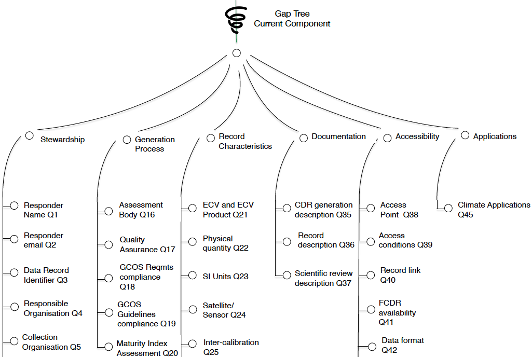
Contents of gap analysis guidelines Current ECV Entries

Slide 6
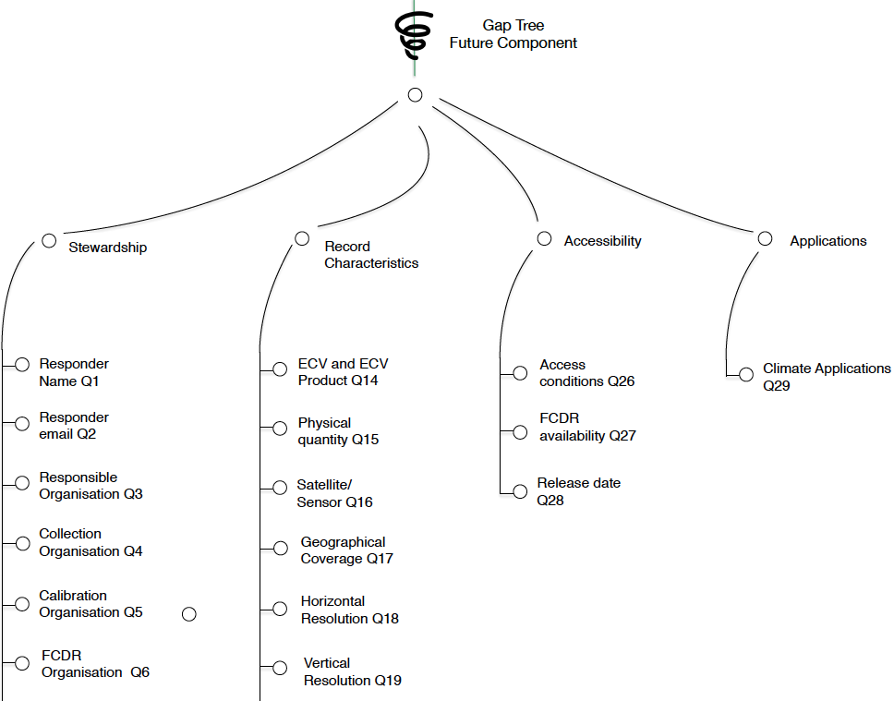
Contents of gap analysis guidelines Future ECV Entries

Slide 7
Contents of gap analysis guidelines - Ctd
LEGEND
Symbol | Denotes
 | “No information Provided”
 | “Information provided but not compliant with Requirements”
 | “Information provided and partially compliant with Requirements”
 | “Information provided and fully compliant with Requirements”

Slide 8
Inherent Uncertainty “Rumsfeld contingency matrix” (GCOS ECVs)
 | Known | Unknown
Known | CDRs within ECV Inventory: fully characterised | (Known) CDRs not captured by ECV Inventory
Unknown | potential CDRs within ECV Inventory: insufficient information | ?
KU: e.g. Non-responsiveness within reach of CEOS/CGMS
Widen reach of data call
Cross-compare with other sources of information …
UK: Not documented / fully assessed

Slide 9
Organisation of the gap analysis Actors & Roles
Gap analysis coordinator (EUMETSAT) – reports to the WG Chairs
Oversees the whole gap analysis process, ensures consistency of approach and outcome across domain teams (i.e. as per #3.1.5 of the guidelines), integrates team outputs into an overall Gap Analysis Report (i.e. as per #4 of Guidelines)
Domain specific gap analysis teams – report to the Gap Analysis Coordinator
Implement the gap analysis following the final gap analysis guide;
Report per ECV data record following the structure explained by Alexandra.
EUMETSAT SupportTeam – report to Gap Analysis Coordinator;
Develops the gap analysis to be used with the ECV Inventory
Supports gap analysis teams with rapid developments of graphical representations of Inventory contents and helps clarifying ECV Inventory content with responders if needed
WGClimate Chairs – report to WGClimate and to bodies
Support the gap analysis coordinator during prototyping, report structuring and domain team establishment;
Report to all bodies (CEOS SIT, CGMS Plenary, CEOS Plenary, SBSTA) as outlined in overall schedule
Take final decisions on inclusions or exclusions of ECV Inventory content for gap analysis
WGClimate Members
Endorse gap analysis report and coordinated action plan

Slide 10
Organisation of the gap analysis Actors & Roles
EUMETSAT Support Team
Atmosphere Team
Ocean Team
Gap Analysis Coordinator
WGClimate Chairs
Terrestrial Team
WGClimate

Slide 11
Gap Analysis Report and Action Plan
Section | Title | Contents
1 | Introduction | Purpose and Scope, Applicable Documents
2 | Implementation Approach | Describes the approach adopted for implementing the Gap Analysis, including schedule of activities and allocation of work to teams (see section 3.1.4)
3 | Generic Gap Analysis | Generic Gap Analysis Statistics (separated into current and future - see section 3.2) Percentage of Records Produced as a Result of International Coordination (separated into current and future - see section 3.2)
4 | Gap Analysis per ECV Product | Gap analysis summary results for each ECV product, with one sub-section for each ECV product and separated between current and future components - see sections 3.3.3 and 3.4.3 for the required content of the sub-sections. Note: the detailed gap analysis results shall be included in appendices
5 | Improvement Suggestions | As described in section 3.1.2, this section shall include a consolidated list of improvement suggestions, covering at least: The content and formulation of the requirements baseline {e.g. as reflected in [RD-1] and [RD-2]}; The structure/content of the ECV Inventory and Questionnaires (e.g. possible need for a better backwards link from TCDRs to FCDRs); The completeness and consistency checking of the ECV Inventory entries; The gap analysis process (as described in this document); The selected implementation approach (e.g. the breakdown of the gap analysis activities into thematic areas and allocation to teams).
Appendix A | Detailed Gap Analysis Results | Detailed gap analysis results for each ECV product, with one sub-section for each ECV product and separated between current and future components - see sections 3.3.2 and 0 for the required content of the sub-sections.
Appendix B | Recommendations for Coordinated Actions | This section shall include an extract of all recommendations for coordinated actions from the main body of the report (for potential inclusion in a coordinated action plan) to address gaps, shortfalls and improvement opportunities

Slide 12
Summary
First brush through the Inventory shows how many ECVs, ECV products and physical quantities are addressed by space agencies – many!
Need to address in the gap analysis report the inherent uncertainty of the gap analysis;
The Gap Analysis Coordinator has started, need to complete domain teams;
Tool development for analysis is rapid and helps with verification process as well;
Will prototype the action plan to get an understanding for the end-to-end chain and to test the Analysis tools.

Slide 13
Overall Schedule
ECV Inventory release 05/06/2017
Gap Analysis Report
First Draft 31/07/2017
Final Draft 31/08/2017
Coordinated Action Plan
First Draft 15/08/2017
Final Draft 15/09/2017
Space Agency Response to the GCOS IP
First Draft 11/09/2017
Final Draft 06/10/2017

