Slide 1
JAXA’s Current EO Contribution & Future Consideration
Committee on Earth Observation Satellites
Teruyuki Nakajima
SIT-33
CEOS Strategic Implementation Team
University of Colorado, Boulder, USA
24th April 2018

Slide 2
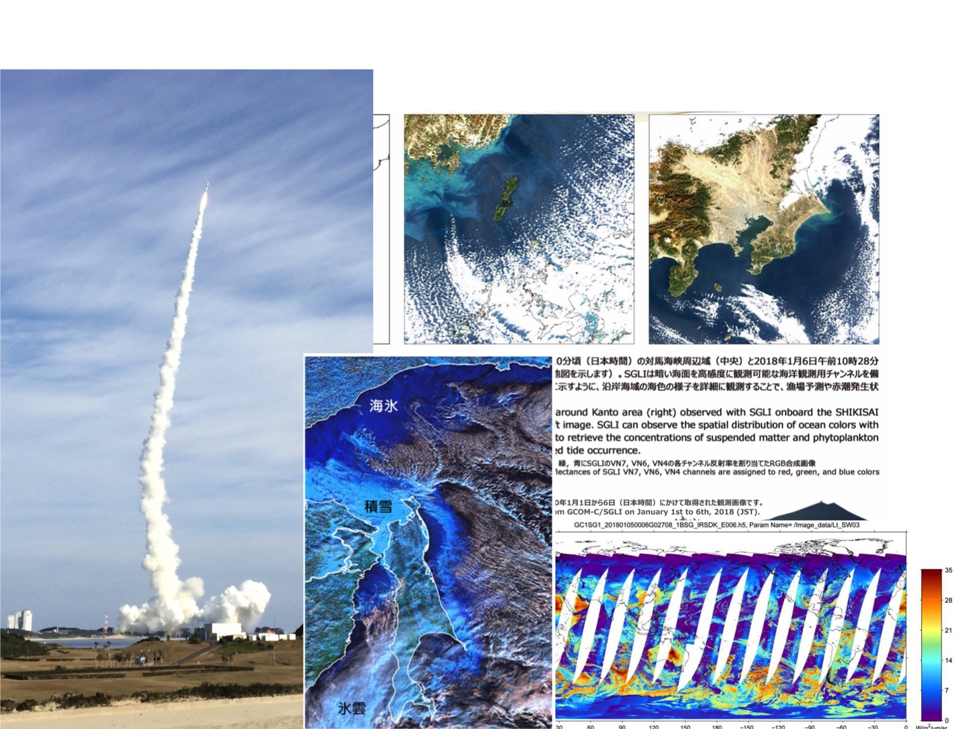
Success of the GCOM-C satellite launch
Launched: Dec. 23, 2017
Ocean and Land color around Japan
Jan. 2018
Degree of polarization
sea ice
snow
1.6 µm radiance
ice cloud
2

Slide 3
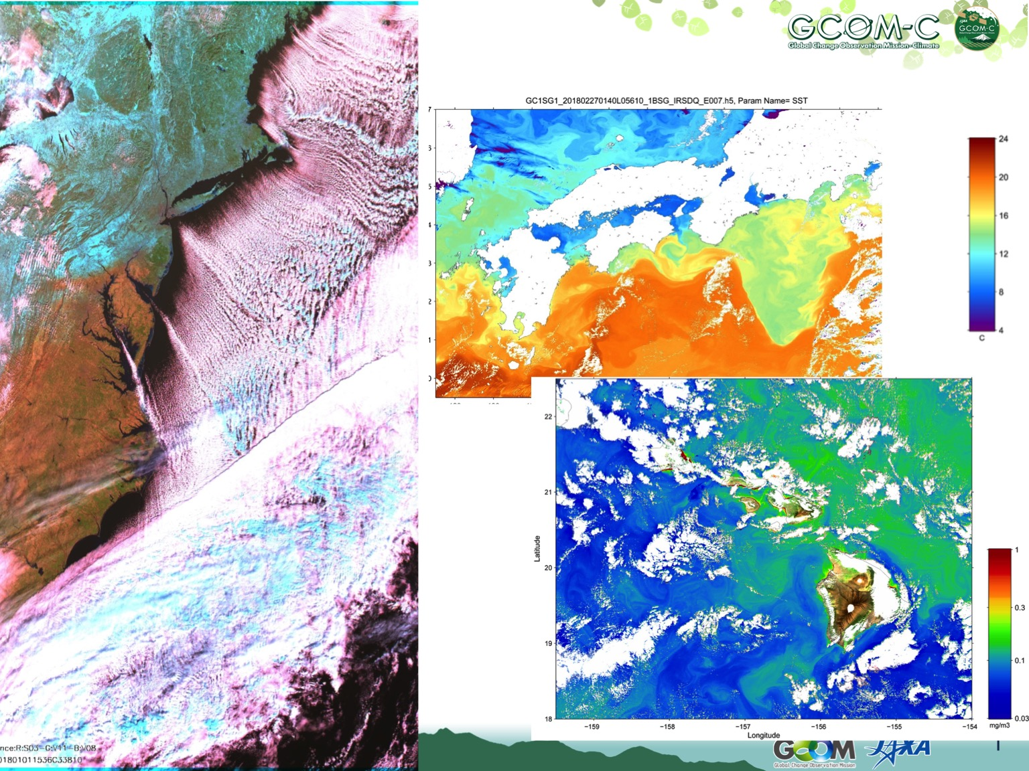
GCOM-C/SGLI acquired images
SST
MOBY
20.82N
157.19W

Slide 4
Japan’s EO Program
Original plan approved in June 2009
Latest revision approved in December 2017
Japanese Fiscal Year
2016 | 2017 | 2018 | 2019 | 2020 | 2021 | 2022 | 2023 | 2024 | 2025 | 2026 | 2027 | 2028 | 2029 | 2030
Disaster
ALOS-2/PALSAR-2
Land Monitoring
ALOS-4 (SAR)
ALOS-4 Follow-on
ALOS-3
(Optical)
ALOS-3 Follow-on
Climate
Change
Budget for development research
approved in December 2017
GCOM-W/AMSR-2
AMSR-2’s Successor Sensor
Water Cycle
Precipitation
GPM/DPR
Vegetation,
Aerosol
GCOM-C/SGLI
Uncertainties
EarthCARE/CPR
Clouds
GOSAT/FTS
Greenhouse
Gases
GOSAT-2/FTS-2
GOSAT-3

Slide 5
GOSAT-3 and AMSR-2 F-O Orbit options
Coordination on orbit with GOSAT-3 and its on-board AMSR-2 follow-on
The best choice for AMSR2 follow-on is entering into A-Train constellation. (Same as that of GCOM-W)
GOSAT-3 orbit is now under consideration.
Welcome CEOS agency’s opinion.
 | GCOM-W* | GOSAT | GOSAT-2
MLTAN | 1:30pm | 1:00am | 1:00am
Altitude | Approx. 700 km | Approx. 666 km | Approx. 613 km
Repeat cycle | 16 days Sub-cycle 2 days | 3 days | 6 days
*Mission requirement of GCOM-W
To observe more than 95 % of area on the equator in two days for each ascending pass and descending pass.

Slide 6
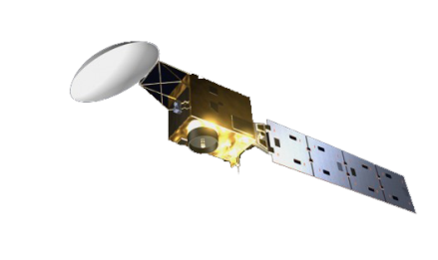
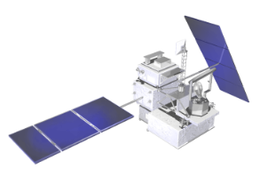
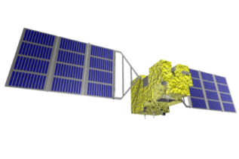
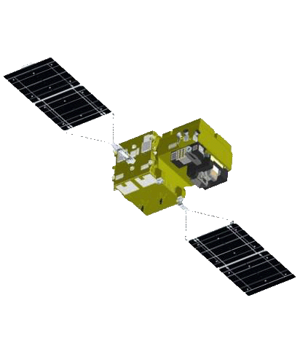
Understanding the Earth for Climate Change Processes
T. Nakajima
Effects to Human Society
& Ecosystem
More Extreme Weather
/Less Typhoon
Mission for understanding global scale climate change and water cycle mechanisms
Mission for forest biomass estimation
Change in
Water Cycle
Rise of Sea-Level
Decrease of Snow and Ice
Ocean Acidification
Extreme Weather
Health Damage
Ecosystem Change
Decrease of Biodiversity
Agricultural Damage
6% Increase?
Measurement of Vertical and Horizontal Distribution of Clouds
Greenhouse Effect
Heating/Cooling
Global Warming
1.4C→2.9C?
CO2
515GtC
→790GtC
@2100
BC: -0.5 C?
Long-Lived Greenhouse Gases
Short-Lived
Climate Pollutants
Change in Clouds & Precipitation
Mission for understanding cloud and precipitation processes
Cloud Condensation Nuclei
Mission for monitoring global environmental changes
Missions for monitoring greenhouse gases
(i.e. GOSAT Series)
Mission for SLCP reduction
Understanding Climate Sensitivity and Interaction（50% improvement）
Accurate Estimation of Radiative Forcing
(50% improvement)
Low level cloud
dln(LWP)/dln(Na)<0?
ΔT_{s,eq} = λ ΔF_{R}
a model example
1/λ ∼ 5.0−2.6−0.5−0.5
Active sensors & high resolution model
BB wv cloud albedo

Slide 7
提案：衛星を用いた全球地球観測システムの構築
Remote Sensing Society Task Force Community (TF) proposal
on an Earth Observation Grand Design
TF: 23 Academic Societies and 2 Groups
Mission for understanding global scale climate change and water cycle mechanisms
AMSR2 F/O with high resolution 6-89GHz plus 166/190GHz(TBD) for solid hydrometeors
Mission for forest biomass estimation
Improved estimate of forest biomass estimate by combined vegetation lidar and L-band SAR．
Mission for SLCP reduction
Estimate of Short-lived Climate Pollutant (SLCP) inventories for its reduction with LEO observation of 1-2 horizontal spatial resolution and UV/VIS/SWIR＋MIR+MW
Mission for understanding cloud and precipitation processes
Combined DPR and CPR measurements with improving sensitivity and spatial resolution
Mission for monitoring global environmental changes
SGLI F/O for long-term and continuous measurements by a NUV-TIR imager
Notes:
GCOM-W: 2012.5 + 5y
GPM: 2014/2 + 3y&2m
GOSAT: 2009/1+5y
EarthCARE: 2018.1+3y
TRMM: 1997.11+17y
Aqua/AMSR-E: 2002.5-2017.12

Slide 8
Japan’s current situation
JAXA implements EO programs as approved by GOJ; however, uncertainties in the future.
JAXA is willing to continue its contribution in response to global agenda as a part of EO community.
Science Council of Japan made recommendations for Japan’s EO in 2017. In response to the recommendations, Remote Sensing Society Task Force Community (TF) proposed construction of Earth Observation Grand Design.
Japan’s space policy emphasizes importance of
International cooperation
Private sector engagement

Slide 9
Outlook of EO Programs
VCs/WGs
WIGOS2040
EU Copernics Program
US Decadal Survey
GCOS IP
Chinese Space Program
Indian Space Program
Japan’s Basic
Plan on Space Policy
SIT-33, 24-25 Apr 2017

Slide 10
Visualization of
EO Space Based Systems of Systems
Sustainable Development Goals (SDGs)
“Paris Agreement”
“Sendai Framework”
Sustainable
EO Data Provision
Policy Requirements
OUTPUT
US: Decadal
Survey
EU: Copernics
Program
Chinese Space
Program
Indian Space
Program
Japan: Basic
Plan on Space
Policy
Coordination of EO Space Based System of Systems
One
Visualization

Slide 11
Proposal from JAXA
Visualize CEOS overarching EO Space-based System of Systems;
Contributing to SDGs, Climate Change and Disaster Risk Reduction
Mapping CEOS VCs/WGs and the similar efforts made by national programs, WMO/WIGOS 2040, CGMS, GCOS IP and others.
Identifying gaps that could be filled by potential future missions for space agency consideration
JAXA will consider to utilize the picture for supporting Japan’s domestic EO mission planning

