Slide 1
WGCapD: Working Group on Capacity Building and Data Democracy
Committee on Earth Observation Satellites
Nancy D. Searby, PhD, NASA, WGCapD Vice-Chair
CEOS SIT-33
Session 4 Working Groups, #4.2
Boulder, CO, USA
24 – 25 April 2018

Slide 2
Linkages to CEOS Work Plan
WGCapD has no open SIT or Plenary actions
CEOS Work Plan 2018-2020v0 – WGCapD’s 11 activities
Global
CB-28, 30, 31: MOOCs on Radar Backscatter, SAR applications, LCLUC
CB-29: Webinar series on multiple topics, e.g. GEOGLAM and disasters
Regional activities – training in GEO regions
CB-20, 26, 27: AmeriGEOSS, AfriGEOSS, AOGEOSS
CB-32: Regional hands-on training in land cover land use change
CB infrastructure
CB-21: portal-based access to CB and training resources
WG collaborations
CB-19: SDG AHT awareness building
FDA-5: FDA´s awareness building and outreach
Notes:
Provide max total of five slides to address these points in your final presentation
Suggestion - 1 slide each to address
Linkages to CEOS Work Plan (e.g. action numbers), open SIT and Plenary actions
Indication of required decisions and discussion points
Team Achievements and Planned Outcomes [See slide 9]
Synergies amongst teams (e.g. VC-VC, VC-WG, WG-VC, WG-WG, other) [See slide 10]
Sustainable commitment [See slide 11]
Proactive Consideration of Plenary and SIT TWS deliverables and discussion items

Slide 3
WGCapD Achievements
& Planned Outputs
Major past achievements
Capacity Building Best Practices document
Training resources posted on INPE-provided Learning Center, which is linked to GEOCab Portal and CEOS WGCapD website
Many regional trainings, e.g. in SRTM 30-m data, SAR
Many webinars on EO and applications
WGCapD World distribution list provides CEOS outreach to all trained
Planned future outputs
Stock taking/gap analyses on Agency, CEOS WG’s & AHT’s, GEO, CGMS, WMO, and UN EO capacity building coordination and resource collection approaches
Increased GEO regions focus for hands-on training
Increased e-learning activities, e.g. multi-lingual MOOCs through EO-College Portal (eo-college.org)
Increased awareness for the use of future global missions, new data sets and applications, e.g. NiSAR, Enmap
Increased engagement of CEOS agencies in Capacity Building and Data Democracy
Notes:
For clarity on the team contribution to the global observing architecture and national planning purposes, please summarise major past achievements and planned future outputs, especially in terms of:
Specific datasets, products, or standards
ECVs
Architecture studies
Gap analyses / advocacy
And comment on the availability of these to contribute to future coordination efforts by CEOS or mission planning activities of its agencies
Identify items that can be followed-up in the next year

Slide 4
Synergies Among WGCapD
and other WGs, VCs, AHTs
WG synergies to support the broader CEOS objectives
Existing: WGISS, SDG AHT
Starting: FDA AHT
Explored: WGClimate, WGCV, SEO data cube
Potential: GEOGLAM AHT, WGDisasters
Not planned currently: VCs
Obstacles/barriers to progress
Lack of clarity on who does what, e.g.
WGCapD provides methods, best practices, builds awareness of other WG and AHT capacity building activities VS.
WGCapD does the capacity building and/or coordination
Approach thus far
Opportunistic leveraging of existing Agency activities
Build awareness for other WGs and AHTs of their training
For future: coordinate with WGs/AHTs, support each other’s activities
Notes:
For your team, please identify synergies that exist, or should exist, between the VCs and the WGs to support the broader CEOS objectives
including opportunities for the framework provided by WG activities to align with and support the thematic activities and aspirations of your VC or all VCs
Identify also any obstacles/barriers to progress and suggestions for how to overcome those obstacles/barriers.

Slide 5
Sustainable Commitment
Agencies and organizations active in WGCapD:
Americas: CRECTEALC, INPE, NASA, USGS
Europe: DLR, ESA; CNES recently joined
Asia-Oceania: ISRO; VTSC recently joined
Africa: SANSA
Global: GEO, GODAN, UNOOSA
Viable team for your objectives?
Yes and no
Making an impact with team and resources we have
Would like increased engagement with others engaged in capacity building and data democracy activities at their agencies
We meet in person annually; by telecom monthly; just added a longer fall work plan/progress telecom prior to fall SIT
Obstacles to future viability?
Ability to plan >1 year in advance
Approaches to ”pool” resources, bring participants to trainings
Notes:
Identify the active agencies in your team and whether this implies a viable team for your objectives
How frequently does your team physically meet?
Are their any obstacles to the future viability of your team meeting its objectives?
A full and frank understanding of the status and outlook for each group will help CEOS understanding of their potential contribution to the observing strategy

Slide 6
Proactive Consideration of Plenary & SIT TWS deliverables & discussion items
Necessary Support for WGCapD to flourish
Increased engagement from other CEOS agencies
Clarity of purpose and coordination with WGs and AHTs
WGCapD already has relationships with GEO and CGMS CB activities
Vice Chair is Co-chair of GEO CBC TT
Single agencies engaged with CGMS, e,g, ISRO upcoming host and e.g. NASA participation as partner in WMO/CGMS VLab Management Group
Single agency and CEOS engagement in GEO regional initiatives
WGCapD is poised to help build awareness of combined GEO/LEO products and their applications
Through the group’s regular objectives and interactions with VCs, WGs, AHTs
Through the group’s relationships with related global networks
Notes:
Identify the active agencies in your team and whether this implies a viable team for your objectives
How frequently does your team physically meet?
Are their any obstacles to the future viability of your team meeting its objectives?
A full and frank understanding of the status and outlook for each group will help CEOS understanding of their potential contribution to the observing strategy

Slide 7
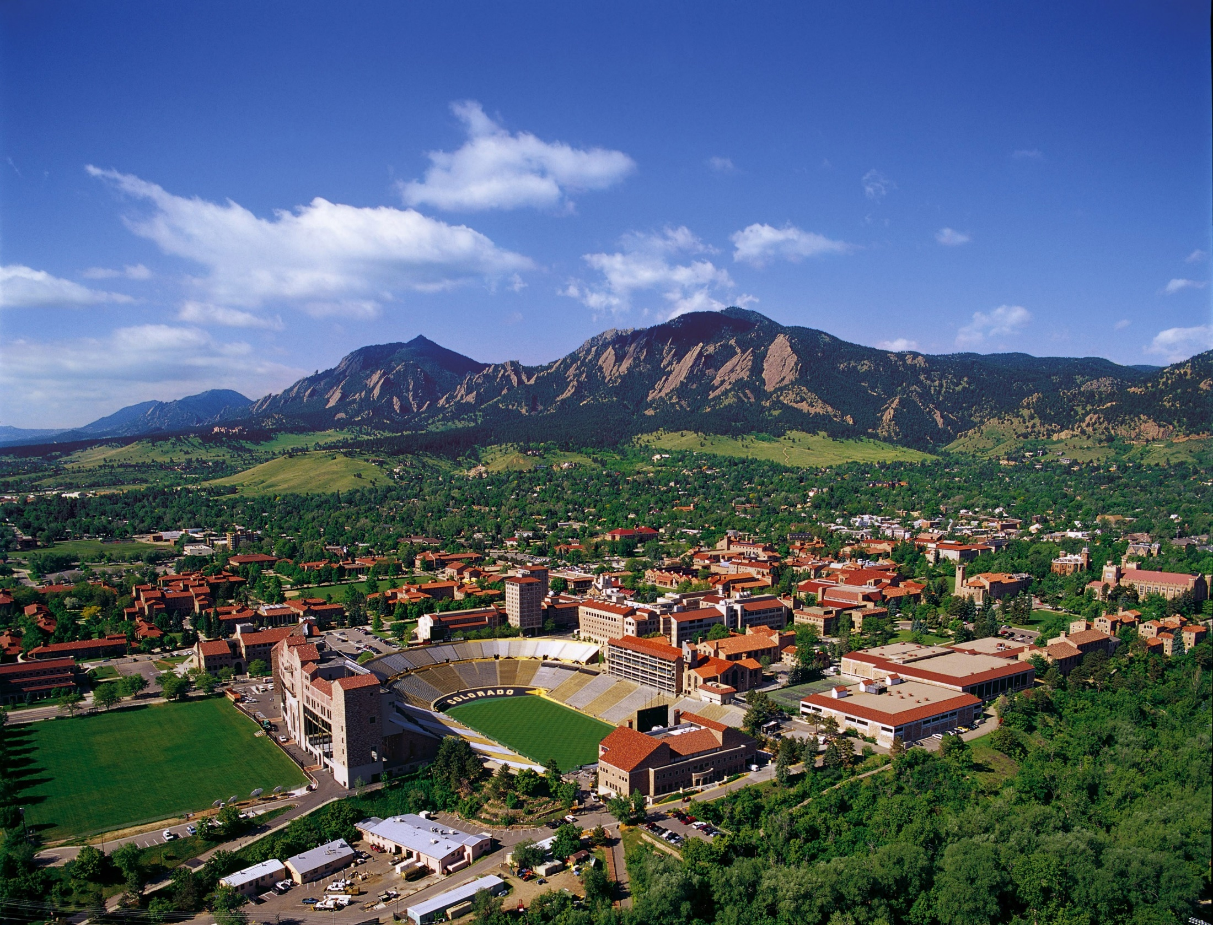
Thanks! Glad to be in Boulder!
Questions?
Chair: Senthil Kumar, senthil@iirs.gov.in
Vice Chair: Nancy.D.Searby@nasa.gov
Secretariat: hilcea@dpi.inpe.br

