Slide 1

5.1 Feasibility Study on Satellite Missions/Instruments Focused on Water Quality Measurements (For Information)
Committee on Earth Observation Satellites
CEOS Plenary 2017
Agenda Item 7.2
Rapid City, South Dakota, USA
19 – 20 October 2017

Slide 2

Status of the Feasibility Study
Report is in Final Draft thanks to the considerable efforts of the writing team:
              Arnold Dekker: Honorary Science Fellow - CSIRO
              Peter Gege - DLR
              Nicole Pinnel - DLR
              Xavier Briottet - France
              Steef W,M, Peters - Netherlands
              Sindy Sterckx - Belgium
              Kevin Turpie - NASA
              Claudia Giardino - Italy
              Elizabeth Botha - CSIRO
              Maycira Costa - Canada
              Martin Bergeron - CSA
              Nima Pahlevan - NASA
              Thomas Heege - Germany
              Andy Court - Netherlands
              Vittorio E. Brando - Italy

Slide 3
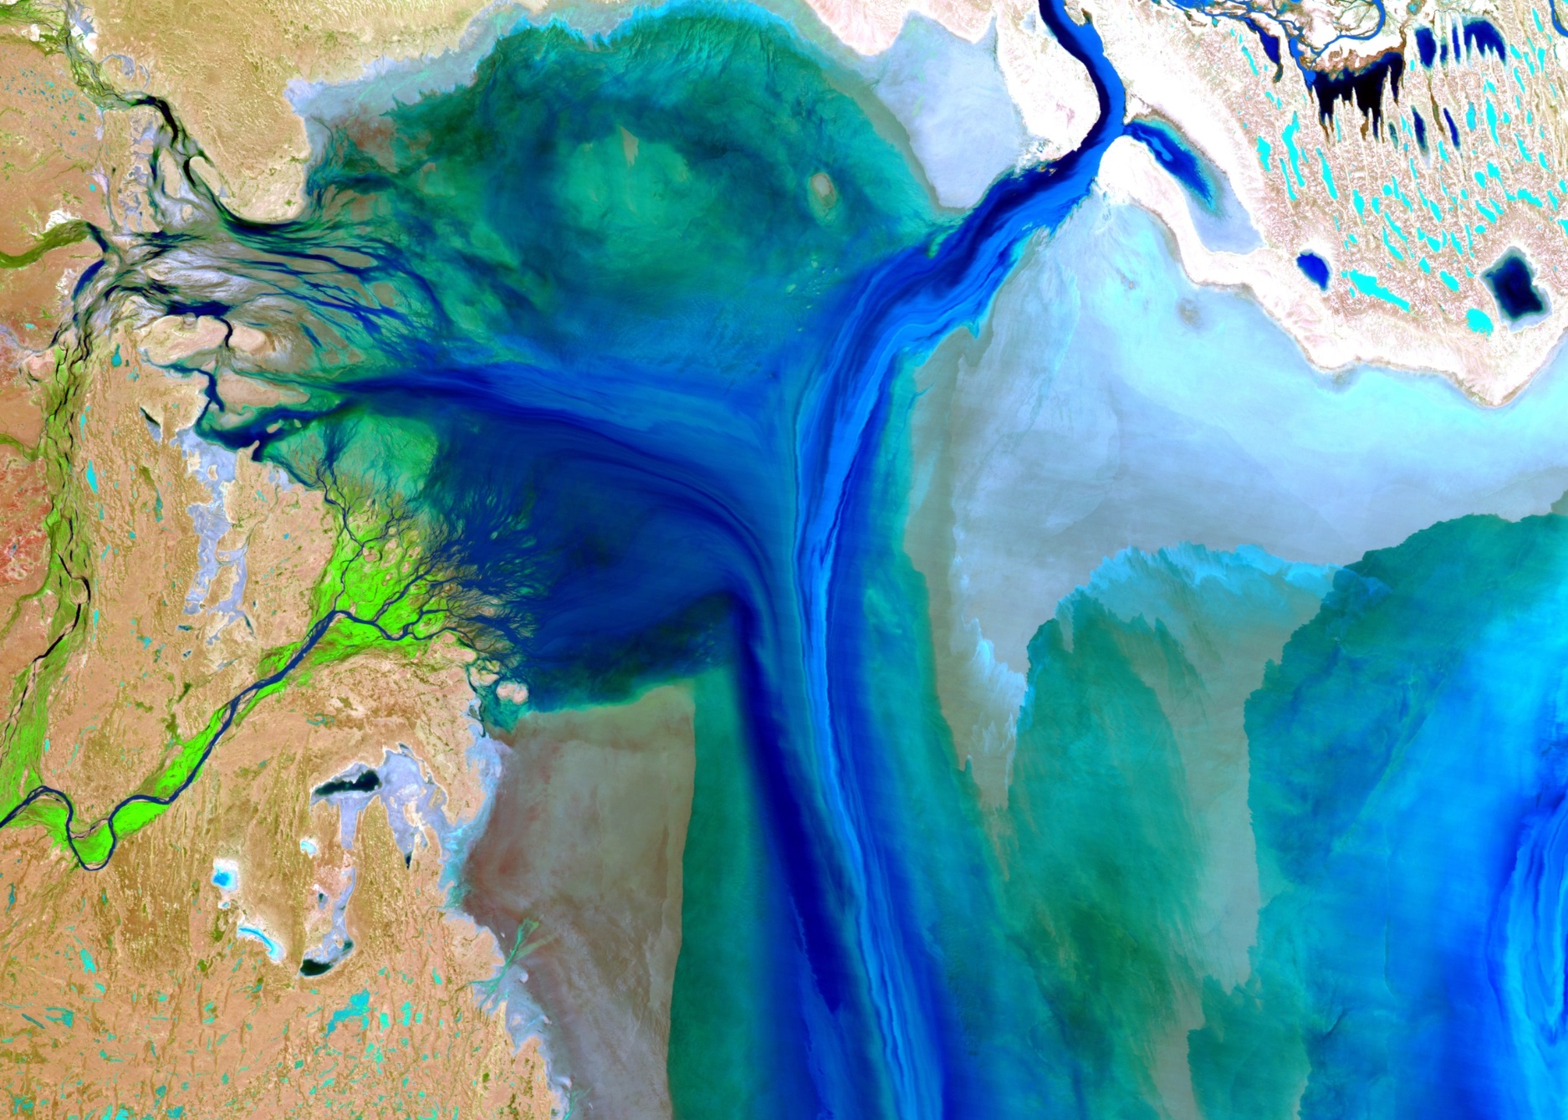
Salt lakes- not so simple
(Lake Eyre- Australia after floods)

Slide 4
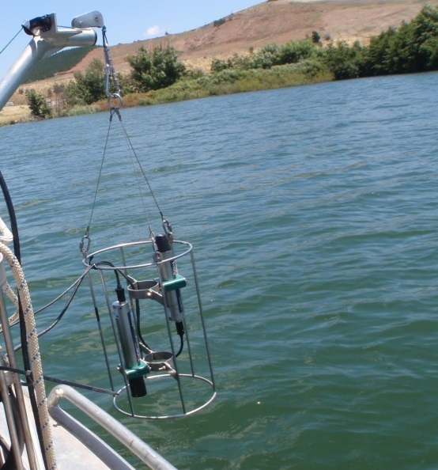
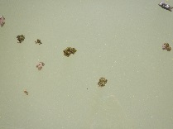


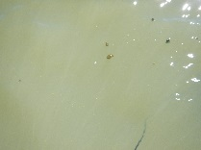
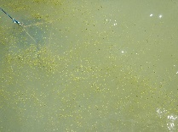

Inland waters: not so simple: land-water boundaries; lakes at -140 to 4500 m altitude
Reflectance

Slide 5
Feasibility Study Content
Background
Science and Applications Driving Sensor Specifications
  - Inland waters, wetlands, transition zones, shallow coastal ecosystems, shallow water bathymetry, air-water interface
Platform Requirements and Mission Design
  - considerations, instrument characteristics, cal/val
Aquatic Ecosystem Earth Observations Enabling Activities
  - Atmospheric and air-water interface corrections, estimation of aquatic variables from water leaving radiance, in-situ measurements for algorithm parameterization, Instrumentation protocols and data collection strategies
Summary of Recommendations
Appendices
  Science Traceability Matrix
  Sensitivity Analysis

Slide 6
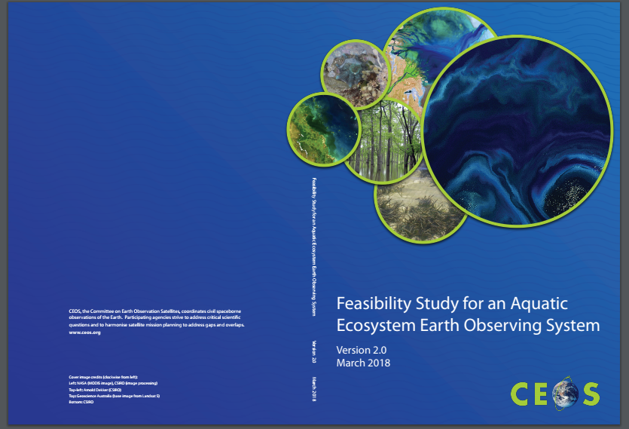
http://ceos.org/document_management/Publications/

Slide 7
Freshwater from Space
Observation Strategy
Committee on Earth Observation Satellites
CEOS SIT April 2018
Agenda Item 5.2
Boulder , Colorado USA
24 April - October 2018

Slide 8
Status
Contributions from CEOS CEO, CNES, CSIRO
Active involvement by StevenH, SelmaC and AlexH
Kick off Workshop May ’18 to capture current efforts in observations and data needs (postponed)
Offer from NL Space Agency to host at IHE Delft Institute for Water Education
Workshop-1 Agenda includes both EO data supply (current and planned) and also end-user community
Reached out to key end-users to provide input to strategy development

Slide 9
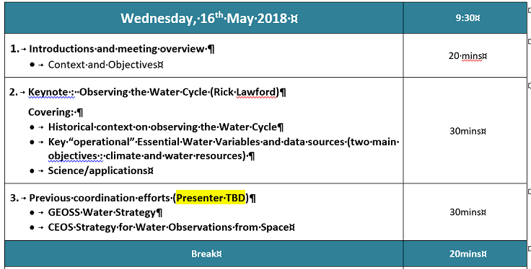
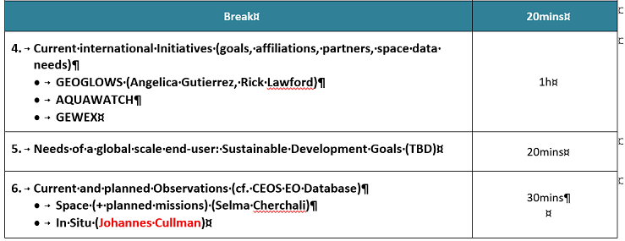
Agenda (1)

Slide 10
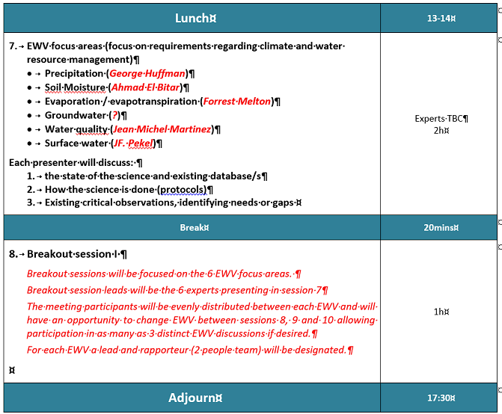
Agenda (2)

Slide 11
Agenda (3)

Slide 12
Next Steps
Postpone workshop to autumn 2018
Follow lessons and processes to build CEOS Carbon Strategy
Initial draft (with output from 1st workshop)
Draft for CEOS early 2019 (tbd) and links to GEO
2nd Consultation workshop mid-2019
Final Strategy Document CEOS Plenary 2019 (Vietnam)

