Slide 1
Future Data Architectures
Committee on Earth Observation Satellites
Nicolaus Hanowski, ESA, FDA AHT co-chair
Steve Labahn, USGS, FDA AHT co-chair
Alex Held, CSIRO, FDA AHT co-chair
CEOS SIT-33
Session and Agenda Item 6.2
Boulder, CO, USA
24 – 25 April 2018

Slide 2
Current CEOS Context
Currenmt CEOS Context
Focus:
FDA Big Data Workshop
26-April 2018
close cooperation of
CEOS chair EC-team
&
FDA leader team

Slide 3
FDA Outlook in October 2017
Analysis Ready Data
Focus on CEOS Analysis Ready Data for Land (CARD4L)
Interoperable Free and Open Tools
Focus on Data Cubes and particular the CEOS Open Data Cube Initiative
Data, Processing, Architecture Interface Standards
Focus on discovery, access, standards for Exploitation Platforms
User Metrics & EO Resources Analysis
Focus on qualitative and quantitative understanding of user engagement
Analytical Processing Capabilities
Focus on processing and analytics across Exploitation Platforms

Slide 4
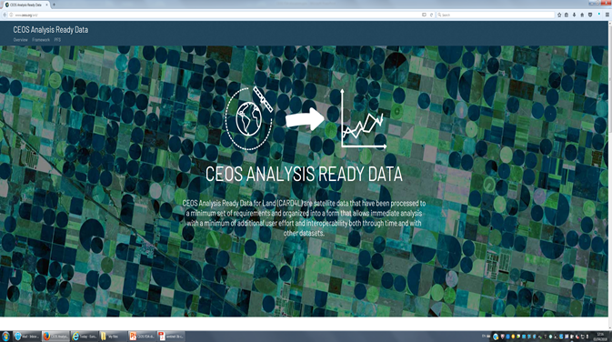
1. Analysis Ready Data (ARD)
& Interoperable Products
CARD4L Status
Product Family Specifications refined in discussion with expert users prior to LSI-VC#5 (February 2018, Tokyo).
3 Product Families:
surface reflectance
land surface temperature
radar backscatter
+ set of future activities
new webpage: www.ceos.org/ard/

Slide 5
1. Analysis Ready Data (ARD)
& Interoperable Products
Initiated activities
ESA and JAXA to complete a baseline SAR backscatter ARD PFS
JAXA to lead a SAR ARD subgroup tasked with discussing additional SAR ARD products (e.g. polarimetry, InSAR) and make recommendations to LSI-VC-6
Stock take for CARD4L projects planned
PFS should be stable once agreed, i.e. no frequent updates
CARD4L implementation to start: Looking for LSI-VC agencies to start piloting the assessment and production process over the coming months (e.g., JAXA on SAR, ESA on Surface Reflectance, USGS on Surface Temperature).

Slide 6
1. Analysis Ready Data (ARD)
& Interoperable Products
USGS-ESA pilot project addressing CARD4L implementation for surface reflectance based on complementarity of Landsat / Sentinel-2
Stepwise approach for ARD implementation for Sentinel-2 and Landsat including implementation steps, specification refinement and harmonised product approach
Short-term: coordinate technical specification for ARD implementation for Landsat, based on ESA's Sentinel-2 approach as 1st step toward harmonised product
Final aim: develop a harmonised product between USGS and ESA (long-term)
Several coordination actions were discussed in preparation for harmonisation
Share GRI (Global Reference Image) test data with USGS
DEM: potential common global procurement Europe and US?

Slide 7
1. Analysis Ready Data (ARD)
& Interoperable Products
Concept Proposal
RI
MRI
S2 Level 2 SR product
All available
products
Product family
S2 Level 2 SR product with general and pixel level metadata aligned with CARD4L PFS
Land surface
Temperature
Some of them
adhere to ARD
SAR
Surface
reflectance
ARD over LAND
= CARD4L
Harmonised
Products
S2 CARD4L SR product using harmonised geo/ atmospheric algorithms and references (e.g. HLS)

Slide 8
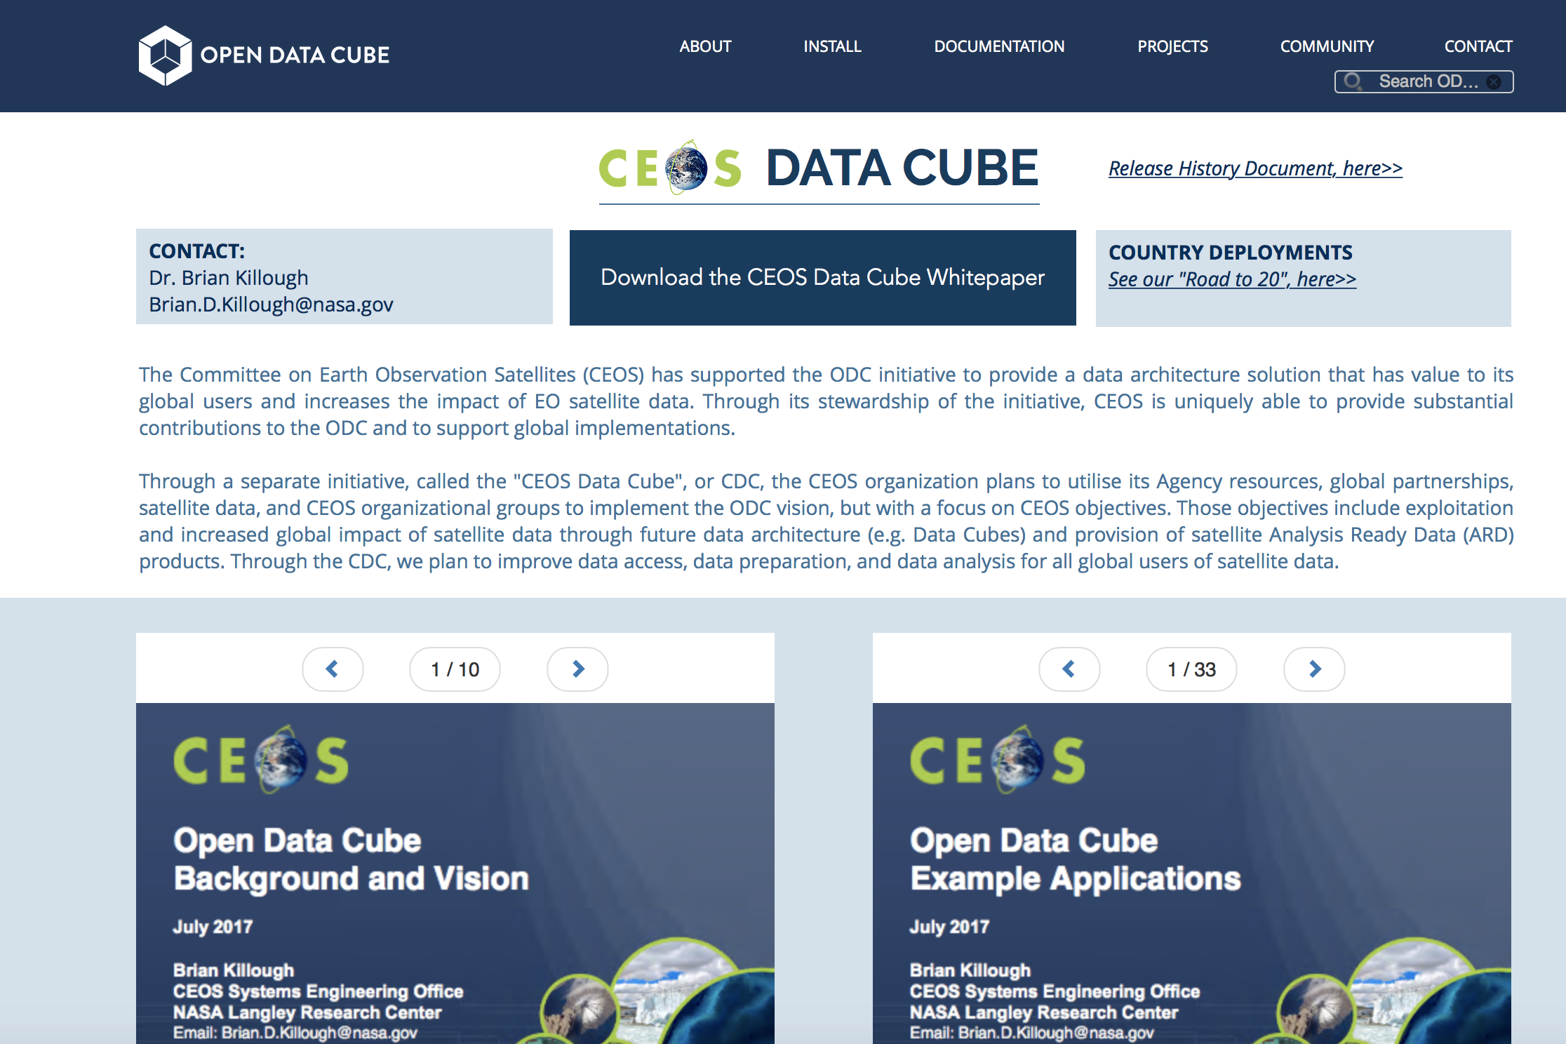
2. Interoperable Free & Open Tools
(→ Data Cubes)
40 Data Cubes referenced in the
CEOS Open Data Cube initaitive
Additional national and
institutional Data Cubes
Additional industrial Data Cubes
→ Data Cubes evolving quickly
Develop and maintain a web-based user interface to demonstrate Data Cube applications
Conduct pilot studies to test approaches and provide user feedback
Engage global stakeholder organizations (e.g. GEO, World Bank, SERVIR) to identify country needs and provide infrastructure and funds for implementation
Develop a group of globally distributed Python programmers who are able to support deployment and customer support

Slide 9
3. Data, Processing, Architecture Interfaces (→ Exploitation Platforms)
Past: Data-to-the-User - Future: User-to-the-Data
Utilise cloud-based architectures (with obvious advantages)
Develop IT-compatible representation
Identify the focal points of services and infrastructures
Highlight relationship between services and and infrastructures
Look at complete landscape: institutional – public - commercial
Services and infrastructures typically reach across layers
Users interact with various layers for various purposes
Identify standards which facilitate the linking of activities across layers

Slide 10
3. Data, Processing, Architecture Interfaces (→ Exploitation Platforms)
EO Data System: the past
… Mission Ground Segments make data available for download
… Users process the data in their own infrastructures

Slide 11
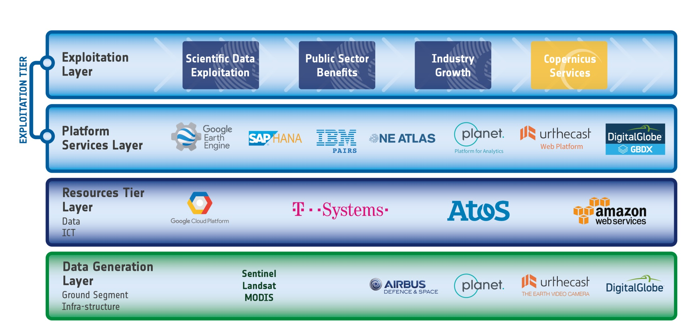
3. Data, Processing, Architecture Interfaces (→ Exploitation Platforms)
EO Data System: the present

Slide 12
3. Data, Processing, Architecture Interfaces (→ Exploitation Platforms)
Copernicus DIAS (Data & Info Access Service) becoming operational
What Can DIAS Do for CEOS?
Bring together multiple communities on one platform
Provide IT resources & makes available diverse/distinct data collections
Fill current institutional and commercial gaps
e.g. host Data Cubes
What Can CEOS Do for DIAS?
Provide feedback which can feed into their evolution
Contribute to better understanding the evolution of the EO ecosystem
Establish and spread the use of best practices in harnessing cloud computing for EO

Slide 13
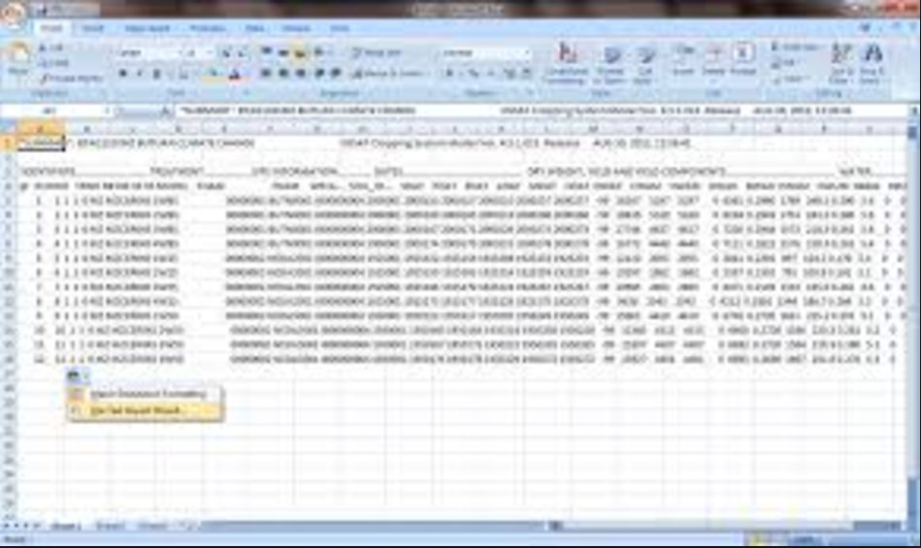
4. Earth EO Resources Analysis
and User Metrics
Two FDA deliverables in CEOS WP 2018-2020
FDA-9: Inventory and characterise existing FDAs operated by both public and private entities …
FDA-13: Develop a User Metrics Best Practice
EO resource inventory describing
Position in 4-layer model
Platform metrics (storage, compute, services, data collections)
User metrics (Nb active users, Data consumed/newly generated)
Financing/Governance model

Slide 14
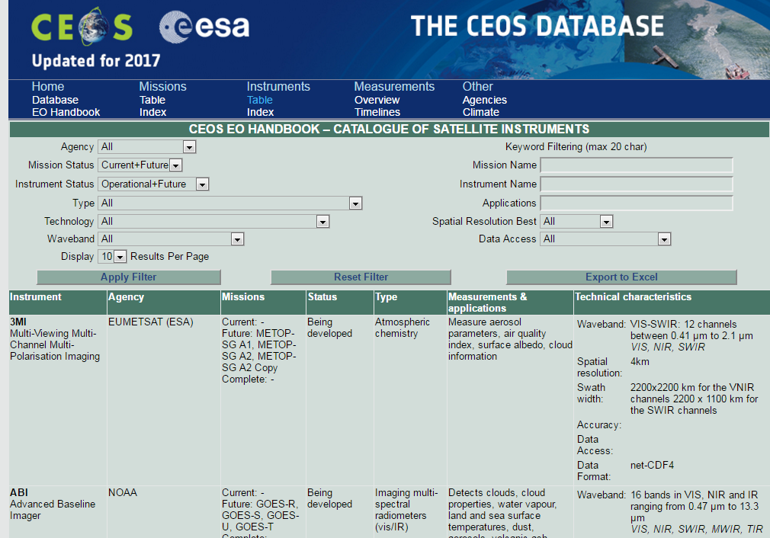
4. Earth EO Resources Analysis
and User Metrics
- Systematics need to be developed and refined
- Content needs to be collected and updated
550 satellite missions
900 corresponding instruments
Measurement classification
URL: http://database.eohandbook.com
Reference

Slide 15
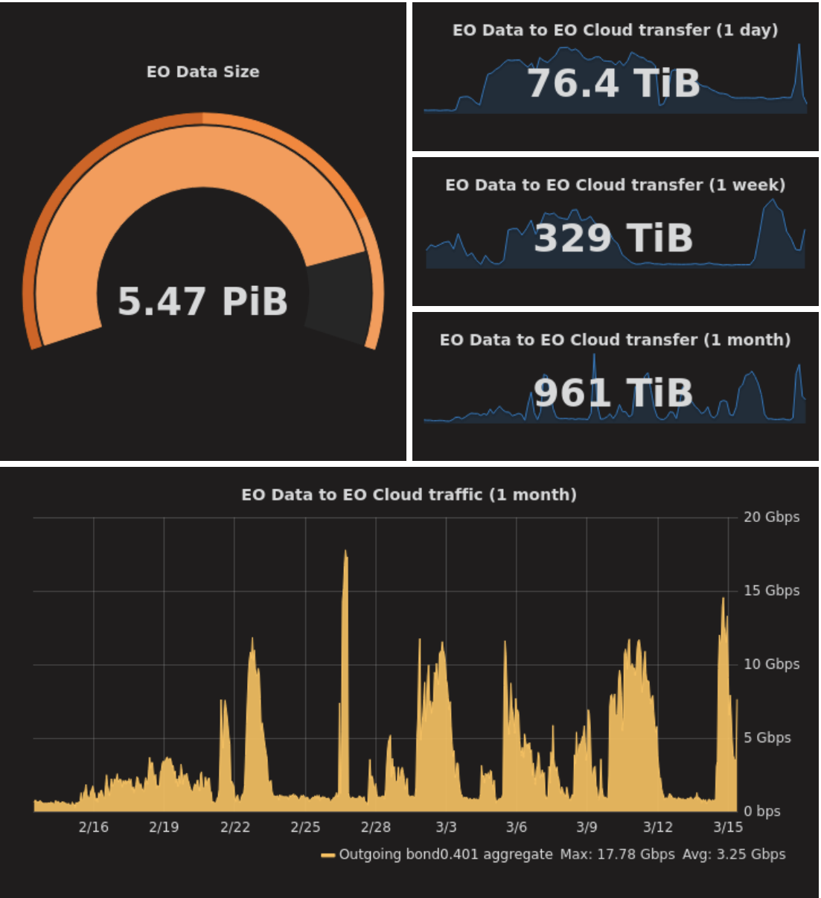
4. Earth EO Resources Analysis
and User Metrics
Motivation and Questions
Motivation behind taxonomy: find criteria which highlight differences between platforms
Will we get enough info ? Will we be able to maintain it ? Should it be exhaustive or indicative ?
Ideas are based on various precursor efforts and aimed at finding out how they contribute to the EO ecosystem.

Slide 16
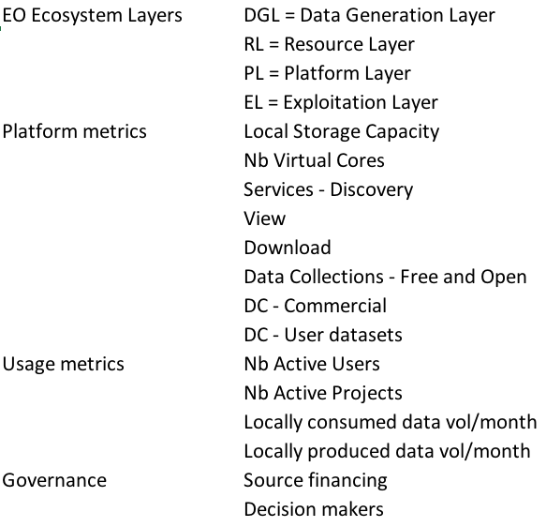
4. Earth EO Resources Analysis
and User Metrics
Basic principles
Cover a spectrum of criteria
Reflect different viewpoints
Be realistic
Be concise
Shed light on differences between efforts
Relation to CEOS
Most useful as a global effort as both data and cloud do not know national boundaries.
Help identify common approaches from agencies.

Slide 17
4. Earth EO Resources Analysis
and User Metrics
Examples:
Copernicus Data Dissemination Hubs – Data Generation Layer
Platform Metrics: 12 PB Storage, 300 Cores
Services: Discovery and Download
Active Users: ~ 4000 per week
Governance: public financing, public service
IPT Poland Platform – Resource Layer + Platform Layer
Platform Metrics: 6 PB Storage, 1800 Cores
Services: Discovery, View, Download, Processing
Active Users: ~ 3000 per week
Governance: public financing, commercial

Slide 18
4. Earth EO Resources Analysis
and User Metrics
Thematic Exploitation Platforms (TEPs) – Platform Layer + Exploitation Layer
Platform Metrics: As needed
Services: Discovery, View, Download, Processing
Data Collections: Free and Open, User Datasets
Active users: up to 70 (Geohazards TEP)
Locally generated data: up to 18.000 products per month (Food Security TEP)
Governance: public financing, semi-open

Slide 19
5. Data Analytics –
Analytical Processing
To be further developed as a CEOS FDA Topic.

