Slide 1

SIT Chair 2018-2019 Priorities and SIT-34 Objectives
Committee on Earth Observation Satellites
Steve Volz, CEOS SIT Chair
National Oceanic and Atmospheric Administration (NOAA)
CEOS SIT-34
Session 1, Agenda Item 1.5
Miami, FL, USA
3 – 4 April 2019

Slide 2
SIT Chair 2018-2019 Priorities

Slide 3
SIT Chair 2018-2019 Priorities
Ensure the efficient execution of existing SIT responsibilities as described in the SIT Terms of Reference, including addressing Working Group and Virtual Constellation (VC) continuity, sustainability, and outputs, including:
  Undertaking gap analyses for each VC, to support ongoing and likely upcoming strategic Agency observatory decisions;
  Seeking observations from VCs and WGs on best practices and possible modifications to existing practices.
Enhance the utility of new observations from next generation of geostationary satellites and exploring development of LEO/GEO combination products and data processing capabilities.

Slide 4
SIT Chair 2018-2019 Priorities
Improve and clarify CEOS relationships with CGMS, GEO, and to a lesser degree WMO, by identifying coordinated activities and, where appropriate, holistic interaction among CEOS, CGMS, GEO, and WMO, emphasizing the unique values of each.
  Identify and focus on areas of appropriate and productive collaboration.
  Take stock of trends and future directions so that CEOS can best serve the needs of its Agencies and execute its role most productively alongside CGMS, GEO, and WMO
  Identify appropriate and productive engagement approaches with commercial sector in the process.
Support initiatives undertaken by CEOS Chairs in 2018 and 2019.

Slide 5
SIT-34 Expectations and Objectives

Slide 6
Expectations
SIT-34 Objectives (slides to follow)
Continue those themes initiated at SIT-33 and pursued at both 2018 SIT Technical Workshop and 32nd CEOS Plenary in accordance with Strategic Directions and Partnerships for CEOS Discussion Paper – 21 March 2018 (slide to follow)
Concept Paper for Restructuring CEOS Virtual Constellations and Creation of a New Working Group Addendum to Discussion Paper (slides to follow)

Slide 7
SIT-34 Objective
Virtual Constellations
Critical assessment results of the Virtual Constellations (VCs), including:
Ongoing activities, tangible outputs, Constellation management, continuity, and VC proposals around leadership rotation (Plenary Action CEOS-32-12).
The results will lead to recommended changes to how CEOS structures its VC activities, engagement of CEOS through the VCs with partners such as GEO and CGMS, and how to evolve and take the next step towards greater interoperability between datasets from multiple satellites and agencies.
Identify areas of concern for further attention, action, and follow-up at SIT Technical Workshop and CEOS Plenary 2019, and into the next CEOS SIT Chair Term.

Slide 8
SIT-34 Objective
ad hoc Teams
Defining the way forward for existing ad hoc Teams (AHTs), including:
Consideration of options for continuity of CEOS activities in support of the Global Forest Observations Initiative (GFOI), GEO Global Agricultural Monitoring (GEOGLAM), and Sustainable Development Goals (SDG) (Plenary Actions CEOS-32-13 and CEOS-32-11).
Considering lessons learned from the trajectory of current and past AHTs, we will discuss a road map for future AHTs, including an initial two-year AHT cycle for start-up and evaluation.
For the AHT for SDGs, we will also determine if CEOS can focus on three or four SDGs/indicators that are most ready to use EO data.

Slide 9
SIT-34 Objective
LEO/GEO
Consider the progress of activities to enhance the utility of new observations from satellites exploring the development of LEO/GEO combined products and data processing capabilities (Plenary Actions CEOS-32-09 and CEOS-32-10).

Slide 10
SIT-34 Objective
CEOS Governance, Processes, and Organization
Drafting language to support potential changes to CEOS Governance, Processes, and organization resulting from discussions on VCs and AHTs and the formal processes CEOS will mandate for them.
Perform a health update on assessment of what is working well within CEOS and reflect upon CEOS internal issues such as structure, efficiency, number of entities and activities, resource allocation;
CEOS external issues such as communication, interaction with key stakeholders;
Strategy for global priorities like caring for our planet, SDGs, carbon, etc.
Consider proposals for further discussion at 2019 SIT TW, and possible recommendation for decision(s) at 33rd CEOS Plenary (Plenary Action CEOS-32-15).

Slide 11
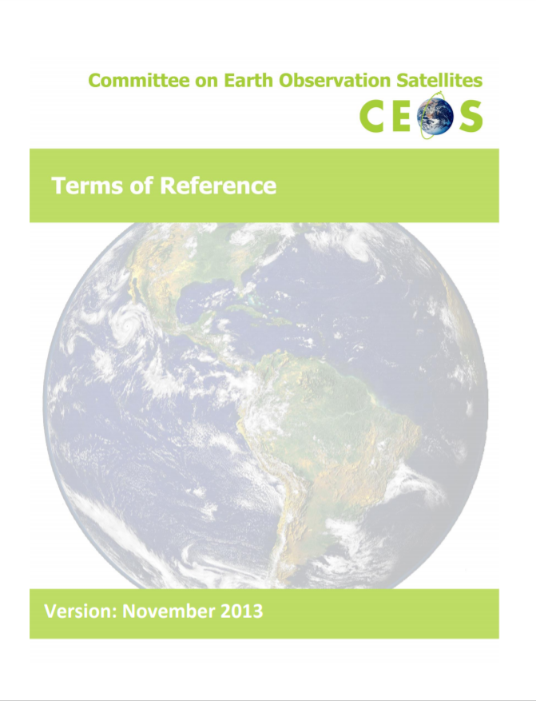
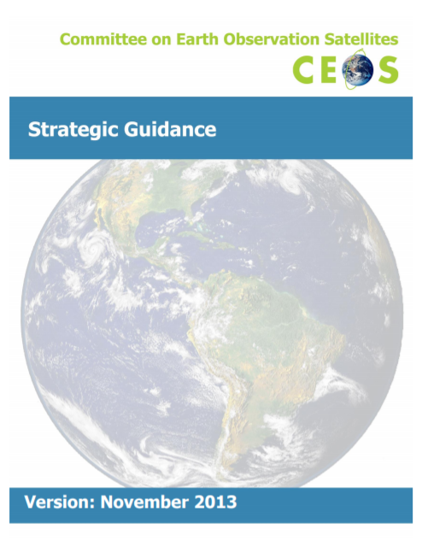
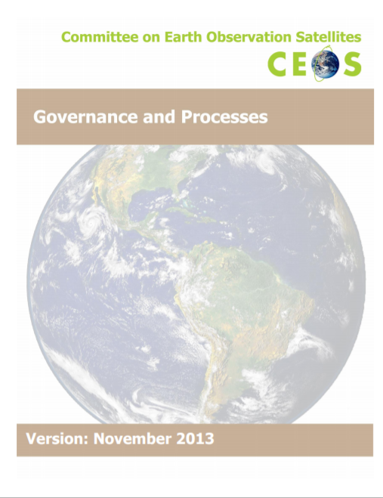
Strategic Guidance Reminder
Mission
CEOS ensures international coordination of civil space-based Earth observation programs and promotes exchange of data to optimize societal benefit and inform decision making for securing a prosperous and sustainable future for humankind.
Update
Proposed Changes in Session 7.4
Update
November 2013
November 2013
7-10 years
March 2019
3 years
November 2013
~5 years
Other governing documents:
Terms of Reference – CEOS Chair, Strategic Implementation Team (SIT) Chair, CEOS Secretariat, CEOS Executive Officer (CEO), CEOS Systems Engineering Office (SEO)
Process Papers – Working Group, Virtual Constellations, and New Initiatives

Slide 12
Strategic Directions and Partnerships for CEOS Discussion Paper
21 March 2018
  Ensuring tangible outcomes from, and sustainable commitment to, our VCs and WGs
  Maximizing the value of VC and WG output for CEOS objectives (e.g., ECVs and SDGs) and for individual CEOS Agency objectives
  Ensuring the necessary support for our existing thematic teams to flourish and to deliver
  Clearer overall CEOS observing system assessment and desired observing strategies – and known contribution from each CEOS Entity
  AHTs to reflect and report on group trajectory and lifecycle, taking into account the outlook and evolution of long-term sustained operations and expectations levied on CEOS and Member Agency participation.

Slide 13
Concept Paper for Restructuring CEOS Virtual Constellations and Creation of a New Working Group - 28 March 2019
Propose two concepts to evolve the CEOS organization and ensure CEOS continues to provide benefit to its members and remains relevant to our external partners and international community:
  Establish a new Working Group focused
  on Information Provision
  Consider broader, thematic-based Virtual Constellations organized around land, ocean, and
  atmosphere themes
Further Discussion in 2.4 and 7.3

Slide 14
SIT-34 Review of Agenda and Meeting Structure

Slide 15
SIT-34 Structure
Day 1 (Wednesday, April 3rd) is focused on revisiting the big picture of CEOS organizational matters, including sustainability and continuity of working-level capabilities, i.e., WGs, VCs, and deployment of AHTs; review of CEOS Work Planning and Partner activities; observations for end users; and consideration of ongoing alignment with progressing the 'Challenges, Opportunities, and Strategic Direction' outlined in Section 7 of the CEOS Strategic Guidance document.
Day 2 (Thursday, April 4th) will open with data-related matters, followed by consideration of oceans and freshwater, a revisit of the organizational matters discussion including confirmation of candidate and required updates to CEOS governance, review of the main discussion points, actions, and additional and any other business.

Slide 16
Day One
Organizational Matters – Part I Session (2)
Introduce a discussion on the sustainability of current CEOS working-level groups that progress the implementation of CEOS priorities and Strategic Directions, i.e. VCs, WGs, AHTs. Frame the discussion by reviewing current CEOS Work Planning, resource allocation, leadership continuity, and then consider the sustainability of current efforts. Carry out an initial discussion leading into substantive discussion afternoon of Day 2.
Partnerships Session (3)
Hear the latest directions from GEO, GCOS, WMO, and consider how CEOS engages with the Work Programme and GEO Week 2019 (Plenary, Ministerial). Updates on CEOS partner-related efforts GEO-LEO, and via the WGCapD.
Observations for End Users Session (4)
Review CEOS user engagement in the areas of climate, disasters, agriculture, forests, and the SDGs. Look for common elements and determine if there is a sustained approach to meet user needs with existing organizational structure. If not possible to meet user needs with current construct, do we propose another?

Slide 17
Day Two
Data Session (5)
Hear the latest on WGISS activities (including progression of Future Data Architecture themes), WGCV, and review progress on ARD both within LSI-VC, and in CEOS more broadly.
Oceans and Water Cycle Session (6)
Hear the latest on CEOS Ocean VCs and consider how to stimulate collaborative activity amongst these VCs. Review plans for freshwater monitoring, including SIT Vice Chair’s plans for related activities. Refer to updated strategy paper for how Ocean VCs can engage in this session.
Organizational Matters – Part II Session (7)
Revisit discussion around sustainability of CEOS working-level efforts, structures, governance, effectiveness in addressing Strategic Directions. Identify actions to take the next steps, including candidate and required updates to governance and processes. This session is the most important session of SIT-34 and expectation that Principals or their proxies will be present.

Slide 18
Agenda
Changes to Agenda
Session 8 – AOB Items
Adopt the Agenda

