Slide 1
A Revisit of CEOS Agency Data Policies
CEOS SIT-34 Meeting
Session 7.2
Coconut Grove, Miami, FL, USA
April 3-4, 2019
Brian Killough
CEOS Systems Engineering Office
NASA Langley Research Center

Slide 2
CEOS Data Policy Summary
CEOS Mission Statement .... CEOS ensures international coordination of civil space-based Earth observation programs and promotes exchange of data to optimize societal benefit and inform decision making for securing a prosperous and sustainable future humankind.
CEOS Strategic Guidance Document ... CEOS desires to provide and share high-quality data ... on a full and open basis, and in accordance with the principles of Data Democracy as enunciated by CEOS at its 2010 Plenary in Rio de Janeiro.

Slide 3
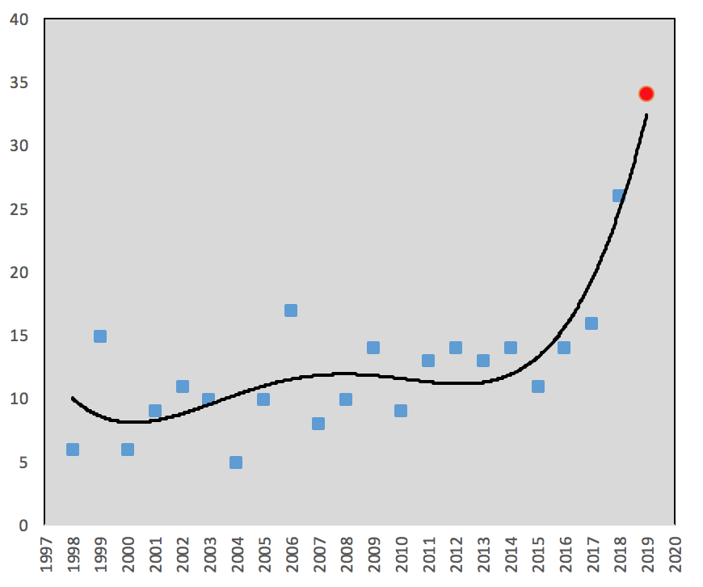
CEOS Data Policy Status
CEOS has 169 missions and 425 instruments in operation!
275 instruments have an an open data policy (65%) and 150 instruments (35%) have restricted or unknown data policies.
Data policies for all CEOS missions and instruments can be found at: www.ceos-datapolicy.org
CEOS mission launches over the last 20 years. A large increase in mission launches was seen in 2018 and many more are expected in 2019.

Slide 4
26 New CEOS Missions in 2018!
China: HY-1C, HY-2B, FY-2H, GF-5/6, Beijing-2 Russia: Kanopus V3/V4
NASA: GRACE-FO, ECOSTRESS, ICESat-2, GEDI NOAA: GOES-17 ESA/EC: Sentinel-3B, ADM-Aeolus EUMETSAT/NOAA/CNES/ESA: Metop-C
JAXA: GOSAT-2 CONAE/ASI: SAOCOM-1A
CNES: CFOsat CDTI: Ingenio KARI: KOMPSAT-2A
DLR: DESIS-ISS ISRO: Cartosat-2F, HYSIS UKSA: NovaSAR UAE: KhalifaSat

Slide 5
34 New Satellites in 2019 ?
India (ISRO): 7 missions
Russia: 7 missions
China: 5 missions
Canada (CSA): 3 satellites (RCM)
Italy (ASI): 3 missions
Korea (KARI): 2 missions
Brazil (INPE): 2 missions
USA (NASA): 2 missions
Argentina (CONAE): 1 mission
Vietnam (VAST): 1 mission
Spain (CDTI): 1 mission

Slide 6
The Future ...
Free and open data is a core mission of CEOS and its data is providing benefits around the world.
In addition to fully open datasets, CEOS has released many datasets that were previously restricted or commercially operated. These include SPOT 1-5, Radarsat-1, ALOS PALSAR Mosaics.
There are many other non-open CEOS datasets from past archives that could be of high value to the global user community (e.g. JAXA, CNES, DLR, ASI, ISRO, CNSA, CSA).
CEOS Agencies should consider release of archived satellite data (over a given age) as these data are a "public good" and may be useful for time series applications and calibration-validation activities.

