Slide 1

Sustainable Development Goals (SDG)
Committee on Earth Observation Satellites
Dr A. Held, CSIRO, SIT Co-Chair,
With contributions of SDG AHT members
CEOS SIT-35
Virtual Meeting
25 – 26 March 2020
#1.3

Slide 2
CEOS and SDG: current status and strategy
SDG Session Introduction
  Why CEOS involvement in the 2030 Agenda on Sustainable Development is needed?
  What has been achieved since the creation of the SDG AHT (Nov 2016)?
  What is the rationale for CEOS actions on 3 specific SDG indicators
  Proposed CEOS deliverables matching the GEO SDG Toolkits needs:
    EO enabling Infrastructures
    EO Good Practice Guidance
    Satellite Data Supply Analysis and Strategy
  Options for the future of CEOS activities on SDGs (starting in 2021)
Tour de Table Talking Points
SDG AHT activities status
Notes:
Indicators: (water-related ecosystems, land degradation neutrality and land use efficiency)
+ looking at others (ocean eutrophication and agriculture addressed by other CEOS bodies)

Slide 3
Why is CEOS in the SDG business?
UN landmark agreements at global level
one of the main global agendas,
one of the 3 GEO priorities (SDGs, Paris Agreement and Sendai Framework).
CEOS role on sustainable development
To overcome inequality between countries (data access),
CEOS acts as a “Space Enabler for the SDGs” in partnership with GEO, promoting the use of global, open, free and sustained satellite data into national SDG monitoring systems, and supporting countries measuring progress towards the SDG Targets and reporting on the SDG Indicators.
Data Supply Analysis and Strategy (draft being reviewed by AHT)
List of core missions available to support SDG
CEOS support to the SDGs, a public duty
CEOS Agencies are required to demonstrate social and environmental benefits of publicly funded satellite observing systems, especially global and free satellite data sets.
Notes:
Overcome inequality: the UN is advocating for a “mobilization of the big data revolution” for the benefits of all, promoting the use of multiple data sources, including geospatial and satellite information.

Slide 4



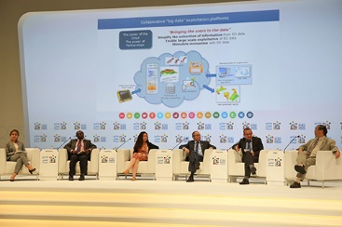
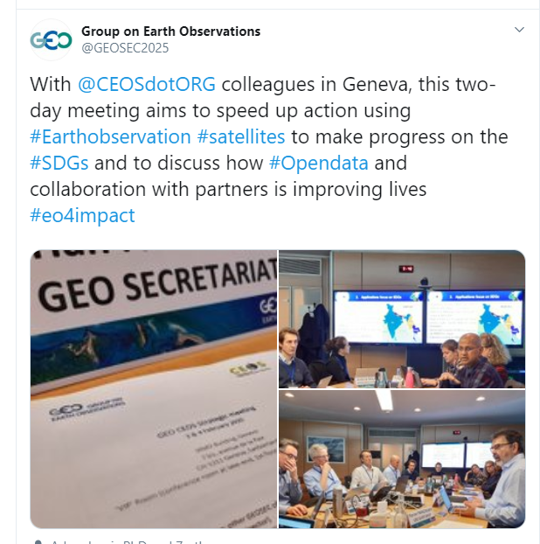
What has been achieved
by the SDG-AHT?
          CEOS publications on SDGs
                EO Handbook on SDGs - March 2018, at the 49th Session of the UN Statistical Commission, during the “Statistical-Geospatial Integration Forum”
          CEOS participation to high level fora on SDGs
                2018 UN High Level Political Forum (HLPF) on sustainable development “Transformation towards sustainable and resilient societies”.
                HLPF side-event on the use of Earth observations for SDGs.
          CEOS animation of EO community on SDGs
                RSE Special Issue on “Earth Observation for the Sustainable
                Development Goals” (UNSW, CSIRO, NASA, GEO) – final editing phase
                RS Special Issue on "EO Solutions to Support Countries
                Implementing the SDGs” (ITC, ESA, NASA, SANSA) – call for papers
          CEOS recognition by the UN governance system on SDGs
            Represented at the IAEG-SDGs WG on Geospatial Information (WGGI)
            Acting at technical events/panels on SDGs (including 2019 GEO Ministerial side-event)
          And CEOS active support to GEO (via EO4SDG but not only): our focus since the last Plenary…
Notes:
CEOS Handbook on SDGs very well received.
Thanks SYMBIOS for their outstanding work.
HLPF
The High-Level Political Forum on Sustainable Development took place in July, in NYC, at the UN headquarters.
The Forum included a Ministerial level meeting, with a central theme "Transformation towards sustainable and resilient societies".
The HLPF was also the opportunity to review progress towards the SDGs and focus in particular on 5 goals: (6 – water sanitation; 7- energy; 11-sustainable cities; 12- sustainable consumption; 15- life on land; 17 – partnerships)
This year, Australia was one of the countries reporting to the UN with its Volunteer National Review report, including Digital Earth Australia and Open Data Cube projects using and promoting satellite data.
Recognising its importance, the Australian Government organised a special side-event around Earth observation and SDG.
With the participation of GEO and CEOS agencies. But also GPSDD, Australia (DEA and Open Data Cube), Canada, Greece, Namibia, Switzerland, Viet Nam
The panel discussion followed by two hands-on workshops were designed to inspire more governments and organisations to take action on using Earth observation, while providing them with the necessary knowledge on how and where to start.
Australia is and will be even more instrumental to bring forward GEO and CEOS work on SDGs with the upcoming GEO Ministerial in Australia in 2019.
Special Issues
Scientific papers are essential especially for the collection of EO best practices and the development of a EO knowledge hub for SDG, which is one of the objective of GEO.
CEOS Compendium
Ongoing but existing doc

Slide 5
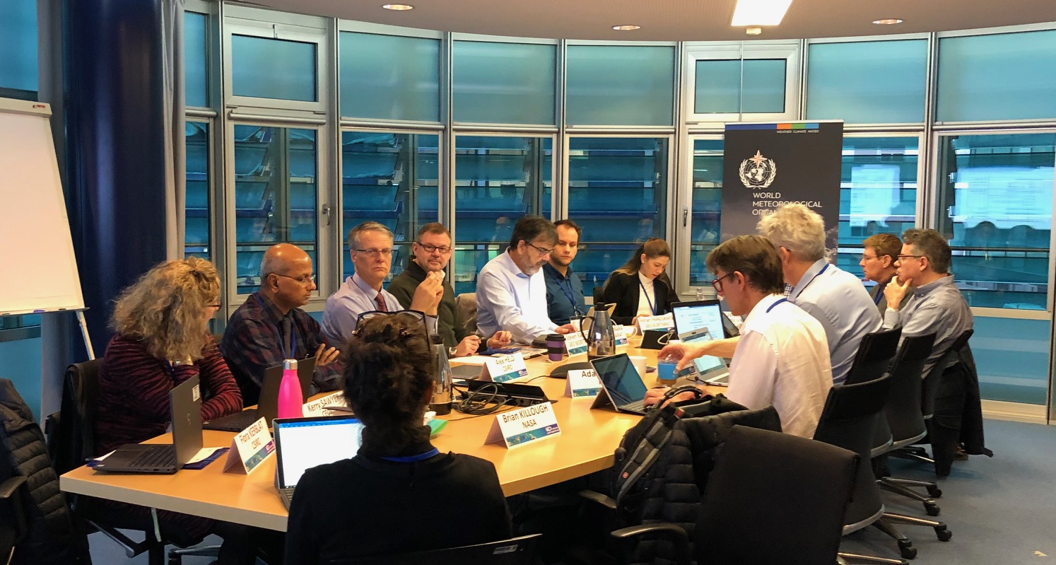
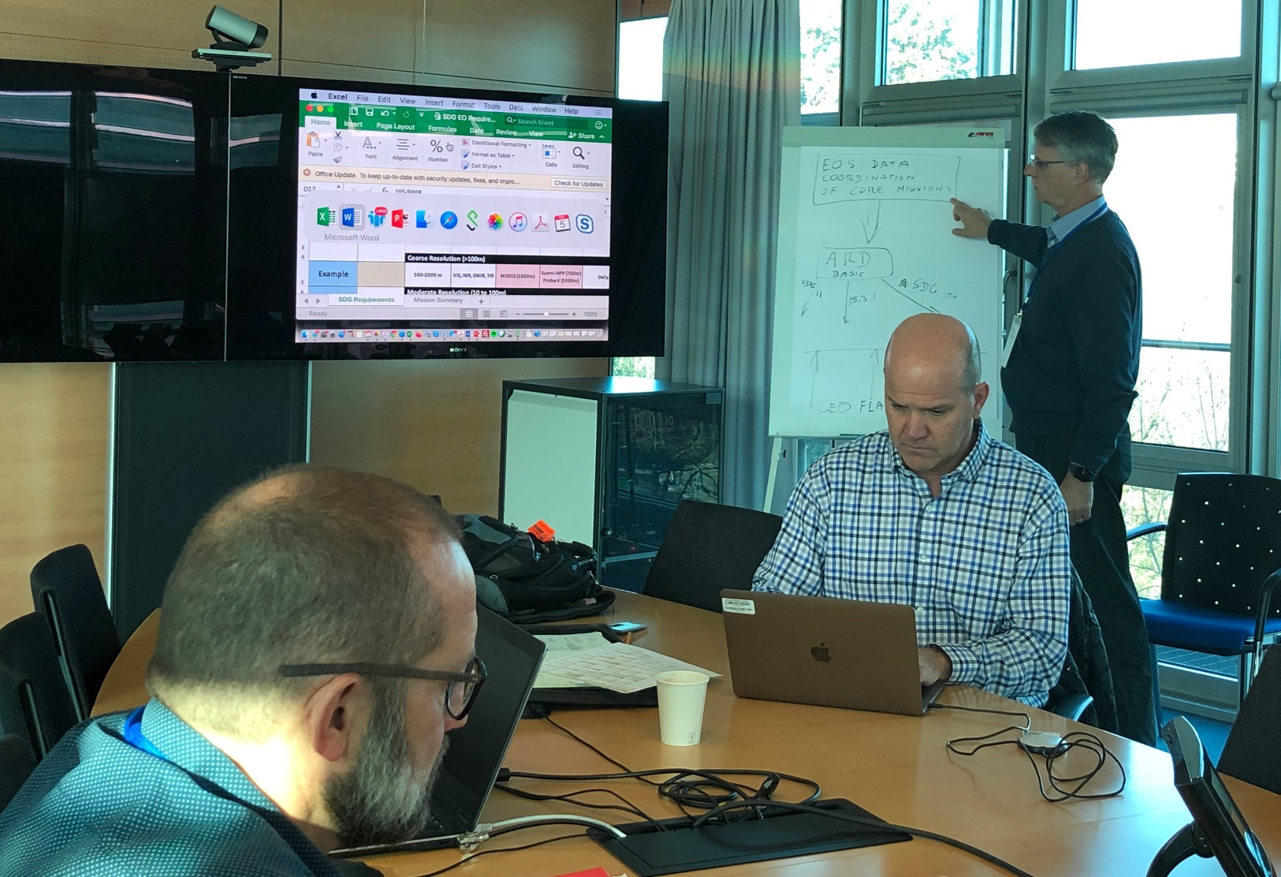
SDG activities status
(more in next presentation)
Increased collaboration with GEO
Capacity building and communication activities
Active support to EO4SDG to conceptualise GEO SDG Toolkits and Federated approach (CEOS coordinated response to Concept Notes)
Meeting in Geneva with GEOSEC (early February)
SDG satellite data requirements table
List of CEOS core missions in support of SDG
  (global, open, free, sustained)
Simplified template drafted
First attempts to fill-in requirements
Recognising SDG as a CEOS cross-cutting activity
Enhanced coordination with other CEOS bodies:
  CEOS general communication and coordination (regular meetings)
  SEO (data requirements), WGISS, WGCapD

Slide 6





Streamlining CEOS activities on SDGs
SDG Indicators
  Starting with 3 SDG Indicators
    6.6.1 (water-related ecosystems)
    11.3.1 (sustainable urbanization)
    15.3.1 (land degradation neutrality)
  Why these 3?
    Need to focus on a limited number of SDG indicators
    “Start small, Think big”
    Indicators selected by UN IAEG-SDGs WGGI as primary for EO uptake
    “Use SDG channels to maximise Impact”
    EO recognised as data sources by UN custodian Agencies in the indicator monitoring guidelines “Build on proven EO technologies”
    More on their way…
    GEO Blue Planet/NOAA/EC for 14.1.1 on coastal eutrophication
    GEOGLAM/NASA for 2.4.1 on sustainable agriculture
    And more to come when matching CEOS Agencies’ interests
Notes:
More on their way: acknowledging tangible progress on other SDG indicators by other GEO activities and CEOS Agencies

Slide 7
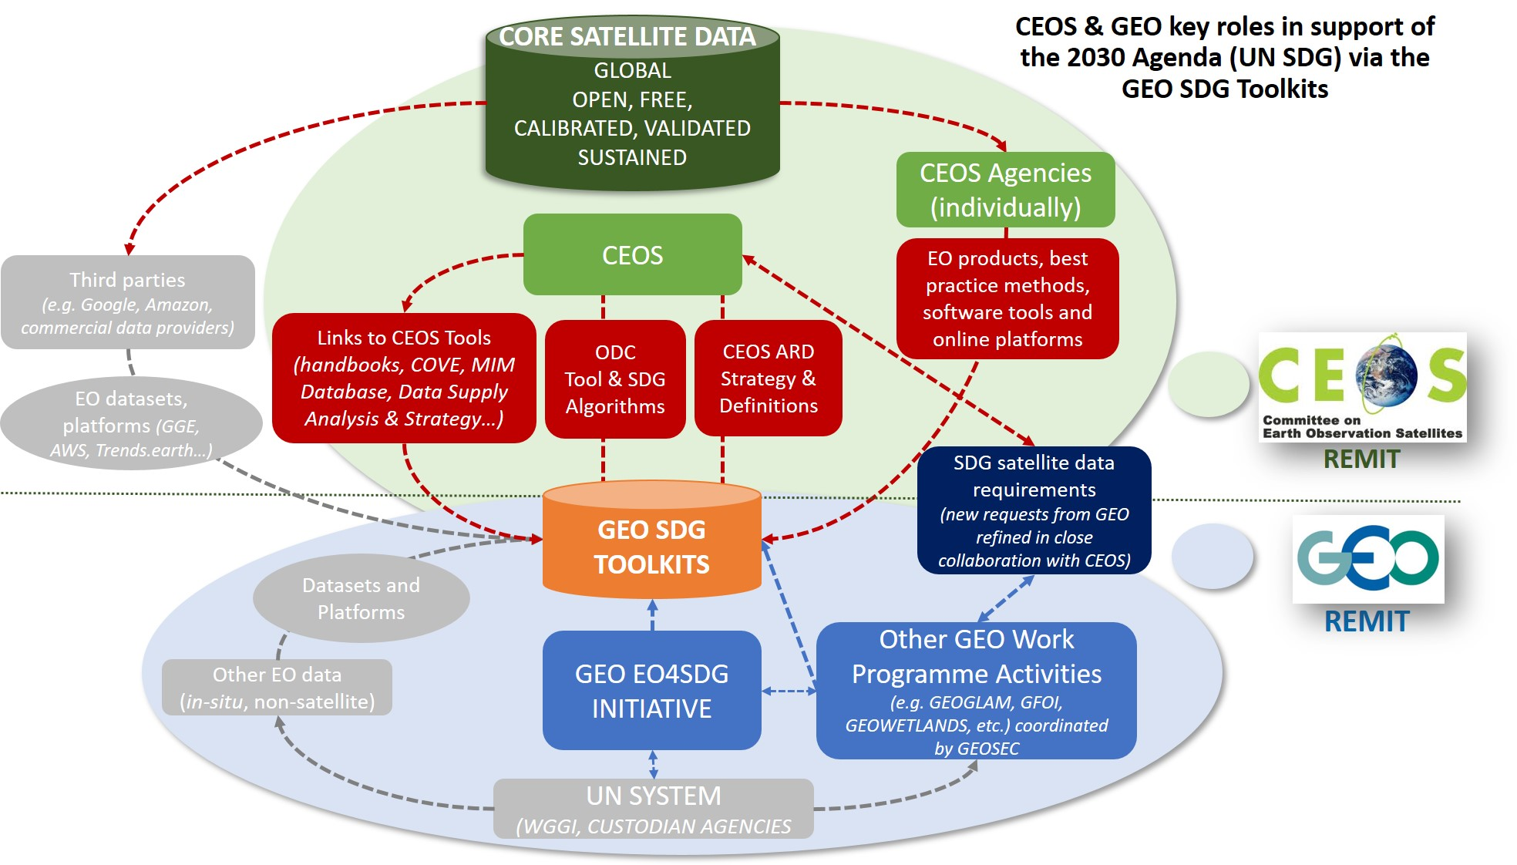
CEOS deliverables
matching GEO SDG Toolkits
Notes:
This reflects SDG AHT thoughts about our role (Focus on CEOS and Agencies) to support the GEO SDG Toolkits
You can note that it also matches our CEOS work plan deliverables
EO enabling Infrastructures for SDGs
E.g. Simple Tools (e.g. Python notebooks) made available on CEOS Open Data Cube (ODC) for easy use by countries.
EO Good Practice Guidance with UN Custodian Agencies
6.6.1: Global Surface Water Explorer (EC/JRC) and Global Mangrove Watch (JAXA) selected by UNEP as default data sets for supporting country monitoring their water-related ecosystems.
11.3.1: SDG 11 selected as the pilot case to design the GEO SDG Toolkits, in partnership with UN Habitat.
15.3.1: New Good Practice Guidance ((GPG) to be revisited in the next few months by GEO LDN, in partnership with UNCCD.
CEOS Data Supply Analysis and Strategy
Draft document available for information (CEOS website)

Slide 8
Tour de table
talking points
SPECIAL THANKS TO SDG AHT AGENCIES AND KEY CONTRIBUTORS
We are interested in….
Your views on the current status of CEOS activities on SDG, and GEO/CEOS roles:
  Adequate; not enough; well planned but hard to implement; increase your engagement with end-users community in GEO; etc.
Your perspective on Future CEOS support to SDG, beyond the Plenary, and suggest:
  Simply dismantle the activity (= no CEOS support to GEO)
  Continue with the AHT (= update AHT ToRs and governance documents)
  Streamline and add CEOS SDG activities into the SEO portfolio (= how, who, for what, how long?)
Your agency’s current and planned contributions
  Clarifications based on the previous scenario
Notes:
We would like to thank and acknowledge CEOS Agencies and individuals who have been helping us in this challenging mission in particular Marc P. from ESA, Brian K, Argie and Lawrence from NASA, Neil and Flora from CSIRO, Chu from JAXA, and others from CSA, SANSA, CNES)

Slide 9
SDG AHT
Background and Context

Slide 10
CEOS Plenary 33 Decision
(October 2019)
The CEOS SDG-AHT invites the CEOS Principals at the CEOS 33rd Plenary:
to approve the renewal of an additional and final year of extension to the CEOS Ad-Hoc Team on SDGs.
to express their support to the implementation of the new CEOS 2020-2021 Workplan on SDGs, which was provided for information, and indicate the level of resources they are ready to assign on the CEOS work plan activities related to the three SDG indicators proposed at SIT-34 (Water related Ecosystems, Sustainable Urbanization, Land Degradation Neutrality)
to designate CEOS Agencies’ staff who can participate to the AHT sub-teams as leads or contributors.
to consider the possibility to designate new co-leads of the SDG-AHT for the upcoming year, in agreement with the AHT leadership rotation of the SDG-AHT Terms of Reference.
Minutes of the 33° CEOS Plenary
15-16 October 2019, Hanoi. Vietnam
10

Slide 11
What has been achieved?
          CEOS publications on SDGs
                CEOS EO Handbook on SDGs officially released in March 2018, at the 49th Session of the UN Statistical Commission, during the “Statistical-Geospatial Integration Forum”
                Very well received by the SDG community; High visibility for CEOS
          CEOS participation to high level fora on SDGs
                CEOS participated to the 2018 UN High Level Political Forum (HLPF) on sustainable development “Transformation towards sustainable and resilient societies”.
                CEOS organised with Australia a HLPF side-event on the use of Earth observations for SDGs.
          CEOS animation of EO community on SDGs
                RSE Special Issue on “Earth Observation for the Sustainable
                Development Goals” (UNSW, CSIRO, NASA, GEO) – editing phase
                RS Special Issue on "EO Solutions to Support Countries
                Implementing the SDGs” (ITC, ESA, NASA, SANSA) – call for papers
          CEOS recognition by the UN governance system on SDGs
            CEOS represented in the IAEG-SDGs Working Group on Geospatial Information (WGGI).
            CEOS participation to UN technical events/panels on SDGs.
Notes:
CEOS Handbook on SDGs very well received.
Thanks SYMBIOS for their outstanding work.
HLPF
The High-Level Political Forum on Sustainable Development took place in July, in NYC, at the UN headquarters.
The Forum included a Ministerial level meeting, with a central theme "Transformation towards sustainable and resilient societies".
The HLPF was also the opportunity to review progress towards the SDGs and focus in particular on 5 goals: (6 – water sanitation; 7- energy; 11-sustainable cities; 12- sustainable consumption; 15- life on land; 17 – partnerships)
This year, Australia was one of the countries reporting to the UN with its Volunteer National Review report, including Digital Earth Australia and Open Data Cube projects using and promoting satellite data.
Recognising its importance, the Australian Government organised a special side-event around Earth observation and SDG.
With the participation of GEO and CEOS agencies. But also GPSDD, Australia (DEA and Open Data Cube), Canada, Greece, Namibia, Switzerland, Viet Nam
The panel discussion followed by two hands-on workshops were designed to inspire more governments and organisations to take action on using Earth observation, while providing them with the necessary knowledge on how and where to start.
Australia is and will be even more instrumental to bring forward GEO and CEOS work on SDGs with the upcoming GEO Ministerial in Australia in 2019.
Special Issues
Scientific papers are essential especially for the collection of EO best practices and the development of a EO knowledge hub for SDG, which is one of the objective of GEO.
CEOS Compendium
Ongoing but existing doc

