Slide 1
Working Team Status & Engagement
Day 2, Session 3.3
Committee on Earth Observation Satellites
SIT-35 Virtual Meeting
25-26 March, 2020

Slide 2
Working teams … what are they?
The Working Teams are ‘engine rooms’ of CEOS activity:
Working Groups
Virtual Constellations
Ad-Hoc Teams
Why this term?
Avoid confusion
The term ‘CEOS Entity’ refers to a broader group, including CEOS Agencies, CEOS Exec Officer, CEOS Systems Engineering Office
Add comments and questions on sli.do (#ceos-sit-35) at any time in the session

Slide 3
Reminder - SIT term approach
Major meetings:
SIT meetings: focused on Principals and strategic directions/issues
Key to have Working Teams in the room to speak up and ensure Principals have informed discussions
SIT TW meetings: reporting & interaction with CEOS working teams; preparation for the Plenary guided by CEOS Chair
All Hands calls for Working Teams 3-4 in each calendar year to share activities and identify opportunities for cross-Working Team cooperation (next 19 May)
Consult directly with VCs
informal, off-the-record, telcons with VC leads (next early June)
focus on identifying and address their problems and needs
CEOS Working Teams Day prior to SIT TW
Supporting and facilitating the Working Teams: their day
Will continue to reflect and learn from the experience
Add comments and questions on sli.do (#ceos-sit-35) at any time in the session

Slide 4
Informal VC call series #1
Building on all the significant contact hours of previous SIT Chairs
4 - 19 December 2019, calls between all 7 VCs and CSIRO-GA Team
SIT Chair Team members present to encourage frank, informal, detailed exchange
We think this approach worked well
Several practical and several strategic issues addressed
Key outcome: General representation of VCs in CEOS WP improved

Slide 5
Informal VC call series #1 (in time order)
SST-VC:
Spring clean of CEOS WP representation
Confirmed new White Paper as defining strategy for next decade of SST coordination
Good on funding, membership & direction
LSI-VC:
New interoperability terminology document - a very “CEOS” activity
Playing key role in engaging industry on ARD via CARD4L
Seeking agency participation in Sep Industry Workshop
Good representation
AC-VC:
Spring clean of CEOS WP representation
Practical support in navigating JAXA sponsorship of new NIES co-lead
Well managed and directed and with an eye on succession planning

Slide 6
Informal VC call series #1 (in time order)
OSVW-VC:
Critical mass of effort really sits outside CEOS in IOVW Science Team
Vision for an OSVW Constellation (VC-14) is being developed through IOVWST
CEOS team and identity not very active?
OCR-VC:
Active but would welcome Principal understanding and support
Improved CEOS WP representation
Keen to contribute to Ocean Carbon Roadmap should CEOS go that way
Interested in future GHG & Ocean Carbon workshop
OST-VC:
Some churn in leadership
Critical mass of effort mainly sits outside CEOS in OST Science Team
VC-43: Update of CEOS OST-VC User Reqts Document provides new strategy

Slide 7
Informal VC call series #1 (in time order)
P-VC:
Strongly encouraged to have better representation in CEOS WP
Interest in a Strategy White Paper to strengthen framework for CEOS efforts
CEOS team and identity not very active
A ‘pitch’ on a future CEOS Precip Strategy had been proposed for SIT-35, but was unfortunately cut due to the shift to ‘virtual only’ - could generate momentum
(P-VC said they may upload materials to the SIT35 presentations folder - interested readers pls check and download)

Slide 8
Working Teams All-Hands Call #1
11 February 2020: an informal forum to share ideas, and discuss collaborations, between the Working Teams: Working Groups, Virtual Constellations, and Ad-Hoc Teams. This approach is experimental and feedback is welcome.
Agenda:
defined based on interest & feedback from Teams
meetings and process updates including Work Plan Deep Dive
focus topics requested by the Teams
Spatial Capacity Development Advisory Board (WGCapD)
CEOS-COAST (AHT, NOAA)
CEOS ARD (LSI-VC)
Open discussion
Based on the follow-up rate reported by Nancy, Paul and Steve from the focus topics we feel that the format worked well.
1.5 hour session seemed about right for 2 longer topics, 1 shorter topic, and open discussion time.

Slide 9
Working Conclusions
The informal, individual calls with the VCs were extremely productive at improving their CEOS WP representation and teasing out both tactical and strategic issues where they needed help
SIT Chair job to ensure this flows into appropriate processes and forums
The All-hands Working Team call was effective in improving awareness and communication across the structure and giving the Teams a sense of empowerment as to the CEOS agenda
As noted by NOAA during its SIT Chair Period, a key opportunity for CEOS is linking between and across Working Teams
SIT Chair will continue with both call series

Slide 10
Working Team Day at SIT TW
As advertised, we want the Working Teams to drive the agenda and formulate the objectives
Brainstorming, cross-communication
All Hands Call #2 will tease out early ideas
If the Working Teams “don’t want it”, they don’t have to have it
VIRTUAL?

Slide 11
chart is available for download on meeting website in high resolution

Slide 12
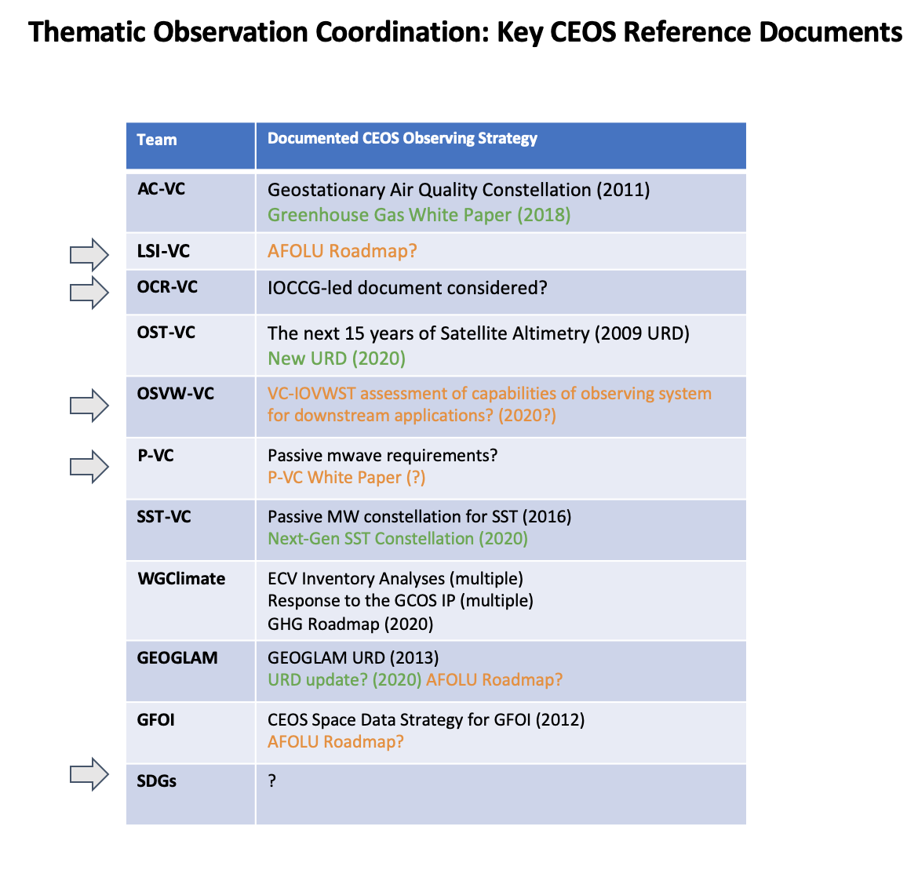

Slide 13
Strategy Documents
Where is our long term vision coming from?
2030 Agenda for Sustainable Development, Sendai Framework, Paris Agreement … yes at a stratospheric level
GEO Strategic Plan and Work Programme, etc … yes a bit more
But how do we link from these other worlds to ‘CEOS land’?
Do we need strategy ‘bridges’ to the CEOS Work Plan?
Strategy Documents are variable across the CEOS structure
Some decadal thematic strategies - supported by strong external communities
Some new strategies in consideration and emerging?
Some grand plans without strong ‘mandate’ and therefore limited follow up
One size likely doesn’t fit all - but scope for filling some gaps?

Slide 14
Interventions
< 25 minutes
Add comments and questions on sli.do (#ceos-sit-35) at any time in the session

