Slide 1
Precipitation Virtual Constellation
Committee on Earth Observation Satellites
Gail Skofronick-Jackson, NASA HQ
Riko Oki, EORC, JAXA
Chris Kidd, NASA/GSFC & UMD/ESSIC
CEOS SIT-35
3.3 Working Team Status and Engagement​
Hobart, Tasmania, Australia
25 – 26 March 2020

Slide 2
Organisation
Co-lead:
Gail Skofronick-Jackson, NASA HQ
Riko Oki, EORC, JAXA
(+ 1 co-lead vacancy)
The GPM mission is the fulfilment of the original P-VC vision: a real constellation!
More than just the satellite hardware, extensive interactions with the NASA Precipitation Measurement Missions Science Team community, extending to the International Precipitation Working Group (IPWG/CGMS).
P-VC science meetings:
Aim to provide 2 meetings per year, at the NASA Precipitation Measurement Mission workshop and one at the IPWG workshop (or virtual).
Current reports (completed or nearing):
GPM Senior Review (led by Scott Braun)
Constellation case (C.Kidd & G.Huffman) ¹
Precipitation assessment (IPWG/GEWEX)²
Special precipitation sessions at major national and international conferences
¹PVC-2020-01 ²PVC-2020-02

Slide 3
P-VC Goals
Main P-VC goals:
Maintain and enhance constellation
Integrate new satellites and sensors
Develop and refine retrieval schemes
Validate precipitation products
Support from CEOS for:
current missions, including continuation of precipitation-capable missions beyond end-of-life (where practical) and for mitigation strategies where necessary;
planned new missions (such as AMSR-3, CMIR, ACCP, etc);
development of a long-term strategy for a viable and sustainable precipitation constellation, including new technologies (next 20-30 years);
maintaining, expansion and exploitation of global ground validation (e.g. USA, Europe, S.Africa, S.America, Japan, S.Korea, India, Australia, etc) (which is generally unfunded).

Slide 4
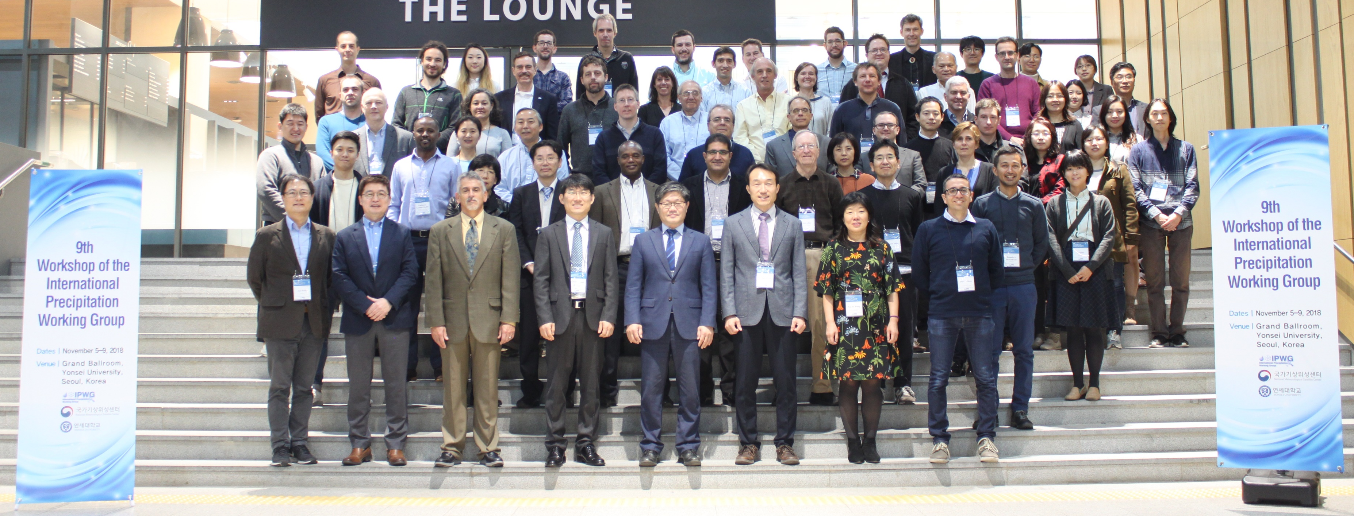
A thriving community!
GPM communications/outreach (last 3 years)³
Active web presence, social media, events, publications, visualizations, print/online materials, stakeholder and community engagement and innovative data access tools:
5.73 million people via online activities
34,500 people in person
66,000 page-views/mo. (GPM main page)
172,000 page-views/mo. (Education page)
53,000 followers on Facebook
28,000 followers on Twitter
50 lesson plans (K-12)
Application workshops
3D LEGO GPM spacecraft & hurricane model
International Precipitation Working Group (IPWG)³
Permanent Working Group of the Coordination Group for Meteorological Satellites (CGMS).
Focuses scientific community on operational and research satellite-based quantitative precipitation measurement, issues and challenges.
Formed in 2001, IPWG has 480 members from 52 countries & 5 international organisations.
Biennial meetings with student training sessions
³PVC-2020-3

Slide 5
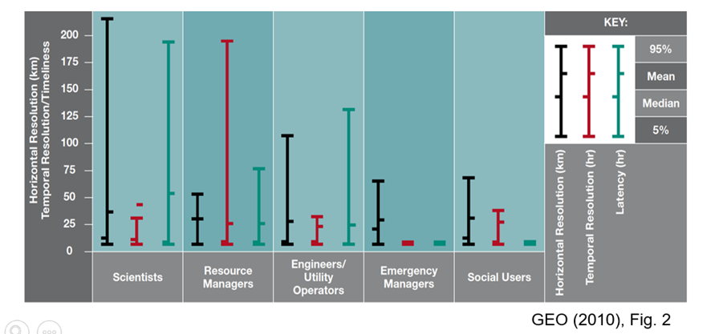
Precipitation user requirements
Wide range of users - wide range of requirements:
Spatial resolutions: 300 m to 50 km;
Temporal scales: 18 mins to 15 days;
Latency (acquisition): 6 mins to 24 hours.

Slide 6
WMO OSCAR database
 | Precipitation at the surface (liquid or solid) |  |  | Accumulated precipitation (over 24 h)
GMI | 2 – very high | No specific information | MW channels around 10, 19, 23, 37 and 90 GHz, to cover sea and land, heavy and light precipitation. High spatial resolution consistent with the scale of precipitation | 2 – very high | Poor time sampling.. Time sampling to be interpolated by GEO. | MW channels around 10, 19, 23, 37 and 90 GHz, with high spatial resolution
AMSR2 | 2 – very high | No specific information | MW channels around 10, 19, 23, 37 and 90 GHz, to cover sea and land, heavy and light precipitation. High spatial resolution consistent with the scale of precipitation | 2 – very high | Poor time sampling.. Time sampling to be interpolated by GEO | MW channels around 10, 19, 23, 37 and 90 GHz, with high spatial resolution
SSMIS | 3 –high | No specific information | MW channels around 19, 23, 37 and 90 GHz; and in bands 54 and 183 GHz, insensitive to surface emissivity and providing information on atmospheric structure | 3-high | Poor time sampling.. Time sampling to be interpolated by GEO | MW channels around 19, 23, 37 and 90 GHz, and in 54 and 183 GHz band
DPR | 1 – primary | No specific information | Ku-band (around 13 GHz) and Ka-band (around 35 GHz) radar. Sensitive to both heavy and light, liquid and solid precipitation | 4 –fair | Poor time sampling.. Time sampling to be interpolated by GEO | Ku-band (around 13 GHz) and Ka-band (around 35 GHz) radar. Sensitive to both liquid and solid precipitation
MHS | 5- marginal | No specific information | MW channels in the 183 GHz band. Suitable for solid precipitation over sea and land, Insensitive to surface emissivity
ATMS | 4 – fair | No specific information | MW channels in the 54 and 183 GHz bands. Suitable for solid and liquid precipitation over sea and land, Insensitive to surface emissivity
SAPHIR | 5 - marginal | No specific information | MW channels in the 183 GHz band. Suitable for solid precipitation over sea and land, Insensitive to surface emissivity
Database does not reflect the (combined) capabilities of the satellite sensors or of the retrieval schemes

Slide 7
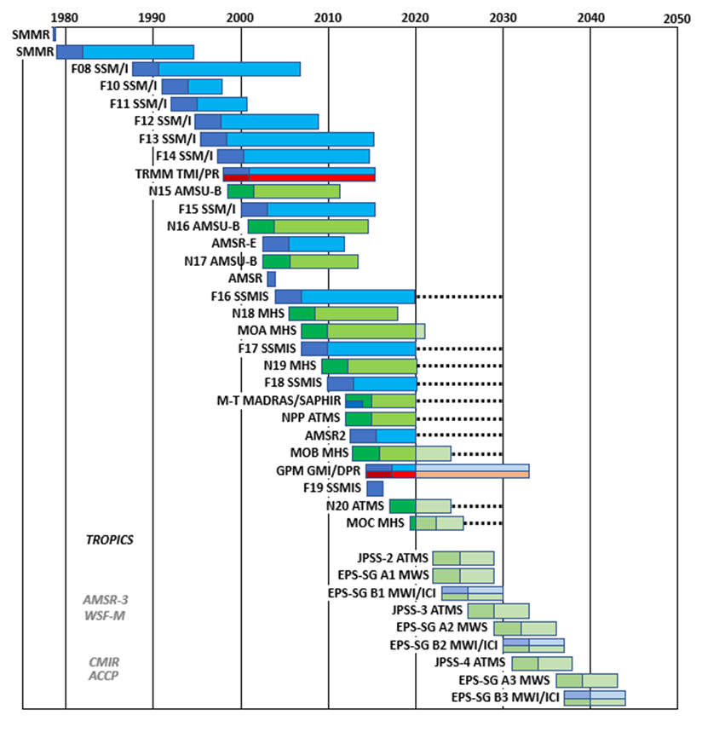
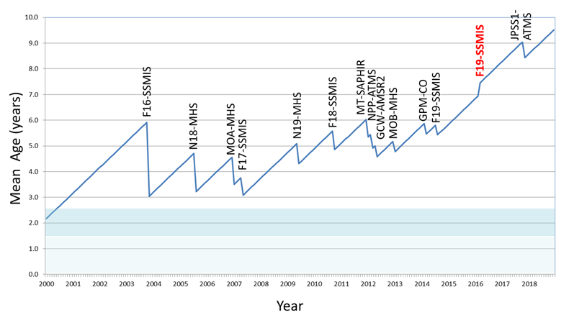
Past and present sensors
Precipitation community has made use of many diverse satellite missions and sensors - not always designed for precipitation retrievals.
Critical to maintain sufficient sensors due to the small scale-lengths of precipitation, and;
The constellation is aging: mean c.9.5 yrs old.

Slide 8
Future outlook
GPM mission provides a real constellation of satellites operated by international agencies – a realization of CEOS PVC.
Not just confined to the scientific community, but many user groups exploit GPM products (such as IMERG and GSMaP) developed by this activity.
Key developments for the Precipitation Constellation:
New/revised retrieval techniques for precipitation (e.g. GPROF⁵, IMERG⁶, GSMaP⁴ ,etc) together with reprocessing of current datasets
New instrumentation: Integration and evaluation of new technology, such as cubesats (TEMPEST-D, RainCube, TROPICS); Decadal survey – Aerosols, Clouds, Convection and Precipitation (ACCP) – to observe and measure cloud-precipitation processes; set new standards - (proposed) AMSR-3 (JAXA) and other opportunities (such as CMIR (ESA)).
⁴PVC-2020-04, ⁵PVC-2020-05, ⁶PVC-2020-06
contact: chris.kidd@nasa.gov

