Slide 1

GEOGLAM – LSI-VC Comeeting Readout
Committee on Earth Observation Satellites
Bradley Doorn and Selma Cherchali
Co-Chairs, Ad-hoc WG on GEOGLAM
LSI-VC 4 / GEOGLAM / SDCG Joint Meeting
ESA/ESRIN, Frascati, Italy
6th-8th September 2017

Slide 2
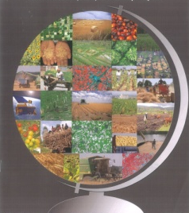
Satellite observation currently used for crop monitoring
Spatial resolution
5km - 1km 1km - 250m 250m - 60m 60m - 10m 10m - 1m
Use
EO
Food
security
Ag prod
trade
hourly images daily images 1 to 3 images per 15 days 1 to 2 images per month 1 to 2 images per season
Revisiting capabilities
Meteo
cond.
Global
coverage
Some
areas
Scientific
literature
+ in situ obs.
Area
outlook
Croplands
mask
Crop type
area
Area
Agric.
map
Crop type at
parcel level
Sample point interpretation
Regression estimate
Area
estimate
Crop
Growth
Agriculture /
veg. conditions
Crop specific
conditions
+ in situ obs.
Monthly
bulletin
Anomalies
detection
Early
warning
Crop stages
Crop variables
Intra-parcel
variability
Precision
farming
Crop growth
model
+ in situ obs.
Yield
forecast
Yield
Yield
estimates
Prod
estimate
+ field report & socio- economic context by analyst
Vulnerab.
report
+ prod. quality, stocks & demand by info brokers
Int market
report
GEOSS Ag
Defourny P., 2010
Notes:
Current practices – black = global use; grey = operational use in specific regions (large fields mainly NA, Brazil); with

Slide 3

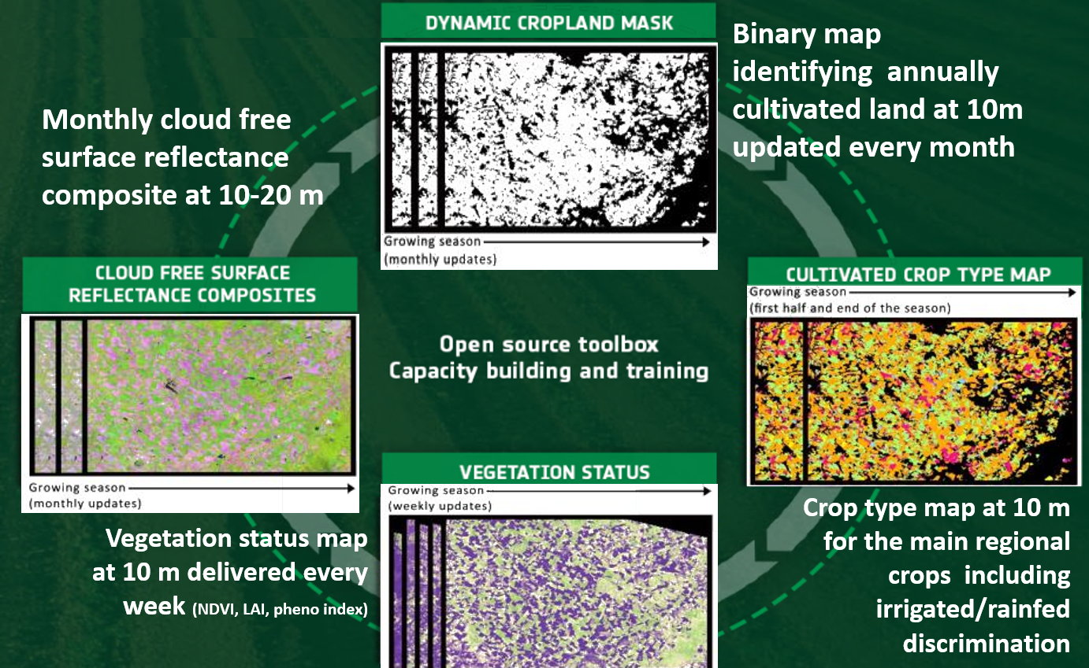
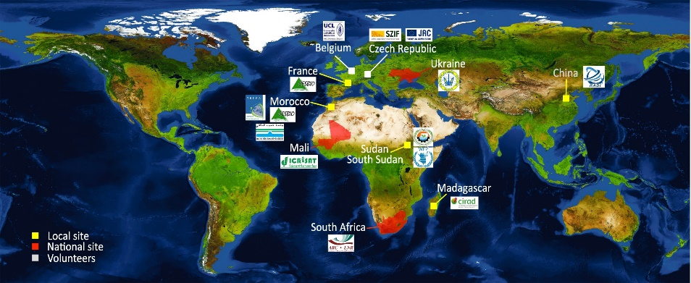
Current dense 10-m time series
already started to change the game
Sentinel-2 A & 2B + L8
Sentinel-2 A & 2B + L8
Sentinel-1 A & 1B
^{Source:} CEOS ACQUISITION STRATEGY FOR GEOGLAM PHASE 1
Sen2-Agri project supported by ESA and let by UCLouvain to develop an open source system to exploit S2&L8 time series for ag.

Slide 4
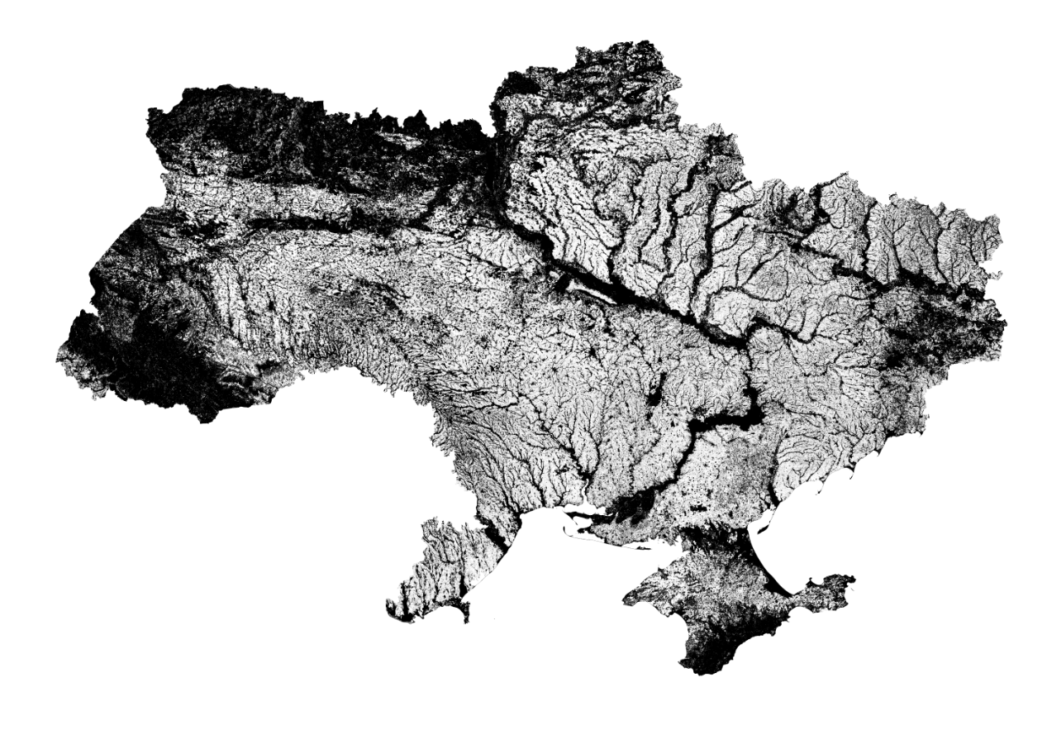
EO for crop acreage estimate thanks to S2 and L8
Sentinel-2 and Landsat-8 provided NRT 10 m cropland and main crop maps nationwide – demonstration for Ukraine, South-Africa and Mali by Sen2-Agri system
S2 & L8
+
Sen2-Agri open source system
+
Cloud computing
+
Nationwide in situ data collection
5-day revisit for crop type mapping
5 to 10 m according to landscape (Waldner ?
Cropland
Non-Cropland
Overall accuracy : 96 %
F-score cropland : 97 %
Sen2-Agri 10 m cropland map for Ukraine (July 2016)

Slide 5

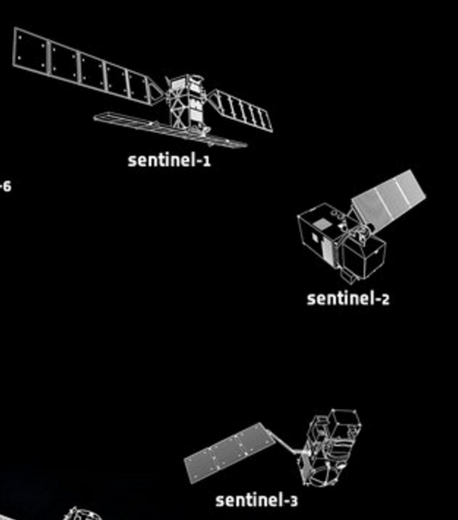

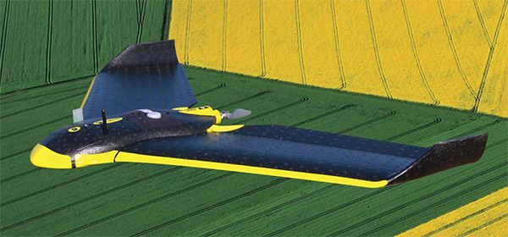

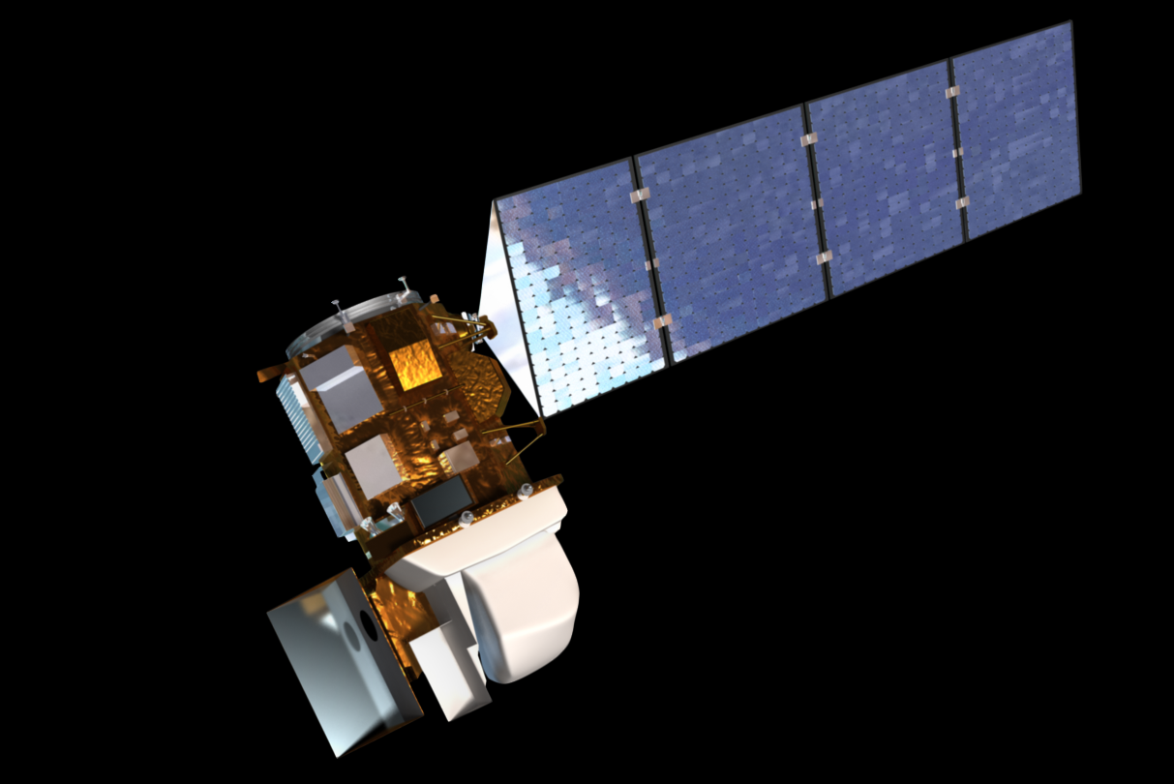





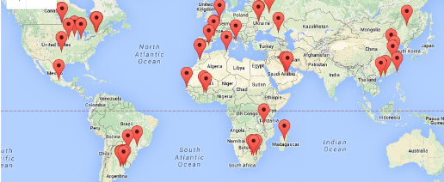

EO and IT (r)evolution change the game
(P. Defourny)
Server farms for big data
Exploitation at low/no cost
EO priority applications for agriculture
Crop monitoring, assessment (annual, multi-annual) and forecasting at global and also national scales
Crop management and yield estimate (dvpt stages, agric. practices, disease impact,…)
Agriculture ressources management (water, soil, …)
Disaster monitoring and crop
damages assessment
Landsat-8
Free, open and long term data policy (EU)
Mobile internet for many
Global network with shared protocols
Notes:
Same methods than 25 year s ago or even 35 year ago

Slide 6
GEOGLAM Requirements Refresh
To better reflect R&D findings – particularly as methods have advanced
In support of data acquisition and future mission planning
To better understand “proximal user” data needs (ARD, FDA)
Consistent with JECAM’s “Minimum Datasets” principle
Supporting Compendium of “Best Practices”
Comparison of Original vs. Requirements Refresh
 | 2012-2014 | 2016-2017
Source | Montreal 2012 WG led by Pierre Defourny (lit review) | Multiple JECAM & Asia-RiCE Sites (experiment)
Variables Described | 7 | 13
Observation Types Collected | Satellite only | Satellite, In Situ, Ag Met
Analytical Needs | Not Addressed | 7 Questions
“Firmness” | Some had ranges | “Minimum” vs. “Preferred”
Application | Not explicit | R&D vs. Operational Latency Requirements Considered

Slide 7
Final Thoughts
LSI-VC: Establish a LSI-VC representative for Annual Ad-hoc WG on GEOGLAM. This meetings will coincide with CEOS SIT meetings.
LSI-VC: Moving from data scarcity to data saturation
  Improved processing is a priority task
    Data Cube for JECAM
    FS-TEP - ESA
  ARD’s are not just an option anymore, but a necessity
    AsiaRice - JAXA
  Integrated multi-sensor products are priority
    SAR Intercomparison
      Sen2Agri, SIGMA, JECAM, AsiaRice
Notes:
Why we need an update – and how we can improve the specificity. This will have implications for mission planning as well.

Slide 8
Final Final Thoughts
LSI-VC: Achieving current requirements and discovering new requirements
  New requirements are more nuanced: minimum vs. preferred, processing capacity, algorithm development, …
  Moving from science-based, qualitative information to science-based, quantitative information for some agriculture applications
LSI-VC: Demonstrated success of EO-based yield, area (i.e. crop production info)
  Defining requirements in Phase 2 for crop management, soil moisture, phenology, etc.
Notes:
Why we need an update – and how we can improve the specificity. This will have implications for mission planning as well.

