Slide 1
Rationalisation of LSI, GFOI, GEOFLAM - recap
Committee on Earth Observation Satellites
Stephen Ward, SIT Chair Team
LSI-VC-4
Agenda Item #J2 6th September 2017

Slide 2
Contents
Background and status
Issues for consideration
Next steps

Slide 3
Background and status
Ongoing discussion for a while around opportunity – 2017 CEOS Chair keen to progress
Agencies represented in LSI, SDCG, GEOGLAM keen
Side meeting at 2016 CEOS Plenary – trial meeting agreed as way forward
Discussion Paper followed and telcon
And this week’s agenda evolved..

Slide 4
Objectives
Explore efficiencies in travel and representation
Increased synergies and co-operation across activities – several already in common

Slide 5
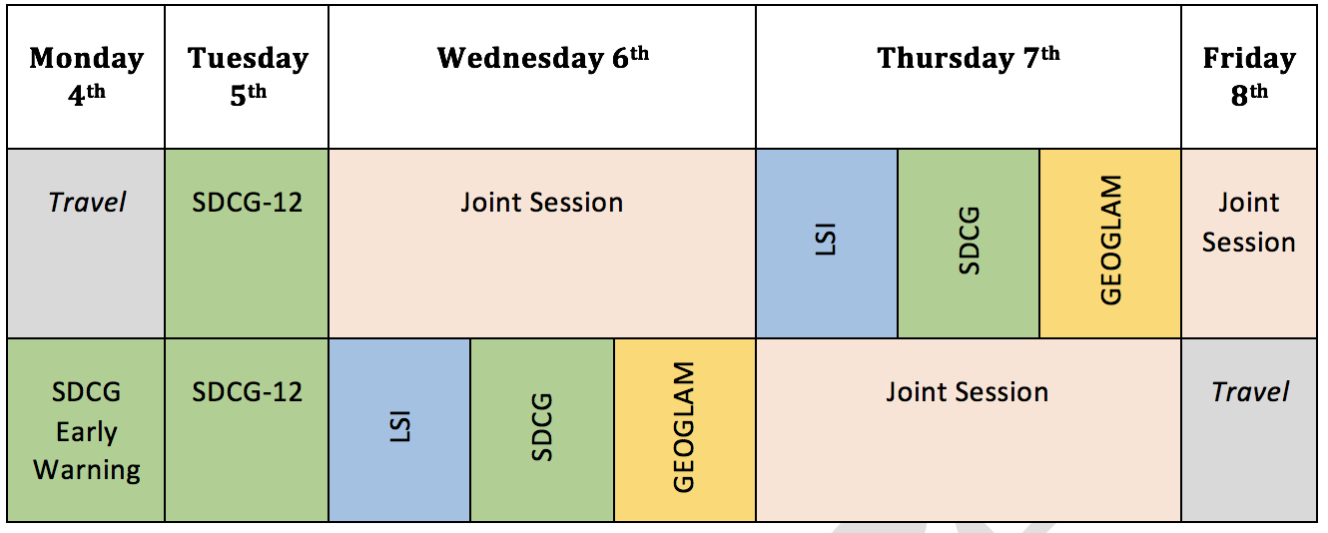
Trial Meeting

Slide 6
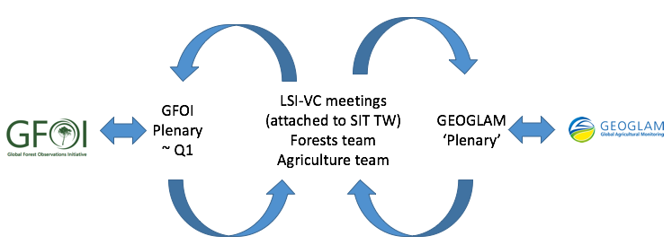
Meeting Cycle & Calendar
‘Forest’ and ’Ag’ teams have to continue to engage with their constituencies and motherships
SDCG meeting cycle constraints: attending annual GFOI Plenaries; week prior to SIT TW ($$)
GEOGLAM meetings (much) less frequent
Sample baseline annual cycle:

Slide 7
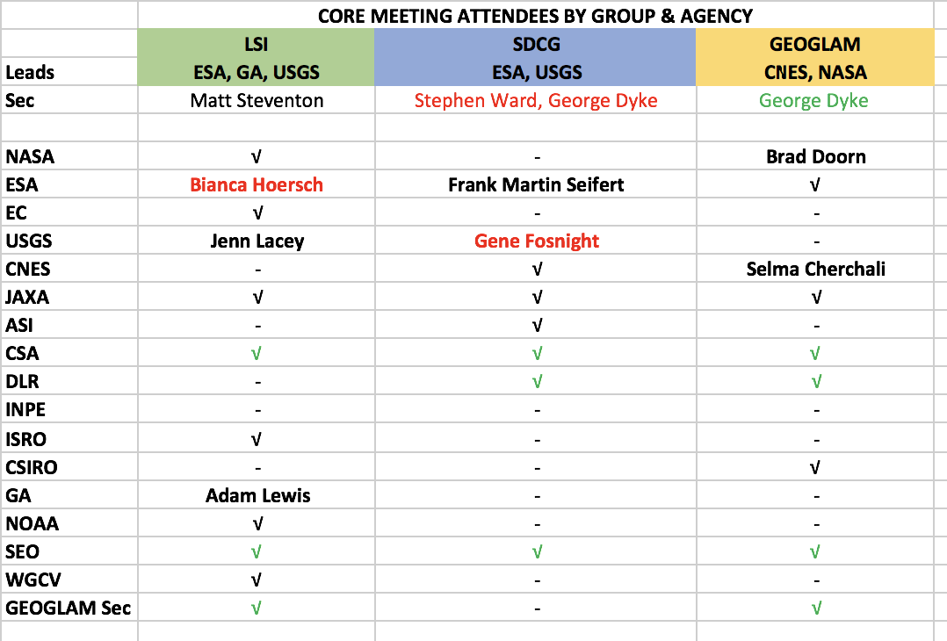
Representation & Leadership
Not huge travel/representation savings through joint meetings
And more complexity (fewer hosts?)
Synergies and efficiencies the main drivers then?

Slide 8
Representation & Leadership
Some changes imminent in SDCG and LSI leadership & capacity and need to be taken into account
Need to consider ‘brand continuity’ for CEOS representation (such as SDCG in GFOI) in external initiatives
If ’nested’ within LSI, forest and ag could retain current leadership
Clustered reporting to CEOS?
Can we handle the constraints on meetings?

Slide 9
Joint Session Substance
ARD
MRI
FDA inc Pilots
Global Data Flows
Common planning & analysis tools
Process

