Slide 1

Agency Reports – USGS
Committee on Earth Observation Satellites
Jenn Lacey
LSI-VC-5
Agenda Item #2
February 2018

Slide 2
USGS Land Remote Sensing
(LRS) Program
Delivers a national and global capability to ensure broad public and scientific availability of observations of the Earth’s land surface:
  Create and preserve a long-term record of the Earth’s land surface at local, regional, and global scales
  Expand scientific understanding and application of remotely sensed data to government and private users nationally and globally
  Support decision makers and policy officials in fulfilling their public responsibilities
  Guide National decisions about meeting current and future needs in land science and land observation
  Coordinate and integrate civil Earth observation with other sources of data including commercial and National Security space systems
Fundamental goal: Ensure public availability of a primary data record about the current state and historical condition of the Earth’s land surface

Slide 3
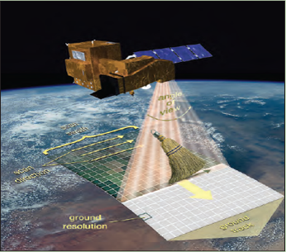

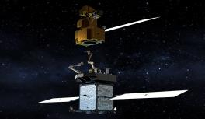
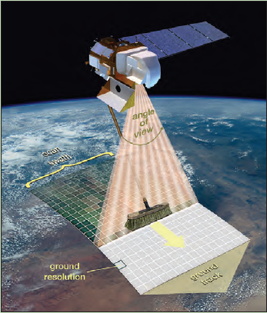
Landsat operational and development status
Landsat 7 (1999)
Collecting about 475 new scenes per day; latest fuel estimate projects operating into 2020/2021
Restore-L refueling remains a possibility
Landsat 8 (2013)
Collecting up to 725 new scenes per day; together with Landsat 7 supports 8-day revisit
Landsat 9 (late 2020 launch)
Essentially a copy of Landsat 8, but with important improvements for accuracy and resiliency
Landsat 10 (~2027-2030 launch)
Technology and requirements studies underway to support a 2018 decision point
EVERYTHING IS ON THE TABLE at this point (e.g., small sat, hyperspectral, data buys, Public-Private Partnerships (P3), etc.)
Landsat 7 (whiskbroom)
Landsat 8 (pushbroom)
3

Slide 4


Free and open Landsat data
changed everything!
Emerging data hosts
Free and open data policy
$1.8B in annual US economic benefit OPR2013-269, USGS/DIO
4

Slide 5
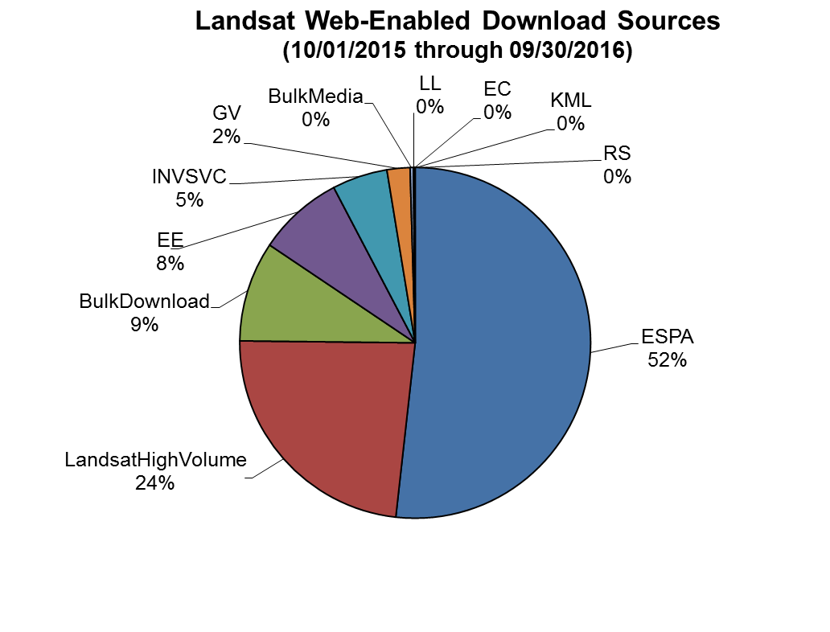
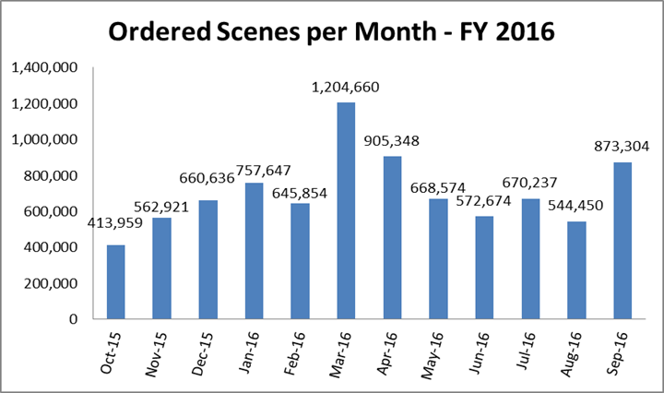
Level-2 Product Demand
In FY16 USGS EROS distributed over 17 million Level-1 scenes
Over ½ of the 17 million Level-1 scenes distributed were improved to TOA/SR (Level-2) through the EROS Science Processing Architecture (ESPA)
Currently, TOA/SR is produced on-demand, but USGS is planning to produce a collection of ARD for the U.S. and the globe
Level-1 Statistics
ESPA / Level-2+ Product Distribution
ARD will be the standard Landsat product in the future
5

Slide 6
USGS CEOS Focus Areas
Future Data Architectures – particularly in the areas of cloud-based solutions that enable burst processing, global data/information distribution, and analytics
CARD4L-Compliant Product Generation – not just for 45+ years of Landsat data but also for other complimentary data sets such as the Sentinels, Resourcesat, CBERS, and others
Moderate Resolution Sensor Interoperability – drive moderate resolution sensors into a state of greater interoperability for the majority of applications by lessons learned and smart choices for geometric, radiometric, and atmospheric corrections

Slide 7
FDA, CARD4L, and MRI
Synergy
User feedback is critical for full exploitation of EO data informing current implementations and future directions
Future Data Architectures
CARD4L-compliant data feed FDAs
MRI identifies good practices for implementation of multi-sensor data sets
Moderate Resolution Interoperability
- Addresses how to combine data / scientific methods to maximize interoperability
    CARD4L is the first step
    - MRI provides feedback to CARD4L
CEOS Analysis Ready Data for Land
Product family specifications facilitate uptake of EO data by the user community

Slide 8
LSI-VC Outcomes Envisioned
(over the next 2-3 years)
Significant global adoption of the CARD4L specification and products being generated (or in work) (CARD4L)
Maximized Landsat and Sentinel-2 interoperability (MRI)
Ubiquitous land surface imaging data access and analytics via global cloud-based architectures (FDA)

