Slide 1

Synthetic Aperture Radar PFSs
Status
Ake Rosenqvist (soloEO) for JAXA , Takeo Tadono (JAXA)
Nuno Miranda (ESA), Bruce Chapman (NASA JPL)
Andreia Siqueira (GA), Medhavy Thankappan (GA),
Marco Lavalle (JPL), Francois Charbonneau (NRCan),
Zheng-Shu Zhou (CSIRO)
LSI-VC-7, Hanoi, Vietnam, February 14-15, 2019
Committee on Earth Observation Satellites

Slide 2
WGCV SAR workshop
Buenos Aires, ARG – Dec 2018
WGCV SAR workshop @CONAE (Buenos Aires, ARG, 5-7 Dec 2018)
~ 30 participants (ESA, DLR, NASA(JPL), JAXA, GA, CSIRO, CONAE, CSA, KARI, PAZ ...)
CARD4L reps (Bruce, Nuno, Medhavy, Ake, Zheng-Shu)
Special Session on CARD4L
  Inform WGCV SAR subgroup of CARD4L process and SAR PFS status
  Invite WGCV members wishing to participate in CARD4L PFS development
  Seek WGCV expert advice & technical feedback on the draft specs
WGCV members volunteered to contribute /review
  NRB – Shen Yuhsyen (JPL) & Marc Simard (JPL)
  GSLC – Dirk Geudtner (ESA) & Brian Hawkins (JPL)
  PRD & CoVar – Ridha Touzi (CCMEO) & Yunling Lou (JPL)
  DInSAR – Dirk G, Marc S. & DLR (TBA)
CV-20 Action: “The Cal/Val SAR subgroup will support LSI-VC with the development of CARD4L SAR Product Family Specifications and support of the CARD4L Product Alignment Assessment Process through peer-review of products generated by data providers adopting these standards.”
Great interest, no pushbacks, but caution not to over-simplify (Touzi)

Slide 3
CARD4L
Synthetic Aperture Radar PFSs
SAR PFSs in the pipeline:
1. Normalised Radar Backscatter (NRB)
2. Geocoded Single-Look Complex (GSLC)
3. Polarimetric Radar Decomposition (PRD)
4. Polarimetric Radar Covariance Matrix (CoVar)
  5. Differential Interferometry Products (DInSAR)
      Geocoded interferograms (wrapped / unwrapped)
      Interferometric coherence

Slide 4
CARD4L
Synthetic Aperture Radar PFSs
Normalised Radar Backscatter (NRB)
Leads/contributors: N. Miranda (ESA), B. Chapman (JPL), A. Siqueira (GA), A. Rosenqvist (JAXA)
Radiometrically Terrain Corrected (RTC) ortho-rectified backscatter product in γ⁰.
v1.0 ready for endorsement at LSI-VC-7
PALSAR-2 mosaic tile
NRB candidate product

Slide 5
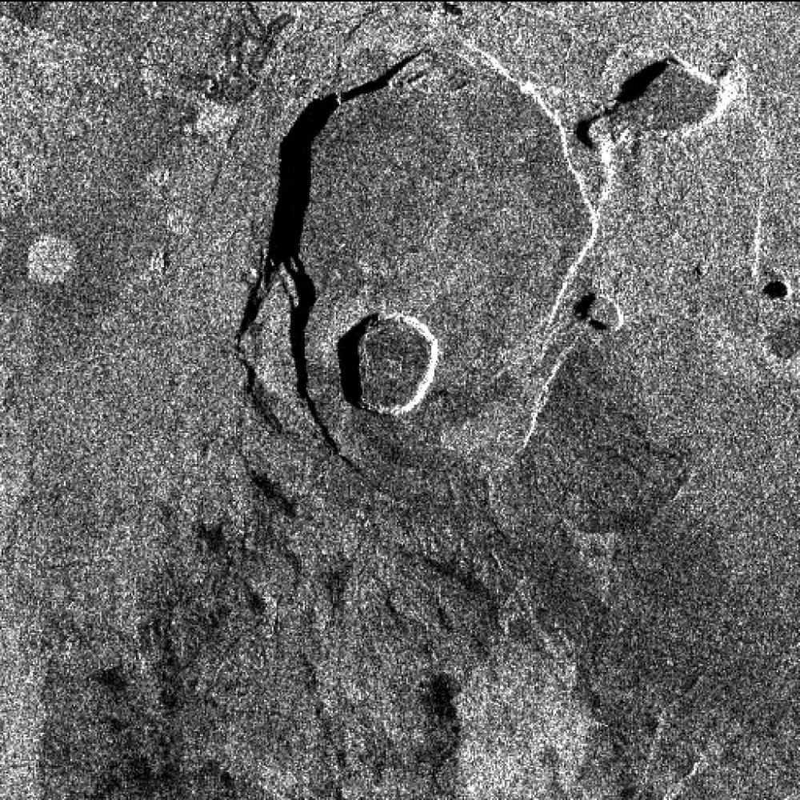
CARD4L
Synthetic Aperture Radar PFSs
Geocoded Single-Look Complex (GSLC)
Lead: B. Chapman (JPL) w input from H. Zebker (Stanford)
Single Look Complex (SLC) is the base Level-1 SAR image product. It contains information on the amplitude and phase of the received radar energy at the sensor. It is provided in slant range geometry.
Geocoding SAR data already at SLC level simplifies generation of interferograms.
Zero Draft based on NISAR NASA SDS Product Description Document (Agram & Buckley, 2018), and NISAR NASA SDS Algorithm Theoretical Basis Document (Agram, Lavelle & Buckley, 2017).
Zebker et al, 2018

Slide 6
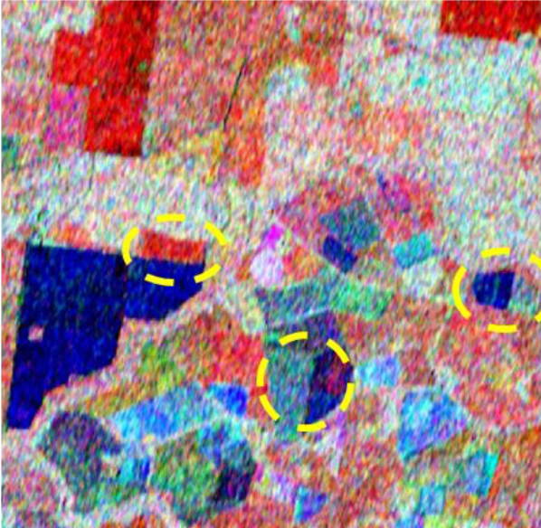
CARD4L
Synthetic Aperture Radar PFSs
Polarimetric Radar Decomposition (PRD)
Lead: M. Lavalle (JPL) & Z-S Zhou (CSIRO)
The individual components of the polarimetric decomposition obtained from the terrain-corrected (γ⁰) covariance matrix represent the backscatter coefficient. Decompositions can be applied to Quad-pol and, for certain decompositions, Dual-pol data.
Large number of decompositions available – selected on demand by user.
Dual-polarisation Entrophy/Alpha decomposition (Zhou et al, 2018)

Slide 7
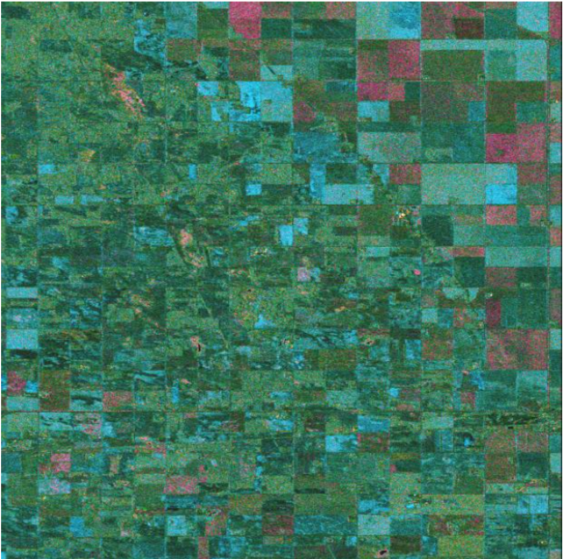
CARD4L
Synthetic Aperture Radar PFSs
Polarimetric Covariance Matrix (CoVar)
Lead: F. Charbonneau (CCRS/NRCan)
Expansion of NRB for inclusion of polarimetric phase(s)
Represented under terrain-corrected (γ⁰) covariance matrix, where intensity data layers are as NRB format (image)
Allows harmonized representation of single, dual and quad polarization data
Allows quick access to various polarimetric decomposition products
m-χ decomposition
(CARD4L-SAR CoVar, 2018)

Slide 8
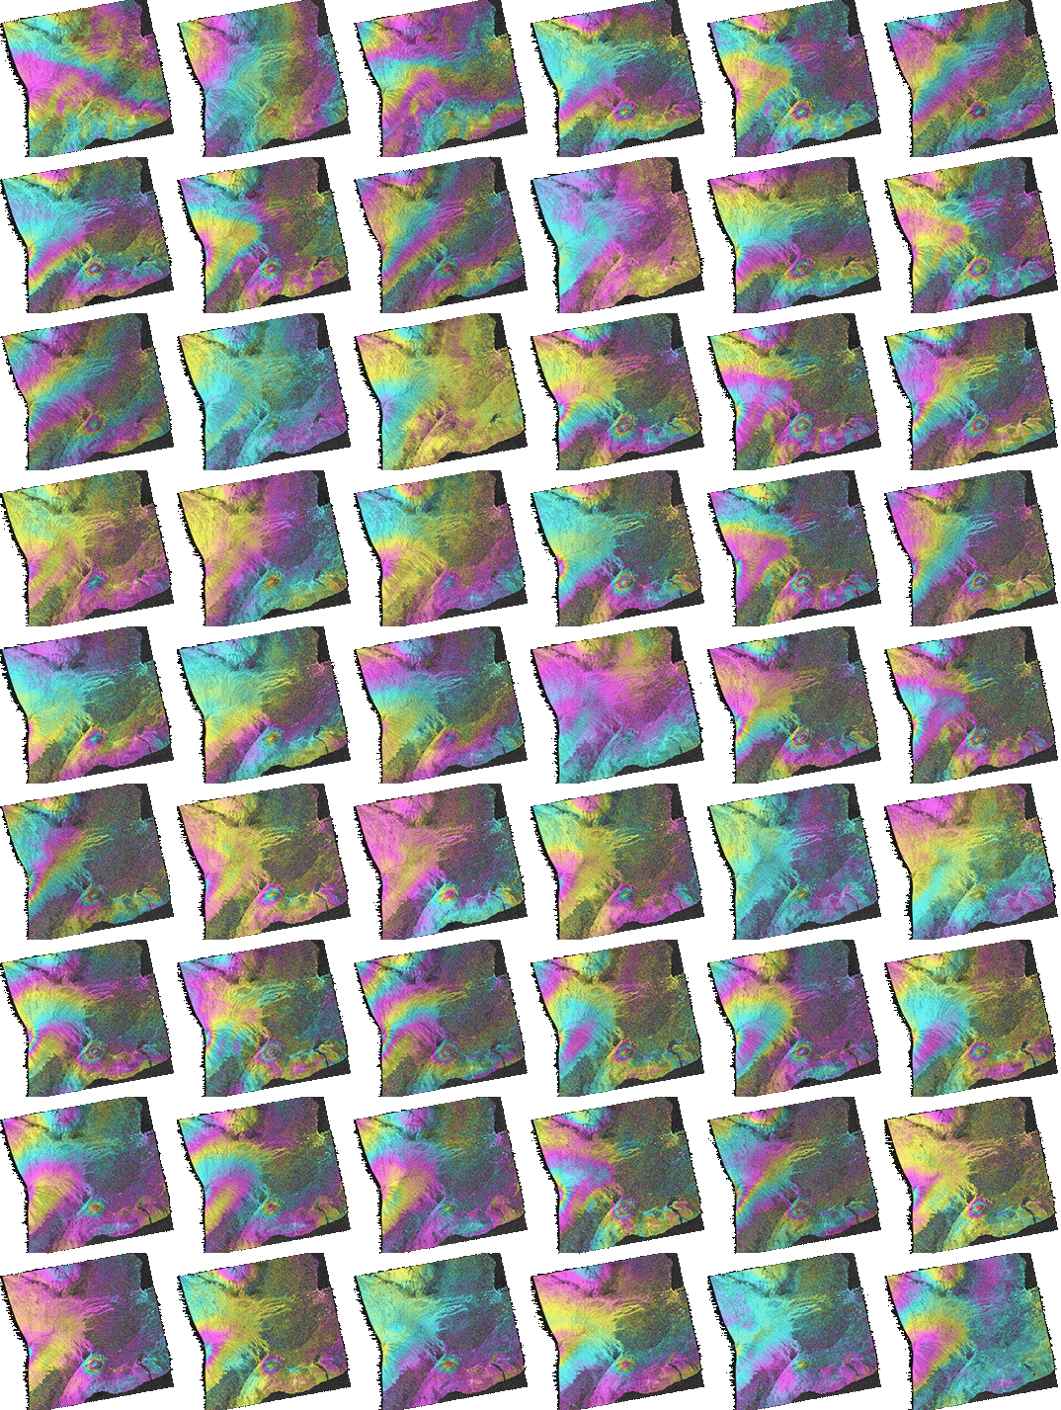
CARD4L
Synthetic Aperture Radar PFSs
Differential Interferometric Products (DInSAR)
Lead: M. Thankappan (GA)
A suite of three products generated by InSAR processing of two SLC images captured of the same geographic area at different times:
  Wrapped interferogram: Image of differential phase signals resulting from complex conjugation of the phase component of two SLC images. Signal is ‘wrapped’ in quantities of 2*π radians, giving an image with ‘fringes’.
  Unwrapped interferogram: Image of differential phase signals where the wrapped fringes are summed to give a continuous phase signal across the image
  Interferometric coherence: Image of phase coherence between two SLC images.
Geocoded (wrapped?) interferograms
(Zebker et al, 2018)

Slide 9
CARD4L
Synthetic Aperture Radar PFSs
Other discussion points:
At least one sample dataset to be generated for each SAR PSF
  NRB – JAXA
  GSLC – JPL
  PRD – JPL & CSIRO
  CoVar – NRCan
  DInSAR – GA
Standardised format for Meta Data (xml - machine readable) .
Harmonisation of Meta Data naming (similar to what is currently led by IEEE)
SAR PFSs still on a “theoretical level”. Self assessment and sample dataset generation expected to reveal detailed feedback that should be incorporated in annual revision cycle.
Schedule:
1. Normalised Radar Backscatter v1.0 ready for endorsement
2. Other products – LSI-VC-8?...

